Slide 1

5th Grade
Curriculum Night
2024-2025

Slide 2
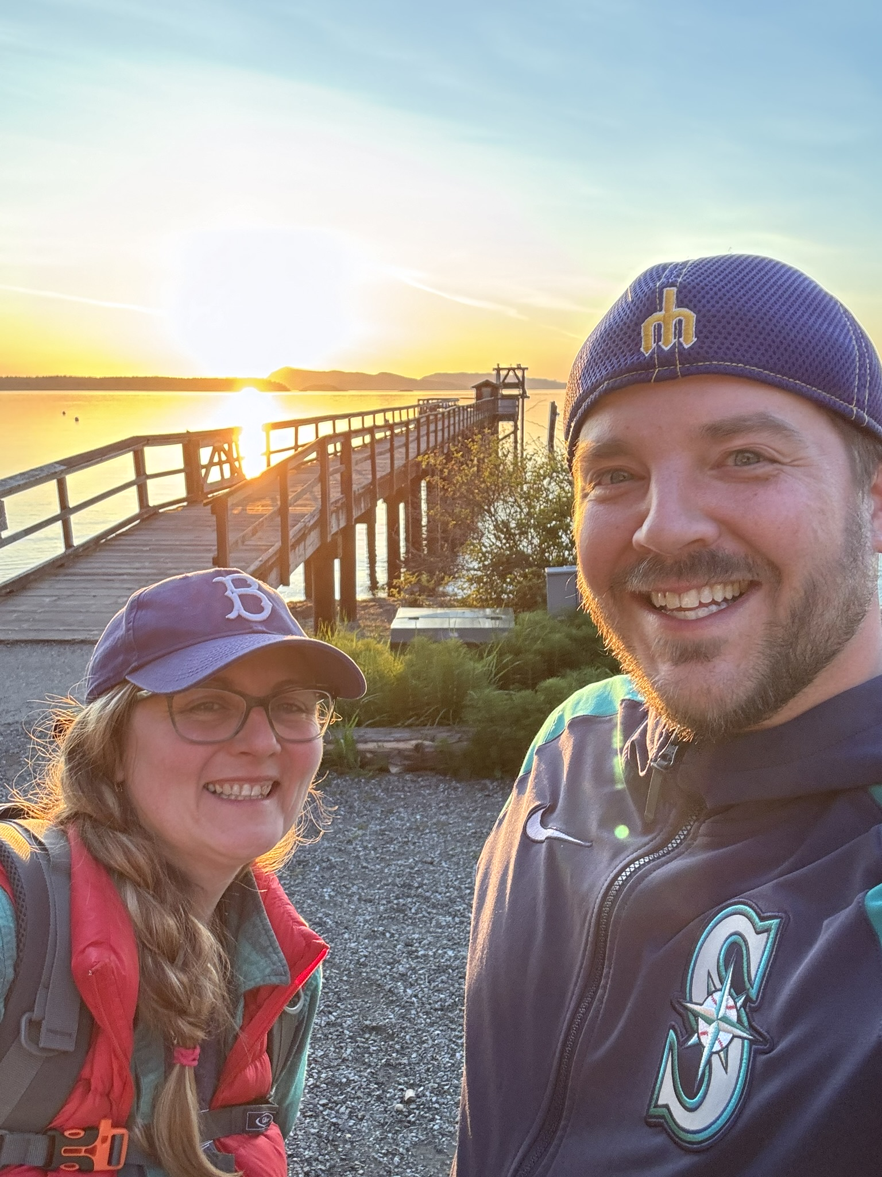
Team 5th Grade
Ms. Murk
10th year teaching 5th grade at Muir
Mr. Kanehen
19th year teaching 5th grade at Muir
Loves woodworking, grilling, Seattle sports, and spending time with family
Loves cooking, reading, long walks, traveling and my dogs Logan & Maverick
The team at Camp Orkila

Slide 3
PBIS & Class Philosophy
P.B.I.S. Link to Framework
JME - R.O.A.R.
Gotcha Tix
Respectuful
On task
Appropriate
Responsible
Positive and based on continual growth
The power of YET
Error vs. Mistake
Trying again for more success

Slide 4
Schedules
Weekly
Annual

Slide 5
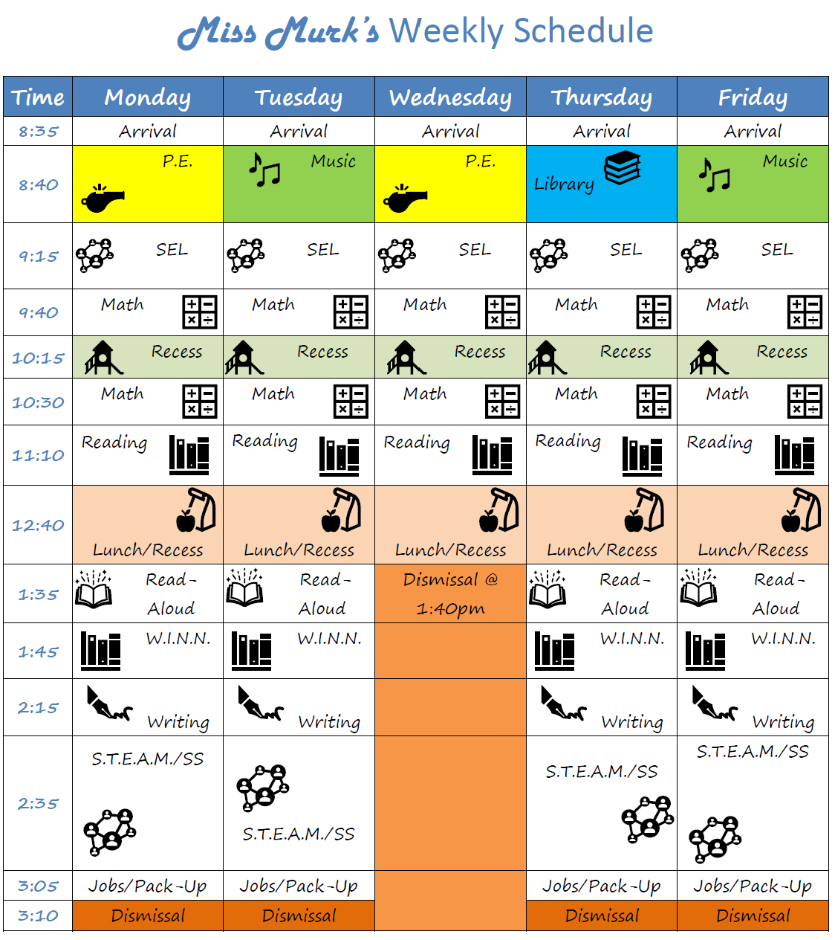
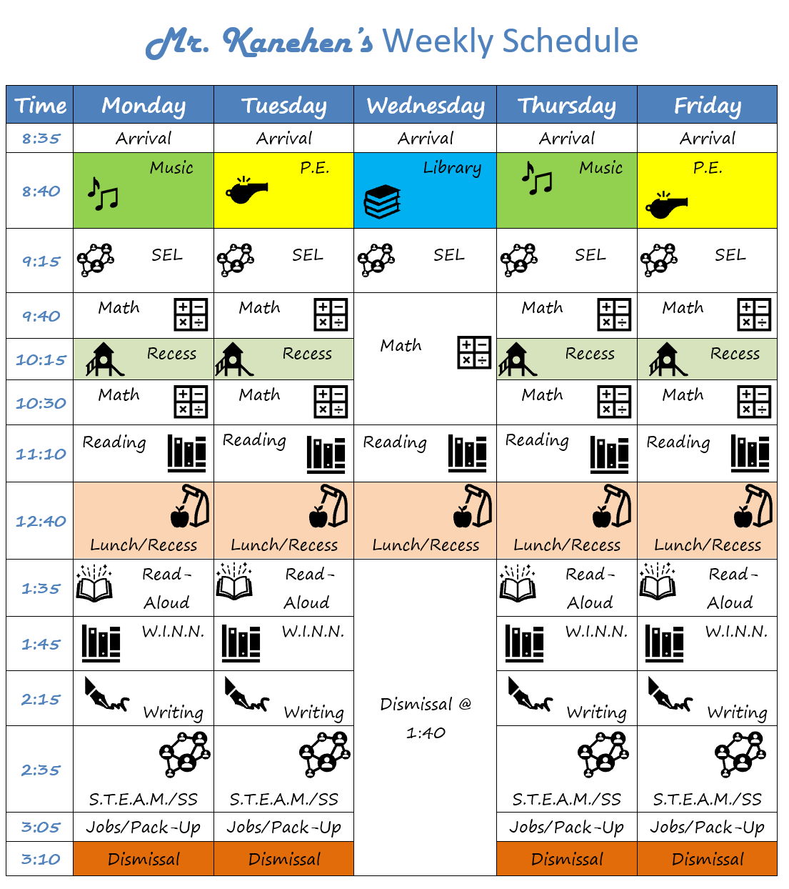
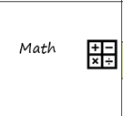
Weekly Schedules

Slide 6
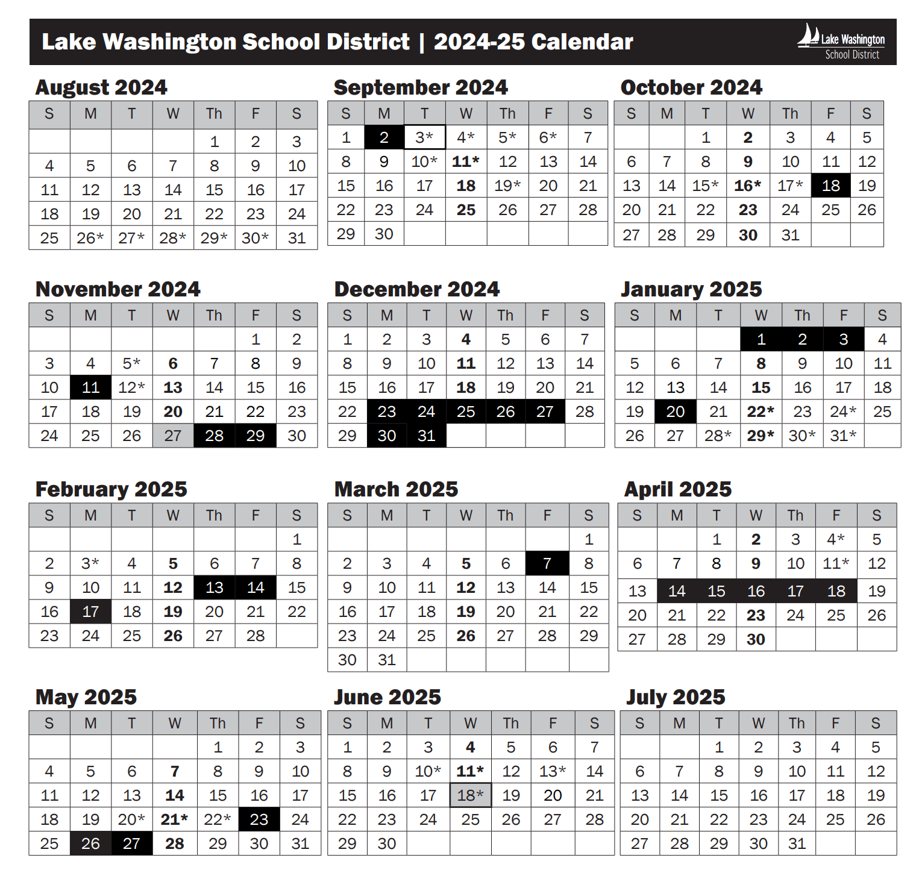
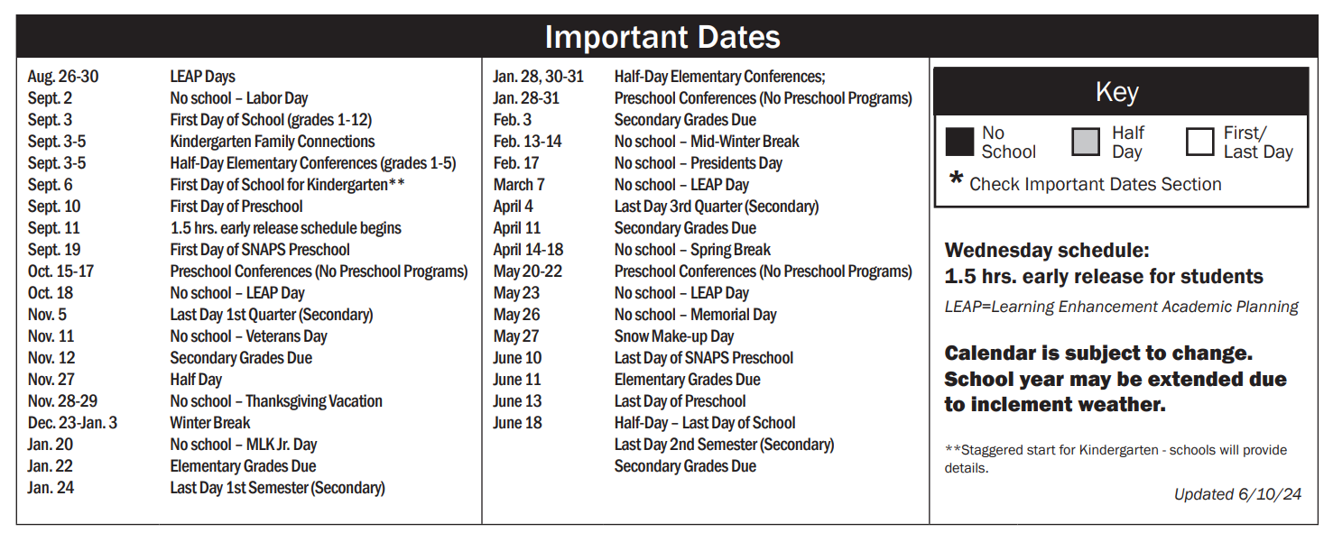
Annual LWSD Calendar
District Calendar

Slide 7

C.C.S.S., N.G.S.S, WA Learning Standards
Core curriculum, teaching and learning aligned with WA OSPI
This Photo by Unknown author is licensed under CC BY.

Slide 8

Social & Emotional Learning
CASEL Framework
Link to Framework
Purposeful People
Second Step
Daily with classroom teacher
With school counselors
Connecting character with SEL

Slide 9

Reading –
Primary Focus: Comprehension
Reading C.C.S.S.
Link to Standards
Wonders
Read Aloud Book
Lexia

Slide 10

Wonders
Weekly Routines:
  Spelling
  Vocabulary
  Phonics / Word Work
  Comprehension Skills
  Comprehension Strategies
  Small Group Instruction

Slide 11

Writing –
Primary Focus:
Organization of Thinking
Writing C.C.S.S.
Link to Standards
LWSD Curriculum
Step Up To Writing Supports
Typing Club
Integration with Content

Slide 12
Writing Units
Informational/Explanatory
Persuasive/Opinion
Narrative/Creative

Slide 13

Math-
Primary Focus:
Operations & Practices
Math C.C.S.S.
Link to Standards
Illustrative Mathematics
Dreambox
Math for Today

Slide 14
Illustrative Math Units
Volume
Fractions
Place Value & Decimal Operations
Multiplication & Division
Shapes & Coordinate

Slide 15

Science-
Primary Focus: Processes & Design
N.G.S.S.
Link to Standards
Amplify
NewsELA
STEAM (STEM)
Science Technology Engineering Art Math

Slide 16
Science Units
Matter
Motion
Environment
Space

Slide 17

Social Studies – Primary Focus: Civics & early U.S. History
WA State Learning Standards Link to Standards
InquirED
iCivics

Slide 18
Social Studies Units of Study
Civics
History
Geography
Social Studies

Slide 19

Technology-
Primary Focus: Word processing and digital citizenship
WA State Technology Standards Link to Standards
Major intersectionality and incorporation with tasks
Common Sense – Digital Citizenship
Microsoft Suite
Code.org

Slide 20

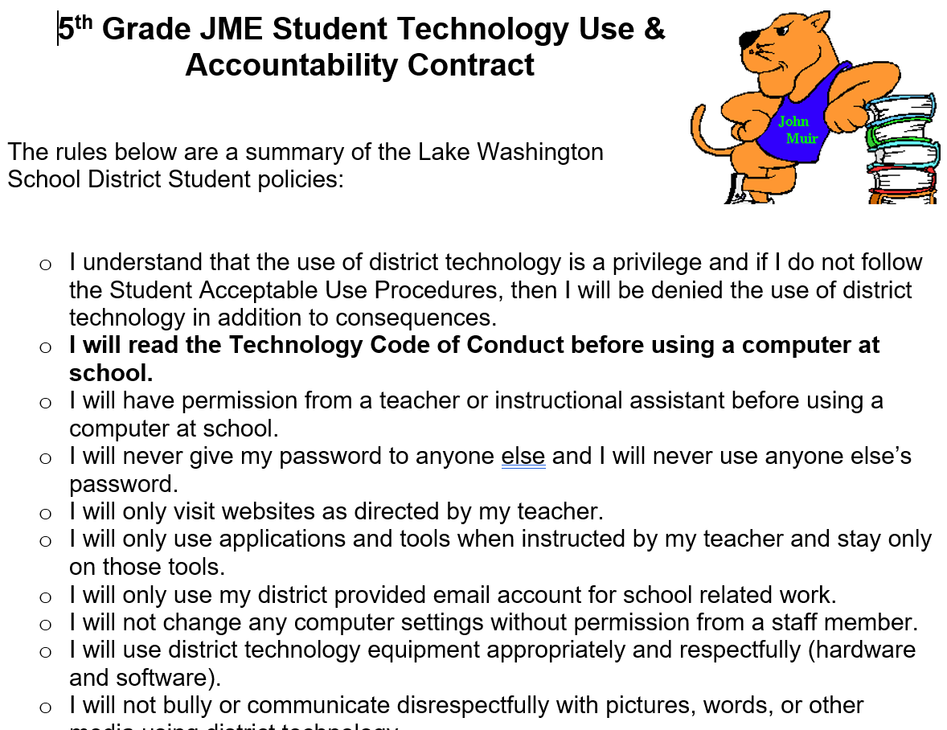
LWSD Technology Code of Conduct
https://www.lwsd.org/services/student-services/student-rights-and-responsibilities

Slide 21

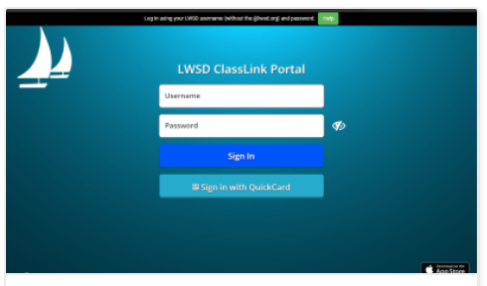
Class Link
-Single Sign On Tool
-Access using district log-in
-From the ClassLink LaunchPad, students are automatically logged into a number of district-provided digital tools so they no longer need to remember multiple usernames and passwords.

Slide 22

Art-
Primary Focus: Visual Arts
Washinton State Art Standards Link to Standards
Deep Space Sparkle
Art Docent
JME National Heritage Month Alignment

Slide 23

Health-
Primary Focus: Puberty and HIV/AIDS
WA State Health Education Standards Link to Standards
KNOW Curriculum
H.I.V./A.I.D.S Prevention
Letter will be sent home with more information in May

Slide 24
Additional Practices
Weekly Report
Each Friday
Dreambox & Lexia
Goal of 30-60 minutes a WEek

Slide 25
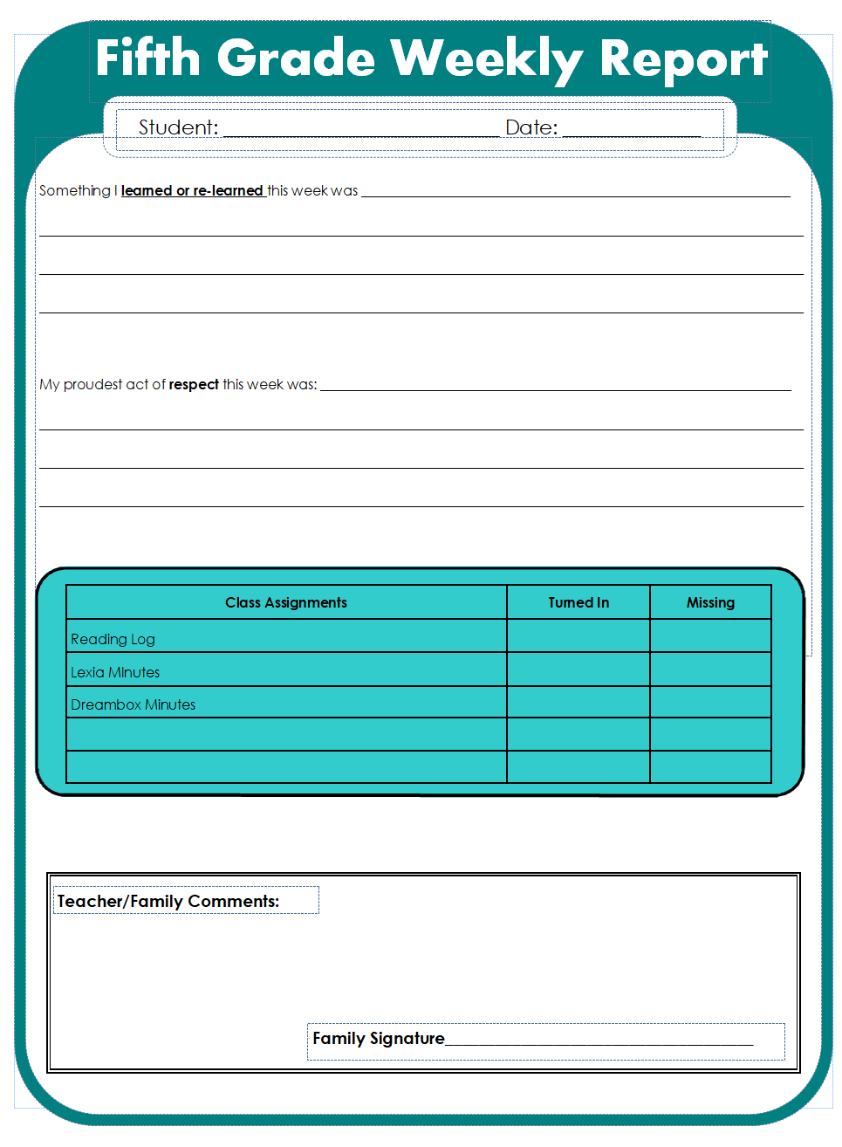
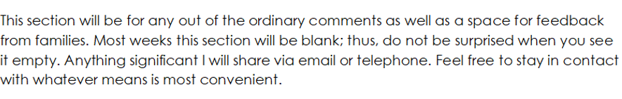
Weekly Report

Slide 26
Communication
Weekly Newsletter on Fridays
Past week learning, Upcoming events
Important announcements
Occasional phone calls –Parent Square

Slide 27

Parent Square
Lake Washington School District uses the ParentSquare platform to simplify school communications and provide options for families for how they want to receive information (email, text and/or app notifications).
ParentSquare - Lake Washington School District (lwsd.org)

Slide 28
Snack
Donations needed – individually packaged
Healthy snacks encouraged. We drink water in the classroom.
Mon/Tues/Wed/Thurs/Fri @ 10:30 am

Slide 29

Birthdays
Community Circle Celebrations
School-wide policy of no birthday treats in classroom

Slide 30

5th Grade Outdoor Education
Orcas Island
May 7-9

Slide 31
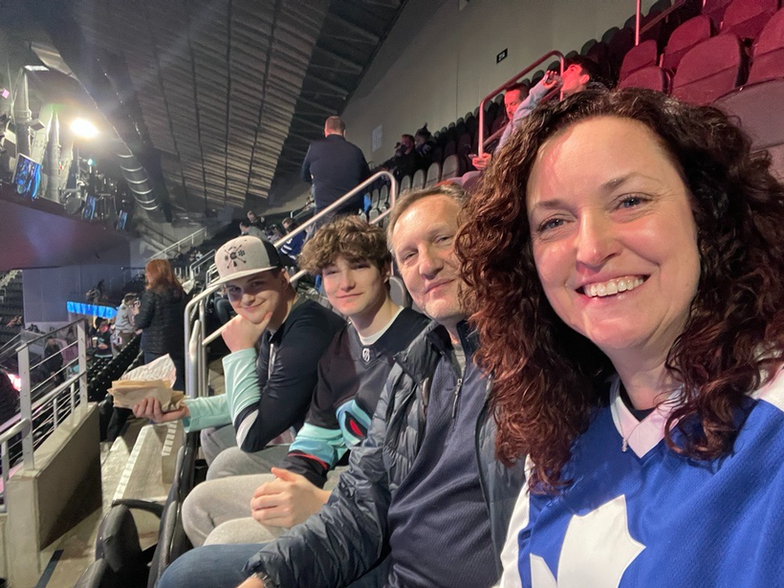
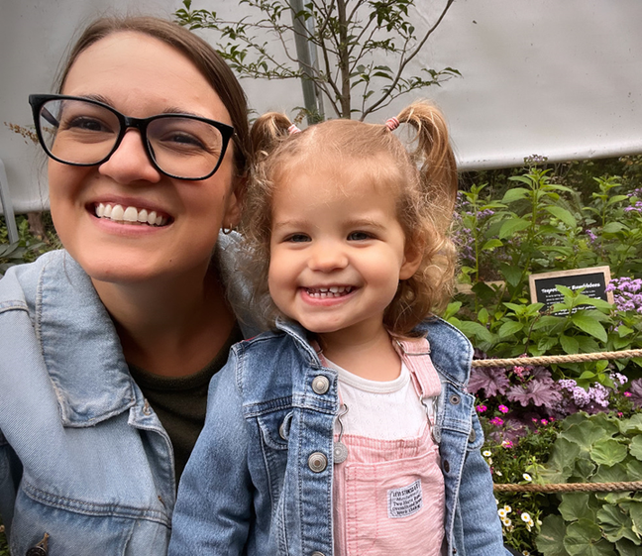
MEET THE SCHOOL COUNSELORS!
Ms. Schroeder. Full-time School counselor at JME. In my spare time I love going to hockey and baseball games with my family, and I love musical theatre especially at 5th Ave and the Paramount. I live at home with my husband, two sons, and two crazy cats.
Ms. Powers! Bonus School Counselor at JME. I work with Ms. Schroeder to help ALL students at JME. You will see me on Monday’s! I love reading, going to the beach, crafting and spending time with my family. I live at home with my husband Jordan, daughter Lucy and cat ROY!

Slide 32


WHAT DOES AN ELEMENTARY SCHOOL COUNSELOR DO?
1
2
3
SUPPORT
EDUCATE
ENCOURAGE
  Academic, social, and emotional development of all of the students here at JME
  Classroom SEL lessons
  Student small groups
  JME community resources
  Students
  Families
  Teachers
  JME community

Slide 33
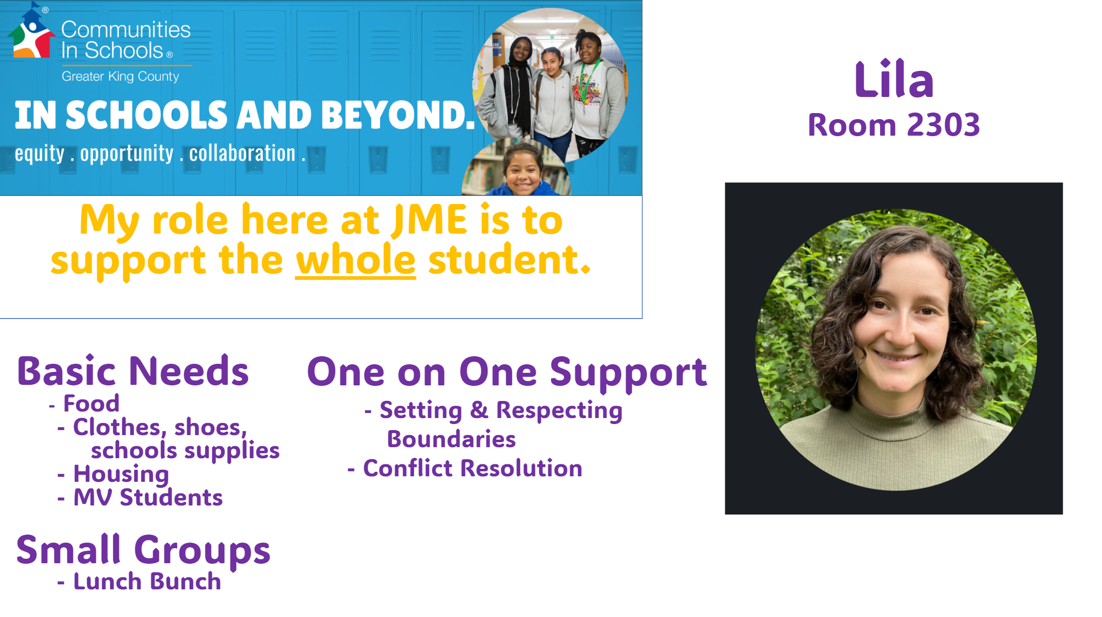

Slide 34





Safety Net
Information
September 2024

Slide 35
Purpose of Safety Net!
Support students in partnership with general education teachers in literacy so they can meet or exceed grade level standards
Safety Net instruction never replaces core instruction with their teacher, it serves as extra instruction for students who qualify

Slide 36

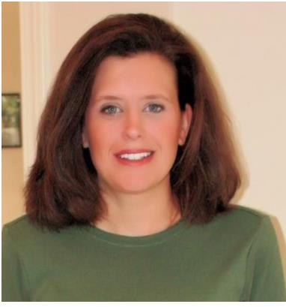
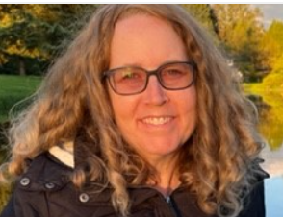
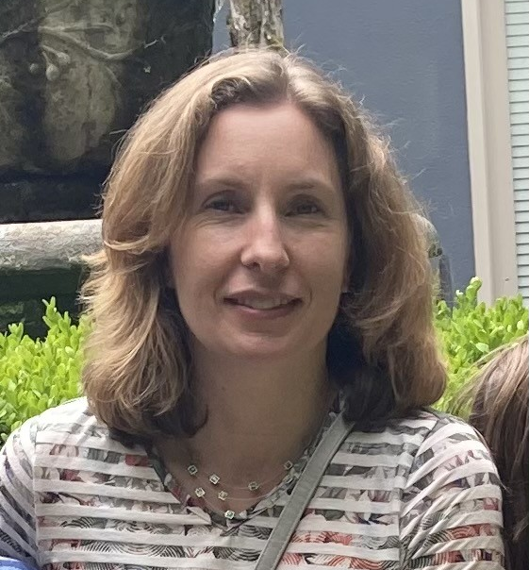
Meet the Team
Julie Palmer
jupalmer@lwsd.org
Michelle Vallene
mvallene@lwsd.org
Ellen Barber
ebarber@lwsd.org

Slide 37
Who is served in safety net?
We serve students who are not meeting district and state academic standards in reading.
Our Reading testing will be through FastBridge, which replaced DIBELS
Safety Net groups will begin when testing has been completed by their classroom teacher.
Parents will be contacted if testing data indicates that their student will benefit from receiving extra support in Safety Net groups.
Safety Net groups will not interrupt or replace classroom instruction, they act as an extra support in addition to core curriculum
Notes:
Maris

Slide 38
Accelerated Programs Testing
  Fall:
  Administered by classroom teacher
  85% or above invited to apply to take the screener (CogAT)
  Regardless of Fall FB score, anyone can and must apply – only scores at or above 85% will receive an outreach letter
  K5HC Teacher
  30 minutes timed
FastBridge
Cognitive Test
(NNAT)
  Completed online by families
  Window closes on 10/20 at 11:59 PM
  K5HC Teacher
  30 minutes-1hour
  Students with qualifying score will move on to the NNAT and IOWA
  K5HC Teacher
  1.5 – 3.5 hours
Academic Test
(IOWA)
Application
Cognitive Screener
(CogAT)
  Classroom Teacher
WINTER FastBridge
Questions? Visit the Accelerated Programs Website
https://www.lwsd.org/programs-and-services/accelerated-programs
Notes:
It is important to remind guardians that ALL students MUST apply if they want to be assessed.
The application MUST be completed by October 20th at 11:59 PM.
No student will be tested without an application.
If they have any further questions beyond the information on this slide, have them contact the Accelerate Program Website or call them.

Slide 39



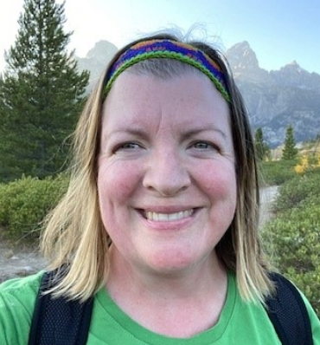
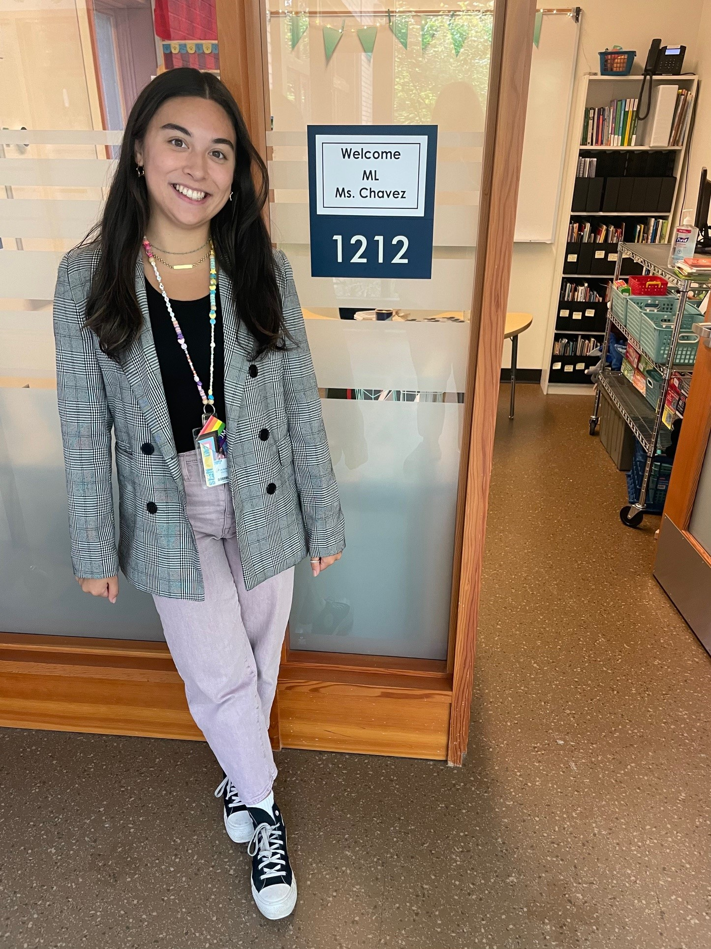


Multilingual Learner (ML) Program
We provide English instruction and support to multilingual students in all grades focusing on …
listening speaking
reading writing
The type and level of English support is determined by students' WIDA test scores and other assessments given by classroom and intervention teachers.
Questions about English support can be directed to the Multilingual Teachers:
Domini Dean
ddean@lwsd.org
Bella Chavez
ichavez@lwsd.org

Slide 40
JME Specialist
Physical Education
Mr. Rothenberg
jrothenberg@lwsd.org
Library
Ms. Kehrli
stkehrli@lwsd.org
Music
Ms. Metz
kmetz@lwsd.org

Slide 41
Music is 2 times a week!
We will learn how to…
Sing!
Play instruments!
Read rhythms!
Read music!
And…DANCE!!!

Slide 42


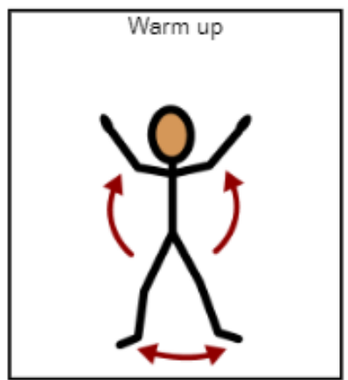
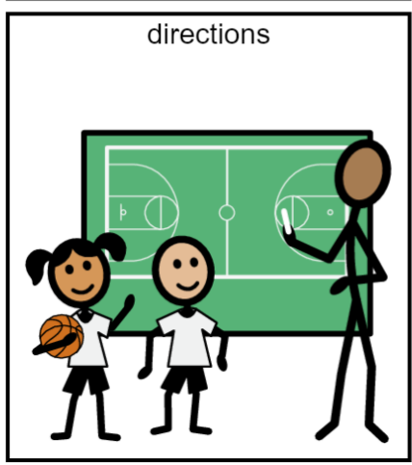
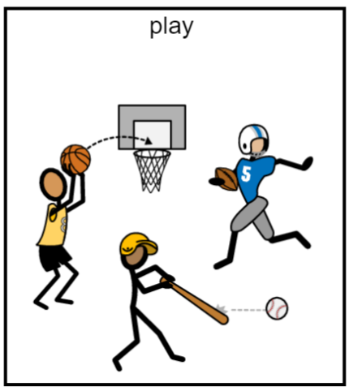


PE Class 2 times each week
Be ready to move by wearing safe running shoes!

Slide 43

JME library
Mrs. Kehrli
stkehrli@lwsd.org

Slide 44
Library Program Information:
All grades visit the library for 30 minutes a week.
Students listen to stories, learn about digital citizenship, and how to explore their information needs.
Grades K-1 Check out one book a week for their classrooms.
Grades 2-3 Check out 2 books to take home. The books are due 1 week later.
Grades 4-5 Check out 2 books to take home. The books are due 2 weeks later. 5th graders in good standing can increase the number of books to take home after Winter Break.

Slide 45

The Amazing Reading Challenge
All 5th graders can participate in ARC- The Amazing Reading Challenge.
Informational letters and permission forms will go out to all 5th grade families, later in the fall.

