Slide 1



Mr. Fisher
Ms. Lor
Mrs. Tucker

Slide 2
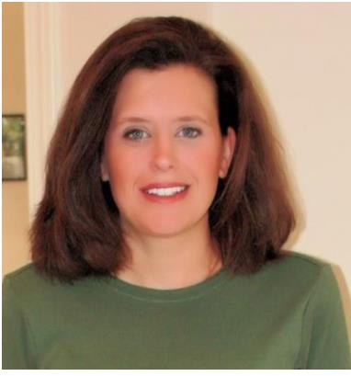
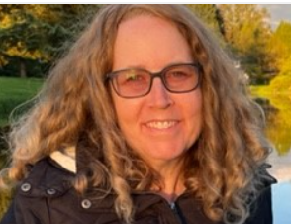
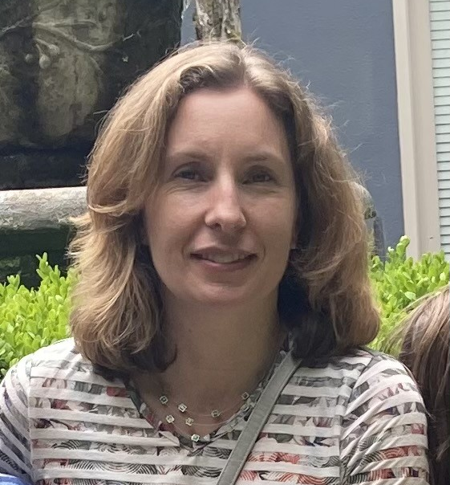
Safety Net Information
Support students in partnership with general education teachers in literacy so they can meet or exceed grade level standards
Safety Net instruction never replaces core instruction with their teacher, it serves as extra instruction for students who qualify
Julie Palmer
jupalmer@lwsd.org
Michelle Vallene
mvallene@lwsd.org
Ellen Barber
ebarber@lwsd.org

Slide 3
Who is served in safety net?
We serve students who are not meeting district and state academic standards in reading.
Our Reading testing will be through FastBridge, which replaced DIBELS
Safety Net groups will begin when testing has been completed by their classroom teacher.
Parents will be contacted if testing data indicates that their student will benefit from receiving extra support in Safety Net groups.
Safety Net groups will not interrupt or replace classroom instruction, they act as an extra support in addition to core curriculum

Slide 4



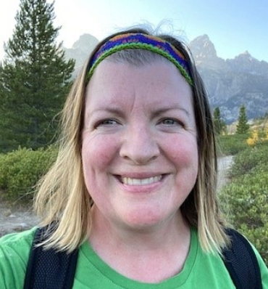
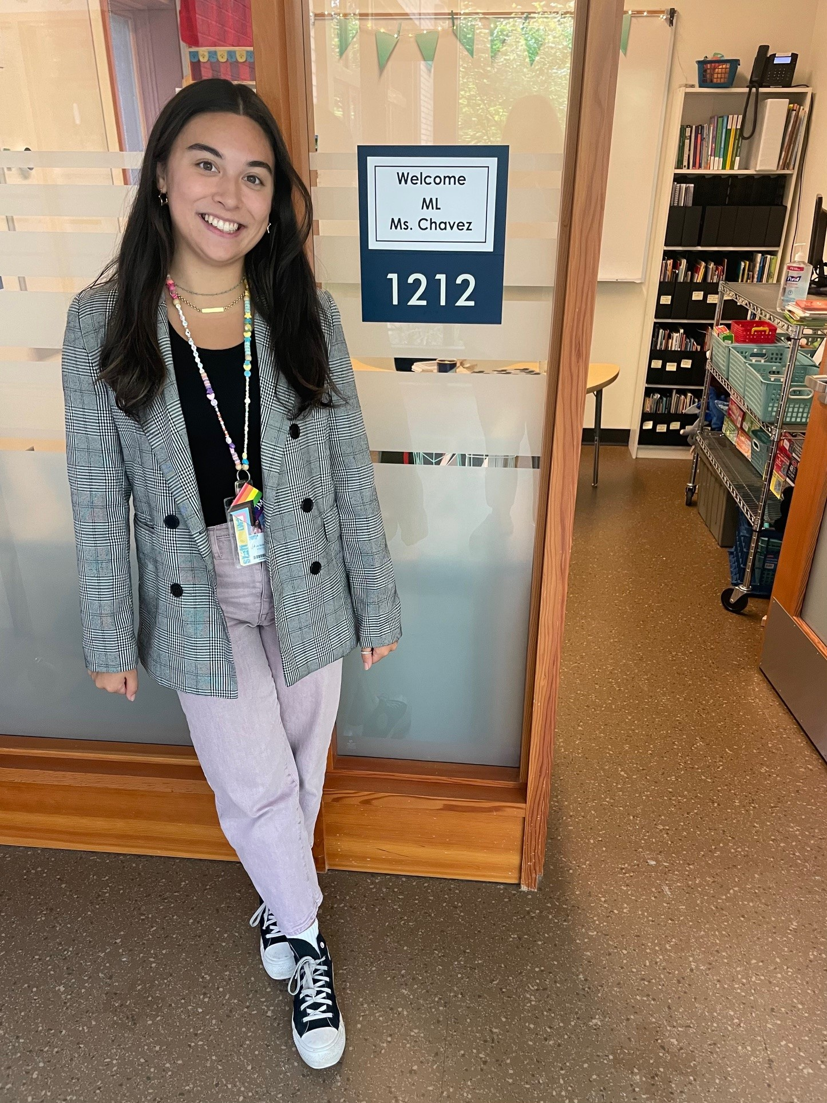


Multilingual Learner (ML) Program
We provide English instruction and support to multilingual students in all grades focusing on …
listening Speaking
reading writing
The type and level of English support is determined by students' WIDA test scores and other assessments given by classroom and intervention teachers.
Questions about English support can be directed to the Multilingual Teachers:
Domini Dean
ddean@lwsd.org
Bella Chavez
ichavez@lwsd.org

Slide 5
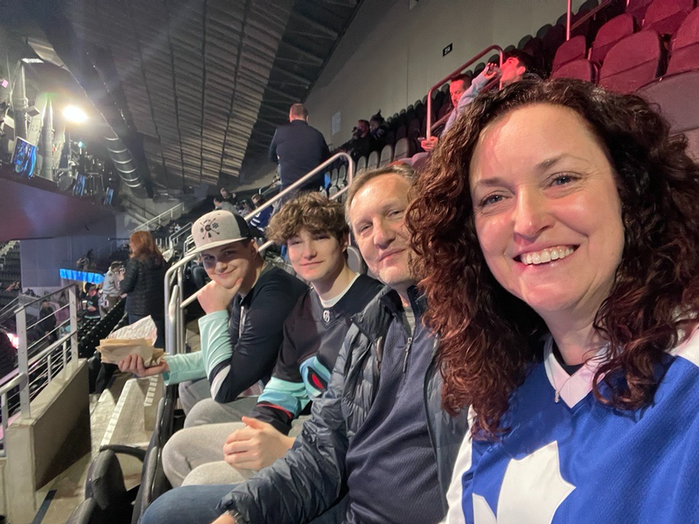
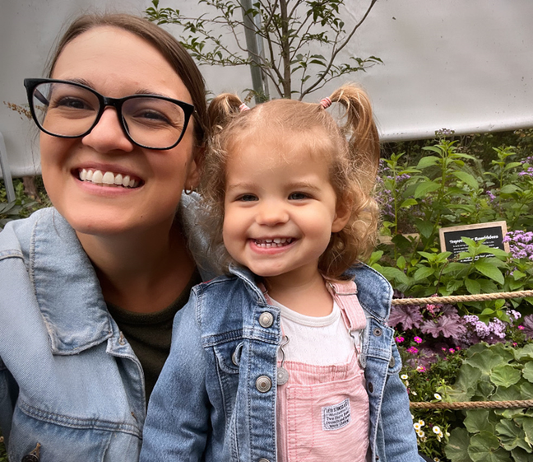
MEET THE SCHOOL COUNSELORS!
Ms. Schroeder. Full-time School counselor at JME. In my spare time I love going to hockey and baseball games with my family, and I love musical theatre especially at 5th Ave and the Paramount. I live at home with my husband, two sons, and two crazy cats.
Ms. Powers! Bonus School Counselor at JME. I work with Ms. Schroeder to help ALL students at JME. You will see me on Monday’s! I love reading, going to the beach, crafting and spending time with my family. I live at home with my husband Jordan, daughter Lucy and cat ROY!

Slide 6
John Muir Expectations:
Respectful
On task
Appropriate
Responsible

Slide 7


WHAT DOES AN ELEMENTARY SCHOOL COUNSELOR DO?
1
2
3
SUPPORT
EDUCATE
ENCOURAGE
  Academic, social, and emotional development of all of the students here at JME
  Classroom SEL lessons
  Student small groups
  JME community resources
  Students
  Families
  Teachers
  JME community

Slide 8


Common Core State Standards (CCSS)
These standards were written to:
Be rigorous
Prepare students for college
Prepare students to compete in a global economy
The CCSS reflect the knowledge and skills that young people need to succeed in college and career. They focus on:
Problem solving
Critical thinking skills.
These standards assist Lake Washington School District in its vision:
Every student future ready:
Prepared for college
Prepared for the global workplace
Prepared for personal success

Slide 9


CCSS and Reading Wonders at K-5
Reading Wonders is fully aligned with the CCSS and provides resources that support the rigor of these new standards in the following ways:
  Builds a strong reading foundation
  Assists students in accessing complex text
  Assists students in finding and using text evidence
  Helps engage students in collaborative conversations
  Engages students in the purposes for writing:
    Informative/explanatory texts
    Opinion/Argument
    Narrative

Slide 10
LITERACY:
LWSD Writing Units
Our writing program is the LWSD Writing Units*, which will provide many opportunities to grow in writing and will prepare the kids for the Smarter Balanced Assessment. These are the main genres of writing we will engage in this year:
  Personal Narratives
  Informational Writing with Research
  Opinion Writing
  Realistic Fiction

Slide 11

Illustrative Mathematics
Illustrative Mathematics K-5, is a problem-based, rigorous curriculum that makes elementary school mathematics accessible, impactful, and memorable for all students. Authored by the Illustrative Mathematics team and delivered in LearnZillion's platform, this curriculum has what is needed to reach all students. There are eight units with a consumable learner workbook.
Introducing Multiplication
Area and Multiplication
Wrapping Up Addition and Subtraction within 1,000
Relating Multiplication to Division
Fractions as Numbers
Measuring Length, Time, Liquid Volume, and Weight
Two-dimensional Shapes and Perimeter
Putting it All Together

Slide 12

Amplify Science Units
Balancing Forces – Floating Trains Phenomenon
Inheritance & Traits – Variation of Species Phenomenon for an adopted Wolf pup
Environments & Survival – Survival Traits & Adaptations for Grove Snails
Weather & Climate – Patterns in Weather Data for Orangutan Habitats

Slide 13
Social Studies: Inquiry Journeys
Themes:
Where in the world are we?
How does geography shape culture?
How are we connected to the global community through what we produce and consume?
How can I play a part in the global community?
How can we take informed actions?

Slide 14
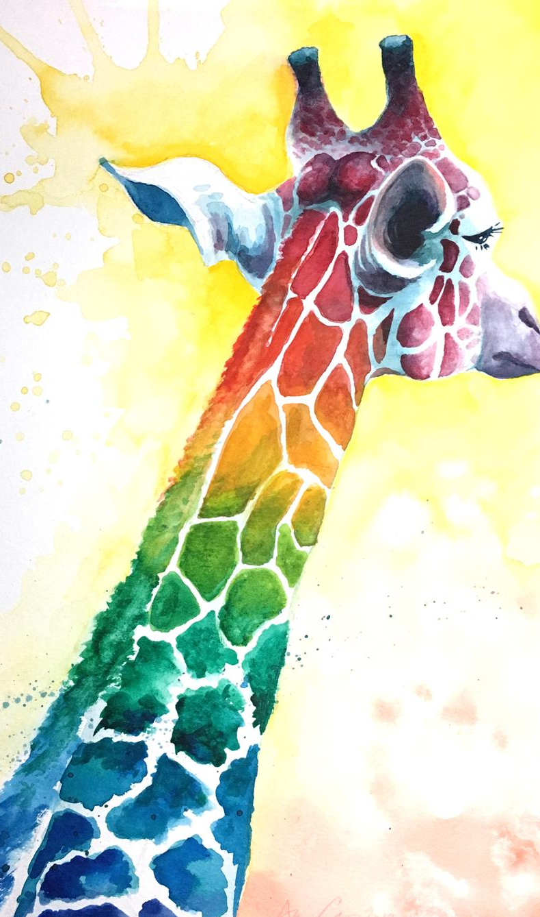

Deep Space Sparkle Art Program

Slide 15


Technology
Keyboarding skills
  Typing Club
Online safety
  Common Sense Media is our curriculum for digital citizenship
SBA prep (To Be Determined)

Slide 16

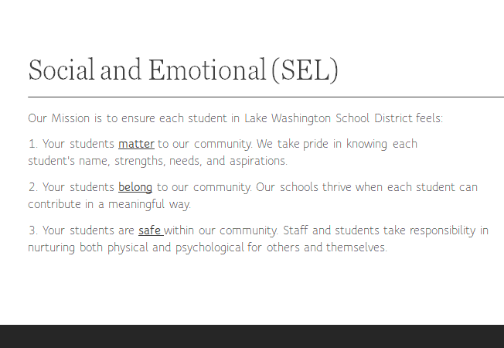

Slide 17



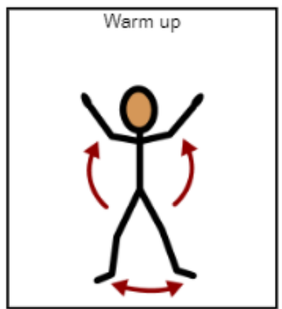
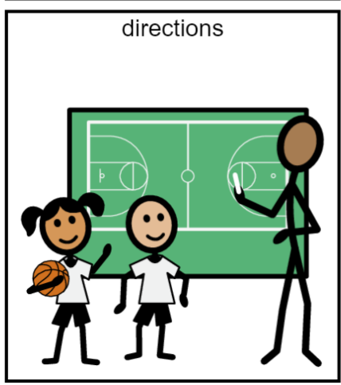
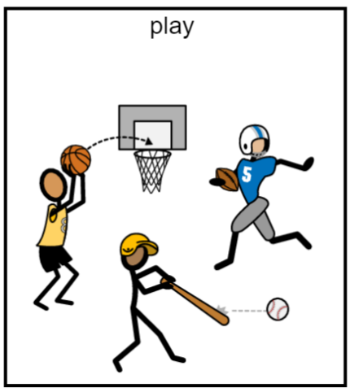
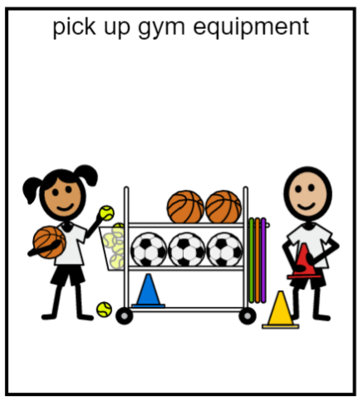

PE Class 2 times each week
Be ready to move by wearing safe running shoes!

Slide 18
Music is 2 times a week!
We will learn how to…
Sing!
Play instruments!
Read rhythms!
Read music!
And…DANCE!!!

Slide 19
JME Library Program Information:
All grades visit the library for 30 minutes a week.
Students listen to stories, learn about digital citizenship, and how to explore their information needs.
Grades 3 Check out 2 books to take home. The books are due 1 week later.
Mrs. Kehrli
stkehrli@lwsd.org

Slide 20
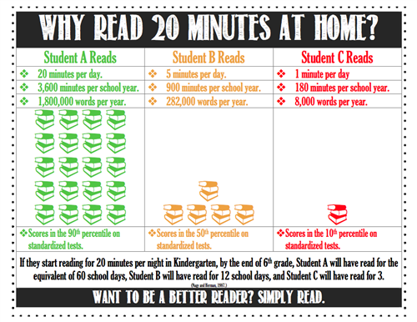
What can we do at home?
Reading at home for 20-30 minutes each night is a good goal!

Slide 21
Accelerated Program Testing
Anyone can apply!
As we move forward with this year, more information regarding Highly Capable Identification process for 2024-2025 will be shared directly to families from the High Capability Program.
More information? Check out the Accelerated Programs here

Slide 22

Questions?
If you have any questions, please reach out to your student’s teacher on Parent Square.

