Slide 1

Welcome to Second Grade!
2024-2025
Melissa Cayabyab
Kiah Moore
Aly Shiels
Celina Ryan
Click for audio
Notes:
Aly

Slide 2



Agenda
Click for audio
Meet the Different JME Teams
Title 1
FastBridge
Safety Net/Multilingual Learner
Schedule
Curriculum Overview
At Home Support
Pick up/Drop off
Additional Information
Notes:
Aly

Slide 3
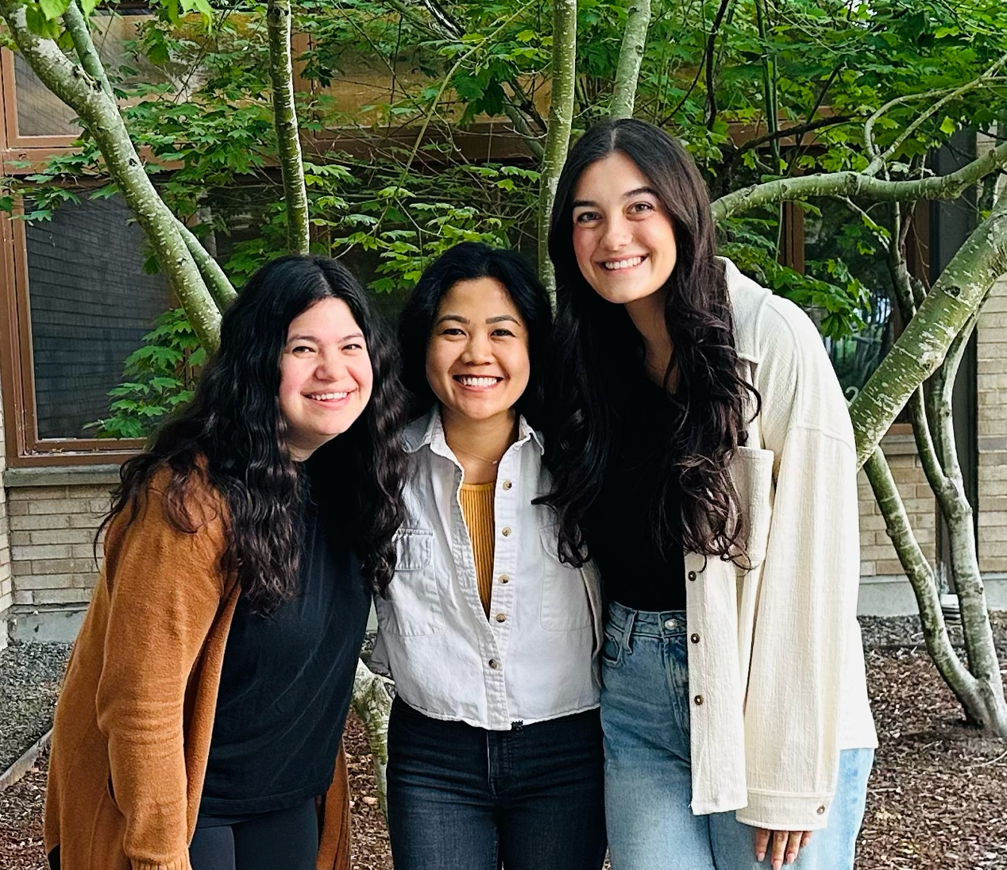

Meet the 2nd grade team
Click for audio
Notes:
Kiah

Slide 4

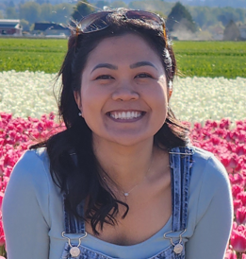

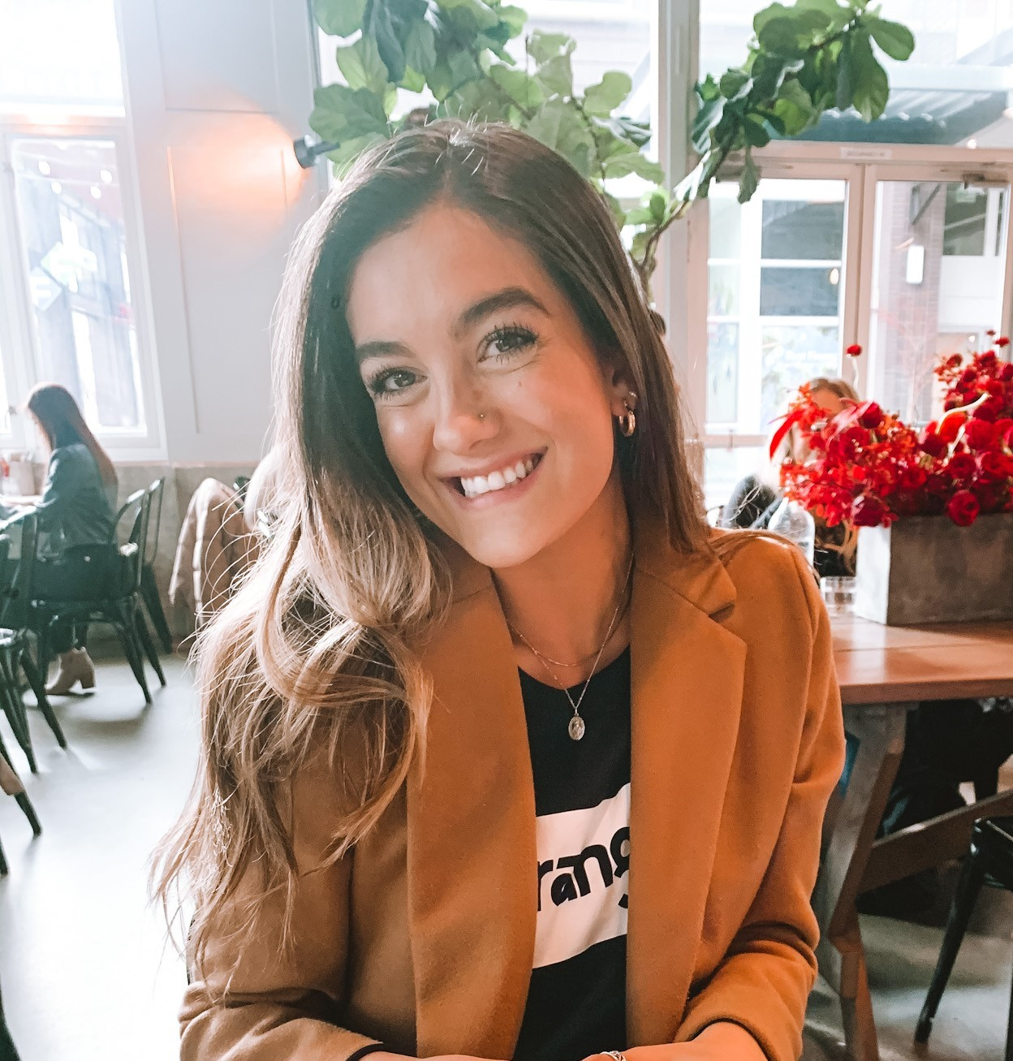
Meet the 2nd grade team
Kiah
Moore
kimoore
@lwsd.org
Melissa Cayabyab
mcayabya
@lwsd.org
Aly
Shiels
ashiels
@lwsd.org
Celina
Ryan
cryan
@lwsd.org
Click for audio
Notes:
Kiah

Slide 5
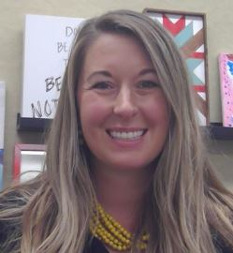
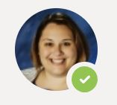
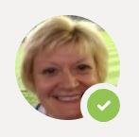
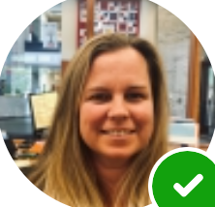

Meet the Office Staff!
Ashley Boughton, Principal
Bridget Ballard, Associate Principal
Gail Anderson, Office Registrar
Jamie Crum,
Office Manager
Casey
Yim,
School Nurse
Click for audio
Notes:
Celina

Slide 6
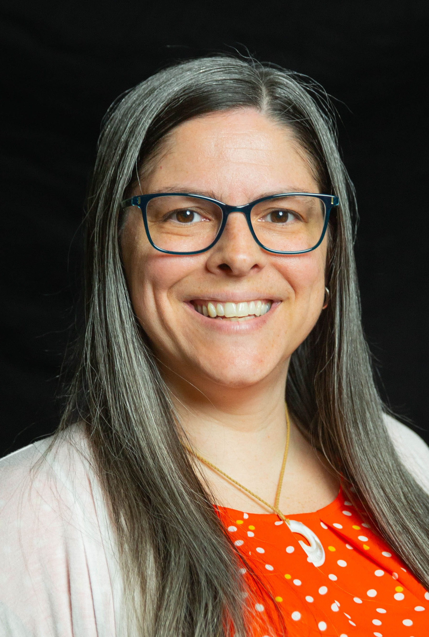
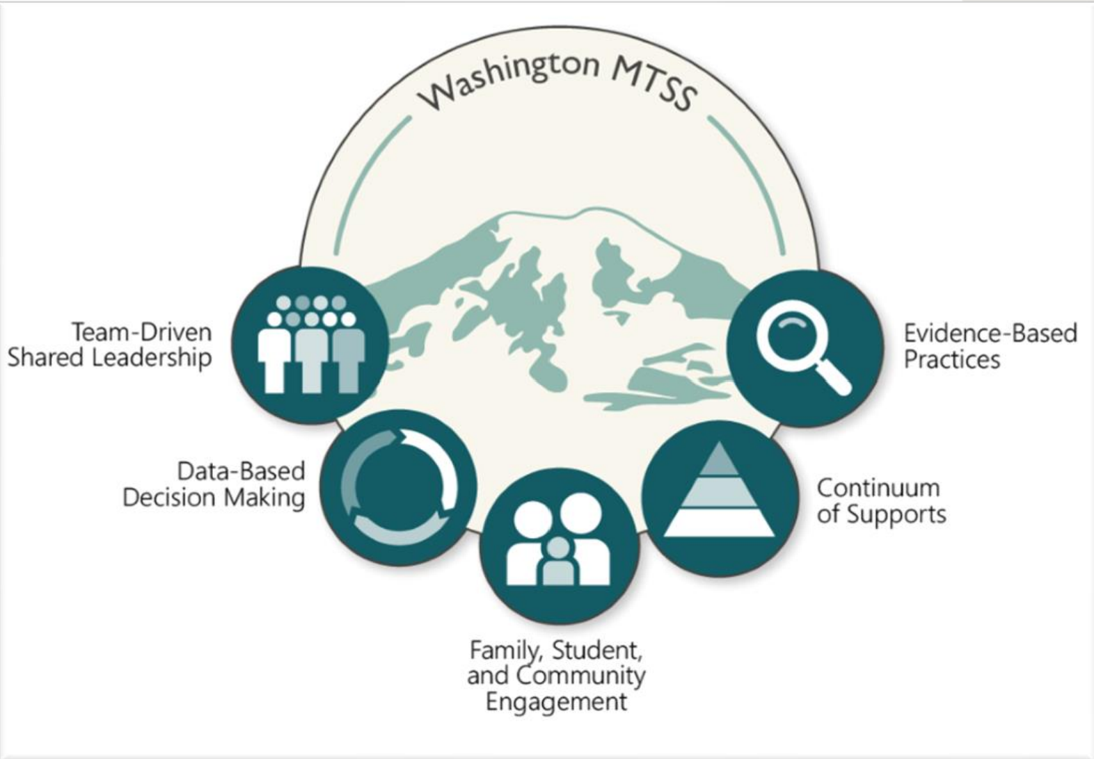
MTSS Coach
Lisa Juvinall
I am the MTSS Instructional Coach this year at Muir. MTSS stands for Multi-Tiered System of Supports, so my job is to partner with teachers to ensure appropriate student supports are in place so that each learner feels a sense of belonging, makes measurable growth, and feels successful here at JME. You may hear your child talk about me as another teacher in their classroom.
Click for audio

Slide 7
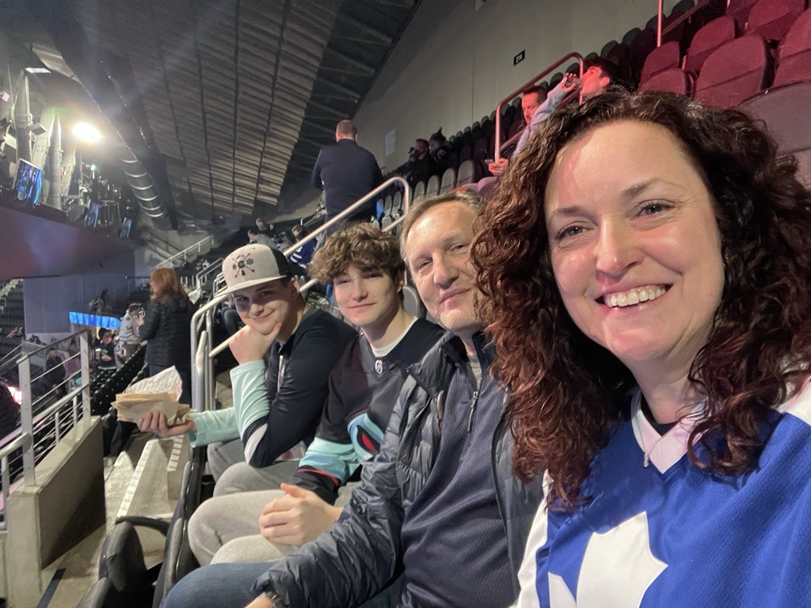
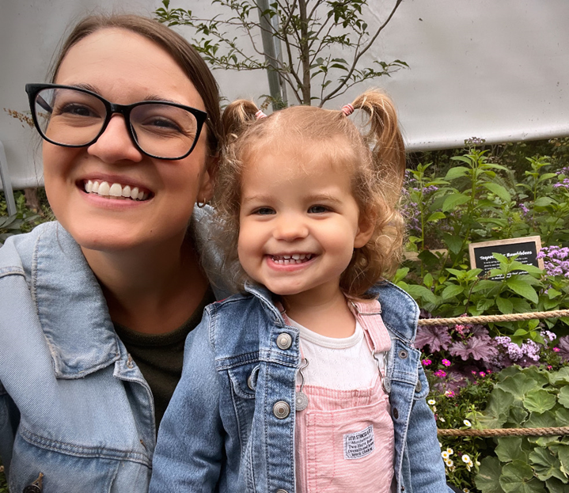
Counselor
Ms. Schroeder
Full-time School counselor at JME. As school counselors Ms. Powers and I play a vital role in supporting the academic, social, and emotional development of all of the students here at JME. I tell all of the students at JME that my main job is to listen because they are the experts on themselves!
In my spare time I love going to hockey and baseball games with my family, and I love musical theatre especially at 5th Ave and the Paramount. I live at home with my husband, two sons, and two crazy cats. Make sure to ask your kids what my cats names are!
Ms. Powers
Bonus School Counselor at JME. I work with Ms. Schroeder to help ALL students at JME. You will see me on Monday’s! I love reading, going to the beach, crafting and spending time with my family. I live at home with my husband Jordan, daughter Lucy and cat ROY!
Click for audio

Slide 8
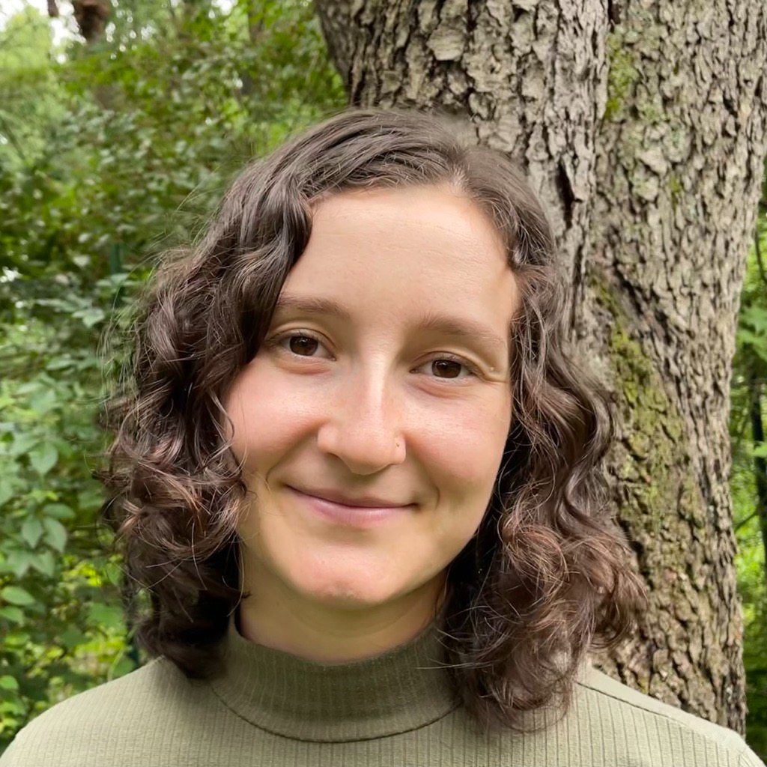

Community in Schools Site Coordinator
Lila Sternberg - She/her works as the Site Coordinator at John Muir Elementary through a non-profit called Communities in Schools (CIS). Her job is to advocate for students and work with their families to minimize barriers to education. Examples of supports she can provide include connecting families with basic needs, such as food, clothes and housing; supporting students to improve their social and emotional connections either in group or individual settings; hosting student and family events to create a stronger community here at Muir; and mentoring students who are not fully engaged, who don’t feel connected to their school, or who are struggling with attendance or are having behavior struggles.
Click for audio

Slide 9

Title I
John Muir Elementary is a Title I School. This means that we receive Federal funding to supplement existing programs in support of student progress toward the state’s challenging academic standards. These funds can be used for parent and family engagement, staff professional development, curricular tools, and other resources.
Click for audio
Notes:
Kiah

Slide 10

Title I Parent and Family Rights
You have the right to…
Participate in the planning and decision-making processes pertaining to Title I
Receive communication and translation services in your home language
Request teacher and paraeducator qualifications
Receive information about curriculum and assessments
If you feel that our school is not meeting the requirements for Title I, you have the right to file a citizen complaint.
Click for audio
Notes:
Kiah

Slide 11
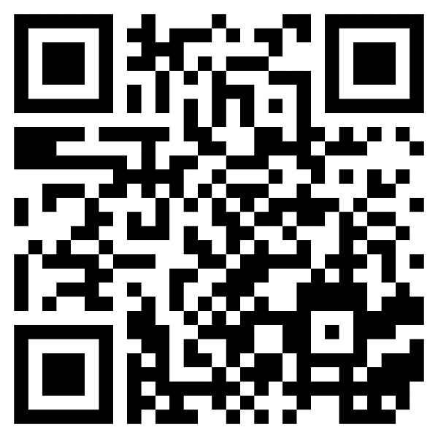

Title I Parent-Family Engagement
Your voice is important in guiding our Title I Program. If you have not already done so, please complete the short survey on Parent Square (Scan QR Code) to share ideas and availability.
Click for audio
Notes:
Kiah

Slide 12

FastBridge
Click for audio
Over the past couple of weeks, your student participated in a reading and math skills check. The screener is called FastBridge and it is a quick, repeatable check on skills.
2nd – 5th graders will complete their assessments on the computer independently.
Reading:
CBMreading
aReading
Math:
FASTtrack Math: aMath and CBMmath Automaticity
Notes:
Aly

Slide 13
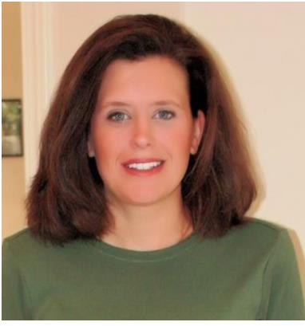
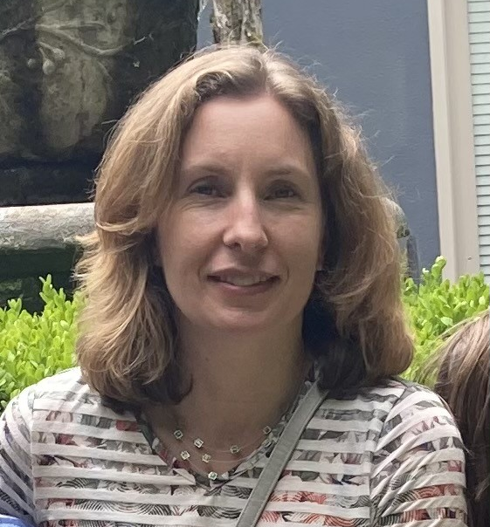
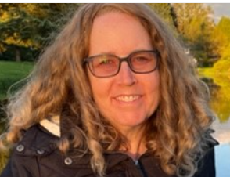
The Purpose of Safety Net
Safety Net works in partnership with general education teachers to help student’s meet or exceed grade level standards in their literacy skills
Safety Net instruction never replaces core instruction with their teacher, it serves as extra instruction for students who qualify
Click for audio
Julie Palmer
Jpalmer
@lwsd.org
Ellen Barber
ebarber
@lwsd.org
Michelle Vallene
mvallene
@lwsd.org
Notes:
Celina

Slide 14
Who is Served in Safety Net?
We serve students who are approaching district and state academic standards in reading.
Our initial reading screener is done through FastBridge. Based on these results, follow up diagnostic screeners may be completed per student profile/need.
Safety Net small groups will begin when testing has been completed.
Safety Net groups will not interrupt or replace classroom instruction, they act as an extra support in addition to core curriculum and classroom small group instruction.
Parents will be contacted if testing data indicates that their student will benefit from receiving extra support in Safety Net groups.
Click for audio
Notes:
Celina

Slide 15





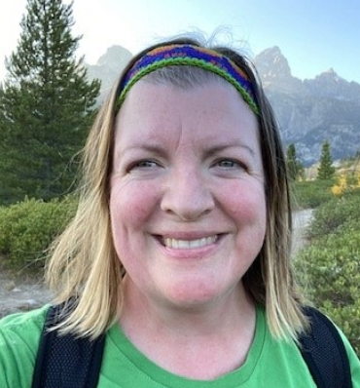
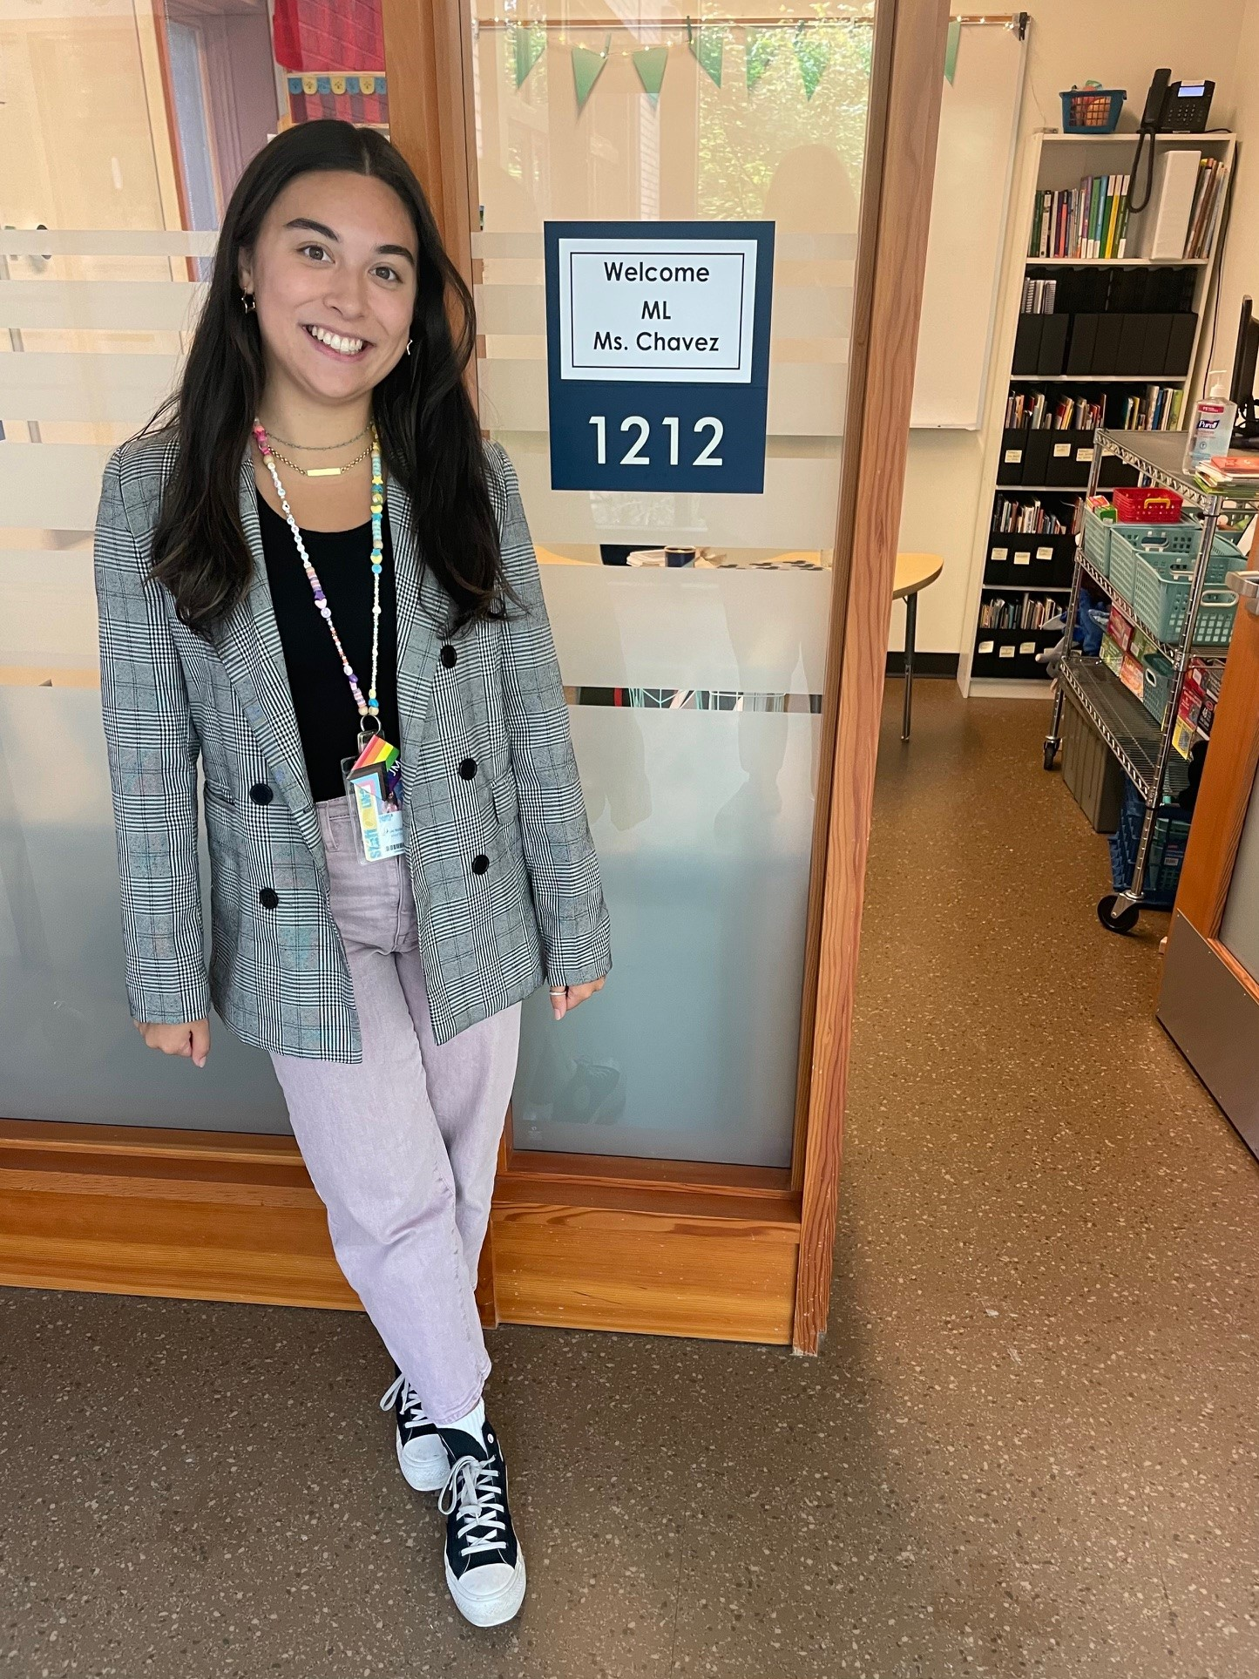
Multilingual Learner (ML) Program
We provide English instruction and support to multilingual students in all grades focusing on …
listening speaking
reading writing
The type and level of English support is determined by students' WIDA test scores and other assessments given by classroom and intervention teachers.
Click for audio
Questions about English support can be directed to the Multilingual Teachers:
Domini Dean
ddean@lwsd.org
Bella Chavez
ichavez@lwsd.org

Slide 16
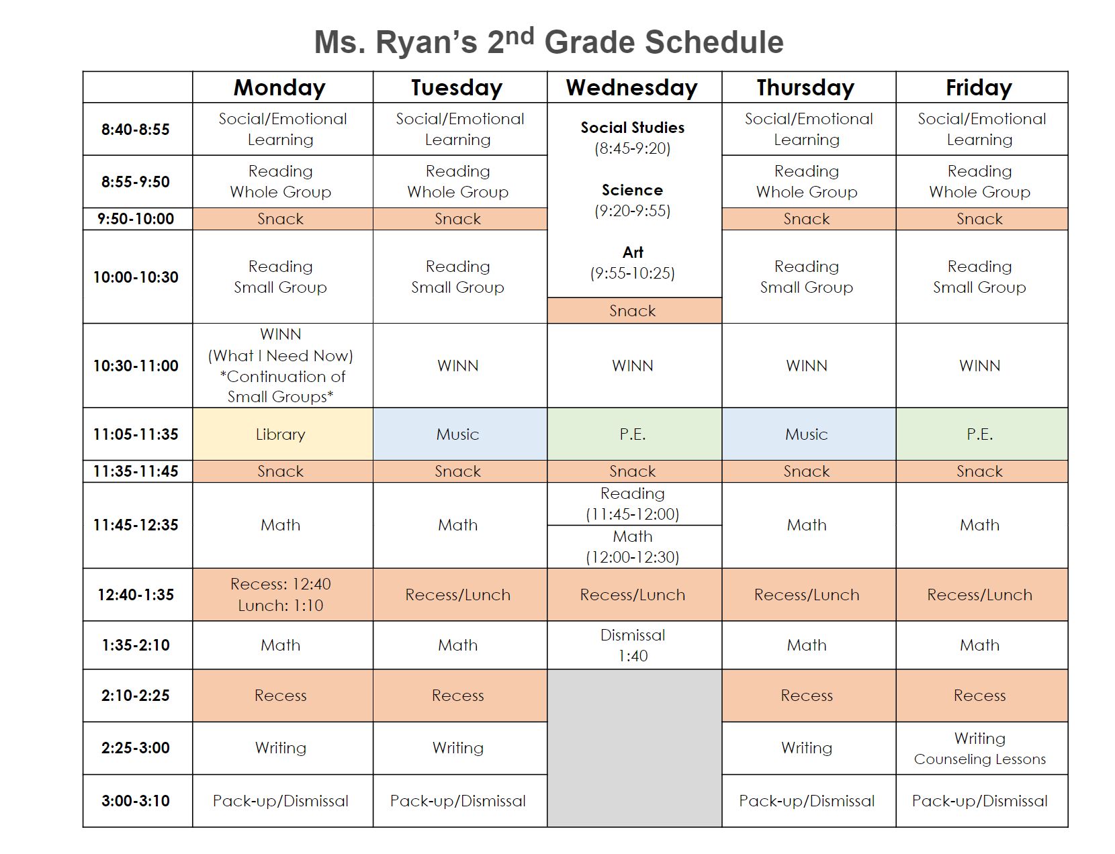
2nd Grade Schedule
Ryan
Click for audio
Notes:
Aly

Slide 17
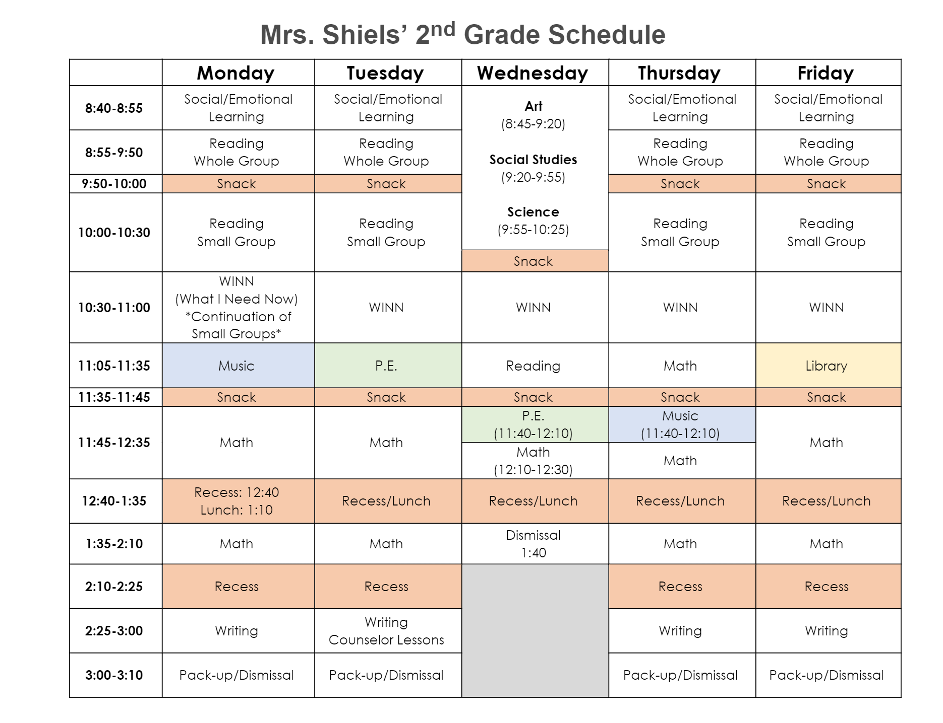
2nd Grade Schedule
Shiels
Notes:
Aly

Slide 18
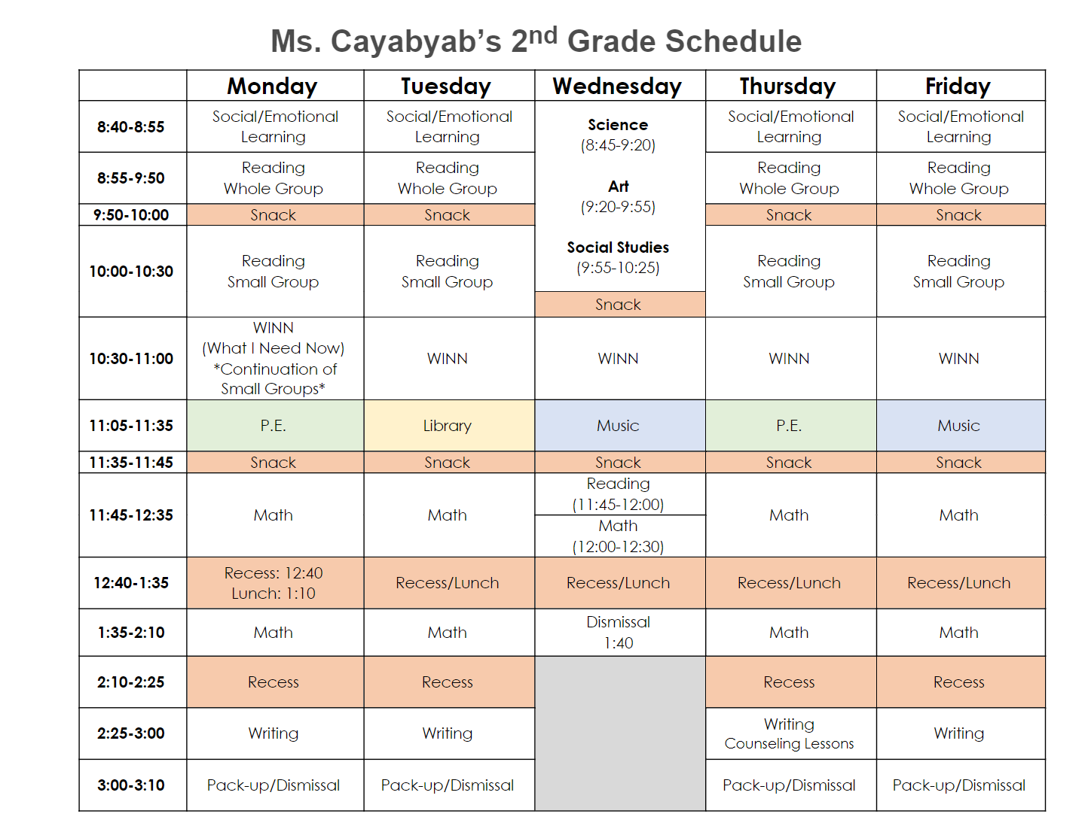
2nd Grade Schedule
Cayabyab/Moore
Notes:
Aly

Slide 19

Social Studies
Geography
Civics
Economics
History
Click for audio
Notes:
Celina

Slide 20
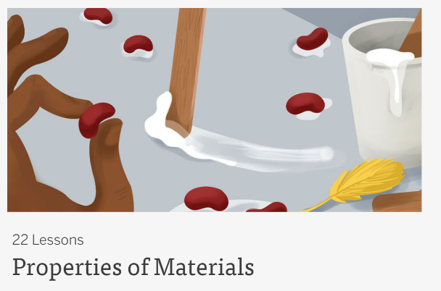
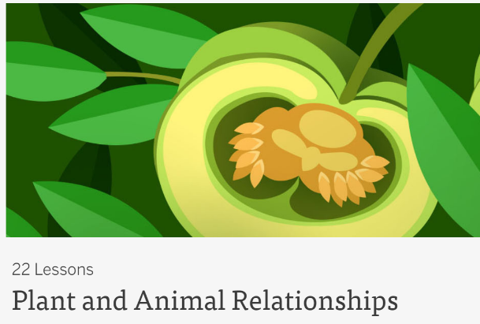
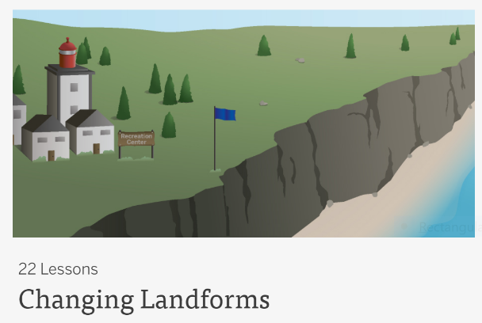
Amplify Science
Plant & Animal Relationships
Properties of Materials
Changing Landforms
Click for audio
Notes:
Kiah

Slide 21

Art
Deep Space Sparkle
Work with different mediums:
  Watercolor
  Oil Pastel
  Paper
  Tempera Paint
Click for audio
Notes:
Aly

Slide 22


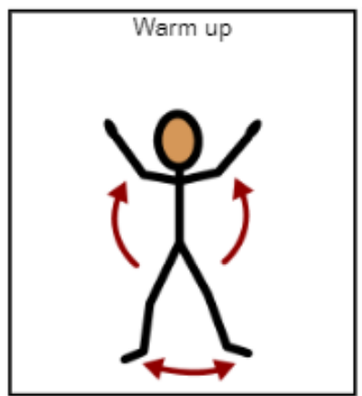
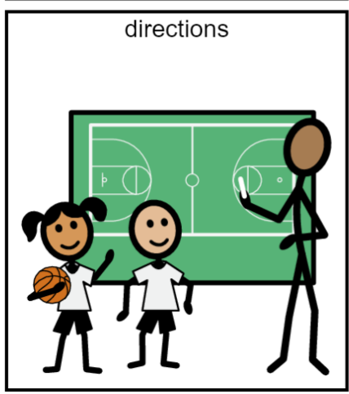
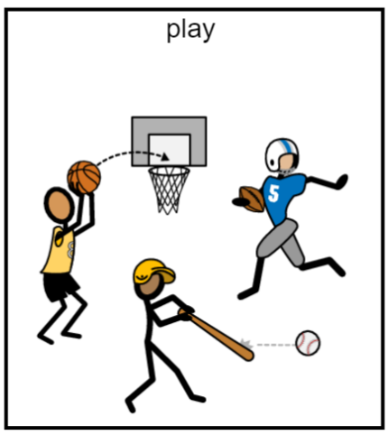
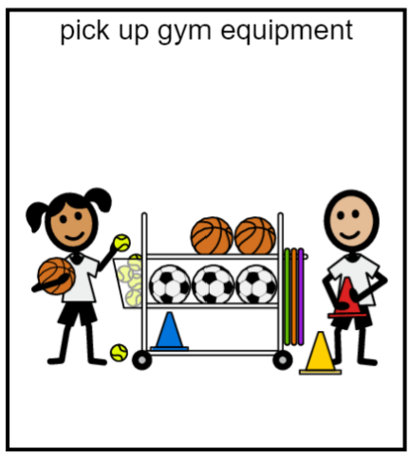

PE Class
2 times each week
Be ready to move by wearing safe running shoes!
Click for audio

Slide 23
Music is 2 times a week!
We will learn how to…
Sing!
Play instruments!
Read rhythms!
Read music!
And…DANCE!!!
Click for audio

Slide 24
Library is 1 time a week!
Library Program Information…
All grades visit the library for 30 minutes a week.
Students listen to stories, learn about digital citizenship, and how to explore their information needs.
Grades K-1 Check out one book a week for their classrooms.
Grades 2-3 Check out 2 books to take home. The books are due 1 week later.
Grades 4-5 Check out 2 books to take home. The books are due 2 weeks later. 5th graders in good standing can increase the number of books to take home after Winter Break.
Click for audio

Slide 25

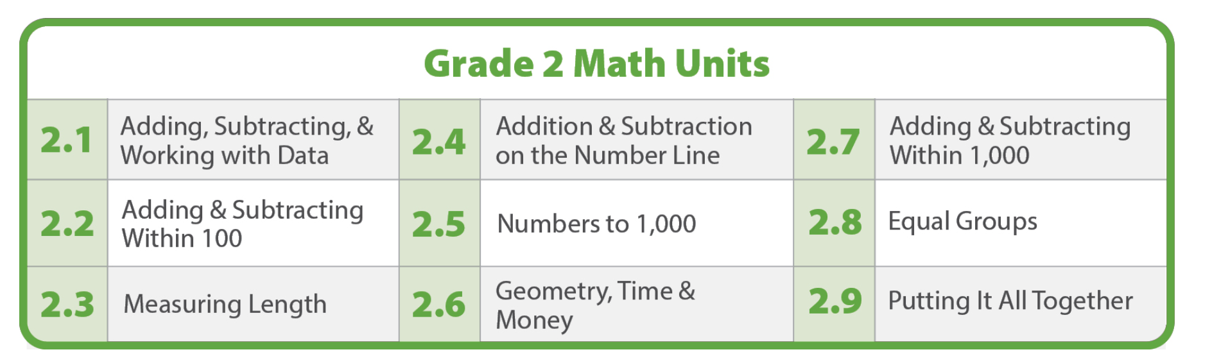
Illustrative Mathematics
Click for audio
Illustrative Mathematics K-5, is a problem-based, rigorous curriculum that makes elementary school mathematics accessible, impactful, and memorable for all students. Authored by the Illustrative Mathematics team and delivered in LearnZillion's platform, this curriculum has what is needed to reach all students.
In second grade there are 9 units
Units vary in length, most are about 3-4 weeks, but can range from 2-6 weeks
Notes:
Kiah

Slide 26
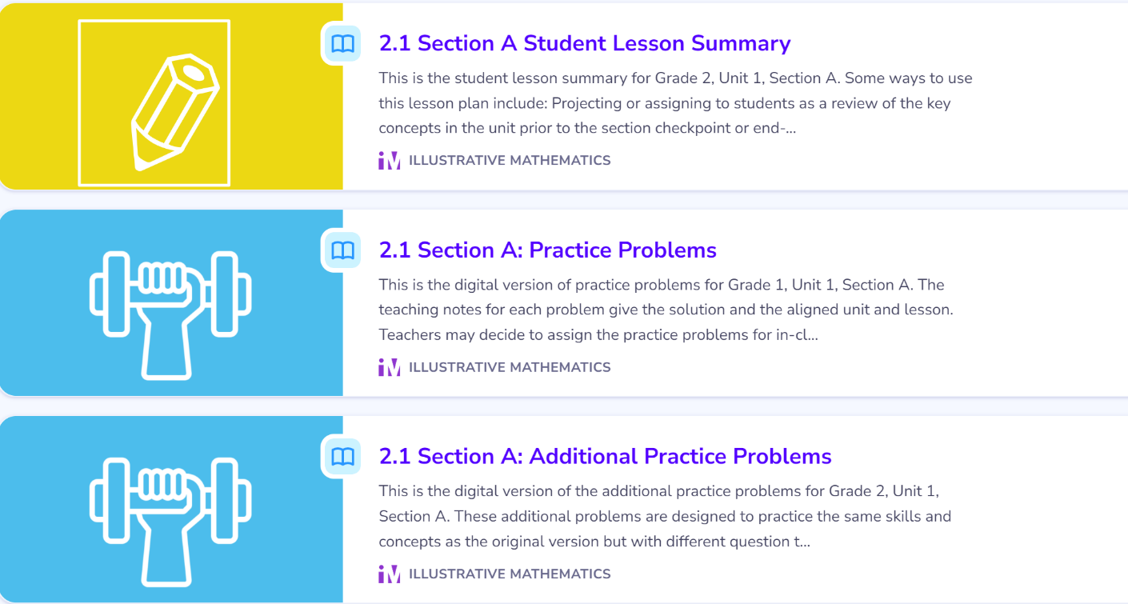
At Home
Math Support
We are a no homework school. For those interested at the end of each section there will be assigned option enrichment activities on your students online illustrative math accounts.
Feel free to engage in this work. This offers them another avenue of connection to what we do in the classroom.
This is optional
Click for audio
Notes:
Kiah

Slide 27

Reading
Whole Group and
Small Group
Click for audio
Wonders is the Reading curriculum currently used in the LWSD
Aligns with CCSS
Research-based
Systematic and explicit sequence for students learning to read
It provides resources that support the rigor of the standards, including:
  Building a strong reading foundation
  Assisting students in accessing complex text
  Assisting students in finding and using text evidence
  Helping engage students in collaborative conversations
Notes:
Celina

Slide 28
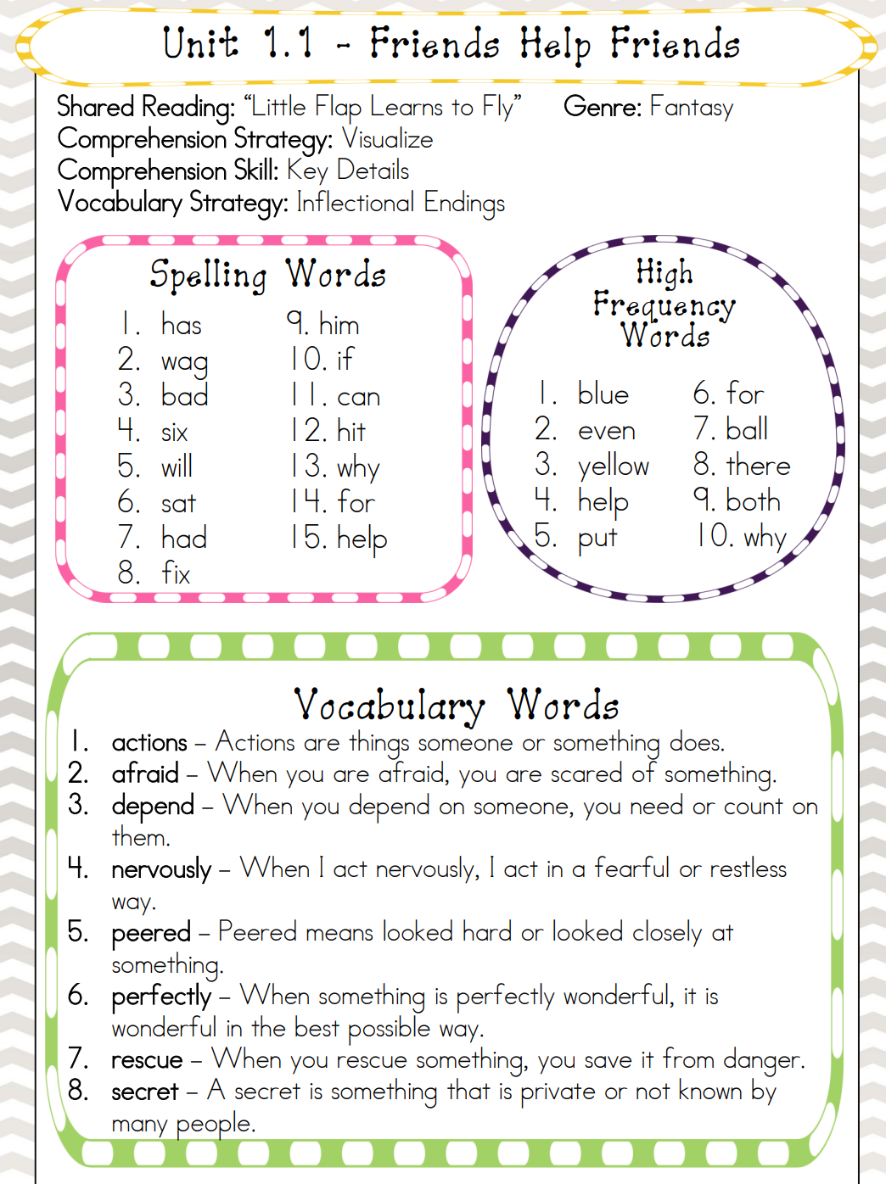
Reading
Whole Group and
Small Group
Click for audio
Every week we will introduce and review:
  Essential Question
  Phonics Skill
  10 High-Frequency Words
  8 Vocabulary Words
  Comprehension
    Genre
    Strategy
    Skill
Notes:
Celina

Slide 29
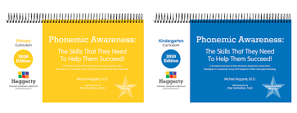
Reading Curricular Tool: Heggerty K-2
Click for audio
Provides structured and systematic daily phonemic awareness instruction
Focuses on the phonemes or sounds we hear in words
Delivered orally with multisensory instructional strategies
Fast-paced and engaging (about 12 minutes per lesson)
Notes:
Celina

Slide 30

Writing
Click for audio
Narrative
  Personal Narrative (Small
  Moment) – We will start this next week!
  Realistic Fiction
Informational
  All About Books
  Narrative Non-Fiction
Opinion
  Book Reviews
  Lettes for Change
Notes:
Aly

Slide 31

Workshop Model
We teach most content areas using the workshop model.
This includes:
Whole group mini lesson
Rotations:
  Independent worktime (seatwork)
  Small group instruction
  Technology time (DreamBox or Lexia)
Wrap Up/Share
Click for audio
Notes:
Aly

Slide 32
Technology
Lexia
  Supplemental Reading Program
Dreambox
  Supplemental Math Program
Typing Club
  Typing Program
PebbleGo
  Research database
Each class makes time for the programs listed above during the school day, no pressure to be done at home.
Click for audio
Notes:
Aly

Slide 33
At home Support
Take Home Folders – check every night and return to school the next day
Wonders- Each week we will send home a week at a glance which provides a list of what we learned during reading which students are encouraged to continue practicing at home.
Homework – We are a no homework school, so we do not send home daily homework assignments. We would still like students to read for 20 minutes every night.
Unfinished Seatwork- We will also send home unfinished work with students who did not finish in class. They can finish work at home for extra practice, but this is not required.
Click for audio
Notes:
Kiah

Slide 34

Click for audio
Notes:
Celina

Slide 35
Snack and Water bottles
Snack
Please send your student with TWO snacks each day
Water Bottles
Please send your student with a water bottle each day
Water ONLY
We are allergy aware classrooms
We may ask for classroom snack donations in the newsletter (individually wrapped please)
Click for audio
Notes:
Celina

Slide 36

Weekly Newsletter
Sent home on Fridays
Includes reminders, shoutouts and other important information
Includes reading week at a glance and weekly decodable story
Sent via ParentSquare
  Download the free ParentSquare app on phone/device. It is much easier to read newsletters this way ☺
Click for audio
Notes:
Aly

Slide 37
Drop Off & pick up
Click for audio
Arrival – 8:25-8:40
Students should arrive no earlier than 8:25 as there is no supervision prior to this time
Students eating breakfast enter directly through cafeteria doors at 8:10
Dismissal
Additional Notes:
Please use designated walk paths and crossings to ensure safety
Only right-hand turns allowed out of parking lot
Please communicate with students how they will be picked up when possible
Teachers walk their students to their designated cone before dismissing them to their loving adult or car pick up
The playground is not accessible to students until 3:20
Please ensure that your wonderful pets stays home
Notes:
Kiah

Slide 38
Volunteers
If you are interested in volunteering this year, you will need to complete the online volunteer application.
You will also need to complete a background check before you are able to volunteer.
Please visit Volunteering in LWSD - Lake Washington School District for more information and to apply to volunteer.
Based on induvial classroom need, teachers will reach out to families who have shown interest in volunteering in their child’s classroom.
Click for audio
Notes:
Aly

Slide 39


Slide 40

Questions?
Click for audio
Notes:
Kiah

