Slide 1


Welcome to First Grade
Marisa Gonzalez Abby Taylor
mgonzalez@lwsd.org ataylor@lwsd.org

Slide 2
Agenda
Title 1 School
Safety Net
ML
Counselor & CIS
Specialists
Highly Capable
Curriculum
  Questions
Notes:
Abby

Slide 3

Title I
John Muir Elementary is a Title I School. This means that we receive Federal funding to supplement existing programs in support of student progress toward the state’s challenging academic standards. These funds can be used for parent and family engagement, staff professional development, curricular tools, and other resources.
Notes:
Marisa

Slide 4
Title I Parent and Family Rights
You have the right to…
Participate in the planning and decision-making processes pertaining to Title I
Receive communication and translation services in your home language
Request teacher and paraeducator qualifications
Receive information about curriculum and assessments
If you feel that our school is not meeting the requirements for Title I, you have the right to file a citizen complaint.
Notes:
Marisa

Slide 5
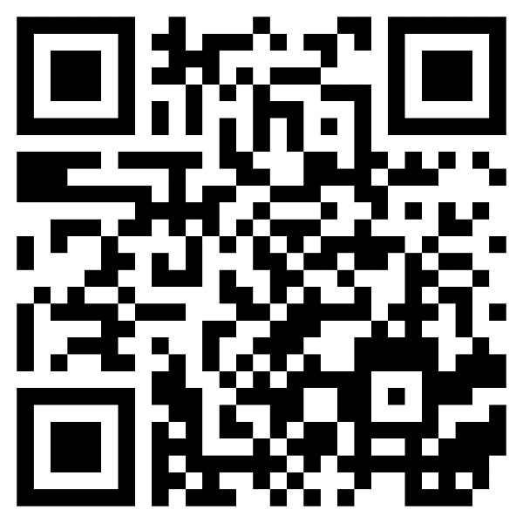

Title I Parent-Family Engagement
Your voice is important in guiding our Title I Program. If you have not already done so, please complete the short survey on Parent Square (Scan QR Code) to share ideas and availability.
Notes:
Marisa

Slide 6

Purpose of Safety Net!
Support students in partnership with general education teachers in literacy so they can meet or exceed grade level standards
Safety Net instruction never replaces core instruction with their teacher, it serves as extra instruction for students who qualify
Notes:
Abby

Slide 7

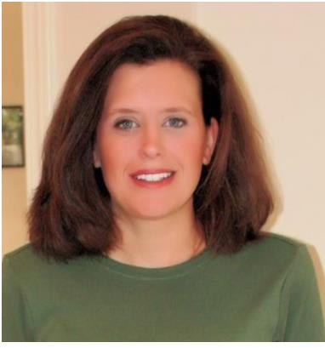
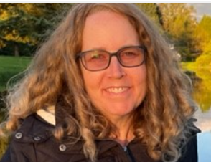
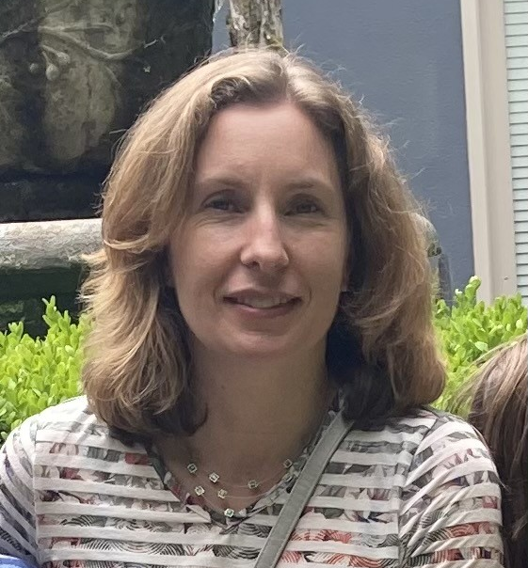
Meet the Team
Julie Palmer
jupalmer@lwsd.org
Michelle Vallene
mvallene@lwsd.org
Ellen Barber
ebarber@lwsd.org
Notes:
Abby

Slide 8

Who is served in safety net?
We serve students who are not meeting district and state academic standards in reading.
Our Reading testing will be through FastBridge, which replaced DIBELS
Safety Net groups will begin when testing has been completed by their classroom teacher.
Parents will be contacted if testing data indicates that their student will benefit from receiving extra support in Safety Net groups.
Safety Net groups will not interrupt or replace classroom instruction, they act as an extra support in addition to core curriculum
Notes:
Abby

Slide 9



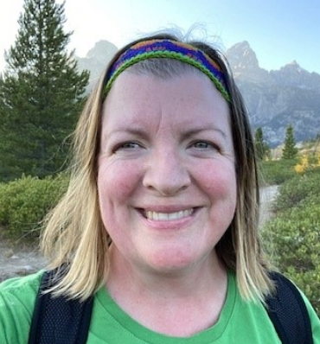
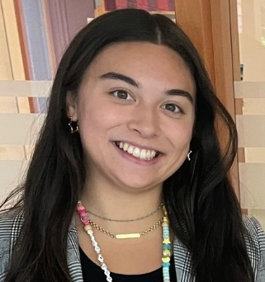


Multilingual Learner (ML) Program
We provide English instruction and support to multilingual students in all grades focusing on …
listening speaking
reading writing
The type and level of English support is determined by students' WIDA test scores and other assessments given by classroom and intervention teachers.
Questions about English support can be directed to the Multilingual Teachers:
Domini Dean
ddean@lwsd.org
Bella Chavez
ichavez@lwsd.org
Notes:
Marisa

Slide 10
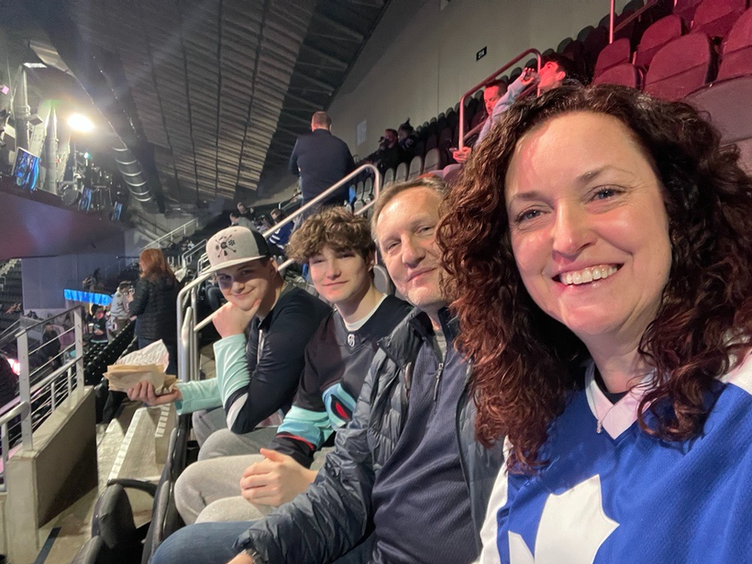
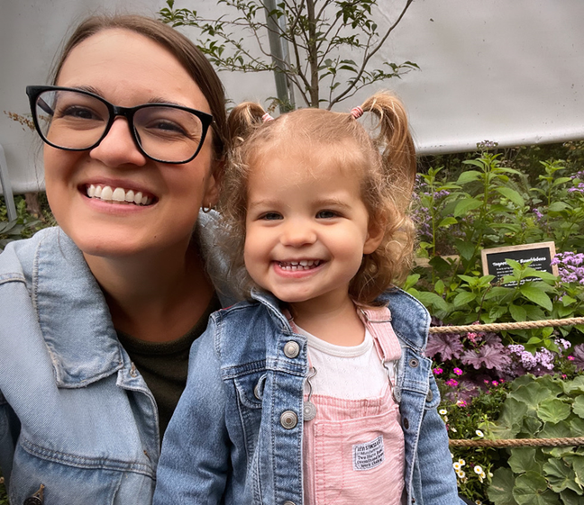
MEET THE SCHOOL COUNSELORS!
Ms. Schroeder. Full-time School counselor at JME. In my spare time I love going to hockey and baseball games with my family, and I love musical theatre especially at 5th Ave and the Paramount. I live at home with my husband, two sons, and two crazy cats.
Ms. Powers! Bonus School Counselor at JME. I work with Ms. Schroeder to help ALL students at JME. You will see me on Monday’s! I love reading, going to the beach, crafting and spending time with my family. I live at home with my husband Jordan, daughter Lucy and cat ROY!

Slide 11


WHAT DOES AN ELEMENTARY SCHOOL COUNSELOR DO?
1
2
3
SUPPORT
EDUCATE
ENCOURAGE
  Academic, social, and emotional development of all of the students here at JME
  Classroom SEL lessons
  Student small groups
  JME community resources
  Students
  Families
  Teachers
  JME community

Slide 12
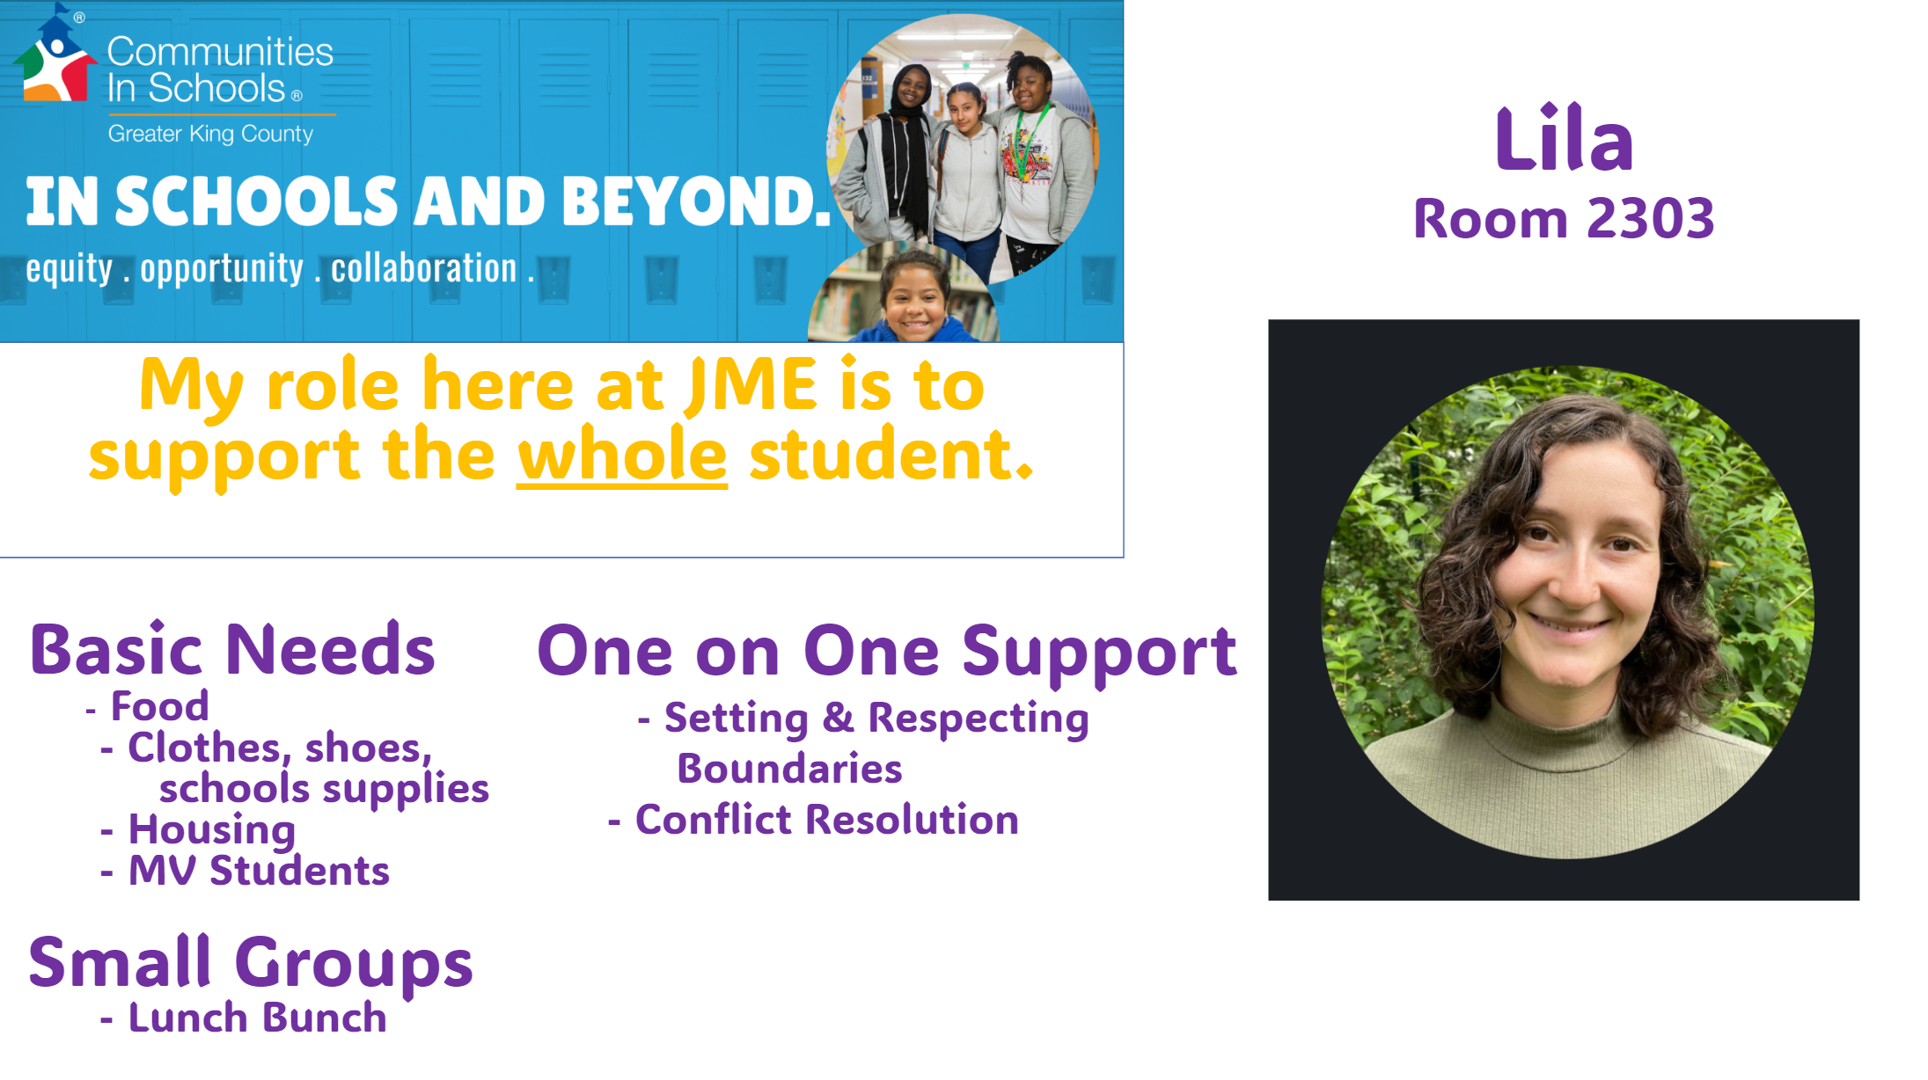

Slide 13
Specialists
If you have any questions regarding library, music, or P.E. you may contact the teachers directly.
Mrs. Kehrli, stkehrli@lwsd.org
Ms. Metz, kmetz@lwsd.org
Mr. Rothenberg, jrothenberg@lwsd.org
Notes:
Abby

Slide 14
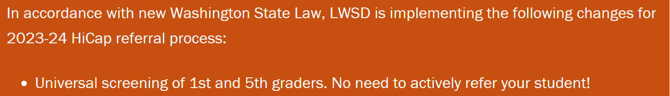
Notes:
Abby

Slide 15
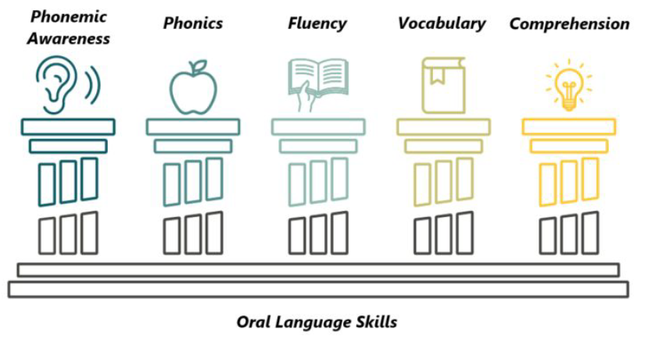
Six Components of Explicit Literacy Development
Notes:
The science of reading is a body of research that outlines literacy instruction best practices and can inform literacy instruction to ensure students are provided with the opportunity to become skills readers. The science of reading encompasses vast research that has been conducted on how people read, how people learn to read, what causes some students to have reading difficulties, and how we can teach students to read. This research has supported 5 main pillars of effective literacy instruction, weaving oral language skills throughout. Our curricular tools support instruction in all of the areas.

Slide 16

Reading Curricular Tool: Wonders
Aligns with CCSS
Research-based
Systematic and explicit sequence for students learning to read
Supports whole group and small group instruction with a comprehensive set of connected resources
Builds a strong reading foundation
Supports students in accessing complex text and finding/using text evidence
Engages students in collaborative conversations
Notes:
We have McGraw Hill’s Wonders as our core research-based reading curriculum. Wonders offers systematic and explicit instruction for students learning to read. It provides a comprehensive set of connected resources for all K-5 learners. It combines the work of literacy experts with research on social emotional learning to meet grade level standards.
Reading Wonders fully aligns with CCSS. It provides resources that support the rigor of the CCSS standards, including:
Building a strong reading foundation
Assisting students in accessing complex text
Assisting students in finding and using text evidence
Helping engage students in collaborative conversations
In addition, it was research and evidence-based in its design. It was developed in collaboration with leading experts and includes all elements of effective literacy instruction. The recursive nature of Wonders provides distributed practice opportunities for students. Wonders utilizes research-verified instructional strategies, methods, and approaches.

Slide 17
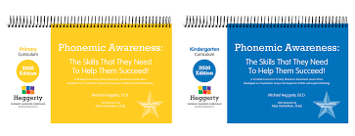
Reading Curricular Tool: Heggerty K-2
Provides structured and systematic daily phonemic awareness instruction
Focuses on the phonemes or sounds we hear in words
Delivered orally with multisensory instructional strategies
Fast-paced and engaging (about 12 minutes per lesson)
Notes:
Heggerty is available for teachers in grades K-2. Heggerty is intended to provide preventative instruction to support all learners in hearing, identifying, and manipulating the sounds in words.
It provides structured and systematic daily phonemic awareness instruction. In Heggerty lessons, students focus on the phonemes, or sounds, we hear in words. It is delivered with multisensory instructional strategies. The lessons are fast-paced and engaging.

Slide 18

Online Adaptive Tool: Lexia
Adaptive blended learning program
Accelerates the development of literacy skills
Research-proven, evidence based
Provides explicit, systematic, personalized learning in the 6 areas of literacy instruction
Targets skill gaps as they emerge
Provides teachers with data and student specific resources
Notes:
Lexia Core5 is an adaptive blended learning program. It accelerates the development of literacy skills in a research-proven, evidence based online tool. It provides explicit, systematic, personalized learning in the 6 areas of literacy instruction. Lexia targets skill gaps as they emerge and provide teachers with another source of data with student specific resources.

Slide 19

Writing Curricular Tool: LWSD Writing Units
Follows Writer’s Workshop format
Instructional framework or approach
Organizes writing time in classroom
Gradual Release of Responsibility
Combines explicit and systematic writing instruction
Develops strong relationship between reading and writing
Notes:
The LWSD writing curriculum was developed by LWSD teachers to follow the writing workshop format. WW is an instructional framework or approach. A way to organize your writing time in the classroom. WW came from Donald Graves and the idea of gradual release of responsibility. WW is apprenticeship learning: I will show you a model, we will practice it together, and you will do it on your own.
The LWSD writing combines explicit and systematic writing instruction with creative writing experiences to allow opportunities to communicate, explain, persuade as well as develop self-expression and reflection. It also aims to develop a strong relationship between reading and writing.

Slide 20

Handwriting Curricular Tool: Zaner-Bloser K-3
Key foundational skill for literacy development
Explicit instruction, research-based
Short time blocks with time for practice and feedback
Brief, explicit, and consistent lessons
Focus on pencil grasp, letter formation, legibility, and automaticity
Notes:
Handwriting is a foundational skill that influences reading, writing, language, and critical thinking. It is a key foundational skill for literacy development. Zaner-Bloser is our adopted district curriculum to support handwriting instruction. It is a research-based program that offers explicit instruction.
The lessons are designed to be delivered in short time blocks with time for practice and feedback. They are brief, explicit, and consistent. The primary focus of the instruction is on pencil grasp, letter formation, legibility, and automaticity.

Slide 21

Illustrative Mathematics
Illustrative Mathematics K-5, is a problem-based, rigorous curriculum that makes elementary school mathematics accessible, impactful, and memorable for all students. Equity-based practices to support mathematics learning, this curriculum has what is needed to reach all students.
1st grade has 8 units
Units vary in length, most are about 3-4 weeks, but can range from 2-6 weeks
Consumable workbooks for each unit
Aligned to the CCSS
Notes:
Fewer questions/problems, but high quality to promote deeper level discussion and understanding

Slide 22

Mathematics Teaching Practices
Provide a framework for strong teaching and learning of mathematics.
Embedded throughout the curriculum.
~Principles to Actions. Reston, VA: NCTM, National Council of Teachers of Mathematics, 2017.

Slide 23
Equity-based Practices to Support Mathematics Learning
Develop
Go deep with mathematics. Develop students’ conceptual understanding, procedural fluency, and problem solving and reasoning.
Leverage
Leverage multiple mathematical competencies. Use students’ different mathematical strengths as a resource for learning.
Affirm
Affirm mathematics learners’ identities. Promote student participation and value different ways of contributing.
Challenge
Challenge spaces of marginality. Embrace student competencies, diminish status, value multiple mathematical contributions.
Draw on
Draw on multiple resources of knowledge (math, language, culture, family). Tap students’ knowledge and experiences as resources for mathematics learning.
~Taking Action: Implementing Effective Mathematics Teaching Practices, K-5. Reston, VA: NCTM, National Council of Teachers of Mathematics, 2017.

Slide 24
We are excited for all students to have opportunities to…
Foster
Foster positive self-image and see themselves in the math.
Develop
Develop deep conceptual understanding and fluency.
Access
Access coherent instruction at and across all levels.
Experience
Experience relevant, real-world problems.
Think
Think critically and creatively.

Slide 25

Online Adaptive Math Program: DreamBox
Adaptive blended learning program, personalized to each student
Accelerates the development of mathematics skills
Research-proven, evidence based
Provides explicit, systematic, personalized learning across mathematics domains
Targets skill gaps as they emerge and extends learning where and when students are ready
Provides teachers with data and student specific resources

Slide 26


Slide 27


Slide 28
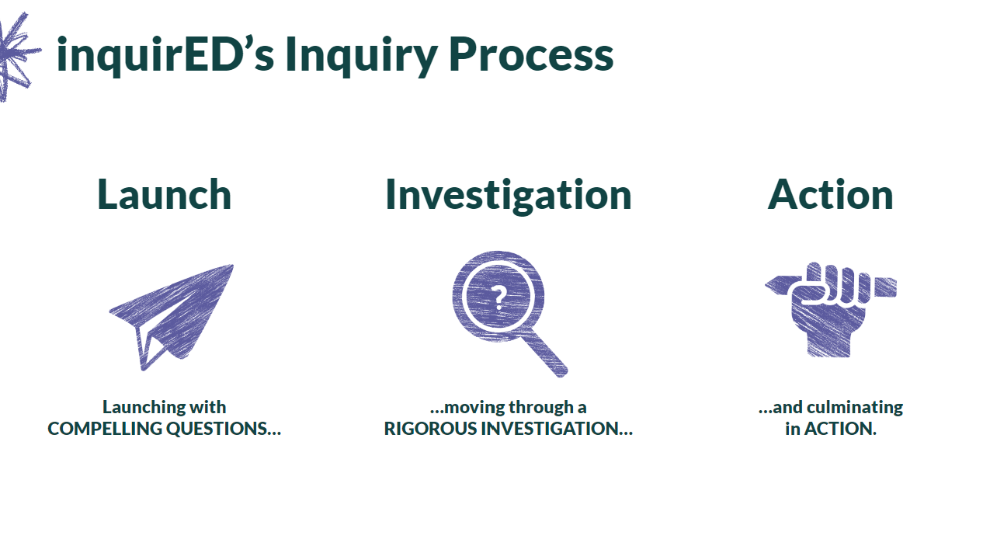

Slide 29
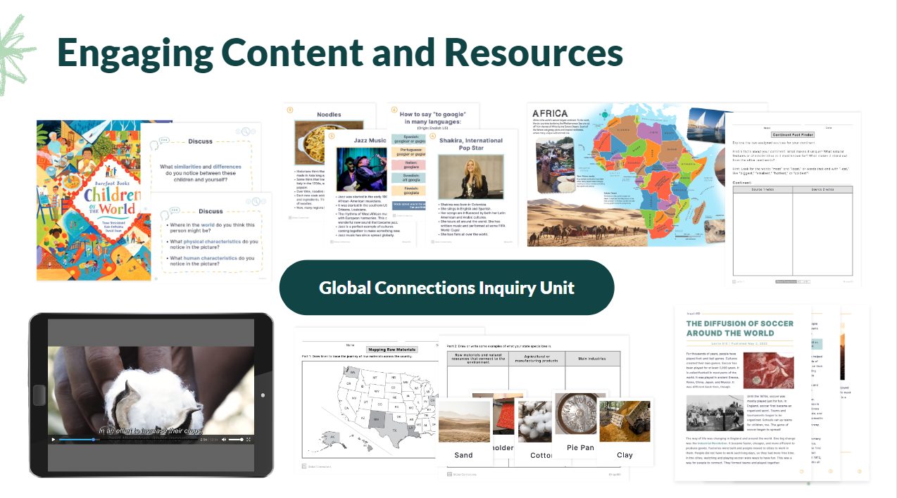

Slide 30
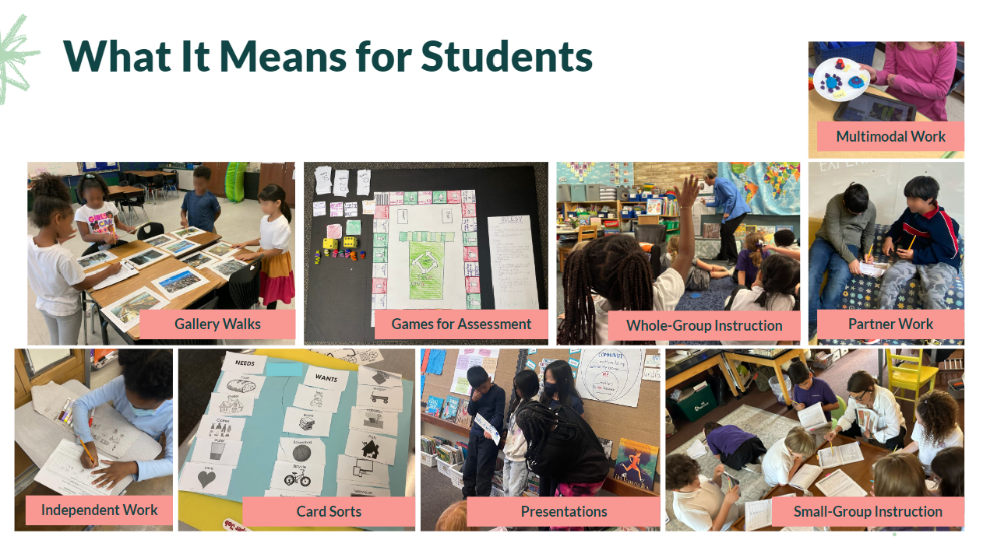

Slide 31

Assessing and Reporting Social Studies in the 2024-25 School Year
As we did with the first year of science implementation, we will not be providing a report card grade for social studies this year.
Students will still be learning social studies and teachers will be giving students feedback on their learning.

Slide 32



Technology
Notes:
Marisa

Slide 33
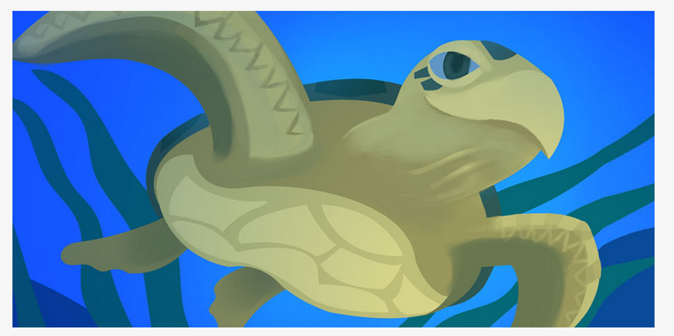
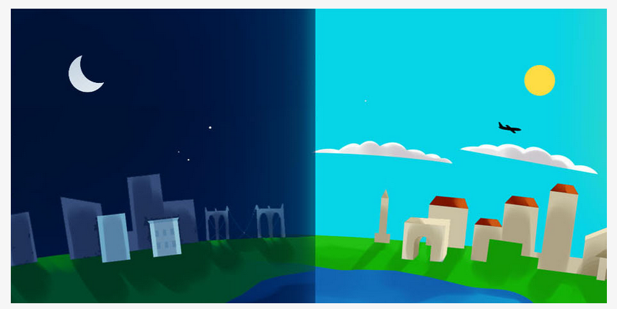
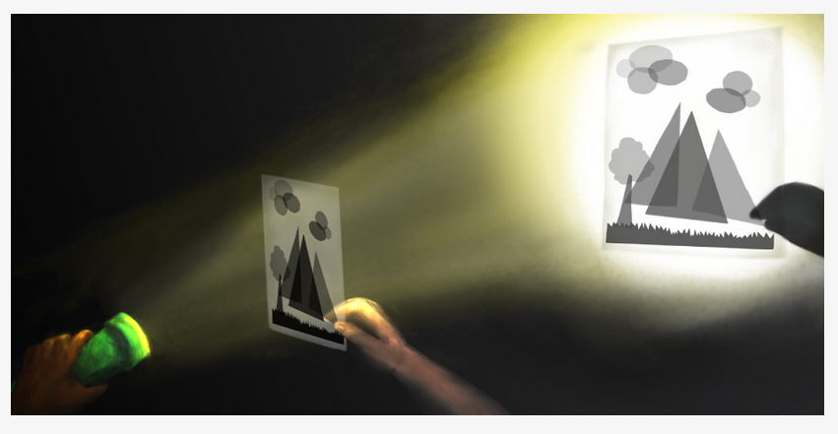

Animal and Plant Defenses
Spinning Earth
Light and Sound
Science
Notes:
Abby

Slide 34
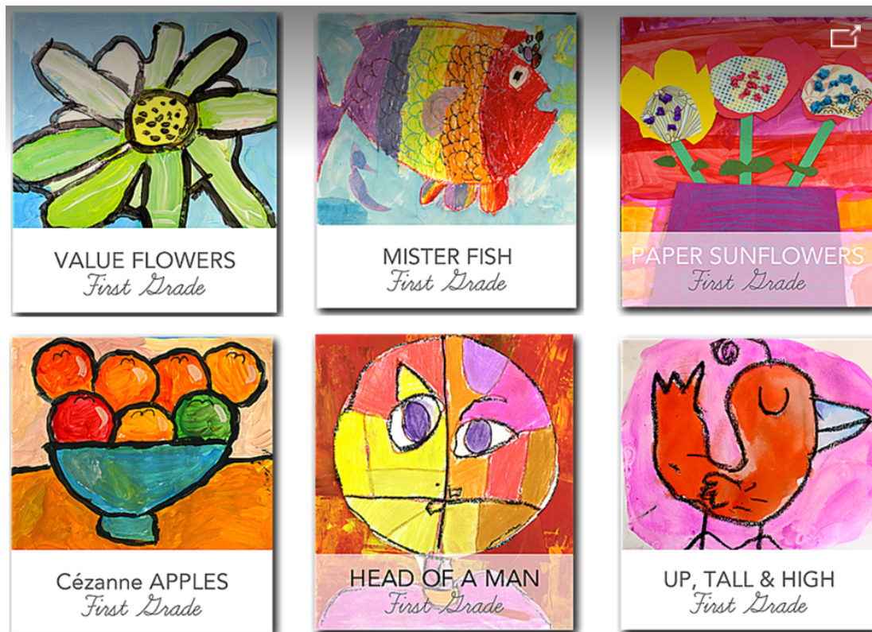
Art- Deep Space Sparkle
Value Flowers
Mister Fish
Paper Sunflowers
Cezanne Apples
Head Of a Man
Notes:
Abby

Slide 35
Questions?
Please contact your student’s teacher
Notes:
Marisa

