Slide 1

Depression, Anxiety, and Managing your Own Emotions
Melissa Jimenez, LMFT

Slide 2

Objectives
What anxiety can look like
How to support your student with anxiety
What depression can look like
How to support your student with depression
Managing your own emotions
Unique stressors as parents
Cognitive Distortions
Coping skills

Slide 3

Anxiety
Excessive and unrealistic fears about day-to-day activities
“What if” questions
Complaints of headaches and/or stomachaches
Difficulty concentrating

Slide 4

Anxiety
Students may worry a lot about everyday things such as family issues, tasks or activities, grades, and/or friendships.
Students with anxiety often want everything to be perfect and are very critical of themselves and their performance. They will seek constant approval or reassurance from others.
Students are often irritable due to not being able to control or understand their feelings of anxiety

Slide 5

anxiety Continued
Students may also isolate themselves from others, have frequent absences from school, and refuse to join in group learning or social activities.
They can become easily frustrated and often have a fear of new activities, so they have difficulty joining in or starting something new.
Their constant preoccupation with ‘worries’ may make paying attention difficult and fear of being wrong, or embarrassed may stop them from engaging.
Students can become tired. Being tired is often overlooked with students with anxiety but it can cause huge impairments for these students.

Slide 6

How can I help my student with anxiety?

Slide 7

Supportive rather than always accommodating
Being supportive means, you DON'T need to always accommodate the anxiety
  Example: If you allow your socially anxious child to stay home from school or excuse them from family activities, you're enabling avoidance, and doing so actually reinforces the anxiety.
    Instead: Help your student take small steps towards facing the fear. It's important to listen and validate that you understand they may be uncomfortable or fearful and have faith in their ability to tolerate the discomfort
      Instead: Help them distinguish between the anxiety and the reality
        Example: child may obsess about what happens if Mom gets sick and can't pick the child up from school. Rather than telling the child that Mom never gets sick, the parent can say, “I’m not sick but if I ever got sick, I’d work very hard to get well. And if I can’t pick you up, Aunt Jane will be there.” Or say you take the child to the doctor to get a shot. Don’t say, ‘it won’t hurt.’ Instead, say ‘it might hurt a little, but I know you’re brave and can handle it,’”

Slide 8

Supportive rather than always accommodating continued
    Instead: Write letters and put them in your student lunch, binder, and pack back
    Instead: Create structure and routines
      Example: Students of all ages thrive with consistency. Making sure bedtime routines and times are the same. Ages 6 to 12 need 9-12 hours of sleep. Ages 13-18 need 8 to 10 hours of sleep
    Instead: Focus on strengths and things your student can control and reward small victories
    Instead: Find the root cause of the anxiety
        Timeline's
        Recent trauma
        New settings

Slide 9



Limit screen time

Slide 10

Grounding Technique:
  Observing the environment either inside or outside can help students turn the focus away from their worries and toward something more tangible. Grounding is a tool to interrupt their spiraling fears.
      5 things you see
      4 things you hear
      3 things you feel
      2 things you smell
      1 thing you taste

Slide 11

Depression
Unusually long-lasting sad moods.
Loss of interest and enjoyment in activities that they once enjoyed.
Feelings of hopeless, worthless, tired, and may have difficulty concentrating and making decisions.
They may isolate themselves from others and be reluctant to engage in activities.
Suicidal thoughts

Slide 12

Depression Continued
Irritable or angry outbursts
Sleeping in class or constantly tired
Emotional
Unusually quiet
STATEMENTS OF SELF-HARM
Negative outlook

Slide 13
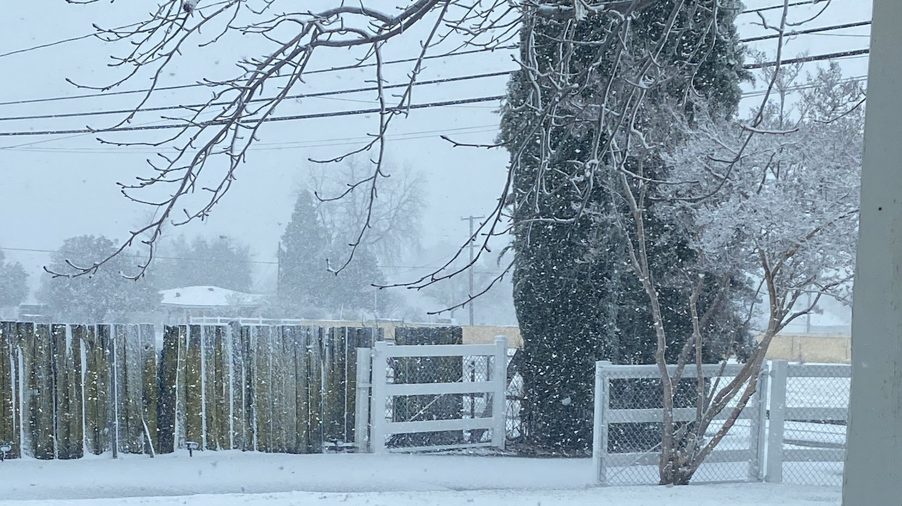
How can I help my student with depression

Slide 14

Supporting students with depression
Set limits on electronics (Just like anxiety)
Create good sleeping habits (Just like anxiety)
  Irritability and exhaustion can play into depression. Sticking to a consistent bedtime, stopping caffeine intake, and regular exercise can improve quality and quantity of sleep.
  Don't allow your child to sleep all day
Plan for transitions
  Example: Allow extra time in the morning if getting to school is difficult.

Slide 15
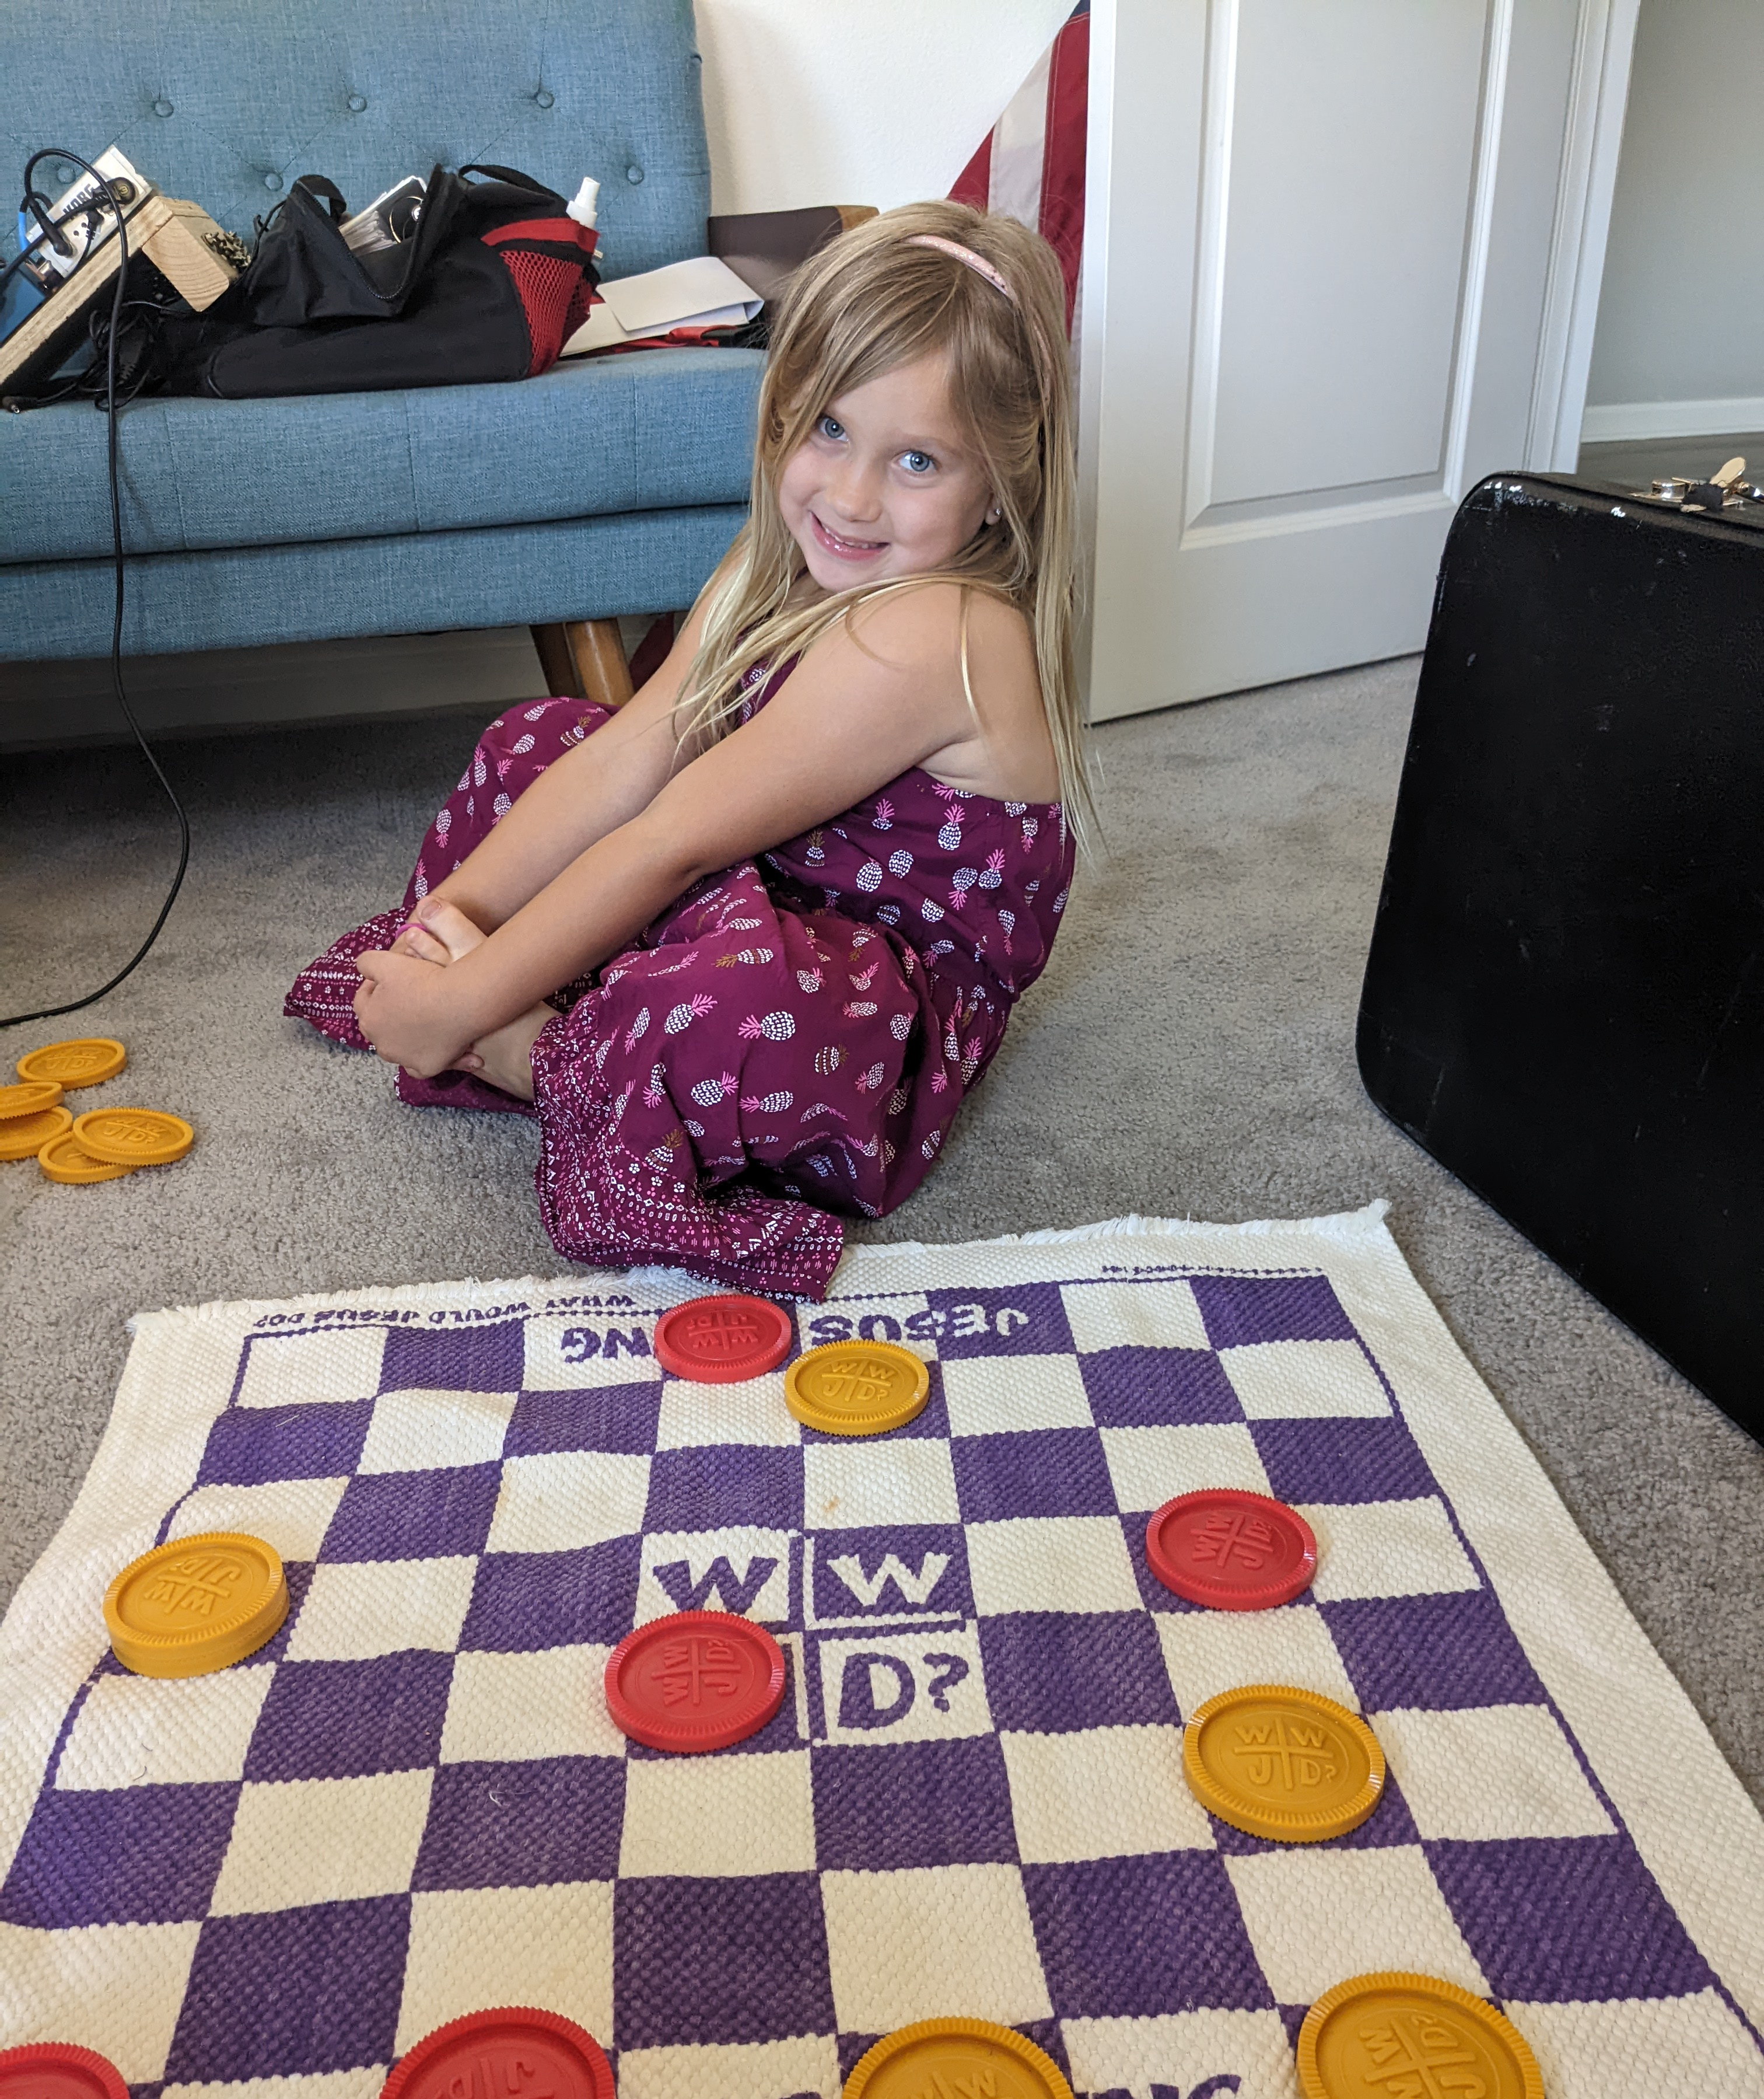
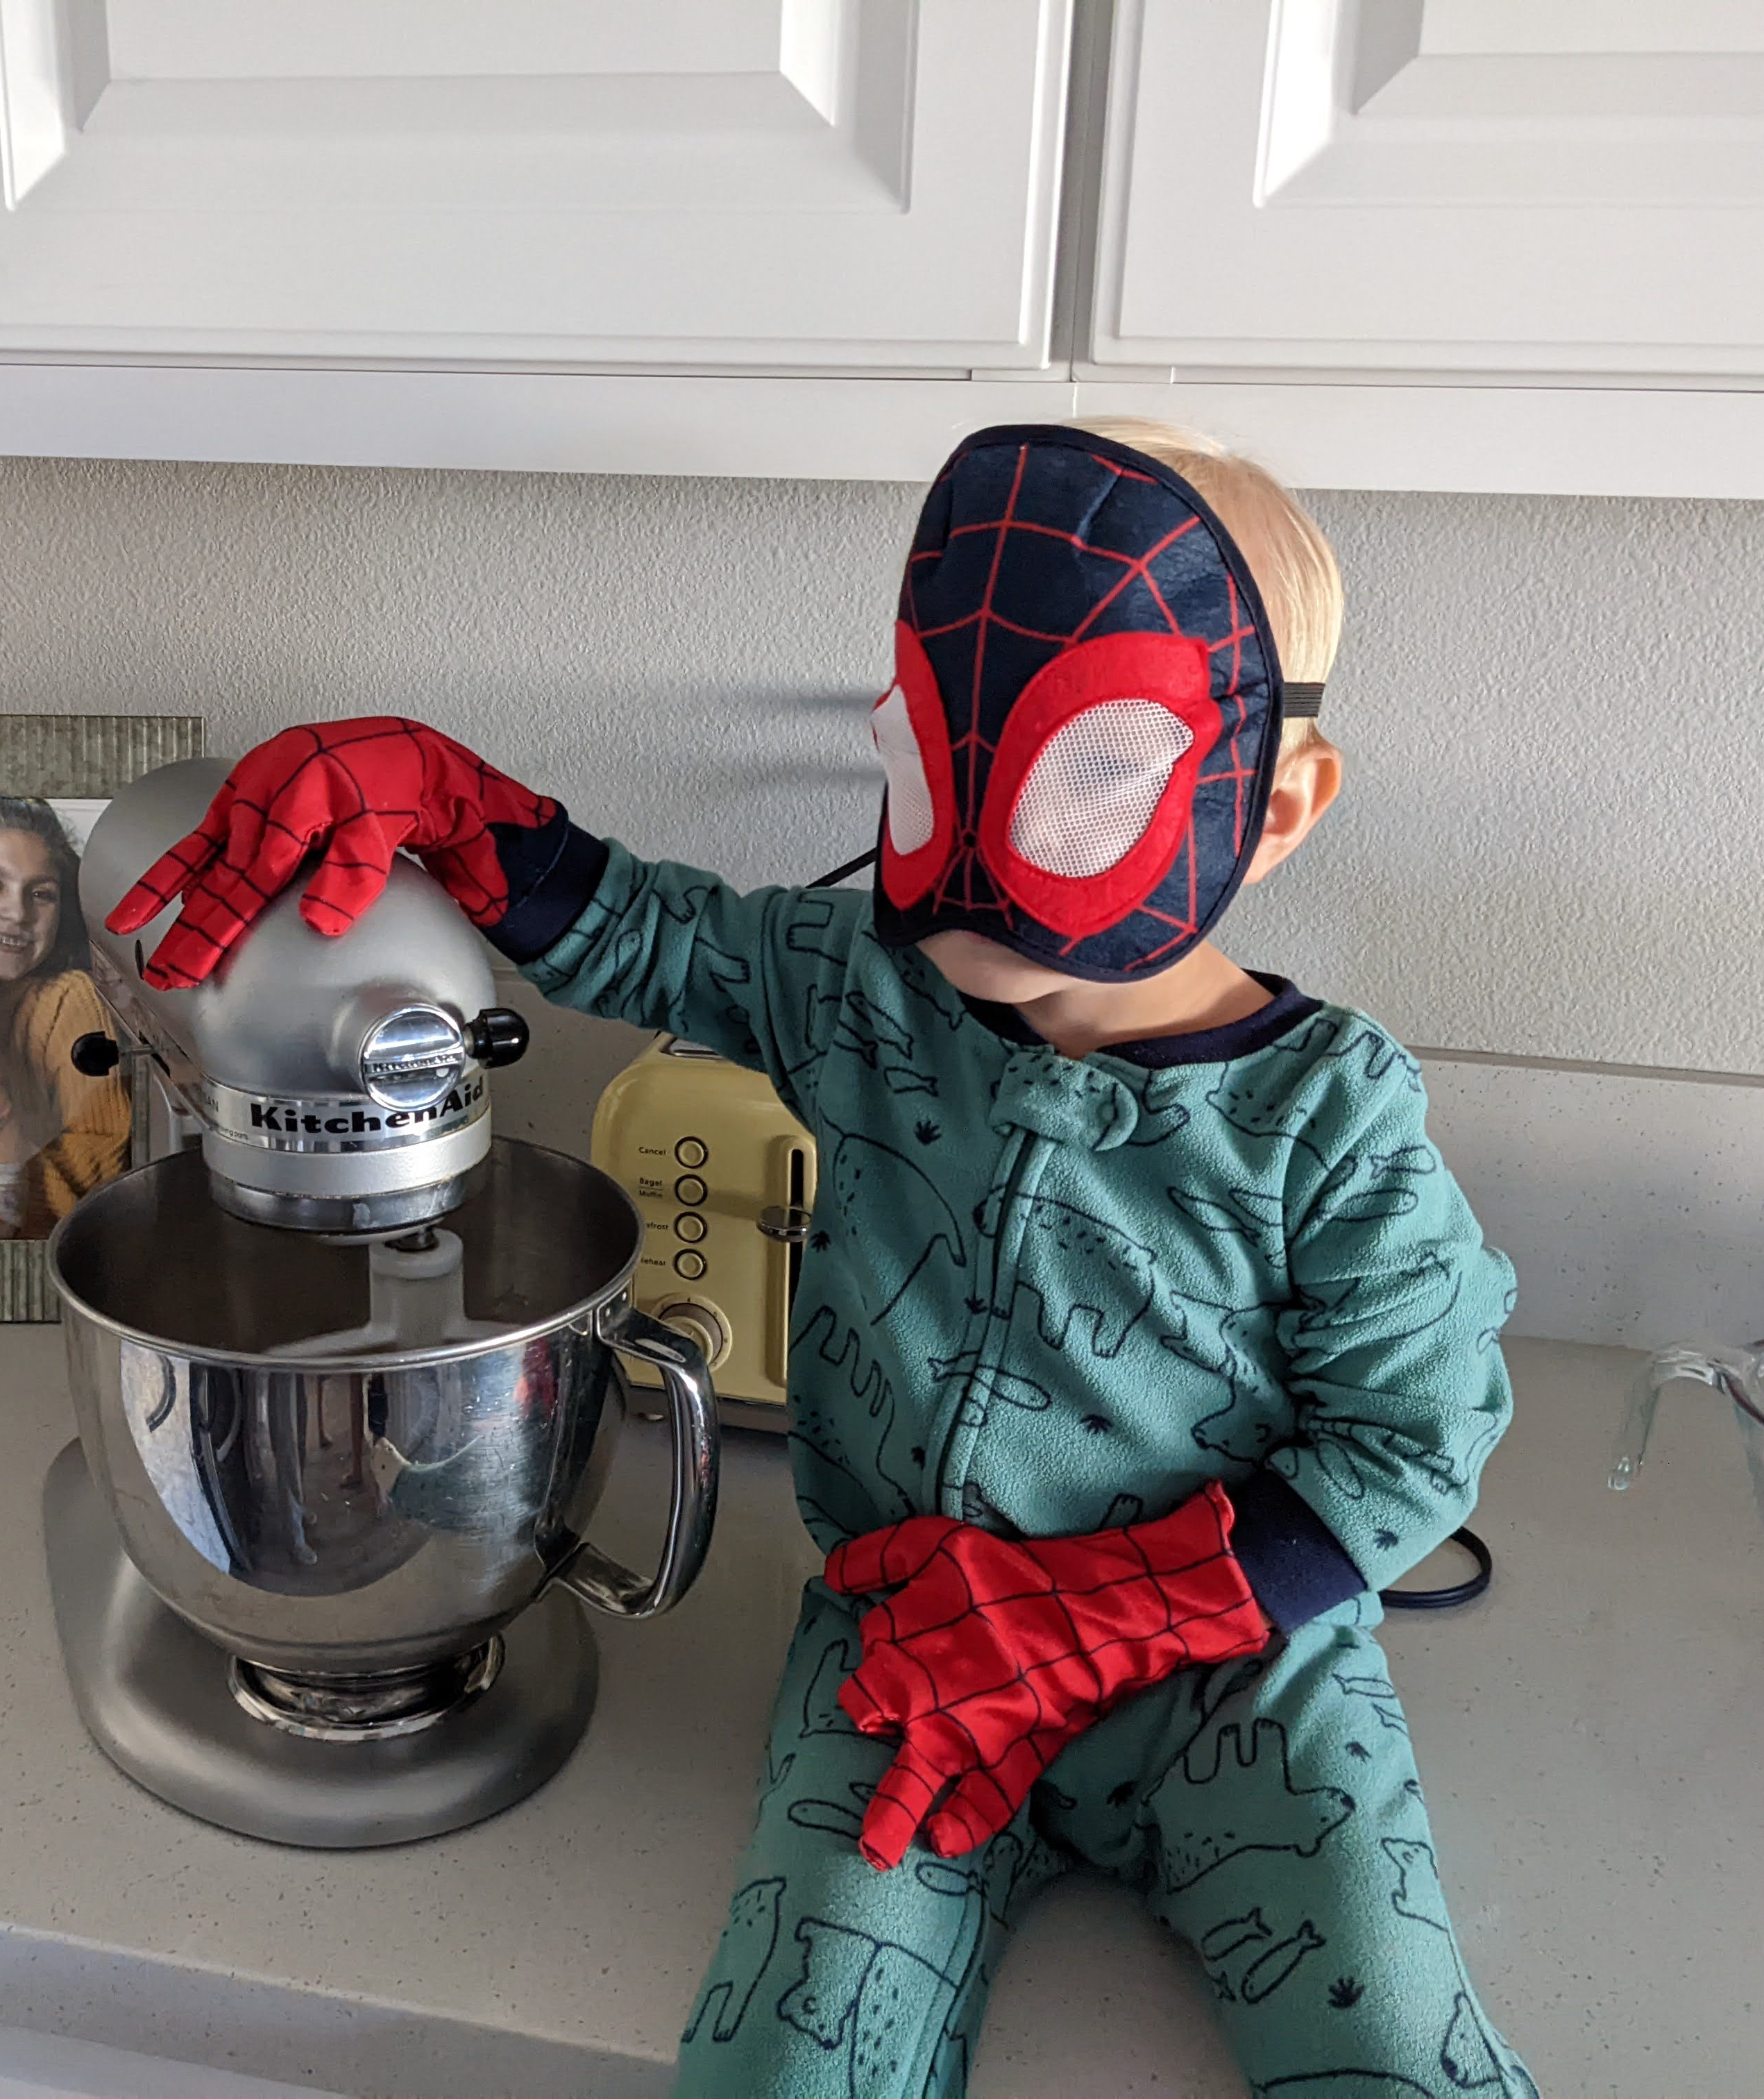
Supporting Students With Depression
Talk about the changes you have observed
Ask and keep Asking
  Start by finding a quiet, private time to have a conversation. It may help to approach the subject with just one parent, since facing two parents at once might overwhelm your child or create an atmosphere of confrontation.
Actively listen
  Encourage your student to talk about their feelings but don't trivialize what they are feeling
Enjoy time together
  It's important to let your student pick some of the activities. Do things they love is an important piece to building a positive relationship.

Slide 16
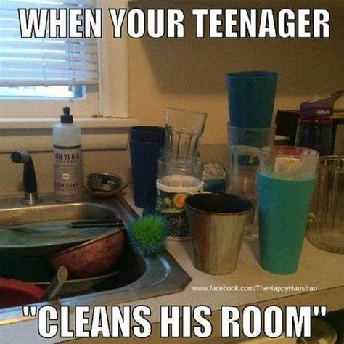


Managing your own emotions as a parent

Slide 17

UNIQUE STRESSORS OF BEING A PARENT
1. Newborn:
  The exhaustion, frustration, and momentous changes all contribute towards massive parenting stress. Sleep deprivation is often the biggest culprit of this stressors. Also, adding the responsibility of an additional family member can be extremely overwhelming.
2. Single Parenting:
  Single parents are constantly under pressure and huge parental stress all the time. Single parents do not always have a "tag your it" button.
3. Busy lives:
  A hectic schedule and no time to relax is one of the most common precursors to parenting stress. As is the case for most parents, they might have all the love in the world for their child but fall victim to the intensive daily routine (ex. Soccer practice, baseball practice, dance, homework).

Slide 18

UNIQUE STRESSORS OF BEING A PARENT CONTINUED
4. Working parent:
  Attempting to be successful not only at your job but at home can be overwhelming. Also, having to be flexible with work schedules while trying to conquer tasks at home can be daunting.
5. Insecurity:
  Very much a modern cause of parenting stress is a parent’s insecurity.
6. Finishing school:
  Parents trying to complete GED or college programs while tackling being a parent

Slide 19
Ten Cognitive Distortions that can affect parent's emotions
All-or-Nothing Thinking
Seeing things in black-or-white. No shades of grey. If things aren’t perfect, you see them as a failure. ”If I’m not perfect, I have failed.”
Overgeneralization
One thing happens, and you believe that it “always” happens to you. Or you want something to happen, and when it doesn’t, you believe it “never” happens to you. These thoughts are upsetting and set up a cycle of defeat. ”Nothing good EVER happens to me.” “It's ALWAYS me that has to do everything”
Mental Filter
Of all the things going well, you pick one negative detail out and focus all your attention on it.
Discounting the Positive
You often feel inadequate or unappreciated because you ignore positive experiences.
Jumping to Conclusions
How often have you jumped to a conclusion based on a feeling or thought without any evidence to support it?

Slide 20
Ten Cognitive Distortions Continued
Magnification/minimization
Your special magnifying glass can magnify an issue, making it bigger than it really is. Or you’re able to minimize the situation and your positive qualities.
Emotional Reasoning
This cognitive distortion allows you to believe that whatever you’re feeling, it must be so. “I feel worthless, so therefore I must be worthless.”
“Should” statements
You have a clear idea about how things “should” or shouldn’t” be. When they don’t turn out that way, we blame ourselves or others.
Labeling
Individuals label themselves in a negative way based on one event
Personalization and blame
You hold yourself responsible for events or things you don’t have 100% control over. “My student is having suicidal thoughts, so I must be a bad mother.”

Slide 21

Unpack your emotions first
Be aware of your own feelings, especially when conflict occurs
2. Label your own feelings
3. Talk to an adult family member, close friend, spouse, or even a therapist
Remember EVERYONE needs help sometimes, even rockstars like you!

Slide 22

BASIC COPING SKILLS FOR PARENTS
Set boundaries
    Give yourself permission to say no
Ask for help
    Ask family members or neighbors you can trust for help. Even if it's just taking your students for a walk around the block.
    Ask your students for help. Your students can help with packing lunches, putting the clothes away, picking up the dog poop, or helping put silverware away.
Be grateful
    Check your mindset. Does it need an adjustment? You are blessed to be a parent and lucky to have someone you have to make dinner for. We are not saying to ignore your stress, We are just saying to remember what is important to you.

Slide 23

Basic coping skills continued
Take some time out
  Self-care is not optional. This could simply be an hour of relaxation, a dinner out, a massage or a movie. Listen to some music, read a book, or dance. Try different things and see what you need.
Find your tribe
  You should never feel isolated. Isolation itself can be stressful. You are not alone, and you will get past this stage. It is good to talk with family and friends but speaking with other parents who can directly relate to your problems can be even better.
Exercise
  Getting exercise is shown to reduce stress significantly. If you have pent up stress or anxiety, go for a walk or a run. Exercise and other physical activity produce endorphins—chemicals in the brain that act as natural painkillers, it also improves the ability to sleep, which in turn reduces stress.

Slide 24


BASIC COPING SKILLS CONTINUED
Laughter
  Laughter really is the best medicine. Short term benefits of laughter include stimulating our hearts, lungs, and muscles. Laughter releases feel-good endorphins, which help relax and reduce stress. REMEMBER, DON"T BE AFRAID TO BE SILLY!
Celebrate yourself
  Don't forget to give yourself rewards, for example celebration Friday's.

Slide 25

Thank you!

