Slide 1
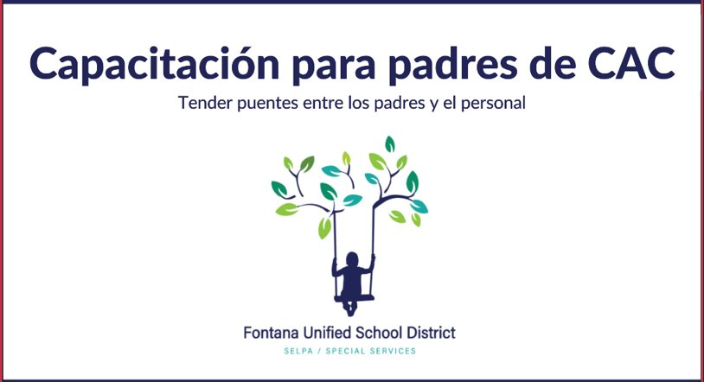

Slide 2
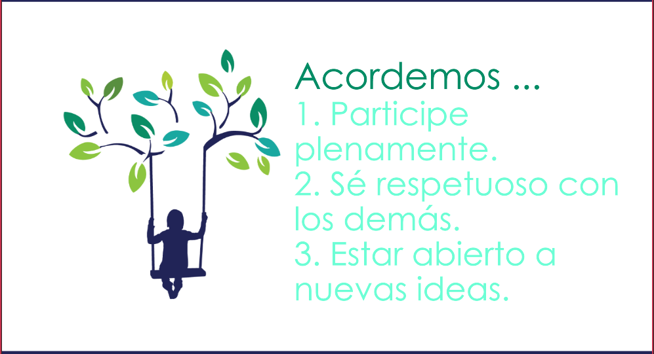

Slide 3
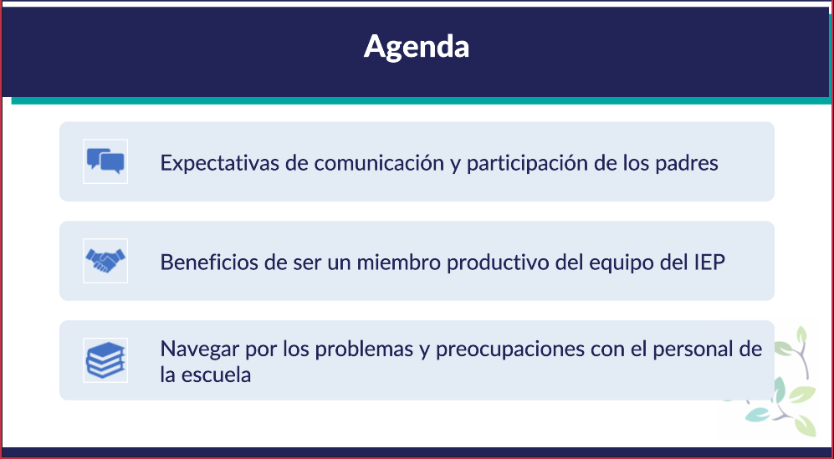

Slide 4
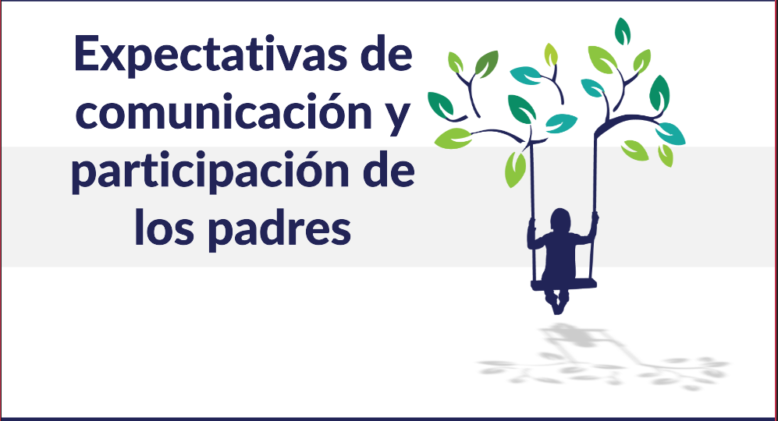

Slide 5
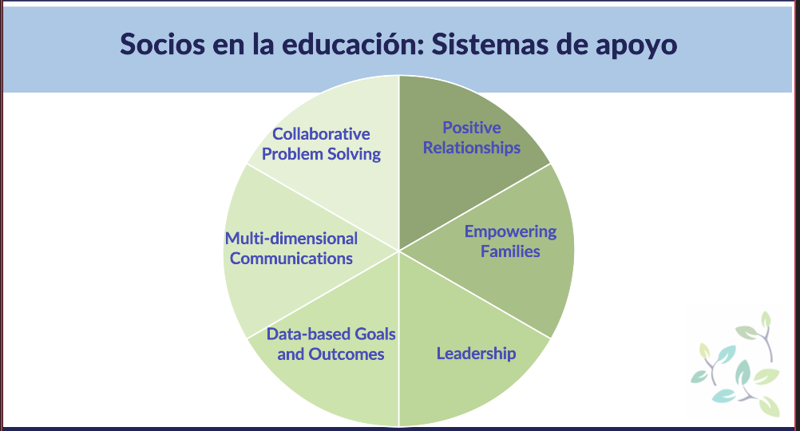
Trabajando juntos para resolver problemas
Relaciones Positivas
Empoderando Familias
Comunicacion
Multi-dimensional
Metas y resultados basados en datos
Liderazgo

Slide 6
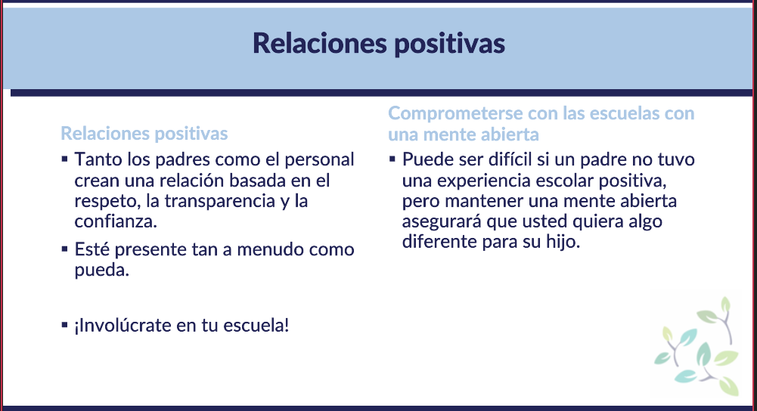

Slide 7
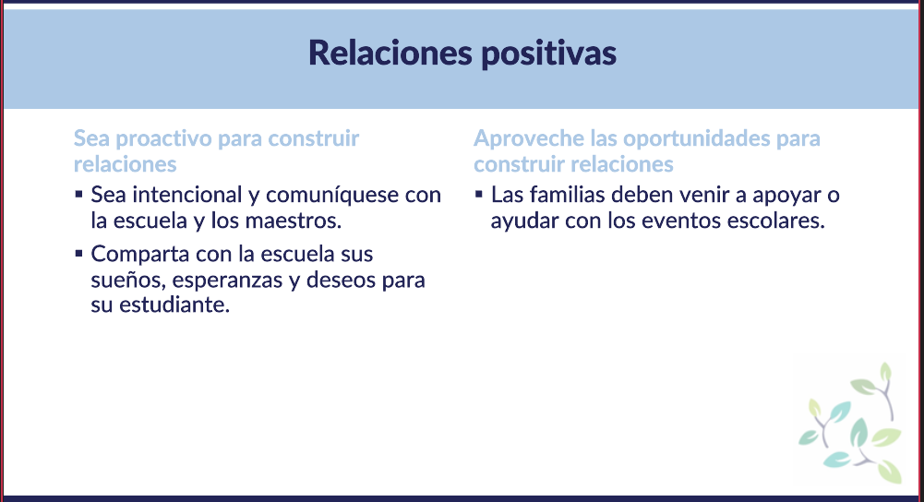

Slide 8
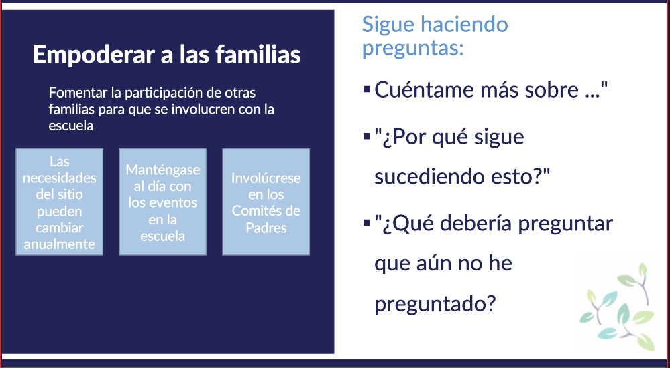

Slide 9
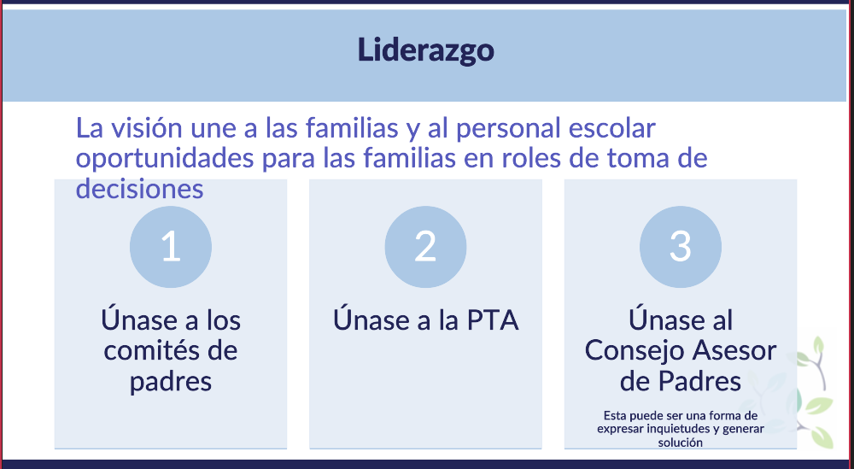

Slide 10
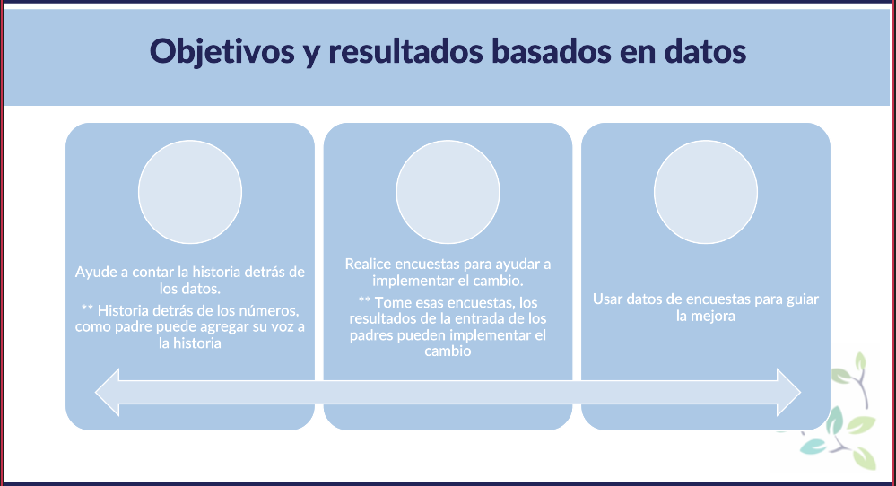

Slide 11
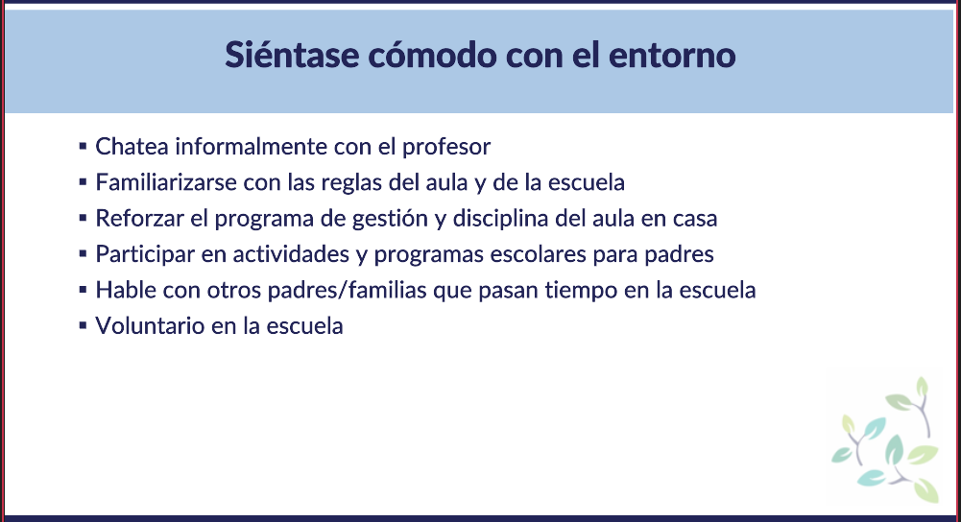

Slide 12
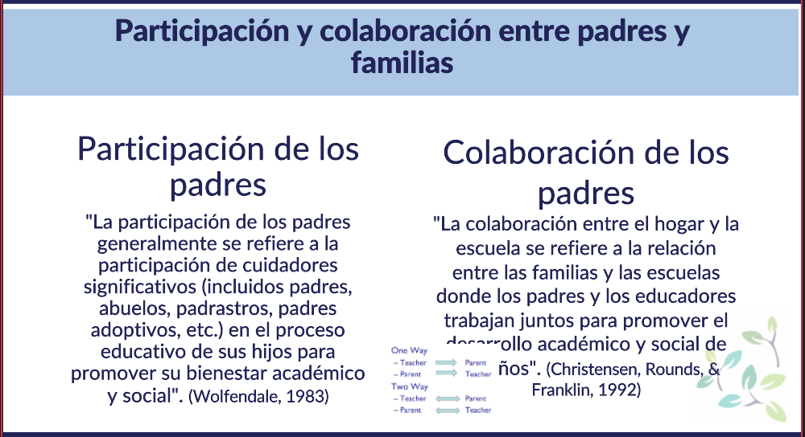

Slide 13
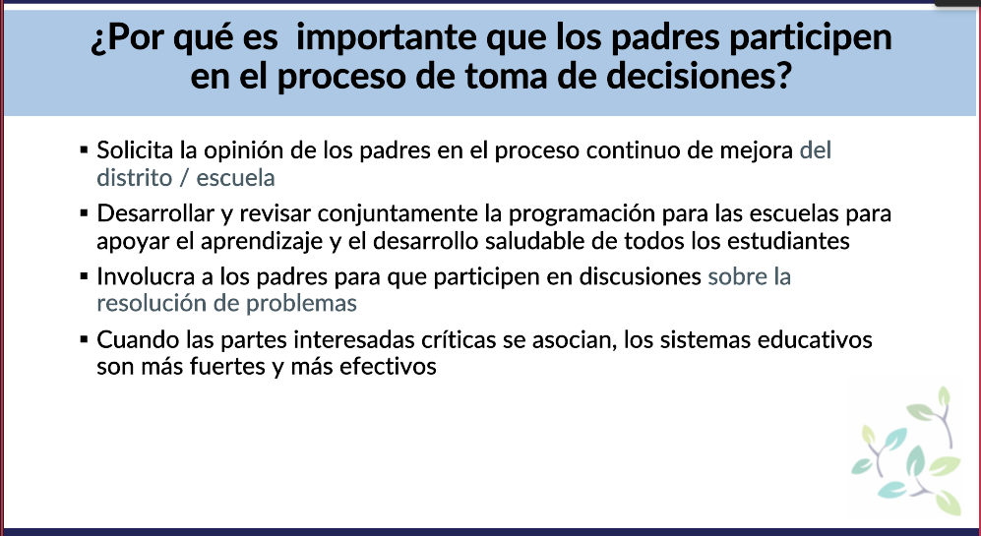
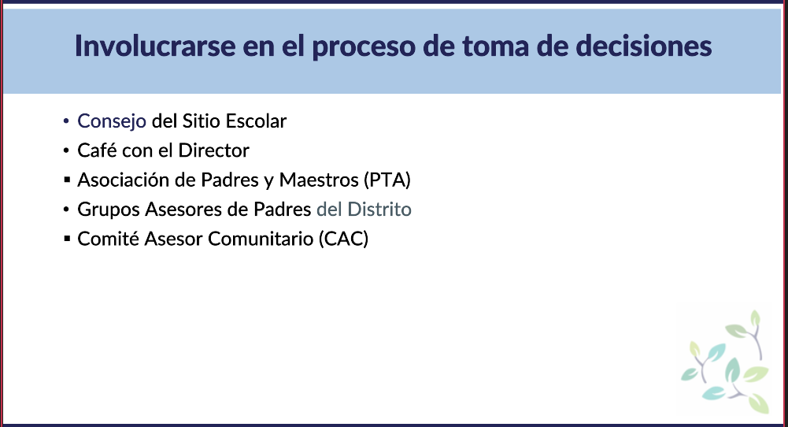
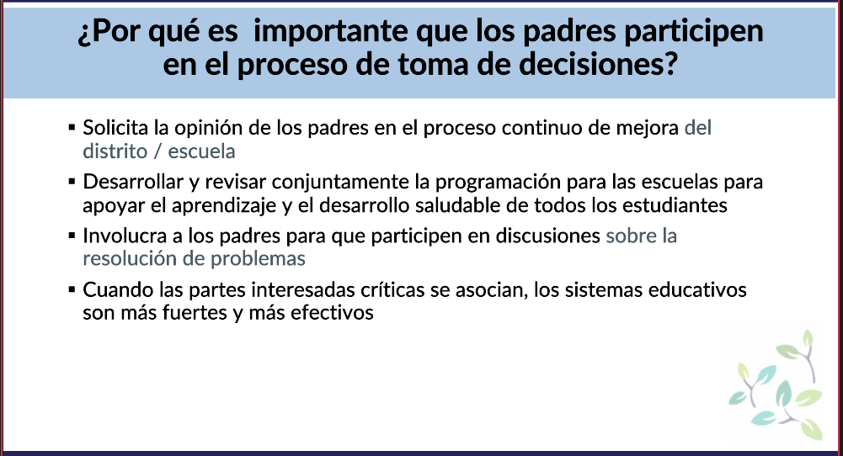

Slide 14
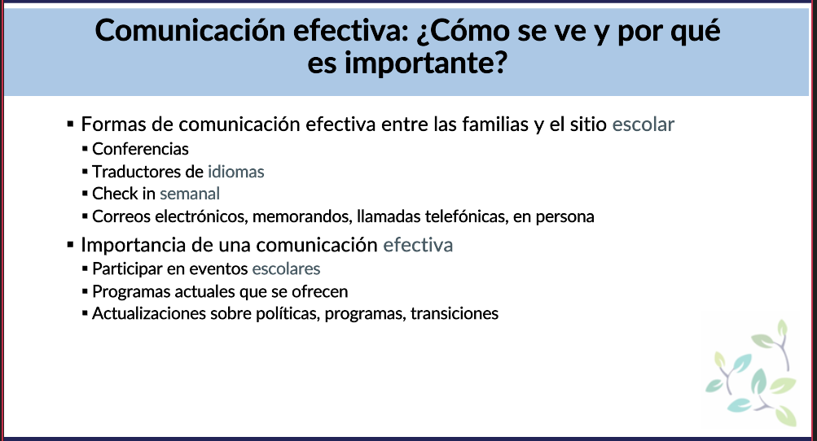

Slide 15
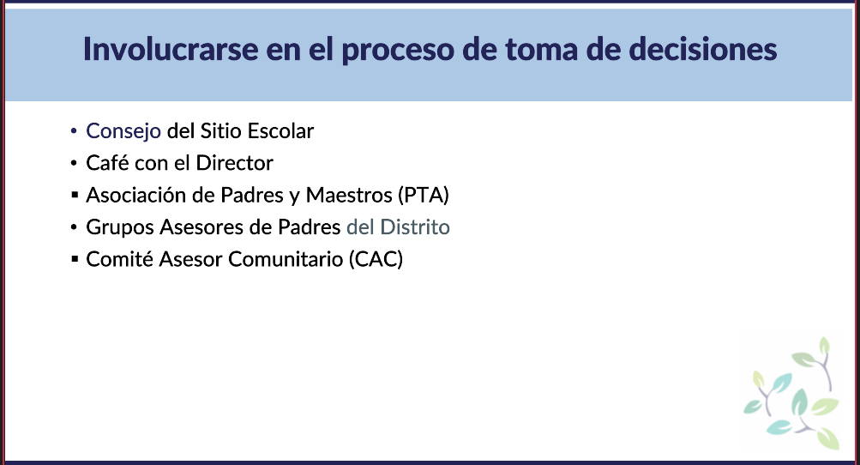

Slide 16
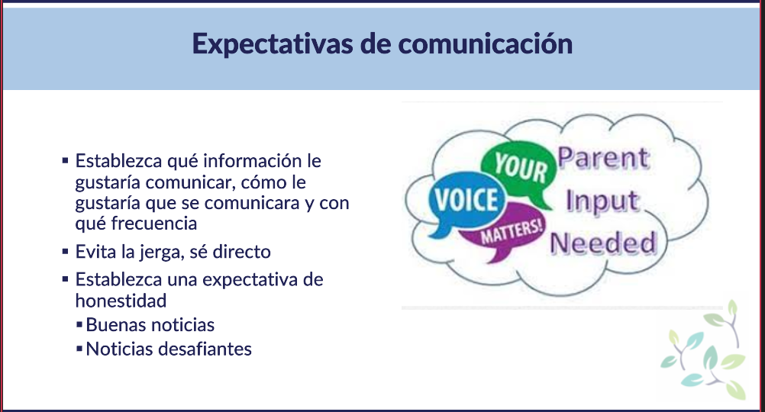

Slide 17
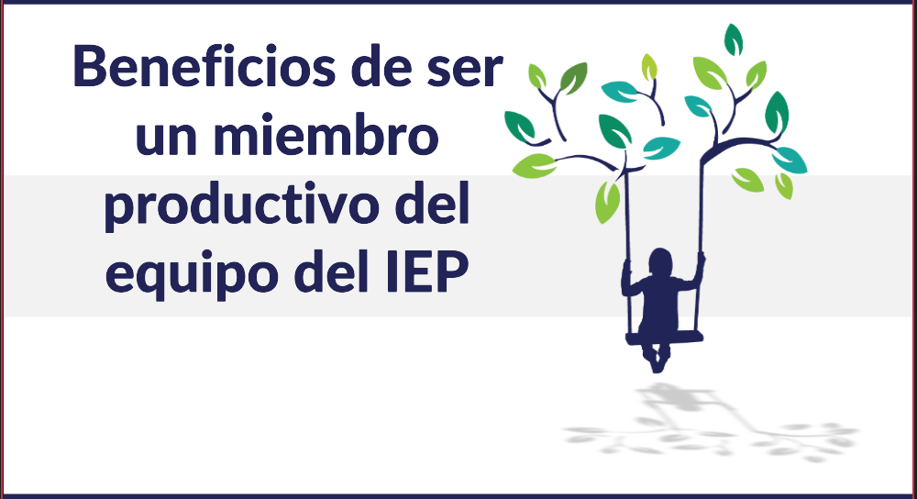

Slide 18
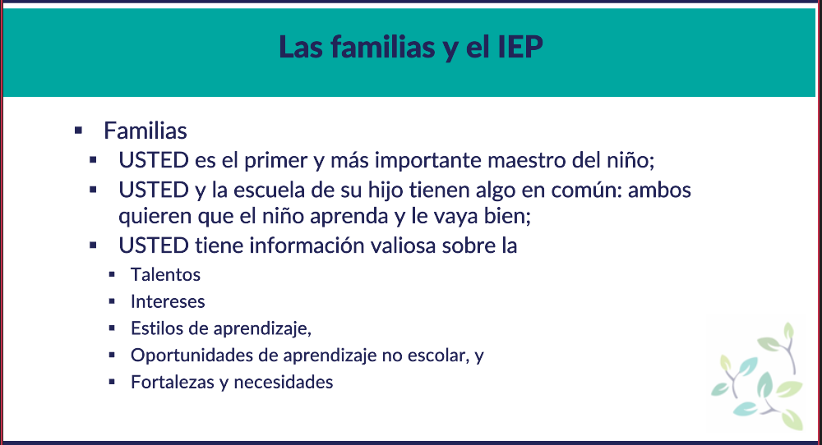

Slide 19
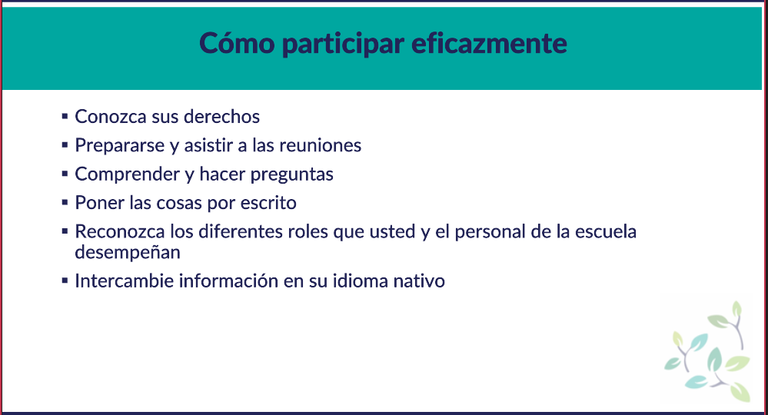

Slide 20
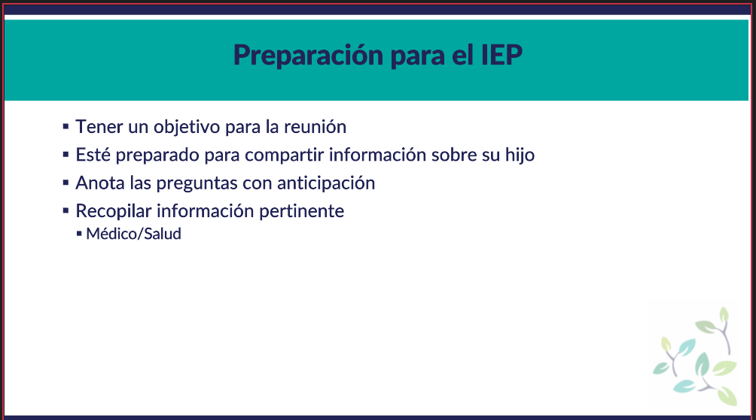

Slide 21

Navegar por los problemas y preocupaciones con el personal de la escuela

Slide 22
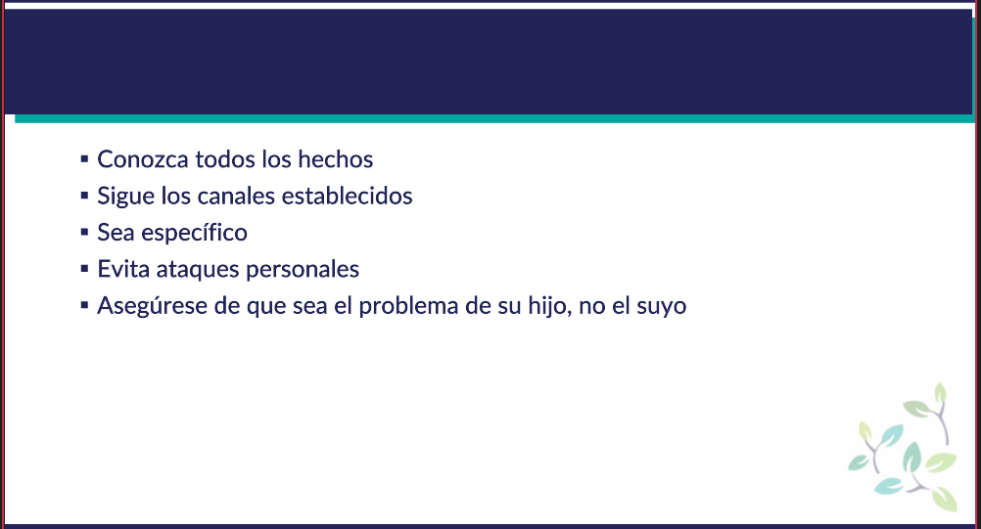

Slide 23
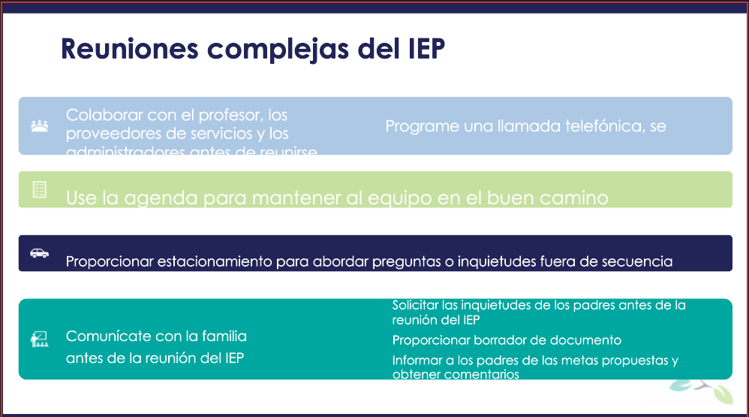

Slide 24
Recursos
How to Effectively Communicate with your IEP Team by Lisa Lightner​
​
Family Engagement with Schools: Strategies to Build Strong Partnerships​
​
“Active Listening Skills: Why Active Listening Is Important, And How To Do It”. Psychology Today. June 2, 2020. By Dianne Grande, Ph.D.​
​
How to Practice Active Listening: 16 Examples and Techniques. PositivePsychology.com. February 8, 2022. By Amanda O'Bryan, Ph.D

Slide 25
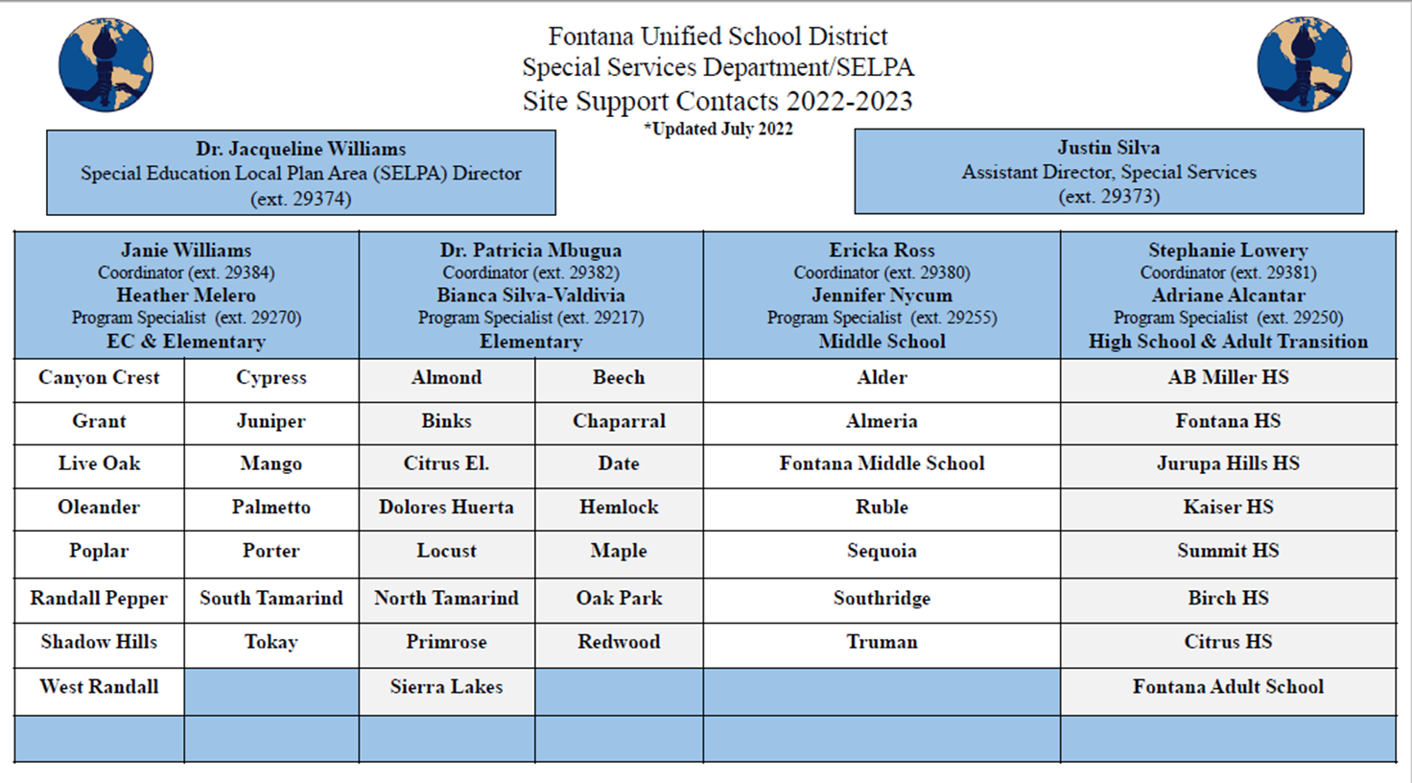
Contactos de SELPA

