Slide 1
Navigating Through an IEP
IEP Basics for Parents

Slide 2

Learning Goals
Participants will be able to navigate all components of SEIS
Participants will gain a foundational understanding of the components and requirements for an IEP
Navigate day to day teaching responsibilities as a special educator

Slide 3
Fontana SELPA
Special Services Department
The office of Special Services, Special Education Local Plan Area (SELPA), is dedicated to providing quality Specialized Academic Instruction (SAI) support and services for students, ages 3 through 21, identified as requiring special education and related services. It is the policy of the Fontana Unified School District (FUSD)/ SELPA that all children with disabilities residing within FUSD boundaries, regardless of the severity of their disability and who are in need of special education and related services, are identified, located, and evaluated. Special Services works collaboratively with the school sites, district departments, agencies and parents to provide the services required to meet the unique need of our students who are eligible for special education and related services.

Slide 4
Fontana SELPA Mission
The mission of the Fontana Special Services Department is to provide equitable, inclusive, and quality education to students with exceptional needs by providing supports, services and resources to students, staff, parents, and the community to prepare students for success in college, career, and postsecondary life.

Slide 5
What is the Notice of Procedural Safeguards?
Must be provided when:
  At each IEP meeting
  Initial referral for assessment
  Each time an Assessment Plan is presented
  Upon receipt of the first state or due process complain in a school year
  Decisions that result in a change in placement
  When you ask for a copy
An overview of educational rights and procedural safeguards

Slide 6
Procedural Safeguards Explained:
Participation
You have the right to participate in meetings about ELIGIBILITY, ASSESSMENT, or EDUCATIONAL PLACEMENT.
You have the right to participate in the development in the IEP.
You have the right to audiotape the proceedings with at least 24-hour prior notice.
You have the right to discuss all program options and be given that information.

Slide 7
Procedural Safeguards Explained:
Who can provide support?
Classroom Teacher(s), Case Carrier, School Psychologist
School Site Administration
Special Education Local Planning Area (SELPA) Office
Parent Organizations
California Parent Organizations- Quality Assurance Process (CA Dept of Education)

Slide 8
Procedural Safeguards Explained:
Prior Written Notice (PWN)
PWN- when a school district proposes or refuses to initiate a change in eligibility, assessment, educational placement or “Offer of FAPE”
  A description of action proposed
  An explanation of why
  A description of each assessment procedure
  Statement related to the Procedural Safeguards
  Resources
  A description of other options considered by the IEP team
  Other relevant factors

Slide 9
Procedural Safeguards Explained:
Parental Consent
You must give informed written consent within 15 days
IEP is developed within 60 days of your consent
Written consent must be given before services can commence
If you consent in part, those “parts” must be implemented
You may revoke consent in writing

Slide 10
Other Components of the Procedural Safeguards
Surrogate Parent Appointment
Non-discriminatory Assessment
Independent Educational Assessment
Access to Educational Records

Slide 11
How Are Disputes Resolved?
Due Process Hearings are an impartial hearing regarding the identification, assessment, educational placement or the provision of FAPE
ADR
Mediation
Pre-hearing mediation conference
Due Process Rights
Written Complaints

Slide 12
Intervention To Assessment
Student Intervention Team (SIT) Process:
  Step 1- Parent, teacher or other professional identifies a concern.
  Step 2- School site holds an SST (student support team) meeting and determine interventions for student.
  Step 3- Provide interventions for a meaningful period of time.
  Step 4- If interventions resolve the concern, continue interventions. If not, adjust interventions.
  Step 5- Team meets again if interventions still not successful. Possible referral for special education assessment.

Slide 13
Assessment Process
A referral is made by parent, SST or other knowledgeable person for special education assessment
Parent is provided an assessment plan within 15 days of referral
Parent is provided 15 days to consent to assessment plan
Parent may request a meeting to discuss assessment plan
If parent consents, the assessment is completed within 60 days of receipt of parent consent
IEP meeting is held to discuss assessment results
If student qualifies, assessment establishes disability

Slide 14
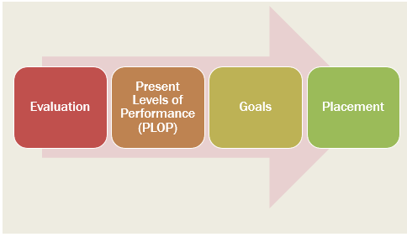
Understanding The Process

Slide 15
13 Eligibility Categories
Autism (AUT) | Deaf- Blindness (DB) | Deafness | Hearing Impairment (HI) | Intellectual Disability (ID) | Emotional Disturbance (ED) | Multiple Disabilities (MD)
Orthopedic Impairment (OI) | Other Health Impairment (OHI) | Specific Learning Disability (SLD) | Speech or Language Impairment (SLI) | Traumatic Brain Injury (TBI) | Visual Impairment (VI)
Assessment establishes eligibility
Student must require special education services to be eligible for special education, regardless of disabling condition

Slide 16
What Is An IEP?
An IEP is an Individual Education Program for a student who is eligible for special education services
An IEP is meant to address a child’s unique learning needs
It is a “contract” for special education services

Slide 17
IEP Team Members
Parent
General Education Teacher
Administrator or Admin Designee
Special Education Teacher or Designated Service Provider(s)
Student (when appropriate and when discussing post-secondary transition)
Other individuals with knowledge and/or expertise regarding the student
Anyone who can interpret the instructional implications of the evaluation if an assessment was conducted

Slide 18
Parent Consent
Parent has the right to…
Consent to all parts of the IEP
  The IEP will be implemented within a reasonable amount of time
Consent to some parts of the IEP
  Only portions of the IEP that the parent consented to will be implemented
Decline the offer of initial special education services
  The IEP will not be implemented
Not consent to the IEP
  The IEP will not be implemented, goals and services listed in the last consented IEP continue

Slide 19
Consent (Continued)
A parent may revoke their consent to all special education services. This must be done in writing
  The district will send prior written notice explain the school placement and that the student will no longer have protections under IDEA
A parent may take an IEP home to review before providing consent

Slide 20
Iep agenda sample
IEP Agenda Sample | IEP Agenda Sample
1. | Introductions
2. | Procedural Safeguards
3. | Parent Concerns/ Input
4. | Assessment Reports
5. | Present Levels
6. | Accommodations, State Testing, Special Factors
7. | Progress on Goals
8. | Goals and Objectives
9. | Supports and Services
10. | Placement/ Offer of FAPE
11. | Consent/ Signatures

Slide 21
Parts Of An IEP
Forms Within an IEP | Forms Within an IEP
1. | Notice of Meeting
2. | IEP Team Member Excusal Form
3. | Information and Eligibility
4. | Present Levels of Academic Achievement and Functional Performance
5. | Special Factors
6. | Statewide Assessments
7. | Individual Transition Plan (16 years old +)
8. | Annual Goals and Objectives
9. | Offer of FAPE- Service Offer of FAPE- Educational Setting
10. | IEP Team Meeting Notes
11. | Emergency Circumstances Program
12. | Signature and Parent Consent
13. | Prior Written Notice (PWN)

Slide 22
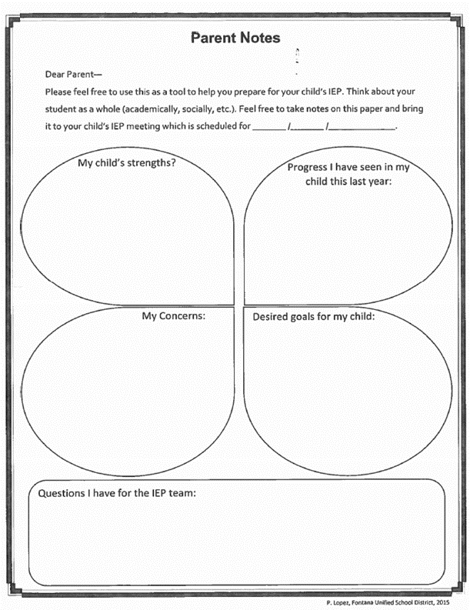
Preparing for the meeting
Make a list of priorities and concerns
Contact the case carrier to discuss goals
Make requests for additional services, testing, or IEP meetings in writing
District is responsible for providing parent with reasonable notice of IEP

Slide 23

Iep binder organization

Slide 24
Iep binder organization

Slide 25
Other Information
A parent may request an IEP. Just put it in writing and the District will hold a meeting within 30 calendar days (with the exception of breaks consisting of more than 5 days)
A parent may request copies of existing student records. The District will provide copies within 5 business days
Parents may request copies of draft IEP and assessment reports prior to the meeting. If available, the District will provide draft copies
A child placed by parent in private school has the right to a service plan but not FAPE

Slide 26
Other Information
If you disagree with your child’s IEP, assessment or services you may request intervention at the local level or state level:
Local Level
  Case manager/school site
  SELPA office/Coordinator
  Alternative Dispute Resolution
State Level
  CDE complaint or Due Process filing

Slide 27
Other Information
If your child is recommended for expulsion or is removed from school placement for over 10 days, the district must hold a Manifestation Determination IEP to determine if the behavior was caused by the disability or a result of the district not providing services in the IEP
A parent has the right to request an IEE (Independent Educational Evaluation) at public expense if they disagree with results of the district assessment. The district either grants the request based on policy or has to file for due process to support the district assessment

Slide 28
Other Information
A parent may request to audio tape an IEP meeting. If this action is desired, a 24-hour notice is required
All rights transfer to the student whey they reach the age of 18 (Age of Majority) unless they are conserved by the courts

Slide 29
Family & School Partnerships
Have you ever wondered or thought…
  How do I communicate with my child’s school?
  What happened? How did we get here?
  Did I miss something?
  What did I do wrong?
  What is the school doing?
  Wow, that meeting went so great…how can we keep this up? What made this meeting work?
  I am worried, who should I talk to first?
  Who can help me?
  Am I all alone?
Have you ever had an issue?
Have you had things work out great?
What did you do to make things go smoothly?
What did the school do?

Slide 30
Working Together Toward Solutions
Developing a positive relationship with your child’s teacher is the first step to success
    If your child sees you respect the teacher, then they know they can trust them
  Developing communication is important

Slide 31
Communication
Communicating with school personnel is not always easy. Both staff and parents need to find the best way to communicate for the specific situation.
  Email - Good for short questions and simple information.
            Be brief, choose your words wisely (a misplaced comma can change the meaning of a sentence), stick to the topic, use open ended questions, “Can we talk about that…?” “What are your thoughts regarding…?” “When is a good time to meet…?”
  Phone Calls – Great way to dialogue on a topic
  Notes Home- Like email, responses to questions, obtaining information, asking simple questions providing information
  Meetings - More complex issues that need problem solving, dialogue, multiple people involved

Slide 32
Effective Communication Skills
Make eye contact
Give the speaker your undivided attention
Body language
Speak in a positive tone
Be an active listener
Speak concisely
Be open-minded

Slide 33
Working Together At IEP Meetings
Be organized
  Create an IEP folder
Communicate issues to staff before the meeting
  Create a list of questions/concerns
  more gets done if people are prepared
Be on time
Prepare questions and concerns
Bring a positive attitude
  Hope for the best but be prepared to ask questions
Remember, the IEP is an ever-changing document and is individualized to your child

Slide 34
Advocating During The IEP
Write down your concerns before the meeting
Review the IEP document and notes
Write a parent comment after the meeting with your consent if you feel something is missing
Ask open ended questions.
  Why do you believe…?
  Have you considered…?

Slide 35
Advocating After The IEP
Put your requests and concerns is writing
Ask for an IEP team meeting
  Put the request in writing
Ask for a meeting with the teacher or administration or other staff to help you understand the school’s offer
Consent only to what you agree with in the offer
  The school will implement the services that you agree with and will work with you to resolve the remaining issues

Slide 36

Seek Mutual Purposes
Try to find mutual areas of agreement
Be open to other choices/ideas
Communicate your core needs and beliefs
Stay focused on the needs of your child
Ask questions, the only “bad” question is the one NOT asked

Slide 37
WHAT TO DO IF THINGS ARE NOT WORKING?
  Ask for a facilitated IEP Team Meeting
  Request a meeting with District Administration
  Call your SELPA and find out what local dispute resolution is available
  File a CDE complaint
  Mediation only request
  If all else fails: You have the right to file for DUE PROCESS

Slide 38


Collaboration Is The Key
Positive relationships lead to student success​

Slide 39
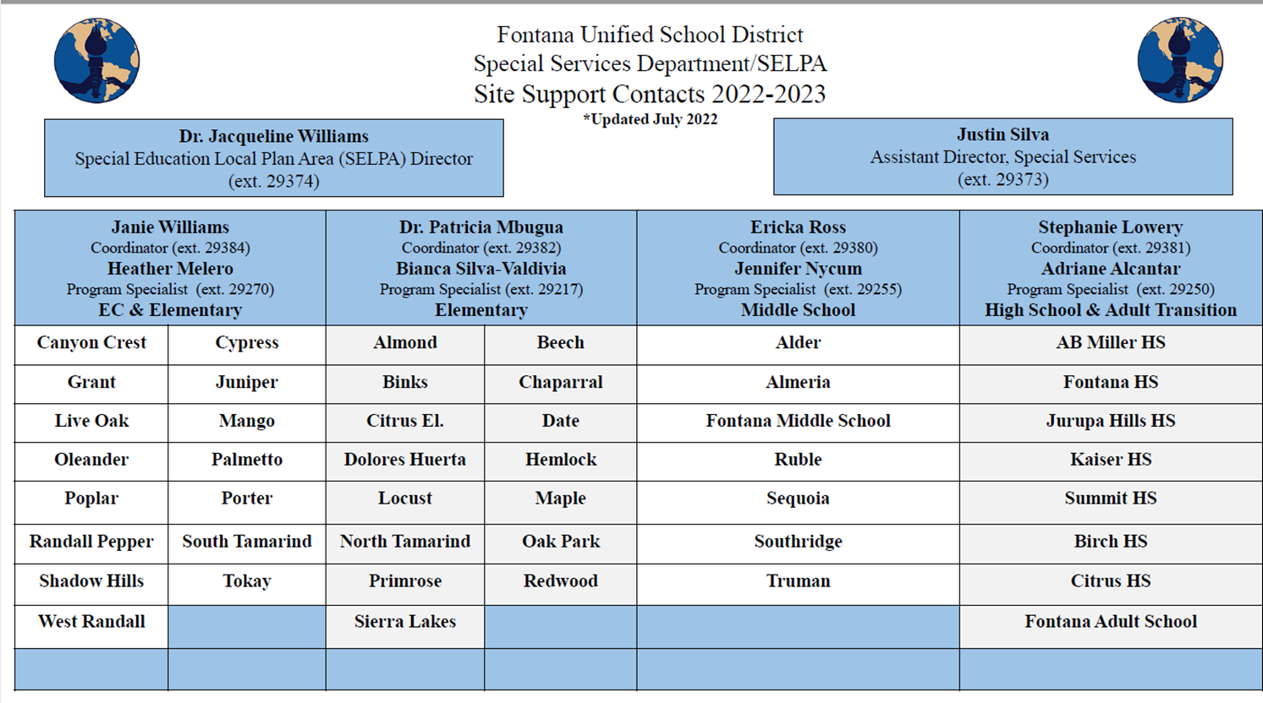
Thank you

