Slide 1
CAC Parent Training
Understanding Your Child’s IEP
Notes:
Good evening and welcome! SELPA is excited to present this CAC training focusing on understanding the basics of your child’s IEP. I want to thank you for being here, your dedication to developing a partnership with schools and the education process is amazing. My name is Heather Melero and I am a Program Specialist with our Fontana SELPA and I will be presenting with my colleague, Jennifer Nycum.

Slide 2
Fontana Special Education Local Plan Area (SELPA)
The office of Special Services, Special Education Local Plan Area (SELPA), is dedicated to providing quality specially designed instructional support and services for students, ages 3 through 21, identified as requiring special education and related services.
It is the policy of the Fontana Unified School District (FUSD) /SELPA that all children with disabilities residing within FUSD boundaries, regardless of the severity of their disability and who are in need of special education and related services, are identified, located, and evaluated.
Special Services works collaboratively with the school sites, district departments, agencies and parents to provide the services required to meet the unique need of our students who are eligible for special education and related services.
Notes:
This is the Fontana SELPA policy of practice and in summary, means we are dedicated see that all children with disabilities who need special education and related services residing within FUSD boundaries are identified, located, and evaluated. Additionally, we work collaboratively with school sites, district departments, agencies, and YOU to meet the needs the unique needs of our students.

Slide 3
Fontana SELPA’s Mission
The Mission of the Fontana Special Education Department is to provide equitable, inclusive, and quality education to students with exceptional needs by providing supports, services and resources to students, staff, parents, and the community to prepare students for success in college, career and life.

Slide 4
Agenda
Importance of Parental Involvement
Active Listening to Encourage Collaboration
Productive Communication with the IEP Team
Navigating the Individualized Education Plan (IEP) Paperwork

Slide 5
Navigating the IEP Paperwork

Slide 6
What is an Individualized Education Plan (IEP)?
An IEP is an Individualized Education Plan for a student who is eligible for special education services.
An IEP is meant to address a child’s unique learning needs.
It is a legally binding document outlining special education services.

Slide 7
Who are the IEP Team members?
Parent
General Education Teacher
Administrator or Admin Designee
Special Education Teacher or Designated Service Provider(s)
Student (when appropriate and when discussing post- secondary transition)
Other individuals with knowledge and/or expertise regarding the student
Anyone who can interpret the instructional implications of the evaluation if an assessment was conducted.

Slide 8
When do we hold an IEP Meeting?
Initial evaluation
Plan Review/Review of Progress (held annually)
Amendment
Parent Request
Eligibility Evaluation (held every three years)
Manifestation Determination

Slide 9
13 Eligibility Categories
Orthopedic Impairment
Other Health Impairment
Specific Learning Disability
Language and Speech Disorder
Traumatic Brain Injury
Visual Impairment
Autism
Deaf/Blind
Deafness
Emotional Disturbance
Hearing Impairment
Intellectual Disability
Multiple Disabilities
When determining Eligibility Fontana uses the two-Pronged Approach to Eligibility.
First the student must meet State Eligibility Criteria
AND
Second the student must require Special Education Services

Slide 10
Understanding the Process
Evaluation
Present Levels of Academic and Functional Performance (PLAFP)
Goals
Services
*Multiple measures of data including, but not limited to, formal/informal assessment, observations, stakeholder/parent input, and student work samples are utilized to assist in Establishing the Present levels of Academic and Functional Performance (PLAFP).

Slide 11

What is the Notice of Procedural Safeguards?
An overview of educational rights and procedural safeguards
Must be provided to you when:
  At each IEP meeting
  Initial referral for assessment
  Each time an assessment plan is presented
  Upon receipt of the first state or due process complaint in a school year
  Decisions that result in a change in placement
  You ask for a copy

Slide 12
Procedural Safeguards explained: Participation
You have the right to participate in meetings about ELIGIBILITY, ASSESSMENT, or EDUCATIONAL PLACEMENT.
You have the right to participate in the development of the IEP.
You have the right to audiotape the proceedings with 24-hour prior notice.
You have the right to discuss all program options and be given that information

Slide 13
Other Components of the Procedural Safeguards
Surrogate Parent Appointment
Nondiscriminatory Assessment
Independent Educational Evaluation (IEE)
Access to Educational Records
Notes:
student’s educational records

Slide 14
Procedural Safeguards: Where can you get help?
Classroom teacher, case carriers, school psychologist
School Site Administration
Special Education Local Planning Area (SELPA) Office
Parent Organizations
California Parent Organizations - Quality Assurance Process (CA Dept of Education)

Slide 15
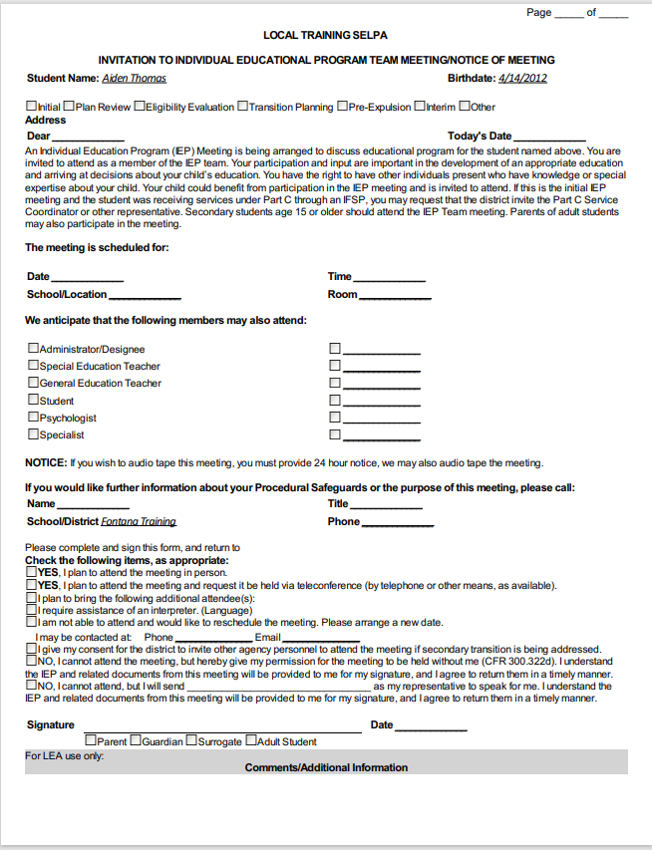
Notice of Meeting
The notice of meeting will give you the logistics for your IEP meeting.
    What type of meeting it is.
    When it will be held.
    Where it will be held.
    Who will be in attendance.
    And who you can contact regarding questions.
  It also gives you the opportunity to let the team know if you are available, need to reschedule, are bringing someone with you, or need translation at the meeting.

Slide 16

Excusal Form
The excusal form is where the Team documents your consent for IEP mandated team members to be excused in whole or in part from an IEP meeting.

Slide 17
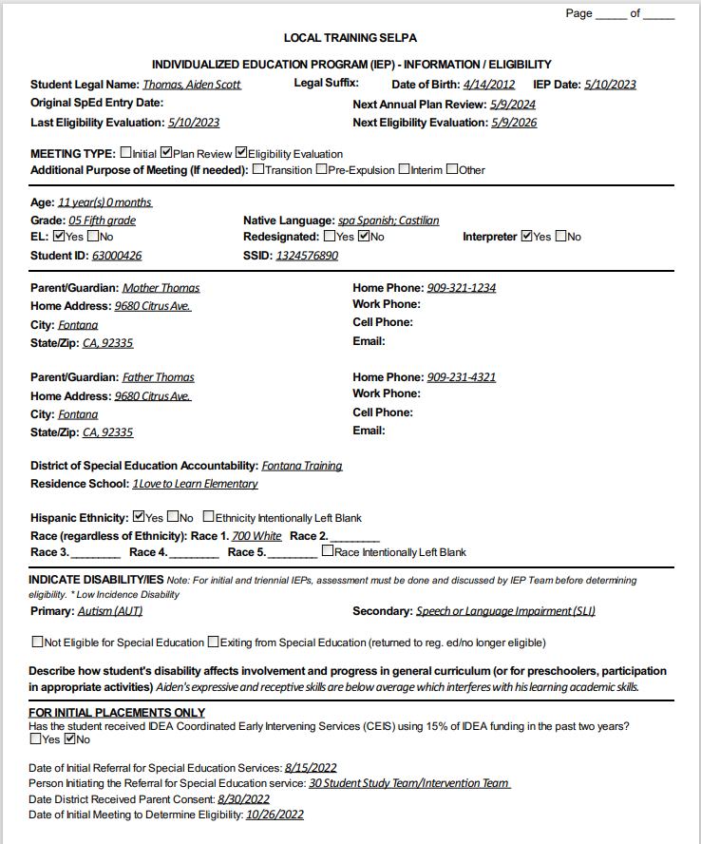
Information/ Eligibility
The information and eligibility page is where identifying information about your student is documented.
  Name, D.O.B., Dates for current and future meetings, Meeting Type, age, grade, EL status, ID #, Parent/Guardian contact information, District and Residence School, as well as Ethnicity and Race.
Eligibility is also documented on this page of the IEP as well as information pertaining to initial placement.
  Primary and/or secondary category student qualifies under.
  If a student is not eligible or being exited.

Slide 18
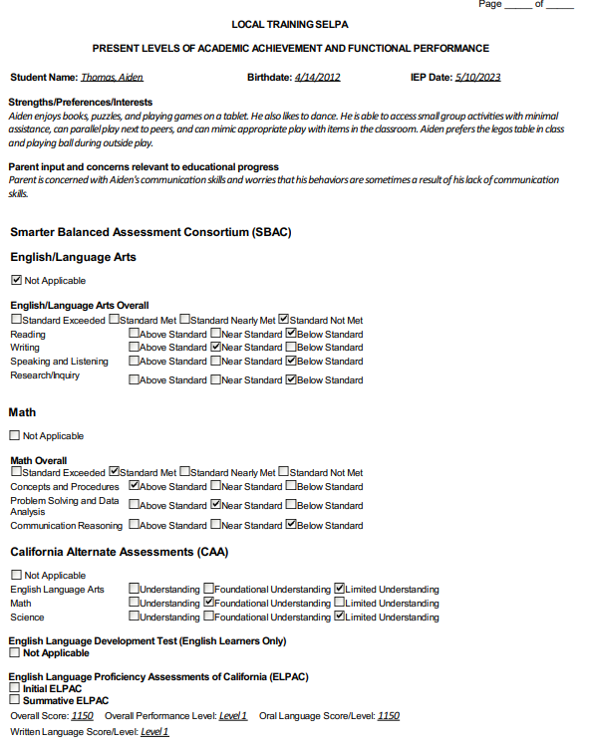
Present Levels of Academic and Functional Performance
The present levels of performance page is where the team will document:
  Student strengths, preferences, and interests.
  Parent input and concerns to educational progress.
  Assessment data (state testing, English Language Development testing, Physical Education testing, and other assessments) as applicable.
  Hearing and vision screening.
  Student’s present level of performance in the areas of: Academics, communication, gross/fine motor, social emotional/behavioral, vocational, adaptive/daily living skills, and health
  What areas goals will be written to address identified need.

Slide 19
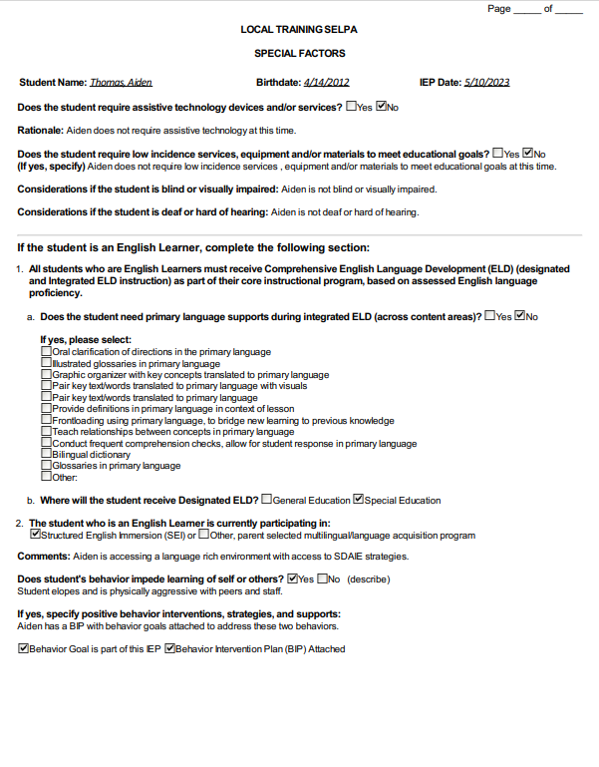
Special Factors
The special factors page is where the team documents assistive technology devices and/or services, low incidence services, equipment, and materials, and considerations if the student is blind, visually impaired, and/or deaf/hard of hearing.
English Language supports are also outlined on this page.
This page is also where the team will indicate behavioral concerns, supports, and if the team has/will develop a behavior goal and/or Behavior Intervention Plan.

Slide 20
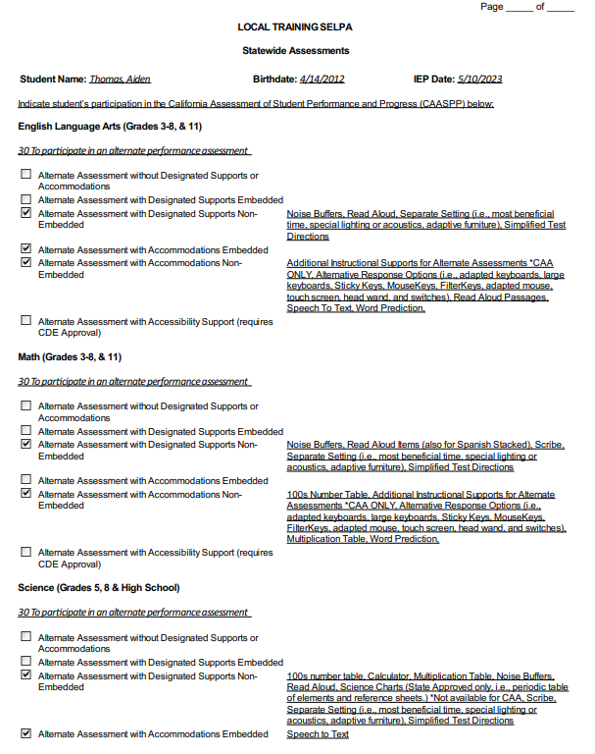
Statewide Assessments
The Statewide Assessment page is where it is indicated what Statewide assessment the student will participate in during that school year.
Additionally, the accommodations for the specific assessments will also be indicated on this page.
The Statewide Assessments in California are SBAC or CAA and for English Learners the ELPAC or Alternative ELPAC.

Slide 21
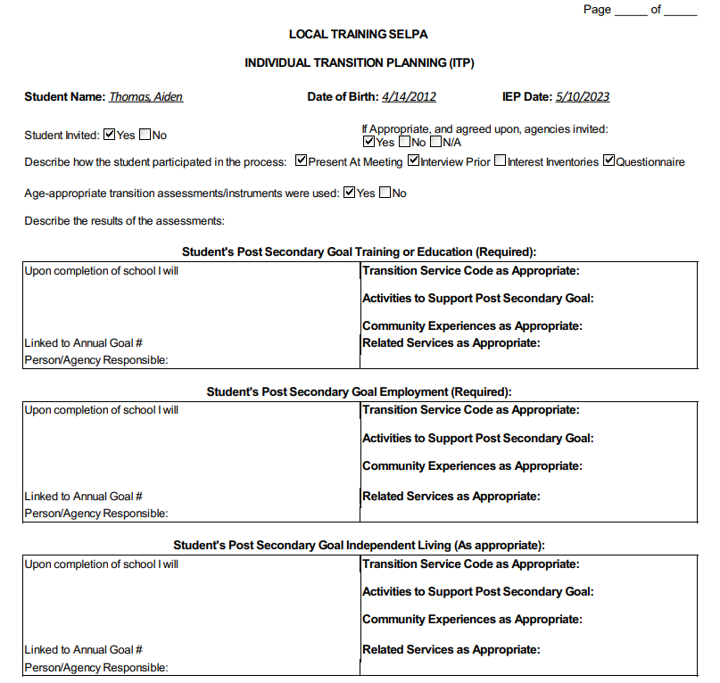
Individual Transition Plan
The Individual Transition Plan (ITP) Page indicates activities to support students as they near post secondary life in the areas of career readiness, college readiness, and other transition services.
It also documents if a student is diploma track bound or certificate of completion track bound. As well as tracking and updating credits earned and credits needed to graduate.

Slide 22
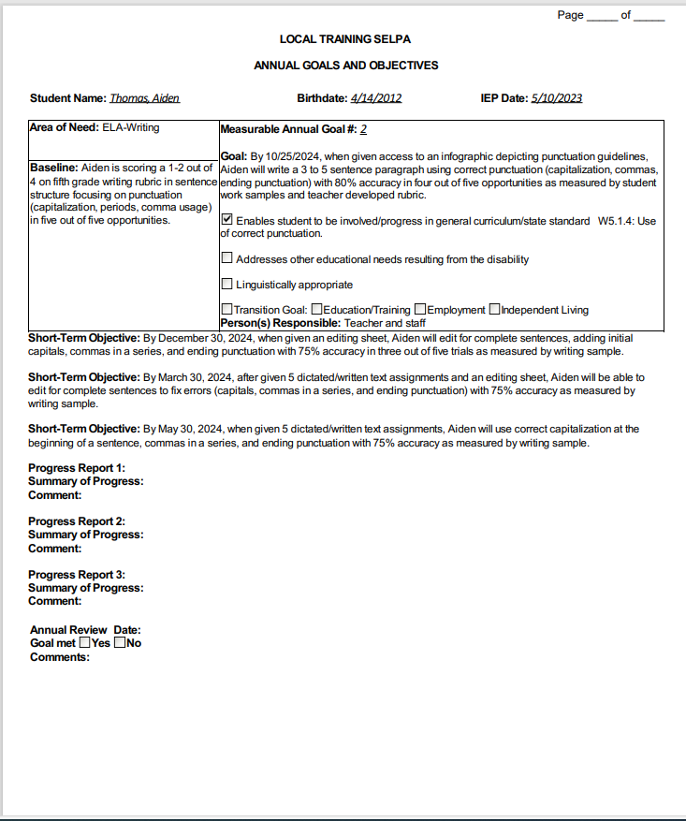
Annual Goals & Objectives
The Annual Goals and Objectives pages will outline the area of need that the goal will address, the baseline (present level of performance) for that identified area of need, and the measurable goal to be targeted within the next IEP year.
This page will also identify the State Standard the goal is addressing and who is responsible for supporting and reporting with implementation and progress reporting.

Slide 23
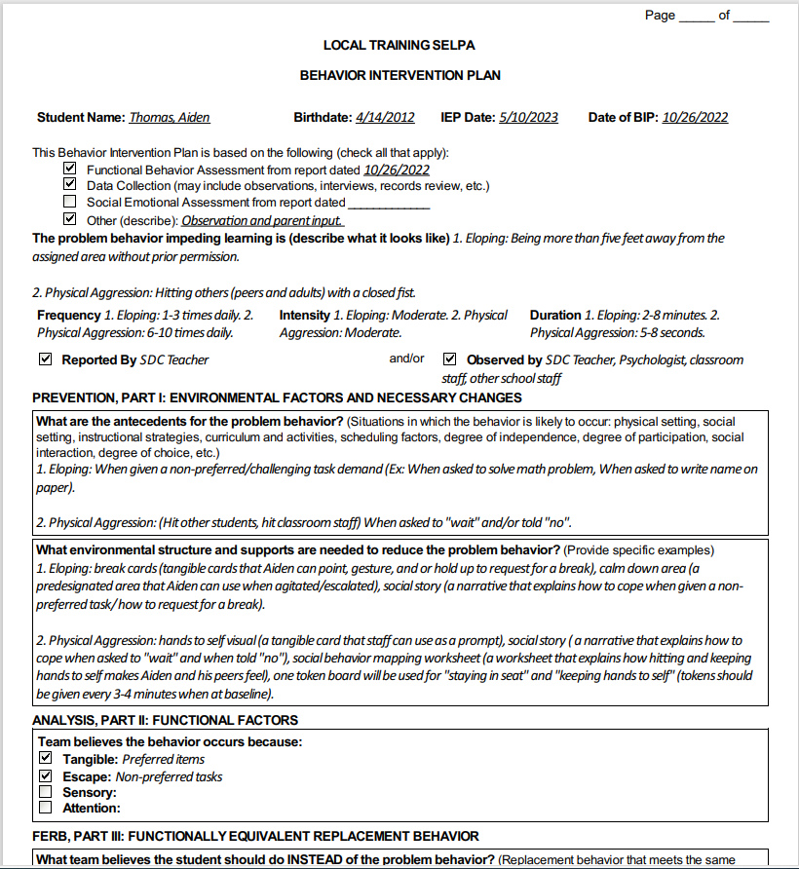
Behavior Intervention Plan
The Behavior Intervention pages are included in the IEP when a student has behaviors that have been identified to impede the learning of themselves and others.
The team will document the means of collecting data on the behavior, a definition of what the behavior looks like, and the frequency duration, and intensity of the behavior based on the data.
This is where the team will document environmental factors considered, what the student is trying to communicate through the behavior, what strategies and structures the team will put in place to help the student gain access to what they are trying to communicate appropriately, and what the student's behavior looks like as it progresses and returns to baseline alongside how staff will respond to support.

Slide 24
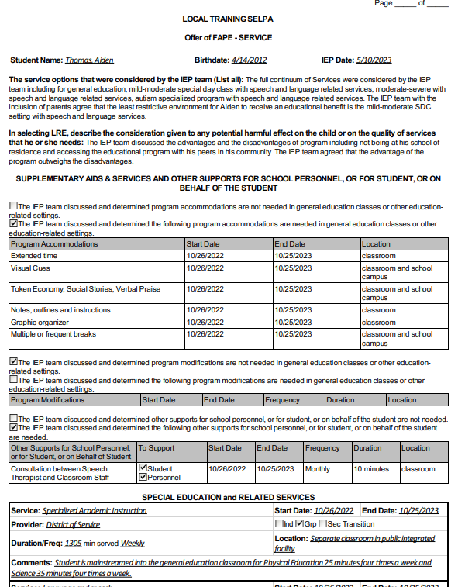
Services and Educational Setting
The Services and Educational Setting Page (Offer of FAPE) describes the service setting options considered during the IEP meeting, the possible harmful effects when accessing the special education environment, as well as any accommodations and modifications needed to access the educational setting.
This page also outlines the services with the defined minutes and location as they will be delivered.

Slide 25
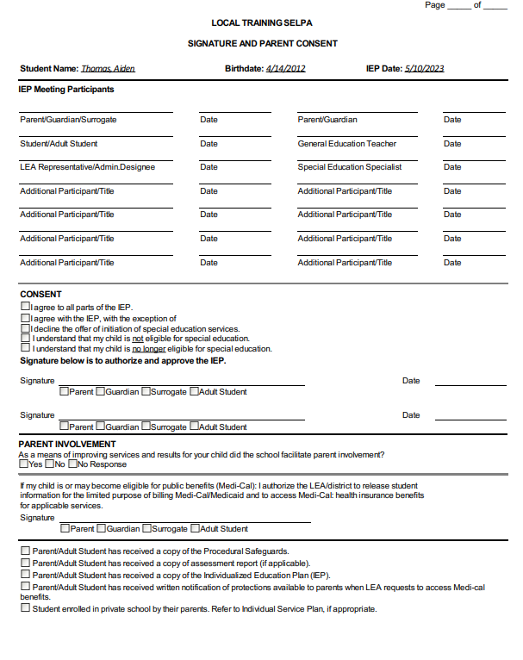
Parent Consent
Consent to all parts of the IEP
  The IEP will be implemented within a reasonable amount of time
Consent to some parts of the IEP
  Only portions of the IEP that the parent consented to will be implemented
Decline the offer of initial special education services
  The IEP will not be implemented
Not consent to the IEP
  The IEP will not be implemented, goals and services listed in the last consented IEP continue.
A parent may revoke their consent to all special education services. This must be done in writing.
    The district will send prior written notice explain the school placement and that the student will no longer have protections under IDEA.

Slide 26
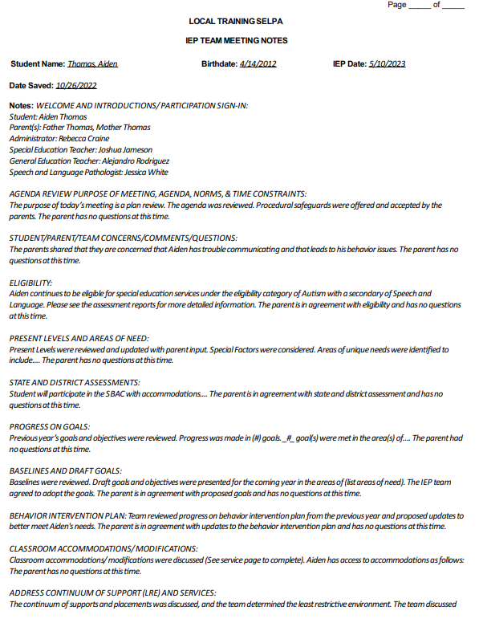
Notes Page
The Notes Page is a summary of the discussions had during the IEP meeting. This is the district’s document.
The IEP team should notate parent concerns and requests on this page as well.

Slide 27
What should be in my IEP Binder?
Evaluation
IEP
Report Cards/ Progress Reports
Work Samples
Behavior Documentation
Communication

Slide 28

IEP binder organization

Slide 29
Other IEP information
If your child is recommended for expulsion or is removed from school placement for over 10 days, the district must hold a Manifestation IEP to determine if the behavior was caused by the disability or a result of the district not providing services in the IEP
A parent has the right to request an Independent Educational Evaluation (IEE) at public expense if they disagree with results of the district assessment. The district either grants the request based on policy or has to file for due process to support the district assessment.
A parent may request to audio tape an IEP meeting. If this action is desired, a 24-hour notice is required
All rights transfer to the student whey they reach the age of 18 unless they are conserved by the courts

Slide 30
Other IEP information
A parent may request an IEP. Please put it in writing and the District will hold a meeting within 30 calendar days (with the exception of breaks consisting of more than 5 days)
A parent may request copies of existing student records. The District will provide copies within 5 business days.
Parents may request copies of draft IEP and assessment reports prior to the meeting. The District will provide draft copies if available.
A child placed by parent in private school has the right to a service plan but not FAPE.

Slide 31
Importance of Parental Involvement
Notes:
Now that we have looked at the IEP document itself, we are going to pivot to the topic of parent involvement and how important your role is in your child's education as a parent/family member/guardian.

Slide 32
Positive Relationships
Get Involved in Schools
Build Relationships
Take Opportunities to Help with Events
Based in respect, transparency, and trust
Be present as often as you can
Be intentional and reach out to the school
Share with school team your desires, dreams, and hopes for your student
Encourage all family members to come and support with school events
Notes:
First we want to look at the dynamic of fostering a positive relationship. Getting involved is a great way to build those relationships that will help you to feel comfortable sharing your hopes and dreams for your child as well as that mutual respect and trust.

Slide 33
Empower Families
Keep Asking Questions:
“Tell me more about…”
“Why does this continue to happen”
“What should I be asking that I haven’t asked about yet?”
Encourage the engagement of other families to be involved with the school
Site needs can change yearly
Stay up to date with events at the school
Get involved in Parent Committees
Notes:
Empowering families. You are our greatest asset to supporting your child. Asking questions and staying involved helps your child's voice be heard and needs be considered when their school and IEP team is developing plans of support. This is especially important when efforts for support and identified areas of need can shift from year to year.

Slide 34
Data Based Goals and Outcomes
Help tell the story behind the data
Story behind the numbers, as a parent you can add your voice to the story
Participate in Surveys to help implement change
Participate in surveys, the results from parent input can implement change
Use data from surveys to guide improvement
Families have a meaningful role in setting engagement goals
Notes:
Families: YOU are the child’s first and most important teacher; YOU and your child’s school have something in common – both want your child to learn and do well; YOU have valuable information about your child’s talents, interests, learning styles, non-school learning opportunities, and strengths and needs that are crucial when planning for student success.

Slide 35
Collaborative Problem Solving
Share Information
Life events can impact student performance
Communicating with teacher, team can develop an action plan to solve instructional needs
Develop Trusting Connections
This person can help support you and may be able to achieve more student success through a collaborative effort
Work Toward a Shared Goal
Collaboration with family and parents creates an honest dialogue
Team can focus on student success as the primary goal
Parents and school staff work together to meet student needs
Teachers cannot do it alone. We need parents so we can learn who your child is.
You know your child best. Teachers need to know your children, so they are fully supported in the classroom.
Notes:
Collaborative problem solving supports getting the most relevant and up to date data and information to consider as we problem solve through concerns as a team to support your child as a whole. You as the parent often have information that is relevant to the how or why when it comes to making growth in the educational setting.

Slide 36
Multi-Dimensional Communications
Face-to- Face
Establishes a relationship
Allows for increased follow up communications
Get Involved & Advocate
Call
Teams meetings
More Support = More Involvement
Tier 2 & Tier 3 levels of support tends to need more parental involvement
May need to attend meetings to progress monitor student growth
Email
Shows your child school and relationships are important
Collaborate with teachers, school counselors, etc.
Use different methods to communicate as needed
Methods of communication may vary based on family need
Notes:
In today's world there are so many modes of communication that we can access to stay connected and get involved. Face-to-face communication, phone calls, emails, and Teams meetings, create a variety of methods to help us to stay connected and involved. This creates a unique opportunity to identify best methods for communication to ensure that we have established and consistent communication.

Slide 37
Active Listening to Encourage Collaboration
Notes:
As you are getting involved in the school and district setting there are going to be lots of conversations happening to build partnerships. Next we are going to look at active listening and the impact that it can have when developing collaboration between families and district staff.

Slide 38

Active Listening
“You cannot truly listen to anyone and do anything else at the same time.”
M. Scott Peck, author of The Road Less Traveled
Notes:
This quote rings true especially in the age of technology that we live in. There are so many distractions and we are all juggling so many responsibilities. Active listening supports us with techniques that can help us to create the space to really hear one another and be productive in our communication.

Slide 39
Why Active Listening Works
Active listening is a way of listening that involves full attention to what is being said for the primary purpose of understanding the speaker.
It is an important skill set for many different circumstances, from personal to professional.
If we are not listening actively, we are likely to miss the real message.
Notes:
Some things to hone in on as we talk about active listening:
Active listening involves giving your full attention to the person speaking and focuses on understanding the speaker's message.
Active listening can be used to develop and enhance communication in all settings, professional and private.
And active listening will help us to not misinterpret the speakers message.

Slide 40
Active Listening
Listen for Total
Meaning
When someone is conveying a message, there are two meanings to gather: the content and the feeling or attitude underlying the message. An active listener is not only tuned in to the information conveyed, but also how it is conveyed and any nonverbal cues present.
Respond to Feelings
After listening, when a response is appropriate, the listener should respond to the feeling of what was said. In this way, the speaker feels understood and empathy is established.
Nonverbal cues include tone of voice, facial or body expressions, and speed of speech. All of these taken together can convey a much deeper meaning than merely the content of what was said.
Note all Cues
Notes:
When engaging in a conversation there is two meanings that are being conveyed through the interaction. First is the actual words, the content that they are sharing. Second is what emotions and attitudes the speaker putting behind those words. While sometimes these two are aligned other times they are not. Having awareness for the non-verbal cues (such as tone of voice, facial expressions, speed of voice, and body language) that accompany a conversation allows us to respond to the feelings within the message establishing empathy and report.

Slide 41
Examples: Signs of Active Listening
Body Language
Building Trust and Rapport
Asking Open- Ended Questions
Shows Interest in Group Discussion
Verbal Affirmations
Tone of Voice
Notes:
Body Language: Maintaining eye contact and appropriate facial expressions; remove distractions
Building trust and rapport: that level of comfort in trusting someone with your feelings and ideas
Asking open ended questions: Ask the questions that encourage that deeper conversation the space where you can be vulnerable
Shows interest in group discussion: When you feel like the listener cares about what you have to say
Verbal affirmations: Verbal affirmations seed that partnership and through comfort
Tone of voice: How you say it makes a huge difference.

Slide 42
Techniques for Active Listening
Technique | Purpose | To Achieve It | Examples
Paraphrasing | Convey interest Encourage the speaker to keep talking | Restate the information just received with your own words | “You showed up at the meeting on time.”
Verbalizing Emotions | Show that you understand Help the speak to evaluate their own feelings | Reflect the speaker’s basic feeling and emotions in words | “And this made you really angry.”
Notes:
Now let's look at some techniques that will support you to participate and facilitate active listening.
Paraphrasing or restating what you have heard in your own words, this will help to clarify the message received is the message intended to be conveyed.
Verbalizing emotions helps us to put a name to our feelings as we are having a conversation so we can be aware of how it is affecting the outcomes of our conversations.

Slide 43
Techniques for Active Listening
Technique | Purpose | To Achieve It | Examples
Asking | Get More information | Ask questions | “And after that, John did not react?”
Summarizing | Review progress Pull together important ideas Establish a basis for further discussion | Restate major ideas expressed, including feelings | “These seem to be the key ideas you’ve expressed.”
Notes:
Asking allows us to get more information to build a better picture of the need at hand.
Summarizing allows us to check for understanding as we communicate in a conversation.

Slide 44
Techniques for Active Listening
Technique | Purpose | To Achieve It | Examples
Clarifying | Clarify what is said Help the speaker see other points of view | Ask questions for vague statements Restate wrong interpretations to force further explanation | “You said that you reacted immediately. Was this still on the same day?”
Encouraging | Convey interest Encourage the speaker to keep talking | Disagree Use varying intonations Offer ideas and suggestions | “Then the student approached you. How did he behave?
Notes:
Clarifying helps us to define
Active listening supports developing, maintain, and grow collaborative partnerships.

Slide 45
Productive Communication with the IEP Team

Slide 46
IEP Team Communication
Put everything in writing
Stay Professional
Stay focused on the child
Notes:
Put everything in writing: Phone & In-Person conversations are still essential. Just make sure you follow up with an email
Stay Professional: Stick to the facts, not emotions. And don’t assume intent
Stay focused on the child: Get in the habit of retelling incidents from the viewpoint of your child. Instead of “the teacher/aide did not do XYZ…” say, “My child did not receive XYZ, which, per his IEP he is to receive during this class.”

Slide 47
Which IEP Team Member Should You Contact?
Case Manager
The case manager is the Education Specialist that is assigned to your student. This person will communicate to all service providers, other teachers, administration, and with the family
Site Administration
Next steps when more support is required, contact the site administration
SELPA Office
Parental Rights and Procedural Safeguards
Address concerns and Facilitate Resolution
State Level
California Department of Education complaint or Due Process Filing.

Slide 48
How are Disputes Resolved?
Alternative Dispute Resolution
Mediation
Due Process Hearings

Slide 49
The "How" of Effective IEP Communication
IEP is the Focus
Evaluations, progress, strategies, etc.
Stick to the Facts
Stick to the facts, not emotions
Do not assume intent
Focus on what happened and how it affected your child
Stay Child Focused
Keep focused on what your child is or isn’t doing
Important Concerns
Transparency
For important concerns, use the IEP process
Request evaluations formally in writing
Pertinent Information to inform with team members: medical diagnosis, medications, unusual behaviors, and/ or educational rights

Slide 50
The “Where” of IEP Communication
Stay professional and respect boundaries. Use designated meetings or office hours. If you see teacher out in public, discourage discussing school matters outside of school.
Keep a designated home/school communication log via email with teacher or binder. Parents have access to student information via Parent Square.
Social media is not a place to discuss your student’s IEP or frustrations with the team. Communicate with the team at school.

Slide 51
The “When” of the IEP Communication
Communicate Student Needs
Request to hold an IEP to discuss student placement, strategies, accommodations, etc.
IEP Meetings
IEPs can be held before the next dated Annual Plan Review
Parent Teacher Conferences
If you’d like to discuss grades, a PTC can be held.
Parent can meet with counselor to discuss credits
Discussion with case carrier does not always warrant an IEP

Slide 52
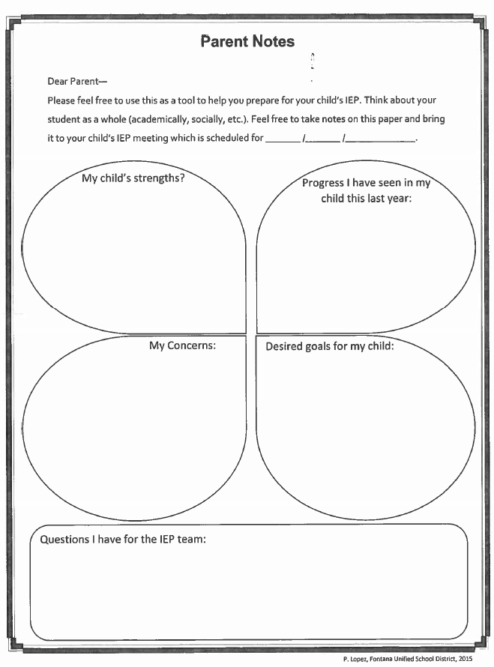
Preparing for the meeting
Make a list of priorities and concerns
Contact the case carrier to discuss goals
Make requests for additional services, testing, or IEP meetings in writing
District is responsible for providing parent with reasonable notice of IEP

Slide 53

Questions and Comments

Slide 54
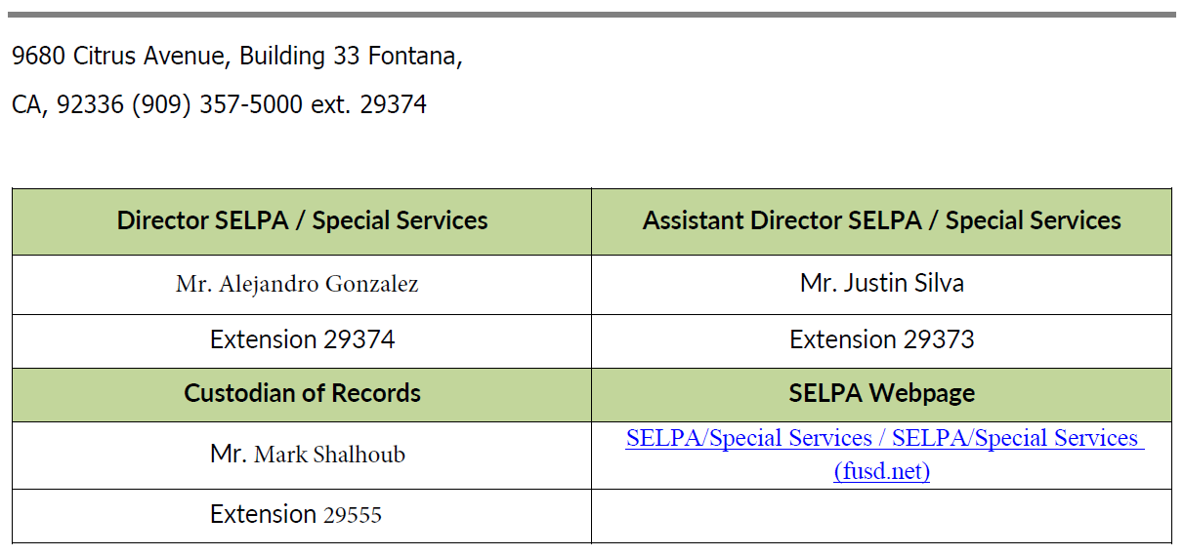
District Contacts

Slide 55


Thank you!
Heather Melero, Program Specialist
MeleHS@fusd.net
Premade IEP binders will be available upon request.
Please send an email to either of the following SELPA representatives if you would like to pick up your IEP binder in building 33 after the winter break.
Those requesting an IEP binder will be notified by email when they can pick up binders from the receptionist area in building 33.
Jennifer Nycum, Program Specialist Nycujn@fusd.net

