Slide 1

Welcome to
Kindergarten Curriculum night!
Tess Camera Melissa Molavi Maris Tanner
Notes:
Melissa

Slide 2
Tonight's Purpose:
To share what we work on in the classroom and collect any questions you may have regarding curriculum.
Notes:
Melissa

Slide 3
Agenda
Title 1
Safety Net
Multilingual Learner Program
Specialist (PE, Music, and Library)
Counselors
Community and Family Liaison
Curriculum:
    Reading
    Writing
    Math
    Science
    Technology
    Social Studies
    Art
    Social Emotional
    FastBridge
    ROAR
    Progress Reports & Conferences
    Volunteers
    Communication
    Nuts and Bolts
    Questions
    Let’s get started!
Notes:
Melissa

Slide 4
John Muir is a Title 1 School
This means we receive federal funding (Title 1 dollars) to supplement the school’s existing programs.
Notes:
Tess

Slide 5
Supplemental Title 1 funds
Are used for…
  Identifying students experiencing academic difficulties and providing timely assistance to help these student’s meet the State’s challenging standards.
  Funding can be used for supplemental staff/programs/materials/supplies and conducting family involvement meetings/trainings/activities
Notes:
Tess

Slide 6

Additional Information
Being a Title 1 school also allows for opportunities for family involvement and communication of parent rights.
If you wish to request information about the qualifications of your child’s teacher and instructional paraprofessionals, please contact;
Principal, Ashley Boughton
aboughton@lwsd.org
425-936-2640
Notes:
Tess

Slide 7

Safety Net Information
Purpose of Safety Net!
Support students in partnership with general education teachers in literacy so they can meet or exceed grade level standards
Safety Net instruction never replaces core instruction with their teacher, it serves as extra instruction for students who qualify

Slide 8

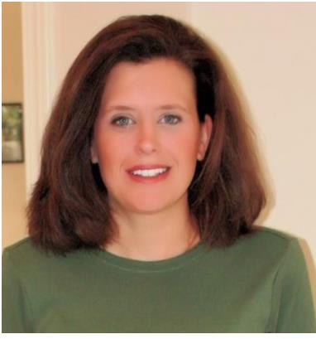
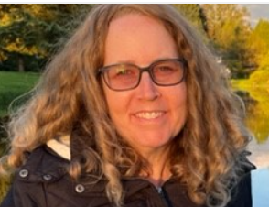
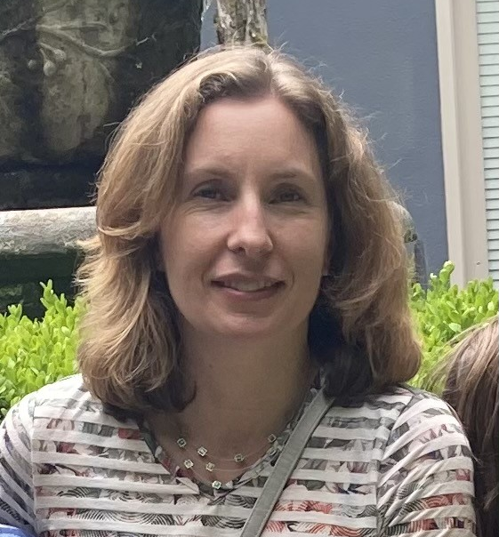
Meet the Team
Julie Palmer
jupalmer@lwsd.org
Michelle Vallene
mvallene@lwsd.org
Ellen Barber
ebarber@lwsd.org

Slide 9

Who is served in safety net?
We serve students who are not meeting district and state academic standards in reading.
Our Reading testing will be through FastBridge, which replaced DIBELS
Safety Net groups will begin when testing has been completed by their classroom teacher.
Parents will be contacted if testing data indicates that their student will benefit from receiving extra support in Safety Net groups.
Safety Net groups will not interrupt or replace classroom instruction, they act as an extra support in addition to core curriculum
Notes:
Maris

Slide 10



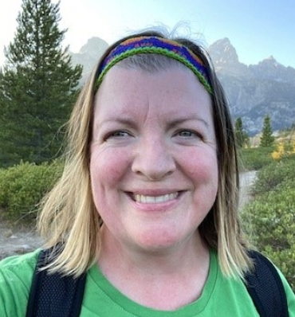
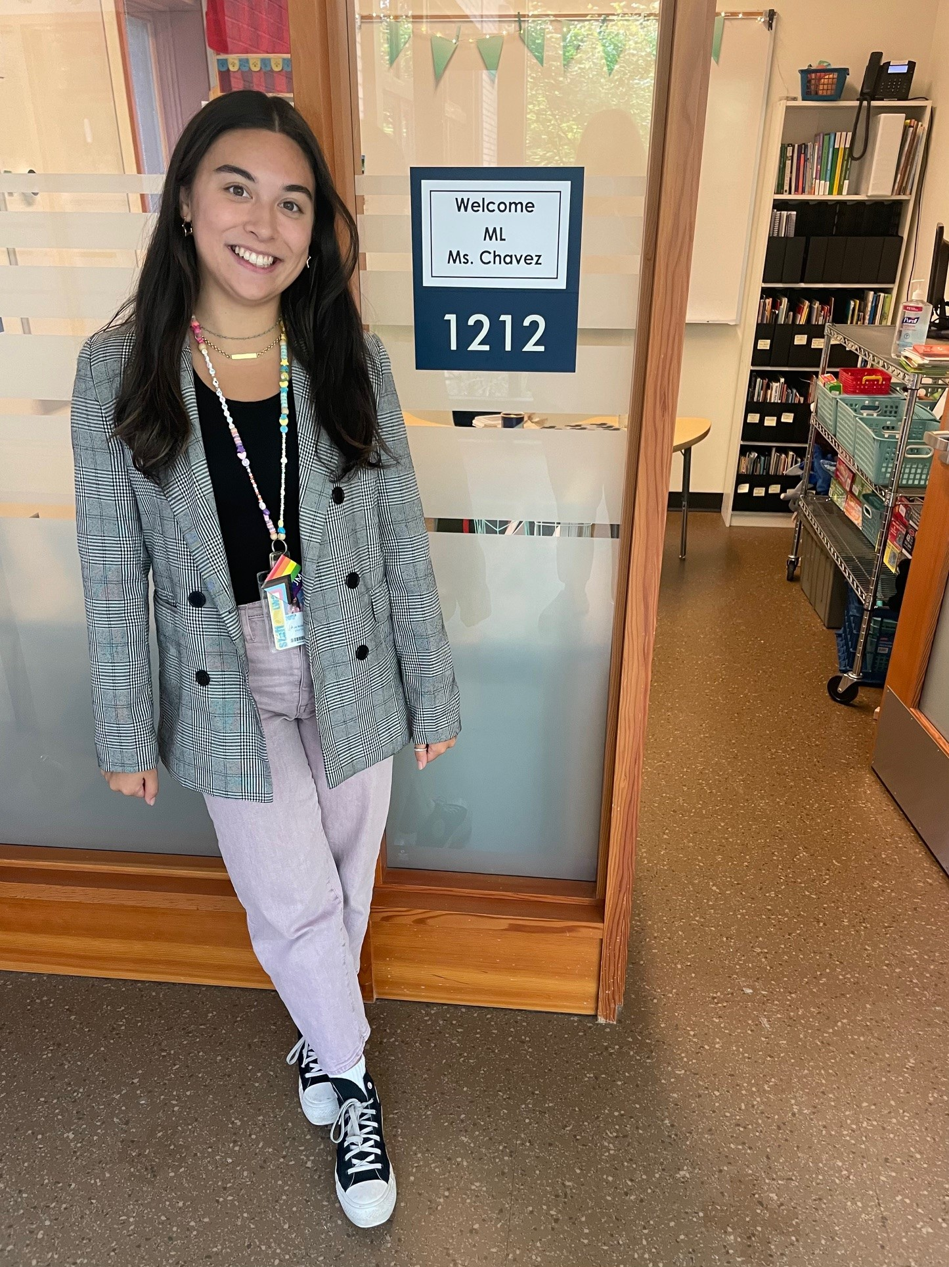


Multilingual Learner (ML) Program
We provide English instruction and support to multilingual students in all grades focusing on …
listening speaking
reading writing
The type and level of English support is determined by students' WIDA test scores and other assessments given by classroom and intervention teachers.
Questions about English support can be directed to the Multilingual Teachers:
Domini Dean
ddean@lwsd.org
Bella Chavez
ichavez@lwsd.org

Slide 11

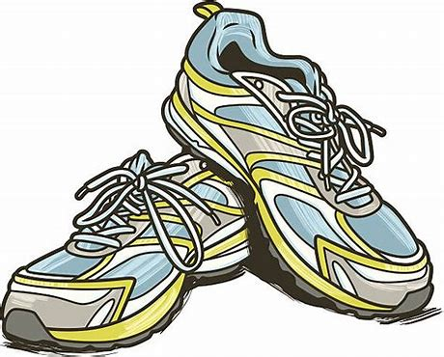

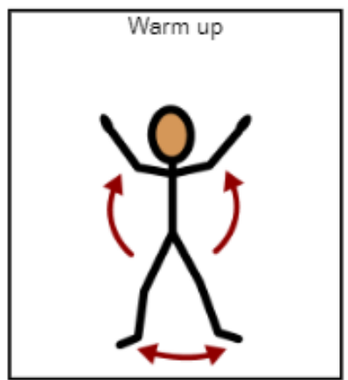
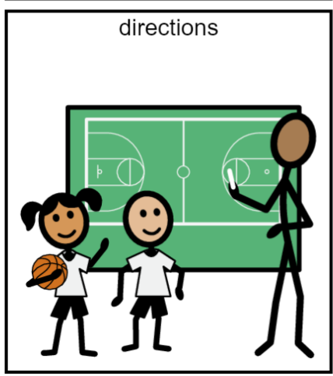
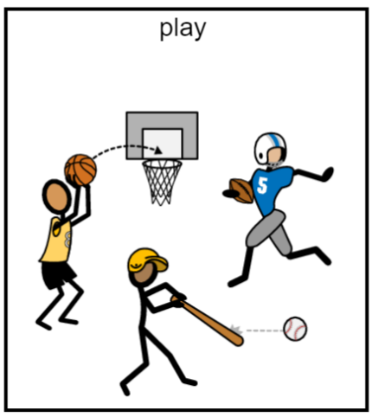
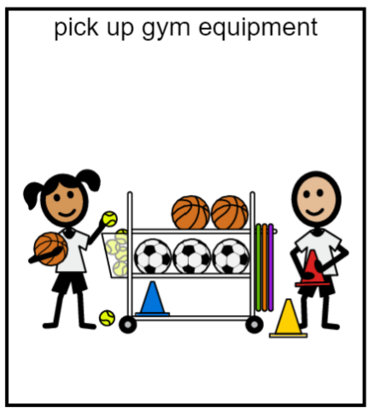

PE Class 2 times each week
Be ready to move by wearing safe running shoes!

Slide 12
Music is 2 times a week!
We will learn how to…
Sing!
Play instruments!
Read rhythms!
Read music!
And…DANCE!!!

Slide 13
Library Program Information:
All grades visit the library for 30 minutes a week.
Students listen to stories, learn about digital citizenship, and how to explore their information needs.
Grades K-1 Check out one book a week for their classrooms.
Grades 2-3 Check out 2 books to take home. The books are due 1 week later.
Grades 4-5 Check out 2 books to take home. The books are due 2 weeks later. 5th graders in good standing can increase the number of books to take home after Winter Break.
Mrs. Kehrli
stkehrli@lwsd.org

Slide 14
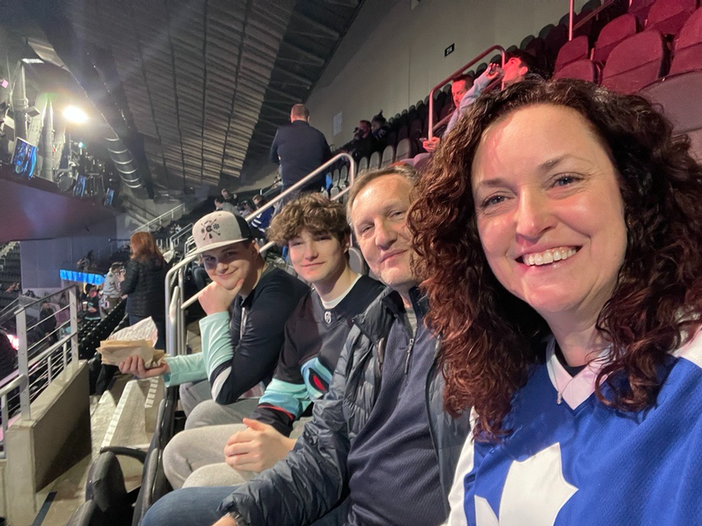
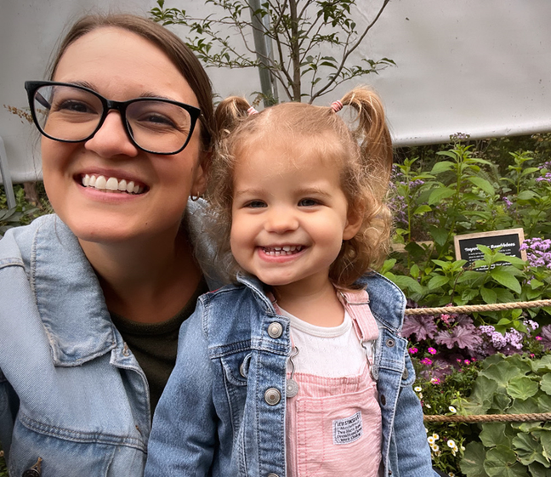
MEET THE SCHOOL COUNSELORS!
Ms. Schroeder. Full-time School counselor at JME. In my spare time I love going to hockey and baseball games with my family, and I love musical theatre especially at 5th Ave and the Paramount. I live at home with my husband, two sons, and two crazy cats.
Ms. Powers! Bonus School Counselor at JME. I work with Ms. Schroeder to help ALL students at JME. You will see me on Monday’s! I love reading, going to the beach, crafting and spending time with my family. I live at home with my husband Jordan, daughter Lucy and cat ROY!

Slide 15


WHAT DOES AN ELEMENTARY SCHOOL COUNSELOR DO?
1
2
3
SUPPORT
EDUCATE
ENCOURAGE
  Academic, social, and emotional development of all of the students here at JME
  Classroom SEL lessons
  Student small groups
  JME community resources
  Students
  Families
  Teachers
  JME community

Slide 16
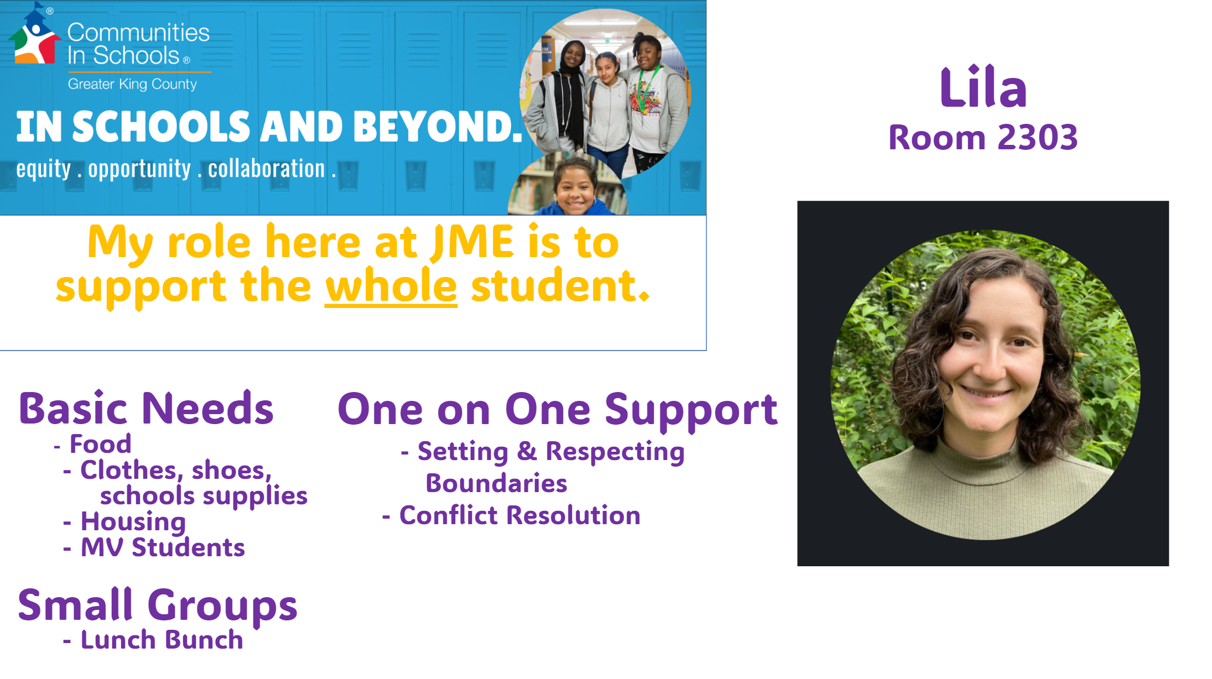

Slide 17


Reading (Wonders)
Wonders is used for both whole group and small group.
Multiple opportunities for practicing reading skills (leveled readers,
short stories, decodable readers)
Tier 2 instruction – differentiation
Lessons focus on:
  Concepts of print (print is what we read, reading from left to right)
  Phonological Awareness (rhyme, onset and rime)
  Phonemic Awareness (blend, segment, manipulation)
  Phonics/Decoding (sound/letter correspondence to blend/read words)
  Fluency (High Frequency Words or Sight Words)
  Vocabulary
  Comprehension Strategies
Notes:
Melissa

Slide 18

Reading at Home
Point out the front cover, back cover, the title, author, and illustrator
Read words left to right, top to bottom
Track with your finger
Notice punctuation
Ask questions about the story while reading
Read for at least 20 minutes a day
Notes:
Melissa

Slide 19
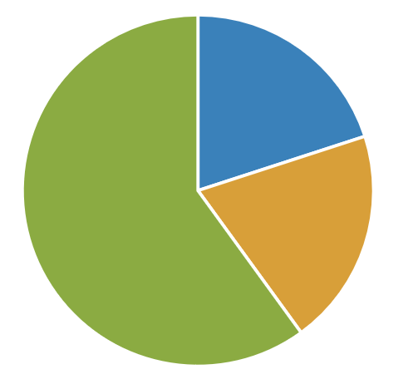
Writing
Writing Workshop Model
    Writers Work for Many Purposes
    Label and Lists/Pattern Books
    Small Moments #1 (Narrative)
    Opinion
    Small Moments #2 (Narrative)
    All About (Informational)
Journals
Strategies your student will learn how to use:
Using sound spelling
Looking at our word wall (high-frequency words)
Adding detailed pictures
Conventions
Mini-Lesson
20%
Sharing
20%
Writing Time 60%
When your student is writing at home, let your student sound out words independently. It is OKAY if words are spelled incorrectly.
Notes:
Melissa

Slide 20

Illustrative math
A problem-based, rigorous curriculum.
Students will have opportunities to:
Foster positive self-image and see themselves in math
Develop deep conceptual understanding and fluency
Access coherent instruction at and across all levels
Experience relevant, real-world problems
Think critically and creatively
Notes:
Tess

Slide 21
Illustrative math
The mathematical work for kindergarten is partitioned into 8 units.
The big ideas in Kindergarten include:
Representing and comparing whole numbers, initially with sets of objects
Understanding and applying addition and subtraction
Describing shapes
*Units vary in length, but math workbooks will be sent home at then end of each unit
Notes:
Tess

Slide 22
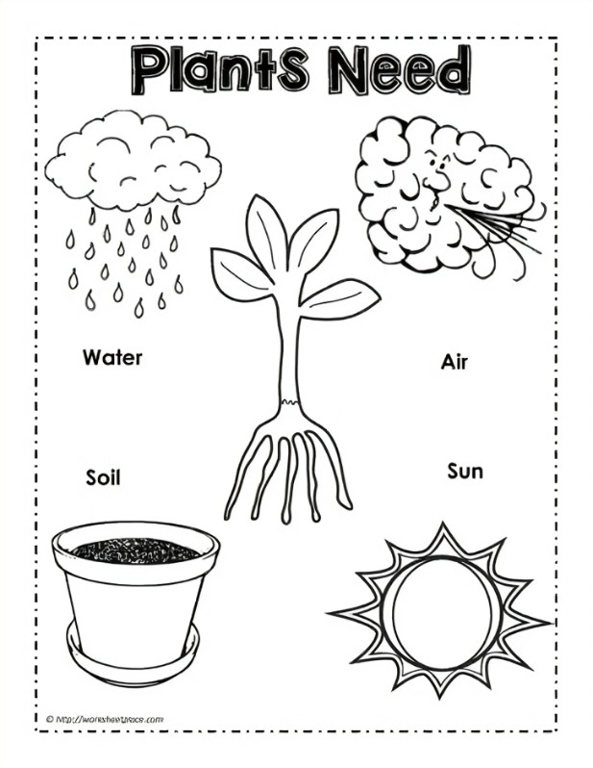
Science
Amplify Science
Hands on and exploratory
Three topics throughout the year:
  Needs of Plants and Animals- Fall
  Sunlight and Weather- Winter
  Pushes and Pulls- Spring

Slide 23

Technology
Technology Skills Continuum
Students use netbooks at school
Categories within the Skills Continuum (observing):
          Desktop Publishing
  Keyboarding
  Digital Citizenship
  Digital Presentation
  Research and Citation
  Data Gathering and Analysis
  Collaboration
Notes:
Maris

Slide 24
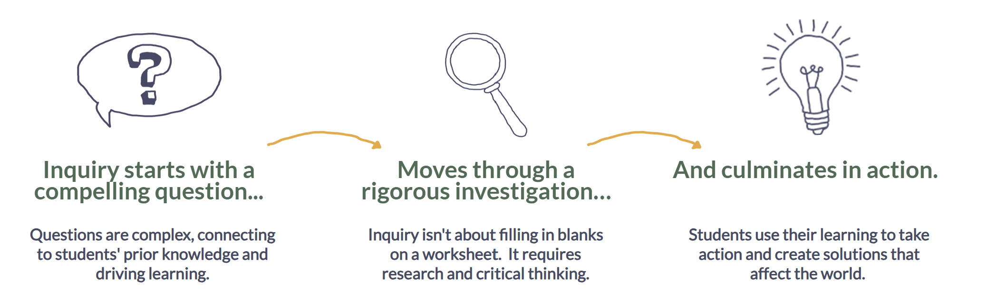
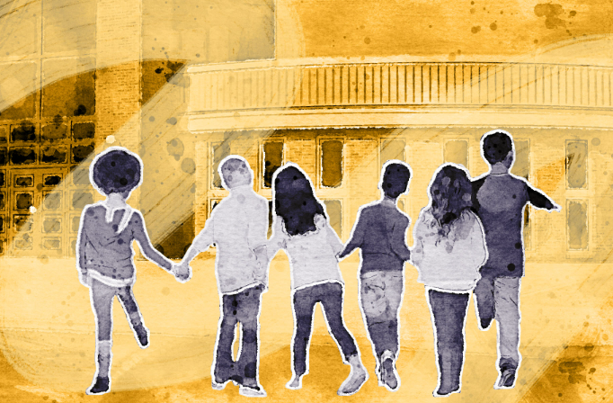

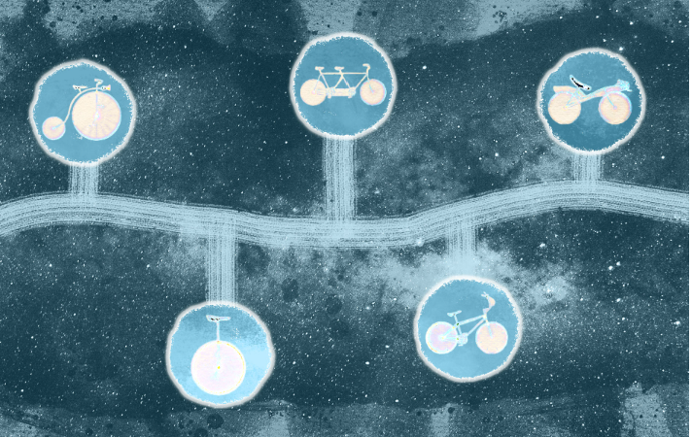
Social Studies
Inquiry Journeys
Navigating School
My Team and Self
Past, Present
and Future
Notes:
Maris

Slide 25

Art
Elements of Visual Arts in Kindergarten:
Color
Line
Shape
Texture
Value
Space
Form
Notes:
Maris

Slide 26
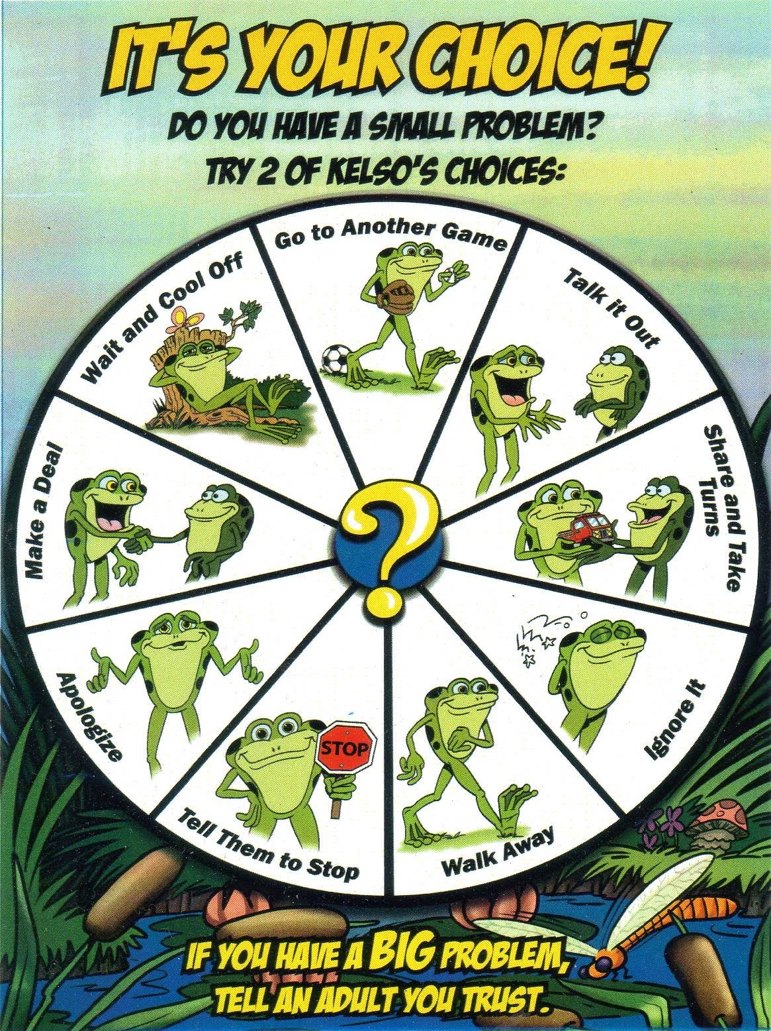
Social Emotional
Kelso’s Choice and Second Step
Taught by school counselor
30 minutes every week
Strategies for problem solving
Small vs. big problems
Purposeful People
Taught in the classroom
Monthly school wide focus
Notes:
Melissa

Slide 27

Roar
John Muir participates in PBIS – Positive Behavior Intervention and Support.
The goal of PBIS at John Muir is to proactively teach students expected behaviors in all areas of the school.
Students and parents can expect:
  Common routines, language and practices used throughout the school to provide consistency
  Positive feedback to students for demonstrating/modeling expected behaviors (ROAR tickets)
  Use of a school wide reward system (ROAR)
It is exciting to earn a ROAR ticket and we encourage you to celebrate your child at home!
Notes:
Melissa

Slide 28
FastBridge
Benchmark assessment tool for reading and math
Administered in the fall, winter and spring
Data used to guide instruction
 | Early Reading | Early Math
Kindergarten | Concepts of Print (F) Letter Names (F) Onset Sounds (FW) Letter Sounds (FWS) Decodable Words (WS) Word Segmenting (WS) Sight Words (WS) | Match Quantity (F) Decomposing (WS) Numeral Identification (FWS) Number Sequence (FWS)
Notes:
Tess

Slide 29
Progress Reports
Sent home twice a year
  January (in time for conferences) and end of year
Paper copy sent home with your student
Parent access in Skyward
Notes:
Tess

Slide 30
Conferences
January 28th, 30th and 31st (half days for students)
Student Participation
More details to come
Notes:
Our next meeting will be January conferences. These conferences will happen on January 28th, 30th and 31st. Which means school will get out at 11 40 and the rest of the day will be set asiad for January conferences. These conferences are to talk about students successes, growth and goals so students should attend these confrencess

Slide 31
Volunteers
We are so excited to be able to have volunteers this year!
If you would like to volunteer, make sure you have completed the online application.
Notes:
Maris

Slide 32


Communication
Parent Square
  Newsletter
Take home folder
Notes:
Maris

Slide 33

Nuts and bolts
Lunch and Snacks
Wednesday – Early Release at 1:40pm
PE – Wear appropriate shoes on assigned PE days
Please remember to have your child’s first and last name labeled on EVERYTHING (water bottles, lunches, coats, etc.)
We go out to recess unless it is severe weather. Please make sure your child is dressed appropriately to play outside in the rain.
Health (when to stay home)
Join the PTSA
Notes:
Melissa

Slide 34

Any questions?
If so, Complete this form
https://forms.office.com/r/ewppT5xQMS
Notes:
Maris

