Slide 1
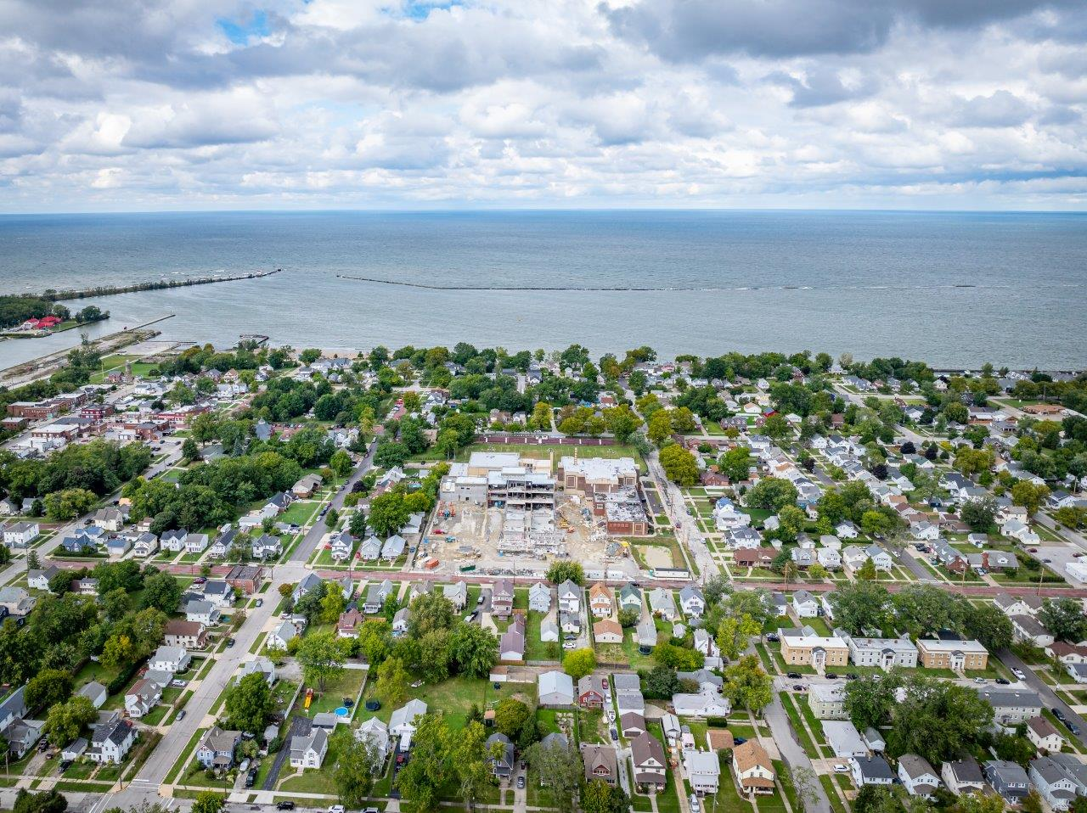



FHEVS – Community Meeting
October 29th , 2024

Slide 2
Agenda
Project Design Update
Introductions
Construction Progress
Schedule Update
Next Steps
Q&A

Slide 3
Introductions
Then Design Architecture(TDA)
Adam Parris, RA – Project Architect
CT Taylor
Ryan Fink – Project Manager
Brian Jackson – Project Engineer
Steve Duhart – Superintendent

Slide 4
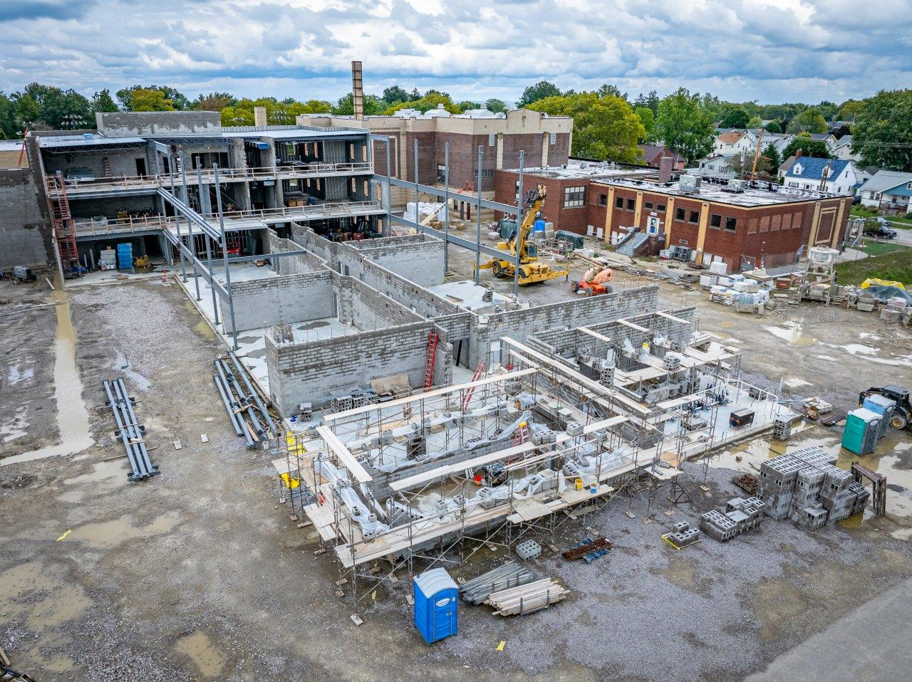
Construction Progress

Slide 5
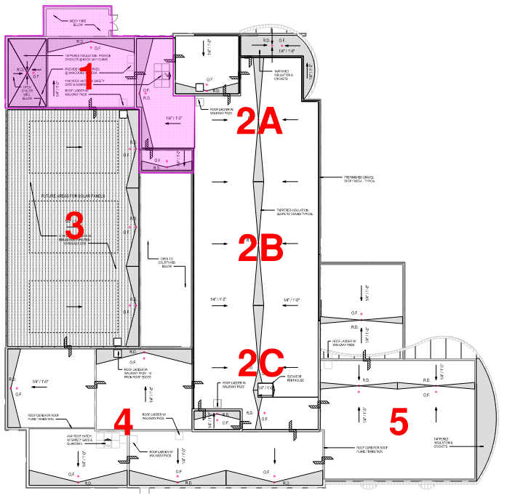
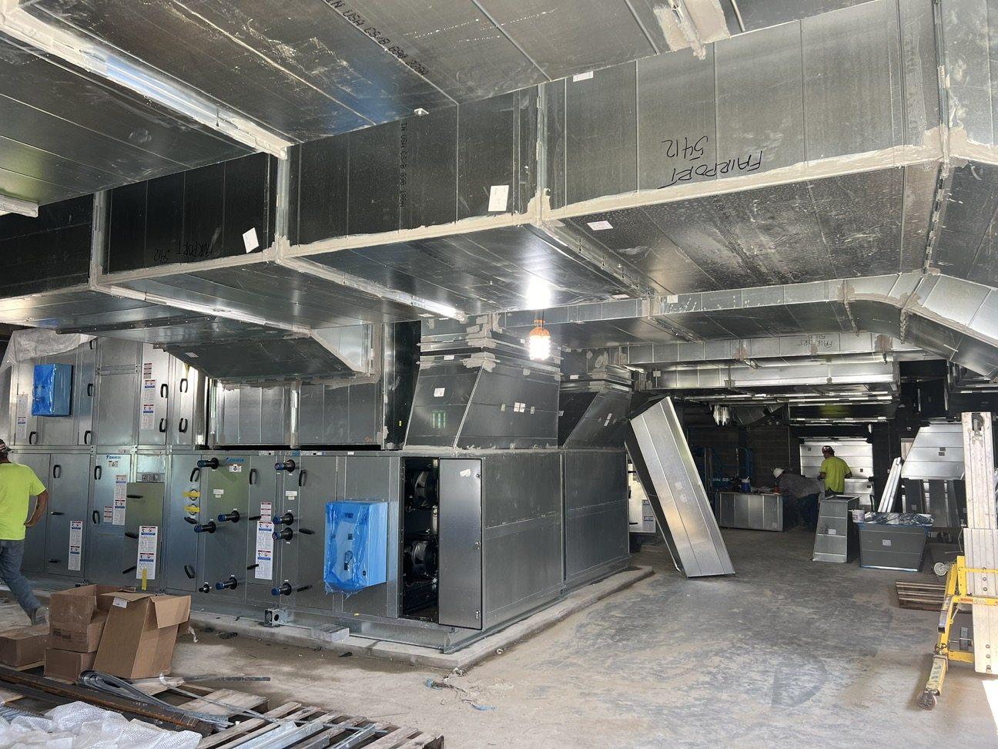
Construction Progress
Current Progress
  Foundations
  Masonry to Third Floor
  Mechanical Rough-Ins
  Electrical Rough-Ins
  Plumbing Rough-Ins
  Chiller
  Air Handlers
  Veneer
  Joist and Deck
  Roof Blocking
Upcoming Progress
  Roof Membrane
  Temp Enclosures
  Paint

Slide 6
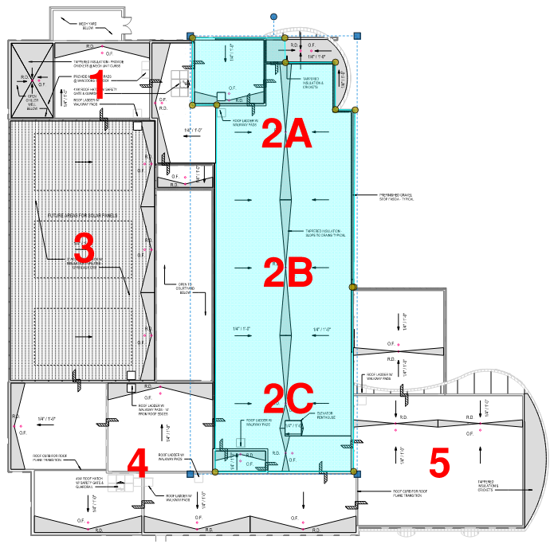
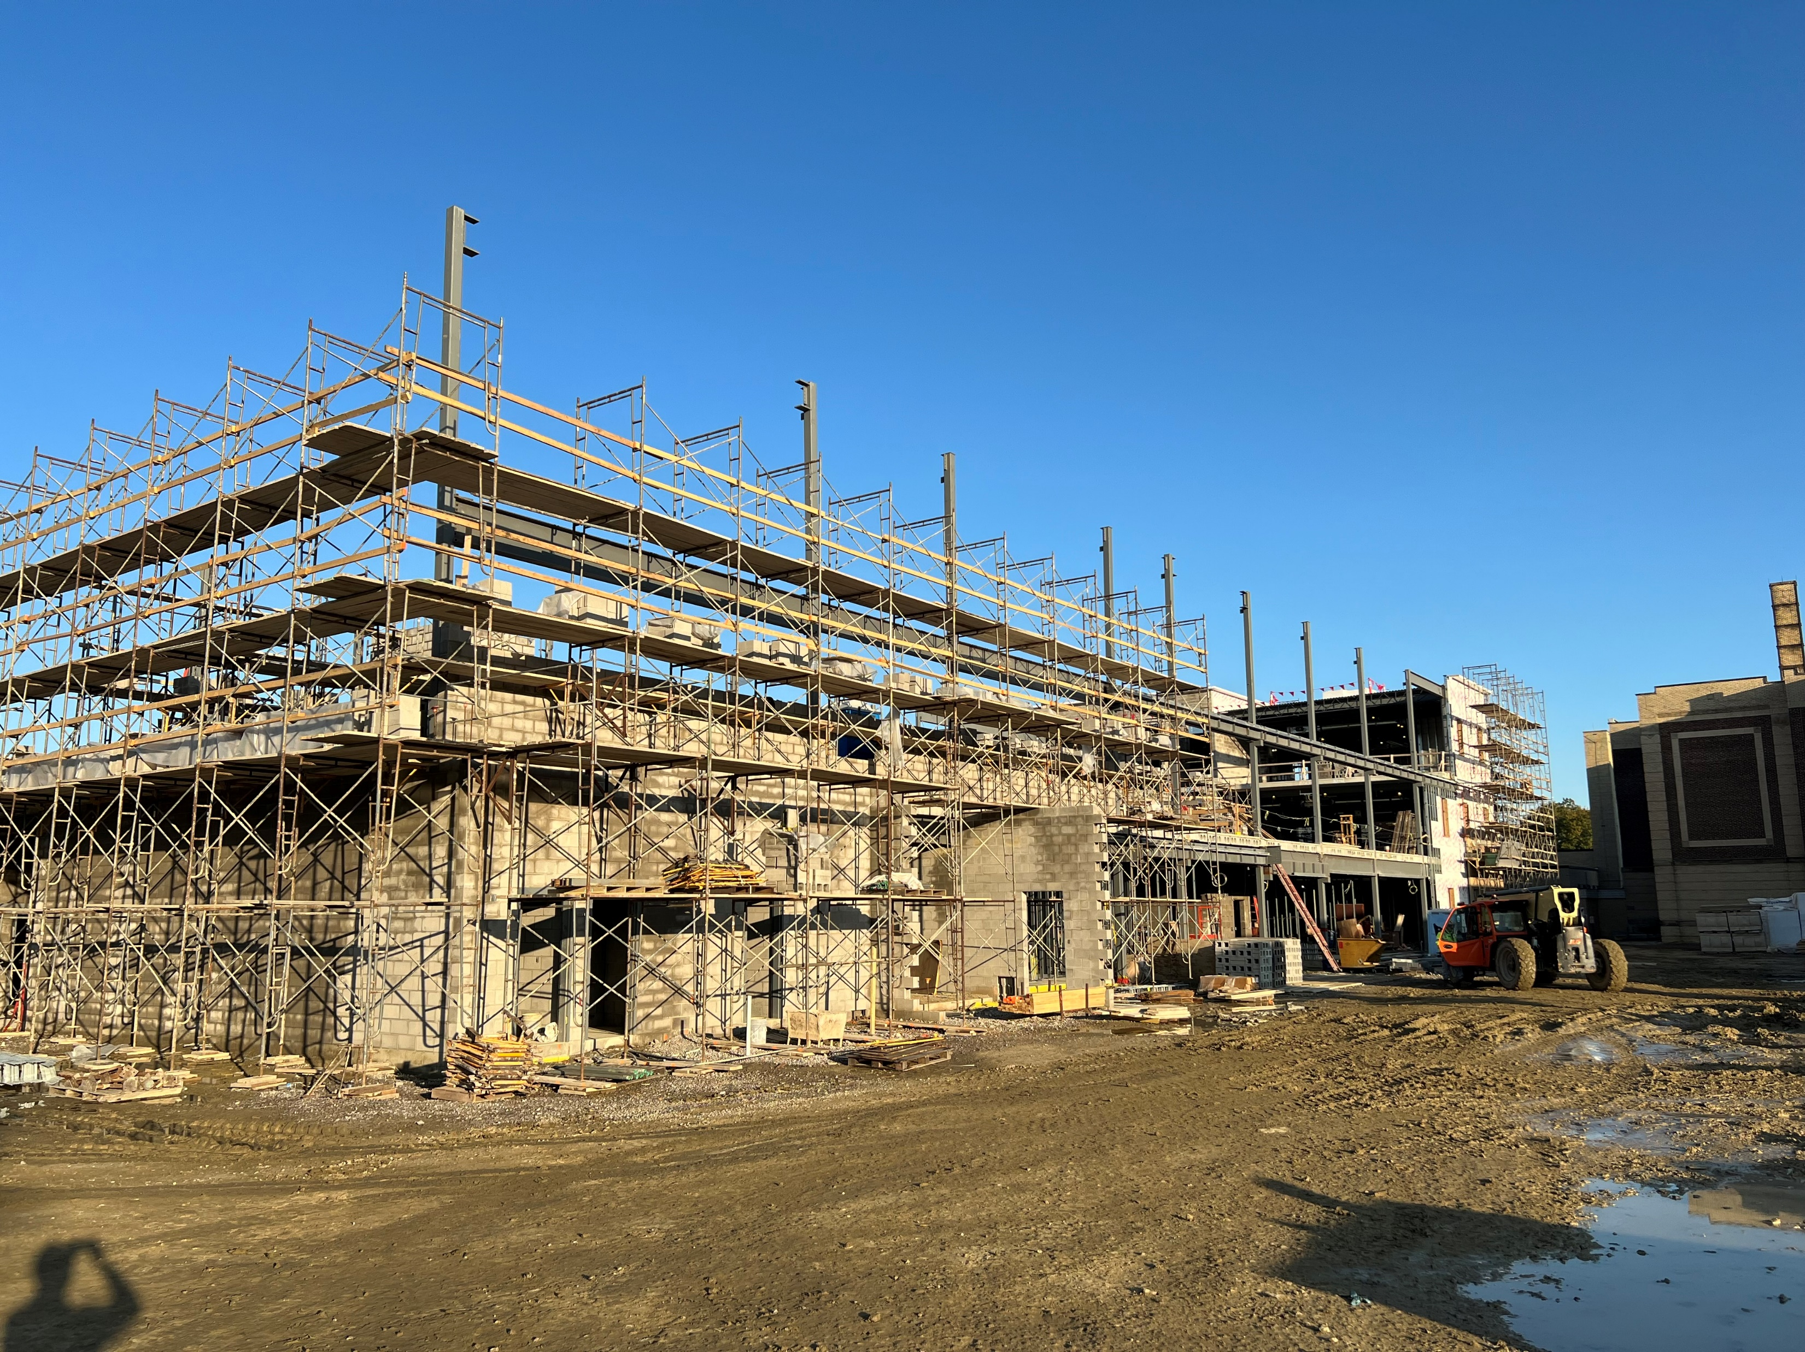
Construction Progress
Current Progress
  Foundations
  Masonry to Roof in 2A
  Mechanical Rough-Ins
  Electrical Rough-Ins
  Plumbing Rough-Ins
  Veneer to 3rd Floor
  Joist and Deck in 2A
Upcoming Progress
  Masonry to Roof
  Precast Floor Plank for 3rd Floor
  Joist and Deck in 2B and 2C
  Veneer in 2B and 2C
  Roof Blocking
  Roof Membrane
  Temp Enclosures
  Drywall
  Paint

Slide 7
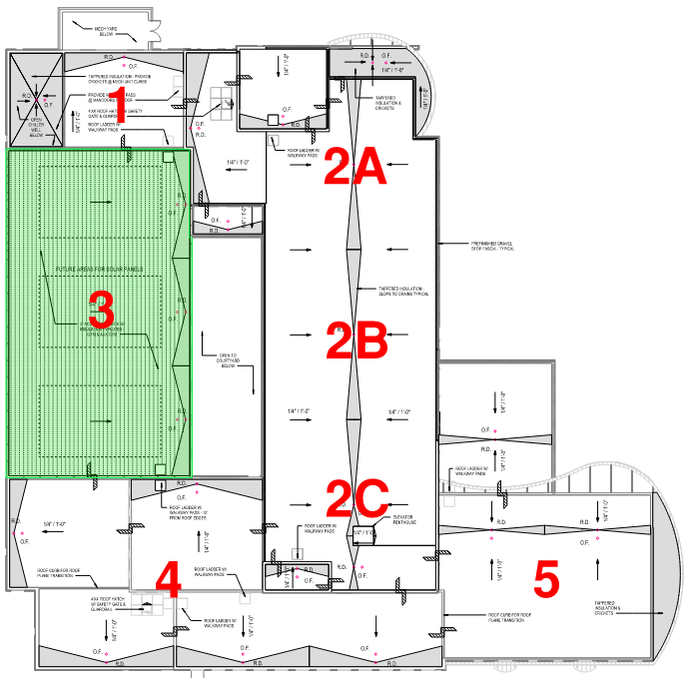
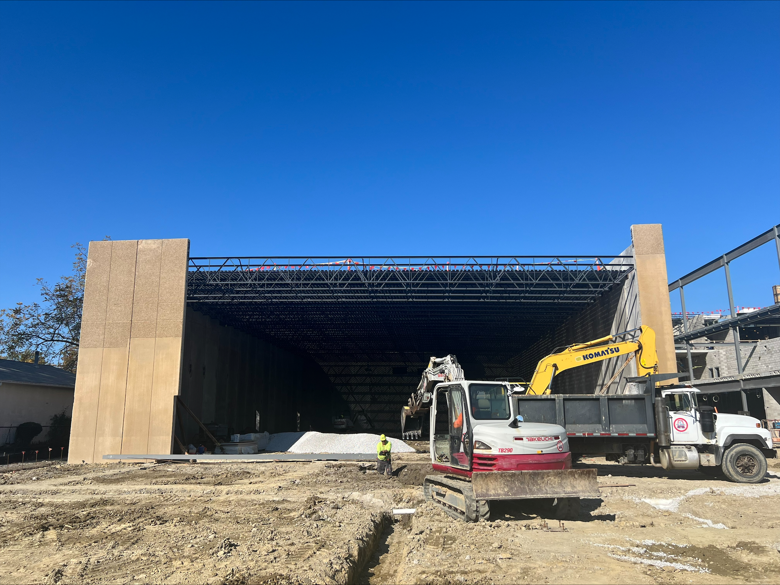
Construction Progress
Current Progress
  Foundations
  Precast Wall Panels
  Joist and Deck
  Auxiliary Gym to Grade
  Underground Electrical
  Roof Blocking
Upcoming Progress
  Roof Membrane
  Prep and Pour Gym Floor
  Overhead Mechanical Rough Ins
  Demising Wall

Slide 8
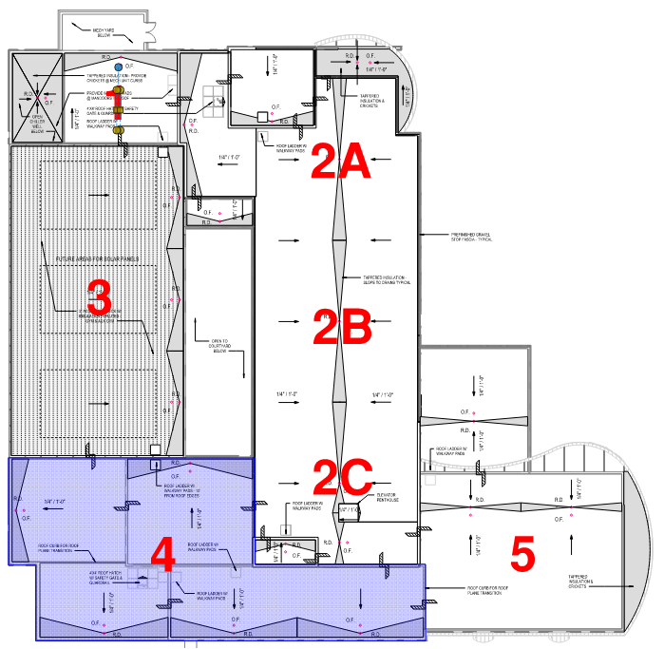
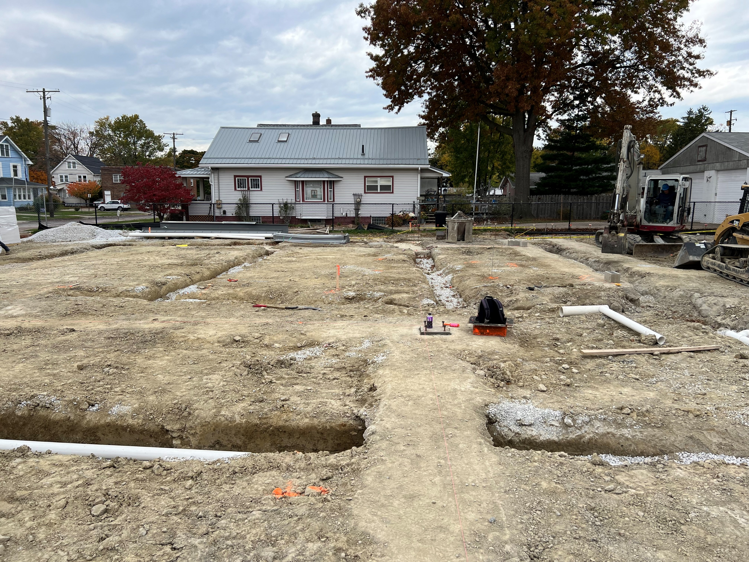
Construction Progress
Current Progress
  Foundations
  Underground Utilities
Upcoming Progress
  Masonry Walls
  Prep and Pour Concrete Floor
  Structural Steel to Roof
  Joist and deck

Slide 9
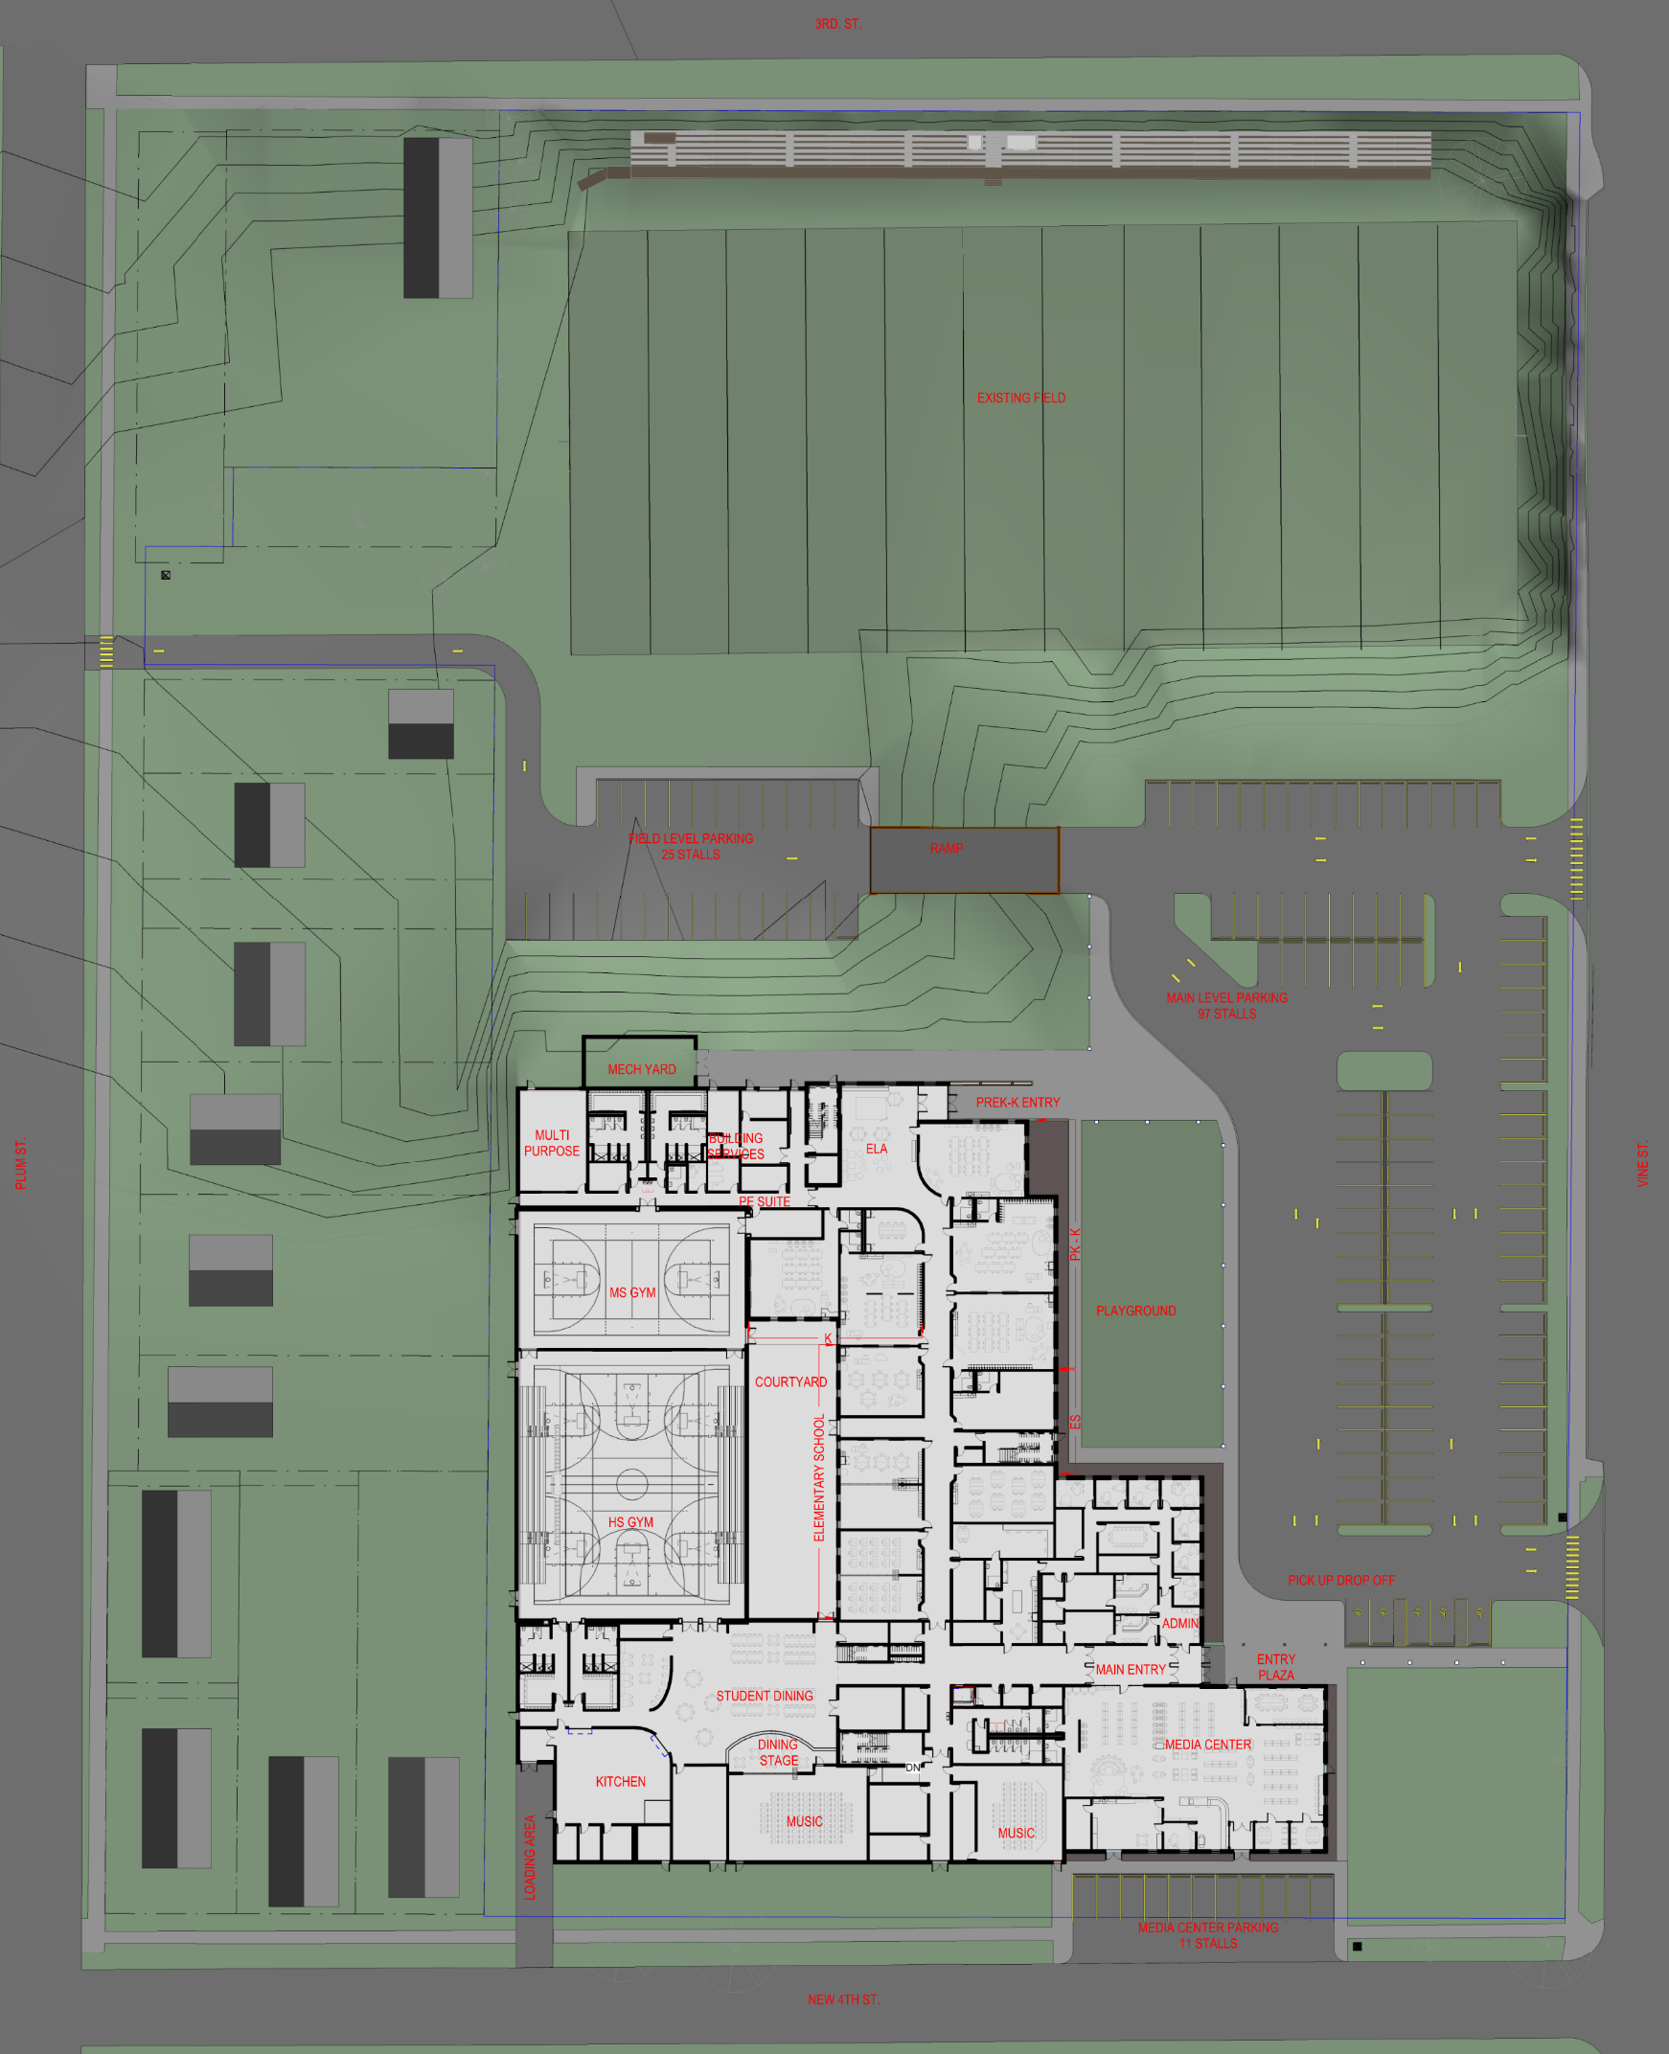
Site Plan

Slide 10
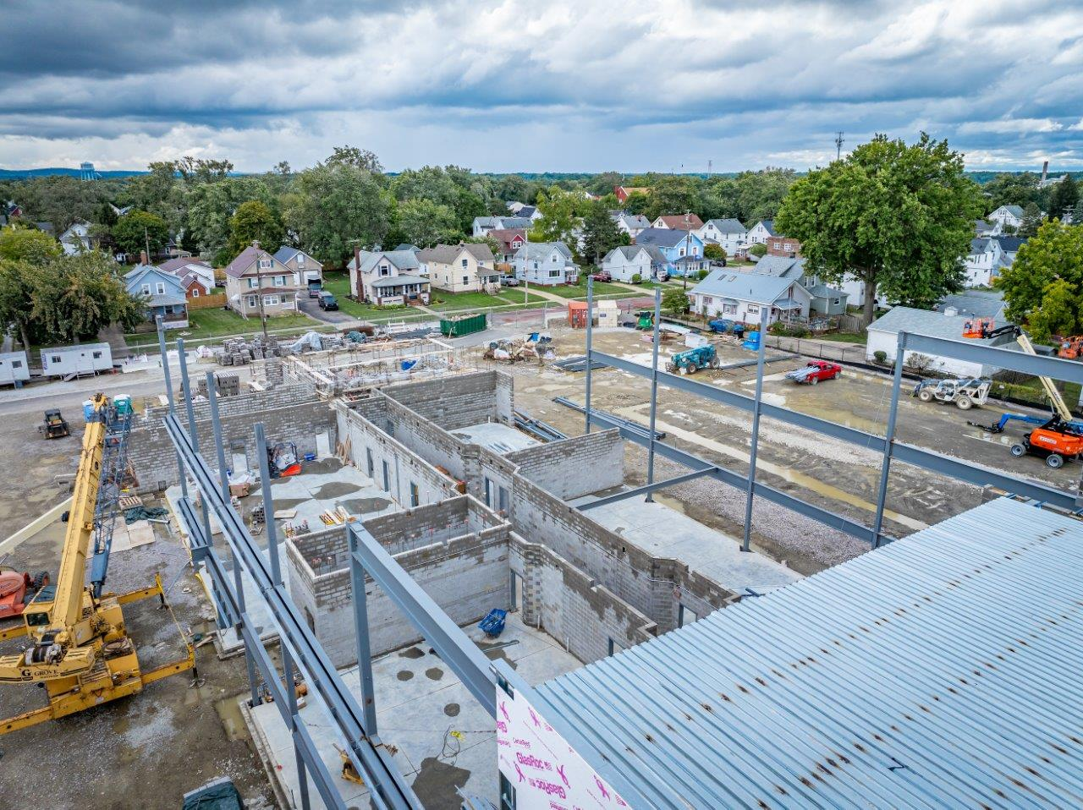
Schedule

Slide 11
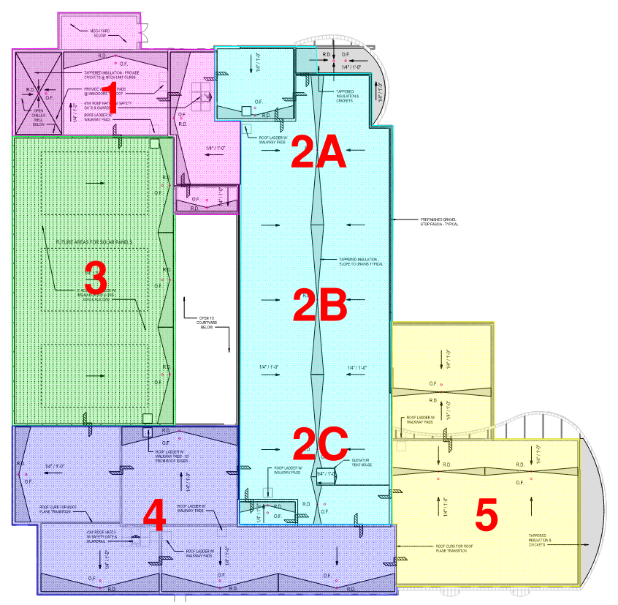
Overall Schedule Update
Substantial Completion Dates
Academic Wing June 2025
Gymnasium July 2025
Kitchen July 2025
Administration September 2025
Student Dining September 2025
Library September 2025
Substantial Completion Dates
Gymnasium July 2025
Academic Wing June 2025
Kitchen July 2025
Administration September 2025
Student Dining September 2025
Library September 2025

Slide 12
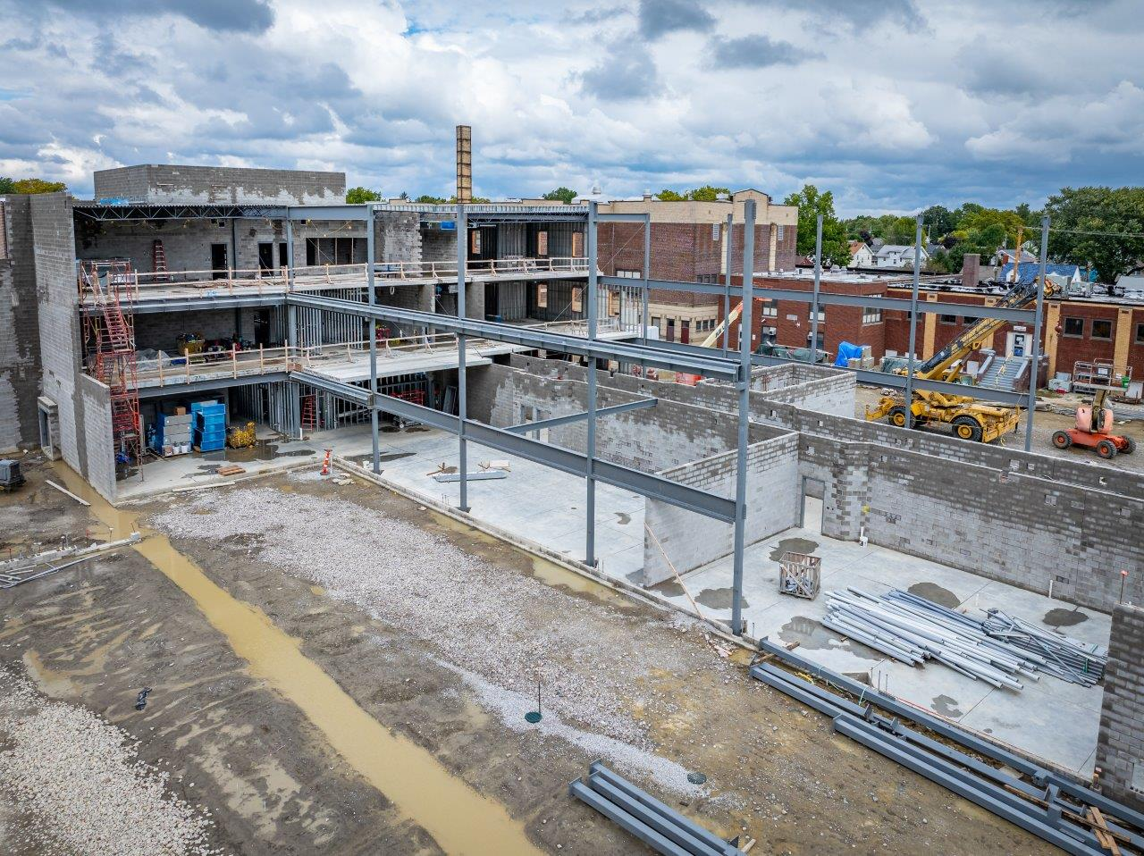
Next Steps

Slide 13
Next Steps
Continue with building construction all phases 1, 2, 3 and 4.
Area 5 to start November 2024
Bidding out Furniture, Fixtures and Equipment package November 2024
Harding Abatement and Demolition to Commence June 2025
Pursuing options to start abatement early

Slide 14
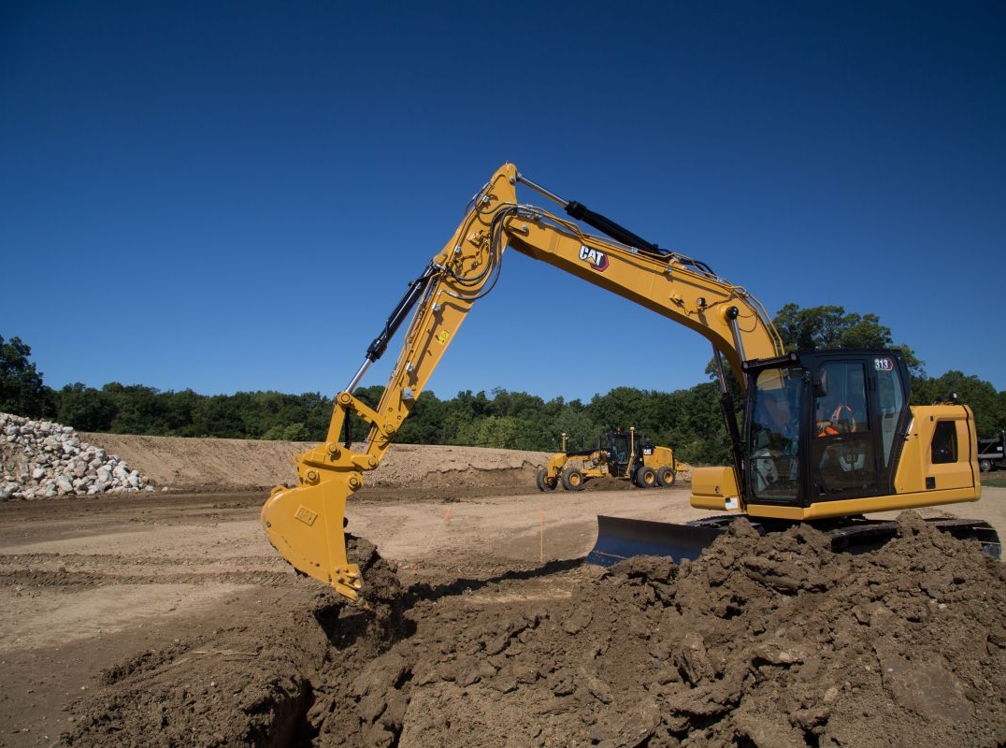
Q&A

