Slide 1

Better FAFSA Training Scenarios

Slide 2

What Will I Learn Today?
Today we are going to review FAFSA training Scenarios

Slide 3

The potential solutions offered here may not be the only path for completing a FAFSA depending on the answers to questions about which parent(s) provide the most financial support for the student.

Slide 4

Scenario A - Amy
Amy is a high school senior, she wants to file her FAFSA.
Her parents are divorced, and neither is remarried.
Amy was living with her father until two weeks ago. He took a job in a different city, and Amy has moved in with her mother and will live there until she graduates from high school.
There is no formal child support arrangement because Amy had lived with her father since the divorce.
Which parent should Amy include in the FAFSA? What is the rationale?

Slide 5
Scenario A - Potential Solution
The parent to be reported on the FAFSA is the parent that provided the greatest amount of financial support for the previous 12 months.
That question would need posed to the student/parents.
Assuming the answer is the father, his financial information would likely be reported on the FAFSA.

Slide 6
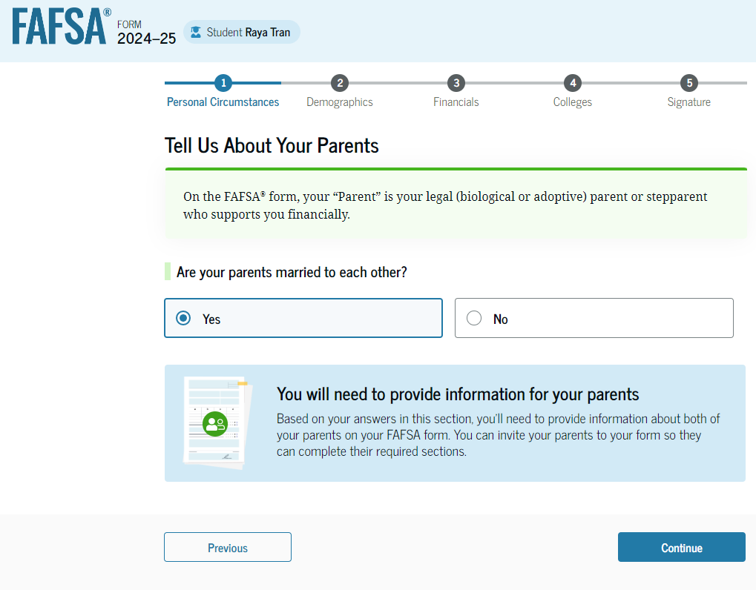
FAFSA Form Changes -Who is the Contributor (Parent)
Parent info to be provided on the FAFSA will no longer be defined as primary custodial parent. New definition is “parent which provided the greater portion of the student’s financial support”
For dependent students-income reported and family size may be for a household that they do not reside in.
FSA has created a parent wizard that will help the student understand whose information should be provided.

Slide 7

Scenario B - Jose
Jose is ready to file his FAFSA.
Jose is a US citizen, but his parents are undocumented.
His parents do not have ITINs.
Each parent has attempted to set up an FSA ID via the new system for those without SSNs. His father was successful, but his mother could not establish an FSA ID with the online process.
Jose has a FAFSA priority deadline in three days.
What steps should Jose and his parents take to get the FAFSA submitted by the deadline? What is the rationale?

Slide 8
Scenario B - Potential Solution
The family may wish to download a paper version of the FAFSA in which they can answer all sections of the form, sign it and mail it in to meet the deadline.
The family could also choose to reach out to the federal information center and seek advice for finalizing the mother’s FSA ID.
If no solution can be reached prior to the deadline, the paper form may be the option to use.

Slide 9
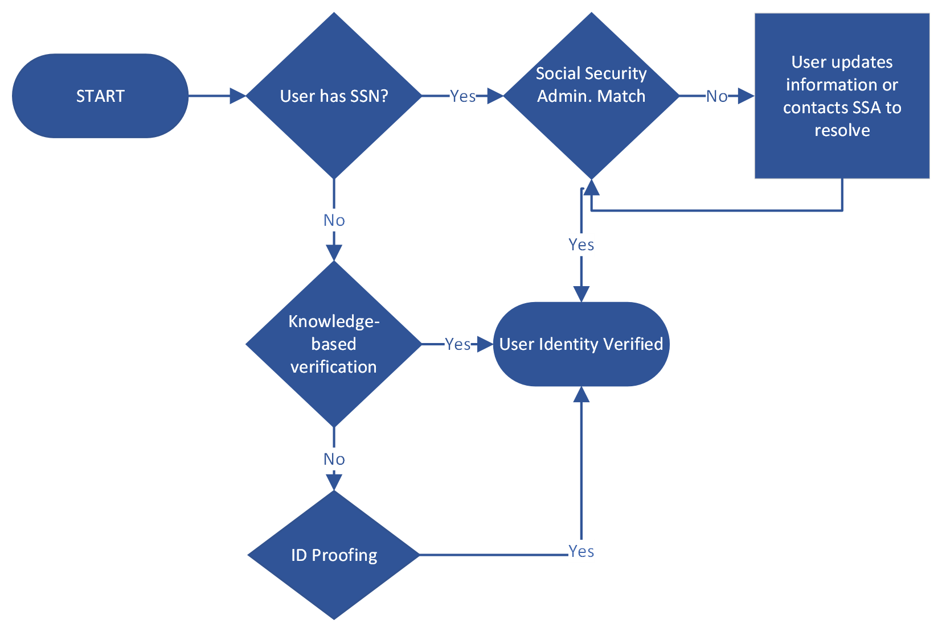
FSA ID Changes - ID Match & Verification Flow

Slide 10
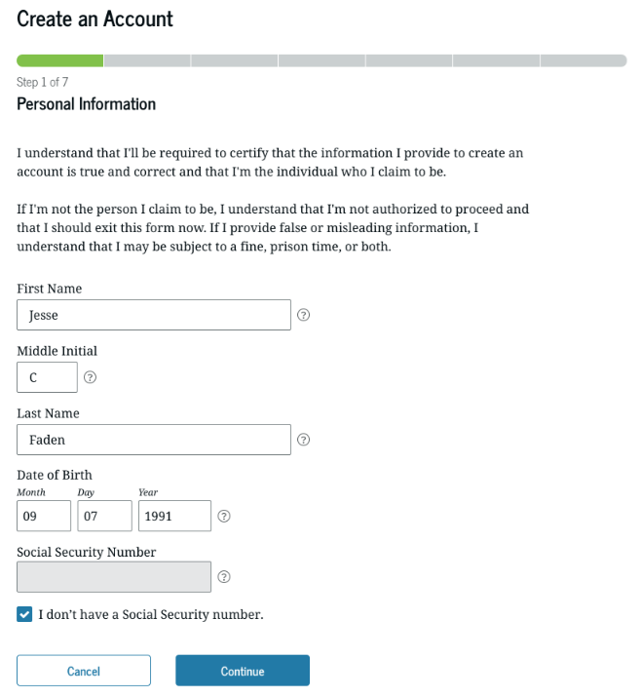
FSA ID Changes - FSA ID for Those Without SSN
FSA is developing a process for people who do not have a social security number to be able to set up an FSA ID
At this point we have limited information on what type of information will be required to verify identity and establish the FSA ID.
There is no wait to verify the FSA ID of a contributor using this process.

Slide 11
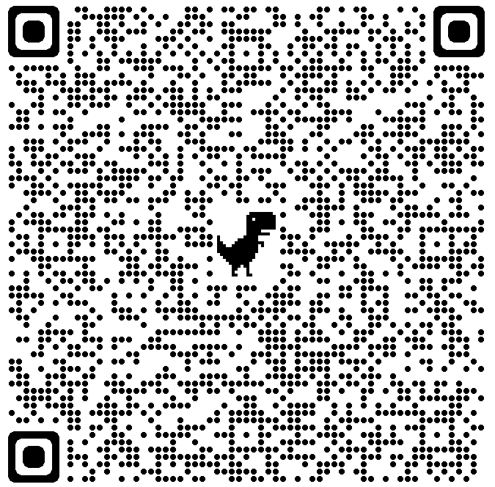
FSA Webinar – FSA Process for Those Without an SSN
Nov. 2, 2023
10–11 a.m. PST
Join FSA for a preview of the new account creation process for users without a Social Security number (SSN), which will be available in December 2023. We will discuss changes to the user experience and provide a walkthrough of the knowledge-based identity verification process with TransUnion. The session will conclude with an opportunity to ask questions

Slide 12

Scenario C - Mohammed
Mohammed wants to file his FAFSA.
He cannot convince his parents to provide consent for the IRS to share their federal tax information for his FAFSA. They manually enter their income information and then submit the form.
Mohammed's college receives his rejected FAFSA and notifies him that he is not eligible for federal financial aid unless his parents consent to transfer their tax information is received.
Upon receiving this news, his father agrees to provide consent for their joint tax return.
What steps should Mohammed and his parents take to grant consent on the FAFSA?

Slide 13
Scenario C - Potential Solution
Assuming at least one of the parents has an FSA ID, that parent can log back into their section of the FAFSA and click the “approve” button to grant consent for the joint tax return.
Colleges cannot create any type of institutional form that a parent could sign to grant consent-it must be done within the FAFSA document.

Slide 14
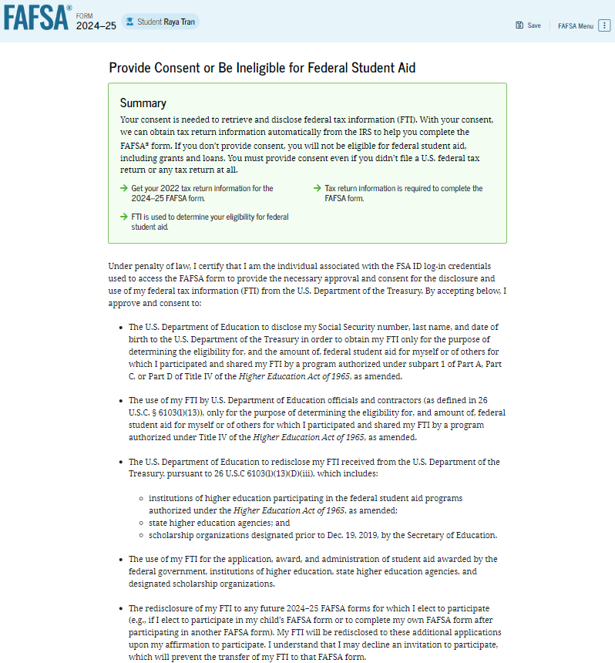
FAFSA Form Changes – Providing Consent
All students, parents, and spouses, regardless of whether they file a US tax return, will be required to provide consent for the IRS to transfer any data they have directly into the FAFSA form.
If no information is on file with the IRS, specific codes will be sent indicating that person’s status with the IRS.

Slide 15

Scenario D - Takisha
Takisha is in the process of filling out her FAFSA.
She is a dependent student, and her parents filed a joint tax return for 2022.
The form requires her to fill in parent information to invite them to contribute to her FAFSA form. The fields required are her parent's legal name, social security number, date of birth, and email address.
She fills in the information for her mother, but her mother does not receive an invitation to provide information in Takisha's FAFSA.
What could be the reasons that her mother did not receive the invitation? How could Takisha fix the situation so that her mother gets the invitation?

Slide 16
Scenario D - Potential Solution
One possible idea is that Takisha could have entered an incorrect email address and the invitation was never received.
The email address that the contributor invitation is sent to does not need to be the one used to establish her mother’s FSA ID. However, when the mother does receive the invitation and attempts to log in, her name, DOB and social security number will need to match what Takisha entered in the form.
Takisha also has the option to go back into her FAFSA and invite the father who could then log in and complete the form.

Slide 17
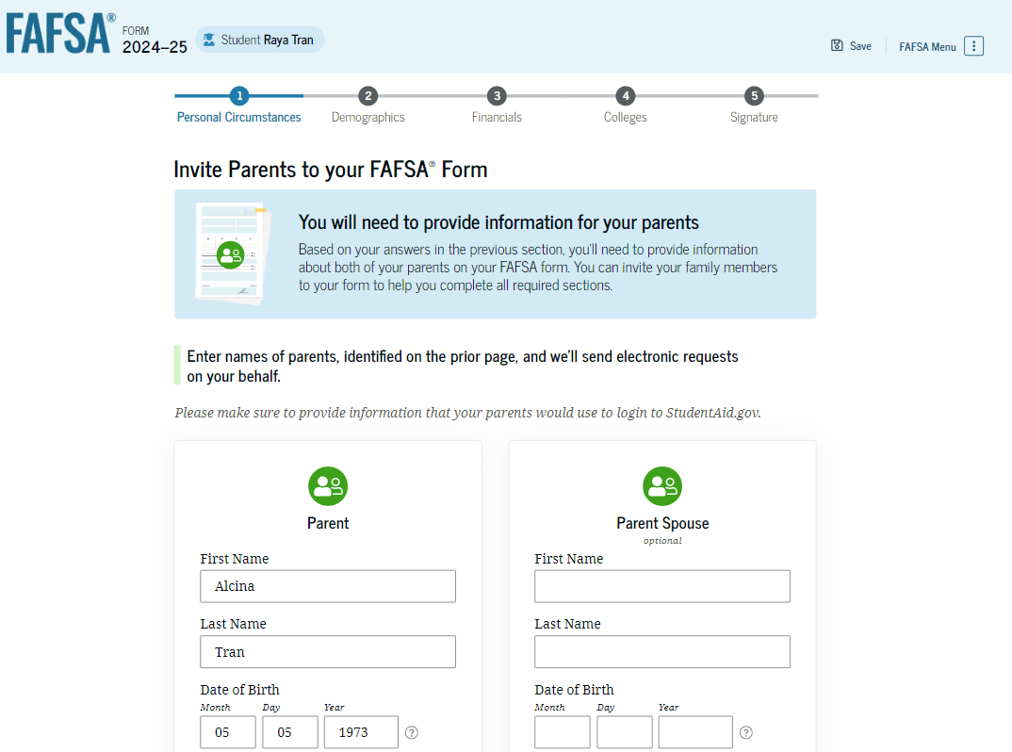
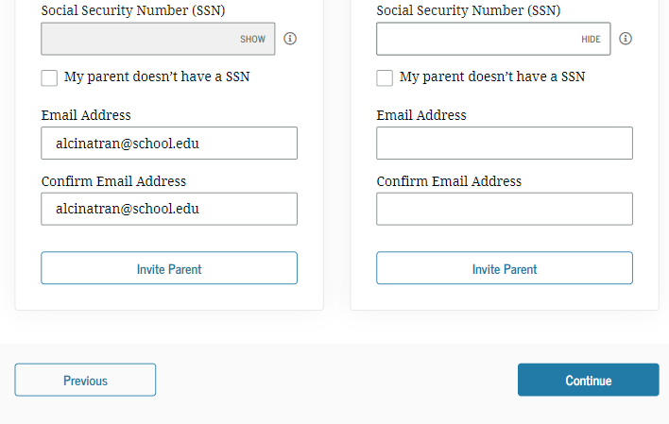
FAFSA Form Changes – Contributor (Parents) Information
The student is asked to enter their parents Name, DOB, SSN (if applicable) and email address. The email does not have to match their FSA ID email address. They have 45 days to access the application.

Slide 18

Scenario E - Jeremy
A college access advisor assists Student Jeremy and his mother at a FAFSA workshop.
Jeremy's mother and father have been separated for a year. While attempting to answer the Parent Wizard questions for separated parents, the mother indicates that each parent provides an equal amount of financial support for Jeremy, and their shared custody arrangement means that Jeremy lives an equal amount of time with each parent.
How should the access advisor guide them in completing the FAFSA? What types of questions might the advisor ask to determine which parent's financial information belongs on the FAFSA? What is the rationale?

Slide 19
Scenario E - Potential Solution
The FAFSA indicates that the parent whose financial information belongs on the form, in cases of separation and divorce, is the parent who provided the most financial support for the last 12 months.
You may wish to identify potential sources that could break the financial tie-does one parent have the student on their health insurance plan and pay a premium for that; does one parent pay child support to the other parent; does one parent cover car insurance for the student?
If nothing breaks the tie, FSA recommends the parent with the highest income/assets be reported on the form

Slide 20
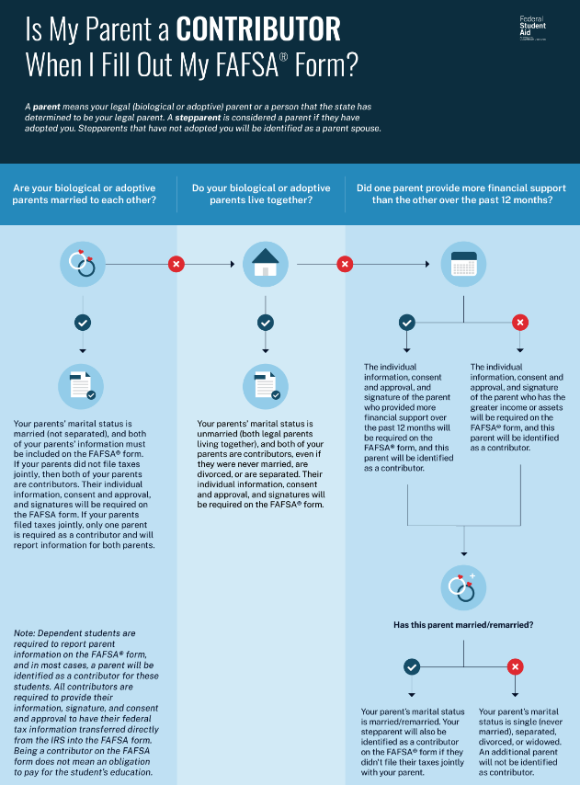

Is My Parent a Contributor Infographic

Slide 21

Scenario F - Sarah
Sarah is dependent and lives with both biological parents, who live together but are not married.
Sarah's parents do not file taxes because their income is below the tax filing threshold.
How many FSA IDs must be set up so Sarah can file her FAFSA? What is the rationale?

Slide 22
Scenario F - Potential Solution
There are three FSA IDs that need to be set up.
One for the student and one for each biological parent so consent can be granted even though they did not file a tax return.
All contributors on the FAFSA must grant consent for the student to be eligible for federal student aid.

Slide 23
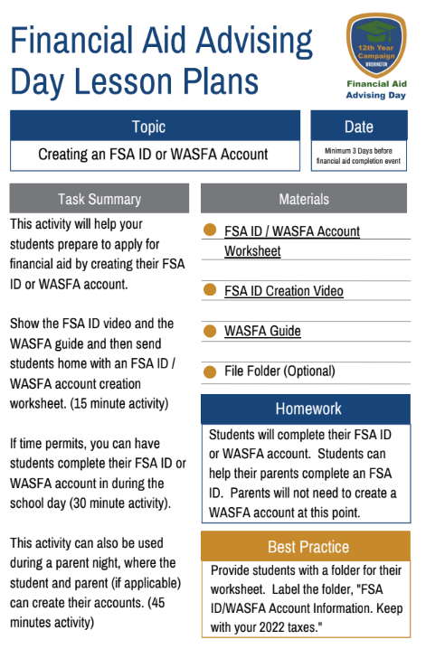
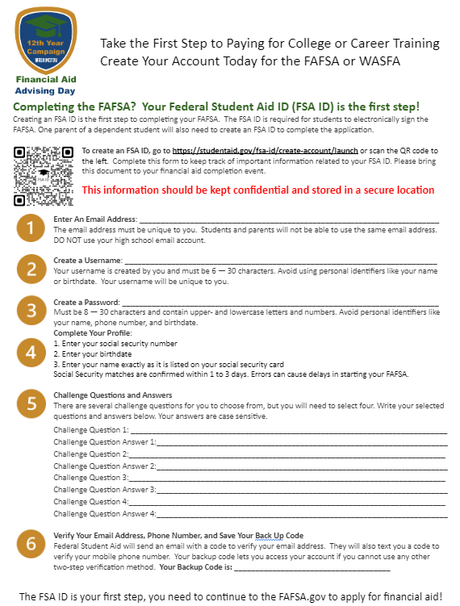
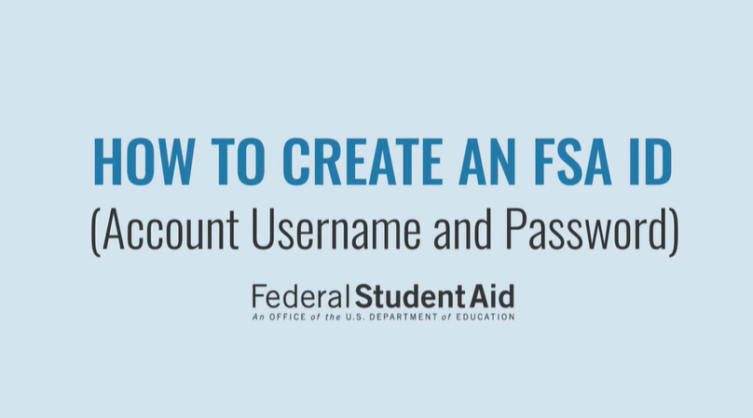
FSA ID / WASFA Account Creation Lesson Plans
  Financial Aid Advising Day lesson plans provide easy to implement activities developed around the required student and family notifications and information.

Slide 24

Scenario G - Caleb
Student Caleb is working on his section of the FAFSA.
He correctly invites his father to be the contributor for his parent's joint tax return.
Caleb's parents combined adjusted gross income is $46,000, but they have not completed their section of the FAFSA yet.
While completing his section, Caleb is required to answer the student asset questions. Why does Caleb see those questions?
Will any assets he reports be taken into consideration when calculating his SAI? What is the rationale?

Slide 25
Scenario G - Potential Solution
Since Caleb started the FAFSA, he will be required to answer the asset questions because the parents have not completed their section of the form and granted consent to bring over their financial information.
Therefore, we do not know yet if the family is exempt from answering asset questions. Once the parent(s) have logged in and completed their section and submitted the form, it will be processed.
If the family income and schedules filed indicate that assets are not to be included, any answers that Caleb provided will not be used in determining his SAI.

Slide 26
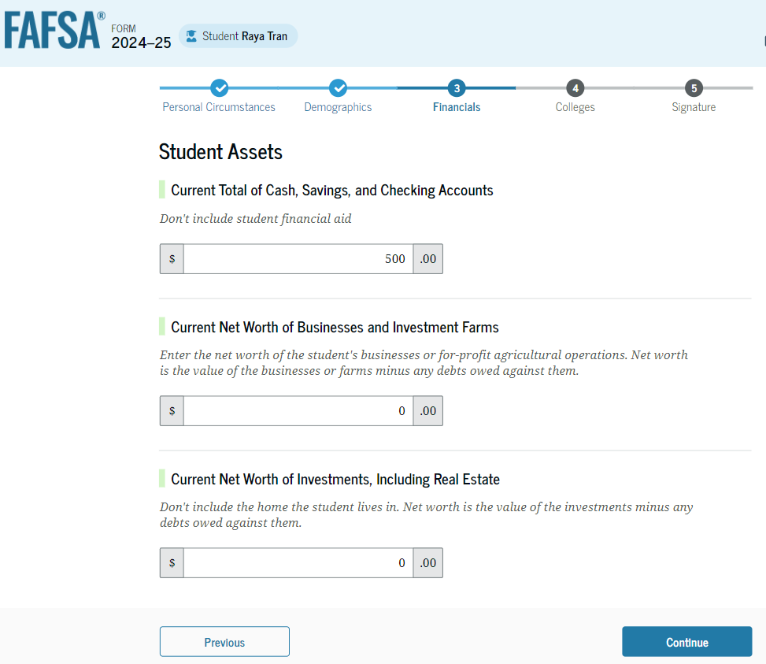
FAFSA Form Changes – Assets
Families with an adjusted gross income of greater than $60,000 (up from $50,000) or those who filed certain schedules will be required to submit assets.
If contributors complete their section first and are not required to provide asset information, the student will not be asked asset questions.

Slide 27

Scenario H - Bryn
Student Bryn has finished the student section of the FAFSA and now has to complete the parent section.
Her biological parents divorced a few years ago, and she lives with her mother and stepfather, who married in February 2023. In 2022, her mother and stepfather did not file their taxes together.
What will the process be to enter the parent income information on the FAFSA?

Slide 28
Scenario H - Potential Solution
The first step should be to confirm which of Bryn’s biological parents provide the most financial support.
If the answer is the mother and Bryn begins the FAFSA, she will need to invite her mother AND her stepfather to be contributors on the form.
Since they did not file a 2022 joint tax return, both will need an FSA ID to log in and grant consent to have their information brought over form the IRS.
Depending on their tax filing status for 2022, the mother and stepfather may be presented with manual paths to enter their financial data.

Slide 29

Scenario I - Aminah
Student Aminah and her mother come in to complete the FAFSA but realize neither has created an FSA ID yet.
They spent the first half of the meeting setting up their FSA IDs.
Will Aminah be able to start the FAFSA today? If so, are there any limitations to completing the FAFSA, and how should they navigate those limitations?

Slide 30
Scenario I - Potential Solution
Aminah and her mother will be able to complete the FAFSA form on the same day as setting up their FSA IDs.
Assuming the mother is the only parent’s information needed on the FAFSA and the mother has a social security number, she will have access to the parent section of the form.
However, since the FSA ID has not been able to be confirmed by the Social Security Administration for the student or parent, they will be presented a manual path through the form to enter all the necessary information (including financial information).
They can sign and submit the FAFSA to be processed. Once the FSA IDs have been confirmed, the form will be reprocessed with bringing over any necessary information from the IRS. Depending on the timing, the student may receive two FAFSA Submission Summaries in a short amount of time.

Slide 31

Scenario J - Isaak
Student Isaak is starting his FAFSA when he shares that he has two new siblings born in June 2023.
What concerns does this raise about using household size based on 2022 tax forms?
What questions could you ask Isaak to get an accurate household size?
How can you ensure the right household size is reported?

Slide 32
Scenario J - Potential Solution
The first steps should include identifying the parent(s) that Isaak lives with and which parent(s) information belongs on the form.
If the parent(s) who provided the greater amount of financial support for Isaak are in the household where Isaak lives and the new siblings are also in that household, the parent(s) will want to use the question to update the family size.
Since the siblings were born in 2023, they could not have been included on the parent(s) 2022 federal tax return as exemptions.

Slide 33
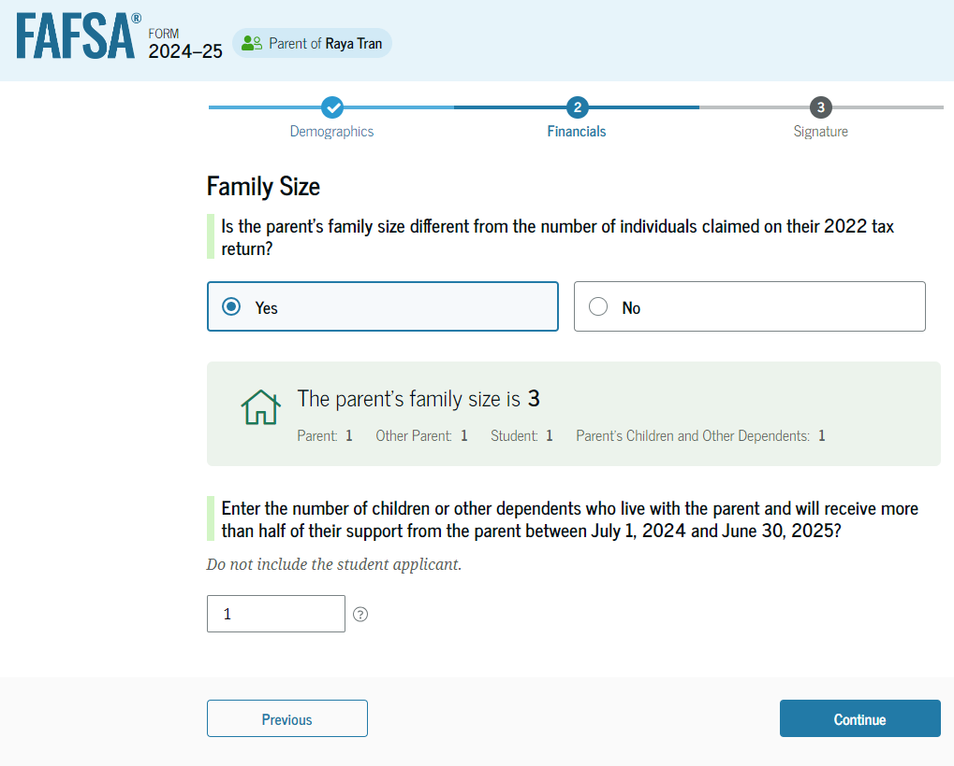
FAFSA Form Changes – Family Size
The new name for household size is family size and will be determined by the number of exemptions claimed on the federal tax returns.
Because family situations can change, there will be a question that allows the student to modify the family size to reflect the current number.

Slide 34

Scenario K - Jamar
Student Jamar has parents that have been separated for almost two years.
Jamar lives with his father. Jamar’s two younger siblings also live in the household.
The father claims all the children on his federal tax return. Jamar’s parents’ tax filing status for the last two years has been married filing jointly since they have not officially divorced.
How would the family determine which parent provides the most financial support? How should Jamar determine the family size to be reported?

Slide 35
Scenario K - Potential Solution
Jamar and his father need to answer the question about which parent provided the most financial support for Jamar for the last 12 months.
If the response is the father, Jamar would invite his father to be the contributor to the parent section of the form. Since the parents were still filing a joint tax return, the father will need to complete a manual path through the parent section so that he can appropriately report only his financial information.
The father should also update the family size question assuming the mother and all siblings have been claimed on the tax return. The father would actually be reducing the family size with that question.

Slide 36

Scenario L - Maria
Student Maria has continual spats with her parents about household rules. She remains living at home as the disagreements are not putting her in harm’s way. Their most recent spat was yesterday, and Maria begins to fill out her FAFSA today.
Because Maria is mad at her parents right now, she indicates that she has “unusual” circumstances and will not provide her parents’ financial information. Maria’s college receives her “provisional independent student” FAFSA and sends a request for follow up information.
Maria realizes that she does not really qualify for unusual circumstances and her parents agree to completing their portion of the FAFSA. What steps should Maria take to update her FAFSA and provide parental information?

Slide 37
Scenario L - Potential Solution
In order to collect her parents’ information on the FAFSA, Maria will need to log back in and update the answer to the question about unusual circumstances.
She should then invite her parents as contributors to the form. The tax filing status of the parents will determine whether Maria needs to invite one or both of her parents to be contributors.
Once the parent(s) receive the invitation, they can log in and complete the parent section of the FAFSA.

Slide 38


Want Access to the Presentation?

Slide 39
Resources

Slide 40
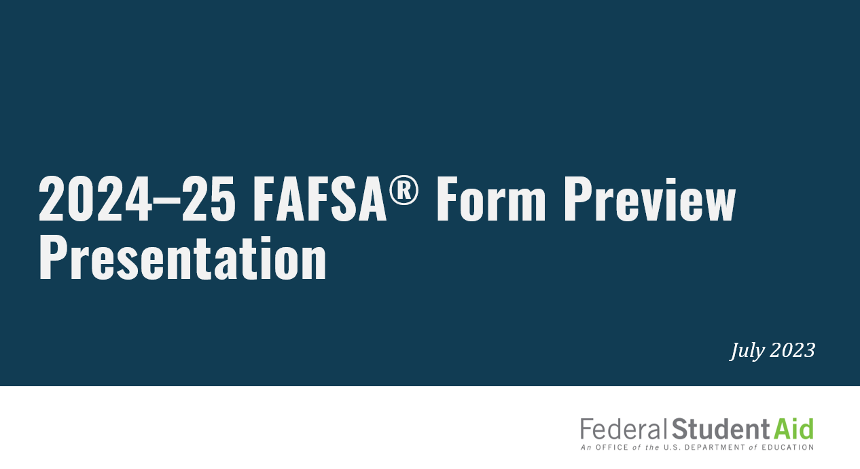
2024–25 FAFSA Form Preview Presentation
https://fsapartners.ed.gov/knowledge-center/library/application-processing/2023-07-31/2024-25-fafsa-form-preview-presentation

Slide 41
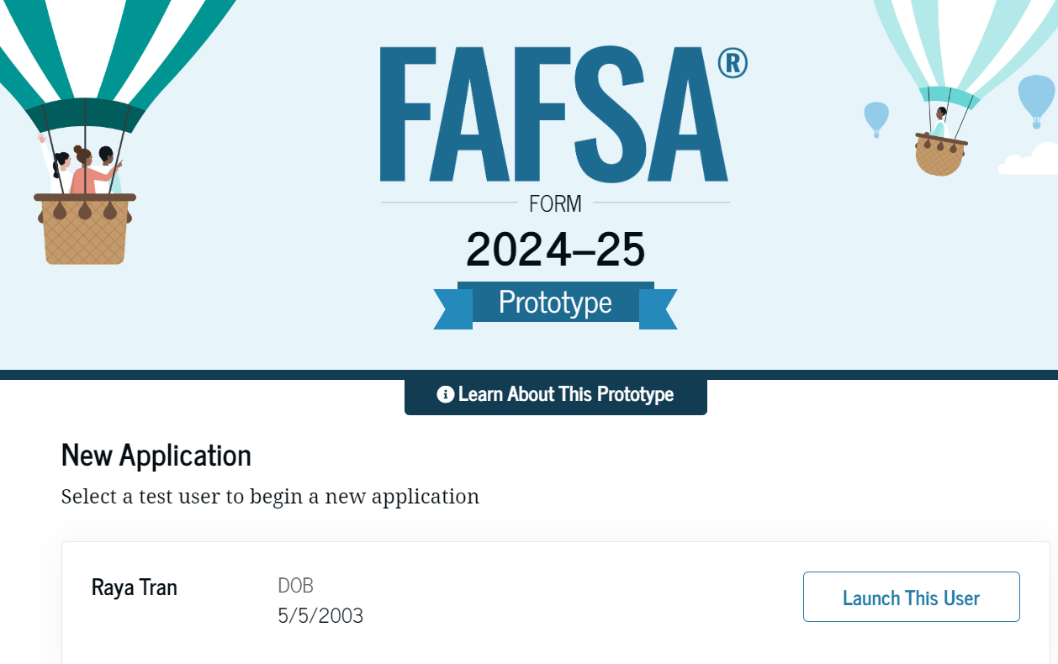
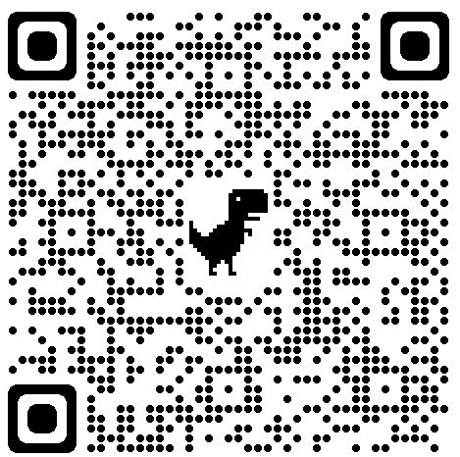
Resources: FAFSA Prototype
The FAFSA prototype is a web-based design tool that allows users to navigate specific scenarios that many 2024–25 applicants will encounter on the live website.

Slide 42
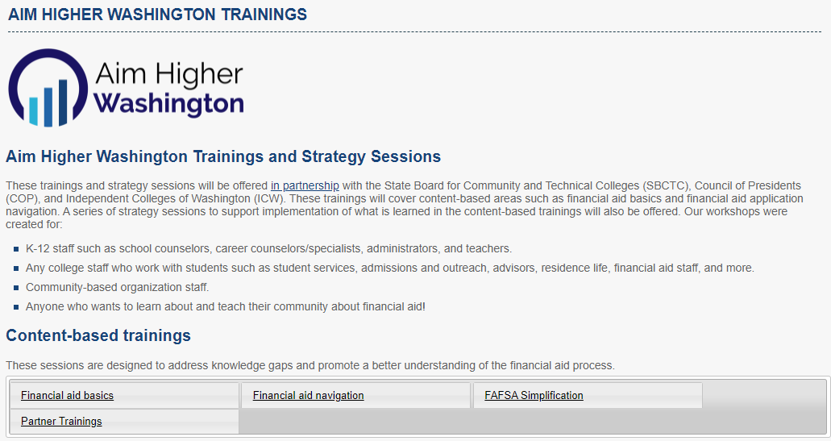
FAFSA Simplification Act Trainings
https://wsac.wa.gov/aim-higher-training

Slide 43
FAFSA Simplification Federal Student Aid Resources
https://financialaidtoolkit.ed.gov/tk/announcement-detail.jsp?id=better-fafsa-better-future

Slide 44

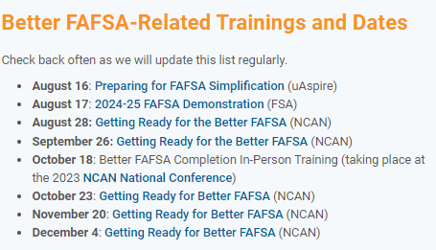
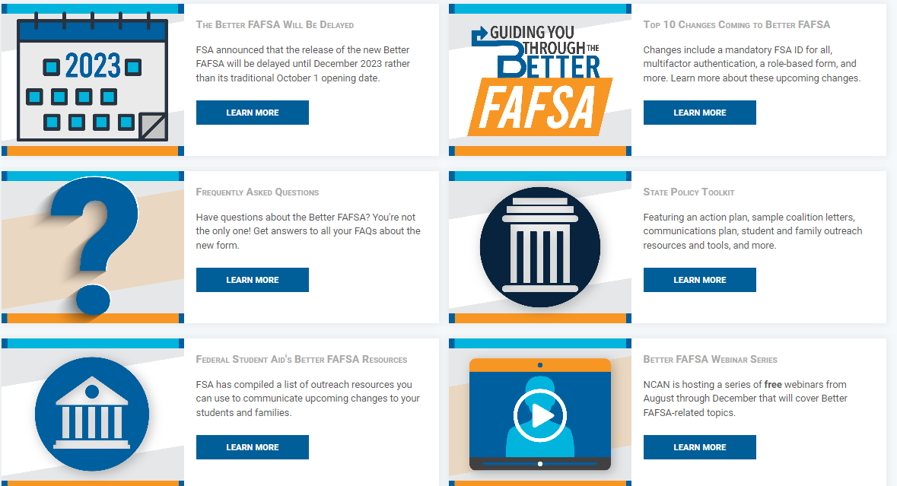
National College Attainment Network (NCAN) Trainings and Resources
https://www.ncan.org/page/better-FAFSA
https://www.ncan.org/page/better-FAFSA-webinar-series

Slide 45
Questions

Slide 46
We Are Here to Help!
Online:
www.thewashboard.org
www.get.wa.gov
On Twitter:
@WSACouncil
On Facebook:
www.facebook.com/WSACouncil
www.wsac.wa.gov

