Slide 1
Independent school district no. 281
Audit Report for Year Ended June 30, 2023

Slide 2
Auditor’s role
OPINION ON FINANCIAL STATEMENTS
INTERNAL CONTROLS AND COMPLIANCE
FINANCIAL STATEMENT AUDIT
STATE LAWS AND REGULATIONS
DISTRICT AUDIT
SINGLE AUDIT OF FEDERAL AWARDS EXPENDITURES
FEDERAL SINGLE AUDIT

Slide 3
Audit RESULTS
DISTRICT FINANCIAL AUDIT
Opinions on Basic Financial Statements
Unmodified “Clean” Opinion

Slide 4
Audit RESULTS (continued)
Internal Controls Over Financial Reporting
  Material Weakness – Compliance With Regulatory Reporting Deadlines
Compliance Over Financial Reporting
  No Findings Reported for Current Year
INTERNAL CONTROL
AND COMPLIANCE – FINANCIAL AUDIT

Slide 5
Audit RESULTS (continued)
MN LEGAL COMPLIANCE
Minnesota Legal Compliance
Timely Submission of Audited Financial Data and Financial Statements
Annual Broker Certifications not Obtained Prior to Investment Transactions

Slide 6
Audit RESULTS – Federal Single Audit
SCHEDULE OF EXPENDITURES OF FEDERAL AWARDS (SEFA)
Opinion on SEFA
Significant Deficiency in Internal Control Over Compliance With Federal Allowable Cost Requirements – Title I Program
Compliance with Federal Reporting Deadline
Fairly Stated in Relation to Financial Statements
Internal Control and Compliance

Slide 7
Follow0Up on Prior Year Findings
Internal Control Over Financial Reporting
Material Weakness Reported For Fiscal Year (FY) 2022, Corrected in FY 2023
Material Audit Adjustment
No Similar Finding For FY 2023

Slide 8
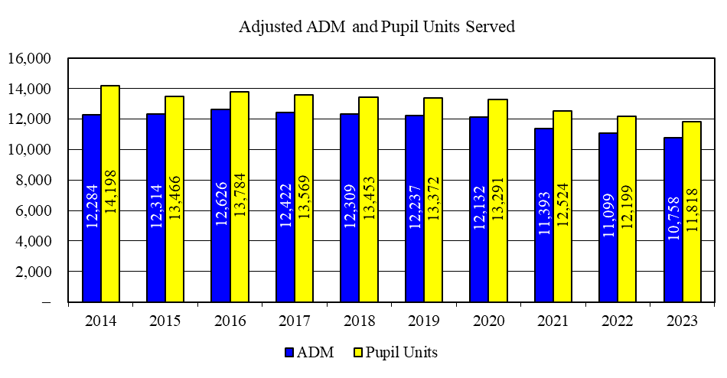
Adjusted Adm and Pupil Units served

Slide 9
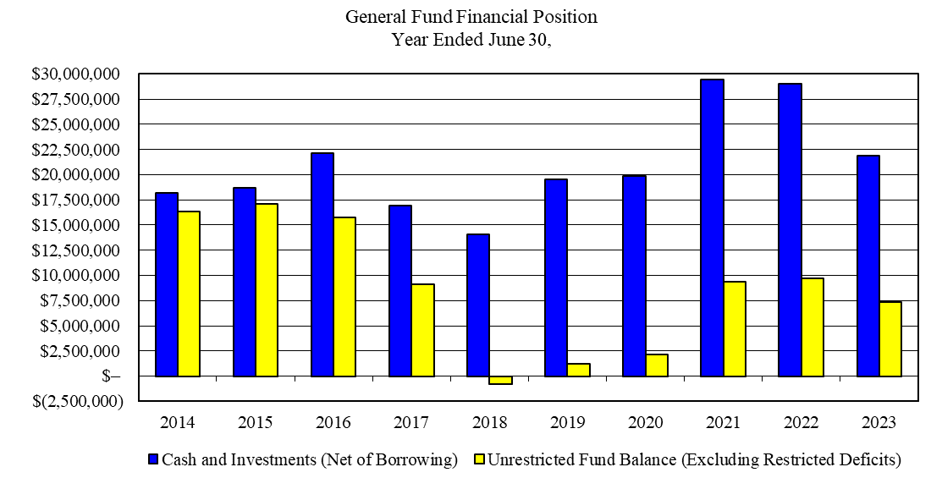
General fund
FINANCIAL POSITION TREND ANALYSIS

Slide 10
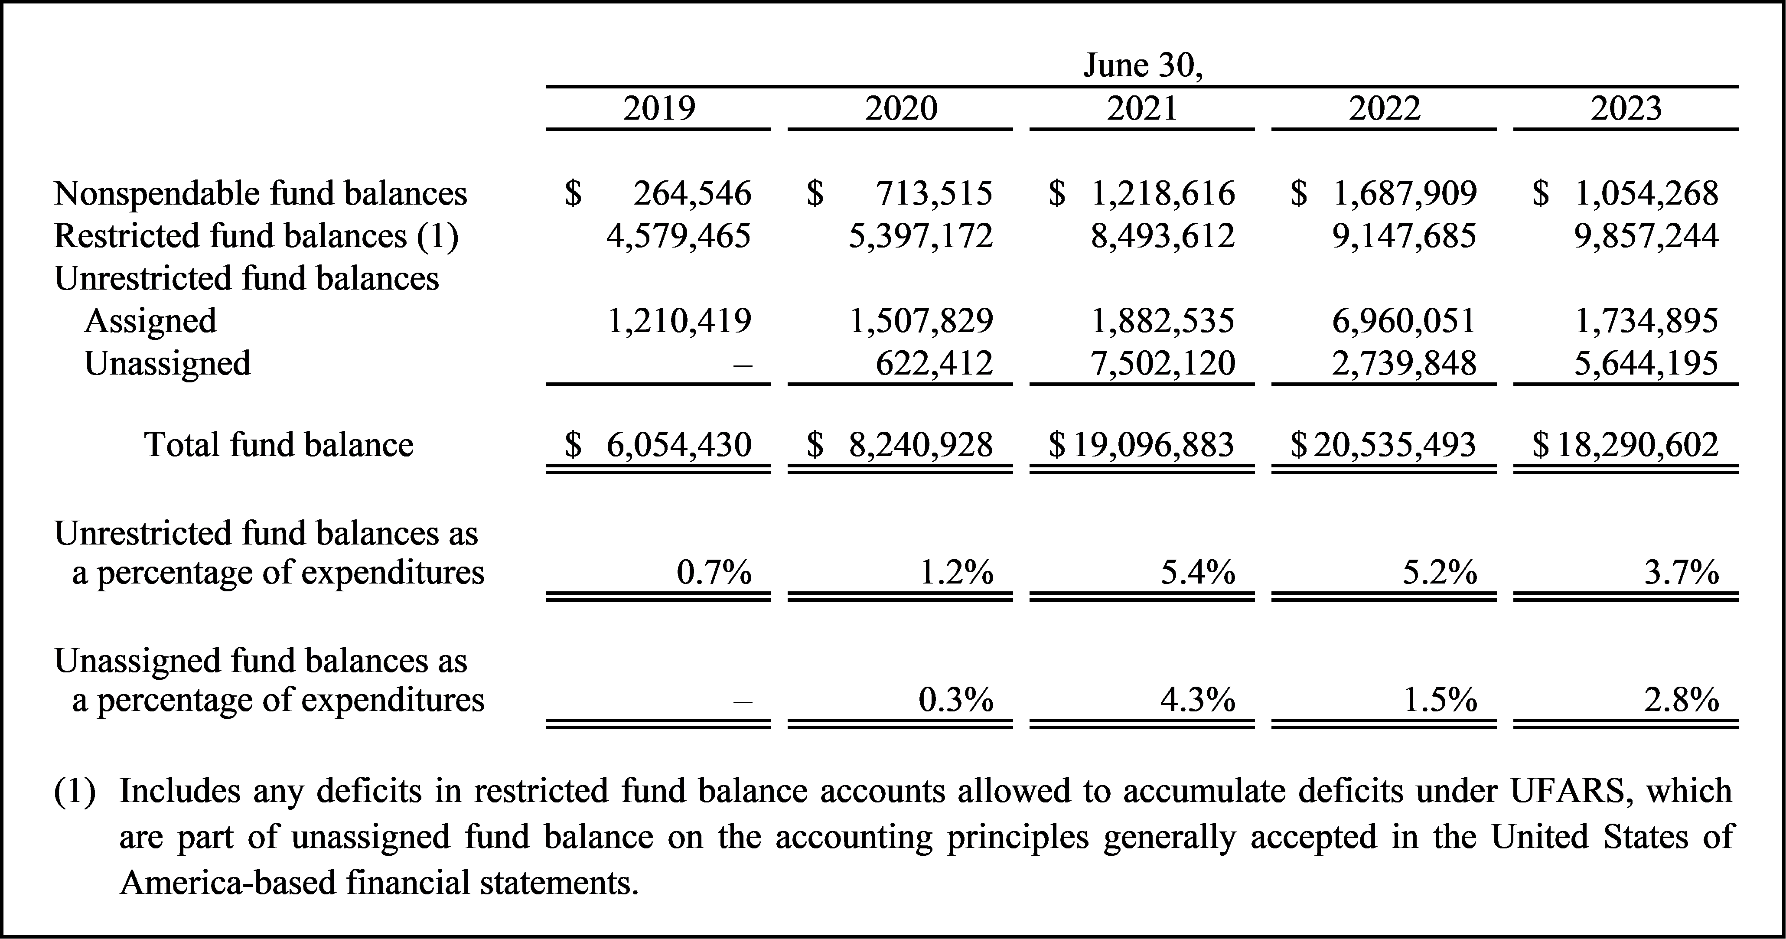
General fund financial position (continued)

Slide 11
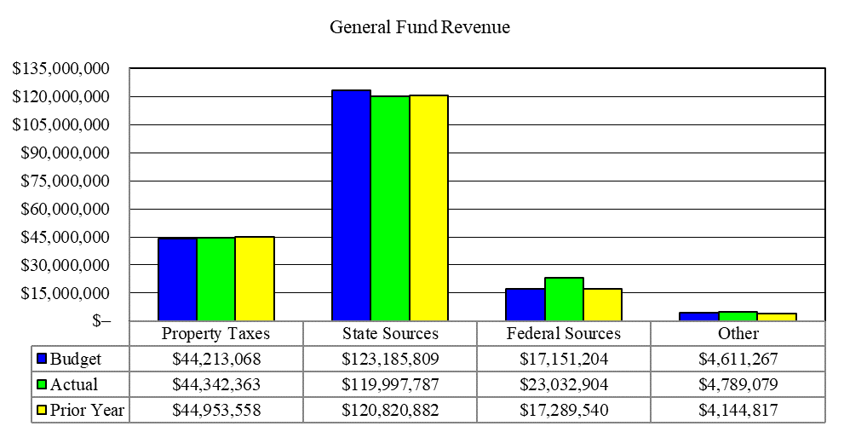
General Fund Revenue

Slide 12
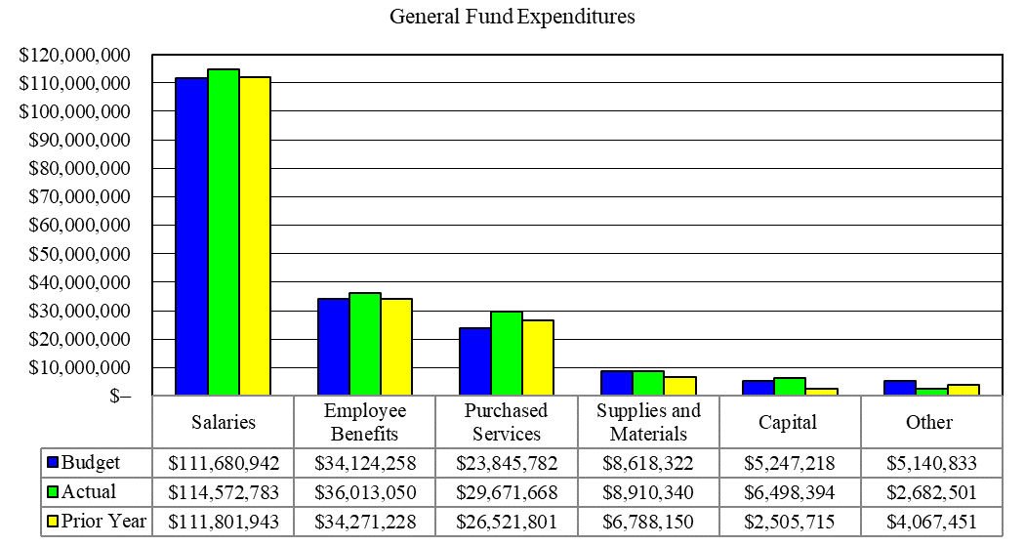
General Fund EXPENDITURES

Slide 13
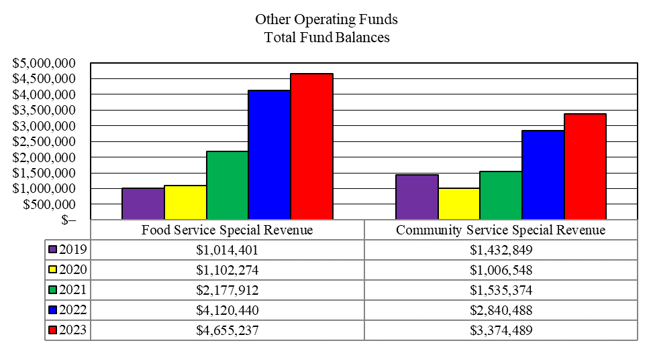
Other governmental
Operating funds

Slide 14
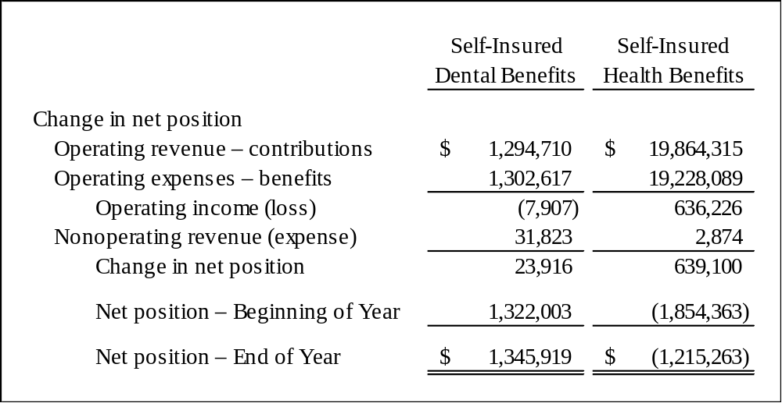
Internal service Funds
– net position

Slide 15
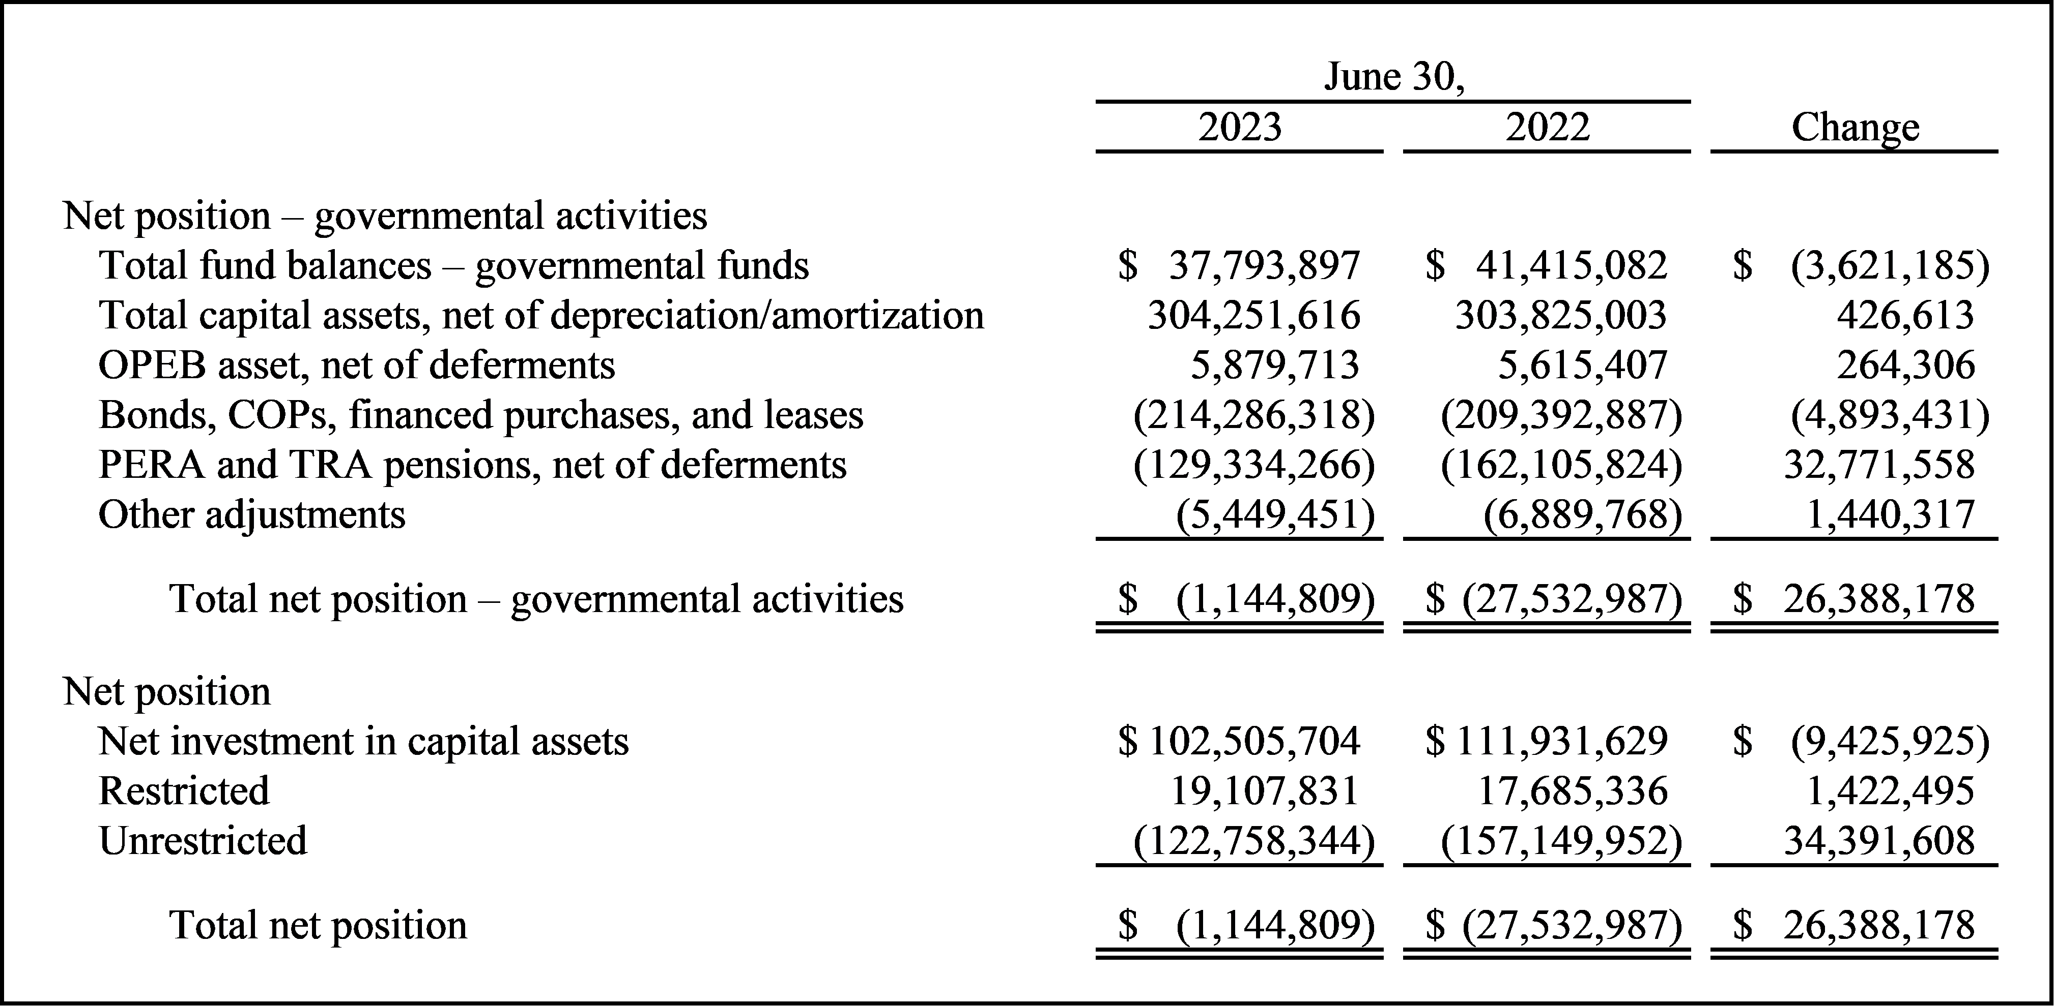
DISTRICT-WIDE
STATEMENT OF NET position

