Slide 1
English Learner Update
DELAC October 15, 2024

Slide 2
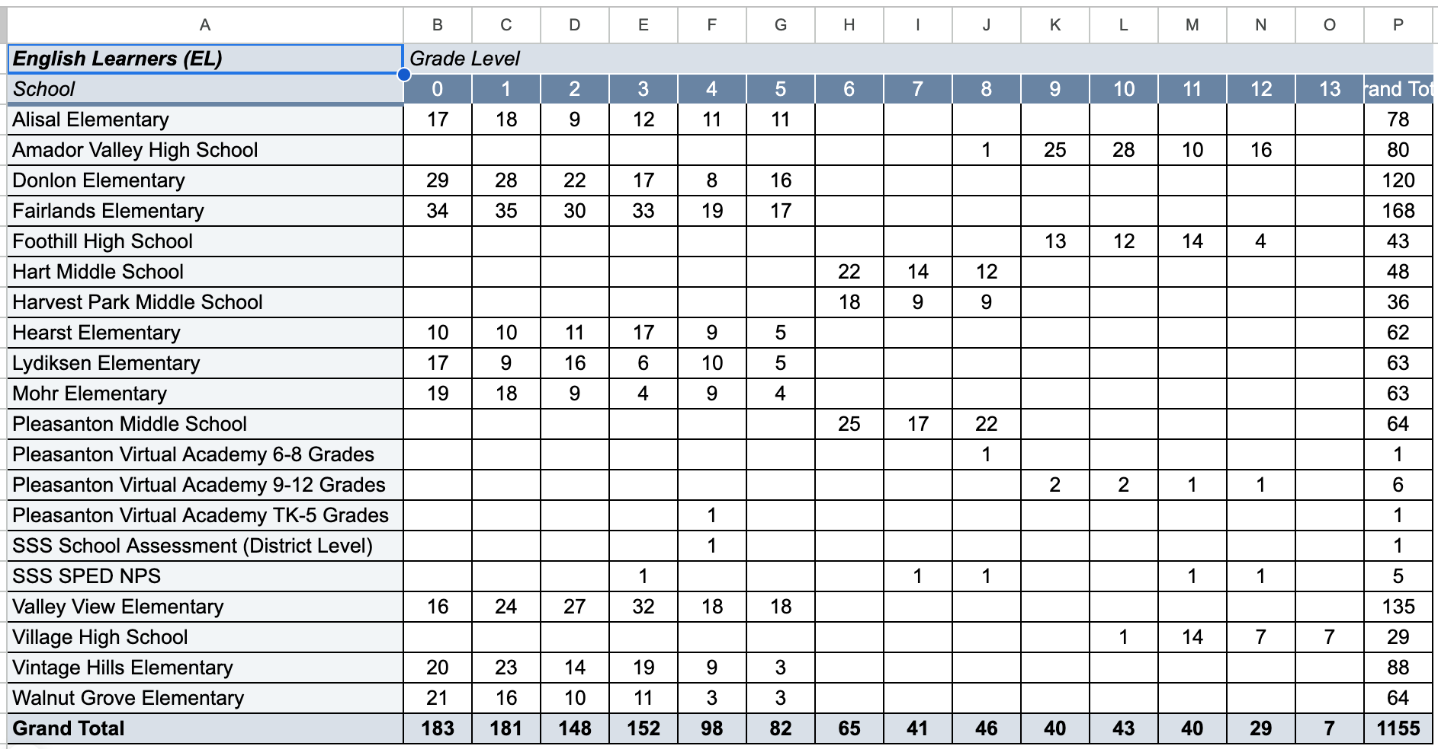
Total English Learner Population

Slide 3
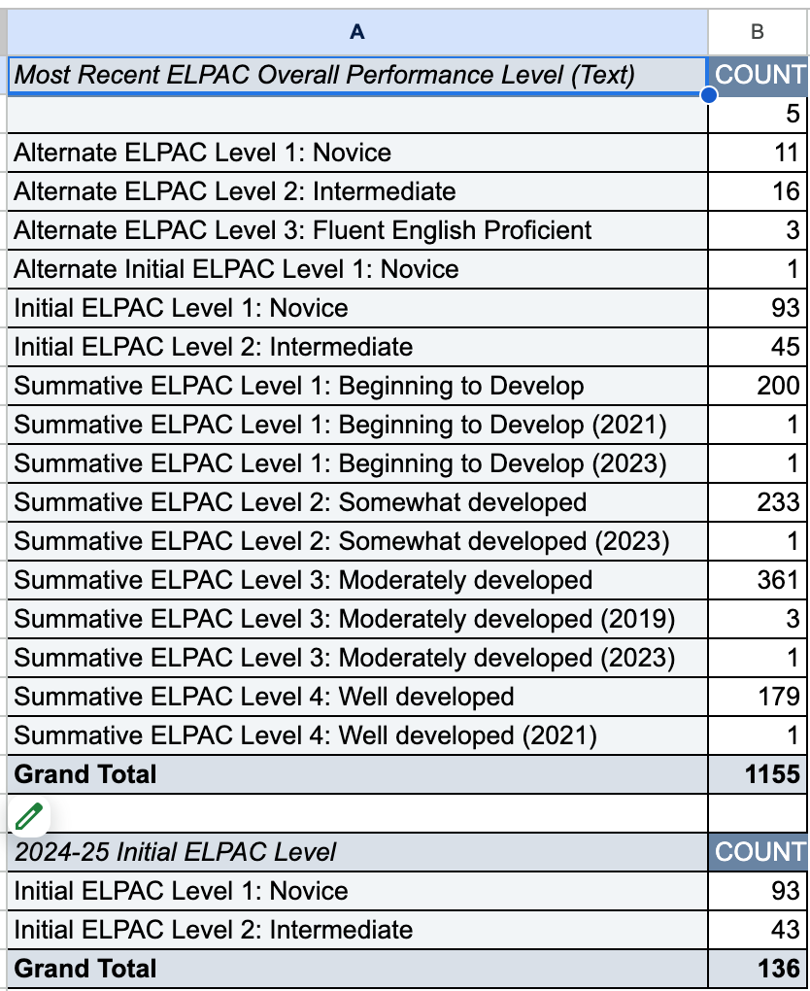
English Learner - Levels
English Learner Levels

Slide 4
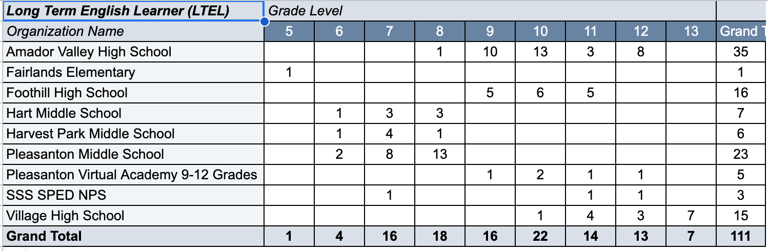
Long Term English Learners

Slide 5
English Language Development (ELD) Support
We provide ELD support in 2 ways per Ed. Code 11300:
Designated ELD is when a specific time (30 minutes) is dedicated every day for explicit language development instruction.
Integrated ELD is when language development instruction is embedded in the content of the subject matter.
The training and resources provided through EL Achieve supports our teachers in providing designated and integrated ELD instruction.
Notes:
Shehnaz:
We provide English language development instruction in two ways as required by the Ed. Code: 11300. Designated ELD is when specific time is set in the daily schedule to provide explicit instruction to our English learners and integrated ELD is when the language development instruction is embedded within the subject matter. The training and resources provided through EL Achieve support our teachers in providing ELD throughout the school day.

Slide 6
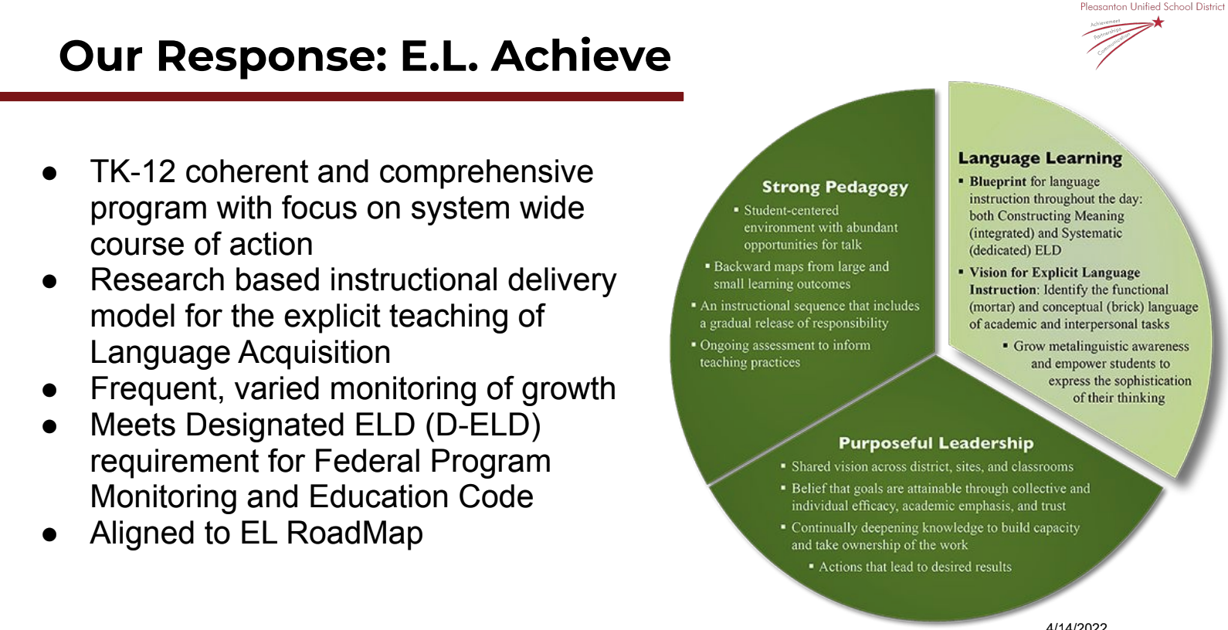
Overview of EL Achieve Program
Notes:
David
With this background and expectations, in 2020 we launched EL Achieve, a program that is research based and provides teachers both the pedagogy and the tools to effectively teach any content area to our EL students. Some key components of this program include that it is comprehensive, aligned to the EL road map, meets the State requirements for EL instruction, and is focused on strategies that are effective at all grade levels in all content areas.

Slide 7
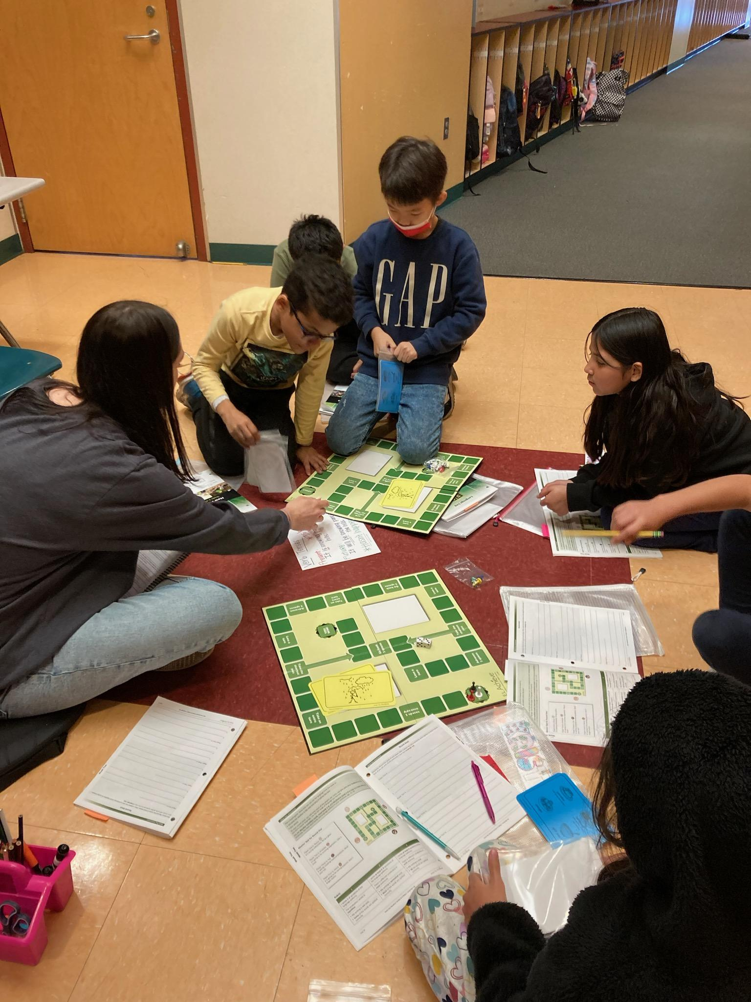
Staff Participation in EL Achieve
2021-2024:
165 Elementary Teachers
54 Secondary Teachers
30 Administrators
Building Capacity:
2 PUSD Elementary Trainers
3 PUSD Secondary Trainers
Notes:
Shehnaz
Since the initial adoption of EL Achieve in April of 2020, we have trained a significant number of our staff. This year we will hold 3 elementary and 1 secondary cohorts that will train 100 teachers by the end of January 2024, bringing the total number of trained teaching staff in PUSD to 219. We are pleased to report that all nearly all secondary DELD teachers have been trained, and that at the end of this year, roughly 70% of elementary teachers will have been trained. Moving into 2024-25, we are working to build our capacity, as several PUSD staff members have enrolled in the leadership cohort which allows our own staff to lead EL Achieve training including some who are here tonight! I will be working with these teachers along with site principals and other staff to determine best strategies for training the remaining staff and sustain these best practices in explicit DELD AND IELD instruction for our EL students.
2021-22 25 teacher
9 Admin
2022-23 65 Elementary
29 Secondary
2023-24 75 Elementary
25 Secondary
PUSD Trainers:
Elementary: Shannon Rinker, Esperanza Jimenez
Secondary: Katrina Wunderlich, Chris Ragg, Jim Krier

Slide 8
EL Achieve Training 2024-25
2024-25:
41 Elementary Teachers
41 Secondary Teachers
Total:
206 Elementary Teachers
95 Secondary Teachers

Slide 9
Questions? Comments?

