Slide 1


2016-17
Annual Report
Public Hearing
Clint Independent School District
February 15, 2018

Slide 2

Clint ISD Mission and Goals
2016-17 Annual Report
The mission of the Clint Independent School District is to prepare all students to be successful citizens. The District will work in partnership with the community and the family to create opportunities for the student to maximize personal potential.
Annual Goals
The District will be a model of high standards for student academic excellence.
The District will ensure a safe well-disciplined positive learning environment for all students.
The District will operate efficiently being fiscally responsible.
The District will become the employer of choice in order to seek and retain effective personnel.
The District will include parents, community, and business members in the education of all students.

Slide 3
7 Sections to the Annual Report
2016-17 Annual Report
2016-17 Texas Academic Performance Report (TAPR)
  For the District and each Campus in the District
PEIMS Financial Standard Report (2015-16 Financial Actual Report)
  For the District and each Campus in the District
2016-17 District Accreditation Status
Campus Performance Objectives
Report on Violent or Criminal Incidents on Campuses
Student Performance in Postsecondary Institutions
  For each High School Campus in the District
2016-17 TAPR Glossary

Slide 4
1. 2016-17 Texas Academic Performance Report (TAPR)
2016-17 Annual Report
Compiled by TEA for every district and campus using PEIMS and Student Assessment Data
Significant changes in 2016-17 TAPR
  New terminology: STAAR Performance Level Descriptors
Terms Used in 2016-17 TAPR | Terms Used in 2015-16 TAPR
Approaches Grade Level | Level II Satisfactory
Meets Grade Level | Level II Postsecondary
Masters Grade Level | Level III Advanced
  2 years of STAAR data reported
    2017
    2016
    2015-16 TAPR only reported 1 year of data due to significant changes to STAAR from 2014-15 to 2015-16

Slide 5
1. 2016-17 Texas Academic Performance Report (TAPR)
2016-17 Annual Report
Organized in 5 parts
  Accountability Ratings
    2017 Accountability Rating
    2017 Distinction Designations
    2017 Special Education Determination Status (District only)
  2016-17 Performance
  2016-17 Participation
  2016-17 Attendance and Postsecondary Readiness
    Data are reported for 2015-16 and 2014-15, NOT 2016-17
  2016-17 Profile

Slide 6
1. 2016-17 Texas Academic Performance Report (TAPR)
2016-17 Annual Report
Part II: 2016-17 Performance
  STAAR Performance by assessment*
    % at Approaches Grade Level or Above
  STAAR Performance by subject area (all grades)
    % at Approaches Grade Level or Above
    % at Meets Grade Level or Above
    % at Masters Grade Level
  STAAR Progress in Reading and Math (all grades)
    % Met or Exceeded Progress
    % Exceeded Progress
  Includes STAAR results from “2017 Accountability Year”
  Only includes results for students in the “accountability subset”
    Students taking assessments who were enrolled in the district/campus on the preceding fall snapshot date (last Friday of October)
Summer 2016 EOCs | December 2016 EOCs | Spring 2017 EOCs and Grades 3-8 assessments
* Student results are grouped based on the assessment taken, not the grade level of the student. For example, an 8th grader who took the Algebra I EOC is included in the Algebra I EOC results, not the Grade 8 Math results.

Slide 7
1. 2016-17 Texas Academic Performance Report (TAPR)
2016-17 Annual Report
Part III: 2016-17 Participation
  2016-17 STAAR Participation – All Grades/All Tests
    Percent Tested | Percent Not Tested
    Of those tested, percent included in accountability
  2015-16 STAAR Participation – All Grades/All Tests
    Percent Tested | Percent Not Tested
    Of those tested, percent included in accountability

Slide 8
1. 2016-17 Texas Academic Performance Report (TAPR)
2016-17 Annual Report
Part IV: 2016-17 Attendance and Postsecondary Readiness
  Attendance Rate
  Annual Dropout Rates (Gr. 7-8 and Gr. 9-12)
  Longitudinal and Annual Graduation Rates and Graduation Plan Rates
  College and Career Readiness Indicators, including
    Advanced Course/Dual Enrollment Completion
    College-Ready and College and Career-Ready Graduates
    CTE Coherent Sequence Completion
    AP/IB Course Completion and Results
    SAT/ACT Results
    Graduates Enrolled in Texas Institutions of Higher Education

Slide 9
1. 2016-17 Texas Academic Performance Report (TAPR)
2016-17 Annual Report
Part V – 2016-17 Profile
  Student Information for 2016-17 (based on Fall 2016 PEIMS Submission)
    Student enrollment (including enrollment by grade level, by ethnicity, by certain student identification indicators, and students with disabilities by primary eligibility category) and other student information (including graduation information, retention rates, and class size information)
  Staff Information for 2016-17 (based on Fall 2016 PEIMS Submission)
    Staff information (including total staff, staff by classification, teachers by ethnicity and gender, teachers by highest degree held and years of experience, experience of campus leadership, staff salary, and teacher turnover rate information)
  Program Information for 2016-17 (based on Fall 2016 PEIMS Submission)
    Student enrollment by program
    Teachers by program

Slide 10
2016-17 Accountability Ratings
2016-17 Annual Report

Slide 11
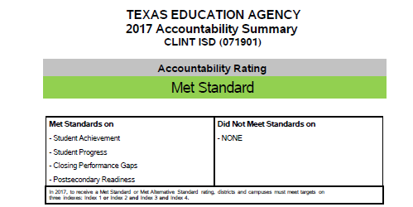
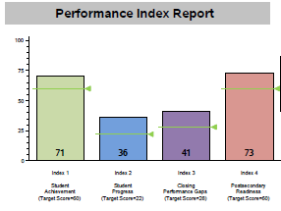
1. 2016-17 Texas Academic Performance Report (TAPR)
2016-17 Annual Report

Slide 12

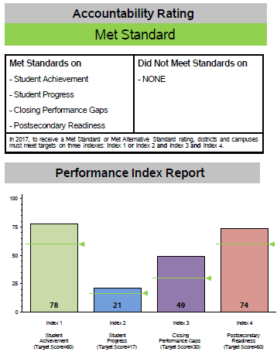
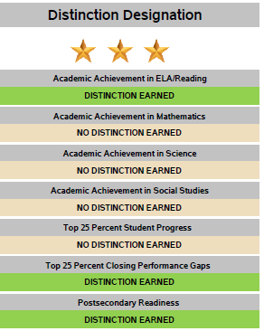
2016-17 Annual Report

Slide 13
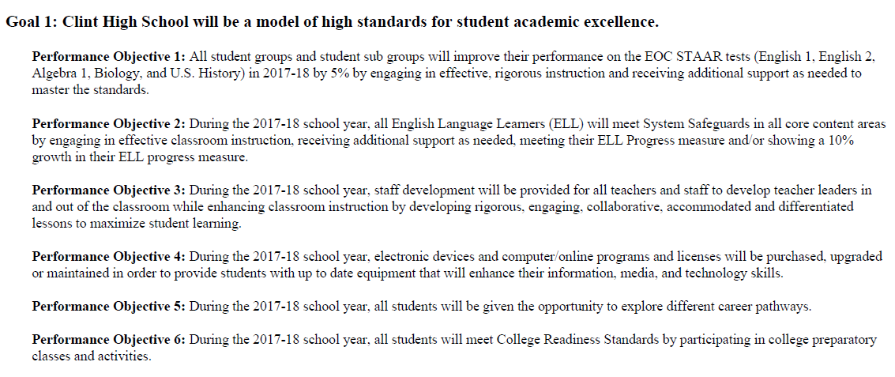
Campus Performance Objectives
2016-17 Annual Report

Slide 14
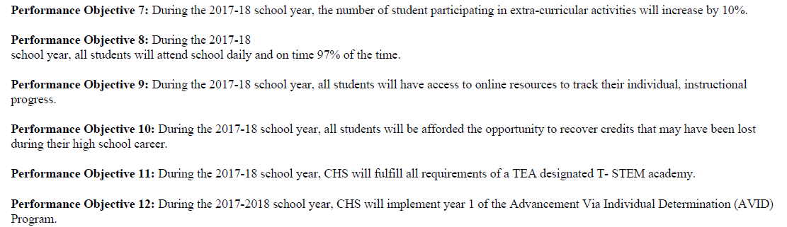
Campus Performance Objectives
2016-17 Annual Report

Slide 15
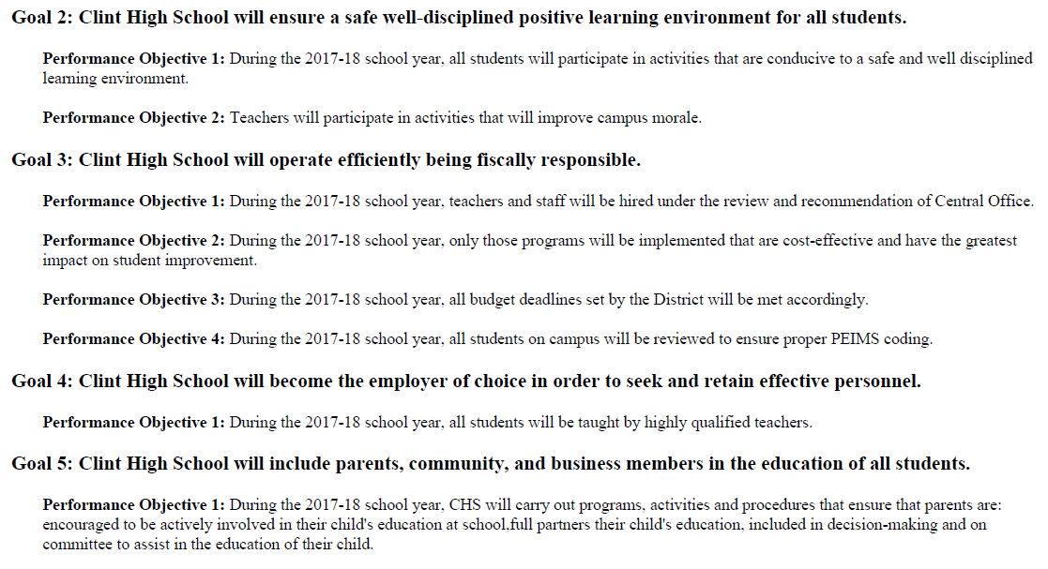
Campus Performance Objectives
2016-17 Annual Report

Slide 16


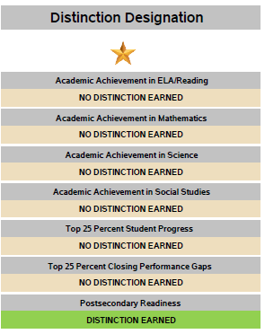
2016-17 Annual Report

Slide 17
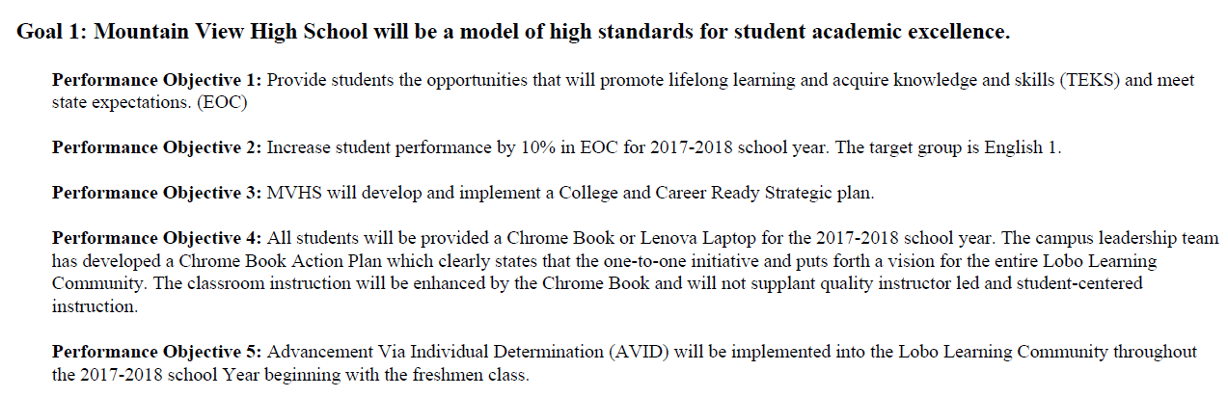
Campus Performance Objectives
2016-17 Annual Report

Slide 18
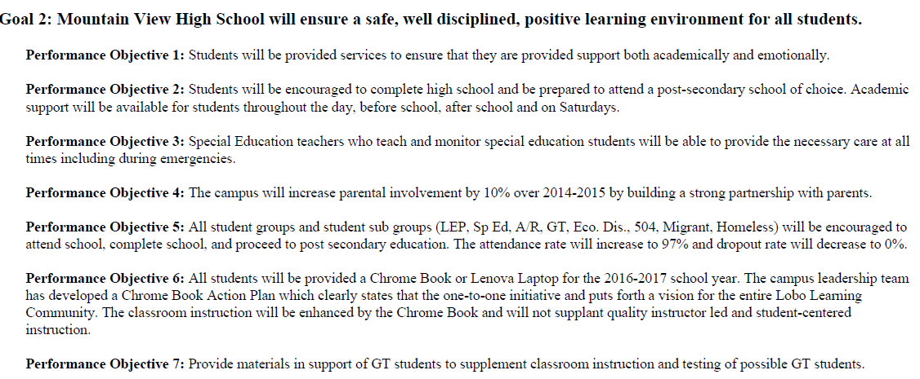
Campus Performance Objectives
2016-17 Annual Report

Slide 19
Campus Performance Objectives
2016-17 Annual Report

Slide 20
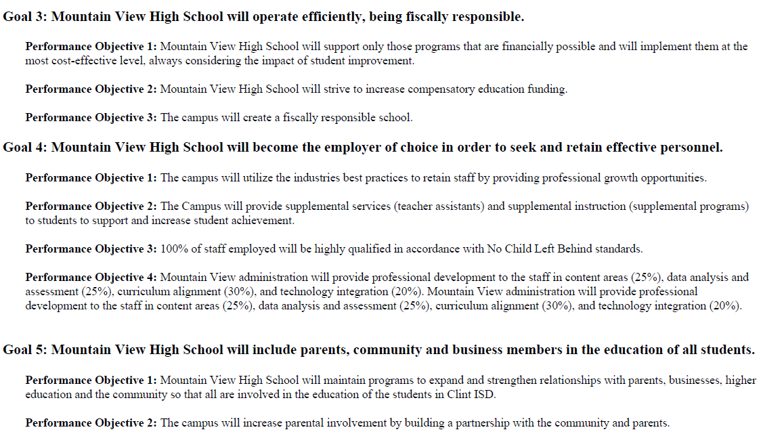
Campus Performance Objectives
2016-17 Annual Report

Slide 21


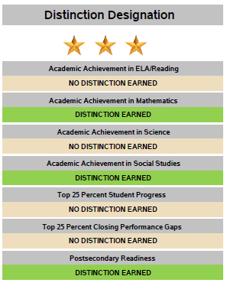
2016-17 Annual Report

Slide 22
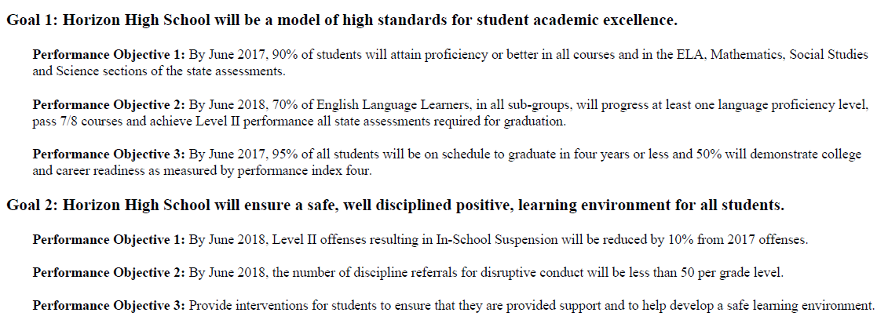
Campus Performance Objectives
2016-17 Annual Report

Slide 23
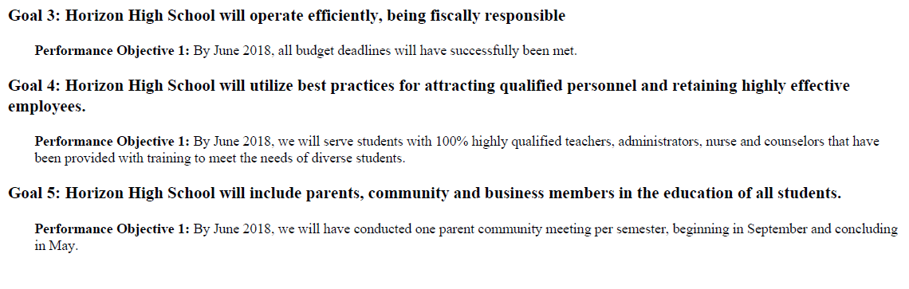
Campus Performance Objectives
2016-17 Annual Report

Slide 24

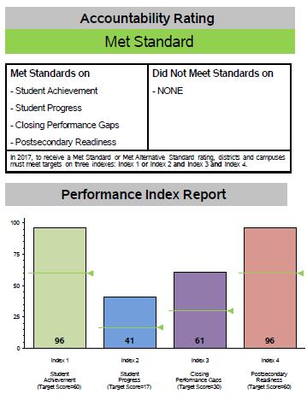
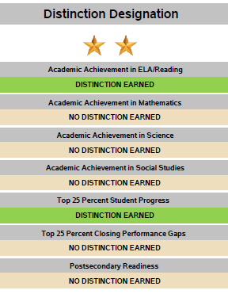
2016-17 Annual Report

Slide 25
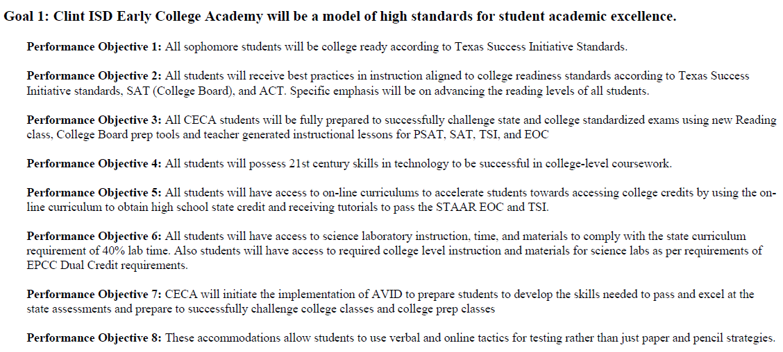
Campus Performance Objectives
2016-17 Annual Report

Slide 26
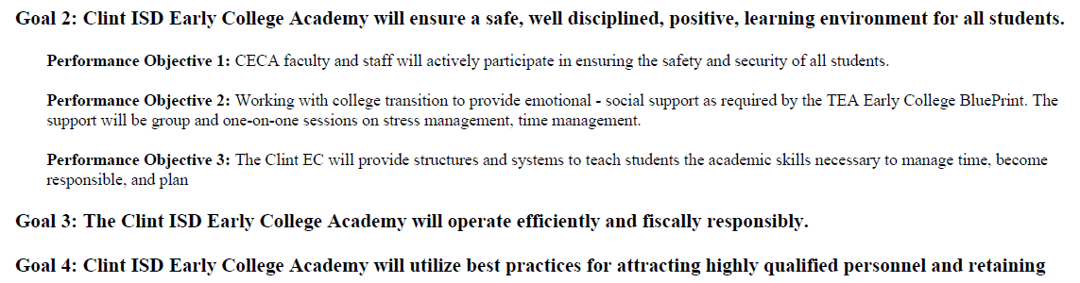
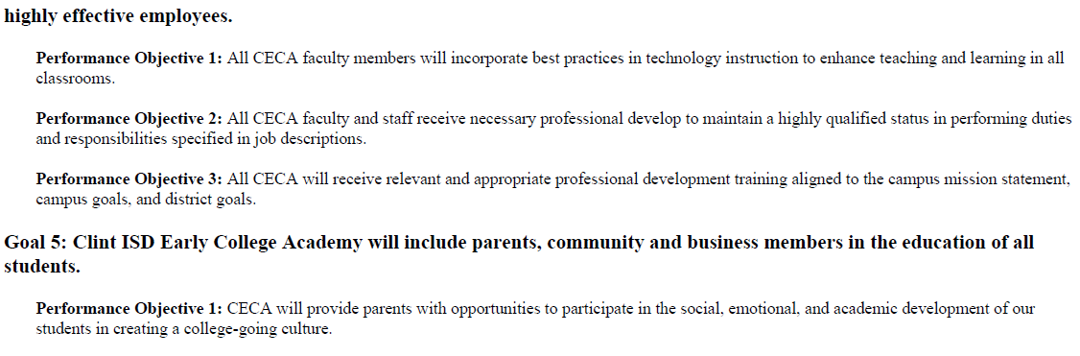
Campus Performance Objectives
2016-17 Annual Report

Slide 27

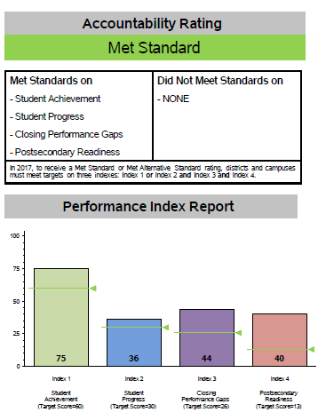
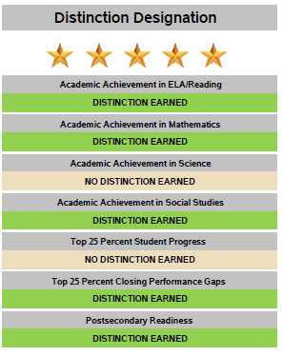
2016-17 Annual Report

Slide 28
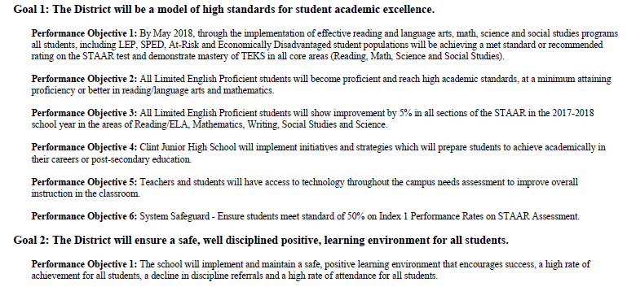
Campus Performance Objectives
2016-17 Annual Report

Slide 29
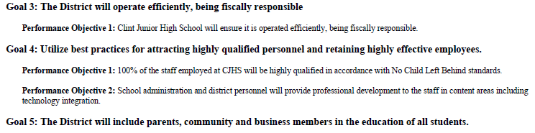
Campus Performance Objectives
2016-17 Annual Report

Slide 30

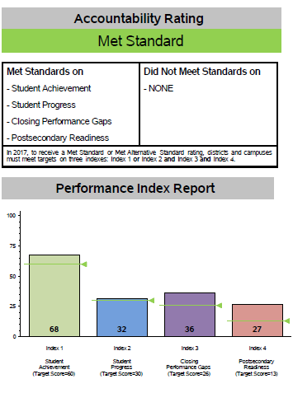
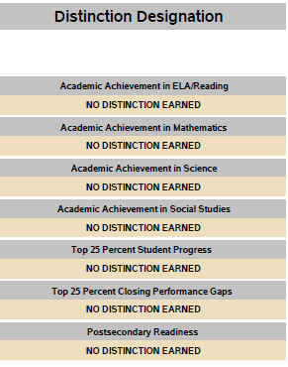
2016-17 Annual Report

Slide 31
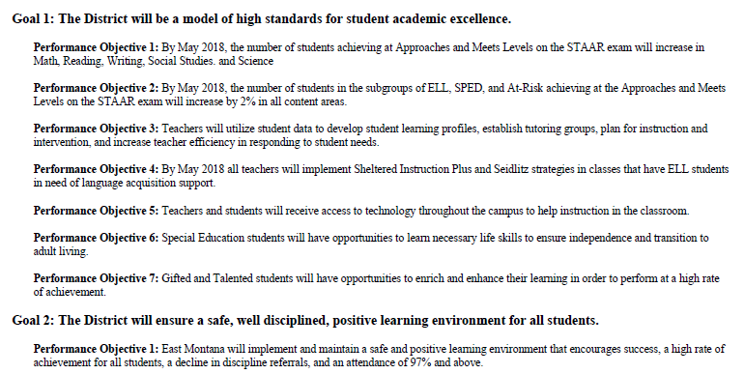
Campus Performance Objectives
2016-17 Annual Report

Slide 32
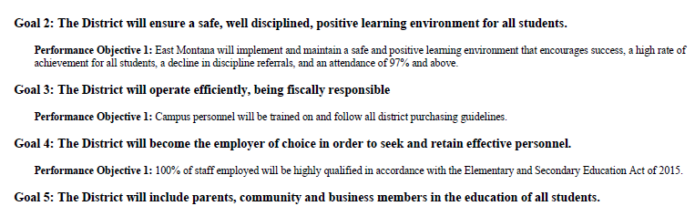
Campus Performance Objectives
2016-17 Annual Report

Slide 33


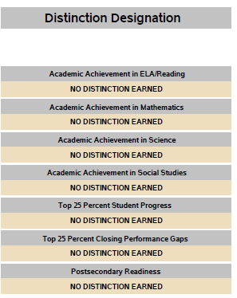
2016-17 Annual Report

Slide 34
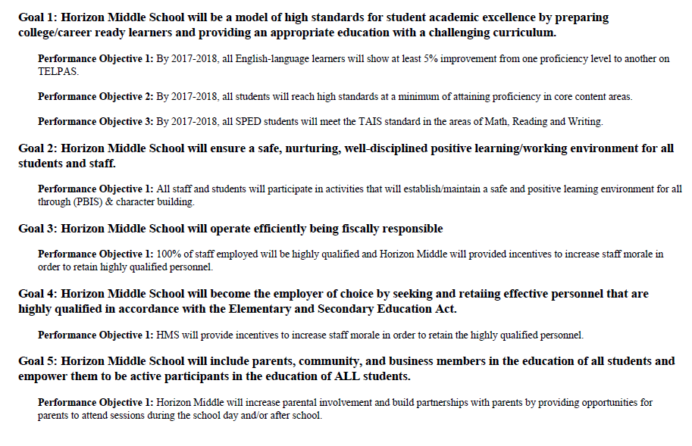
Campus Performance Objectives
2016-17 Annual Report

Slide 35

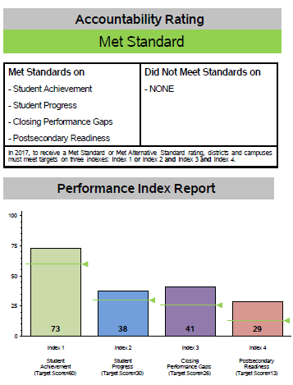
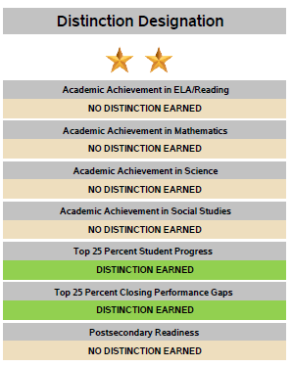
2016-17 Annual Report

Slide 36
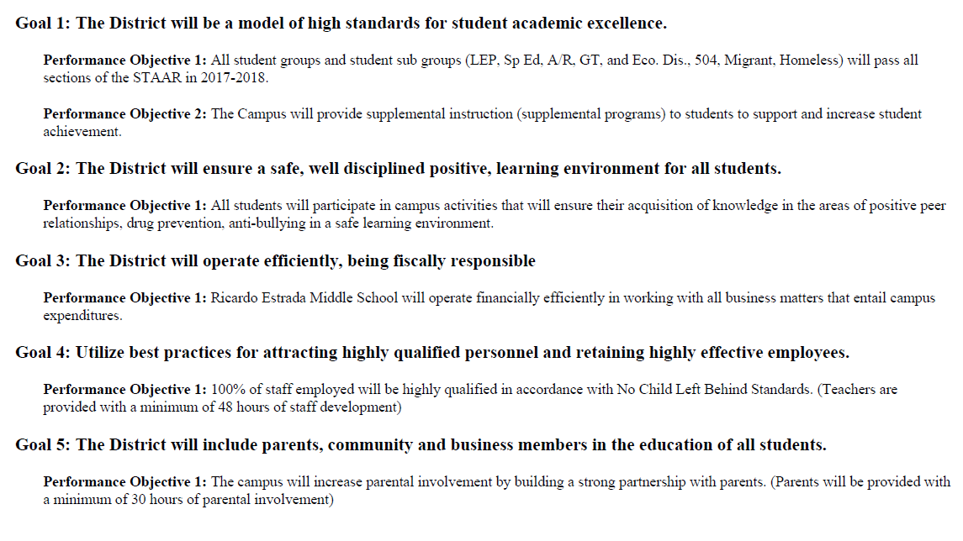
Campus Performance Objectives
2016-17 Annual Report

Slide 37

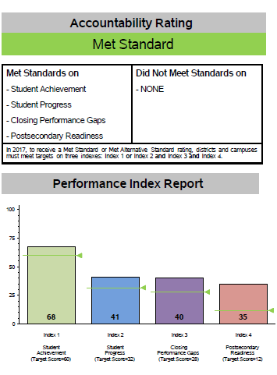
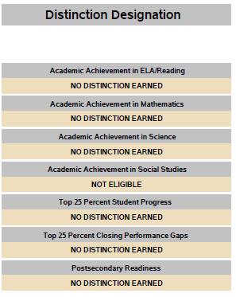
2016-17 Annual Report

Slide 38
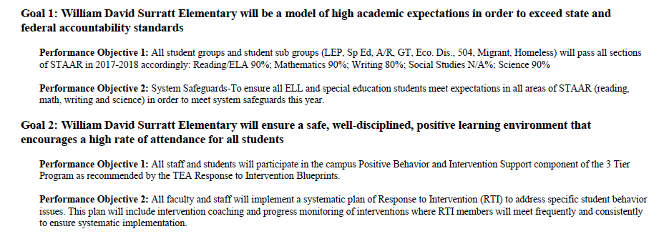
Campus Performance Objectives
2016-17 Annual Report

Slide 39
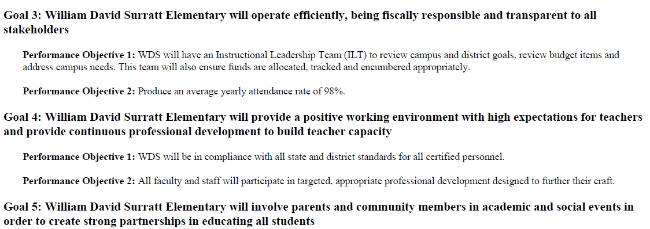
Campus Performance Objectives
2016-17 Annual Report

Slide 40

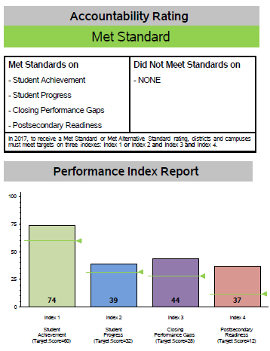
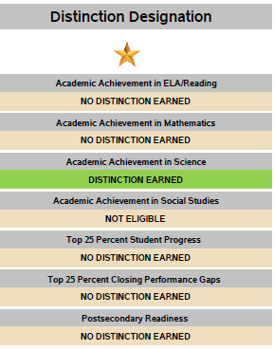
2016-17 Annual Report

Slide 41
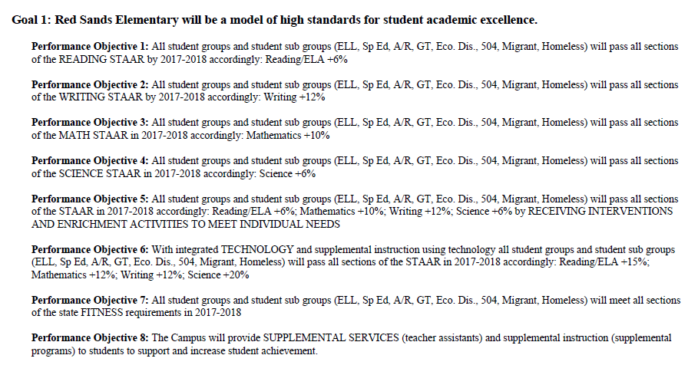
Campus Performance Objectives
2016-17 Annual Report

Slide 42
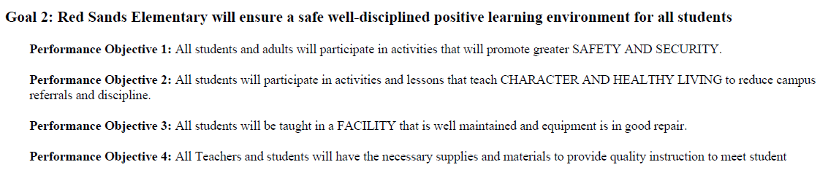
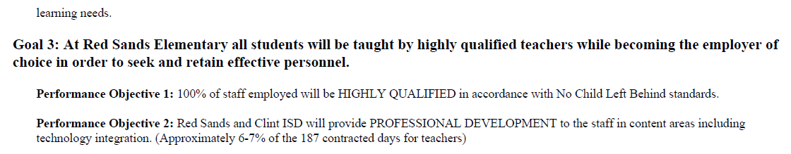
Campus Performance Objectives
2016-17 Annual Report

Slide 43
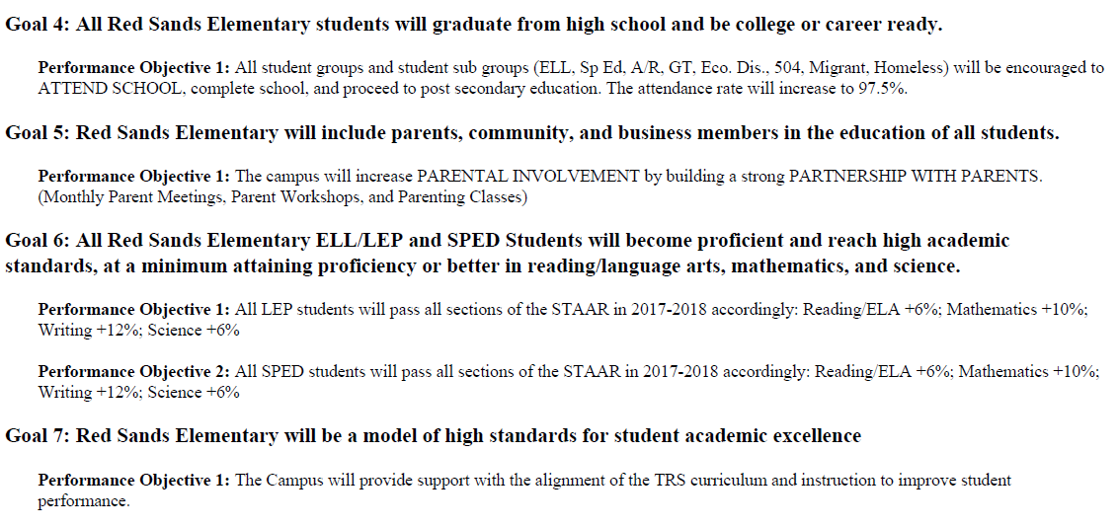
Campus Performance Objectives
2016-17 Annual Report

Slide 44

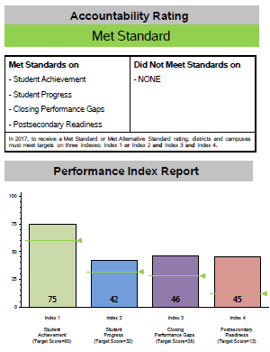
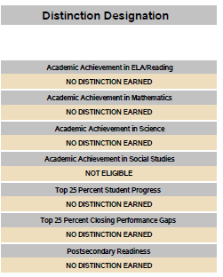
2016-17 Annual Report

Slide 45
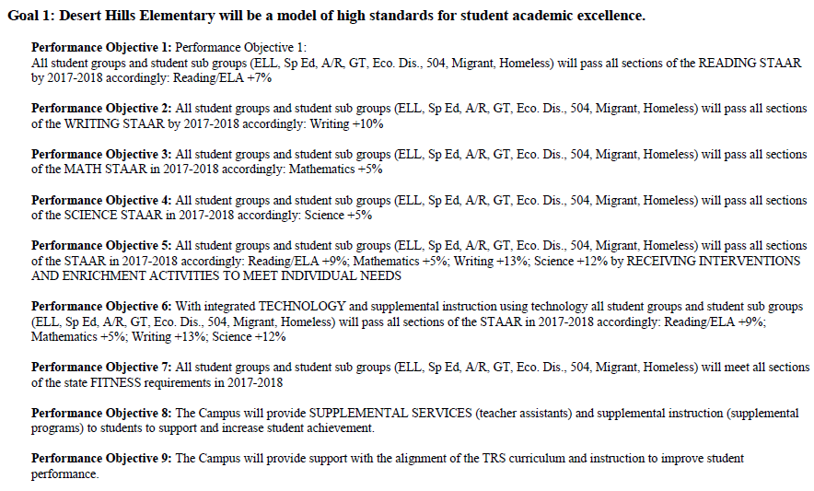
Campus Performance Objectives
2016-17 Annual Report

Slide 46
Campus Performance Objectives
2016-17 Annual Report

Slide 47
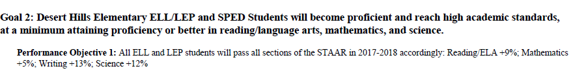
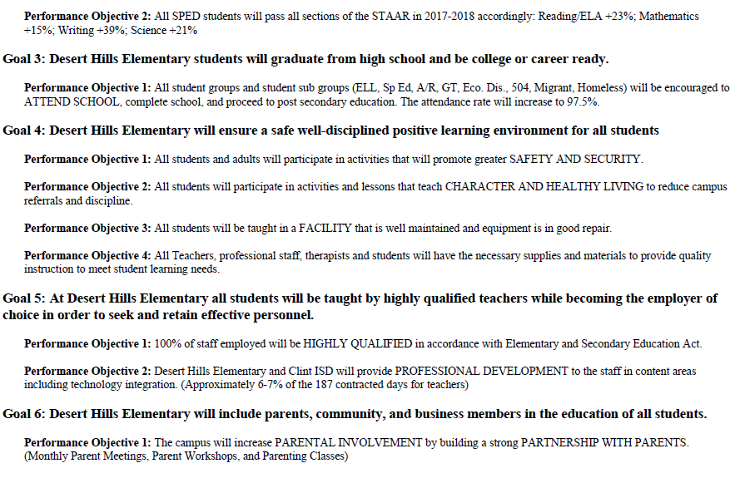
Campus Performance Objectives
2016-17 Annual Report

Slide 48
Campus Performance Objectives
2016-17 Annual Report

Slide 49

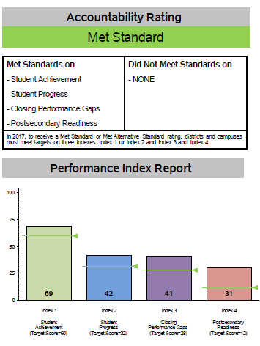
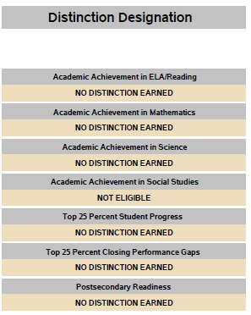
2016-17 Annual Report

Slide 50
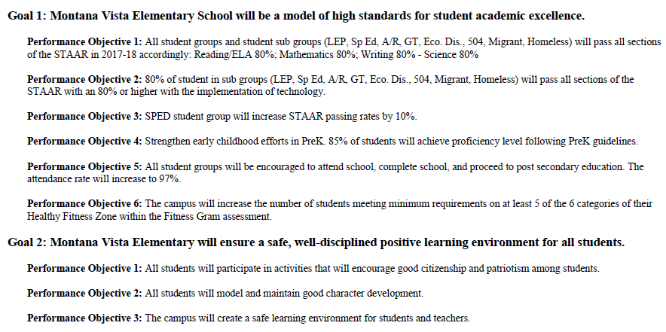
Campus Performance Objectives
2016-17 Annual Report

Slide 51


Campus Performance Objectives
2016-17 Annual Report

Slide 52



2016-17 Annual Report

Slide 53

Campus Performance Objectives
2016-17 Annual Report

Slide 54

Campus Performance Objectives
2016-17 Annual Report

Slide 55


Campus Performance Objectives
2016-17 Annual Report

Slide 56



2016-17 Annual Report

Slide 57

Campus Performance Objectives
2016-17 Annual Report

Slide 58


2016-17 Special Education Determination Status
2016-17 Annual Report
The TEA cleared Clint ISD on December 13, 2017, the TAPR was published on November 16, 2017

Slide 59

Participation Rates
2016-17 Annual Report

Slide 60

Attendance Rates
2016-17 Annual Report

Slide 61

Graduation Rate
2016-17 Annual Report

Slide 62

Post Secondary Readiness
2016-17 Annual Report

Slide 63
CTE Coherent Sequence
2016-17 Annual Report

Slide 64

Dual Credit Courses
2016-17 Annual Report

Slide 65
Texas Success Initiative Assessment (TSI)
2016-17 Annual Report

Slide 66
AP/IB Course Completion
2016-17 Annual Report

Slide 67

SAT Results
2016-17 Annual Report

Slide 68
2. PEIMS Financial Standard Report
(2015-16 Financial Actual Report)
2016-17 Annual Report
2015-16 Actual Financial Data
(District)
Receipts
Fund Balances
Disbursements
Program Expenditures
Tax Rates
2014 Tax Year State Certified Property Values
Unassigned Fund Balance (% of Total Budgeted Expenditures)
2015-16 Actual Financial Data
(Each Campus)
Expenditures by Object
Expenditures by Function
Program Expenditures by Program
2015-2016 Audit Presented to the Board on January 19, 2017

Slide 69


2. PEIMS Financial Standard Report (2015-16 Financial Actual Report)
2016-17 Annual Report

Slide 70

2. PEIMS Financial Standard Report (2015-16 Financial Actual Report)
2016-17 Annual Report

Slide 71

2. PEIMS Financial Standard Report (By Function)
2016-17 Annual Report

Slide 72
2. PEIMS Financial Standard Report (By Function)
2016-17 Annual Report

Slide 73

2. PEIMS Financial Standard Report (Total Disbursements)
2016-17 Annual Report

Slide 74

2. PEIMS Financial Standard Report (Program Expenditures)
2016-17 Annual Report

Slide 75
2. PEIMS Financial Standard Report (Program Expenditures)
2016-17 Annual Report

Slide 76
3. 2016-17 District Accreditation Status
2016-17 Annual Report
Each year, TEA assigns one of four accreditation statuses to each district in the state:
  Accredited
  Accredited-Warned
  Accredited-Probation
  Not Accredited-Revoked
In assigning an accreditation status to a district, TEA considers
  Academic accountability ratings
  Financial accountability ratings
  Data integrity
  Program-area deficiencies identified through PBMAS

Slide 77

3. 2016-17 District Accreditation Status
2016-17 Annual Report

Slide 78
4. Campus Performance Objectives
2016-17 Annual Report
Campus Improvement Plans (CIP)
  Each campus has developed and is implementing a CIP, as required by TEC §11.253
  Each CIP includes performance objectives based on data analysis and needs assessments (including data reported in the 2015-16 TAPR)
  Each campus periodically measures progress toward its performance objectives
Campus Performance Objectives are approved by the Board
The Performance Objectives were listed after each campus rating
Campus CIPs are posted on the district’s website and are available for review at the district’s central office or on each campus

Slide 79
5. Report on Violent or Criminal Incidents
2016-17 Annual Report
TEC Section 39.306 requires each district to publish, as part of its Annual Report, a report on violent and criminal incidents at each campus in the district
The report must include
  Number, rate and type of violent or criminal incidents that occurred on each campus
  Information concerning school violence prevention and violence intervention policies and procedures the district is using to protect students
  Findings that result from evaluations conducted under the Safe and Drug-Free Schools and Communities Act

Slide 80
5. Report on Violent or Criminal Incidents
2016-17 Annual Report
Report on Violent or Criminal Incidents Student Disciplinary Action Incident Counts by Reason Code 2016-17 School Year
Reason Code | Description | Clint High School
 |  | 071-901-001
11 | Used, exhibited, possessed firearm | 0
12 | Used, exhibited possessed illegal knife | 0
13 | Used, exhibited, possessed illegal club | 0
14 | Used, exhibited, possessed prohibited weapon | 0
16 | Arson | 0
17 | Murder, capital murder, criminal attempt to commit murder/capital murder | 0
18 | Indecency with a child | 0
19 | Aggravated kidnapping | 0
29 | Aggravated assault against school district employee/volunteer | 0
30 | Aggravated assault against non-employee/volunteer | 0
31 | Sexual assault/aggravated sexual assault against school district employee/volunteer | 0
32 | Sexual assault/aggravated sexual assault against non-employee volunteer | 0
36 | Felony controlled substance violation | *
37 | Felony alcohol violation | 0
46 | Aggravated robbery | 0
47 | Manslaughter | 0
48 | Criminally negligent homicide | 0
Total Incidents |  | *
Student Enrollment (Fall 2016 PEIMS Snapshot) |  | 645
Incident Rate |  | 0.2%

Slide 81
5. Report on Violent or Criminal Incidents
2016-17 Annual Report
District Programs on violence prevention and intervention:
  Required in Campus Improvement Plans under Goal #2
  David’s Law Procedures – Anonymous Alerts, Fraud Report Site
  8-Step Discipline Plan – District Standard consequences
  Counseling Services
  Annual “Standards of Conduct Training” for all staff
  PBIS Support at most campuses
  Communities in Schools
  SRO officers and Presentations
  Character Education Programs

Slide 82
5. Report on Violent or Criminal Incidents
2016-17 Annual Report
Annual District Climate Survey of 3-12 graders
  7000 students completed the survey
  82% of students
Board Policy on Safety and Violence Prevention
  BQ (Legal)
  FOCA (Legal)
  FOC (Legal)
  FOD (Legal)
  FFI (Local)
  FDB (Local)
  FDE (Local)

Slide 83

5. Annual Safety Survey (Elementary)
2016-17 Annual Report

Slide 84


5. Annual Safety Survey (Elementary)
2016-17 Annual Report

Slide 85


5. Annual Safety Survey (Elementary)
2016-17 Annual Report

Slide 86


5. Annual Safety Survey (Elementary)
2016-17 Annual Report

Slide 87

5. Annual Safety Survey (Secondary)
2016-17 Annual Report

Slide 88


5. Annual Safety Survey (Secondary)
2016-17 Annual Report

Slide 89


5. Annual Safety Survey (Secondary)
2016-17 Annual Report

Slide 90


5. Annual Safety Survey (Secondary)
2016-17 Annual Report

Slide 91


5. Annual Safety Survey (Secondary)
2016-17 Annual Report

Slide 92
6. Student Performance in Postsecondary Institutions
2016-17 Annual Report
TEC Section 39.306 requires each district to publish, as part of its Annual Report, a report on student performance in postsecondary institutions during the first year enrolled after graduation from high school
These data are compiled by the Texas Higher Education Coordinating Board (THECB)
The most current report is for 2014-15 High School Graduates
  Clint ISD has also included information from the National Clearinghouse data from the 2017 graduating class

Slide 93

6. Student Performance in Postsecondary Institutions
2016-17 Annual Report

Slide 94

6. Student Performance in Postsecondary Institutions
2016-17 Annual Report

Slide 95

6. Student Performance in Postsecondary Institutions
2016-17 Annual Report

Slide 96

6. Student Performance in Postsecondary Institutions
2016-17 Annual Report

Slide 97

6. Student Performance in Postsecondary Institutions
2016-17 Annual Report

Slide 98

6. Student Performance in Postsecondary Institutions
2016-17 Annual Report

Slide 99
7. TAPR Glossary
2016-17 Annual Report
Provides definitions, describes methodologies, and lists sources for each data point in the TAPR
A Spanish translation of the TAPR Glossary is scheduled for release in January 2018
https://rptsvr1.tea.texas.gov/perfreport/tapr/2017/glosary.pdf

Slide 100
Resources and Availability of Annual Report
2016-17 Annual Report
The District’s Annual Report will be posted on the district’s website within 2 weeks after this meeting
Paper copies of the District’s Annual Report will also available at the district’s central office and on each campus in the district
For questions or more information, contact:
Name | Jim Littlejohn
Position | Assistant Superintendent of Secondary Instruction
Phone | 915-926-4031
Email | James.Littlejohn@clint.net

