Slide 1

2018-2019
Annual Report
Public Hearing

Slide 2
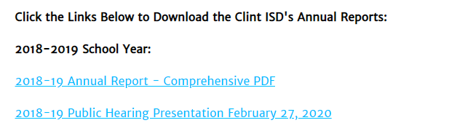
How to Download or View the District’s Annual Report
2018-19 Annual Report
  Go to www.clintweb.net
  Click Departments on the top menu bar
  Click Accountability and Student Achievement
  Click Annual Reports from the left-side options

Slide 3
Contents of District’s 2018-19 Annual Report (7 sections)
2018-19 Annual Report
  Section 1: 2018-19 Texas Academic Performance Report (TAPR)
    District
    Each Campus
  Section 2: PEIMS Financial Standard Report (2017-18 Financial Actual Report)
    District
    Each Campus
  Section 3: 2018-19 District Accreditation Status
  Section 4: Campus Performance Objectives
  Section 5: Report on Violent or Criminal Incidents on Campuses
  Section 6: Student Performance in Postsecondary Institutions
    Each High School Campus
  Section 7: 2018-19 TAPR Glossary

Slide 4
Why Now?
The Annual Report is the “final” report of the 2018-19 school year.
It cannot be issued until after all Accountability Ratings are final (meaning after TEA has resolved all appeals)
The data being reported in the 2018-19 Annual Report are not new – this is simply the final reporting for the 2018-19 school year

Slide 5
Start of Section 1 - TAPR

Slide 6
Section 1: 2018-19 Texas Academic Performance Report (TAPR)
Compiled by TEA for every district and campus using
  PEIMS
  Student Assessment Data
Beginning in 2017-18, TAPR is published in 2 different formats
  A comprehensive, “dynamic” online data system
    Data will be added as they become available
  A PDF version (the “Paper TAPR”)
    Only includes major, statutorily-required data points
    Designed to allow districts to fulfill their public notification requirements (i.e., the Annual Report)

Slide 7
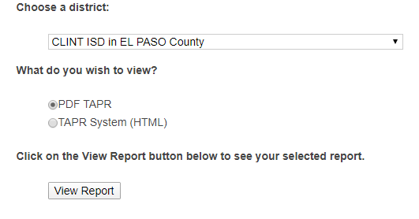
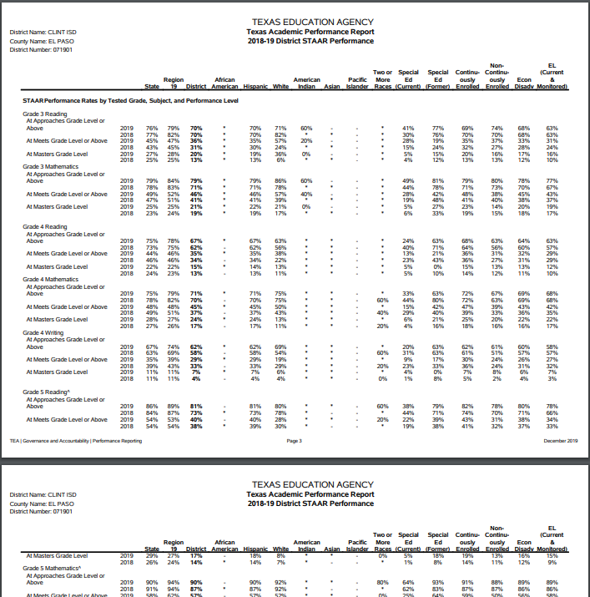
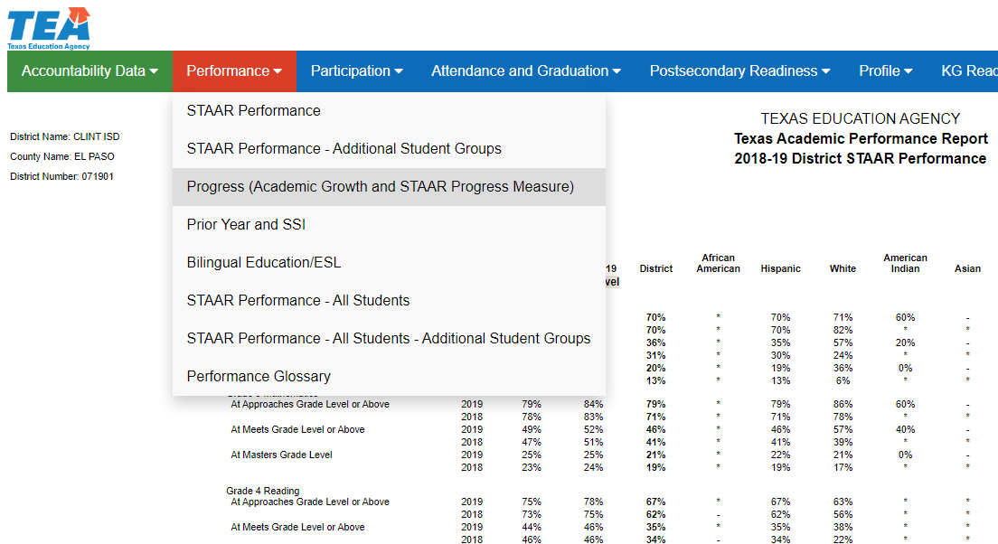
Section 1: 2018-19 TAPR
Two Versions Available
PDF Version
HTML - Web Version
One PDF file in a printable format.
Website that allows for easier access of data.
https://rptsvr1.tea.texas.gov/perfreport/tapr/2019/srch.html?srch=D

Slide 8
Section 1: 2018-19 TAPR
Cover Page of TAPR Report
  2019 District/Campus Rating
    District
    Each Campus
  2019 Special Education Determination Status
    District Only
  2019 Distinction Designations (if earned)
    District
    Each Campus

Slide 9
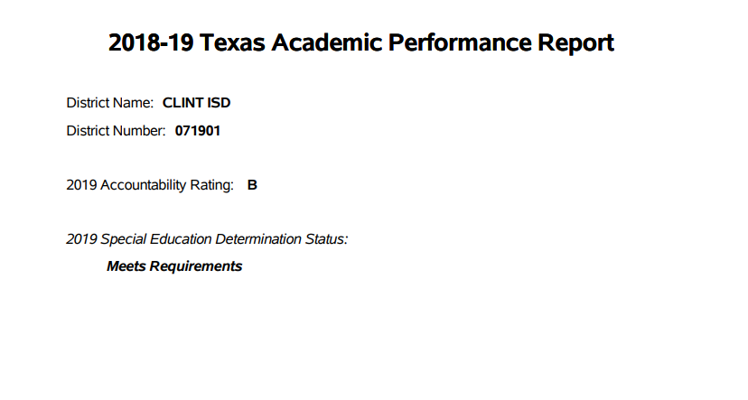
Clint ISD TAPR Cover Page
Meets Requirements
Needs Assistance
Needs Intervention
Needs Substantial Intervention
Notes:
This label represents an integrated determination status based on an evaluation of each district’s Performance-Based Monitoring Analysis (PBMAS) indicators in the special education program area; the State Performance Plan (SPP) compliance indicators 9, 10, 11, 12, and 13; data integrity; uncorrected noncompliance; and audit findings.

Slide 10
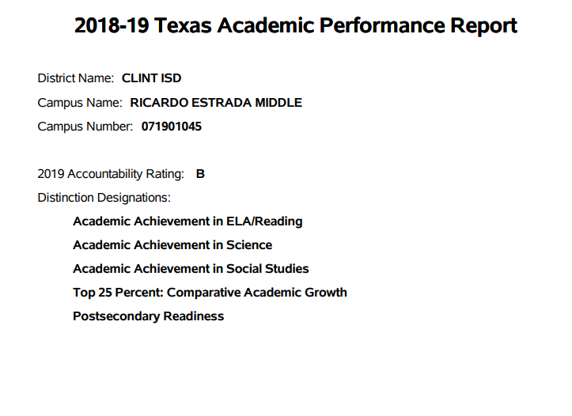
Example Campus Cover Page
5 Distinction Designations Earned

Slide 11
Section 1: 2018-19 TAPR
STAAR Performance
  All 3 performance rates
    Approaches Grade Level or Above
    Meets Grade Level or Above
    Masters Grade Level
  Reported for
    Each Assessment
    All Grades All Subjects
    All Grades by Subject
  Performance data includes results from 2019 Accountability Year
  Only includes results for students in the accountability subset
    Students taking assessments who were enrolled in the district/campus on the preceding fall snapshot date (last Friday of October)
Summer 2018 EOCs | December 2018 EOCs | Spring 2019 EOCs and all Grades 3-8 Assessments (including 1st and 2nd administrations of Grades 5 and 8 Reading and Math)

Slide 12

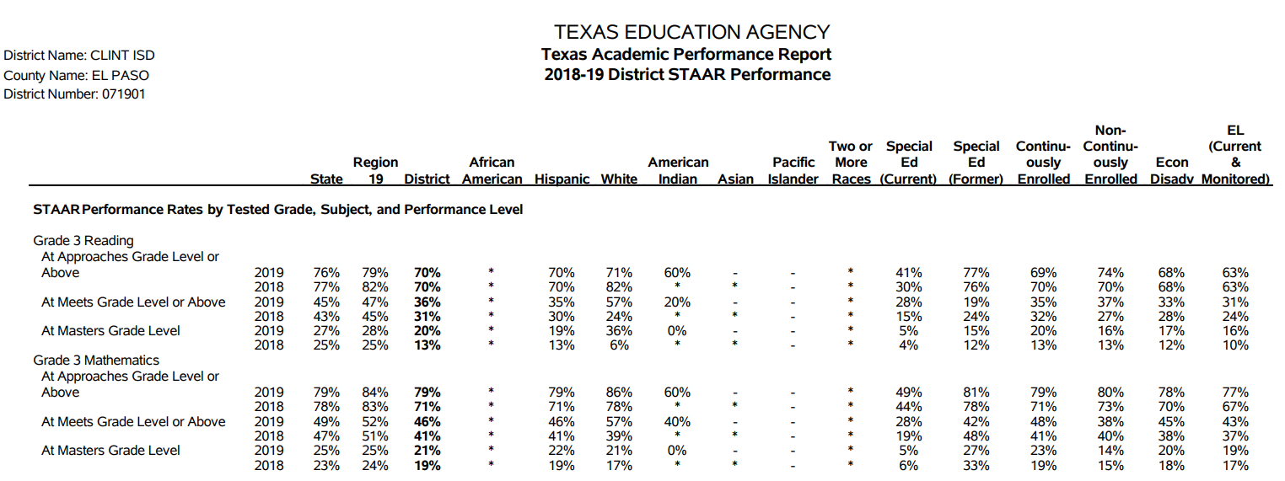

Section 1: 2018-19 TAPR
STAAR Performance

Slide 13
Section 1: 2018-19 TAPR
Other Data Sets Included for STAAR:
Progress
  Academic Growth (School Progress Domain)
Prior Year and Student Success Initiative
  Progress of Prior Year Non-Proficient Students
  Student Success Initiative (SSI)
Bilingual Education/English as a Second Language
  Includes performance and progress measures (disaggregated by various program instructional models) for students identified as current ELs in the 2018-19 school year

Slide 14
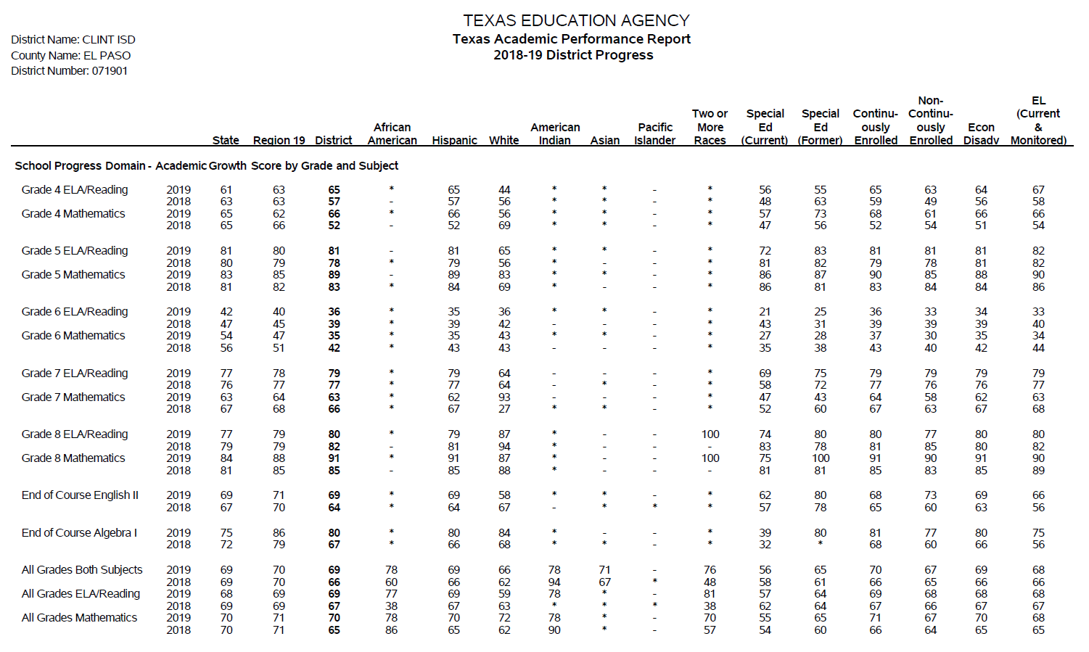
Section 1: 2018-19 TAPR
School Progress – Academic Growth

Slide 15
Section 1: 2018-19 TAPR
Participation in Assessments
  Percent Tested | Percent Not Tested
  Of those tested, percent included in accountability
Attendance, Graduation, and Dropout Rates
College, Career and Military Readiness (CCMR) Data
  College, Career and Military Readiness (CCMR)
    CCMR Graduates
    College Ready Graduates
    Career/Military Ready Graduates
  CCMR-Related Indicators
    TSIA Results
    CTE Coherent Sequence
    Completed and Received Credit for College Prep Courses
    AP/IB Results
    SAT/ACT Results

Slide 16
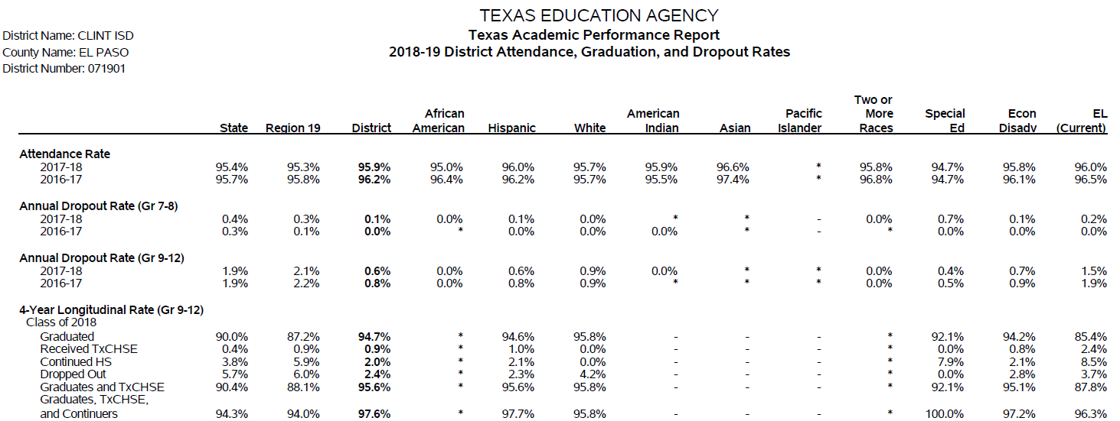
Section 1: 2018-19 TAPR
Attendance, Graduation, and Dropout Rates

Slide 17
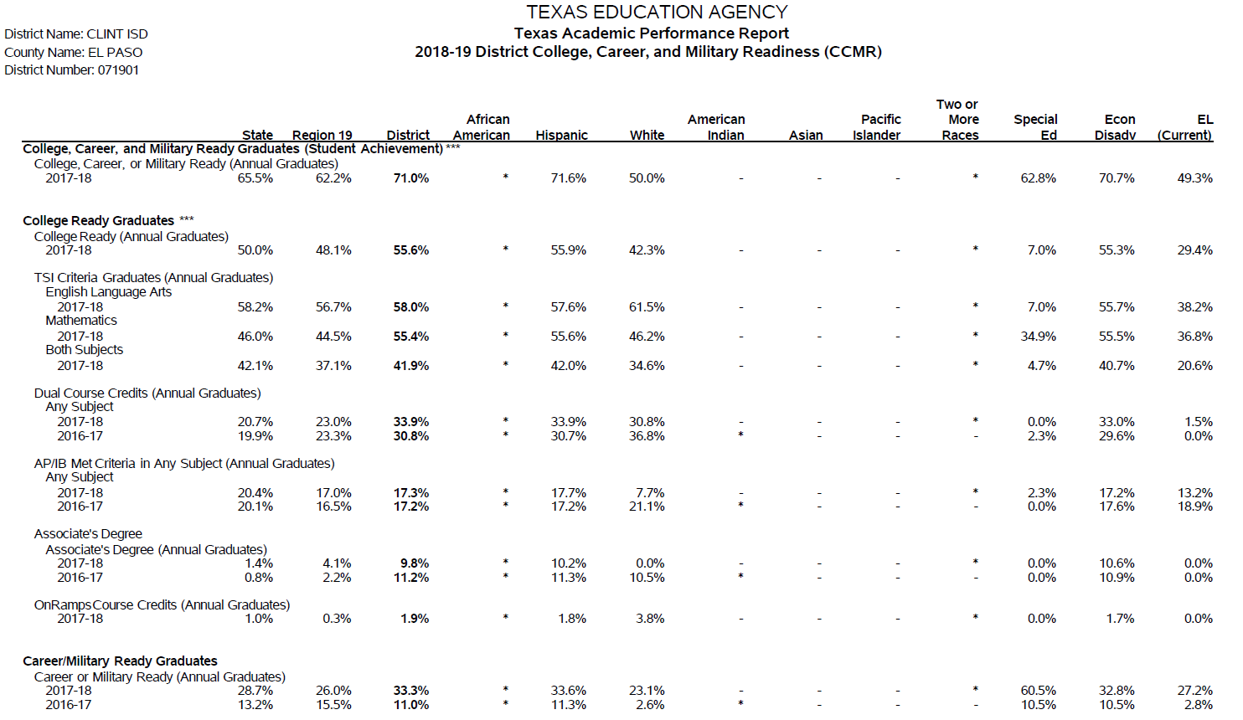
Section 1: 2018-19 TAPR
College, Career and Military Readiness (CCMR) Data

Slide 18
Other Data Indicators included within TAPR:
Section 1: 2018-19 TAPR
Other Postsecondary Indicators
  Dual-credit course completion, graduates enrolled in Texas institutions of higher education, graduates completing a year with remediation
Student Information
  Student enrollment (including enrollment by grade level, by ethnicity, by certain student identification indicators, and students with disabilities by primary eligibility category) and other student information (including graduation information, retention rates, and class size information)
Staff Information
  Staff information (including total staff, staff by classification, teachers by ethnicity and gender, teachers by highest degree held and years of experience, experience of campus leadership, staff salary, and teacher turnover rate information)
Program Information
  Student enrollment by program
  Teachers by program

Slide 19
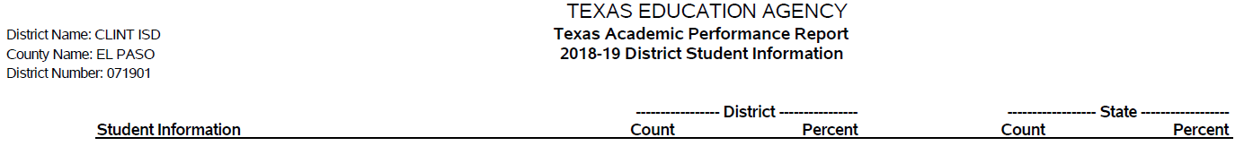
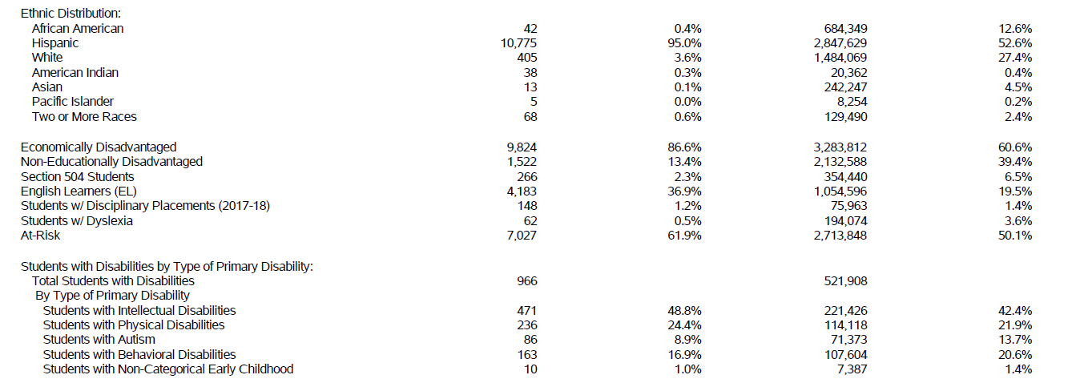
Section 1: 2018-19 TAPR
Student Information

Slide 20
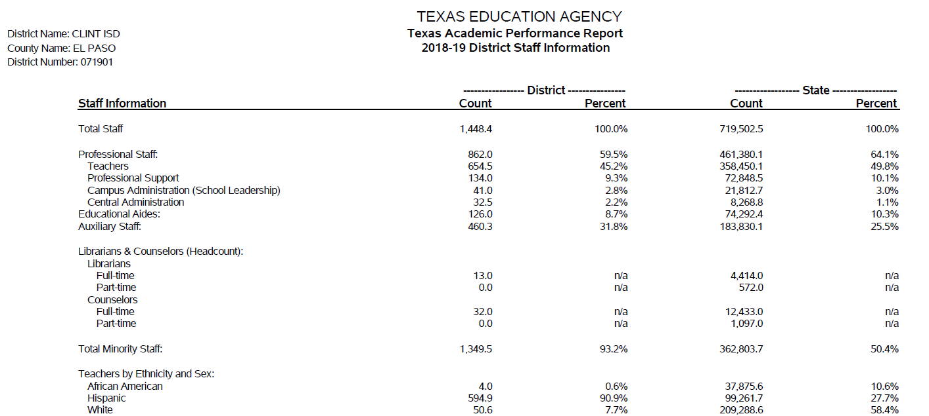
Section 1: 2018-19 TAPR
Staff Information

Slide 21

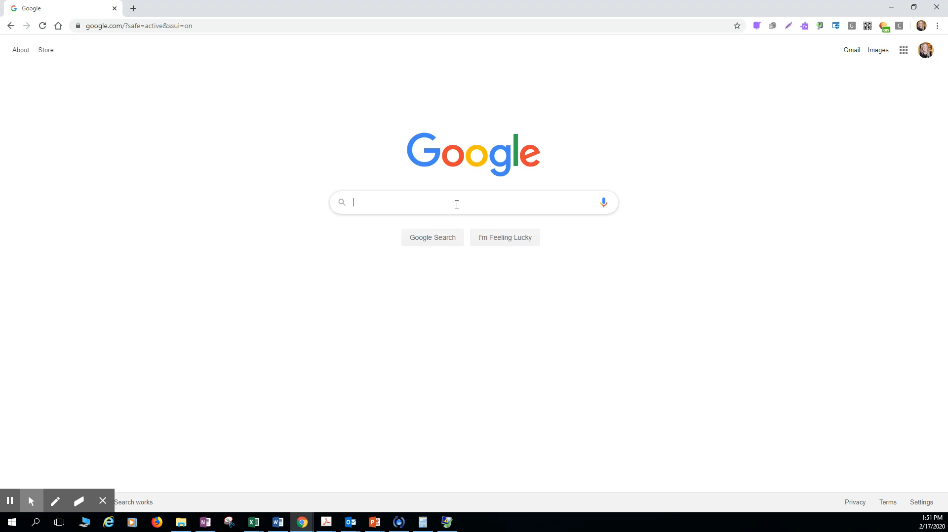
How To Access the District and Campus TAPR Reports
Clint ISD Website > Departments > Accountability & Student Achievement > TAPR Report

Slide 22
End of Section 1
TAPR
Start of Section 2
Financial Standard Reports

Slide 23
Section 2:PEIMS Financial Standard Reports
(2017-18 Financial Actual Reports)
2017-18 Actual Financial Data
(District)
Receipts
Fund Balances
Disbursements
Program Expenditures
Tax Rates
2016 Tax Year State Certified Property Values
Unassigned Fund Balance (% of Total Budgeted Expenditures)
2017-18 Actual Financial Data
(Each Campus)
Expenditures by Object
Expenditures by Function
Program Expenditures by Program
Financial information has been shared with the School Board of Trustees during the annual audit financial review and approval.
The district and each campus financial standard report can be found within the 2017-18 Annual Report, which is posted on the district’s website.

Slide 24
End of Section 2
Financial Standard Reports
Start of Section 3
District Accreditation Status

Slide 25
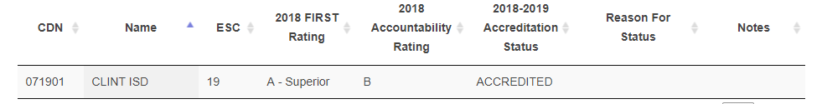
Section 3: 2018-19 District Accreditation Status
Each year, TEA assigns one of four accreditation statuses to each district in the state:
  Accredited
  Accredited-Warned
  Accredited-Probation
  Not Accredited-Revoked
In assigning an accreditation status to a district, TEA considers
  Academic accountability ratings
  Financial accountability ratings
  Data integrity
  Program-area deficiencies identified through PBMAS
The District’s 2018-19 Accreditation Status is: ACCREDITED

Slide 26
End of Section 3
District Accreditation Status
Start of Section 4
Campus Performance Objectives

Slide 27
Section 4: Campus Performance Objectives
Campus Improvement Plans (CIP)
  Each campus has developed and is implementing a CIP, as required by TEC §11.253
  Each CIP includes performance objectives (approved by the Board) that are based on data analysis and needs assessments – including data reported in annual TAPR reports
  Each campus periodically measures progress toward its performance objectives
Campus Performance Objectives are approved by the Board
Campus CIPs are posted on the school’s website and are available for review at the district’s central office or on each campus
The 2018-19 performance objectives and progress toward each can be found within the 2018-19 Annual Report, which is posted on the district’s website.

Slide 28
End of Section 4
Campus Performance Objectives
Start of Section 5
Report on Violent or Criminal Incidents

Slide 29
Section 5: Report on Violent or Criminal Incidents
TEC Section 39.306 requires each district to publish, as part of its Annual Report, a report on violent and criminal incidents at each campus in the district
The report must include
  Number, rate and type of violent or criminal incidents that occurred on each campus
  Information concerning school violence prevention and violence intervention policies and procedures the district is using to protect students
  Findings that result from evaluations conducted under the Safe and Drug-Free Schools and Communities Act
The 2018-19 report on violent or criminal incidents can be found within the 2018-19 Annual Report, which is posted on the district’s website.

Slide 30
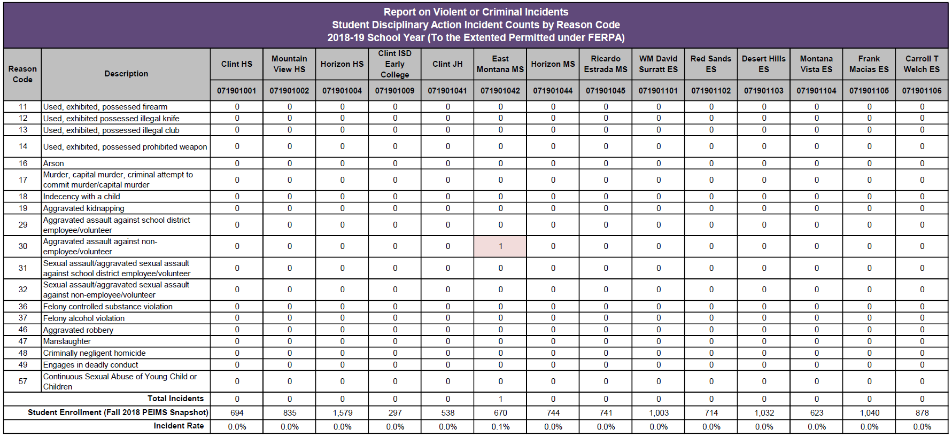
Section 5: Report on Violent or Criminal Incidents

Slide 31
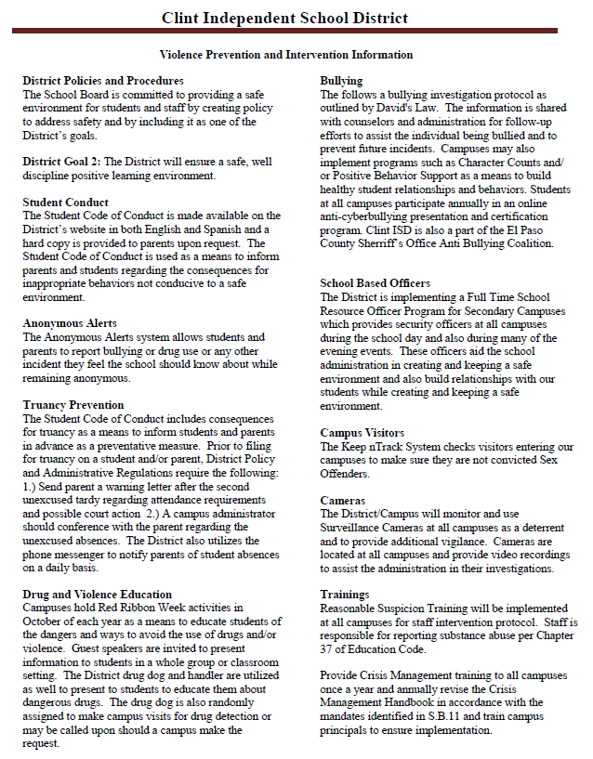
School Violence Prevention
District Policies – BQ and FF
Student Code of Conduct
Anonymous Alerts
Truancy Prevention
Drug and Violence Education – Red Ribbon Week
Bullying Investigation Protocol – David’s Law
School Based Officers
Check-In of Campus Visitors
Cameras
Training – Reasonable Suspicion

Slide 32
End of Section 5
Report on Violent or Criminal Incidents
Start of Section 6
Student Performance in Postsecondary Institutions

Slide 33
Section 6: Student Performance in Postsecondary Institutions
TEC Section 39.306 requires each district to publish, as part of its Annual Report, a report on student performance in postsecondary institutions during the first year enrolled after graduation from high school
These data are compiled by the Texas Higher Education Coordinating Board (THECB)
The most current report is for 2016-17 High School Graduates
  Student performance is measured by the Grade Point Average (GPA) earned by 2016-17 high school graduates who attended public four-year and two-year institutions of higher education in fiscal year 2018
  For each student, the grade points and college-level semester credit hours earned by the student in Fall 2017, Spring 2018, and Summer 2018 are added together and averaged to determine the GPA

Slide 34
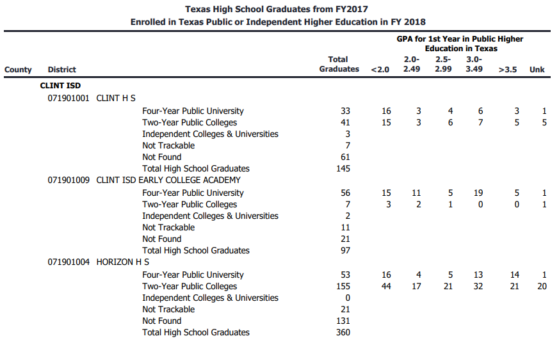
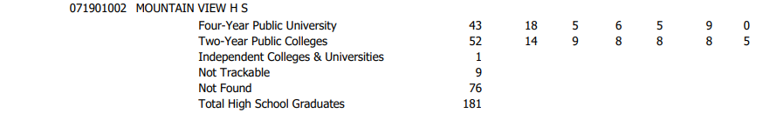
Section 6: Student Performance in Postsecondary Institutions

Slide 37
End of Section 6
Student Performance in Postsecondary Institutions
Start of Section 7
TAPR Glossary

Slide 38
Section 7: TAPR Glossary
Provides definitions, describes methodologies, and lists sources for each data point in the TAPR
The TAPR Glossary is available within the 2018-19 Annual Report posted on the district’s website.

Slide 39
End of Section 7
TAPR Glossary

Slide 40
Resources and Availability of Annual Report
The District’s TAPR and 2018-19 Annual Report are posted on the district’s website
Paper copies of the TAPR will also available at the district’s central office and on each campus in the district
For questions or more information, contact:
Name | Ms. Jessie Cline
Position | Coordinator of Data and Accountability
Phone | (915) 926-4044
Email | Jessie.Cline@clint.net

Slide 41

Questions?

Slide 42

Thank you!

