Slide 1
Spring 2024 Standardized Assessment Results
Presentation to the Woodbridge Board of Education
October, 2024
Presented by:
Jimmy Sapia - Assistant Principal
Cheryl Tafel - Assistant Principal
October 21st, 2024

Slide 2
Foundational Points
Smarter Balanced Assessment assesses grades 3-8 students in literacy & mathematics
Next-Generation Science Standards (NGSS) Assessment assesses grade 5 students in science
Accurately describes student achievement and growth
Measures students’ progress/attainment of knowledge and skills
Provides an annual snapshot of student achievement
Aligned to Common Core State Standards
Utilizes computer adaptive testing
Includes one math performance task

Slide 3
Achievement Levels
Four Achievement Levels:
•Level 1 = Does not meet the achievement standard
•Level 2 = Approaching the achievement standard
•Level 3 = Meets the achievement standard
•Level 4 = Exceeds the achievement standard
Achievement levels:
Specify the knowledge and skills at a certain level
Are less precise than scale scores
Note: characterizing a student’s achievement solely in terms of a level is an oversimplification

Slide 4
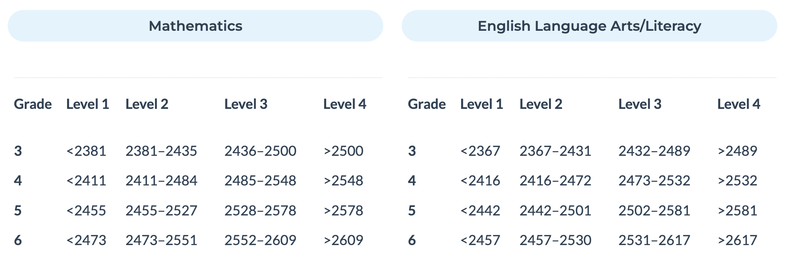
Average Vertical Scaled Score

Slide 5
Background Information: English Language Arts
Areas of Knowledge and Skills Measured | Statement About Student Learning From Which the Assessment was Built
Reading | Students can read closely and analytically to comprehend a range of increasingly complex literary and informational texts.
Writing | Students can produce effective and well-grounded writing for a range of purposes and audiences.
Listening | Students can employ effective speaking and listening skills for a range of purposes and audiences.
Research/Inquiry | Students can engage in research/inquiry to investigate topics, and to analyze, integrate, and present information.

Slide 6
Smarter Balanced Literacy
2023- 2024 | Levels 3 + 4 (Met or Exceeded Grade-Level Standard) | Level 3 (Met Grade-Level Standard) | Level 4 (Exceeded Grade-Level Standard)
Grade 3 | 71.8% | 21.4% | 50.4%
Grade 4 | 81.8% | 28.2% | 53.6%
Grade 5 | 80.3% | 18.8% | 61.5%
Grade 6 | 90.8% | 36.6% | 54.2%

Slide 7
Background Information: Mathematics
Areas of Knowledge and Skills Measured | Statement About Student Learning From Which the Assessment was Built
Concepts and Procedures | Students can explain and apply mathematical concepts and interpret and carry out mathematical procedures with precision and fluency.
Problem Solving | Students can solve a range of complex well-posed problems in pure and applied mathematics, making productive use of knowledge and problem-solving strategies.
Communicating Reasoning | Students can clearly and precisely construct viable arguments to support their own reasoning and to critique the reasoning of others.
Modeling and Data Analysis | Students can analyze complex, real-world scenarios and can construct and use mathematical models to interpret and solve problems.

Slide 8
Smarter Balanced Mathematics
2023- 2024 | Levels 3 + 4 (Met or Exceeded Grade-Level Standard | Level 3 (Met Grade-Level Standard) | Level 4 (Exceeded Grade-Level Standard)
Grade 3 | 79.5% | 29.9% | 49.6%
Grade 4 | 78.9% | 35.8% | 43.1%
Grade 5 | 74.4% | 17.9% | 56.4%
Grade 6 | 84.7% | 17.6% | 67.2%

Slide 9
NGSS Science - A Deeper Look
 | Levels 3 + 4 (Met or Exceeded Grade-Level Standard) | Level 3 (Met Grade-Level Standard) | Level 4 (Exceeded Grade-Level Standard)
Grade 5 | 79.5% | 44.4% | 35.0%

Slide 10
The Results: ELA - All Students
Grade | Percent Scoring Level 3 and Above |  |  | Average Vertical Scale Score
 | 2021-2022 | 2022-2023 | 2023-2024 | 2021-2022 | 2022-2023 | 2023-2024
3 | 73.4% | 75.5% | 71.8% | 2489 | 2487 | 2485
4 | 79.1% | 84.6% | 81.8% | 2547 | 2555 | 2539
5 | 83.5% | 84.4% | 80.3% | 2588 | 2593 | 2588
6 | 85.4% | 81.4% | 90.8% | 2609 | 2609 | 2622
All Grades | 80.35% | 81.47% | 81.17% | N/A | N/A | N/A
Notes:
Statewide trend was a decrease in LA
Not a matched cohort-- students have moved in and out
Note growth across years-- Grade 3 to grade 6 there is consistent growth
DRG growth across grades not as high

Slide 11
The Results: Math - All Students
Grade | Percent Scoring Level 3 and Above |  |  | Average Vertical Scale Score
 | 2021-2022 | 2022-2023 | 2023-2024 | 2021-2022 | 2022-2023 | 2023-2024
3 | 79.8% | 75.7% | 79.5% | 2497 | 2488 | 2499
4 | 80.6% | 87.2% | 78.9% | 2545 | 2552 | 2540
5 | 66.1% | 82.8% | 74.4% | 2557 | 2586 | 2581
6 | 79.7% | 76.5% | 84.7% | 2614 | 2609 | 2632
All Grades | 76.55% | 80.55% | 79.37% | N/A | N/A | N/A
Notes:
Asked state to verify results of grade 5 students
State cohort trend: Grade 3 in 2014-2015: 47.7%
Grade 4 in 2015-2016: 47.9%
Grade 5 in 2016-2017: 42.9% (Overall downward trend)

Slide 12
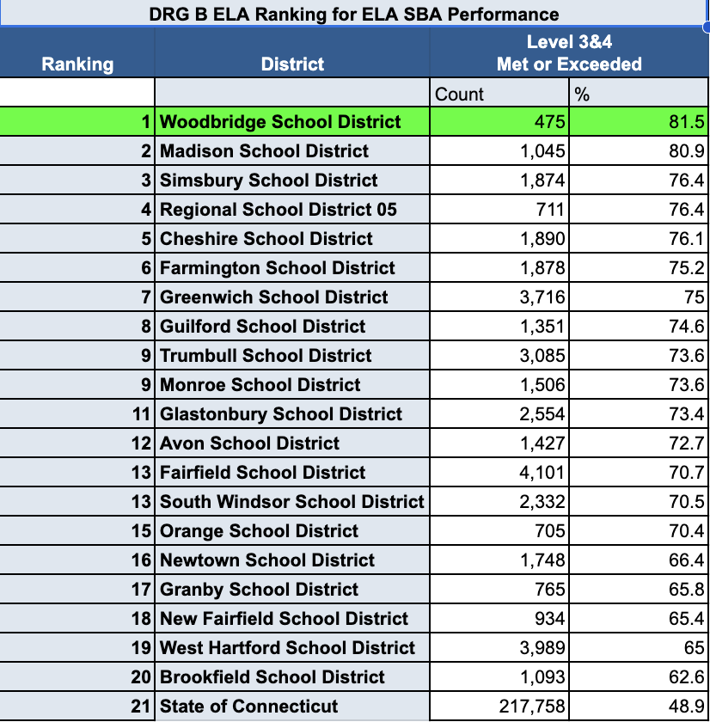
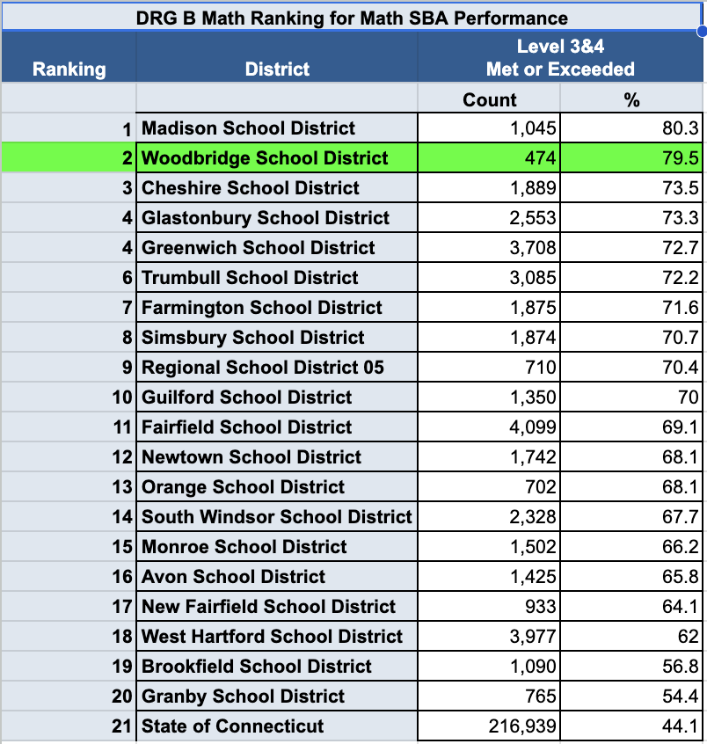
DRG

Slide 13
What is growth? How is it different from achievement?
Achievement: A one-time snapshot measurement of a student’s academic performance
Growth: Change in achievement score for the same student between two or more points in time.

Slide 14
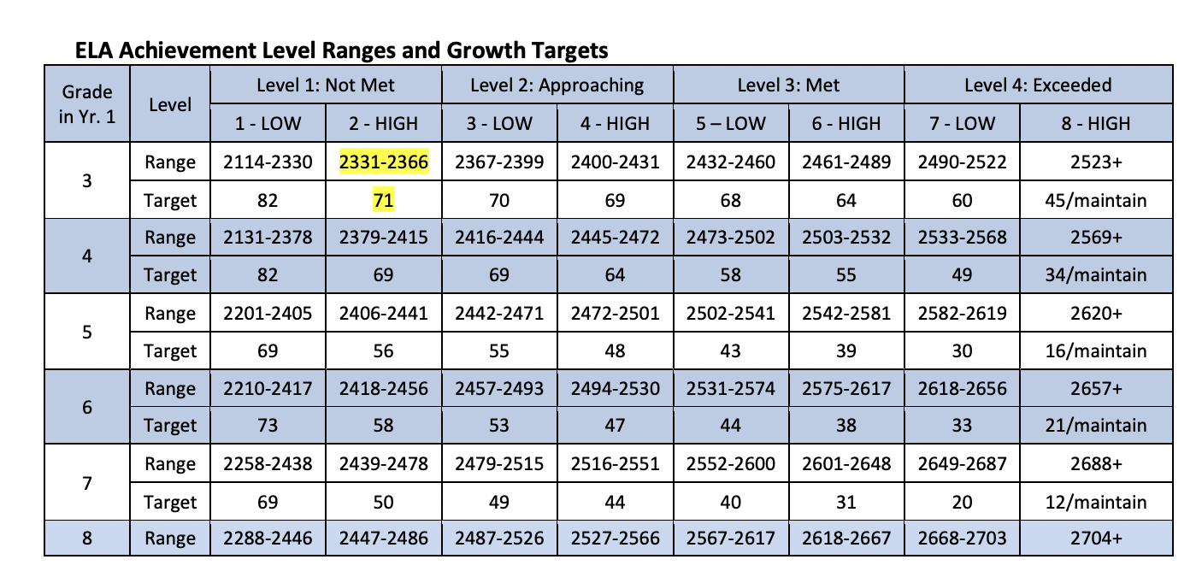

Slide 15
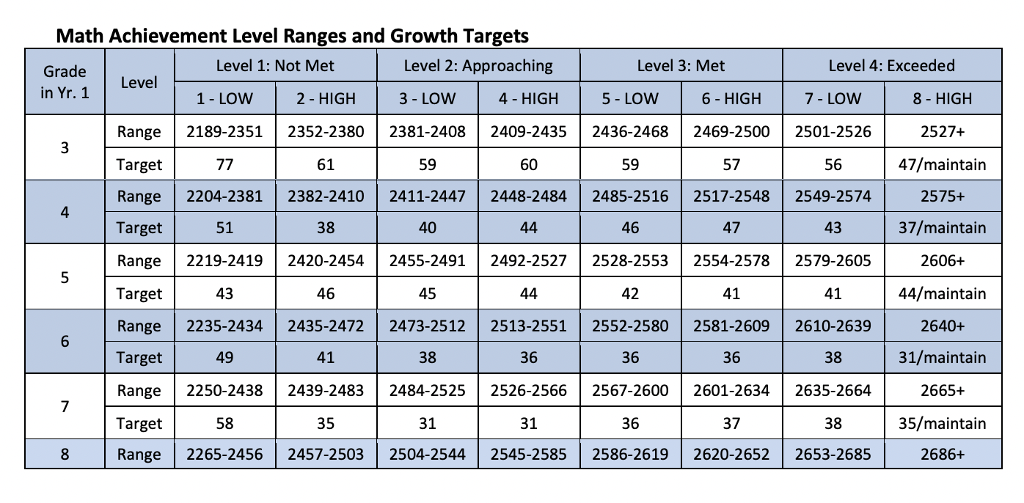

Slide 16
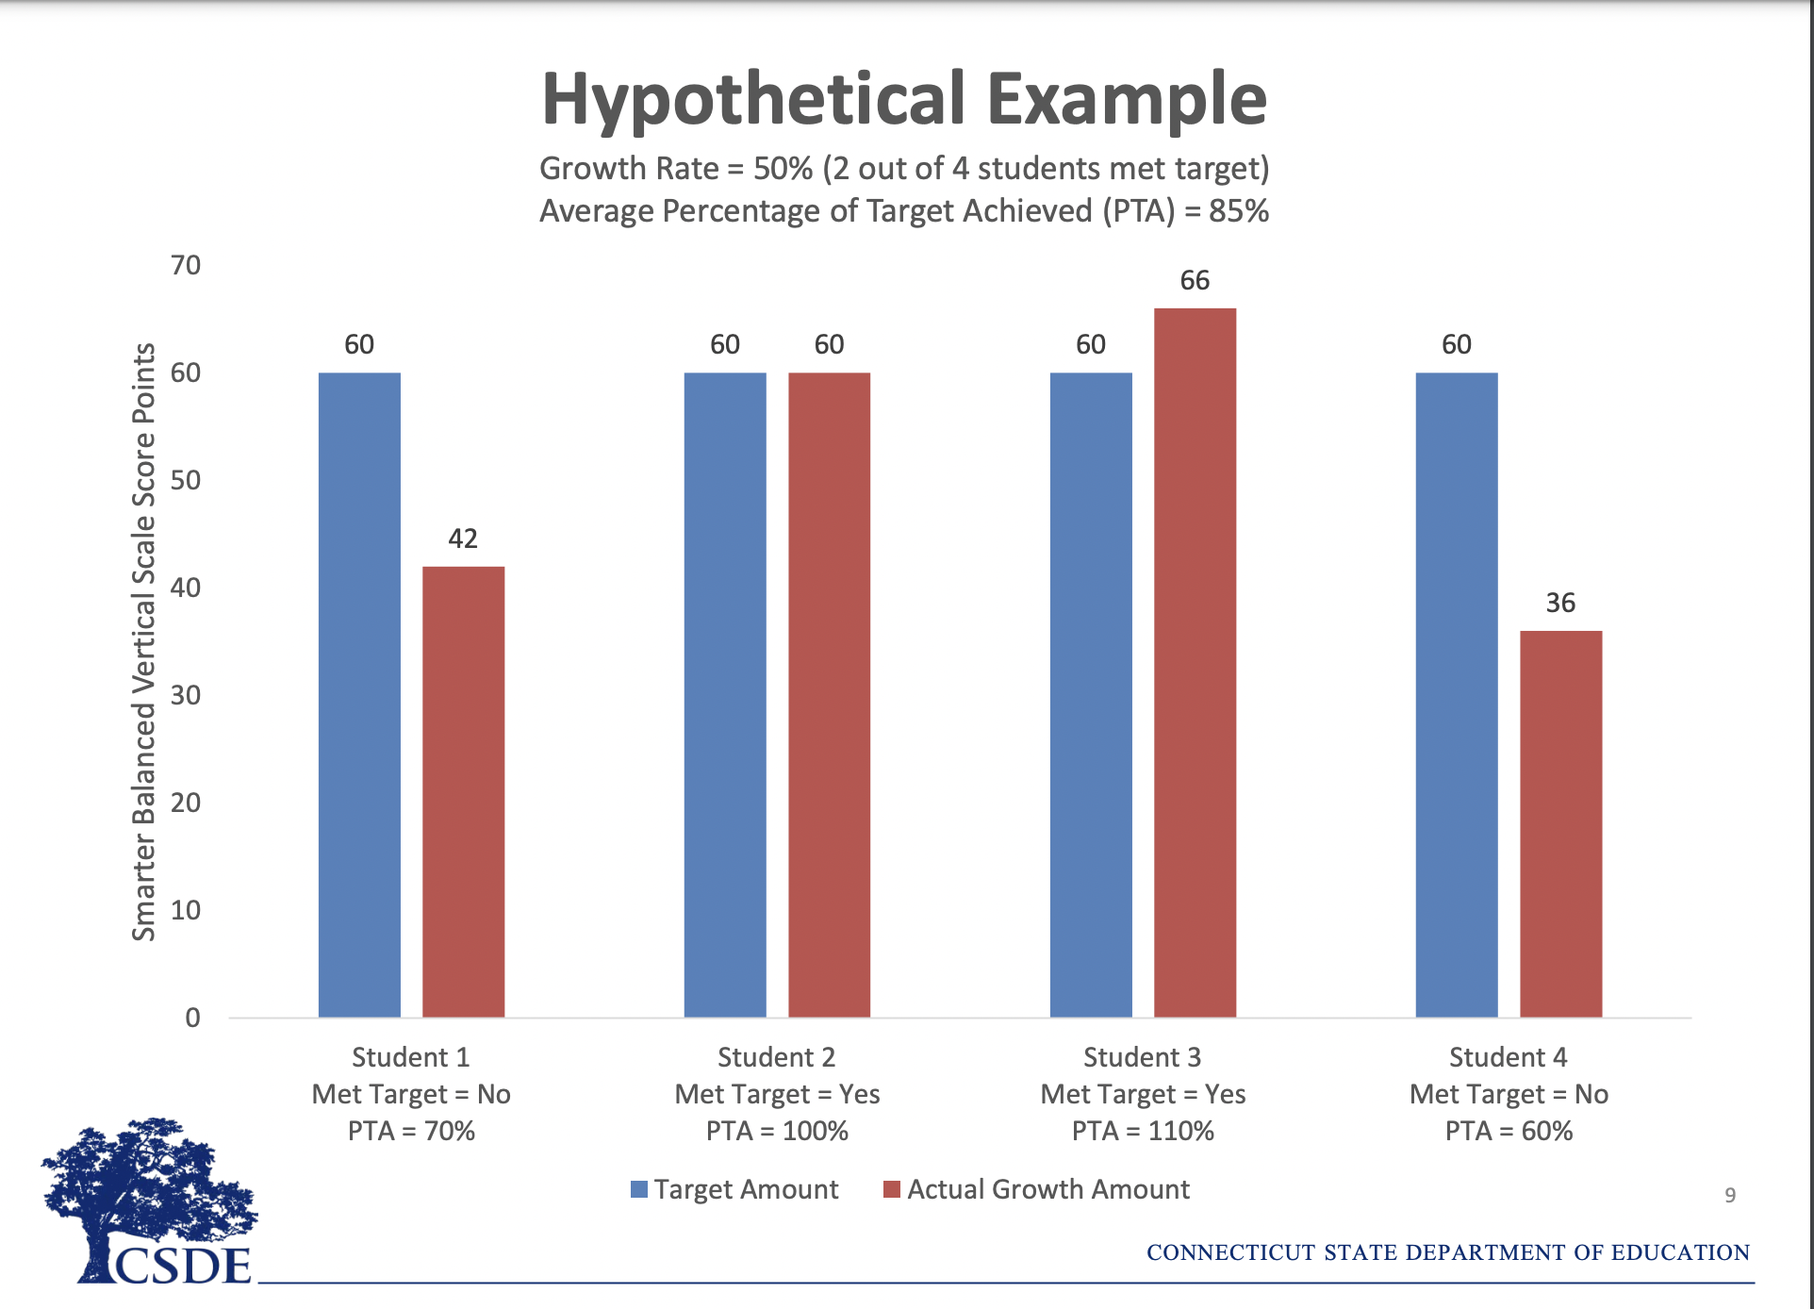

Slide 17
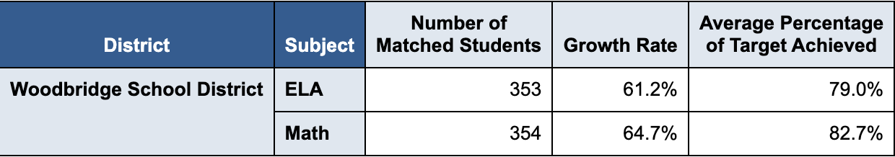
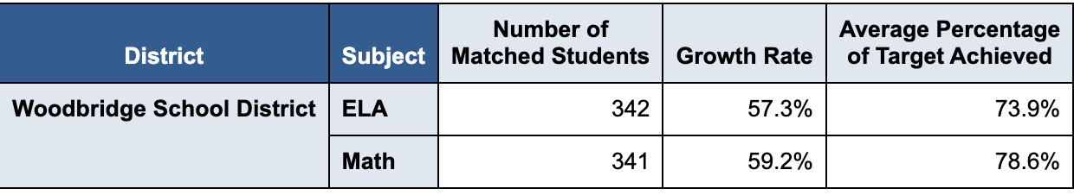
Growth Rate and Average Percentage of Target Achieved;
2022-2023
2023-2024

Slide 18
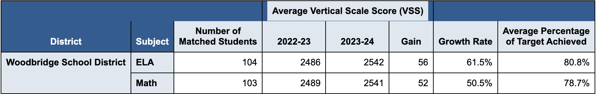
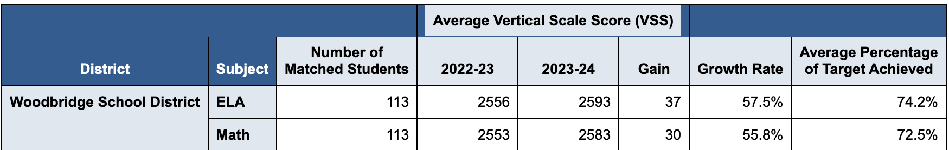
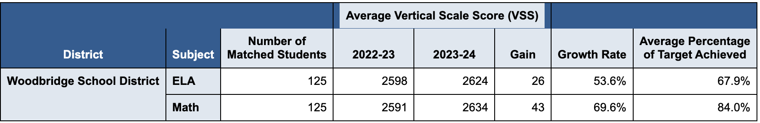
Grade 4
Grade 5
Grade 6

Slide 19
Follow Up and Next Steps
Grade level analysis of SBA data by homeroom and former students
Continued ongoing professional learning and curriculum review/development
Progress monitoring using STAR, Dibels, Classroom Assessments
Feedback and coaching within the classroom and PLC meetings
Earlier implementation of Interim Assessment Blocks administered at all grade levels and utilizing data to support students.
  Give students appropriate exposure and practice to the tools necessary to demonstrate knowledge
Administrative review of teacher longitudinal data to analyze trends to drive next steps around instructional strategies to support teacher growth
Continued focus on the whole child

Slide 20


