Slide 1

West Valley Central School
2015-2016 School Budget Hearing
May 11, 2015

Slide 2


Overview of Budget
 | 2014-2015 | 2015-2016 | $ Increase | % Increase
Budget | 8,719,882 | 8,875,000 | 155,118 | 1.78%
Tax Levy | 3,253,939 | 3,253,939 | - | 0.00%
Rate on True Value | 23.65 | 23.65 | - | 0.00%
Actual change in true value from 2013-2014 ($23.83 per thousand of assessed value) to 2014-2015 ($23.65 per thousand of assessed value) was -.18 cents or -.7%

Slide 3

Summary of Revenues
Summary of Revenues & Other Sources of Funding
 | 2014-2015 | 2015-2016 | Inc (Dec)
 | Budget | Proposed Budget | Over Prior Year
State Aid | $ 4,435,649 | $ 4,680,501 | $ 244,852
PILOT(Payments in Lieu of Tax) | 322,245 | 323,511 | 1,266
Other Revenue | 40,400 | 32,400 | (8,000)
Estimated Tax Levy & STAR Reimb. | 3,253,939 | 3,253,939
TOTAL REVENUE | $ 8,052,233 | $ 8,290,351 | $ 238,118
Interfund Transfer of Debt Service | 65,000 | - | (65,000)
Appropriated Fund Balance | 569,500 | 551,500 | (18,000)
Appropriated Retirement Reserve | 33,149 | 33,149 | -
TOTAL REVENUE & OTHER SOURCES | $ 8,719,882 | $ 8,875,000 | $ 155,118

Slide 4
Gap Elimination Adjustment
What is the Gap Elimination Adjustment (GEA)?
The GEA was instituted by NYS in 2010-2011 to assist in closing the State’s budget gap
West Valley CSD has lost $2,670,581 in state aid since its inception
For 2015-2016, $233,889 of the District’s GEA was restored leaving a current reduction of -$126,999
The GEA formula has created additional inequity between wealthy and poor districts.
Average need Districts such as West Valley have been hit the hardest.
Note: In 2009-2010 the District lost an additional $267,826
In state aid through the Deficit Reduction Assessment (DRA)

Slide 5
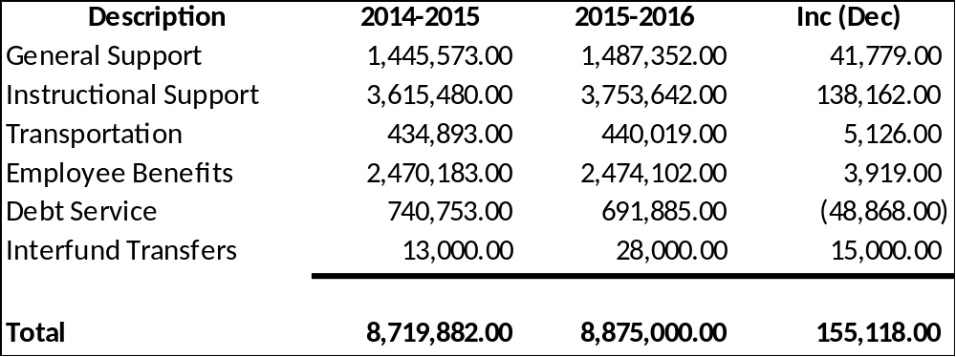

Budget Summary

Slide 6
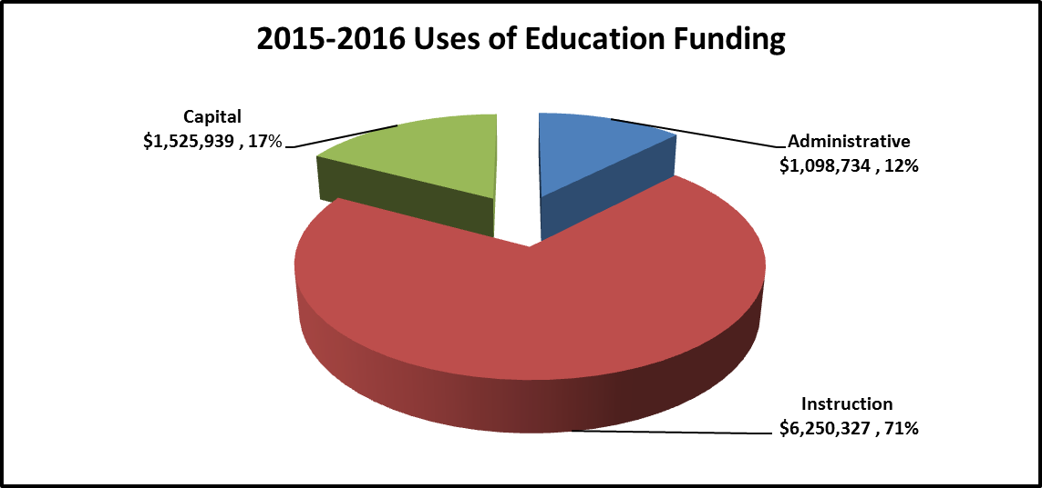
Budget Components

Slide 7
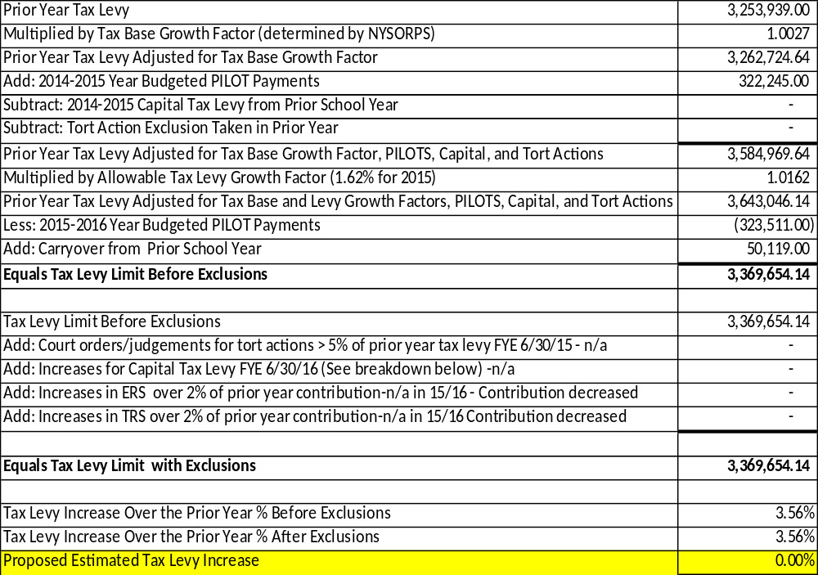
Property Tax Limit

Slide 8
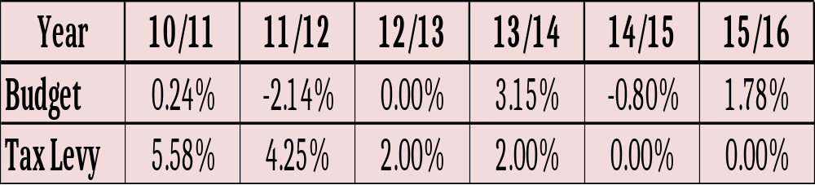

History of Budget and
Tax Levy Increases

Slide 9
History of State Aid
& Tax Levy

Slide 10
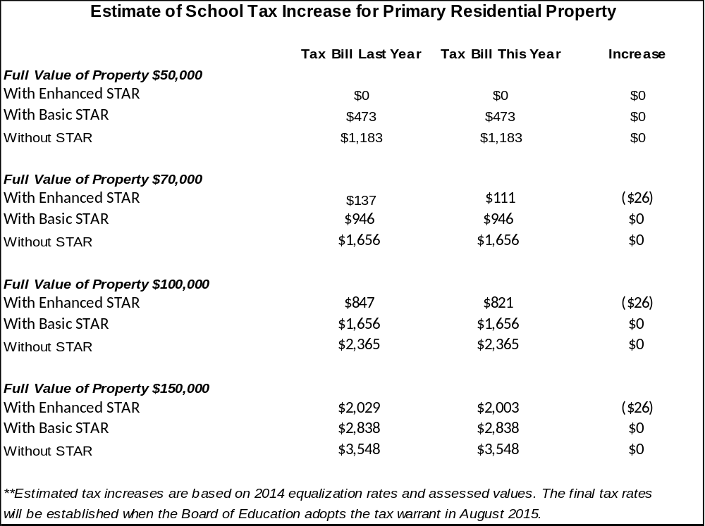
Estimated Impact on
Property Tax Bill

Slide 11
STAR
(School Tax Property Relief)
Includes two components:
  $30,000 – Basic Exemption
  $65,300 – Enhanced Exemption (Increase of $1,100 over prior year)
Exemptions are adjusted for equalization rates and a sales price differential factor developed by the NYS Office of Real Property
The maximum STAR savings cannot exceed more than 2% of the prior year savings-Simply stated the STAR savings cannot grow by more than 2%.
Who is eligible?
  Primary residences qualify for the Basic Exemption if the combined income of the owners is $500,000 or less
  Homeowner’s of primary residences with at least one person 65 years of age or older with a household income of less than $81,900 qualify for the Enhanced Exemption
Basic Star Recipients must register with the NYS Tax Department

Slide 12
Property Tax Freeze Credit
Establishes a credit for residential property owners who are eligible for the STAR exemption
If a homeowner failed to apply for STAR they will still receive the credit
The credit is effective for years 2014-2015 and 2015-2016
To be eligible for credit on school taxes the District will have to comply with the tax levy limit
including exclusions
To be eligible for credit on town and county taxes each individual municipality will have to
comply with their own tax levy limit
Rebate checks will be issued by the NYS Department of Tax and Finance in October
The rebate will be equal to the greater of the 2015-2016 increase in school tax, or 1.62% of
the 2014-2015 tax bill
The estimated rebate for a homeowner who resided in a home with a fair market value
of $100,000 is: $27 if you receive the Basic STAR exemption, $14 if you receive the Enhanced
STAR exemption

Slide 13
Property Tax Freeze Credit
(continued)
To be eligible for the rebate in 2015-2016 the District must comply with the tax levy limit
and have an approved efficiency plan on file with NYS
The efficiency plan must demonstrate that the District will achieve 3 years of savings
equivalent to 1% of its tax levy starting in 2016-2017. For WVCS this equals approx. $32,000
The rebate will be equal to the 2014-2015 rebate plus the greater of the increase in school
taxes in 2015-2016 or the 2014-2015 school taxes multiplied by the lesser of 2% or the
applicable CPI
Rebates will not include an increase in taxes for property improvements, or loss of
exemptions
The rebate is not dependent on when, or if a tax bill is paid
The District will be filing a multi-government efficiency plan with 21 component districts in the
Cattaraugus Allegany BOCES. Our savings will be based on the result of the quote we received
for prescription service for the self funded health insurance consortium the district’s participate
In. Total saved for all the district’s is $1.681 million. West Valley’s savings is $57,624 which is
above the 1% needed.

Slide 14


Proposition #3 - School Bus
Proposition #3 includes the purchase of one 65
passenger bus at a cost not to exceed $108,000.
Bus #80, which has approximately 118,000 miles,
will be traded in upon purchase of the new bus.
Trade-in value = $4,000.
For every $1 spent on a bus purchase approximately
$.775 is received back from NYS. The estimated local
Share for this bus is estimated at $24,000.

Slide 15

Proposition #4 - Capital
Reserve Fund
Proposition #4 will ask the voters to create a Capital Reserve Fund. This fund will allow the District to set aside money over time to be used to maintain the school facility. The creation of the fund would allow the District to set aside up to $950,000. The reserve funds would be used to pay for the local share of a capital project, avoiding the need to increase taxes. Protecting the District’s investment by maintaining the school building and property through capital projects results in the least amount of cost to the local taxpayer as 85% of the project’s cost is reimbursed by New York State. The District’s school building will continue to have needs as it ages. After creation of a Capital Reserve Fund the voters would also have to approve future use of the funds.
The amount originally authorized, $950,000, could only be used once. Any additional amounts added to the reserve would need voter approval. For example, if $400,000 was used there would only be $550,000 remaining in the fund unless the voters authorized more.

Slide 16

School Board Member Election
There are two seats open for election to the Board of Education.
One seat carries a 5 year term to replace Dennis McCauley who is not running.
The other seat also carries a 5 year term to replace Jim Boberg.
There are no candidates running the election, so write in options will be available.

Slide 17


Annual Budget, School Board Election, and Capital Project Vote
Tuesday, May 19th
WVCS Main Entrance Foyer
12:00 noon to 9:00 pm
Education is the most
powerful weapon
Which you can use to
change the world.
~Nelson Mandela~
Thank you for your support!

