Slide 1
West Valley School Budget
2023-2024
First look at Budget Process and NYS Updates
February 2023

Slide 2
Goals & Direction
Create a budget that maintains & enhances core values and programmatic requirements.
Be mindful of the tax impact on our community and keep the tax burden at or below NYS’s tax cap as applied to our District.
Create an atmosphere that returns West Valley to being a school of destination...things like…

Slide 3


Slide 4
Albany SCHOOL Updates
The Governor's proposal:
FULLY FUNDS FOUNDATION AID
EXPANDS PRE-K
INCREASES CERTAIN MENTAL HEALTH SERVICES
INCREASES TO MINIMUM WAGE
ESTABLISHES AID FOR ZERO-EMISSION BUSSES (Goals to 2035)

Slide 5
What does this mean to us
Approx. a 3% increase to foundation aid meaning $106K
We’ll monitor the State’s budget process
Lobby for more, higher, funding levels
Review our remaining Federal Funds to maximize their use being aware that we have parts of 9 positions that we will need to incorporate (or reduce) for the 2024-2025 budget year; we have already begun to build the flexibility needed by not filling certain positions through attrition.

Slide 6
Still Reviewing…..
Special Education placements and costs
School Resource Officer; possible collaboration with the Town of Ashford
Continuing professional development once grant funds are reduced or eliminated
Refinish gymnasium floor
Other items in the Gov. proposal that have an impact on schools; either directly or indirectly.

Slide 7
Next Steps
Reviewing and inputting the NYS Real Property Tax Levy Limit Law numbers into the NYS Comptroller’s site (TAX CAP CALCULATION)
April 1st is the deadline date for the Gov & Legislature to finalize a budget; will we receive additional funds, hopeful but doubtful.
Reviewing all expense estimates especially:
  NYS Retirement Systems
  Health Coverage
  Capital project

Slide 8
Time Frame
MARCH BOE MEETING
  We will have recommendations for a proposed budget and tax levy
  Still pending NYS budget approval
APRIL BOE MEETING:
  Final budget proposal will be approved
MAY 16th
  Budget Vote
  BOE Candidates Vote
  Bus Purchase

Slide 9

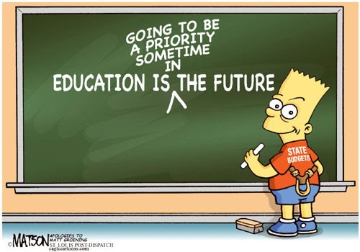
Q U E S T I N S ?
This Photo by Unknown Author is licensed under CC BY-SA

