Slide 1
College Essay Workshop
Jade Saybolt ‘16
sayboltj@lafayette.edu
Lafayette College

Slide 2
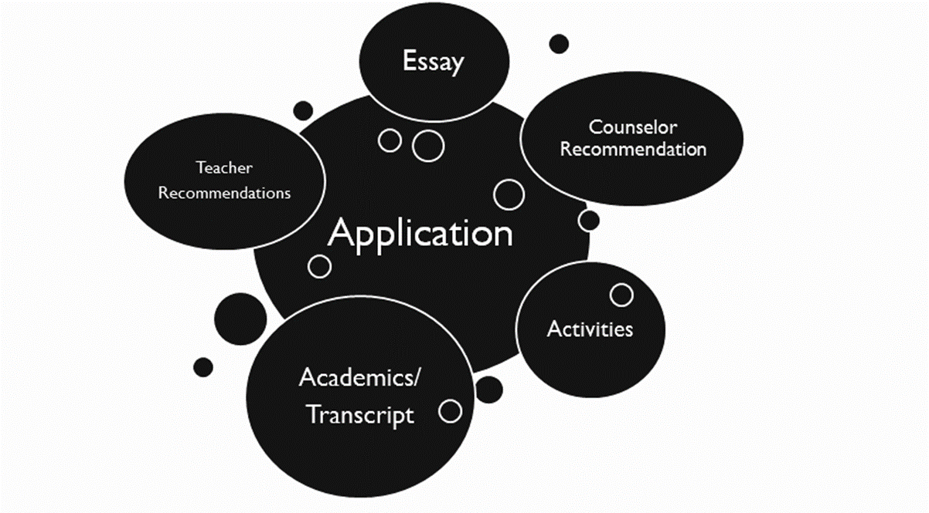
Holistic Review- Many sources of Info
Notes:
The Common App
-what is it
-why do we have it
-do all schools subscribe to it?

Slide 3
What are Schools Looking for?
Potential to Contribute to Community
Diversity of backgrounds, interests and experiences
Evidence of Academic Preparation

Slide 4




Your Words Matter: College Essay
Four C’s to Aim for
Content
Clarity
Correctness
Creativity
Notes:
Essay
-many ways to share who you are through your writing
-the purpose of essay is about YOU! (not your topic, good for context)
-share your story, who you are, what’s important to you
-each section is a different way for you to express yourself
-essay is more formal, add info is less formal, supplemental is school specific
-write in whatever style you want, there’s no right way to write an essay

Slide 5
Your Writing Communicates
Help the reader feel like they’ve met you
Writing Skills
Intellectual Interests
Personality & Character
Broader Context

Slide 6

Tips for Moving Forward
Do:
●Focus (blade of grass, not field)
●Respond to the prompt
●Read your essay aloud
●Be your most genuine and mature self
●Ask yourself, “What do I want the reader to know about me after reading this essay?”
Don’t:
●Take inappropriate risks
●Draw overly simplistic conclusions
●Use another college’s name
●Make simple grammatical and spelling errors
●Lose your authentic voice

Slide 7


Questions?

