Slide 1




ANNUAL TITLE I PARENT MEETING
Ridgeview Charter Middle School
Thursday, September 7th @ 5:30 PM
FEDERAL PROGRAMS
FULTON COUNTY SCHOOLS
2023-2024

Slide 2

WELCOME
STAFF
PARENTS/GUARDIANS
FAMILIES
COMMUNITY MEMBERS
WELCOME

Slide 3

Objectives
Understand what makes our school a Title I school including requirements, funding, and associated programs
Understand school provided resources such as curriculum, assessment, parent resources, and staff contact information
Understand Family Engagement at our school

Slide 4


What is a title I school?
The largest federally funded educational program
Provides supplemental funds to districts to assist schools with the highest student concentrations of economic hardship
Provides supplemental funds to districts to assist schools with concentrations of economic hardship to meet school educational goals
A school receiving federal funds for Title I students
Every Student Succeeds Act (ESSA) includes provisions that will help to ensure success for students and schools

Slide 5

How does our school spend title I money?
Personnel
  Additional Math Teacher
  Additional Reading Teacher
Parent Resource Center
Instructional Materials
Professional Learning

Slide 6


How is title I parent and family engagement money spent?
Parent Liaison
Parent Resource Center Materials
Parent Workshops (academic, technology, etc.)

Slide 7

How does our school participate in the title I program?
Title I Schoolwide Program
A Title I schoolwide program is a comprehensive reform strategy designed to upgrade the entire educational program in a Title I school
Primary goal is to ensure that all students, particularly those who are low-achieving, demonstrate proficient and advanced levels of achievement on state academic standards

Slide 8

What are our school’s title I schoolwide requirements?
Provide high-quality curriculum and instruction
Required to hold an Annual Title I Meeting
Family Engagement
Professional Development
Parent’s right to know
Annual Evaluations

Slide 9

Ridgeview Middle School Schoolwide program – past and present
80% of all students will pass ELA, Math, Science, and SS with 45% of students having a 45% proficiency rate in all content areas.

Slide 10
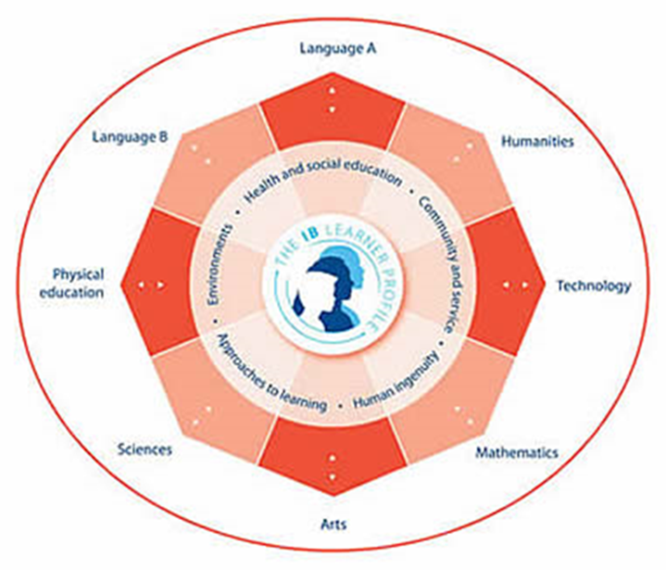
MYP
Framework of instruction that changes how we teach SMF curriculum:
All subjects focus on attaining knowledge, inquiring as a process, and critically thinking as an outcome.
IB projects one or two times per semester in each class to apply knowledge, demonstrate inquiry, and produce a critically interrogated outcome.
Community service and global-mindedness
We are the state’s 2nd cluster of K-12 schools offering the most rigorous IB education to families

Slide 11

AVID and WICOR
Teaching and learning strategies which are high-engagement and develop needed skills in all classes when utilized weekly:
  Writing strategies
  Inquiry strategies
  Collaboration strategies
  Organization of learning strategies
  Reading strategies
We are a showcase school for AVID, a model of implementing these instructional approaches to successfully benefit students.

Slide 12
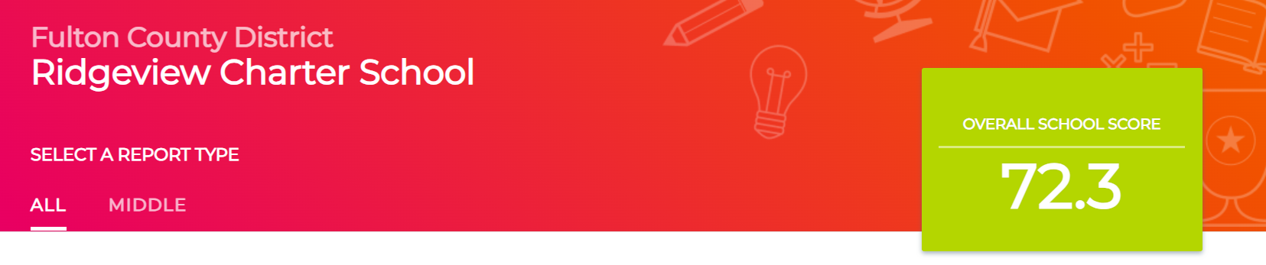

What is the state’s grades report for our school?
https://gosa.georgia.gov/dashboards-data-report-card/georgia-school-grades-reports
IMPORTANT Note regarding 2019-2020, 2020-2021, and 2021-2022 data:
For school years 2019-2020, 2020-2021, and 2021-2022, various pandemic-related issues resulted in incomplete data for most metrics and there was significant variation in student participation rates where data are available. Therefore, it is not advisable to make comparisons between schools and/or districts for these years. Additionally, the GaDOE did not calculate a CCRPI for school years 2019-2020, 2020-2021, and 2021-2022. Since GOSA’s A-F grade is based on the school’s CCRPI calculation, this site will not include a letter grade for the affected years.

Slide 13


What curriculum does our school use?
Fulton County uses the Standards Mastery Framework to ensure all students are meeting mastery of state standards
State standards are provided by Georgia Department of Education

Slide 14
What is the Standards Mastery Framework?
Standards Mastery Framework in FCS
The Standards Mastery Framework (SMF) is a set of tools designed to ensure a guaranteed and viable curriculum and deeper personalization of the learning experience for FCS students.
The tools include:
Learning Maps that consist of
  Prioritized Standards
  Proficiency Scales
  Evidence Blueprints
Assessment items and tasks
Scoring guides and student exemplars
Scales for reporting student success skills
Focus lessons
With the Standards Mastery Framework, teachers may enable each student to advance within and between courses upon demonstrated mastery and plan their instruction by considering 5 essential questions:
What do students need to know?
How do we know that they know it?
What is the plan for initial learning?
What do we do if they don’t know it?
What do we do if they already know it?

Slide 15
Essentially, a guaranteed and viable curriculum is one that is being taught in every classroom and can be taught in the time available.
What is a Guaranteed and Viable Curriculum?

Slide 16

What tests will my child be taking?
i-Ready and MAP Diagnostics
An Adaptive Diagnostic Assessment showing what students know and what they are ready to learn. An Adaptive Diagnostic means the questions change based on answers to earlier questions
WriteScore
A standards-based, Georgia Milestones-aligned writing assessment given to students in grades 3-8 that offers data analysis, reporting, and resources for teachers to use throughout the year to improve their student’s writing
WIDAW-APT
WIDA ​ACCESS is administered annually to all English learners in Georgia. ​​​​​​​​​​​​​​​​​​​​​​​​​​​​​​​​​​​​​​​​​​​​​​​​​​​​​​​​​​WIDA ​ACCESS is a standards-based, criterion-referenced English language proficiency test designed to measure English learners’ social and academic proficiency in English. It assesses social and instructional English as well as the language associated with language arts, mathematics, science, and social studies within the school context across the four language domains. ​​​​​​​​​​​​​​​​​​​​​​​​​​​​​​​​​​​​​​​​​​​​​​​​​​​​​​​​​​
Georgia Milestones Assessment System (GMAS)
Georgia Milestones is administered to students in grades 3 – 8. GMAS measures how well students have learned the knowledge and skills outlined in the state-adopted content standards in English language arts, mathematics, science, and social studies.
ACCESS for ELLs
ACCESS for ELLs is an English language proficiency assessment administered annually to kindergarten through 12th grade

Slide 17
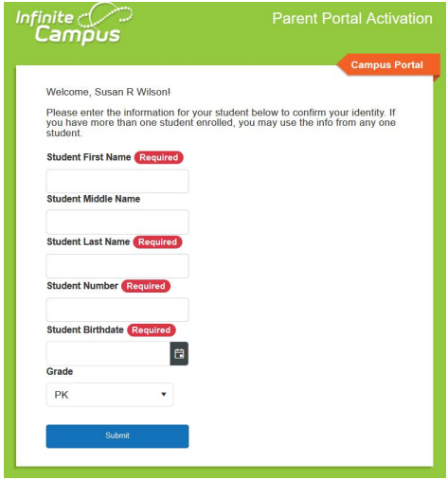
Infinite Campus
Infinite Campus – Parent Portal is the Fulton County Schools system to connect parents and students to student information. All parents must register to begin accessing Campus Parent
All current parents will receive an email to register
All parents new to Fulton will receive an email within 24 hours of enrollment
To register you must provide the following information
Student First Name, Last Name
Student Birthdate
FCS Student ID Number
Grade Level
https://www.fultonschools.org/infinitecampus

Slide 18

What is required by law for parent and family engagement?
Title I requires that all Title I schools ensure that all parents and families are given the opportunity for meaningful consultation in their child’s education:
School-Family Compact
Parent and Family Engagement Plan (PFEP)
District Parent and Family Engagement Plan
Title I also requires staff, families, and students must jointly develop the school compact
Parents & Families
Students
Staff

Slide 19

What is the district’s and school’s Parent and family engagement plan?
  https://bit.ly/DistrictPFEP_FY24_Eng
  https://bit.ly/DistrictPFEP_FY24_Spanish

Slide 20





What is a school-family compact?
Shared Responsibility
Linked to Learning
Jointly Developed
Increased Student Academic Achievement

Slide 21

Does my child’s teacher meet professional qualifications?
Parent’s right to know (pg.50)
In the 2023-2024 FCS Code of Conduct and Discipline Handbook
Electronic signature for acknowledgement of receipt form for handbook:
https://www.fultonschools.org/studentdiscipline

Slide 22

What opportunities does the school provide for family engagement?
Ridgeview Charter Middle School has opportunities for family engagement, volunteer opportunities and parent decision making meetings are listed below.
Thursday October 2nd: ELL Night (Virtual)
Tuesday, November 14th: Technology Night (Virtual)
Monday, December 4th: PBIS Workshop (Virtual)
Thursday, January 25th: Assessment Workshop (Virtual)
Thursday, March 21st: Georgia Milestones Night

Slide 23

How responsive will the school be to my questions when staff is contacted?
Ridgeview Charter Middle School
  5340 S. Trimble Road
  Sandy Springs, GA 30342
  (470)254-8570
Thomas Garrett, Principal
  garrettt1@fultonschools.org
Grecia Soledad, Bilingual Parent Liaison

Slide 24

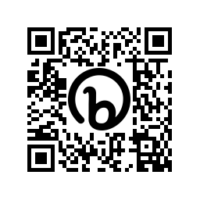
Closing and evaluation Link
This survey is to evaluate the effectiveness of the meeting.
https://bit.ly/FCSEvaluation_Survey
Scan Me

Slide 25
end

