Slide 1

Understanding Your Transcript:
Knowing Where You Stand
by TR Counseling Department

Slide 2
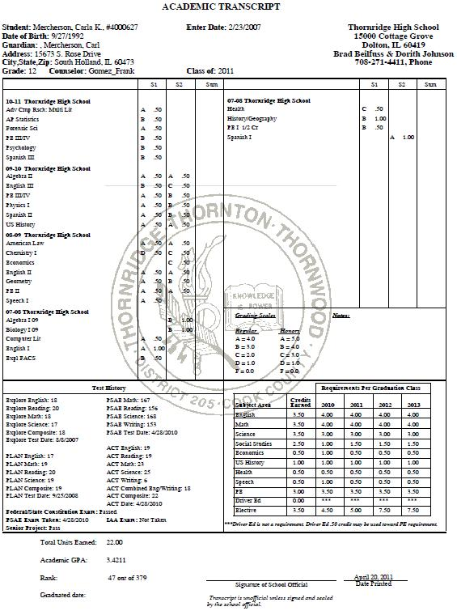
Understanding Your Transcript: Knowing Where You Stand
Your Name
Date of Birth
Guardian
Address
The academic transcript will show student coursework from all 4 years
The transcript will post only semester grades
S1 = Semester One, and S2 = Semester 2 grades
Sum = recovery grades that were made up over the summer or during credit recovery during the year
We have two Grading Scales – a Regular grading scale, and an Honors grading scale (where you earn 1 point higher for grades that are C or higher towards your GPA average)
Your Test History - will show your scores from standardized tests you take during your 4 years in high school. Colleges, and the NCAA (if you plan to play sports) will particularly need your ACT score.
Graduation Requirements/Progress - will be charted for you – so keep track of what you need to take!
Cumulative Data – All your credits are added, your semester grades are averaged , and you are ranked amongst your classmates here.

Slide 3


Understanding Your Transcript: Knowing Where You Stand
Important to Know
Colleges will first look at your overall GPA – so study hard to raise your grades!
Colleges will next look at the rigor/difficulty of your classes – so challenge yourself!
Colleges will lastly look for patterns/improvements – so continue to get better!
You are more than a transcript – get involved in extracurricular activities so that colleges can see your involvement on campus, your leadership, your team work, dependability, etc.
Failures are NOT replaced when you do recovery work, they still remain on your transcript, so make sure you do all the right things to never get one in the first place!
PE Classes are NOT averaged in with your GPA but the grade on the transcript is just as important!
Freshman and Sophomore years are SOOOOOOO important in establishing your GPA because the more grades you earn the less percentage they have in averaging in to the overall grade – which means it gets harder to raise your overall GPA as you go through high school…so don’t expect some last year miracle…do the work EARLY and OFTEN!!!!!

Slide 4
Understanding Your Transcript:
Knowing Where You Stand
by TR Counseling Department

