Slide 1
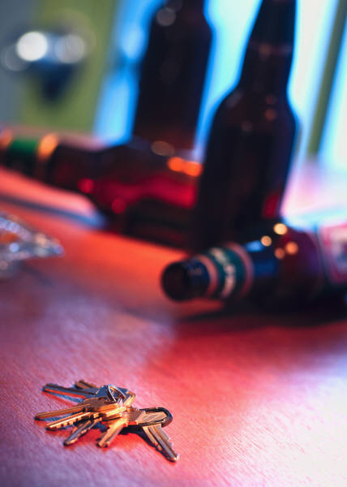
CHAPTER 15
ALCOHOL, OTHER DRUGS, AND DRIVING

Slide 2
15.1
EFFECTS OF ALCOHOL AND DRIVING SAFELY
OBJECTIVES
Explain how alcohol affects mental and physical abilities needed for driving.
Define blood-alcohol concentration.
Explain factors that affect blood-alcohol concentration.
List five myths and truths about the use of alcohol.

Slide 3
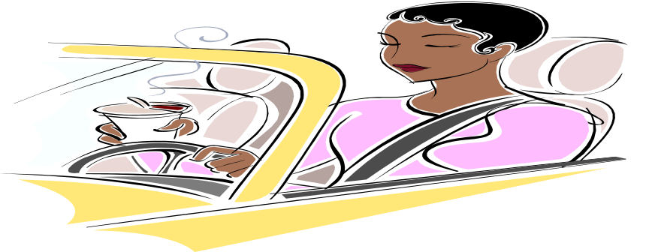
important facts about alcohol
Alcohol facts
How alcohol affects behavior
Mental abilities and alcohol
Judgment and reasoning
Inhibitions
Physical abilities and alcohol
Reaction time and coordination
Seeing and speaking abilities
Other physical problems
Alcohol in the body
Blood alcohol concentration (BAC)
Amount of alcohol in a drink
Factors affecting BAC
Amount of alcohol consumed
Amount of time over which a amount
of alcohol is consumed.
Person’s body weight
Controlling impairment
Myths and truths about alcohol
I can sober up by drinking black
coffee, taking a cold shower, or doing
exercises.
One little drink won’t hurt me.
I will not be affected because I am only drinking beer.
I can drive better after a drinks.
A younger person cannot become a problem drinker.
Reducing driving risk
Designated driver

Slide 4
15.2 other drugs and driving
OBJECTIVES
Explain the difference between the purchase of over-the-
counter medicine and the purchase of prescription.
Explain how depressants, stimulants, and
hallucinogenic drugs can affect a driver.
Describe the effects of combining alcohol with other
drugs.

Slide 5
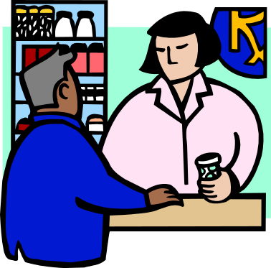

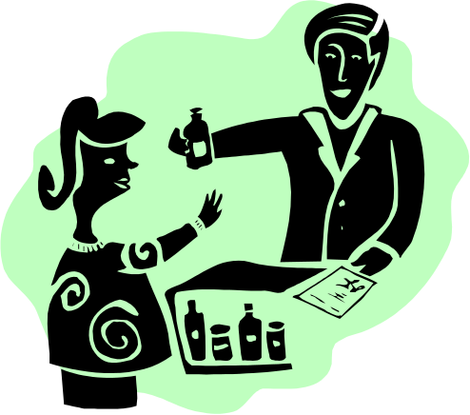
Be aware of the different types of drugs that can impact your driving
Types of drugs
Over-the-counter medicine
Prescription medicines
Depressants
Stimulants
Hallucinogens
Combining drugs

Slide 6
15.3
TRAFFIC LAWS GOVERNING THE USE OF ALCOHOL
OBJECTIVES
Explain what is meant by the implied-consent law.
Describe zero-tolerance levels of intoxication, and tell how these levels can be measured.
Explain what a driver should do when stopped by a police officer.

Slide 7
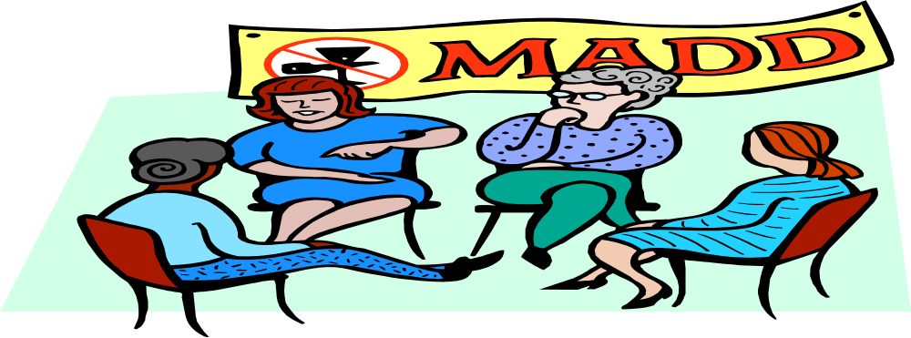
The law applies to all drivers
Implied-consent law
Levels of intoxication
Driving while intoxicated
(DWI)
Driving under the influence
(DUI)
Penalties for conviction
Zero tolerance law
Test for intoxication
Chemical testing
Field sobriety testing
Nystagmus

Slide 8
15.4 coping with peer pressure
OBJECTIVES
Tell how peer pressure might affect one’s decision about drinking and driving.
List five steps involved in making a responsible decision.
Explain what is meant by peer education.
Explain why everyone should share the responsibility of preventing friends from drinking and driving.

Slide 9

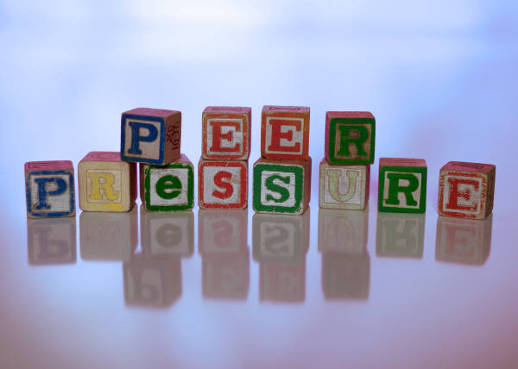
PEER PRESSURE
Understanding peer
pressure
Positive peer pressure
Negative peer pressure
Making responsible
decisions
Deciding about drinking
Peer education
Actions you can take
Responsibility to others
What you and others can do

