Slide 1

CHAPTER 13
HANDLING EMERGENCIES

Slide 2
13.1
VEHICLE MALFUNCTIONS
OBJECTIVES
List actions to take if tire blows out.
List proper steps to follow if brakes fail.
Explain what to do if your accelerator sticks.
Describe what to do in case of steering failure.

Slide 3

THINGS THAT CAN HAPPEN TO YOUR VEHICLE
Tire failure Steering failure
Blowout Total steering failure
Changing tire Power-steering failure
Brake failure Loss of forward vision
Total break failure Hood flies up
Power break failure Headlights fail
Accelerator malfunctions Splashed windshield
Broken spring Vehicle on fire
Stuck accelerator Engine compartment fire
Engine failure Vehicle stalls on railroad tracks
Flooded engine
Overheated engine

Slide 4
13.2
DRIVING ERRORS
OBJECTIVES
Describe how to return to the roadway if your vehicle runs off the roadway.
Explain when to use an emergency swerve.

Slide 5
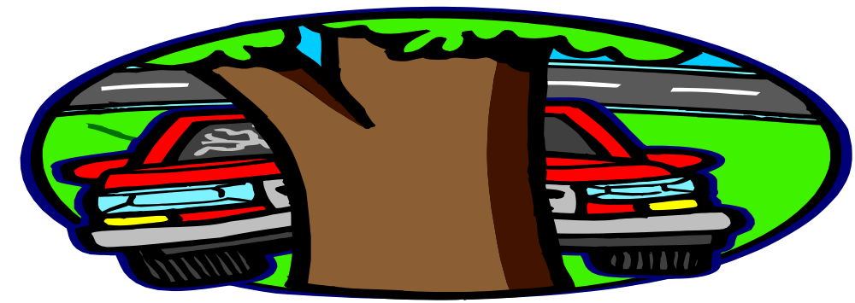
BE AWARE OF YOUR SURROUNDINGS
DRIVING OFF THE ROAD
OFF-ROAD RECOVERY
EMGERGENCY SWERVING
THE STOP-SWERVE DECISION
EXECUTING AN EMERGENCY SWERVE
HOW SHARPLY TO SWERVE

Slide 6
13.3
ROADWAYS HAZARDS
OBJECTIVES
Describe how to minimize vehicle damage caused by potholes.
Explain what to do if you enter a curve too fast.
Tell how to escape from a vehicle that is sinking in water.

Slide 7

PAY ATTENTION AT ALL TIMES
Potholes in the roadway
Sharp curve
Object in the roadway
Vehicle in deep water

Slide 8
13.4
COLLISIONS
OBJECTIVES
Explain how to avoid or minimize head-on, side impact, and rear-end collisions.
List the immediate steps to take if a collision occurs.
Describe other follow-up steps needed after a collision.

Slide 9
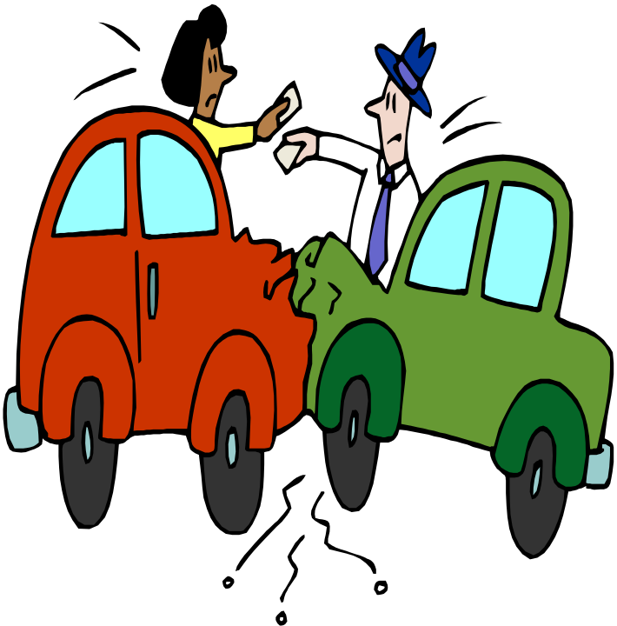
LOOK OUT FOR OTHER DRIVERS/CARS WHEN DRIVING
Minimizing effects of collision
Threat of a head-on collision
Threat of a side-impact collision
Threat of a rear-end collision
If you have a collision
Stop immediately
Aide the injured
Prevent further damage
Send for police
Exchange information
Additional steps
Record witnesses’ names and addresses
Give police the facts
File necessary reports

