Slide 1
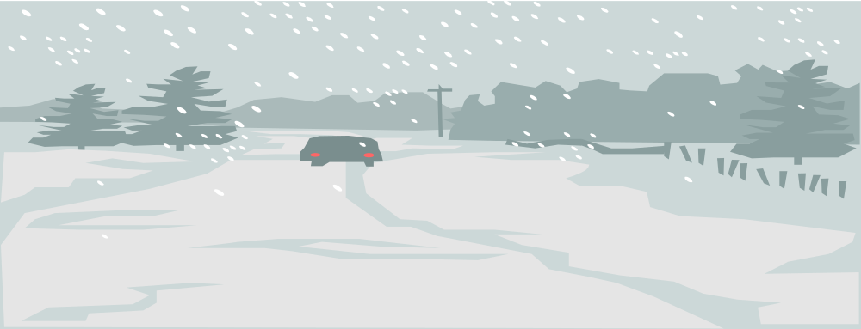
CHAPTER 12
DRIVING IN ADVERSE CONDITIONS

Slide 2
12.1
REDUCED VISIBILITY
OBJECTIVES
Tell how to use the IPDE Process to manage risks in bad weather.
Explain what you can do to help others see you at dawn and dusk.
Describe the special techniques you can use for night driving.
Explain the procedure to use at night when an oncoming driver fails to use low-beam headlights.

Slide 3
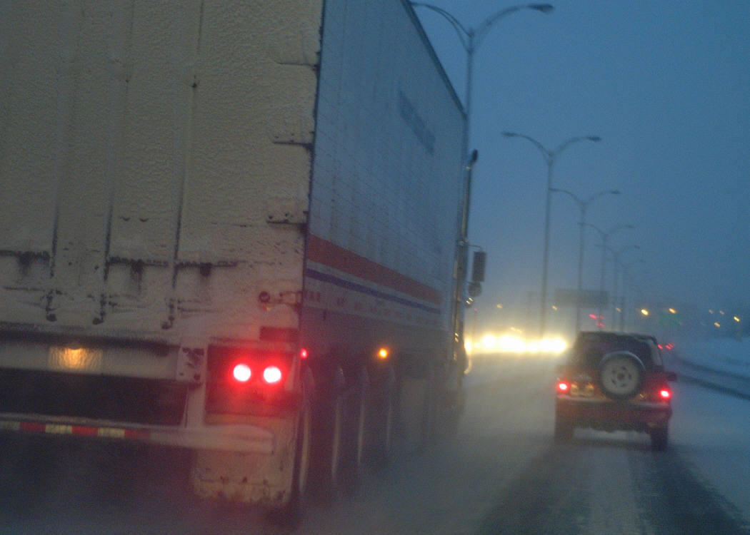
KEEP YOU EYES ON THE ROAD AT ALL TIMES
Your vehicle windows
Sun glare
Dawn and dusk
Night
Headlights
Meeting other vehicles
Overdriving headlights
Fog
Rain
Snow

Slide 4
12.2
REDUCED TRACTION
OBJECTIVES
Describe what happens to traction during rain and snow.
List the steps you can take to avoid hydroplaning.
Describe how to correct a rear-wheel skid.
Tell how to use the controlled-breaking technique.

Slide 5
MAKE SURE YOU ARE AWARE OF WEATHER CONDITIONS WHILE DRIVING
Wet roadways
When rain starts
Hydroplaning
Deep water
Snow
Driving techniques for snow
Rocking a vehicle
Ice
Ice on bridges
Black ice
Ice un the tire tracks
Other reduced-traction situations
Gravel roads
Leaves
Skidding
Over-power skid
Over-braking skid
Front wheel skid
Rear wheel skid
Skidding in a curve
Controlled braking

Slide 6
12.3
OTHER ADVERSE WEATHER CONDITIONS
OBJECTIVES
Explain how to control your vehicle in windy conditions.
List precautions fro driving in extremely hot or cold weather.
Describe what to do to maintain vehicle control during winter driving.

Slide 7
KNOW WHAT TO DO WHEN DRIVNIG IN BAD WEATHER CONDITIONS
WIND
HOT WEATHER
COLD WEATHER
BE ALERT FOR EXHAUST LEAKS
NO NOT RACE A COLD ENGINE
DO SET YOUR PARKING BREAK
TIPS FOR SMOOTH WINTER DRIVING
LOOK LISTEN FOR TRAFFIC REPORTS
KEEP WINDOWS CLEAR
RESPECT SPEEDS
KEEP A SAFE FOLLOWING DISTANCE
TRY TO KEEP MOVING IN THE SNOW
USE A LOWER GEAR ON SLIPPERY ROADS
AVOID CRUISE CONTROL

