Slide 1
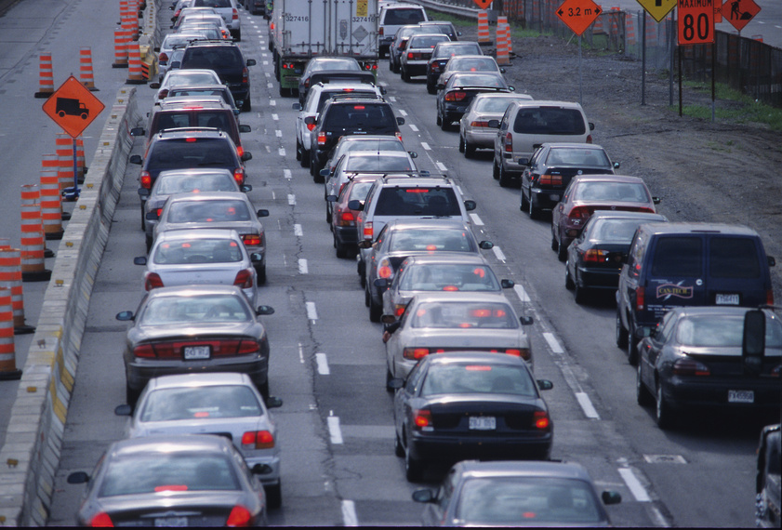
CHAPTER 11
DRIVING ON EXPRESSWAYS

Slide 2
11.1
Characteristics of expressway driving
OBJECTIVES
List five reasons why expressways have lower collisions rates than other highways.
Describe four different types of expressway interchanges.
List strategies for low-risk driving on expressways.

Slide 3

TYPES OF EXPRESSWAYS
Advantages of expressways
Expressway interchange
Cloverleaf interchange
Diamond interchange
Trumpet interchange
All-Directional Interchange
Safe Driving Strategies
Build experience gradually
Concentrate on the driving task
Cooperate with other drivers

Slide 4
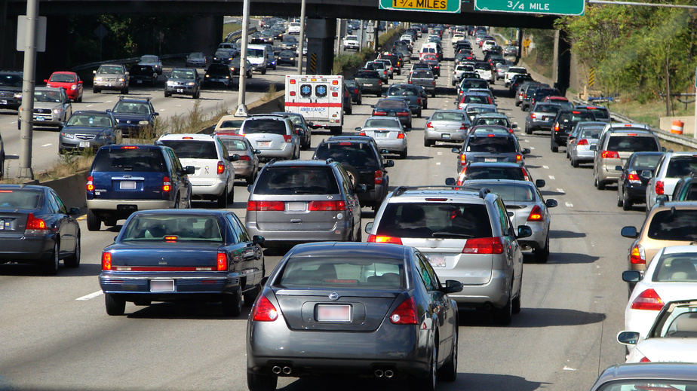
11.2
ENTERING AN EXPRESSWAY
OBJECTIVES
Explain how to enter an expressway properly.
Describe four possible entrance problems.
Explain why entering an expressway from the left is more hazardous than entering from the right.

Slide 5
Important factors to remember when driving on the expressway
Expressway Entrances
Entrance Ramp
Acceleration Lane
Merging Area
Steps for Entering
Make sure the entrance is the one you want. Look for a red and white wrong way or do not enter sign.
Once on the entrance ramp, check your front and rear zone. Signal and take quick glances through your left outside rearview mirror and over your left shoulder to find a gap in traffic where one can safely merge.
Once you are in the acceleration lane, gradually increase your speed. Continue to quickly glance over your left shoulder and through your outside rearview mirror. Decide when it is safe time and place to merge into the gap of traffic.
Before entering the merge area, decide which vehicle to follow in the flow of expressway traffic. As one enters the merging area, adjust the speed to match the traffic flow. Position your vehicle at a safe interval behind the vehicle one plans to follow. Merge smoothly.
Once on the expressway, cancel your signal and adjust to the speed of traffic. Keep a space cushion around your vehicle.

Slide 6
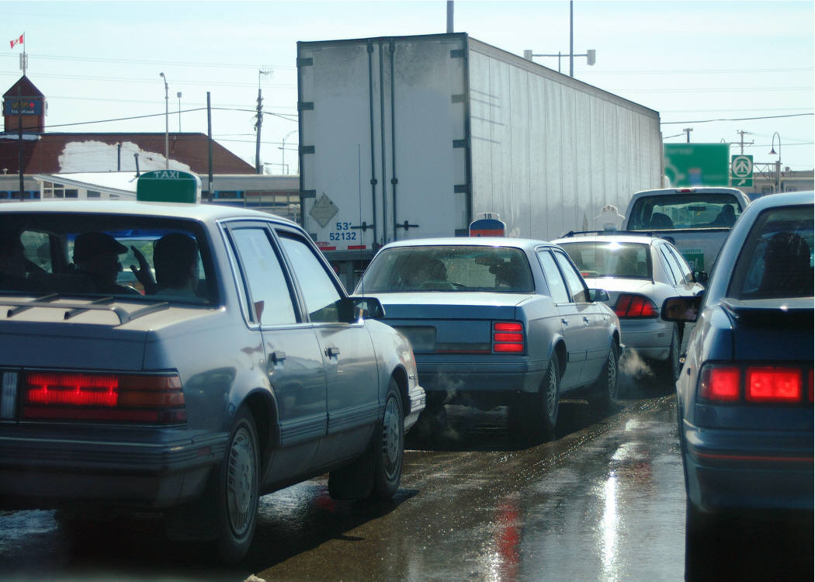
Cont.
11.2
Possible Entrance Problems
Using the IPDE Process at all expressway entrances is critical.
Make your visual checks and zone evaluation quickly. Identity possible problems on each part of the expressway entrance.
Predict actions of the other drivers,
Decide on your entrance gap and speed.
Execute your merge into traffic smoothly and safely.
Entrance Ramp Problems
Entrance Ramp Signal Lights
Acceleration Lane Problems
Merging Area Problems
Entrance Ramp on Left

Slide 7
11.3
STRATEGIES FOR DRIVING ON EXPRESSWAYS
OBJECTIVES
Explain how to use the IPDE Process to achieve a safe path of travel.
Describe when following distances should be increased for expressway driving.
Tell what actions to take when you are being tailgated.
Describe three actions that should be automatic when you are changing lanes on the expressway.

Slide 8
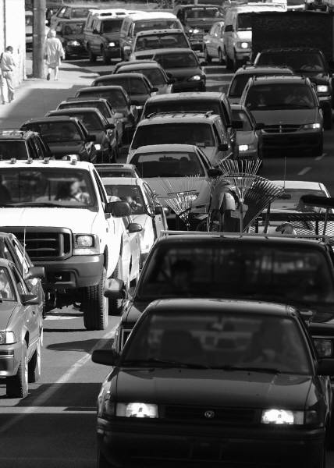
IMPORTANT FACTORS TO REMEMBER WHEN DRIVING ON THE EXPRESSWAYS
Apply the IDPE Process
Lane Choice
Signs, Signals, and Roadway Markings
Speed Limits
Minimum Speed Limit
Common Speed
Wolf Packs
Following
Blind Spots
Being Followed
Lane Changing
Passing and Being Passed

Slide 9
11.4
Exiting expressways
Deceleration Lane
Exit Ramp
Applying the IPDE Process
Steps for Exiting
Possible Exiting Problems
Crossing Paths
Ramp Overflow
Short Deceleration Lane

Slide 10


11.5
Special expressway problems
Diver Condition
Highway Hypnosis
Fall-Asleep Collisions
Velocitation
Roadway Conditions
Expressway Through Cities
Disabled Vehicle
Roadway Repair
Rural Repair
Rural Interstate Highways
Tollbooths
Using Expressway Safely

