Slide 1

Chapter 10 driving in rural areas

Slide 2
10.1
Characteristics of Rural Traffic
OBJECTIVES
Describe rural roadways
Describe factors to consider when selecting a safe speed.
Identify traffic controls and how they help inform, warn, and regulate drivers on rural roads.

Slide 3
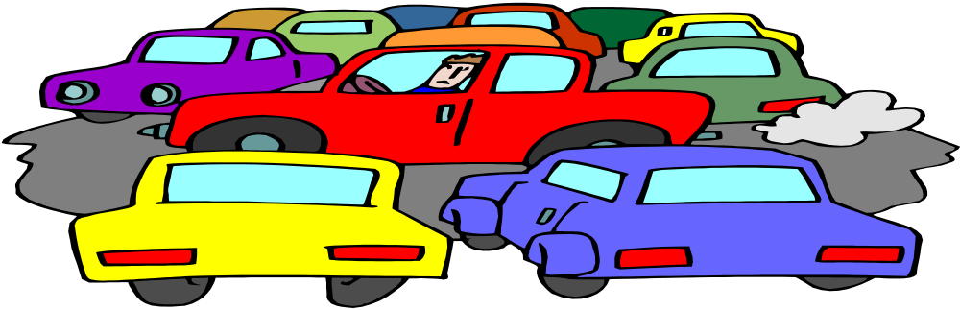
Important Things to Remember
Roadways
Speed
Traffic Controls
Roadside Hazards

Slide 4

10.2
Using Basic Skills in Rural Areas
OBJECTIVES
Explain how the IPDE Process should be used in rural driving.
Know the steps to safely handle a curve.
List rural situations that require increased following distance.
Explain how to enter a multilane rural highway.

Slide 5
Things A Driver Should Observe
Applying the IPDE process
Visual Search Pattern
Driving on Two-Lane Roads
Curves
Intersections
Hills
Advisory Speed Signs
Following traffic
Driving on Multilane Roads

Slide 6

10.3
PASSING AND BEING PASSED ON RURAL ROADS
OBJECTIVES
List the checks to make before passing another vehicle.
List the steps for passing on a two-lane rural road.
List situations where passing should never be attempted.

Slide 7
Important Steps To Take When Passing Another Vehicle
Passing
Deciding to Pass
Preparing to Pass
Executing a Pass on Two-lane Roads
No - Passing Situation
No Passing on Roads Going Uphill
No Passing at intersections
Other No-Passing Situations
Passing on Multilane Roads
Being Passed

Slide 8
10.4
RURAL SITUATIONS YOU MIGHT ENCOUNTER
OBJECTIVES
Explain how to pass a slow-moving vehicle.
Explain the steps to take to deal with animals on or along the roadway.
Explain how you can allow hazards to separate when meeting traffic.

Slide 9
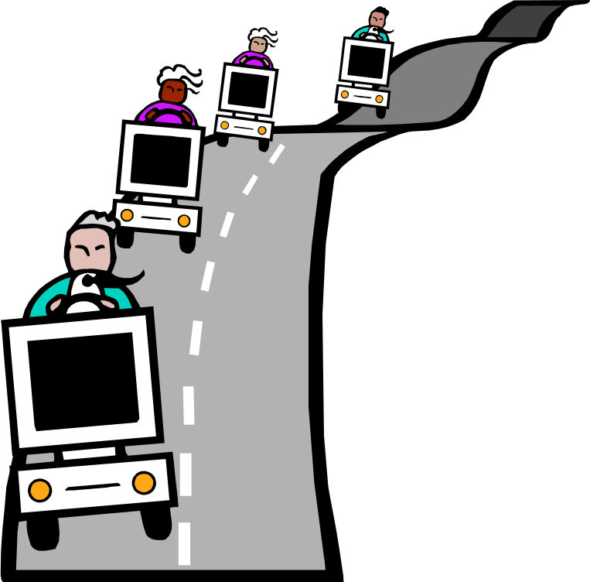
Important Factors In Rural Areas
Slow-Moving Vehicles
Animals
Meeting Oncoming Traffic
Meeting Slow-Moving Vehicles
Meeting at Night
Railroad Crossings

Slide 10
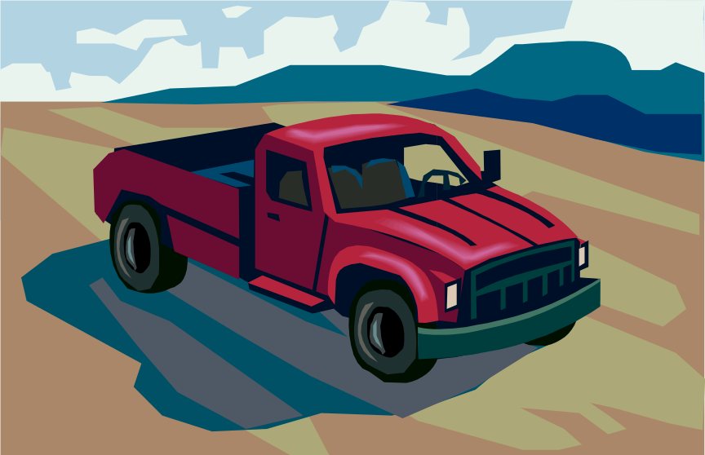
10.5
Special Driving Environments
OBJECTIVES
Describe special safety precautions for mountain driving.
Describe special safety precautions for desert driving.

Slide 11
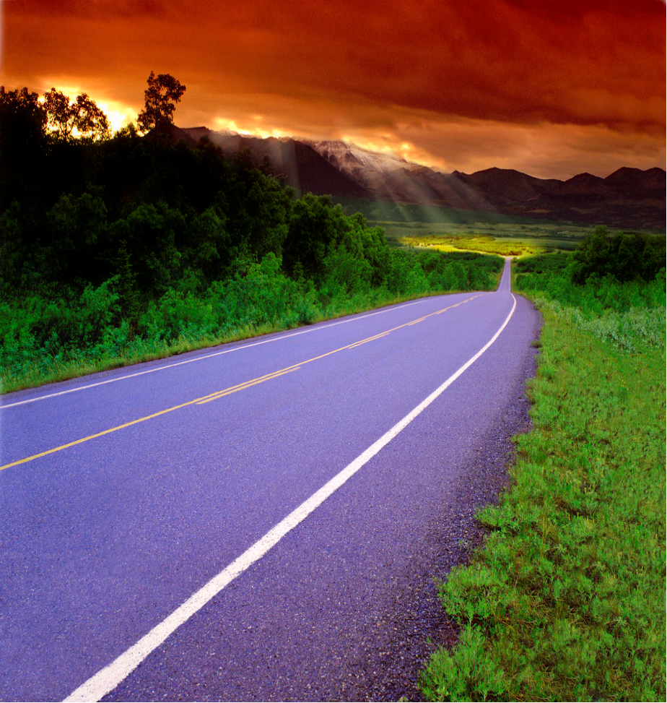
Practice Safe Driving in These Areas
Mountain Driving
Driving Up a Mountain
Driving Down a Mountain
Weather in the Mountain
Effects of Altitude on Drivers
Effects of Altitude on Vehicles
Desert Driving
Effects of Heat on Drivers
Effects of Heat on Vehicles
The Desert Roadway
Sandstorms and Dust Storms
Flash Floods

