Slide 1

Chapter 7 negotiating intersections

Slide 2
7.1
SERCHING INTERSECTIONS
SECTION OBJECTIVES
Explain how to search an intersection after it has been identified.
Tell when you are at the point of no return.
Describe what you should do when you have a closed front zone at an intersection.

Slide 3
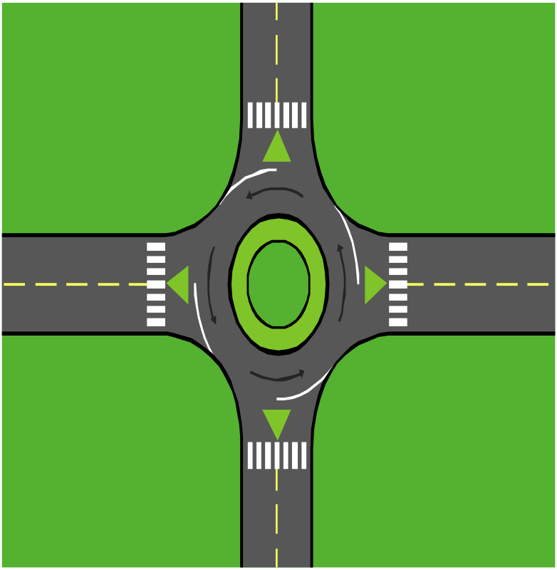
IMPORTANT THINGS TO LOOK FOR WHILE DRIVING
Approaching an intersection
Continue moving ahead
Decide to stop
Moving after a stop

Slide 4
7.2
CONTROLLED INTERSECTION
SECTION OBJECTIVES
EXPLAIN HOW TO APPROACH A CONTROLLED INTERSECTION.
TELL HOW TO MOVE FROM A STOP SIGN WHEN YOUR VIEW IS BLOCKED.
DESCRIBE HOW TO MAKE RIGHT TURNS AND LEFT TURNS AT CONTROLLED INTERSECTIONS.

Slide 5
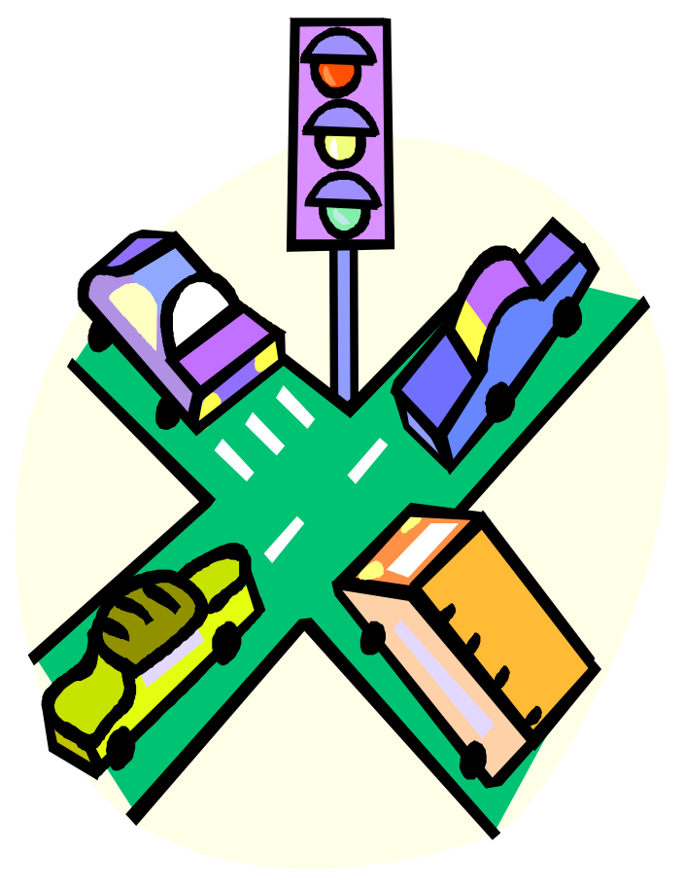
FACTS THAT WILL ASSIST ONE WHILE DRIVING
Controlled intersections with signs
Controlled intersections with signals
Signals
Unprotected left turns
Protected left turns
Turns on red
Controlled railroad crossings

Slide 6
7.3
UNCONTROLLED INTERSECTIONS
SECTION OBJECTIVES
Tell how to identify an uncontrolled intersection.
Explain the procedures to follow at uncontrolled intersection.
Describe the proper procedures for crossing uncontrolled railroad tracks.

Slide 7
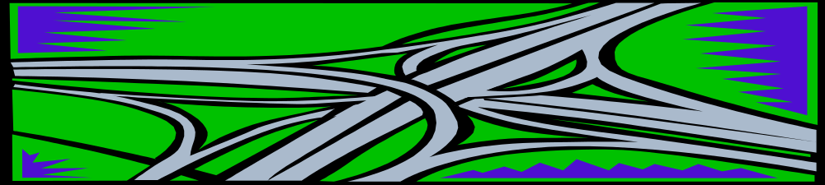
IMPORTANT THINGS TO REMEMBER WHILE OPERATING A VEHICLE
Approaching uncontrolled intersections
Procedures at uncontrolled intersections
  IPDE process at 2, 4-6, and 12-15 seconds from intersection
Uncontrolled railroad crossings
  Crossing railroad tracks

Slide 8
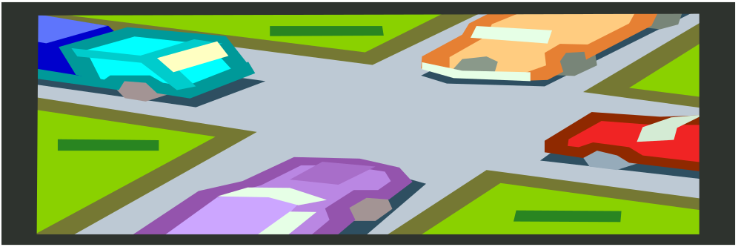
7.4
DETERMINING RIGHT OF WAY AND JUDGING GAPS
SECCTION OBJECTIVES
Define right of way.
Describe the situations in which you, the driver, must yield the right of way.
Identify how long it takes to cross and join traffic.

Slide 9
FACTS TO REMEMBER WHILE DRIVING
What is right of way?
Situations when you must yield
Judging the size of the gap
Crossing and joining traffic

