Slide 1
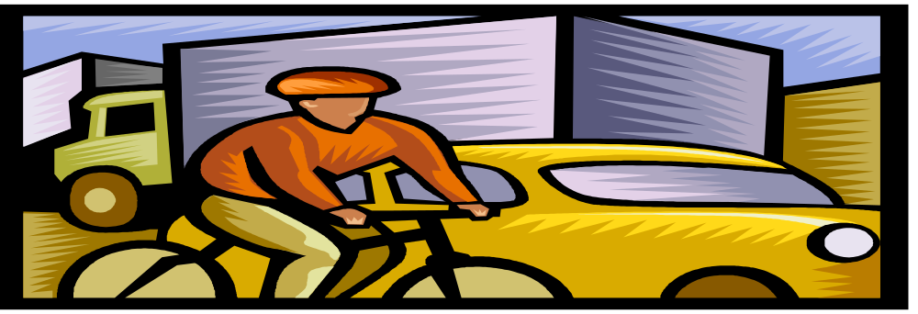
Chapter 9
DRIVING IN URBAN TRAFFIC

Slide 2
9.1
ADJUSTING TO URBAN TRAFFIC
SECTION OBJECTIVES
Name two factors that can make driving difficult in city traffic.
Describe how to use the IPDE process for city driving.

Slide 3
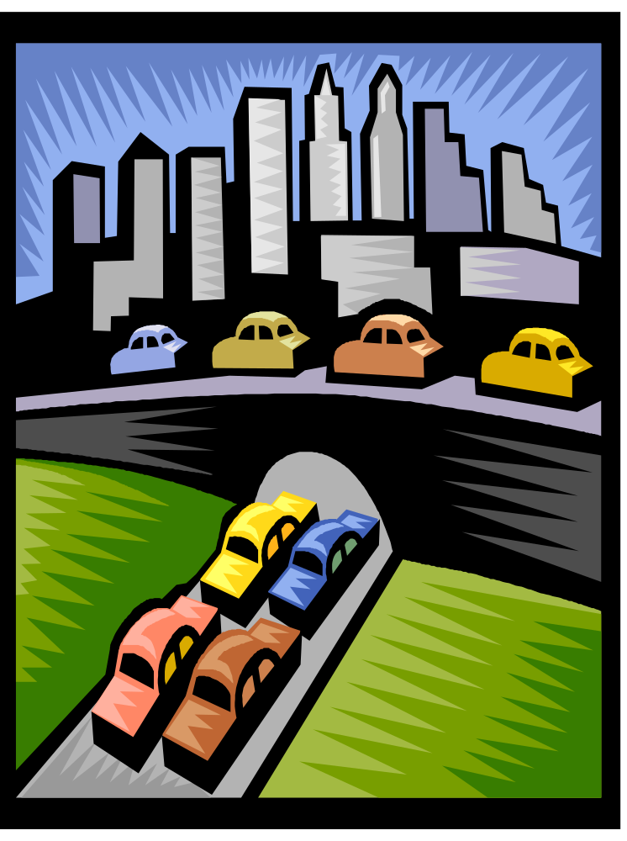
IMPORTANT TERMS TO REMEMBER IN THIS CHAPTER
Traffic complexity
  Number of hazards
  Time, distance, and speed
Using the IPDE process
  Identify
  Predict
  Decide
  Execute

Slide 4
9.2
FOLLOWING AND MEETING TRAFFIC
SECTION OBJECTIVES
Describe how to use the 3-second following distance rule.
Describe how you can safely manage a tailgater.
List the steps to take to avoid conflicts with oncoming traffic

Slide 5
IMPORTANT THINGS TO REMEMBER WHILE OPERATING A VEHICLE
Following others
  3-second following distance
  Looking beyond the vehicle ahead
  Areas for sudden stops
  When to look away
  Being Followed
  Tailgaters are hazards
  Responding to oncoming traffic
  Reasons for crossing the center line
  Avoiding conflicts

Slide 6
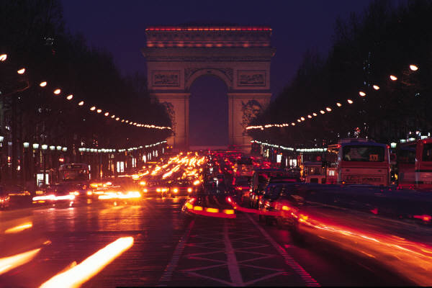
9.3
MANAGING SPACE IN URBAN TRAFFIC
SECTION OBJECTIVES
Describe how far ahead you should look in city traffic.
Tell how to cover the brake.
Explain how to select the proper lane for driving.

Slide 7
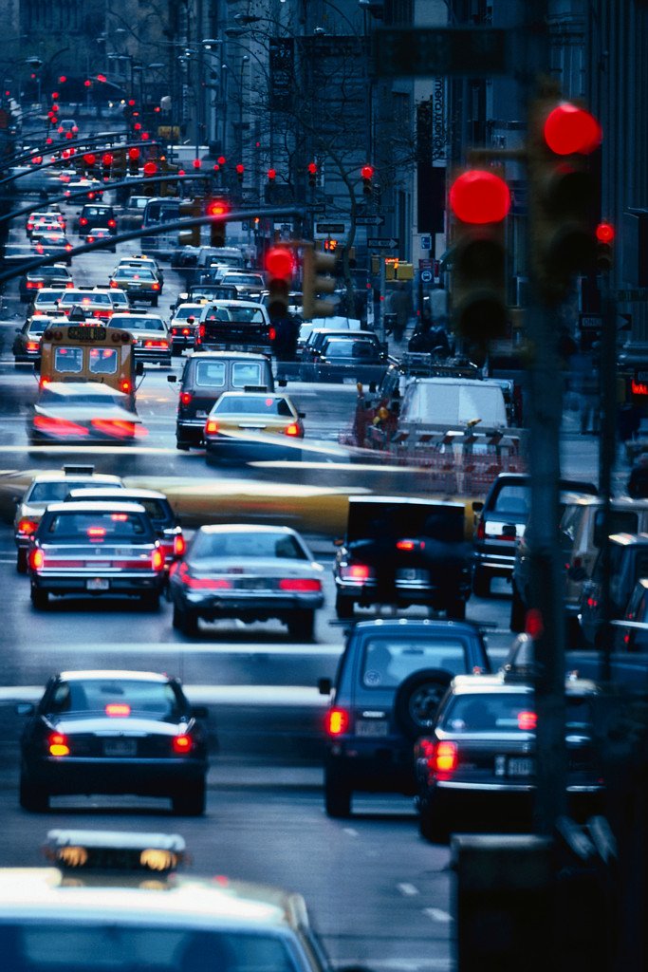
IMPORTANT THINGS TO REMEMBER WHILE DRIVING IN TRAFFIC
Looking ahead while staying back
Approaching traffic signals
Covering the brake
Adjusting speed
Selecting the best lane
Changing lanes
Overtaking and passing
Special traffic lanes

Slide 8
9.4
SPECIAL URBAN SITUATIONS
SECTION OBJECTIVES
Describe the procedure for turning left or right from a one-way street.
Explain how to warn a driver who is driving the wrong way on a street.

Slide 9
FACTS TO REMEMBER
Driving on two-way streets
Driving on one-way streets
  Identify one-way streets
  Entering one-way streets
  Lane choice on one-way streets
  Leaving one-way streets
  Signaling wrong-way drivers
Unexpected situations on crowed streets

