Slide 1
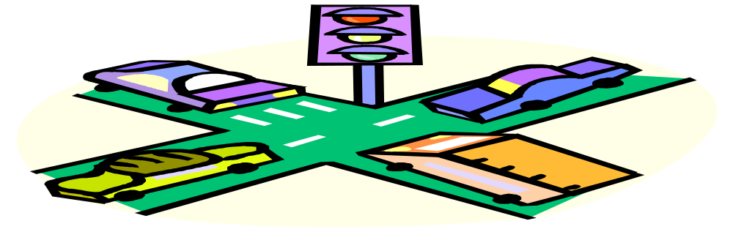
Chapter 5
NATURAL LAWS AND CAR CONTROL

Slide 2
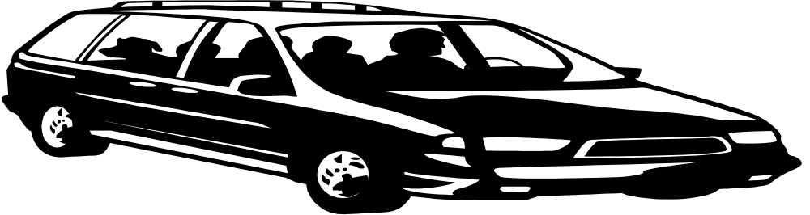
5.1
GRAVITY AND ENERGY OF MOTION
SECTION OBJECTIVES
Explain how gravity affects ones car.
Describe the factors that energy affect energy of motion.

Slide 3
IMPORTANT FACTORS TO REMEMBER WHILE OPERATING A CAR
Gravity
driving up and down hills
center of gravity
Energy of motion
when an object moves acquires energy, which is also kinetic energy .

Slide 4
5.2
FRICTION AND TRACTION
SECTION OBJECTIVES
Explain how traction controls your car.
List three things that can reduce traction.
Describe how you can check traction while driving.
List factors that affect you car in a curve.

Slide 5

THINGS TO REMEMBER WHEN IT COMES TRACTION
TIRES
*tread and traction
*inflation and traction
*split traction
Reduced traction
*vehicle condition
*road service
*checking traction
CURVES
*vehicle control
VEHICAL CAPABILITIES

Slide 6
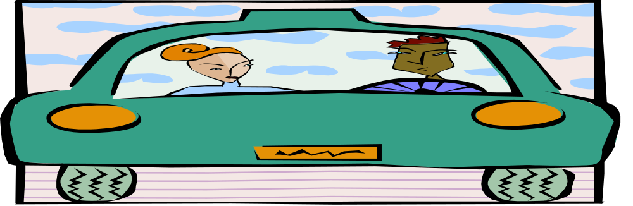
5.3
STOPPING DISTANCE
SECTION OBJECTIVES
Define total stopping distance.
Explain how to use the four second rule.
Name four factors that affect braking distance.

Slide 7
KEY POINTS TO REMEMBER WHILE DRIVING
TOTAL STOPPING DISTANCE
*Perception time and distance
*Reaction time and distance
*Breaking distance
ESTIMATING STOPPING DISTANCE
*Pick a fixed checkpoint
*Count off four seconds
*Check vehicles’ position
FACTORS THAT AFFECT BRAKING DISTANCE
*Speed *roadway surface *driver ability
*Vehicle condition *antilock braking system, (ABS)
*Hills *loads

Slide 8
5.4
CONTROLING FORCE OF IMPACT
SECTION OBJECTIVES
List three factors that will change your vehicle’s force of impact in a collision.
Explain the correct way to adjust safety belts.
Describe how a drivers and passenger should position themselves to benefit from air bags.
ex[plain how to best position and use child safety seats.

Slide 9


HERE ARE SOME SAFETY TIPS TO ASSIT ONE WHILE DRIVING
Knowledge of force of impact
How to wear safety belts
Air bags
Other protection devices
automatic safety belts
energy-absorbing bumpers
side door beams
reinforced windshield
energy-absorbing steering wheel and column
padded dash
child seats
head restraints

