Slide 1
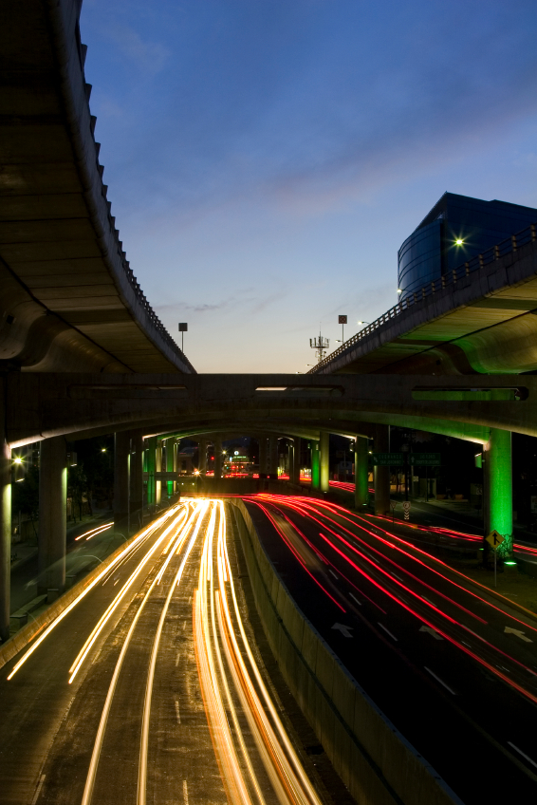
Chapter 4 managing risk with the ipde process

Slide 2
4.1
THE IPDE PROCESS
SECTION OBJECTIVES
Name three major factors that can contribute to the degree of risk you encounter while driving.
Name the four steps of the IPDE Process.
List the five rules of the Smith System.
Explain the structure of the Zone Control System.

Slide 3
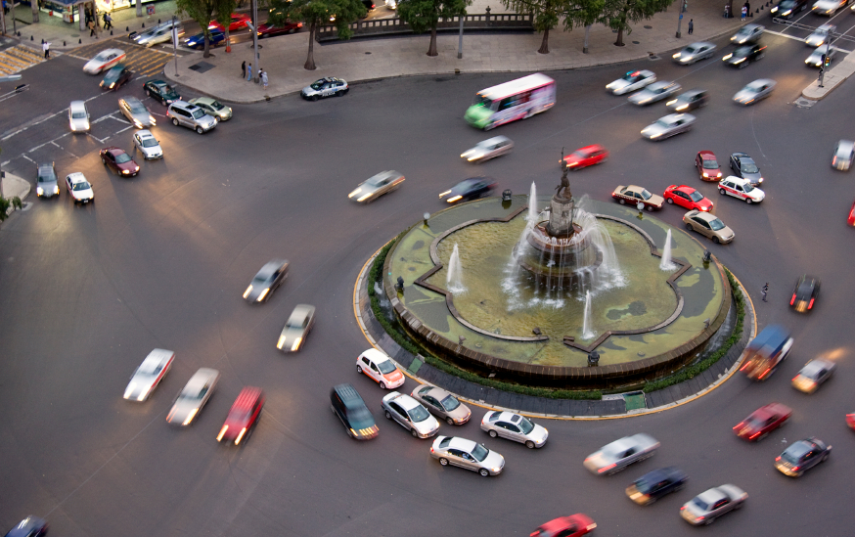
IMPORTANT FACTORS TO KNOW WHILE OPERATING A VEHICLE
Risk
Bald tires
Poorly adjusted brakes
Dirty windshield
Worn wiper blades
Snow and ice
Dark shadows
Construction
The IPDE Process
Identify
Predict
Decide
Execute

Slide 4
4.2
IDENTIFY AND PREDICT
SECTION OBJECTIVES
Describe the location of each of the six Zones Control System.
Explain what is meant by an open zone and a closed zone.
Describe an orderly visual search pattern.
Explain how knowledge and experience help you make accurate predictions.

Slide 5
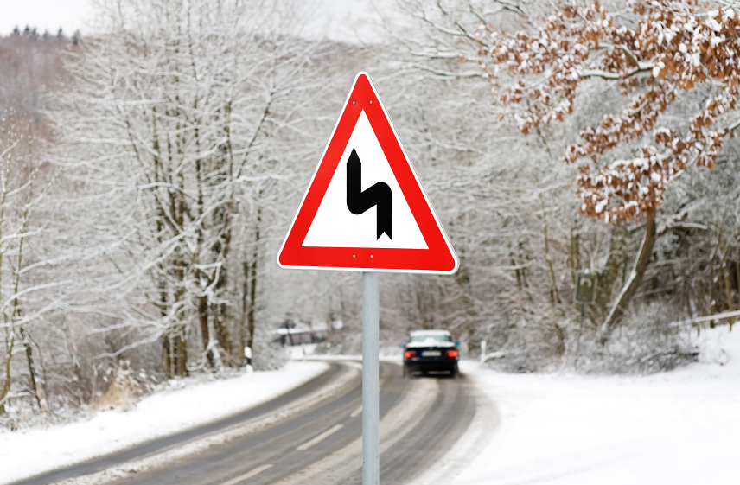
TIPS FOR SAFE DRIVING
Identify all zones that involve the IPDE Process
Searching ranges
Orderly visual search patterns
Where and how to look in various driving conditions
What to look for while driving
What and how to predict actions of others

Slide 6
4.3
DECIDE AND EXECUTE
SECTION OBJECTIVES
Name the three decisions one must make when applying the IPDE Process.
Describe the three different lane positions available to one within their lane.
Explain what is meant when one minimize s or separates a hazard or compromises their space.
List the three most important actions one can take to avoid conflict.

Slide 7
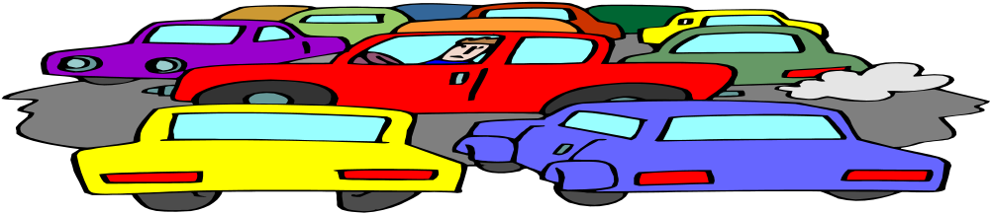
FACTORS TO CONSIDER
Knowing when and how to decide change in speed and direction while operating a vehicle.
Traffic flow
Execute control when it comes to speed, steering, and communication with other drivers on the road.

Slide 8
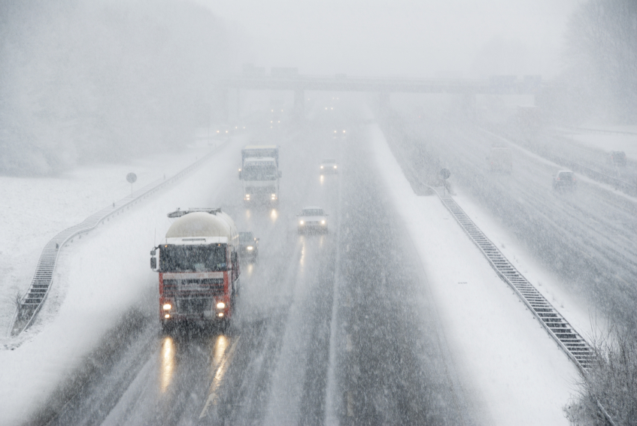
4.4
USING THE IPDE PROCESS
SECTION OBJECTIVES
Explain what is meant by commentary driving
Describe what is meant by selective use of IPDE Process.
Explain why the IPDE Process takes time.

Slide 9
HERE ARE THE NECESSARY TOOLS THAT ARE ESENTIAL TO DRIVING
Practice of the IPDE Process through commentary driving
Putting the IPDE Process into to action with the use of selective IPDE while operating ones vehicle.
Remember the IPDE Process takes time and one must have time to identify clues, predict the actions of others, and changing zones.
Do not allow complacency or laziness to creep into ones driving habits.
By making conscious effort to continually apply the IPDE Process, one can achieve the reward of low- risk, low-stress driving enjoyment.

