Slide 1

CHAPTER 2
SIGNS, SIGNALS
AND
ROADWAY MARKINGS

Slide 2
2.1
TRAFFIC SIGNS
SECTION OBJECTIVES
State the meaning of the eight shapes and colors used for traffic signs
Describe the actions to take at stop, yield, and speed limit signs.
List situations wear warning signs might be used.
Explain how guide signs and international signs help when driving.

Slide 3



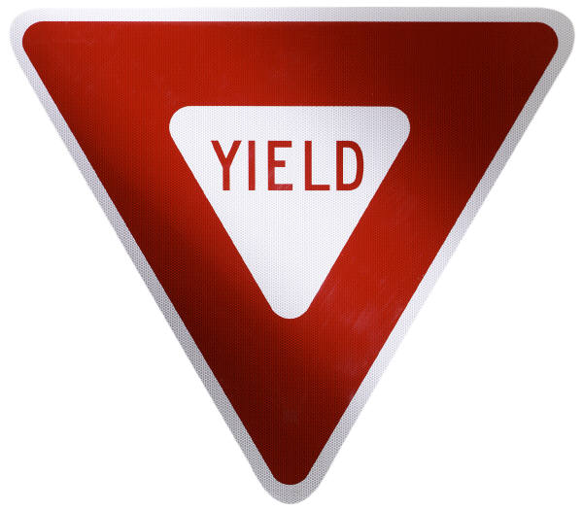
TYPES OF TRAFFIC SIGNS TO OBEY
WHILE DRIVING
Shapes and colors
Regulatory signs
Warning signs
Guide signs
International signs

Slide 4
2.2
TRAFFIC SIGNALS
SECTION OBJECTIVES
Explain what to do at the green light, yellow light, and a red light.
Describe the action to take when approach a flashing red signal or a flashing yellow signal.
Describe the actions to take with pedestrian signals and traffic control officers’ signals.

Slide 5
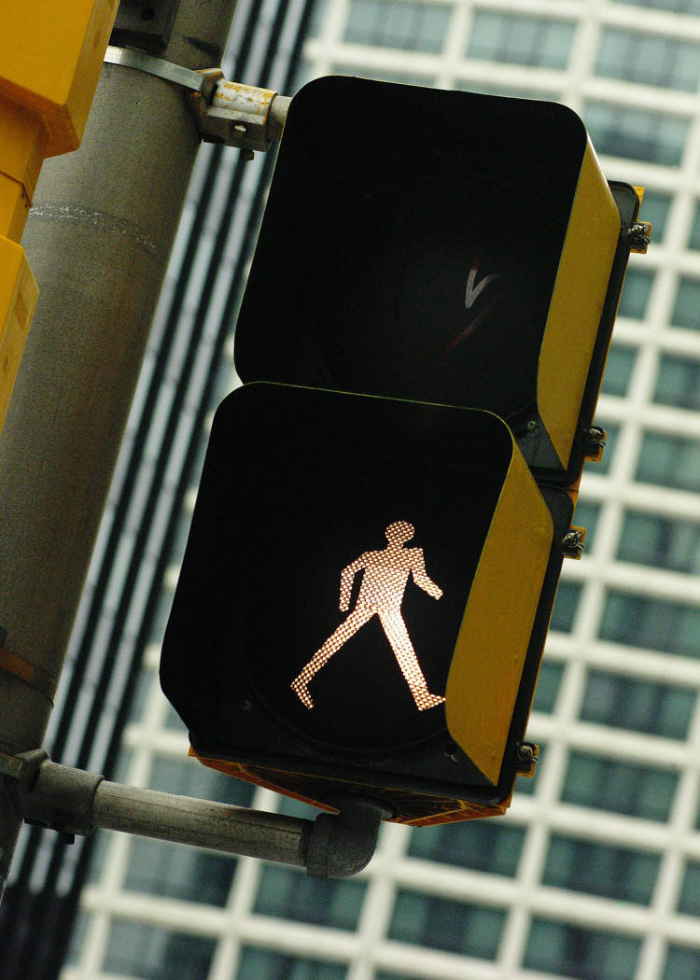
IMORTANT THINGS TO KNOW WHILE DRIVING A VEHICLE
Traffic lights
Flashing signals
Arrows
Lane signals
Pedestrian signals
Officers signals

Slide 6
2.3
ROADWAY MARKINGS
SECTION OBJECTIVES
Describe the difference between broken yellow lines and broken white lines.
Explain the difference between a shared left-turn lane and a left-turn lane.
List six types of special roadway makings.

Slide 7
IMPORTANT MARKINGS TO FOLLOW AS ONE DRIVES
Yellow line markings
White line markings
Rumble strips and raised roadway markers
other roadway markings

