Slide 1

Crusin USA
By Mr. Potacki
& Mr. Miller

Slide 2
Itinerary
We will go from my house in Dolton, Il. To State Capitol Springfield, Il.
After spending a day in Springfield we will go to Champaign, Il. to watch a University of Illinois crush the Ohio State Buckeyes in a football game.
After spending a day in Champaign we will go to Chicago, Illinois to watch the Chicago Bears beat up on the lowly Seattle Seahawks.
After the Bears whip up on the Seahawks we will head back home to good old Dolton Ill.

Slide 3
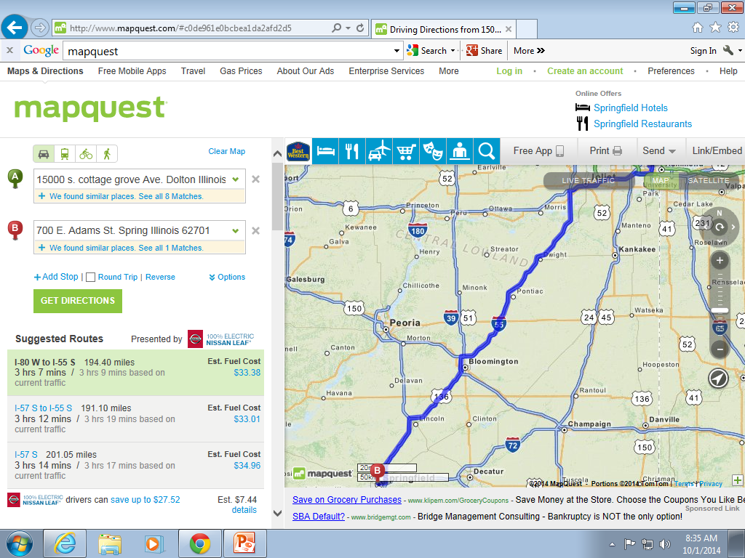
From Dolton Illinois to State Capitol Springfield Illinois
194.4 Miles
15000 S. Cottage Grove Ave. Dolton Il.
To 700 E. Adams St. Springfield Il.

Slide 4

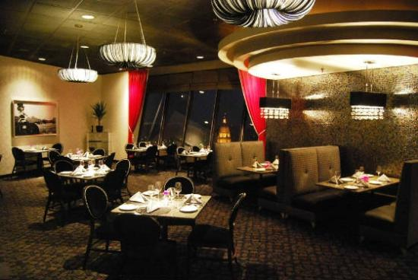
Springfield, Illinois Hotels and Restaurants
Nick & Nino's Penthouse Steakhouse
Hilton Hotel
700 E Adams St, Springfield, IL 62701
$103 per night
700 E. Adams Street, 30th floor, Springfield, IL

Slide 5

State Capitol Building

Slide 6
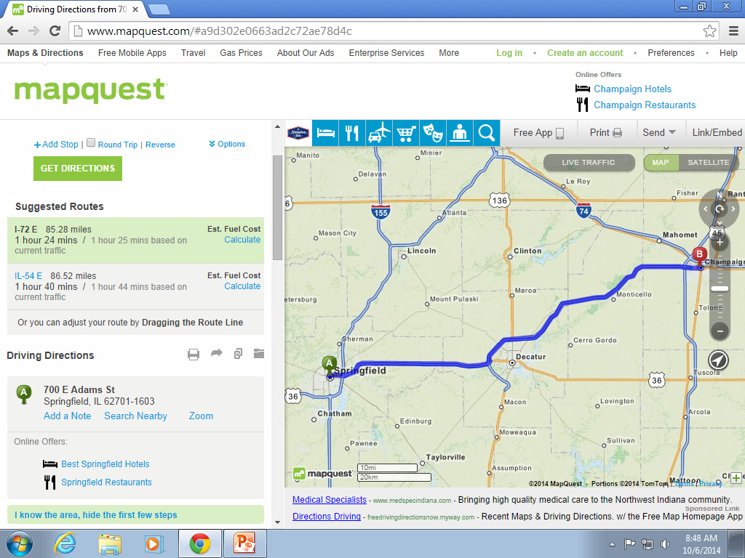
From Springfield to Champaign Illinois
85.28 Miles

Slide 7
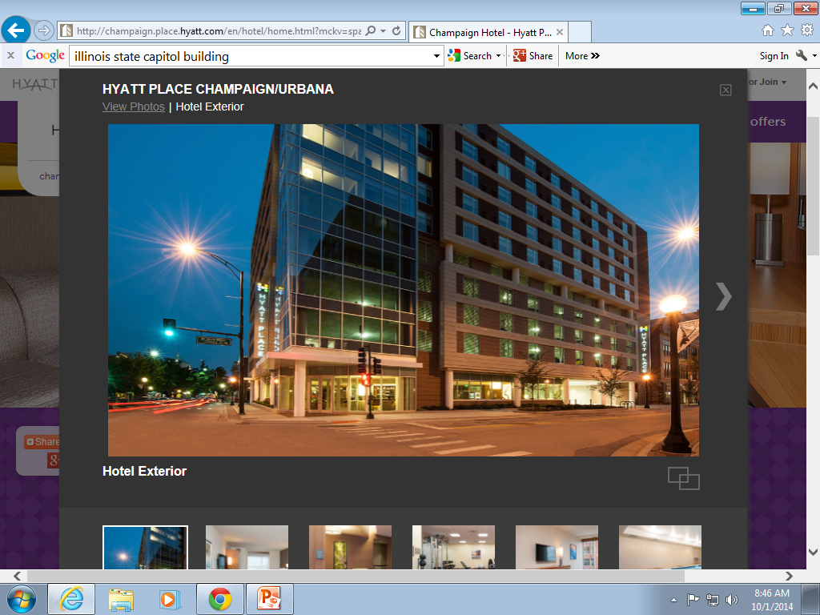
Hyatt Place Champaign
217 N. Neil Street
Champaign Illinois 61820
$132 per Night

Slide 8
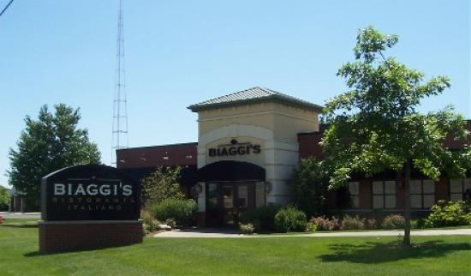
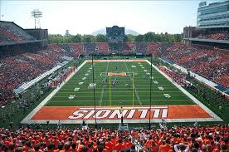
Places to eat and things to do
Biaggi”s Restaurants
2235 S. Neil Street, Champaign, 61820
U of I
Football Game
Ticket $60
Parking $25

Slide 9
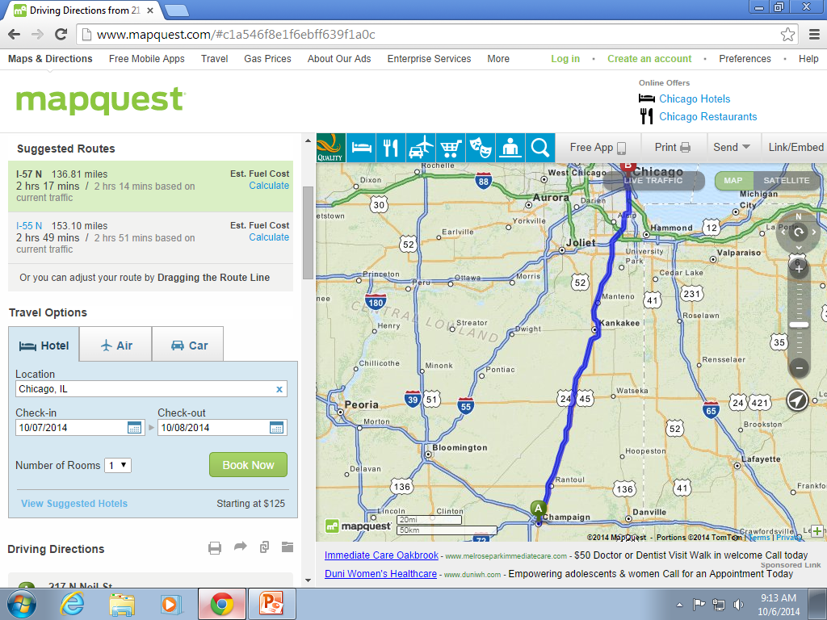
Champaign Illinois to Chicago Illinois
136.81 Miles

Slide 10
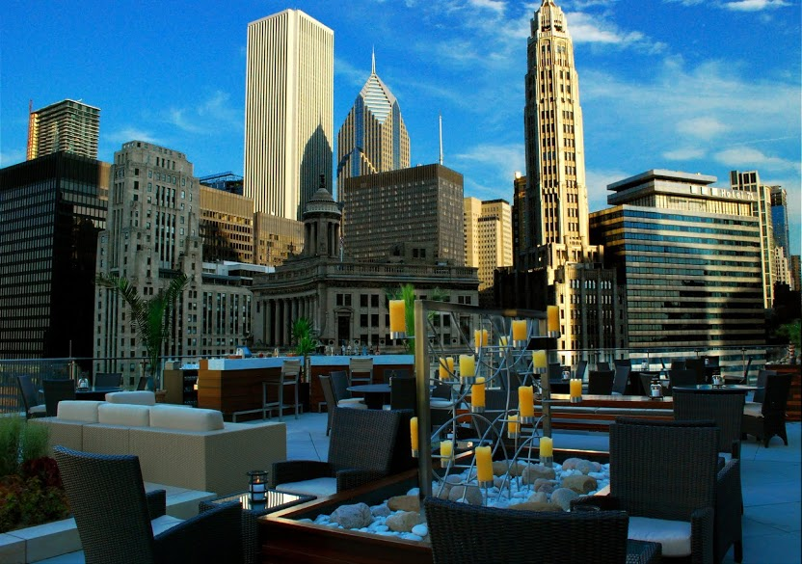
Trump International Hotel & Tower Chicago
401 N Wabash Ave, Chicago, IL 60611
$525 Per Night

Slide 11
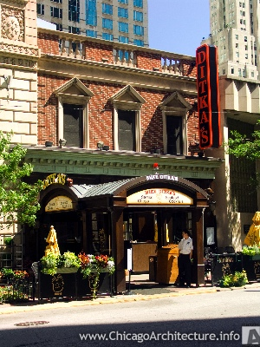
Ditkas Restaurant
100 East Chestnut
Chicago Illinois

Slide 12
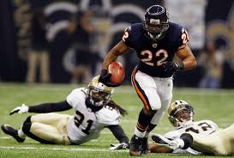
Chicago Bears Game
Game Ticket $405.00
Parking $50

Slide 13
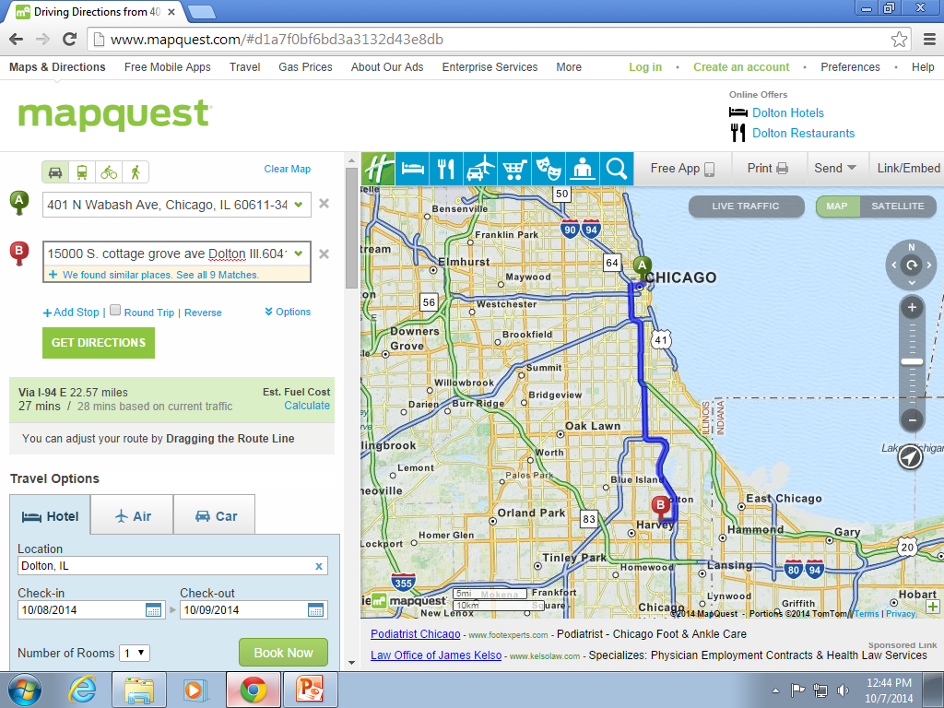
Chicago to Dolton Illinois
22.57 Miles

Slide 14
 | Travel Day | Miles Traveled | Gas (3.00) | Hotels | Meals | Extra | Total
Day 1 | Springfield | 194.4 Miles | $29.16 | $103 | $60 |  | $192.16
Day 2 | Champaign | 85.28 Miles | $12.79 | $138 | $55 | $100 | $305.79
Day 3 | Chicago | 136.81 Miles | $20.52 | $525 | $75 | $455 | $1,075.52
Day 4 | Dolton | 22.57 Miles | $3.41 |  |  |  | $3.41
Total |  | 439.06 Miles | $65.88 | $766 | $190 | $555 | $1,576.88

Slide 15
Summary
This project taught me a lot about planning a vacation and what needs to get done. In this project I learned how to calculate gas and how much money I will be spending, I also learned how to look for hotels and the amount of money I will be spending for lodging. The last thing I learned is how to look for restaurant in the area and plan for meals.
On my project I found out that the capitol of the great state of Illinois is Springfield. After visiting Springfield I went on to watch the Fighting Illini go out and whip up on the Buckeyes of Ohio State. After visiting Champaign I traveled up to Chicago and watched the Bears pulverize the Seahawks of Seattle. Then I traveled back Home.
My Final Thoughts are that Mr. Potacki & Ms. Lawson are geniuses for developing this project because this is something that will be useful when I have a family and cannot afford flying to these places with the whole family. I think that because of this project I will vote Mr. Potacki & Ms. Lawson as Teachers of the Year!!!!!!!!

