Slide 1
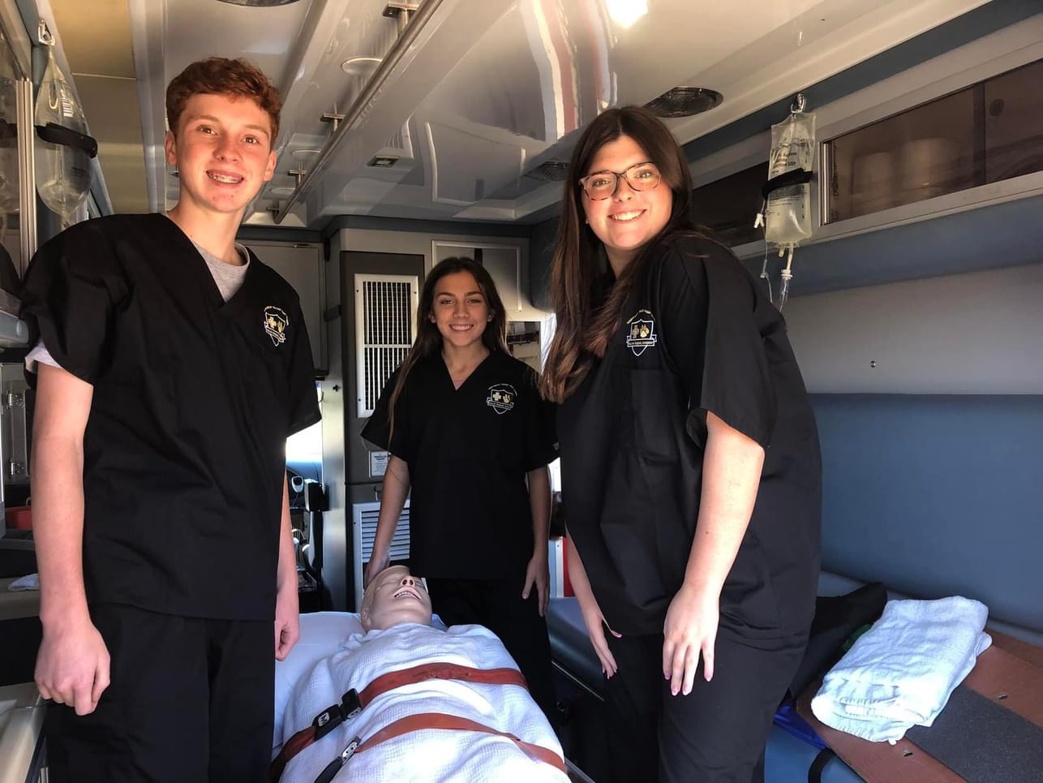

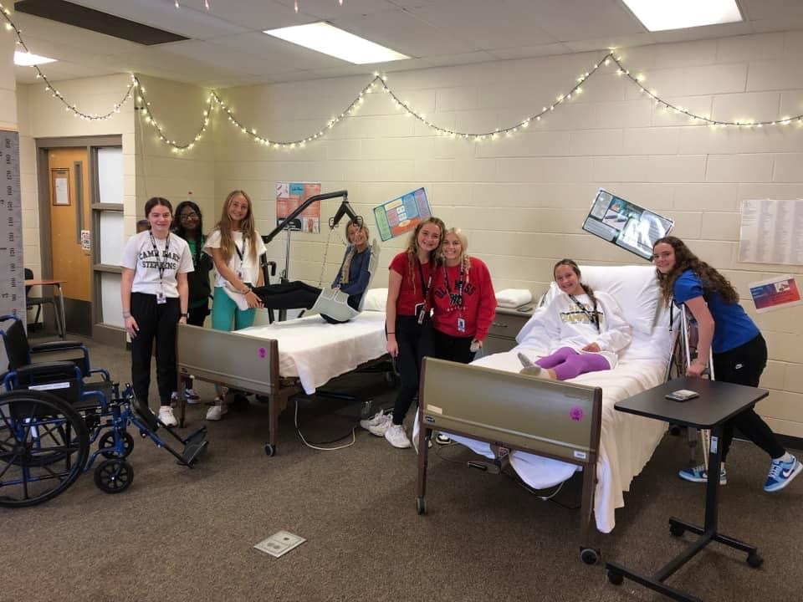
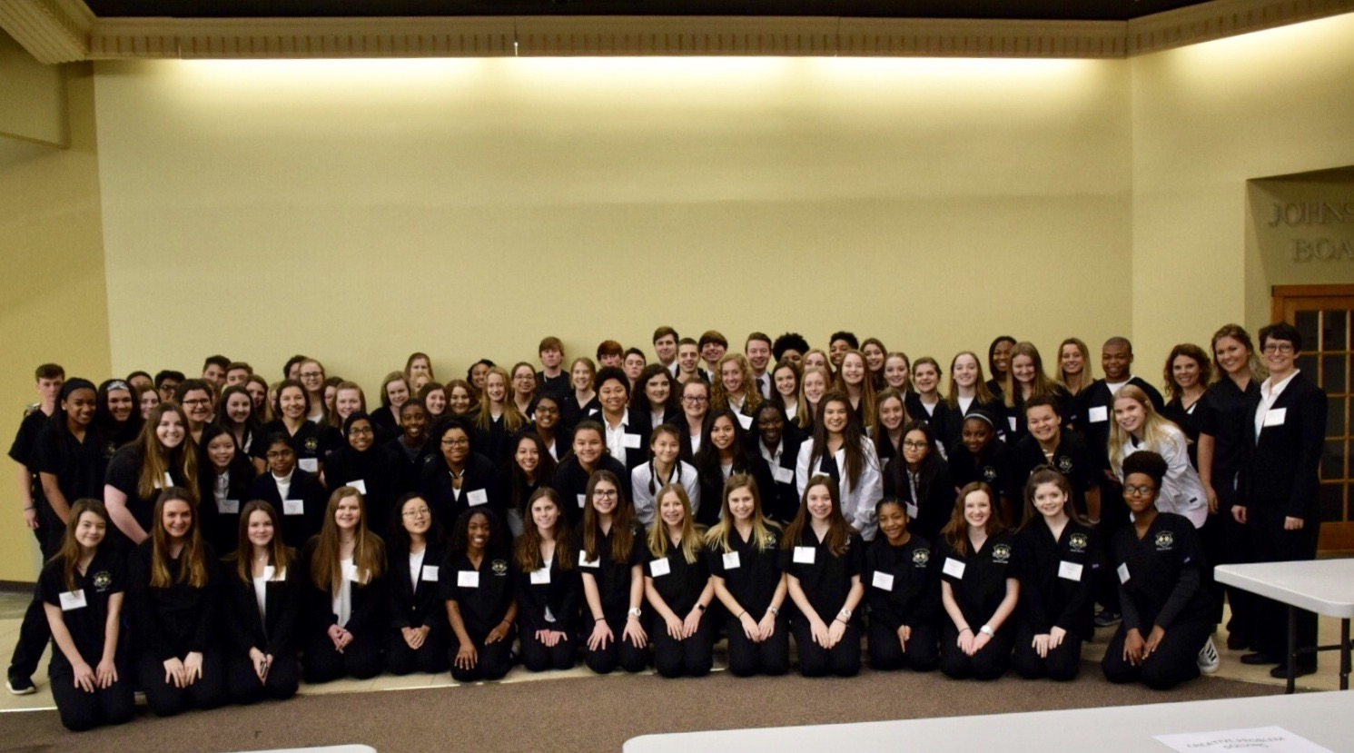
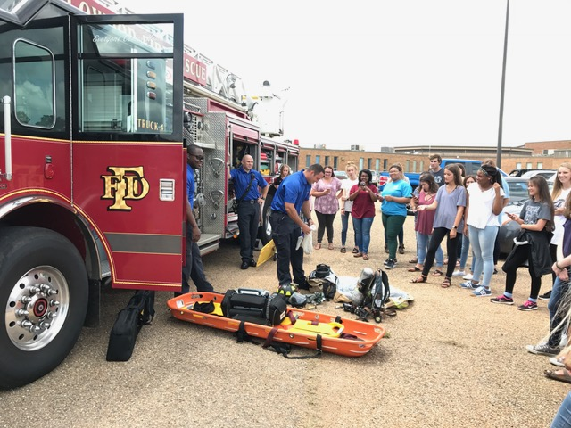
Health Science Instructors
Lorri Smith, BS, RN (9th & 10th)
lorri.smith@rcsd.ms
Chuncey McGowan RN, BSN (10th & 11th)
chu500@rcsd.ms
Rhonda Clark RN, BSN (11th & 12th)
rho503@rcsd.ms
Northwest Rankin High School
Health Science Academy
Northwest Rankin High School
5875 Hwy. 25
Flowood, MS 39232
Phone: 601.992.2242

Slide 2
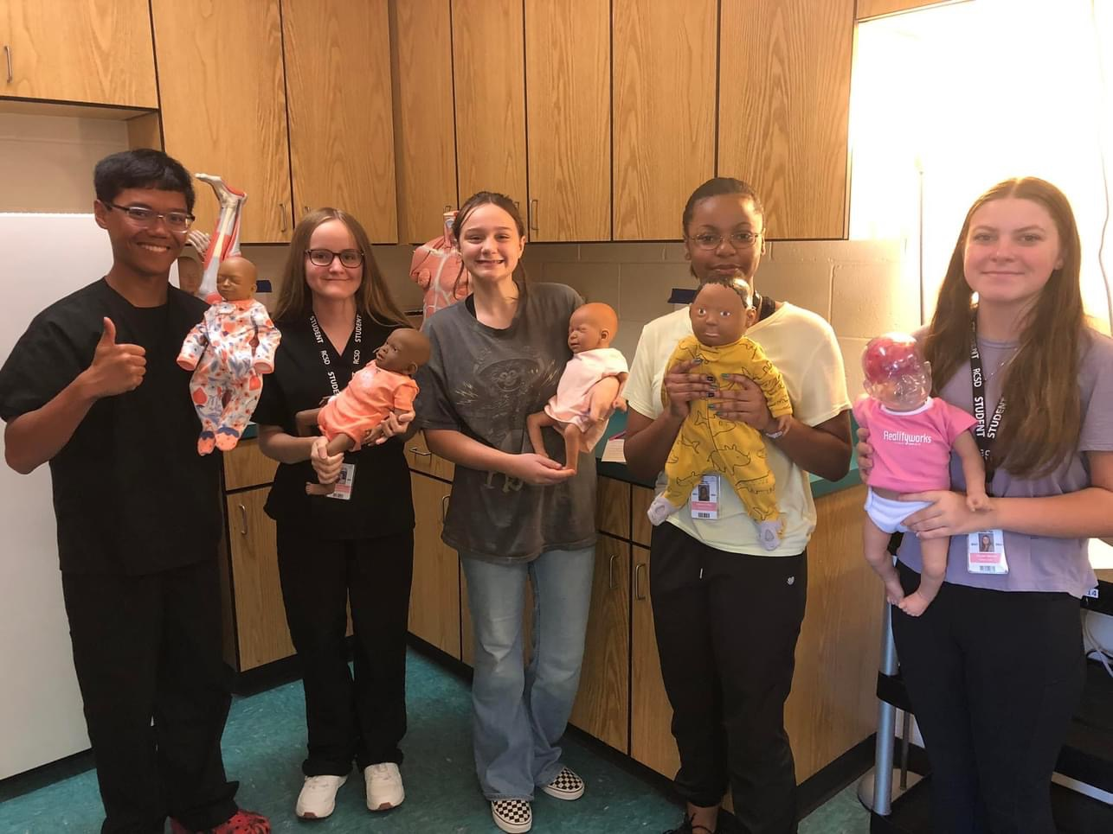
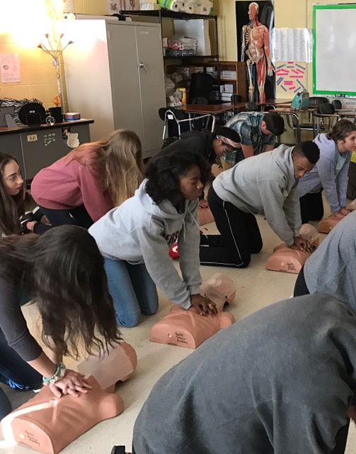
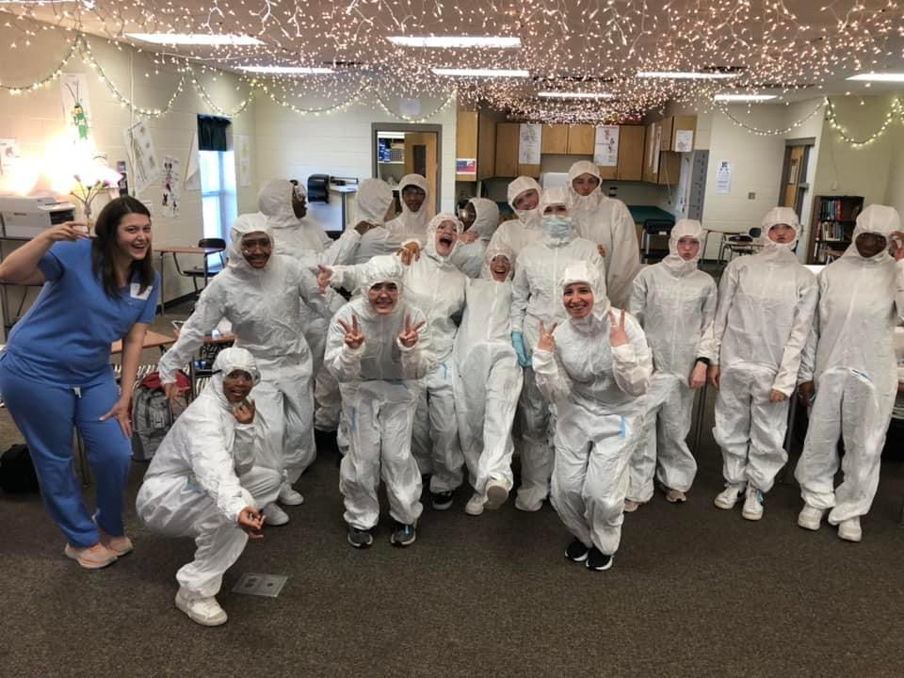
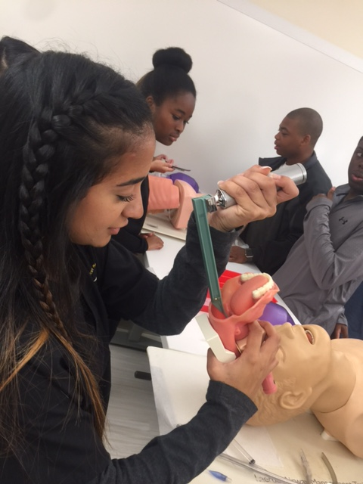
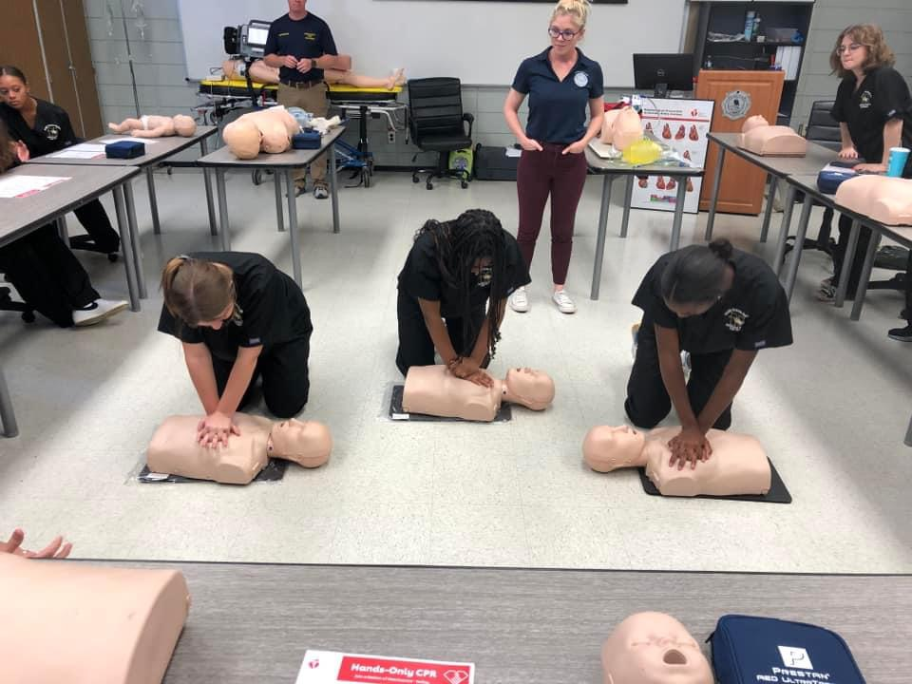
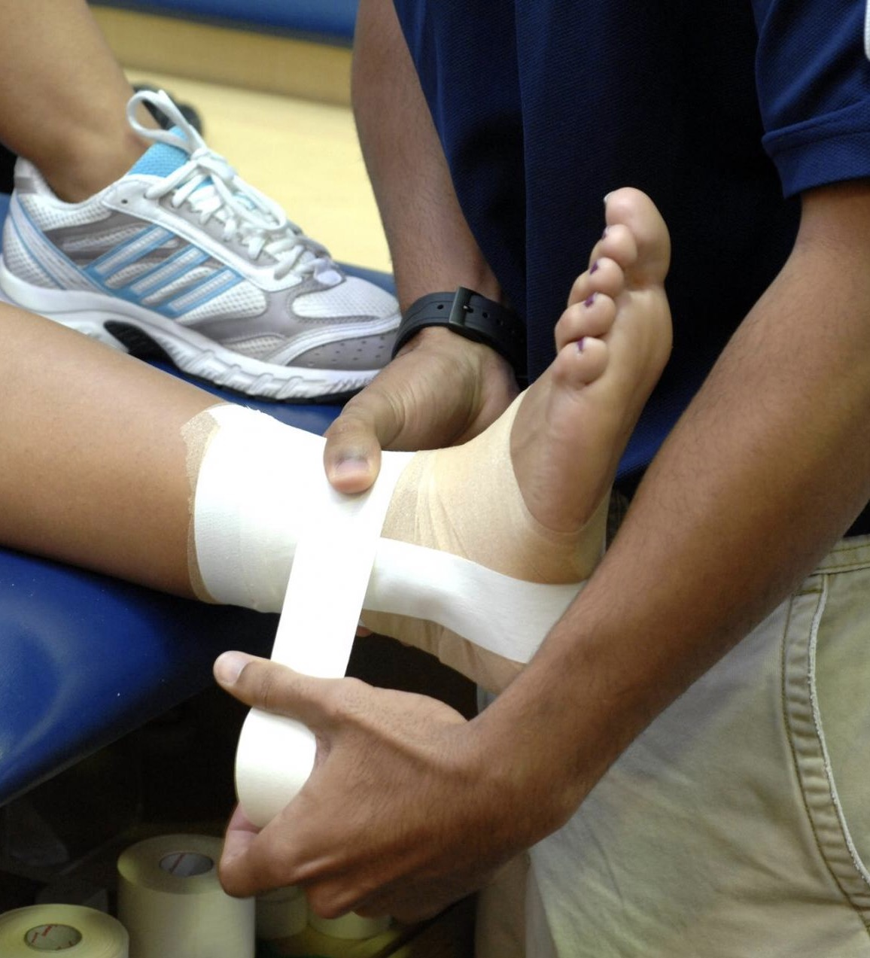

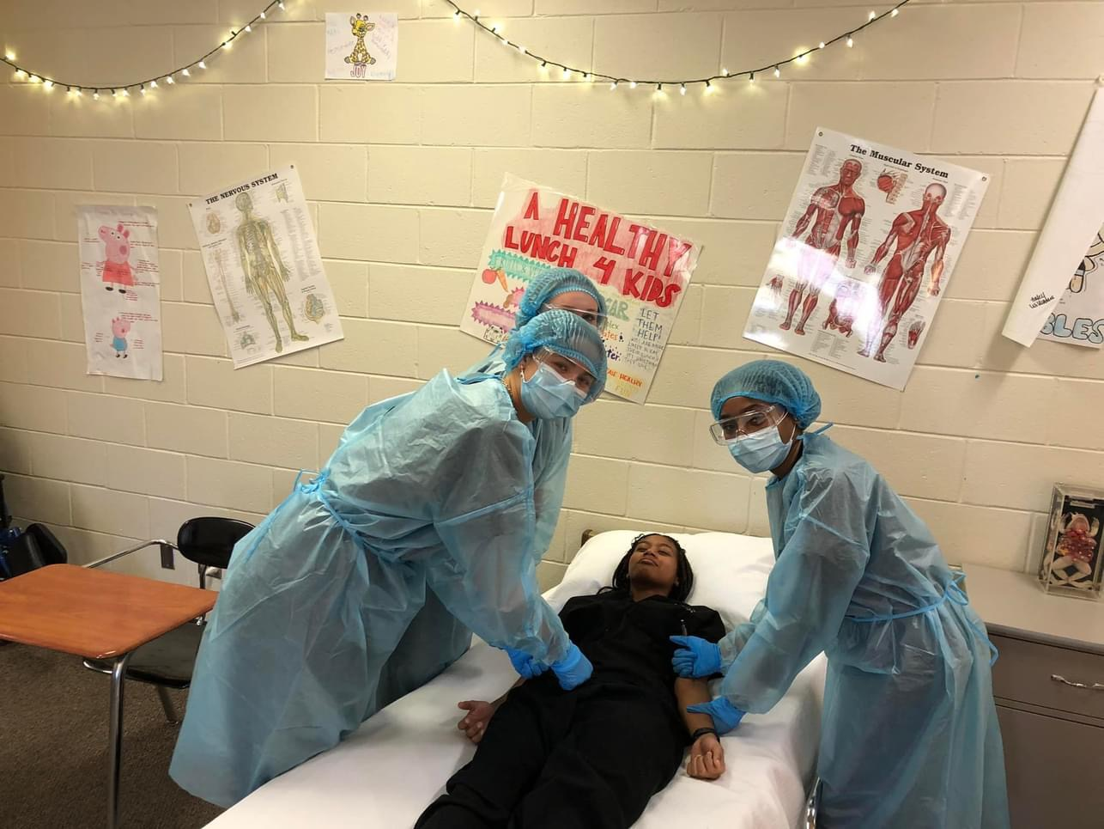
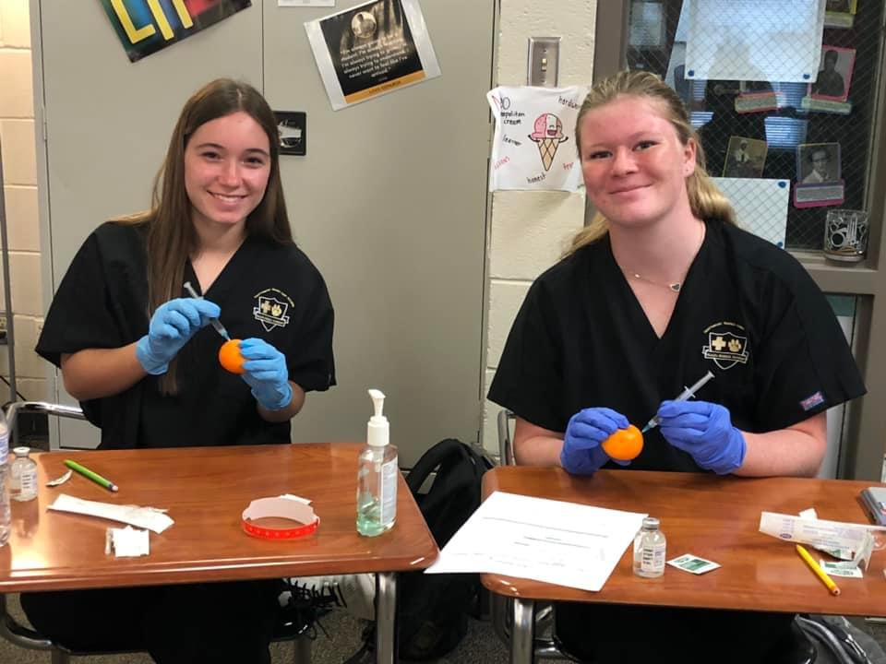
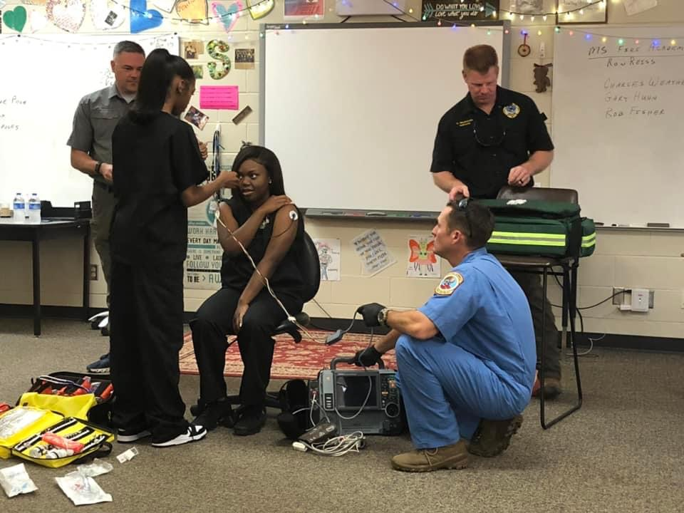
What is the Health Science Academy?
Health Science Academy is 4-year program that includes:
* Preparation for those planning to enter any healthcare field
* Exploration of various health career options
* Development of skills
* Shadowing various medical professionals
*Visiting medical facilities
Students learn:
* Medical terminology
* Body systems
* Legal and ethical issues
* Health care skills
* Much more…
Students gain:
* Advanced knowledge
* Exposure to as many different medical careers as possible.
Apply for NWRHS academies by the deadline. If you want to go into any health-related field, make sure you mark Health Science Academy as your FIRST choice. To apply, the link will also be emailed to all 8th graders.

