Slide 1

September 2024
Monthly Financial Report

Slide 2
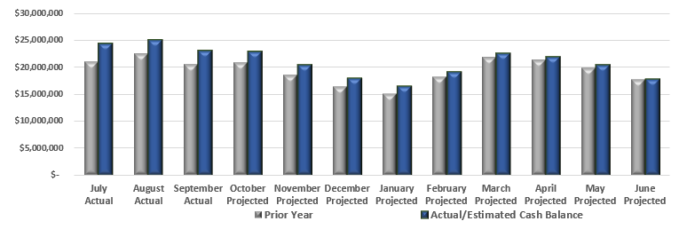

Cash Balance Comparison
September 2024 cash balance is $2,416,904 more than last September. This is due to the carryover cash balance.

Slide 3
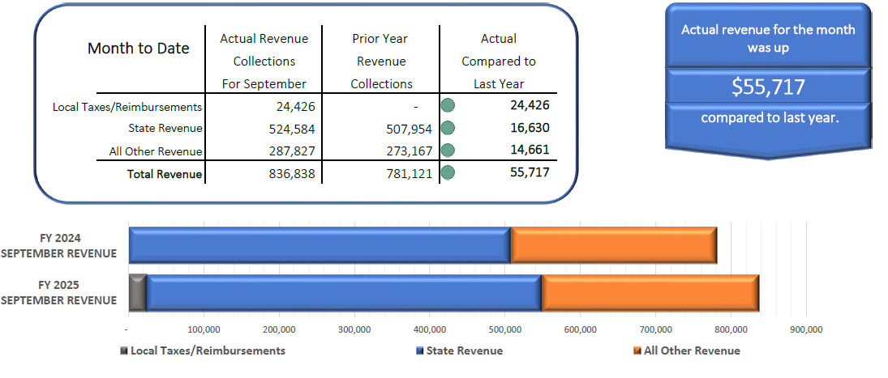
September Revenue Collections Compared to Prior Year

Slide 4
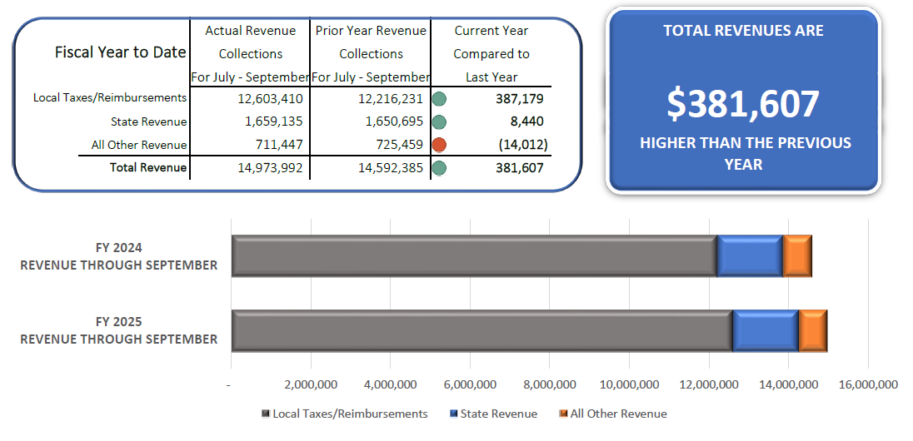
FYTD Revenue Collections Compared to Prior Year
Local tax revenue is up due to an increase in the income tax and increase in property tax revenue from inside millage and new construction

Slide 5
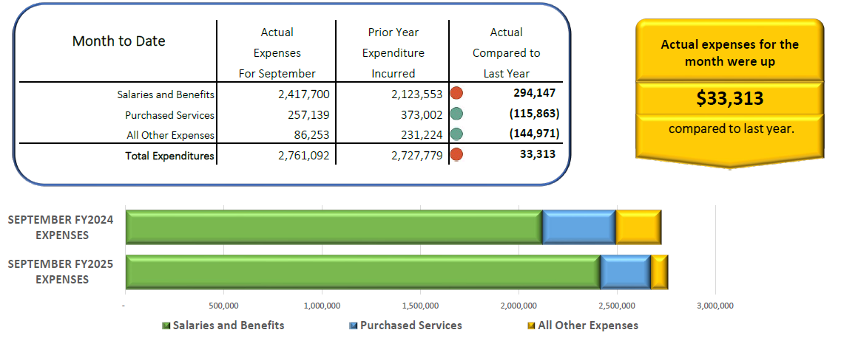
September Expenditures Compared to Prior Year
Increase in base salary/steps and additional staff
Purchased services are down due to a refund received for special education services
All other expenses included the purchase of bus radios in the prior year

Slide 6
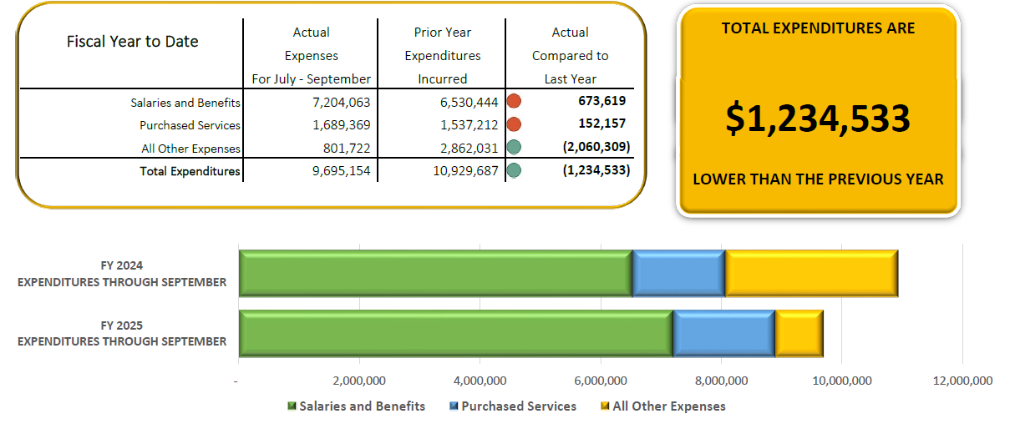
FYTD Expenditures Compared to Prior Year
After adjusting for the capital projects, expenditures are up $833,991 over prior year
Increase in base salary/steps and additional staff
Purchased services continue to increase due to special education contracted services
All other expenditures includes the capital projects fund transfer in prior year

Slide 7
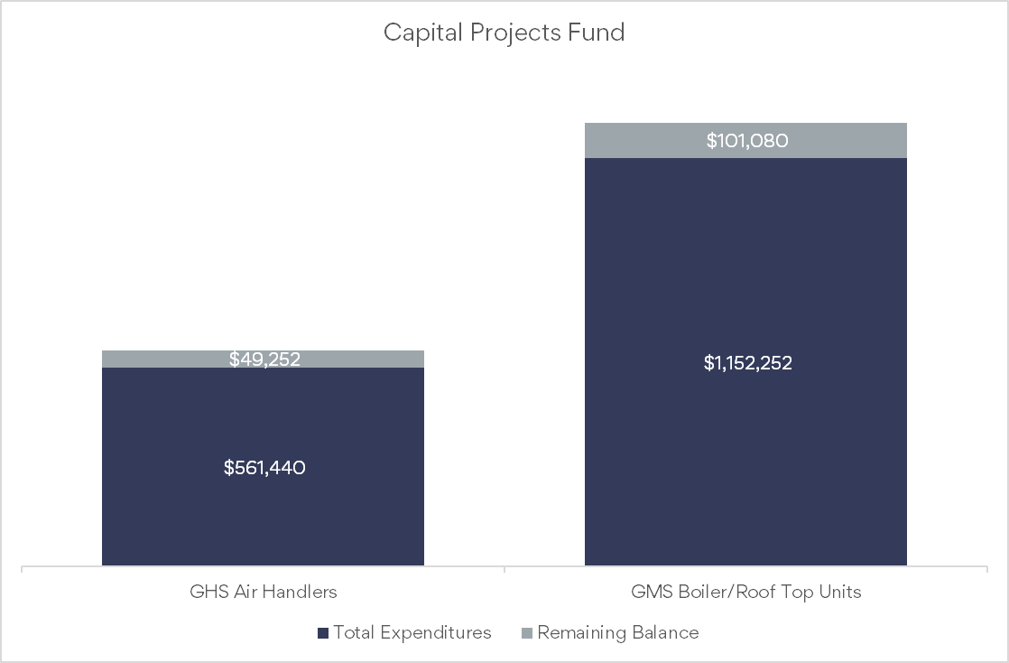
Capital Projects Fund

Slide 8
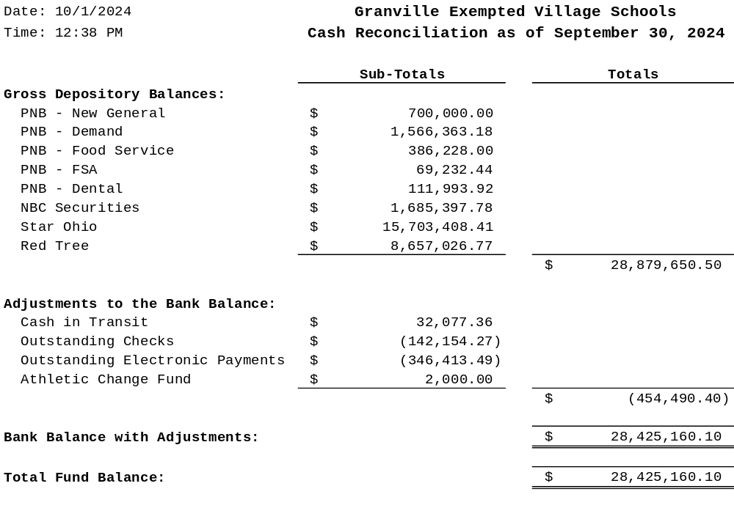
Cash Reconciliation

