Slide 1
Community Engagement
Princeton Public Schools
October 8, 2024

Slide 2
AGENDA
1. Welcome & Quick Recap (5 minutes)
Overview of previous discussions
Framing today’s focus: aligning our vision with our facilities
2. Discussing the Future of Education (60 minutes)
Ben Barton, Superintendent
Jessica Town-Gunderson, Director of Teaching & Learning
  Academic innovations and priorities for student growth
Heather Sorenson, Tiger Career Academies Coordinator
  Expanding career pathways and hands-on learning opportunities
  Tara Kude, Jessie Lupkes, Charissa Larson
Ryan Jensen, High School Principal
  Vision for student success and holistic development
Darin Laabs, Activities Director
  Developing leadership and life skills through extracurricular activities
Sarah Marxhausen, Middle School Principal
  Visions for the Middle School
3. Dreaming Big for Princeton Public Schools - Table Discussions (20 minutes)
4. Setting Priorities (5 minutes)

Slide 3
Mission
Princeton Public Schools is an innovative leader in instruction, developing in EVERY learner the ability to succeed in an ever-changing world.
Vision
Princeton Public Schools will equip every student to be career and college ready through personalized instruction, community partnerships, and collaboration.

Slide 4

Notes:
Video link: https://youtu.be/FTRJlmN6jeU?si=oMWw-ySyNbaq9dFg

Slide 5
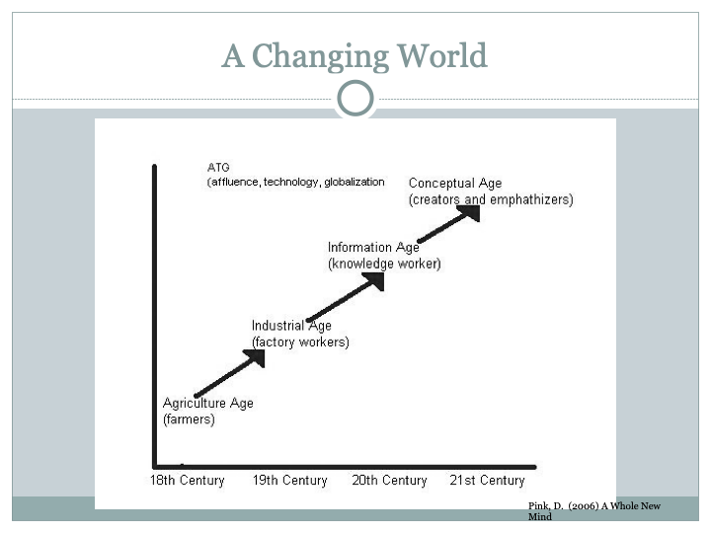

Slide 6
Tony Wagner - Survival Skills
Critical Thinking and Problem Solving
Collaboration across Networks and Leading by Influence
Agility and Adaptability
Initiative and Entrepreneurialism
Effective Oral and Written Communication
Accessing and Analyzing Information
Curiosity and Imagination

Slide 7
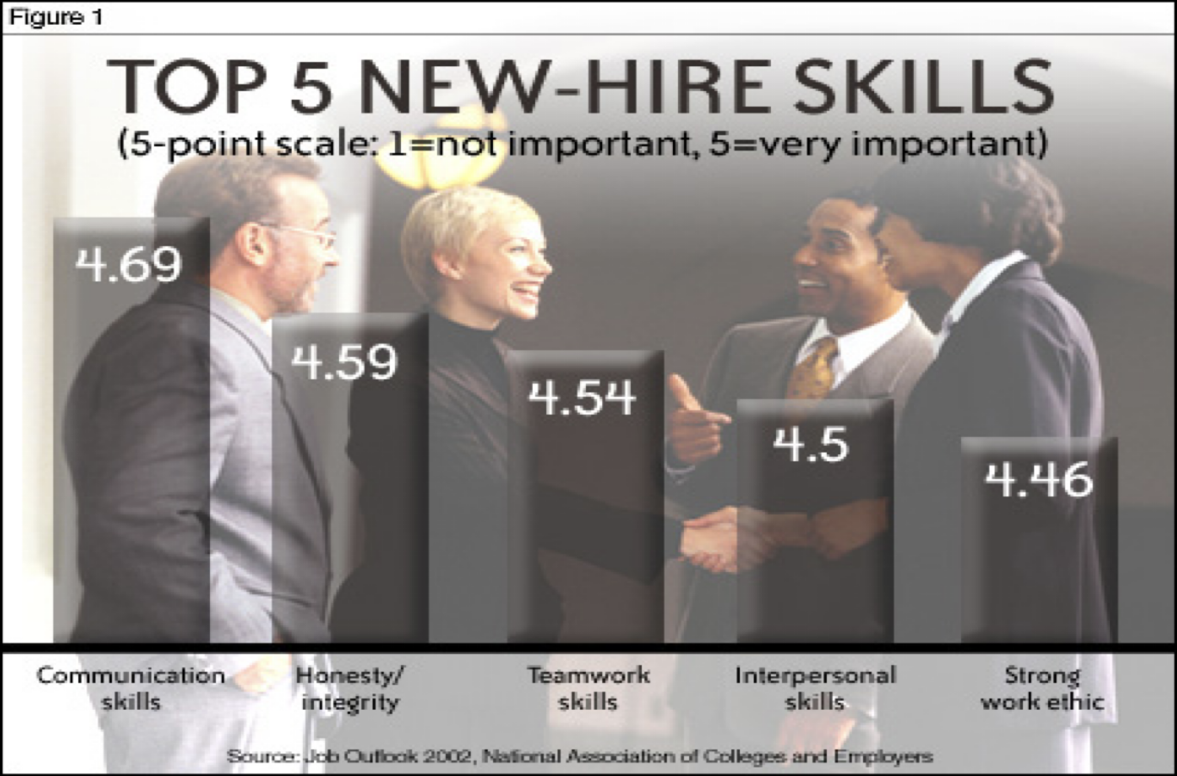

Slide 8
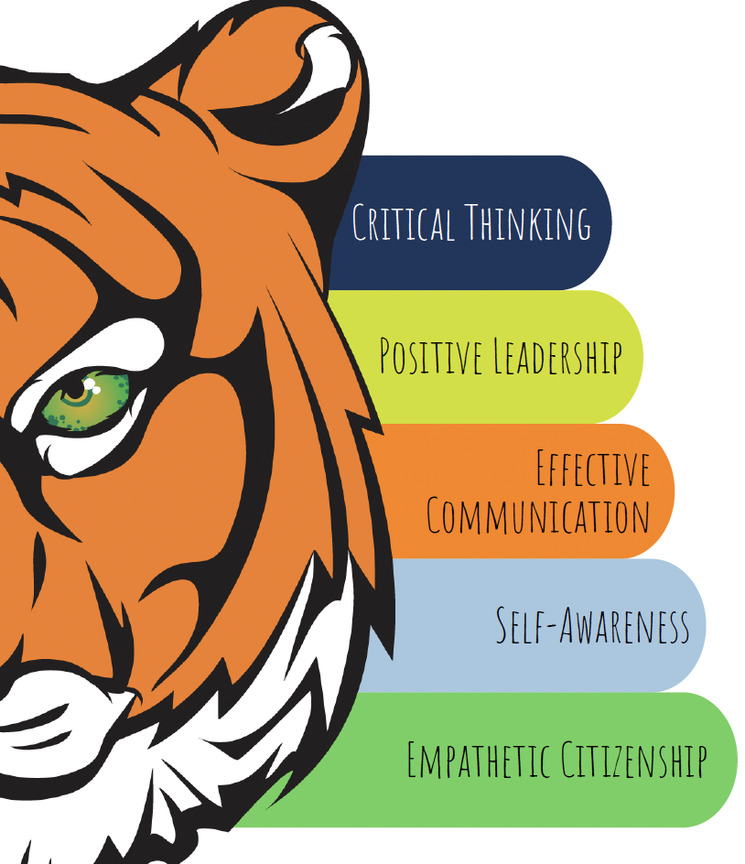
Framing Our Vision
This is what we want for ALL our students—a set of core competencies that prepare them for success in life, work, and citizenship.

Slide 9
Why Facilities Matter to Our Vision
Removing Barriers to Student Success
Facilities directly impact learning environments
Technology has changed what and how we teach, but our facilities limit what we can do
Current limitations hinder progress toward our vision
We have a better understanding of how students learn, and how much their environment impacts their ability to learn
Princeton Public Schools is an innovative leader in instruction, developing in EVERY learner the ability to succeed in an ever-changing world.

Slide 10
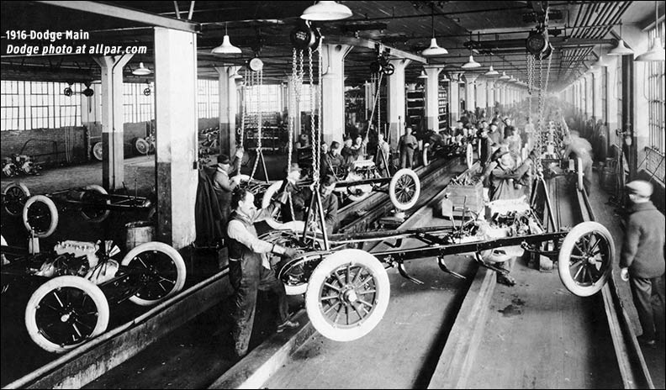
past
Notes:
Jobs have changed significantly

Slide 11
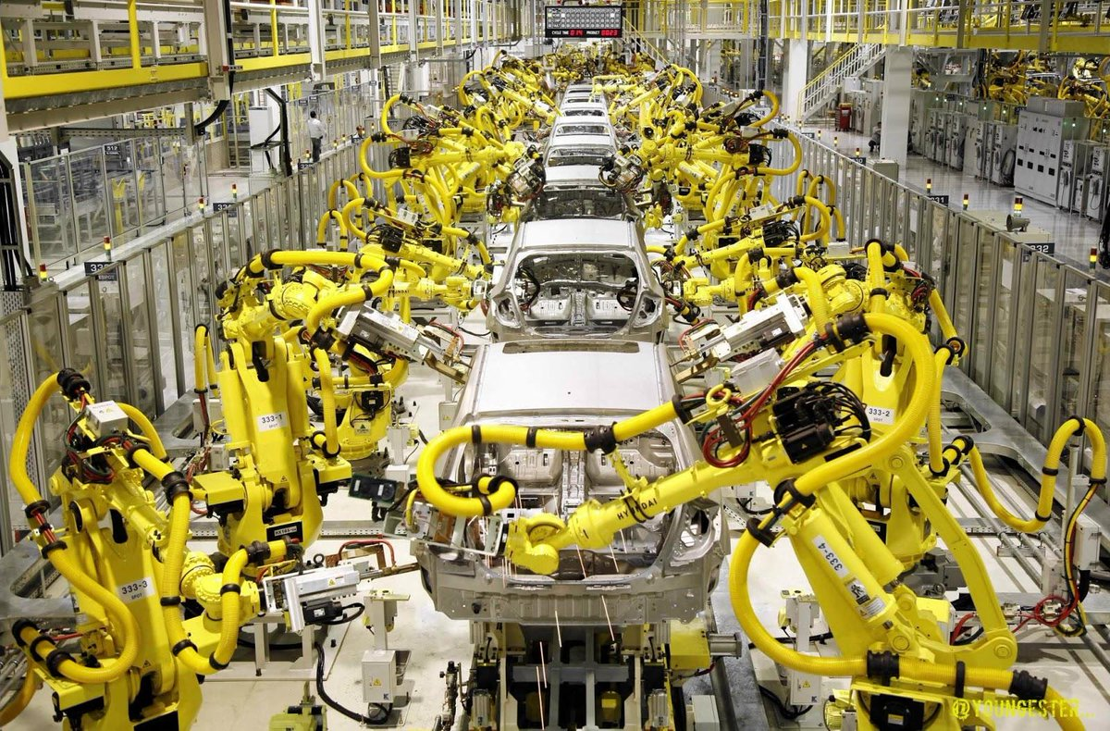
present

Slide 12
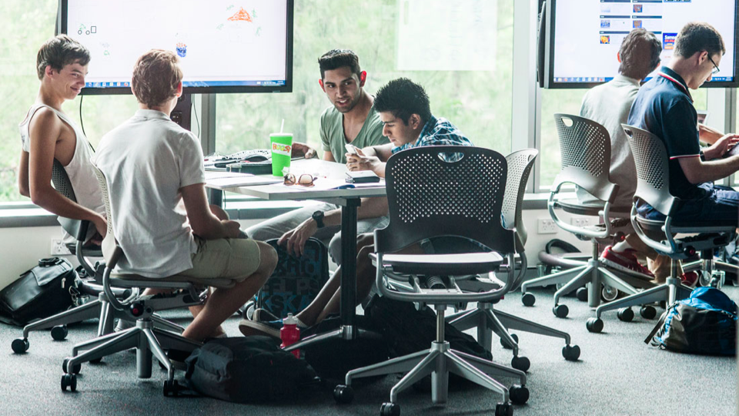
present

Slide 13
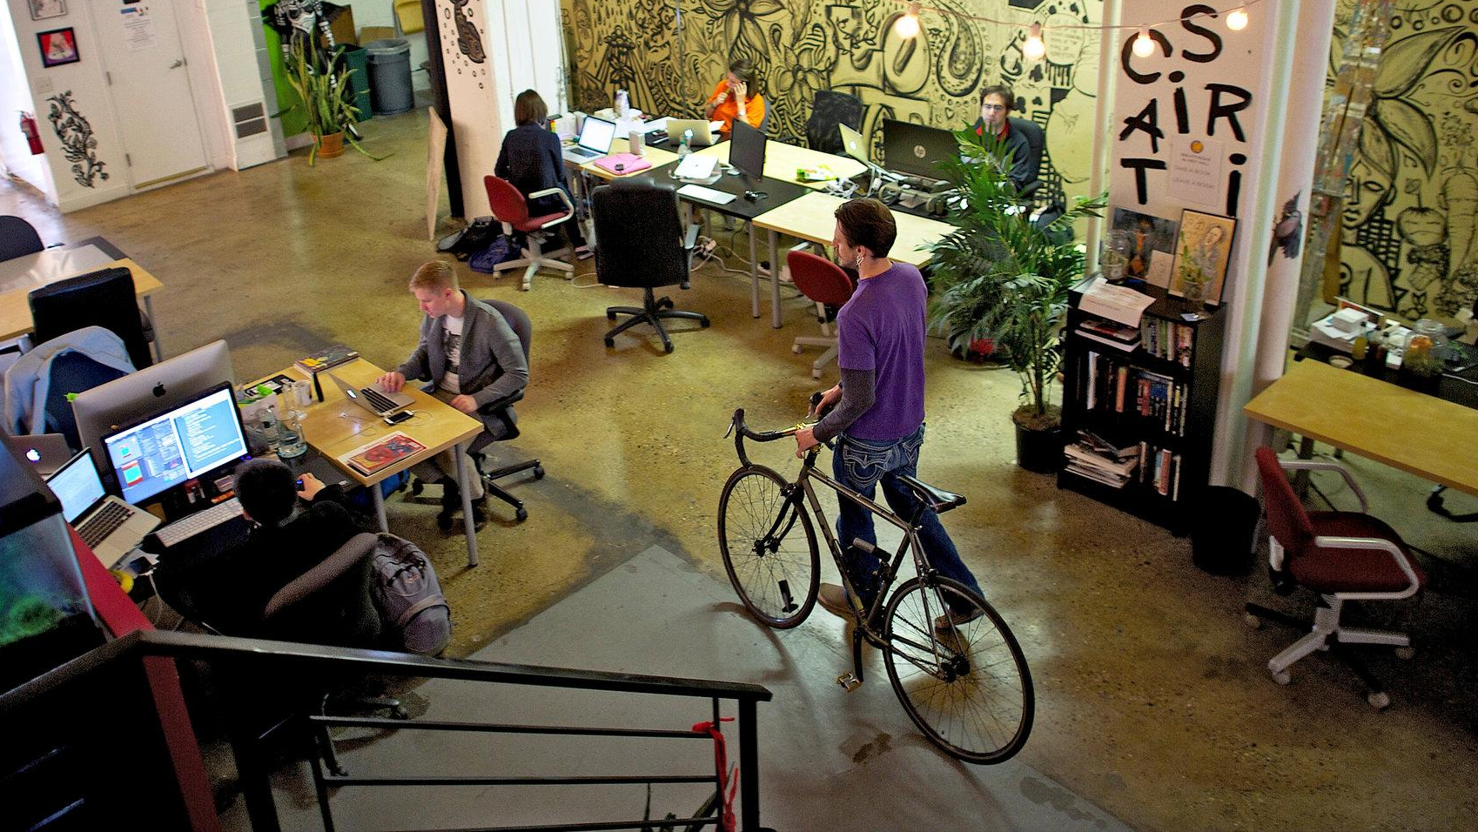
present
Notes:
The future is not only about preparing students for college but for the real world and the changing landscape of learning.

Slide 14
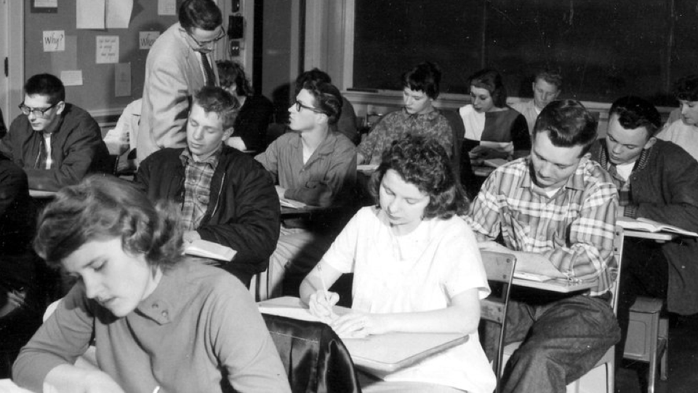
past
Notes:
But our facilities haven’t been able to keep up with the changing technological demands of today’s college students and workforce skills.

Slide 15
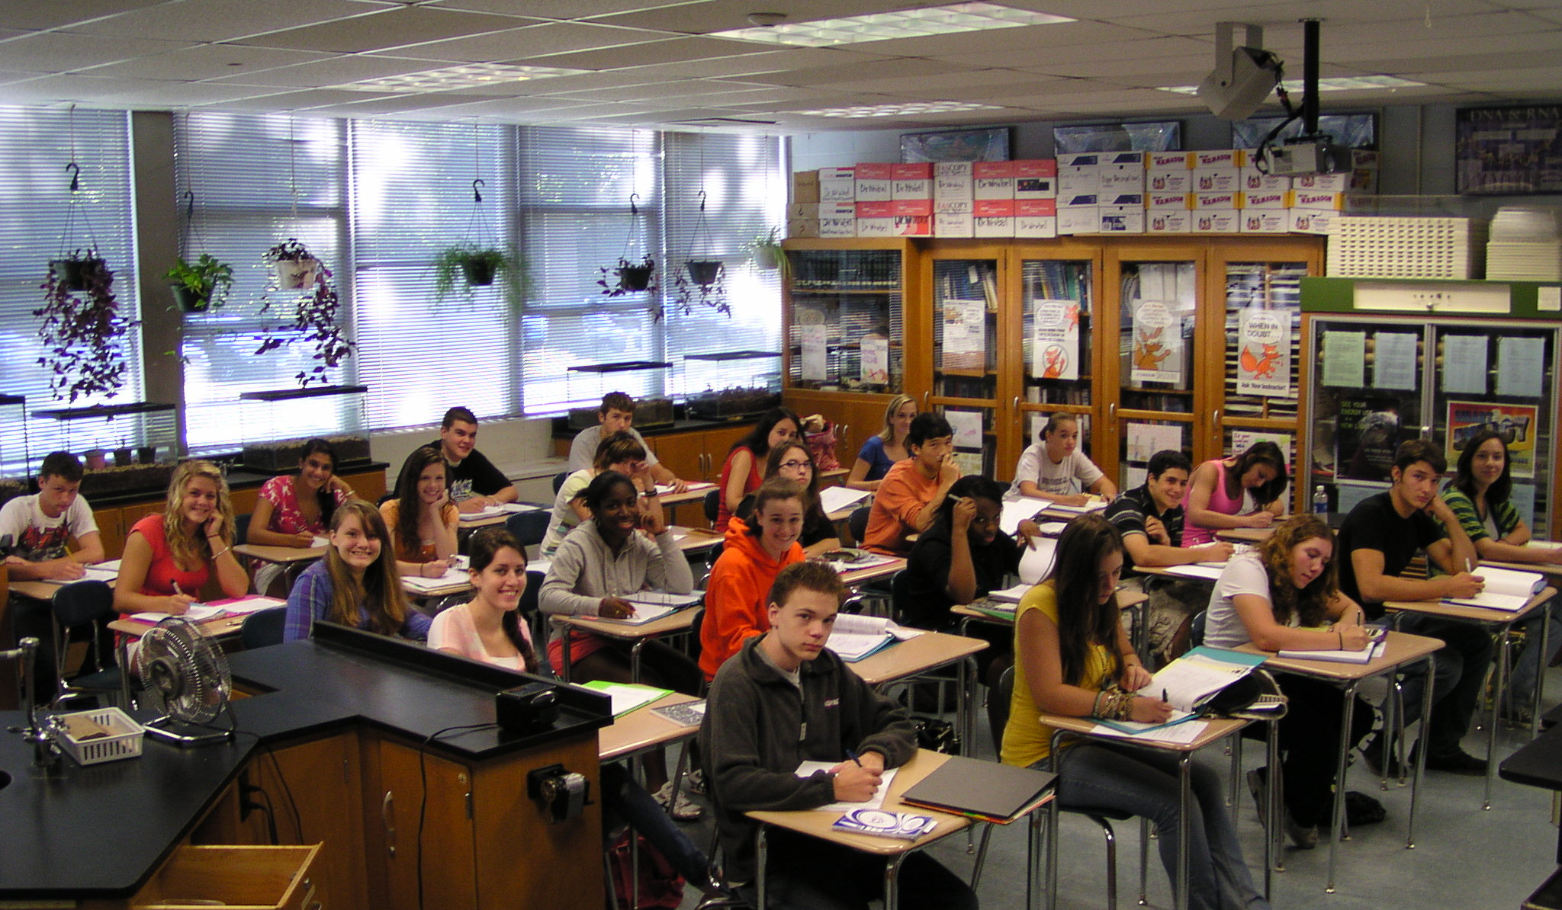

present

Slide 16
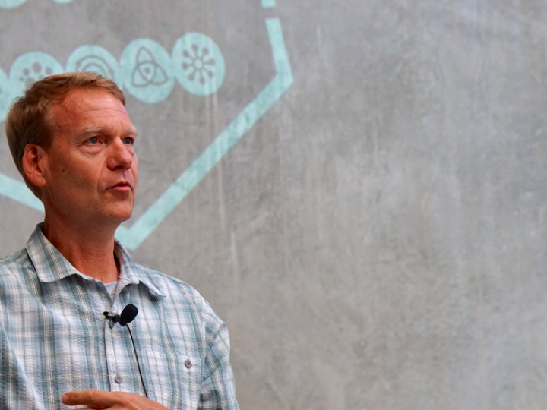

human-centered
design
Notes:
This is Doug Dietz, lead engineer at GE.

Slide 17
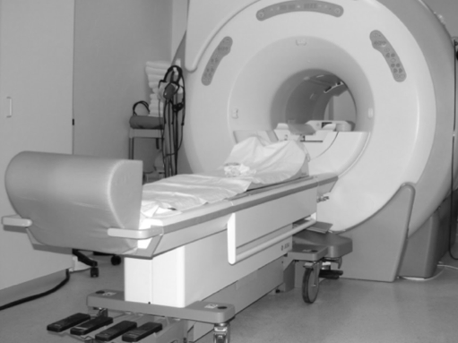
Notes:
Doug and his teams are responsible for designing MRi machines.
After Doug and his team create a new machine they test it in a few hospitals around the country.

Slide 18
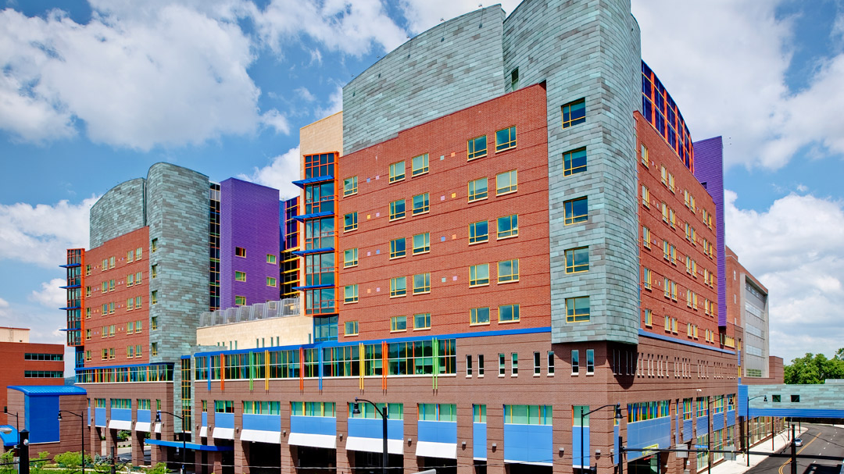
Notes:
One of those hospitals was the Children’s Hospital in Pittsburgh. They got the tour of the hospital and got tons of praise from the technicians and staff how amazing the new MRi was and how satisfied they were. As they were leaving, they were walking through the waiting room and Doug noticed a young girl who was absolutely hysterical with panic. Doug asked the tech next to him what was going on there and the tech, very nonchalantly, said “oh, most kids are terrified of the MRi, we need to sedate about 80% of them.” Well, Doug was shocked. He was like “what?!” He knew he had to change that experience for kids.

Slide 19

Notes:
So, he enrolled in a program he heard of from a mentor at the school at Stanford. It was there that Doug and his team learned about the power of design, more specifically, human centered design.
Doug and his team integrated human centered design into their work and quickly realized that this was the best work they had ever done and the most creative. They spent time talking to children, learning about the things they liked and did. And from those empathy interviews and insights they arrived at ….

Slide 20
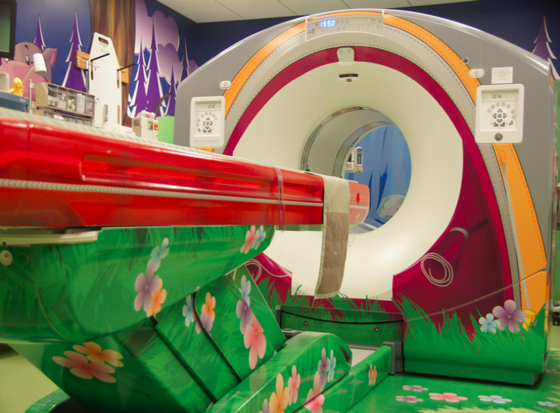
Notes:
Theme based MRi rooms that not only were a fresh coat of paint but “experiences” built around the things kids dig. Fairy princess themes, pirate themes, space travel etc…. The impact of this new design, in a few short months the hospital went from sedating 80% of the kids to 20%!

Slide 21
Let’s Start By Reimagining
If we could achieve anything, what would it look like?
How can our facilities support, rather than limit, our vision?
What career skills could we offer with expanded space?
How might we expand our Tiger Career Academies if space wasn’t a barrier?
Princeton Public Schools is an innovative leader in instruction, developing in EVERY learner the ability to succeed in an ever-changing world.

Slide 22
Focusing on What Matters Most
With so many great ideas, what should we prioritize first?
What would have the greatest impact on our students' success?
Princeton Public Schools is an innovative leader in instruction, developing in EVERY learner the ability to succeed in an ever-changing world.

Slide 23
Tiger Career Academies with Heather Sorenson
Empowering Students through Tiger Career Academies
Bridging the gap between classroom learning & real world
Collaborations with local businesses
Exploration of passions & skill development
Customized educational experience preparing students for their future careers, college, & life!
Future-Ready Graduates
Shaping Leaders and Innovators
Princeton Public Schools is an innovative leader in instruction, developing in EVERY learner the ability to succeed in an ever-changing world.

Slide 24






Tiger Career Academies
Comprehensive Career Groupings
  Each academy organizes careers into broad, logical categories
Targeted Career Pathways
  Within each academy, students can choose from specialized pathways
Industry-Specific Skill Development
  Each pathway provides a range of elective courses designed to equip students with specialized knowledge and skills
Princeton Public Schools is an innovative leader in instruction, developing in EVERY learner the ability to succeed in an ever-changing world.

Slide 25
Tiger Career Academies
Tiger Career Academies open a student up to so many opportunities:
Participation in special events (field trips, workforce panels, mentorship programs, job shadows…)
Tiger Career Academy Internships
Princeton Public Schools is an innovative leader in instruction, developing in EVERY learner the ability to succeed in an ever-changing world.

Slide 26
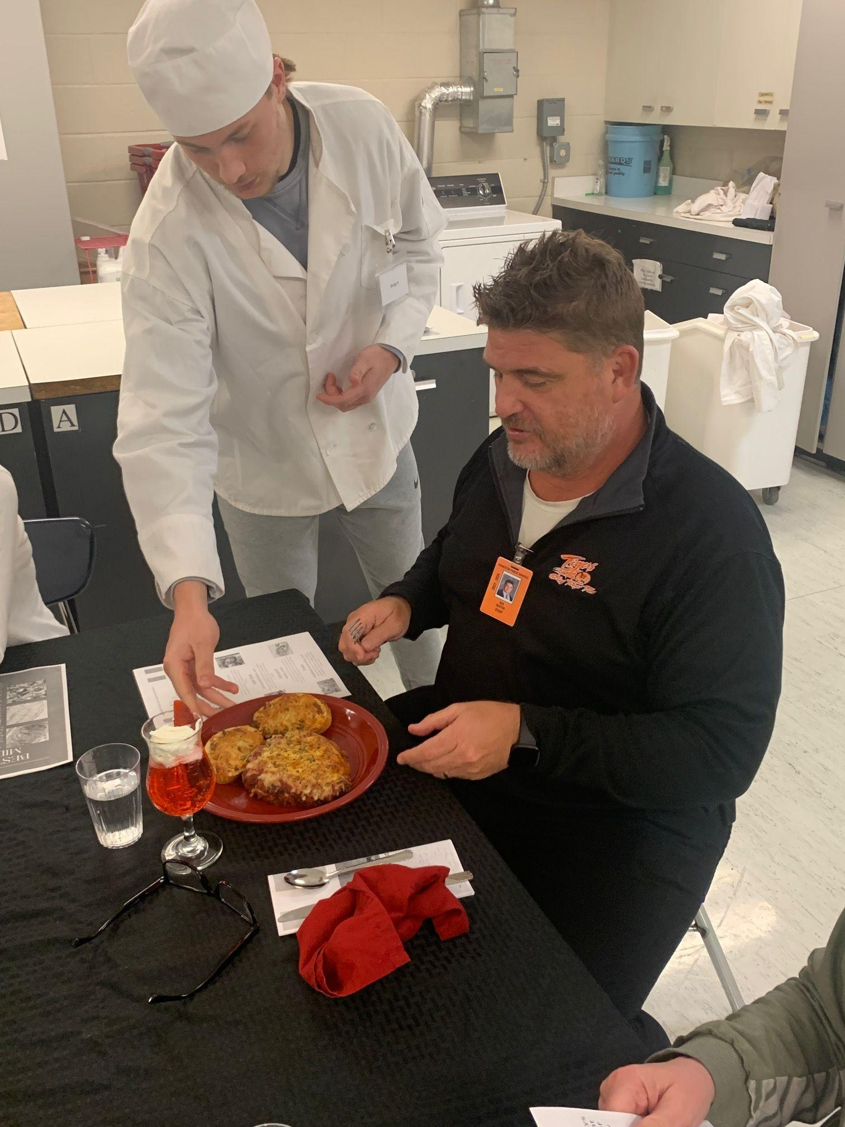
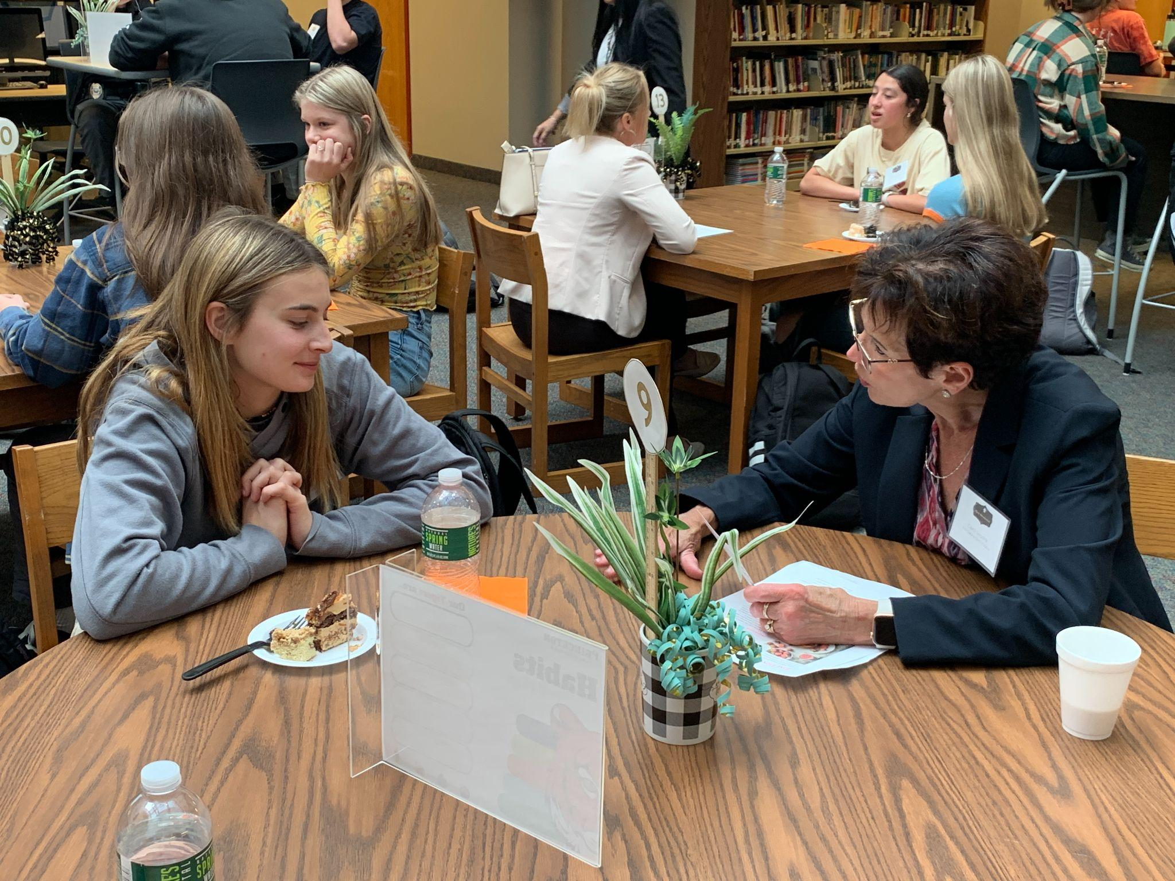
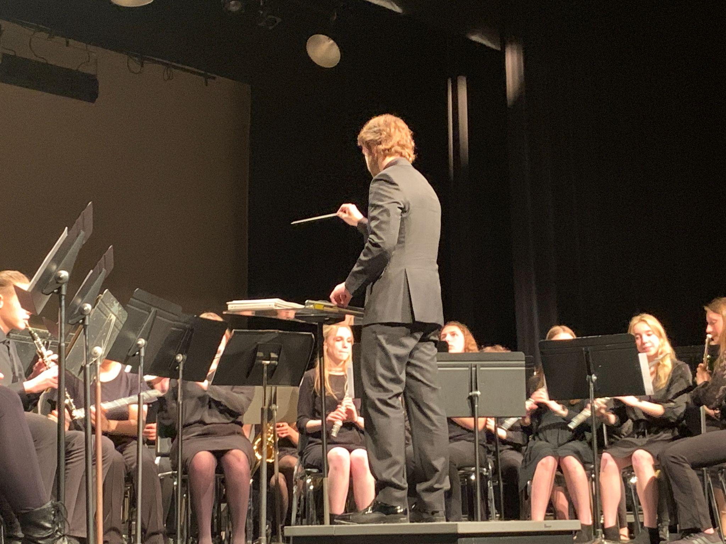
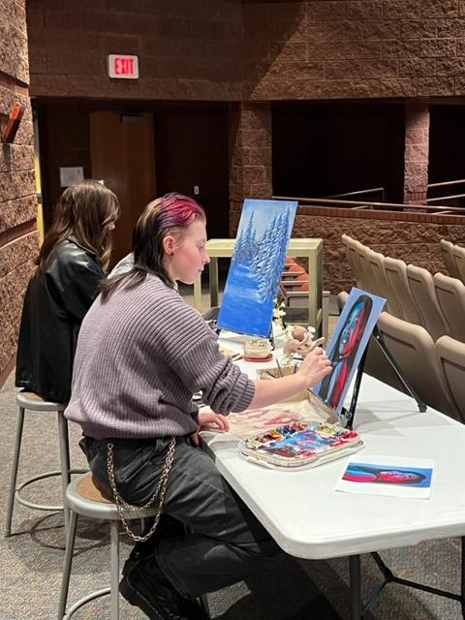
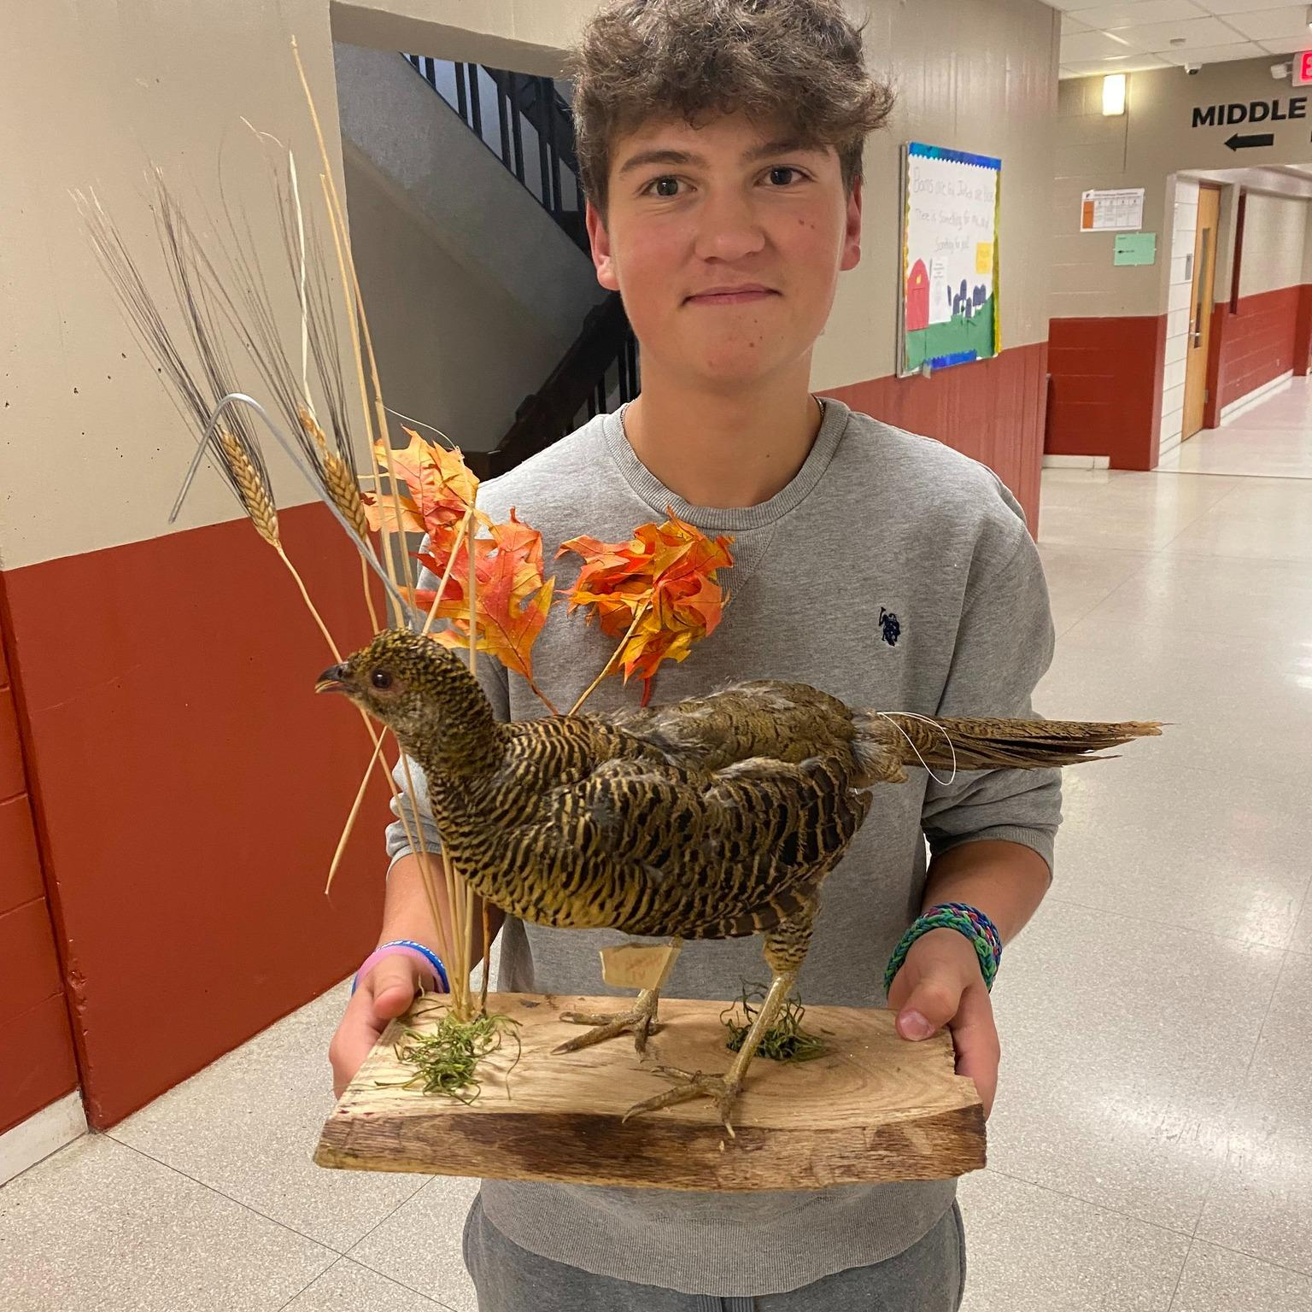
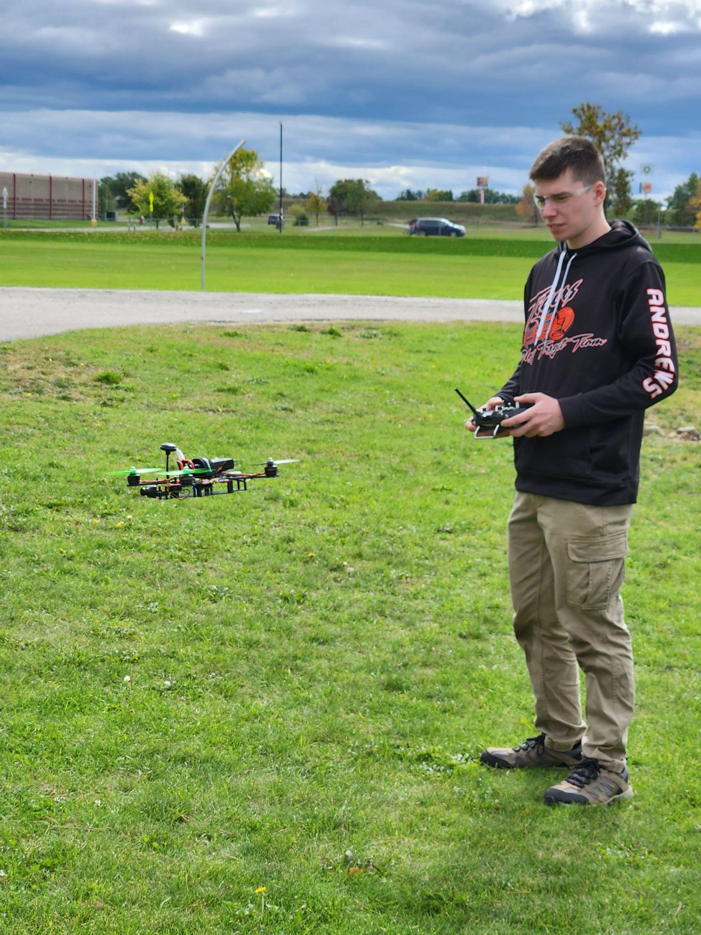
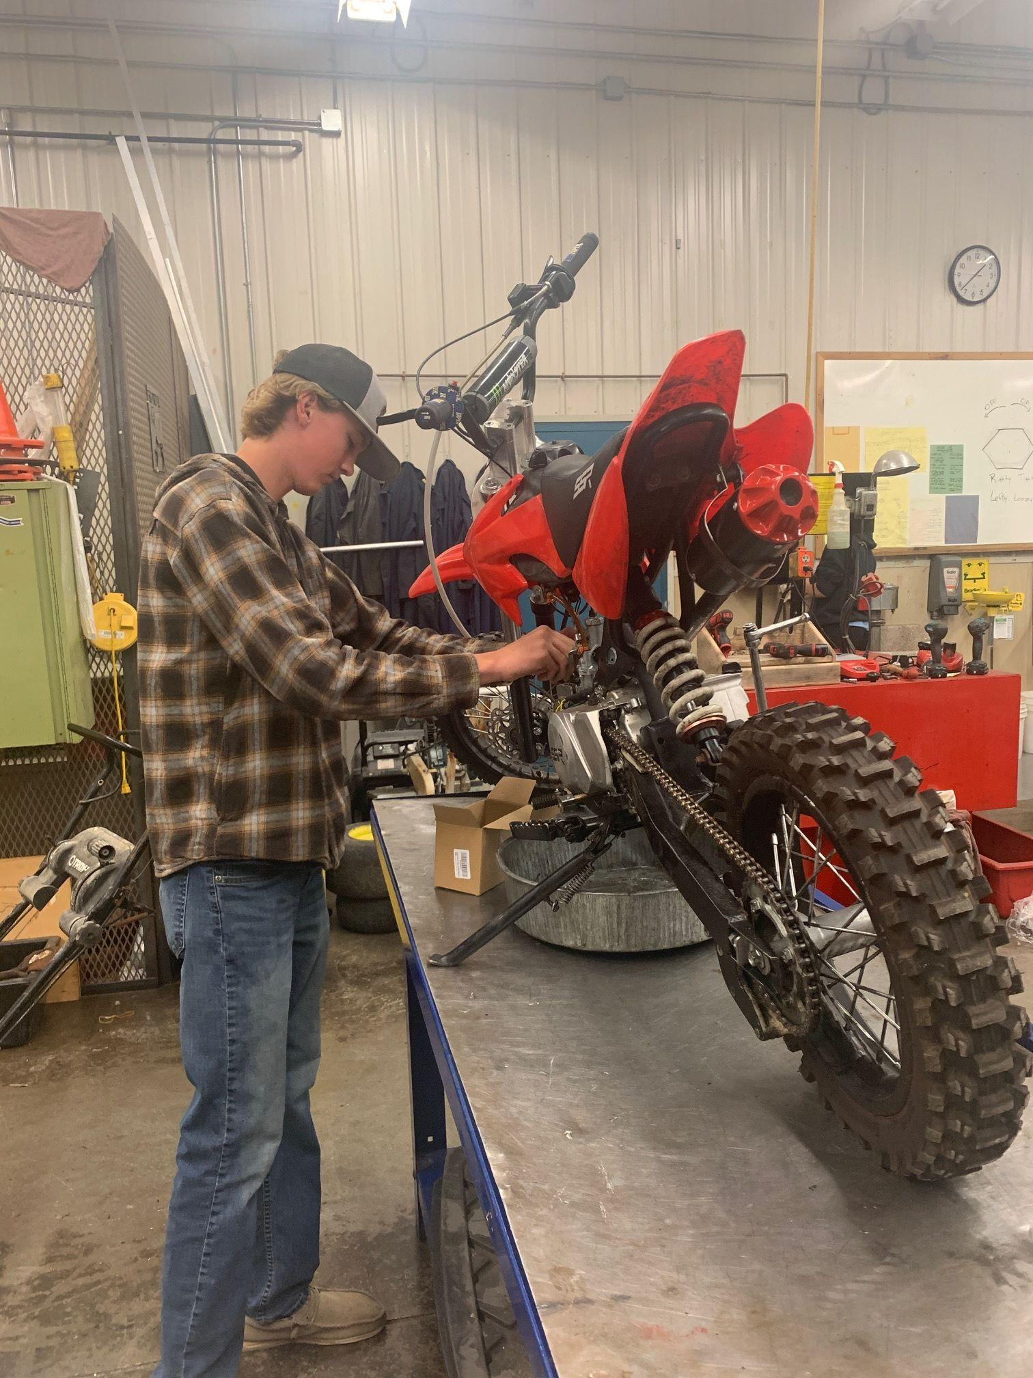
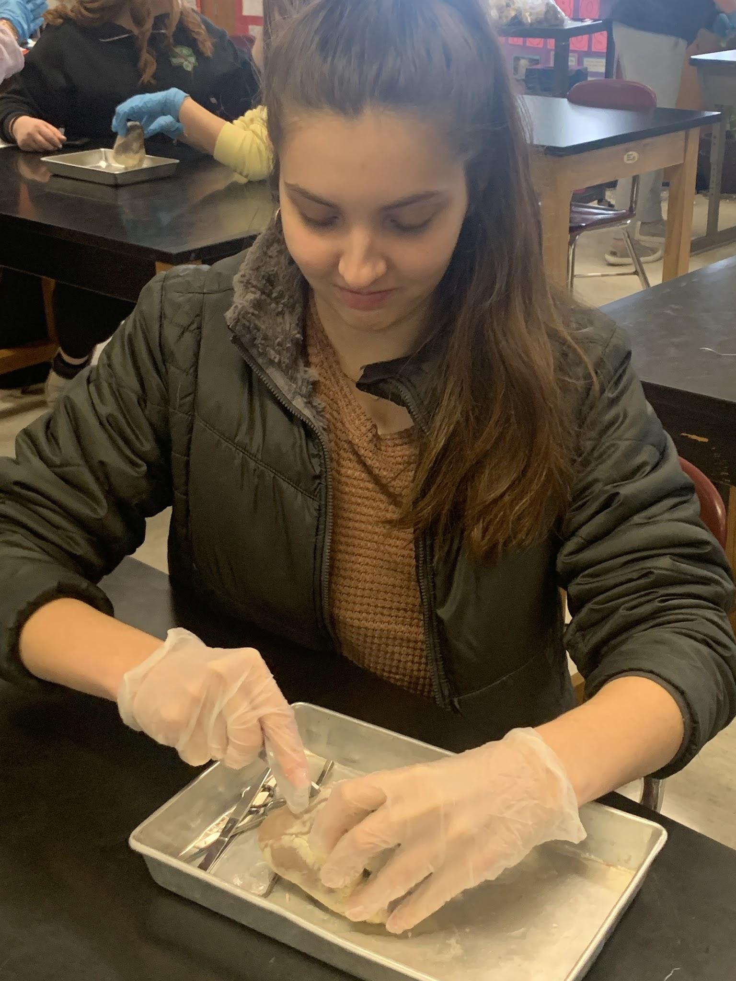
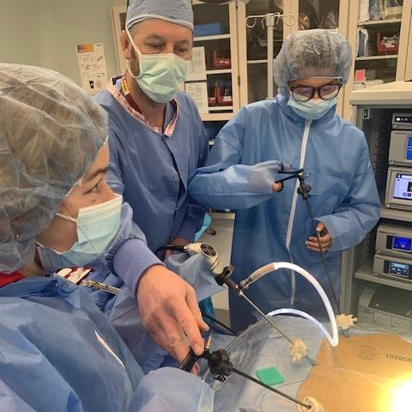
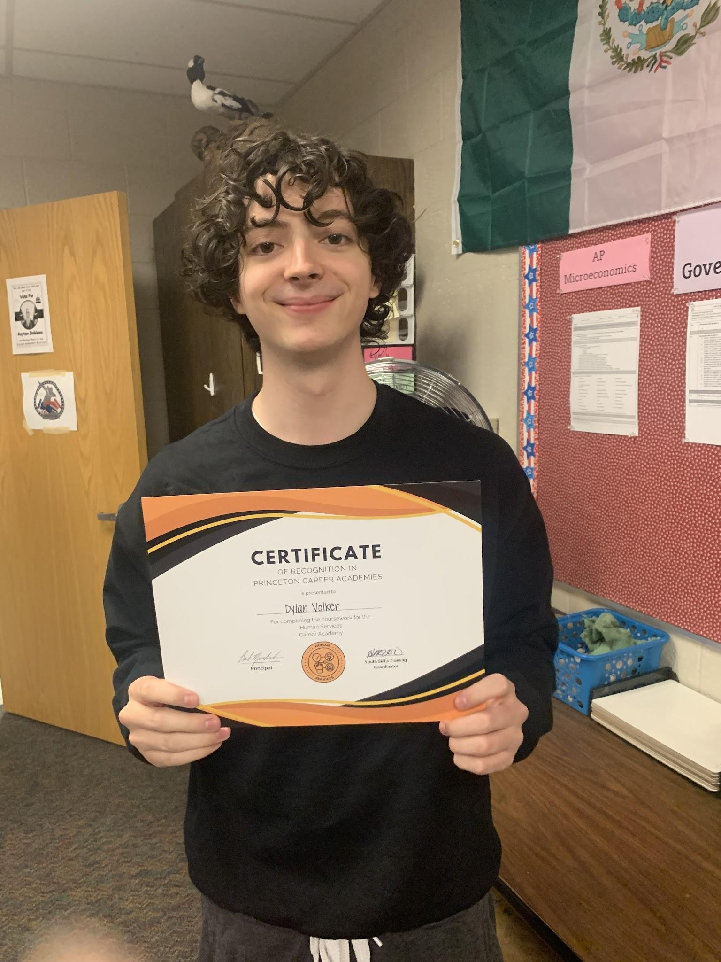
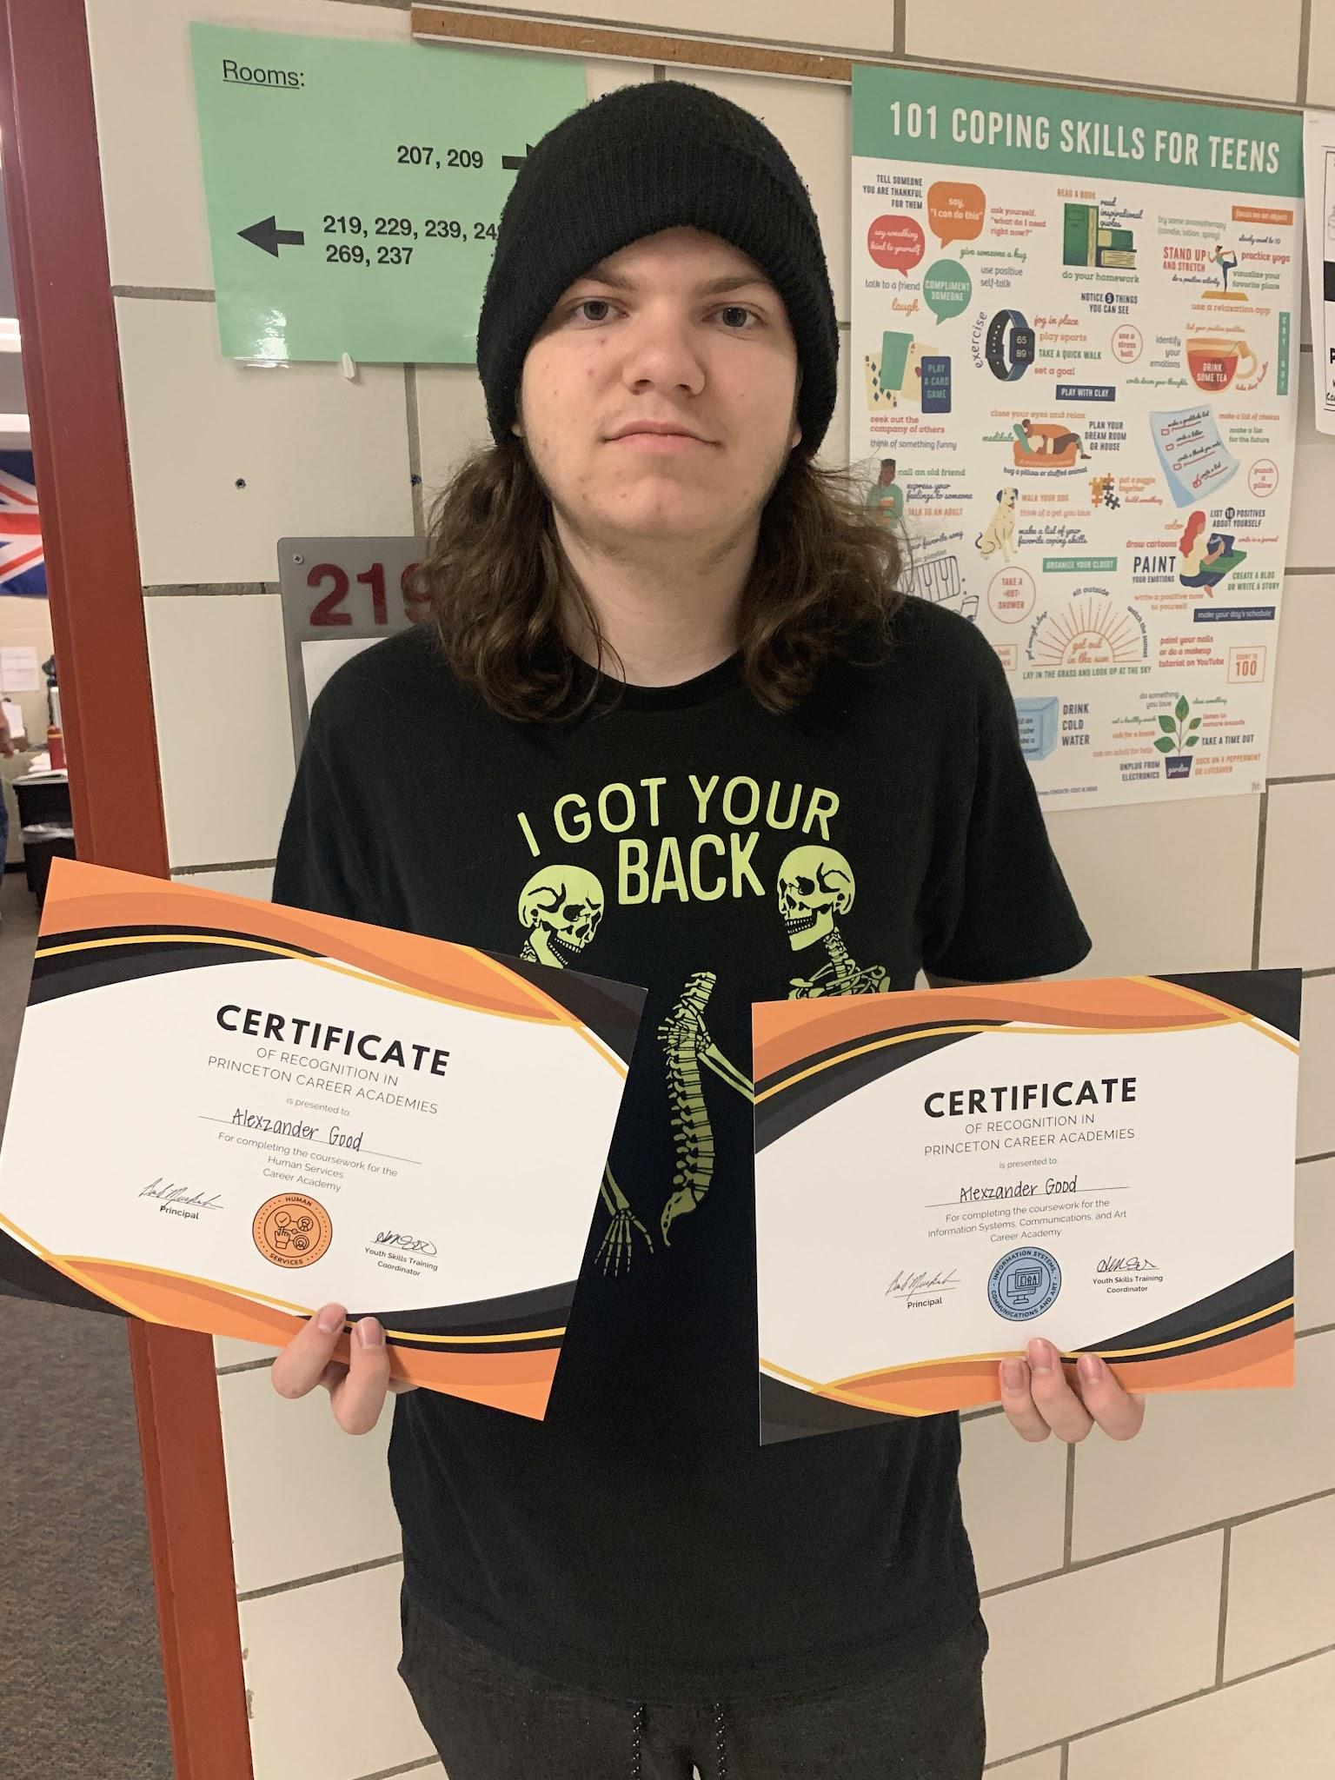
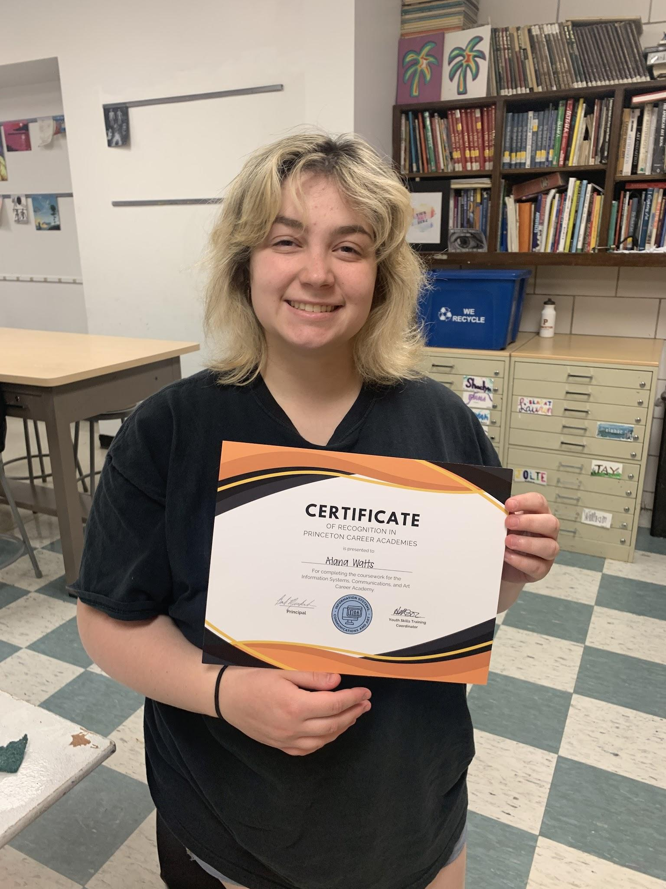
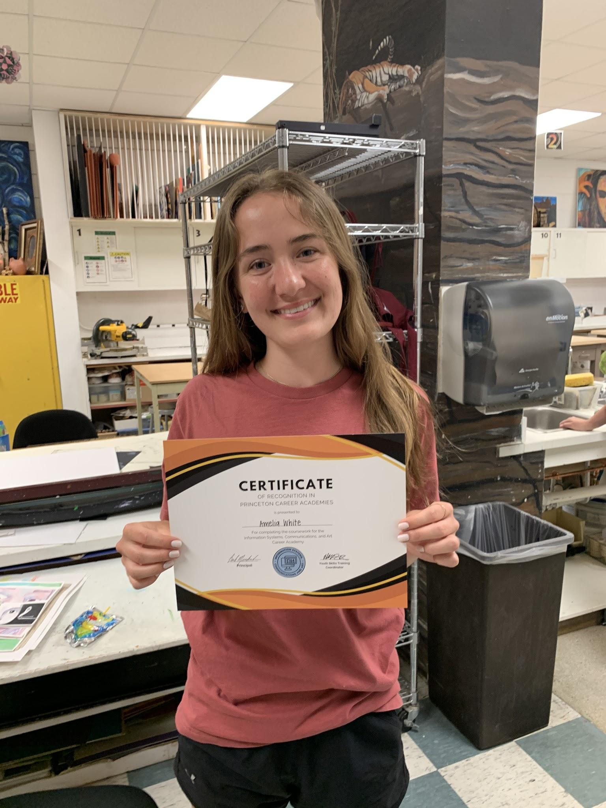
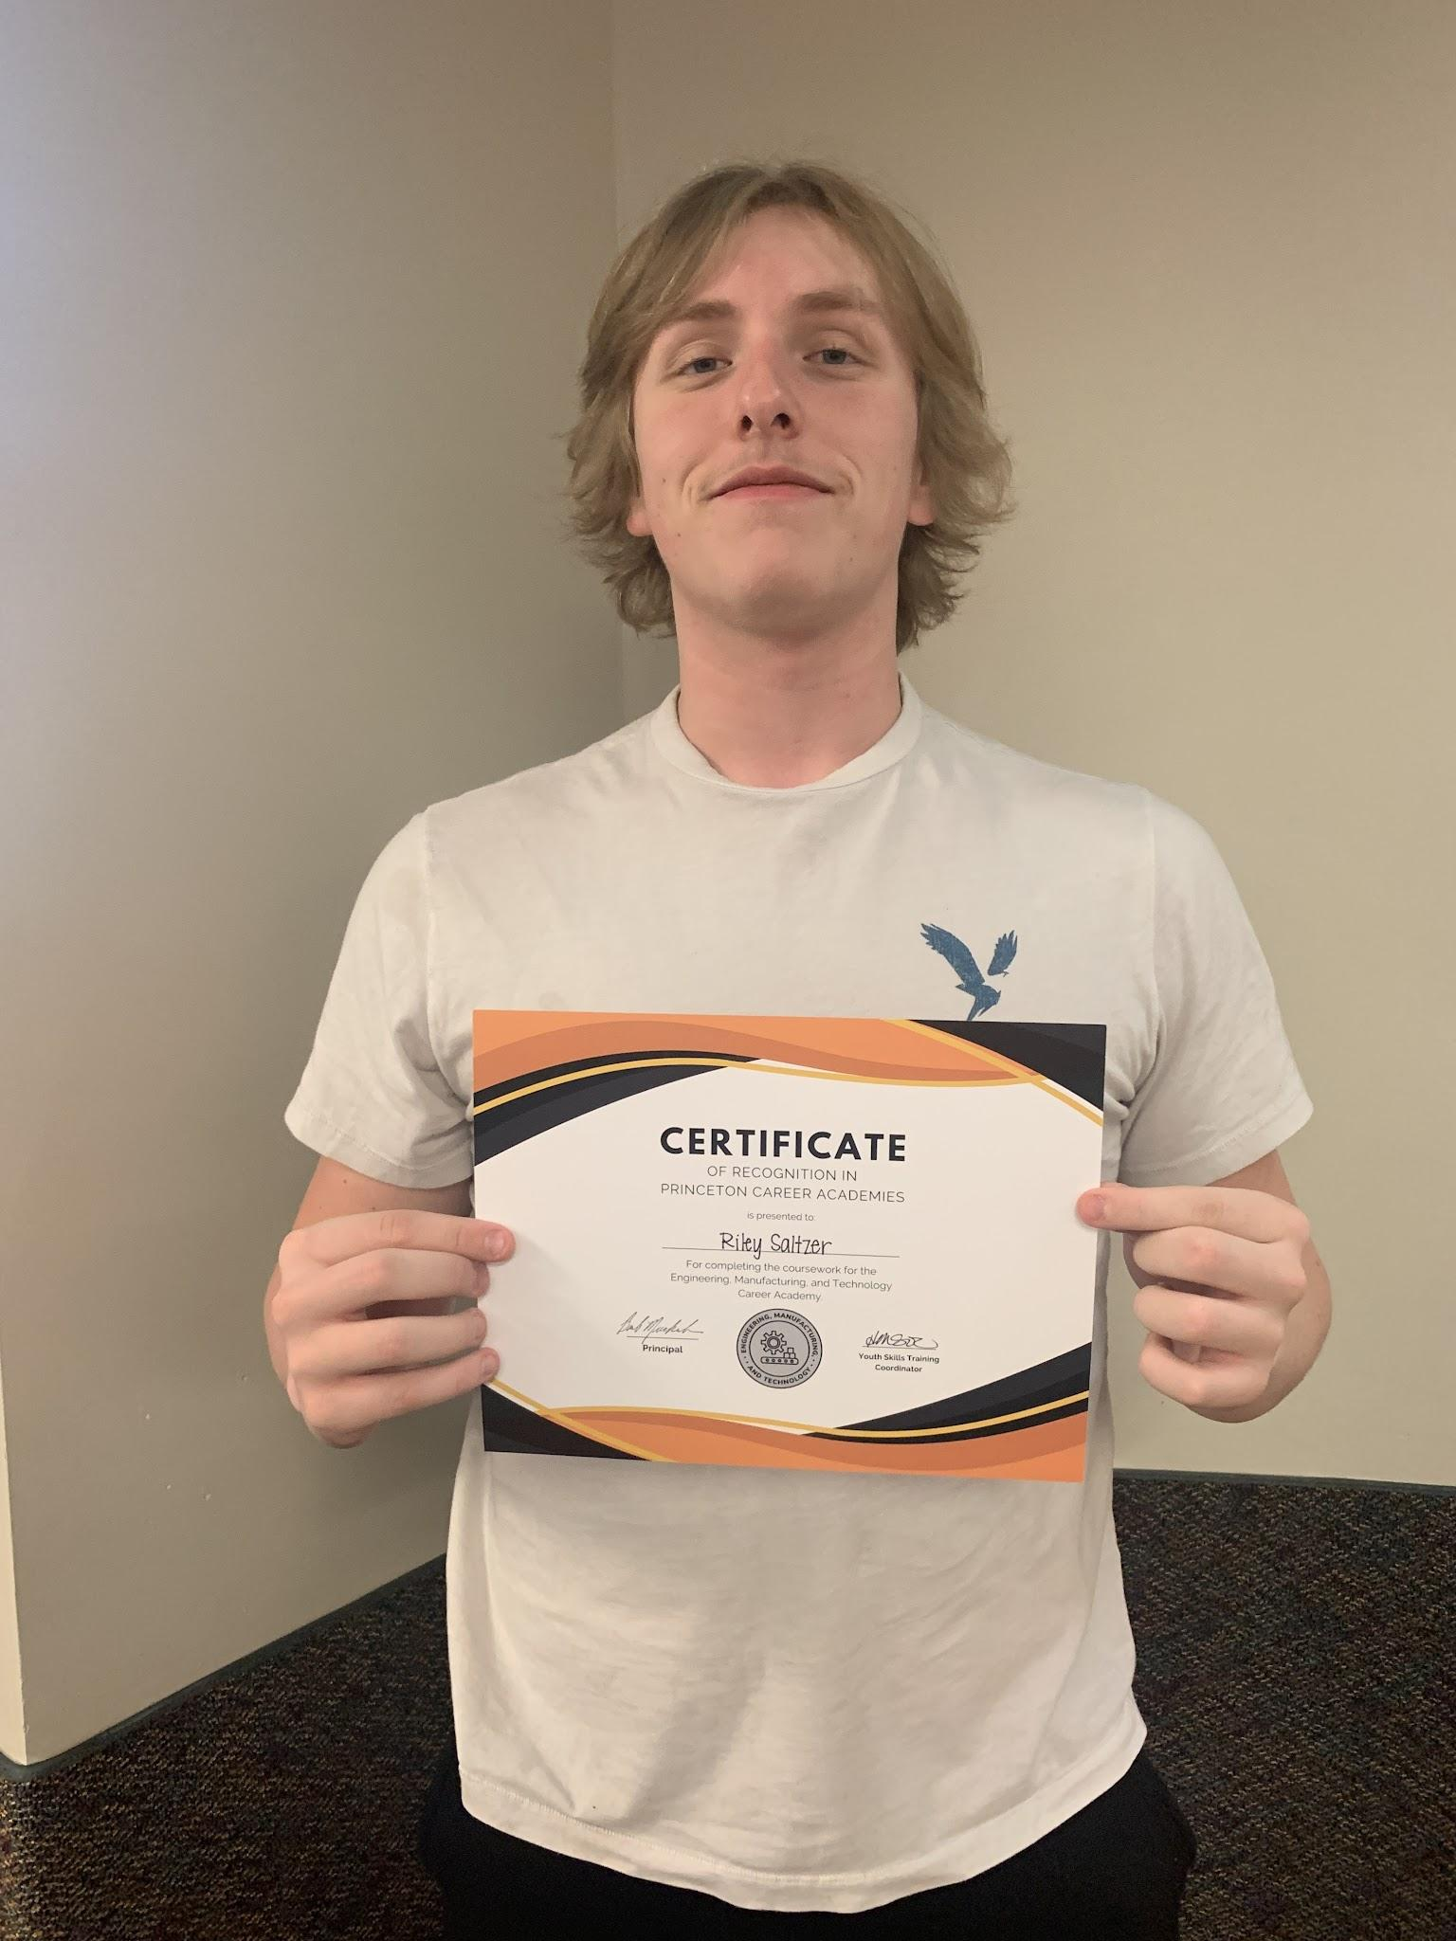
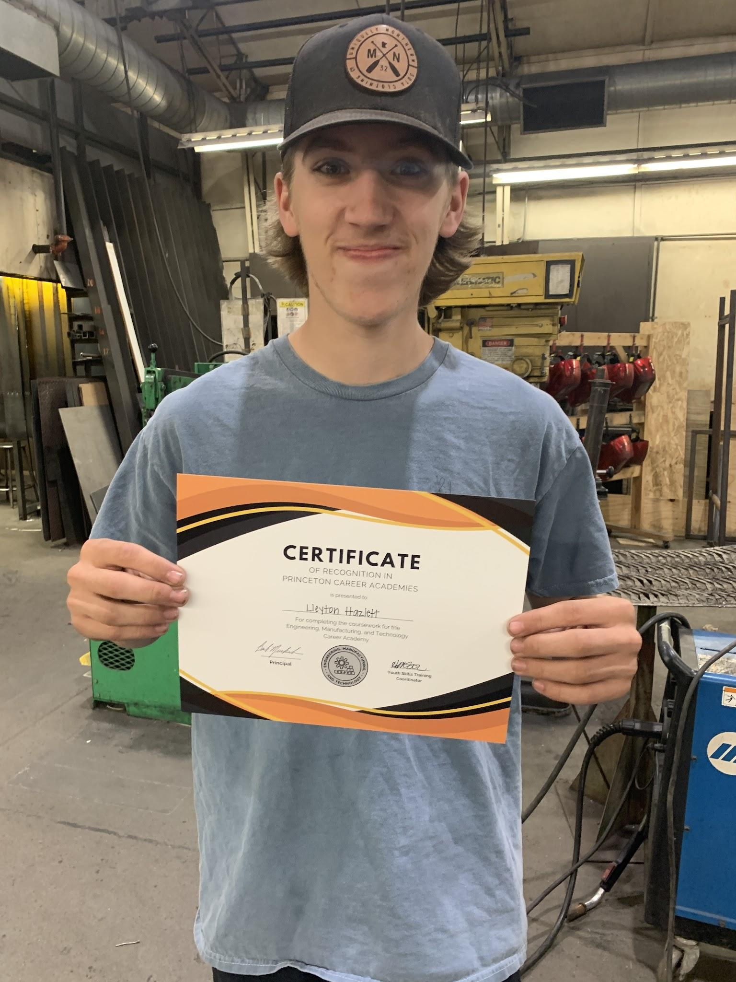
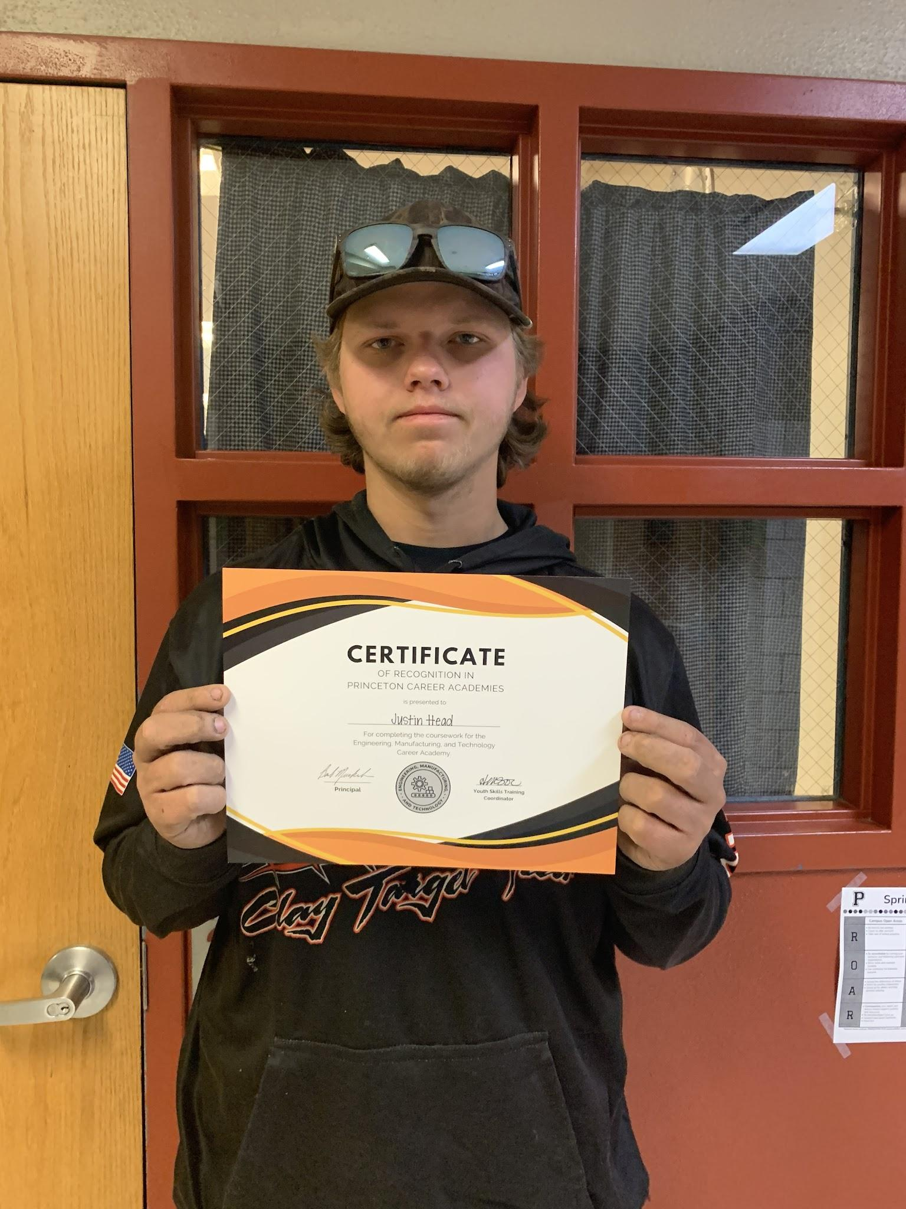
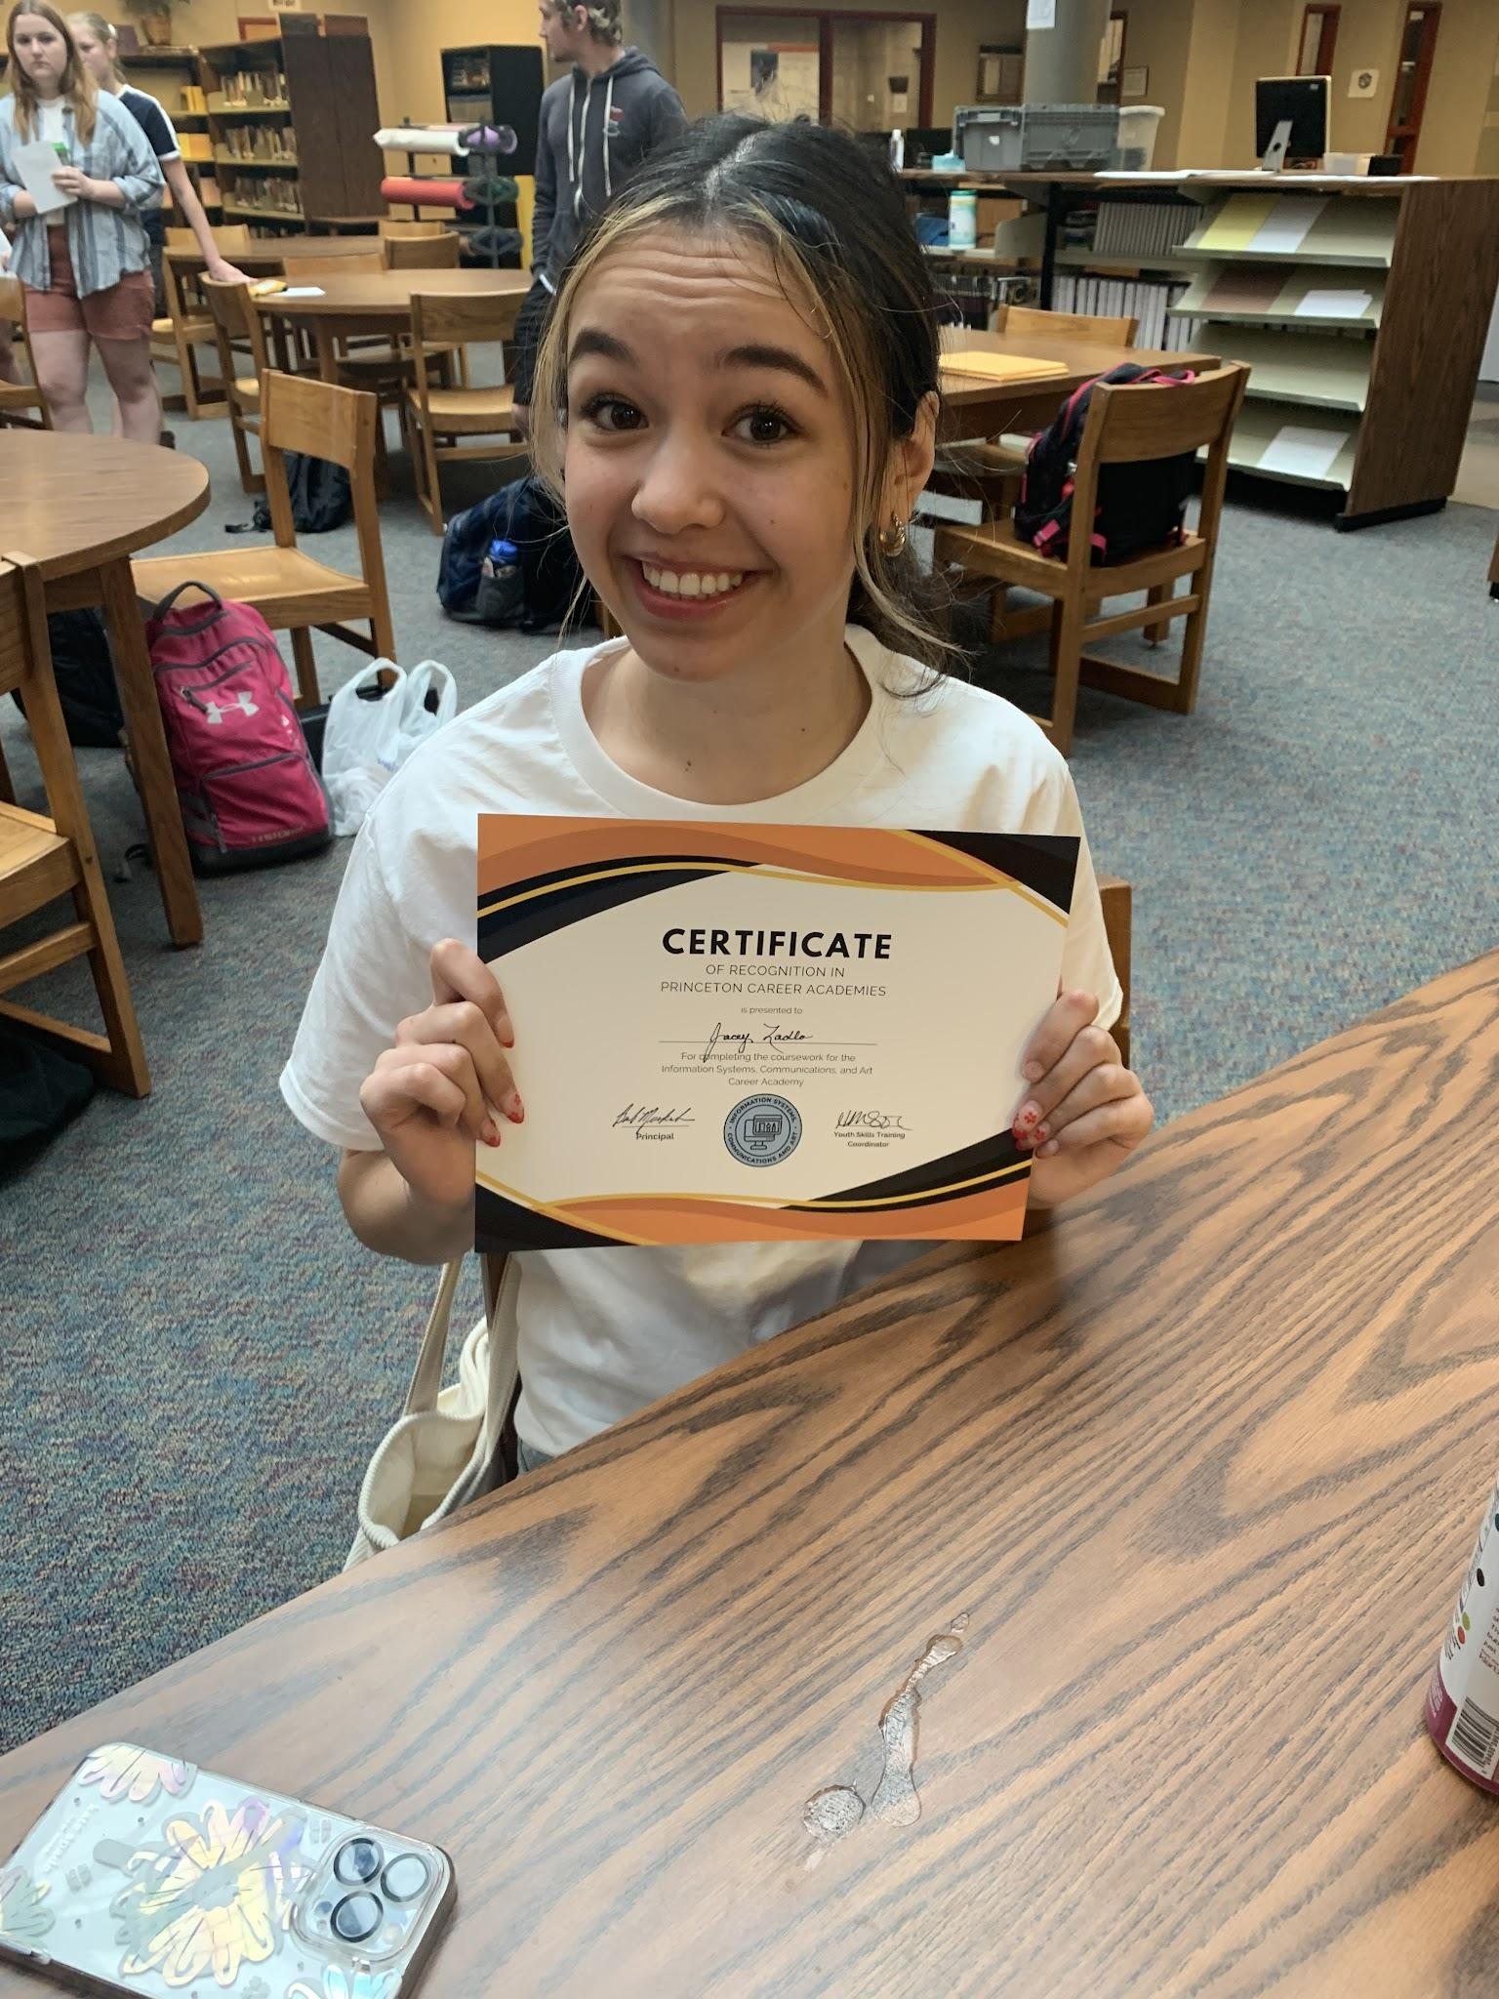
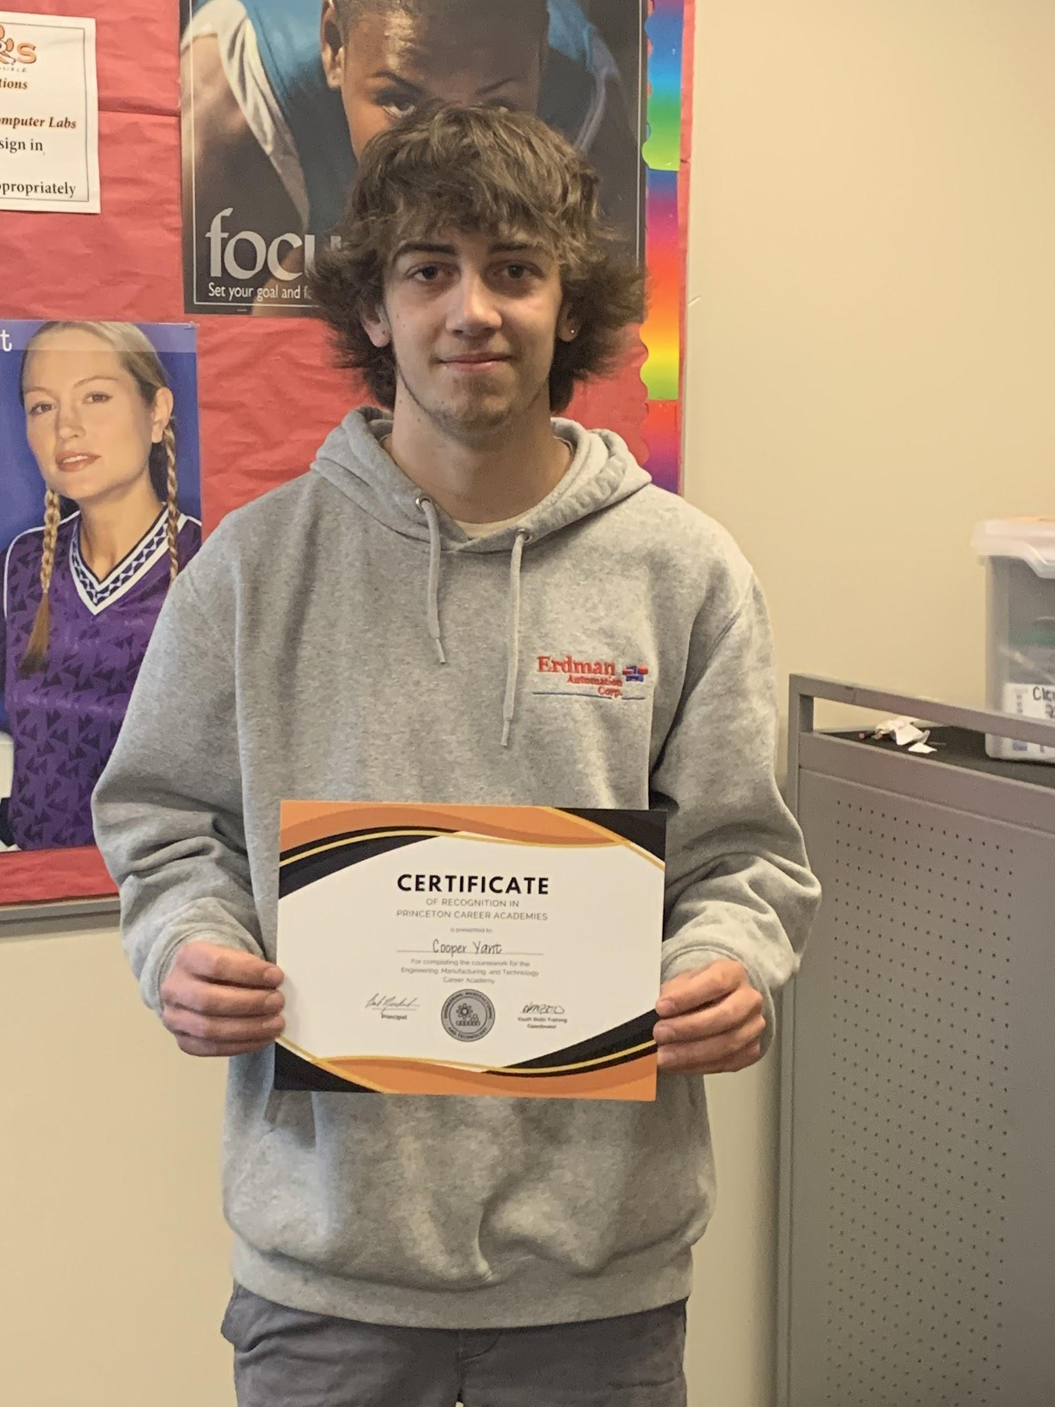

Slide 27
Tiger Career Academies
Diploma Plus Advantage
Through the Tiger Career Academies our mission is to equip EVERY graduate with a valuable industry credential, certification, workplace experience, college credit, internship, or mentorship, in addition to their high school diploma.
Class of 2024 - 81.17% met the Diploma Plus Advantage goal
  4.63% increase from the previous year
Class of 2025 - goal 85%
Princeton Public Schools is an innovative leader in instruction, developing in EVERY learner the ability to succeed in an ever-changing world.

Slide 28
Career & Technical Education
What the future could hold…
Charissa Larson, Family & Consumer Science Teacher
  Business, Management, and Administration Academy
Jessie Lupkes, Agriculture/Industrial Technology Teacher
  Agriculture & Natural Resources Academy
Tara Kude, Industrial Technology Teacher
  Information Systems, Communications, & Art Academy
  Engineering, Manufacturing, & Technology Academy
Princeton Public Schools is an innovative leader in instruction, developing in EVERY learner the ability to succeed in an ever-changing world.

Slide 29
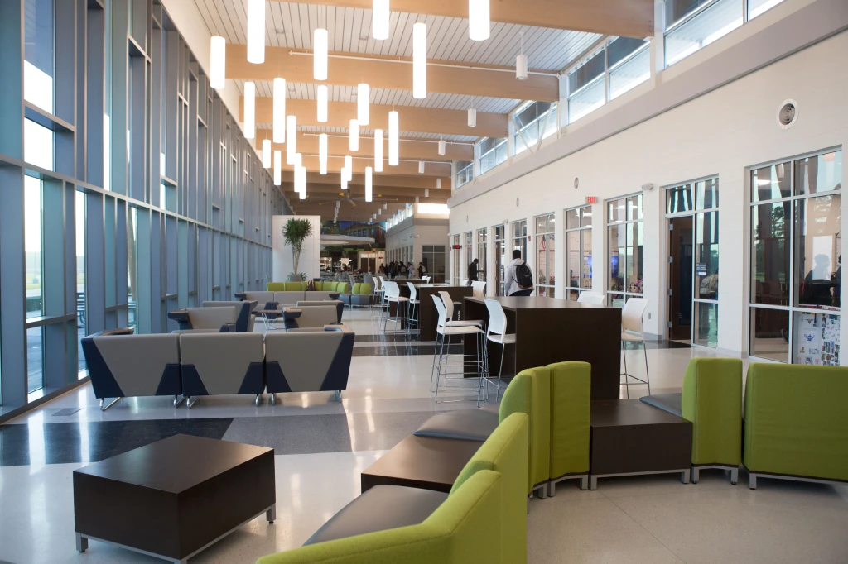
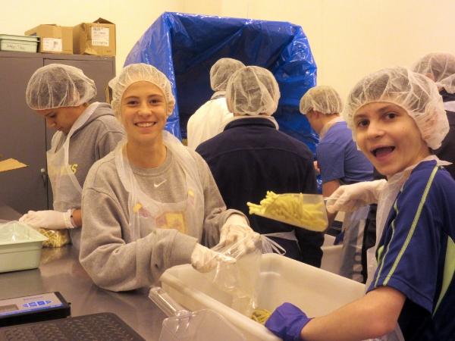
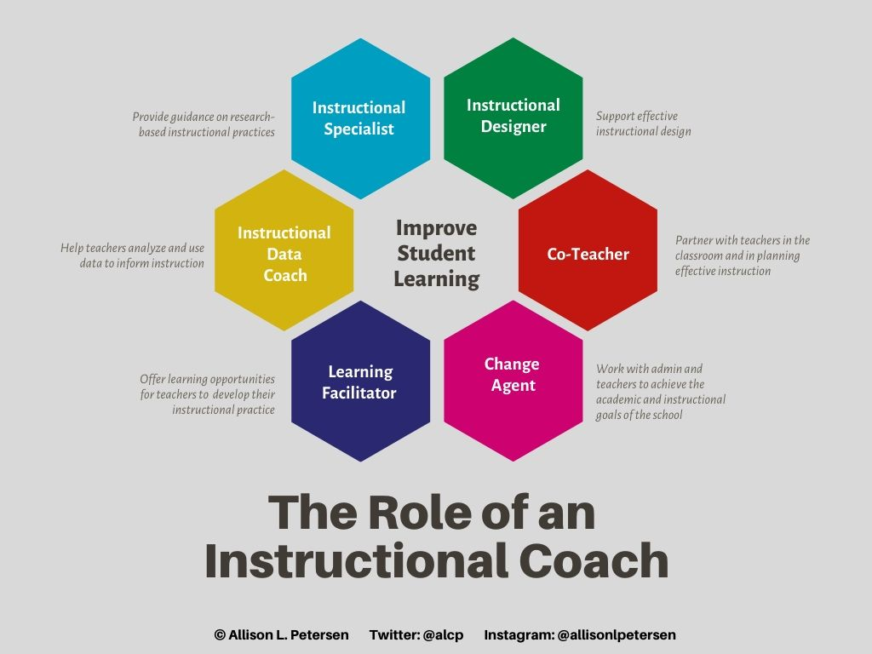
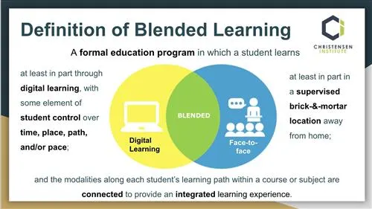
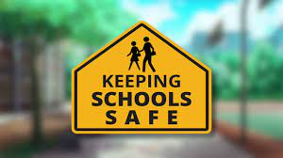
Improving the 9-12 Experience - Ryan Jensen
Princeton Public Schools is an innovative leader in instruction, developing in EVERY learner the ability to succeed in an ever-changing world.

Slide 30
Activities Dream Big with Darin Laabs
Leadership and Growth through Extracurriculars
Activities develop self-discipline, empathy, and leadership
Participation fosters team-building and effective communication
Extracurriculars build positive community ties, pride, self esteem
  Problem solving skills, resilience, perseverance…
-Field House (4 station w/ 5 lane track), Pool w/ diving well, Stadium (turf, video board, Bleachers with under storage, locker rooms, plumbing to concession stand, Wrestling Room, Cardio room, Gymnastics gym, expand training room, expand weight room, add team locker rooms, Indoor concession (running water, increase space), Add officials changing facility with showers, baseball and softball upgrades.
Princeton Public Schools is an innovative leader in instruction, developing in EVERY learner the ability to succeed in an ever-changing world.

Slide 31
Middle School Vision with Sarah Marxhausen
Middle School Programming & Building Security
Building Infrastructure
  Front office
Career Academies @ MN
  6th to 8th grade exposure & experience
Mental Health needs & Teamming
Princeton Public Schools is an innovative leader in instruction, developing in EVERY learner the ability to succeed in an ever-changing world.

Slide 32
Vision/Dreams with Barton
Safe
Meet space demands
  Early Childhood
  Activity/Gym Space
Social, Emotional, and Mental Health Supports
Reasonable Classsize

Slide 33
Our Path Forward
Aligning Our Facilities with Our Vision
Facilities must support the academic, career, and personal growth of students
What gives us the “biggest bang for our buck?” What creative solutions will make the biggest impact for all students?
Our community has always supported our commitment to providing a high-quality education, and we can’t do it without community support and involvement
Princeton Public Schools is an innovative leader in instruction, developing in EVERY learner the ability to succeed in an ever-changing world.

Slide 34
Join Us in Shaping the Future of Princeton
We need your ideas and support
Our facilities should reflect our shared vision for student success
Together, we can ensure our students are prepared to succeed in an ever-changing world
Princeton Public Schools is an innovative leader in instruction, developing in EVERY learner the ability to succeed in an ever-changing world.

Slide 35

Table Discussions
How can we meet our mission?
Princeton Public Schools is an innovative leader in instruction, developing in EVERY learner the ability to succeed in an ever-changing world.

Slide 36
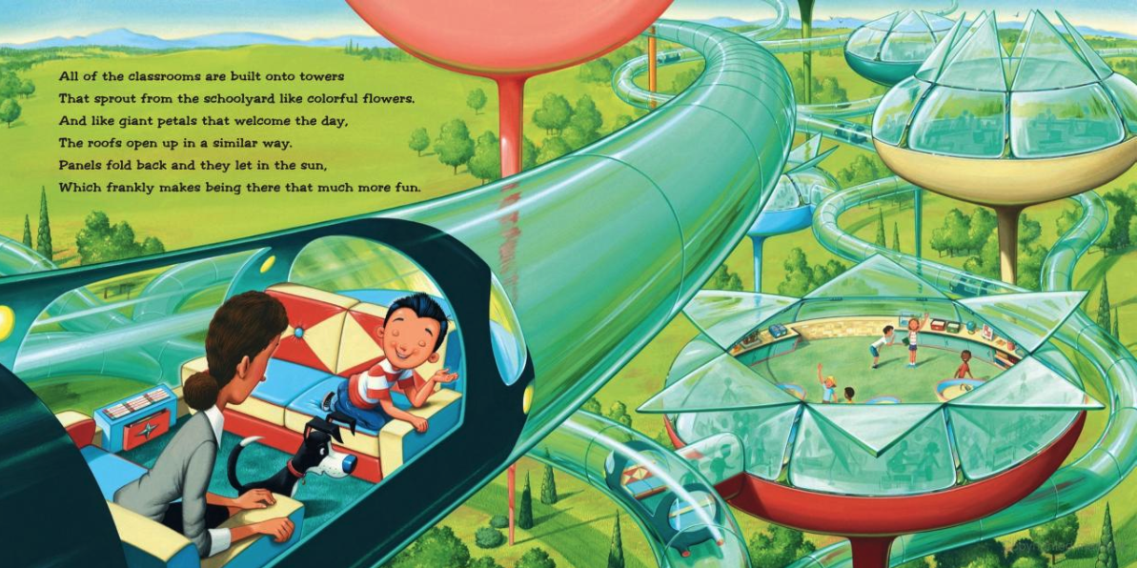
What would YOU do?

Slide 37
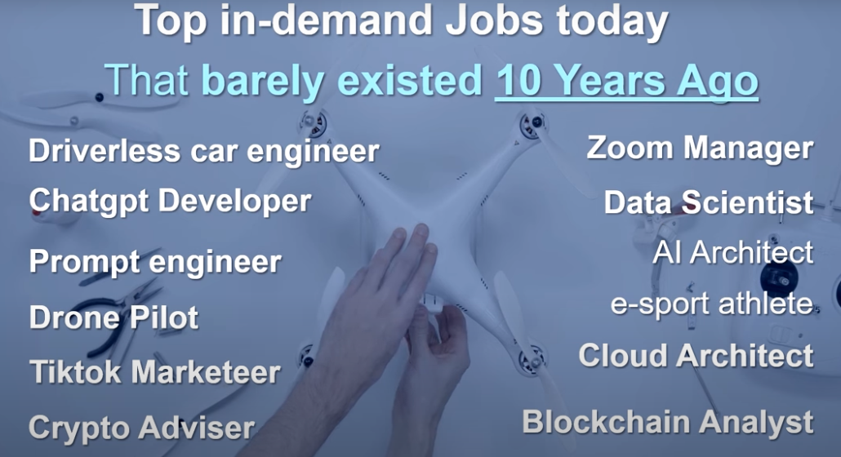
How do we prepare students for jobs like these?

Slide 38
Task Force Meeting Dates/Times/Location
All future meetings will be held at the high school in the media center starting at 6pm. See dates below:
Oct. 22
Nov. 12
Dec. 10
Jan. 14
Jan. 28
Feb. 11

Slide 39
Thank you!!
You are the owners of our schools.
We appreciate your time and focus on these important issues!
www.isd477.org/task-force
Princeton Public Schools is an innovative leader in instruction, developing in EVERY learner the ability to succeed in an ever-changing world.

