Slide 1



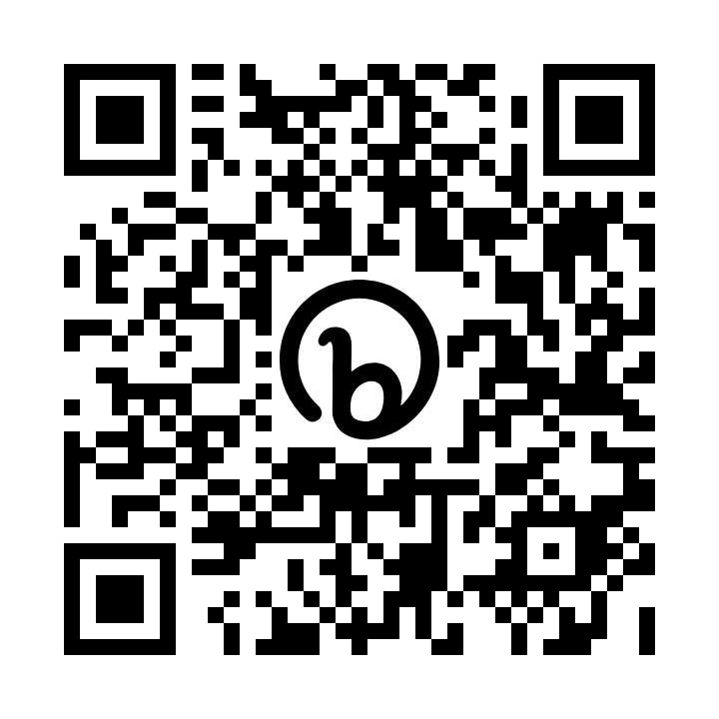


School-Family Compact
New Digital Signature Process
Mimosa Elementary School
1550 Warsaw Rd
Roswell, GA 30076
https://mimosa.fultonschools.org/
  All students above 10 years of age should sign digitally.
  All parents/guardians are asked to digitally sign the School-Family Compact regardless of their child’s age.
  Your digital signature acknowledges you have read, received, and agree to the School-Family Compact.
  Parents and students can digitally sign by using the online portal or the app on their smartphone/device.
M. Ariane Holcombe, Principal
Mimosa Title I webpage:
https://mimosa.fultonschools.org/our-school/title-i
School-Family Compact
A School-Family Compact for Achievement is an agreement that families, students, and teachers develop together. It explains how families and teachers will work together to make sure all students get the individual support they need to reach and exceed grade-level standards.
INFINITE CAMPUS
PARENT/STUDENT PORTAL
https://bit.ly/InfiniteCampus_Portal
NEED MORE INFORMATION?
CONTACT US
If you need support or assistance logging in to Infinite Campus, please contact Robin Burke burker3@fultonschools.org
470-254-9723
YOU MAY VISIT YOUR SCHOOL’S WEBSITE (TITLE I PAGE) OR CONTACT A SCHOOL REPRESENTATIVE TO REQUEST A COPY OF THE SCHOOL-FAMILY COMPACT.

