Slide 1

Notes:
Scripture to be read: Luke 3:9-14

Slide 2





Slide 3
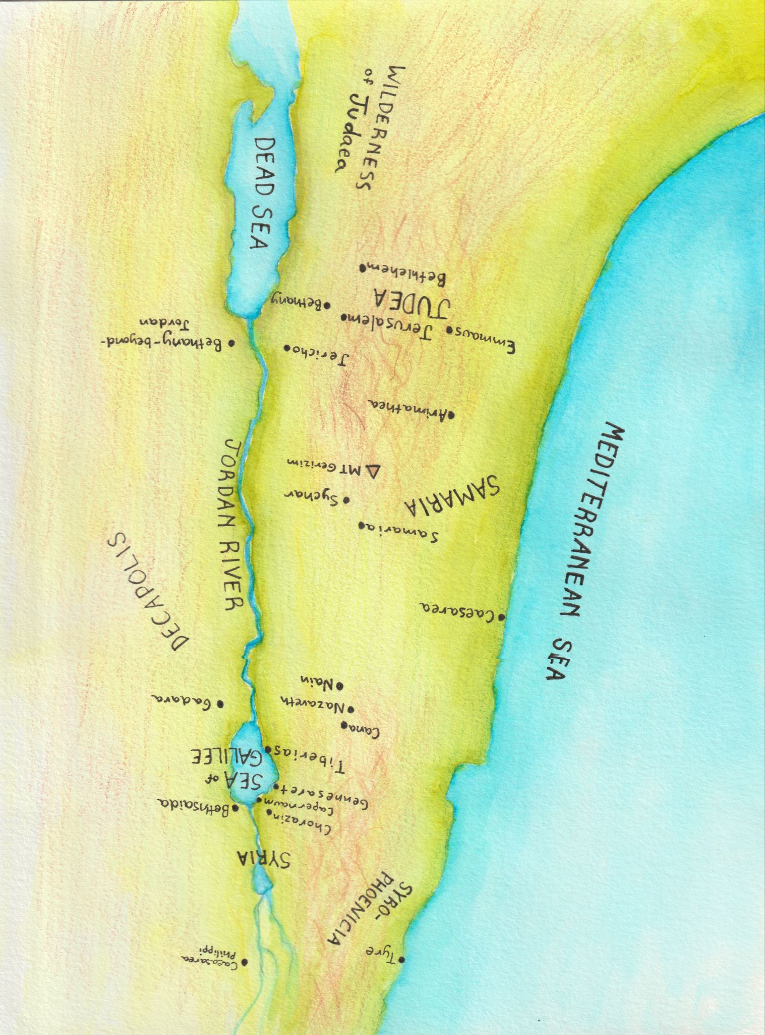

Slide 4
REPENT, RESIST, RELY
Today’s Outline –
Prophetic message of John the Baptist:
Repent, for the end is near
Jesus’ response to Satan:
    Resist temptation
The only way to Repent and Resist temptation is to Rely on the Power of the Holy Spirit.

Slide 5
REPENT, RESIST, RELY
John Chastises as he Baptizes
Luke 3:10-14
DON’T DO
Be stingy Share w/poor
Extort money Work honorably
Lie & steal Seek righteousness
CROWD
TAX COLLECTORS
SOLDIERS

Slide 6
REPENT, RESIST, RELY
Jesus comes to John to be baptized
Father declares Jesus is His Son, whom He loves
Holy Spirit descends on Jesus like a dove

Slide 7
REPENT, RESIST, RELY
Jesus’ Genealogy
Royalty – King David
Israelite Heritage – Abraham, Isaac & Jacob
Historic Significance – Noah, Shem
All Humanity – Adam
Jesus, the Son of God

Slide 8
REPENT, RESIST, RELY
Jesus says: “It is written…”
‘Man shall not live on bread alone.’ Deut. 8:3
‘Worship the Lord your God and serve Him only.’ Deut. 6:13
Satan says, “For it is written: ‘He will command his angels concerning you to guard you carefully; they will lift you up in their hands, so that you will not strike your foot against a stone.’” Psalm 91:11-12
‘Do not put the Lord your God to the test.’ Deut. 6:16

Slide 9
REPENT, RESIST, RELY
John preached repentance and social disruption
He called out each group’s sin: stop hoarding, stealing and lying
Give cheerfully: 2 Corinthians 9:6-7
Jesus modeled resistance to temptation and personal interruption
We must read, know and recall Scripture
Recite powerfully: 2 Timothy 3:16

Slide 10
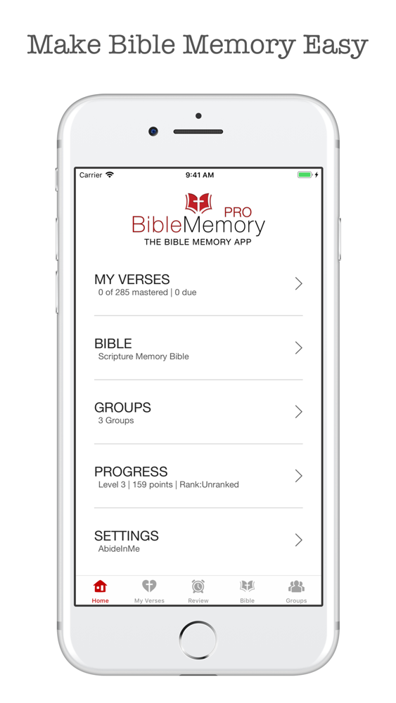
REPENT, RESIST, RELY
Methods of Memorizing Scripture
The Bible Memory app – free
Dwell app (audio Bible)
Use acronyms
Write
Songs
Phone lock screen
Post-It on mirror

Slide 11
REPENT, RESIST, RELY
Key Message:
The only way to Repent and Resist temptation is to Rely on the Power of the Holy Spirit.

Slide 12
REPENT, RESIST, RELY
Learning statement:
  Because I am being transformed by the Holy Spirit, I can
  experience joy in the interruptions, participate in Jesus’
  kingdom work of cultural disruptions, and rest in the
  assurance of the Father’s kingdom to come.

Slide 13



