Slide 1



Food Allergies in Schools
Notes:
Welcome back to a new school year. This presentation is part of the Cherry Hill Public Schools mandatory inservice program for health services. In this presentation, we will explain food allergies.
The goal of this presentation is
To explain food allergies and how they impact the body.
To demonstrate the prevalence of food allergies in schools
To identify foods and other allergens that may trigger an allergic reaction
To provide staff with classroom strategies to promote inclusiveness of students with food allergies, to minimize exposure to allergens and to reduce the risk of an anaphylactic reaction.

Slide 2

According to CDC data:
One in thirteen children have food allergies—that’s about two in every U.S. classroom.
40 percent of these children have already experienced a severe allergic reaction.
25 percent of severe reactions experienced at school are among children having no previous diagnosis of food allergy.
Everyone from the school nurse to the cafeteria staff plays a role in creating a safe environment for students with food allergies.
Why do we educate our staff about food allergies?
Notes:
According to CDC data:
One in thirteen children have food allergies—that’s about two in every U.S. classroom.
40 percent of these children have already experienced a severe allergic reaction.
25 percent of severe reactions experienced at school are among children having no previous diagnosis of food allergy.
Everyone from the school nurse to the cafeteria staff plays a role in creating a safe environment for students with food allergies.

Slide 3

A food allergy is a potentially serious immune response to eating or coming into contact with certain foods.
The immune system mistakenly targets a harmless food protein (an allergen) as a threat and attacks it.
There is no cure for food allergies.
This reaction may be life threatening.
**NOTE: Non-Food allergens such as latex, wasps/bee stings and medications can also cause a life threatening allergic reaction.
What is a food allergy?
Listen to how your students may feel.
Notes:
A food allergy is a potentially serious immune response to eating or coming into contact with certain foods. The immune system mistakenly targets a harmless food protein (an allergen) as a threat and attacks it. This reaction may be life threatening. Even small amounts of a food allergen can cause a reaction. Symptoms usually start as soon as a few minutes after eating the food and as long as two hours after.
Food allergies can sometimes be confused with food intolerances. An intolerance means that your body has difficulty digesting a food which can make you feel bad but is not life-threatening. For example: a lactose intolerance may cause an upset stomach if you consume milk.
There is no cure for food allergies. Allergies can sometimes be outgrown. Peanut, tree nut, fish and shellfish allergies are usually life long. Milk, egg, wheat and soy allergies usually begin in childhood and may be outgrown. Frequently individuals with food allergies also have asthma.
It is important to note that Non-Food allergens such as latex, wasps/bee stings and medications can also cause a life threatening allergic reaction.
Listen to the video to see how students with food allergies may feel in school and in other social situations.

Slide 4
What does an allergic reaction look like?
Mild symptoms
Severe symptoms
NOSE: Itchy or runny nose, sneezing
MOUTH: Itchy mouth
SKIN: A few hives, mild itch
STOMACH: Mild nausea or discomfort
LUNGS: Short of breath, wheezing, repetitive cough
HEART: Pale or bluish skin, faintness, weak pulse, dizziness
THROAT: Tight or hoarse throat, trouble breathing or swallowing
MOUTH: Significant swelling of the tongue or lips
SKIN: Many hives over body, widespread redness
STOMACH: Repetitive vomiting, severe diarrhea
OTHER: Feeling something bad is about to happen, anxiety, confusion**
Notes:
An allergic reaction may be mild or severe. Individuals may have had a mild reaction in the past and may suddenly experience a severe reaction. Mild symptoms may include an itchy or runny nose, sneezing, itchy mouth, a few hives, mild itch, mild nausea or stomach discomfort. Severe symptoms may include shortness of breath, wheezing, cough, bluish or pale skin, dizziness, throat tightness, swelling of the lips or tongue, widespread hives or redness, repetitive vomiting or diarrhea, anxiety or the feeling something bad is going to happen.

Slide 5



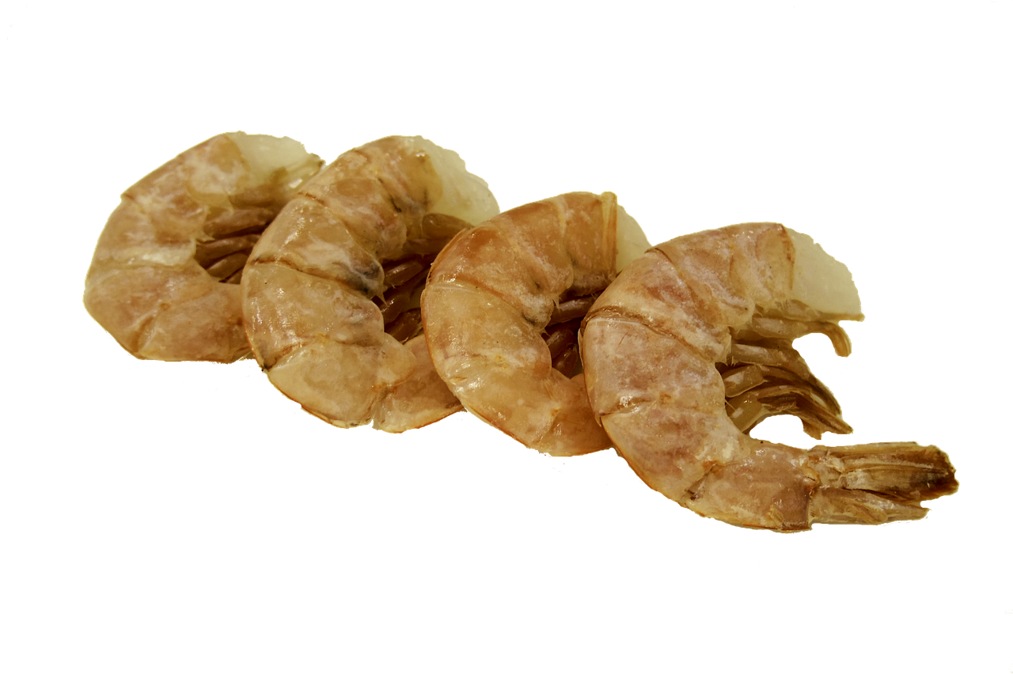

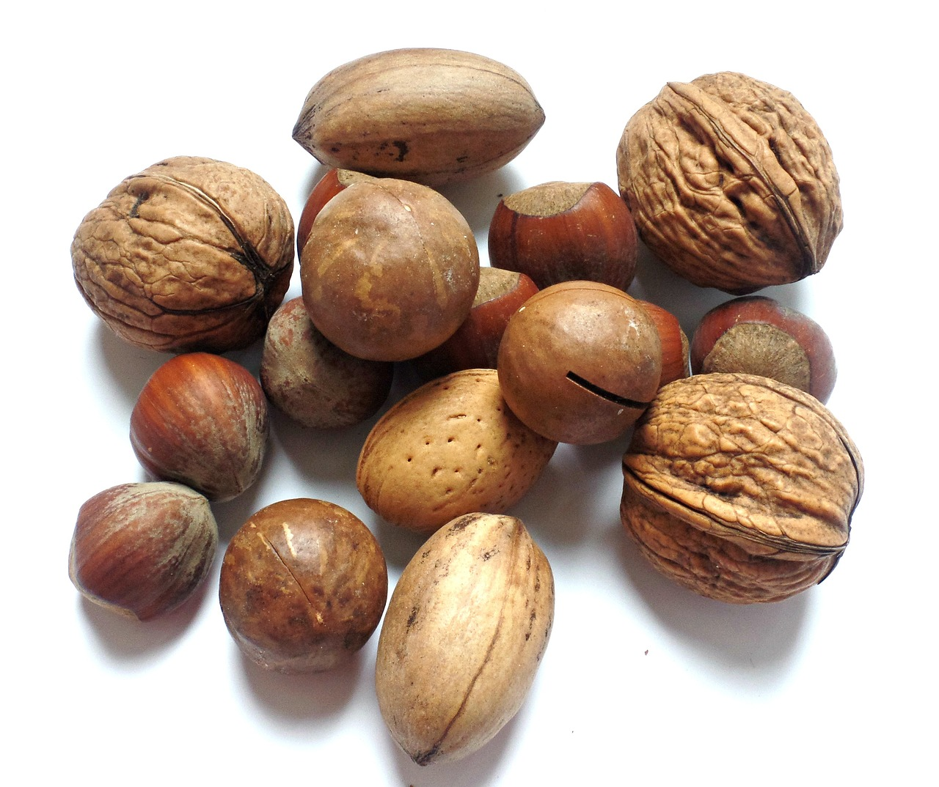

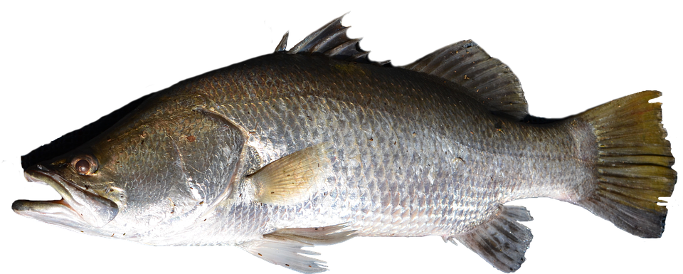
COMMON ALLERGENS
Although nearly any food can trigger an allergic reaction, there are nine foods that cause the majority of reactions.
Milk
Eggs
Peanuts/tree nuts
Fish/shellfish
Wheat
Soy
Sesame
Notes:
Although nearly any food can trigger an allergic reaction, there are nine foods that cause the majority of reactions: Milk, Eggs, Peanuts/tree nuts, Fish/shellfish, Wheat, Soy, Sesame

Slide 6

What are some things staff can do?
Work with parents, the school nurse, and other appropriate school personnel to determine if any classroom modifications are needed to make sure that students with food allergies can participate fully in class activities.
Avoid the use of identified allergens in class projects, parties, holidays and celebrations, arts, crafts, science experiments, cooking, snacks, or rewards. Modify class materials as needed
Use non-food incentives for prizes, gifts, and awards
Encourage children to wash hands before and after handling or consuming food.
Include information about students with known food allergies in the instructions to substitute teachers.
Be a role model by respecting the needs of students with food allergies and reinforcing the school’s rules against discrimination and bullying.
Notes:
What can you do as a staff member? Work with parents, the school nurse, and other appropriate school personnel to determine if any classroom modifications are needed to make sure that students with food allergies can participate fully in class activities.
Avoid the use of identified allergens in class projects, parties, holidays and celebrations, arts, crafts, science experiments, cooking, snacks, or rewards. Modify class materials as needed.
Use non-food incentives for prizes, gifts, and awards.
Encourage children to wash hands before and after handling or consuming food.
Include information about students with known food allergies in the instructions to substitute teachers.
Be a role model by respecting the needs of students with food allergies and reinforcing the school’s rules against discrimination and bullying.

Slide 7

The State of NJ allows for the delegation of epinephrine to unlicensed school personnel in the event of a life threatening allergic reaction.
Watch this video to see how to administer an epipen auto injector.
If you think this is something you can do, contact your school nurse for further training to be a delegate.
Consider becoming a delegate!
Notes:
Each school year, the nurses in the Cherry Hill Public Schools look for staff members who are willing to become delegates. The State of NJ allows for the delegation of epinephrine to unlicensed school personnel in the event of a life threatening allergic reaction.
Watch this video to see how to administer an epipen auto injector.
If you think this is something you can do, contact your school nurse for further training to be a delegate.

Slide 8

Food Allergies are real and can be life threatening.
Notes:
Food allergies are real and can be life threatening. Quick action can be the difference between life and death. Watch this video to hear families tell their story.

