Slide 1

Take Flight Curriculum by Scottish Rite
Parent Information

Slide 2
Instructional Approaches
Multisensory
Process-Oriented
Systematic, Sequential & Cumulative
Meaning-Based

Slide 3
Direct Instruction
Alphabet Skills
Decoding
Fluency
Phonemic Awareness
Spelling
Comprehension Skills

Slide 4
Alphabet Instruction
Recognition
Sequencing
Alphabetizing Practice
Accent

Slide 5
Decoding Instruction
Decoding is looking at letters and translating them into speech sounds. Links all the letter and sounds in English.
26 letters, 44 sounds, 98 letters/letter clusters
Coding Marks, such as the breve & macron

Slide 6
Fluency Instruction
Fluency is reading accurately at a smooth and even pace.
RAP, Repeated Accurate Practice
Instant Words
Timed reading for rate
Repeated reading for smoothness

Slide 7
Phonemic Awareness Instruction
Increase sensitivity to how we make the sounds
  What happens with out tongue, teeth, lips, air, voice and how does it feel?
Increase appreciation: sounds make, syllables, sounds that make words, words form sentences
Develops ability to separate, blend, and manipulate sounds in words

Slide 8
Spelling Instruction
Links the 44 sounds in English with the letter or letters that represent those sounds
Direct Instruction:
  Spelling generalizations
  Spelling rules

Slide 9
Comprehension Instruction
Comprehension is getting meaning from what is read.
Direct Instruction
  Preview
  Predict
  Identify important information
  Develop self-correcting strategies

Slide 10
Shared Responsibility
Responsibility for a student’s learning, growth, and success are shared by the parents, student, and Dyslexia Therapist

Slide 11
Handwriting Practice
Lower Case Cursive Handwriting
Begins at a consistent starting point for each letter
Reduces reversals of letters
Provides unique shapes

Slide 12
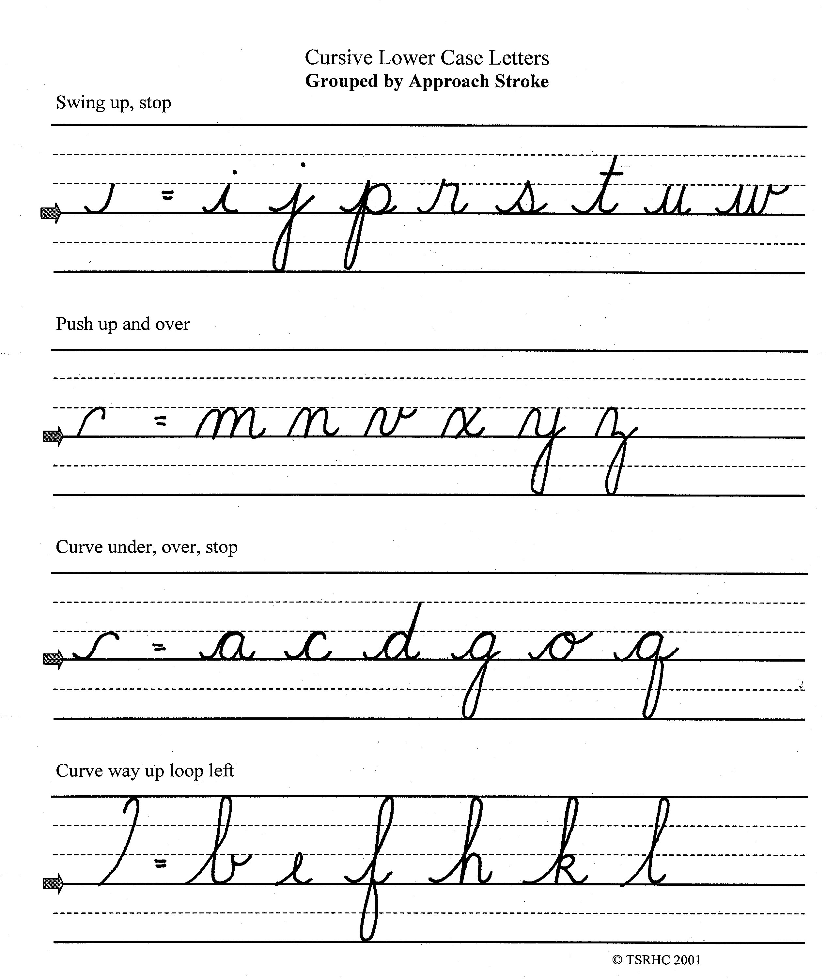

Slide 13
Handwriting Check Points
Encourage correct pencil grip
Observe writing position
Feet flat
Straight back
Paper anchored with non-writing hand
Paper parallel to writing arm
Pencil pointing over shoulder

Slide 14
RAP: Rapid Automatic Practice
Purpose
Connect the printed letter to its name and sound
Develop accurate and effortless reading through repeated practice
Increase reading speed while maintaining accuracy

Slide 15
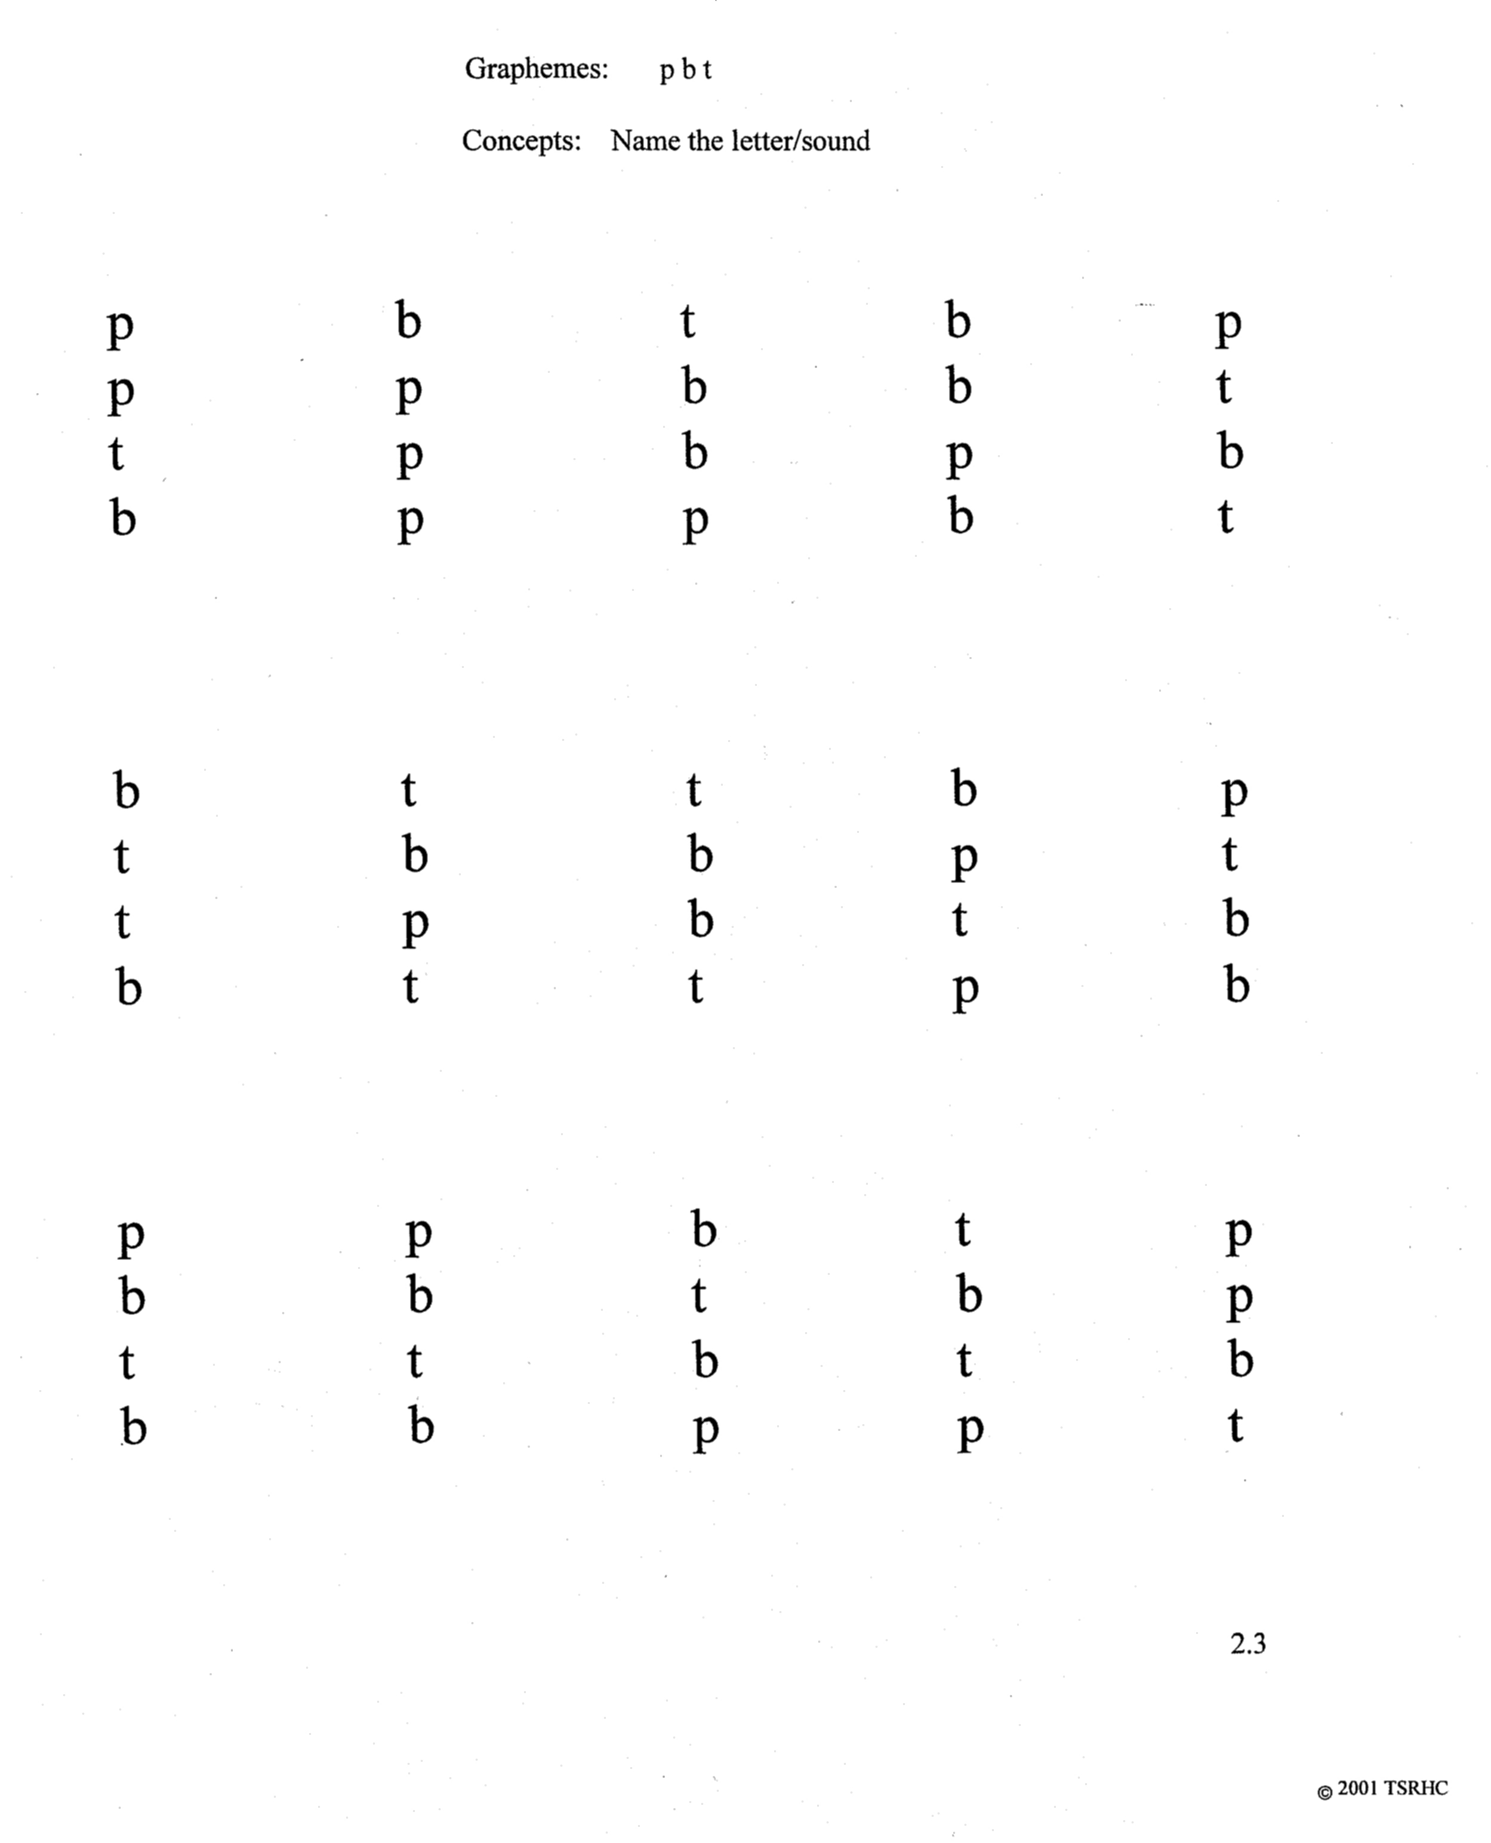

Slide 16
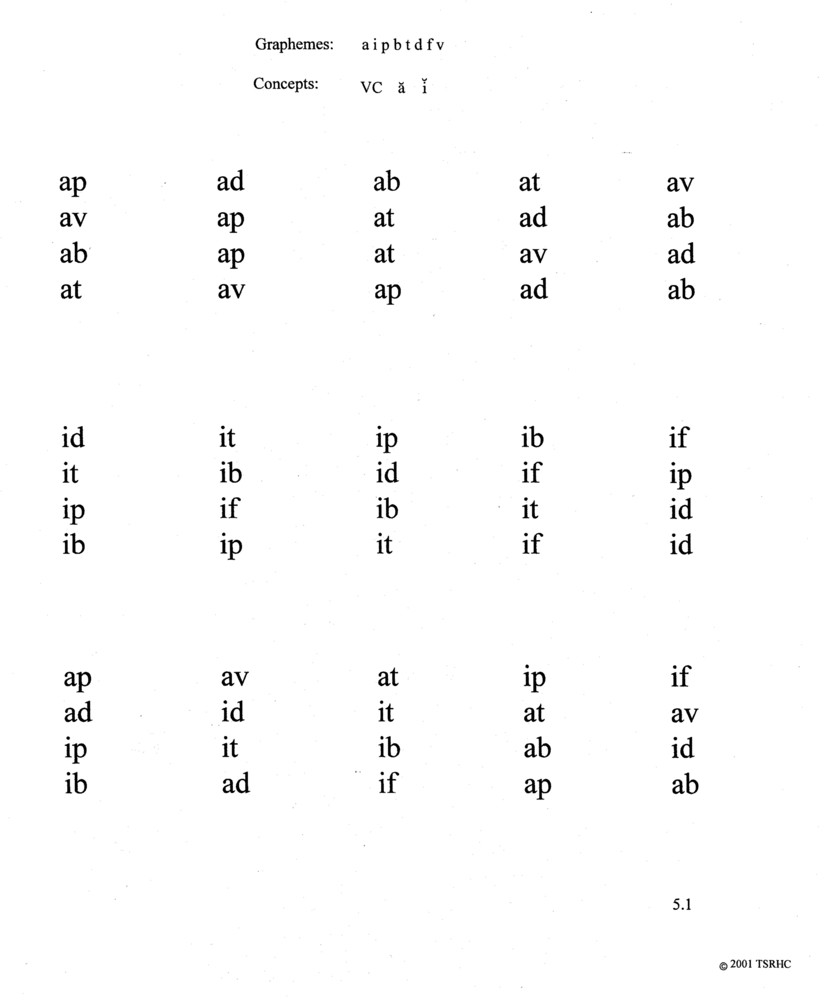

Slide 17
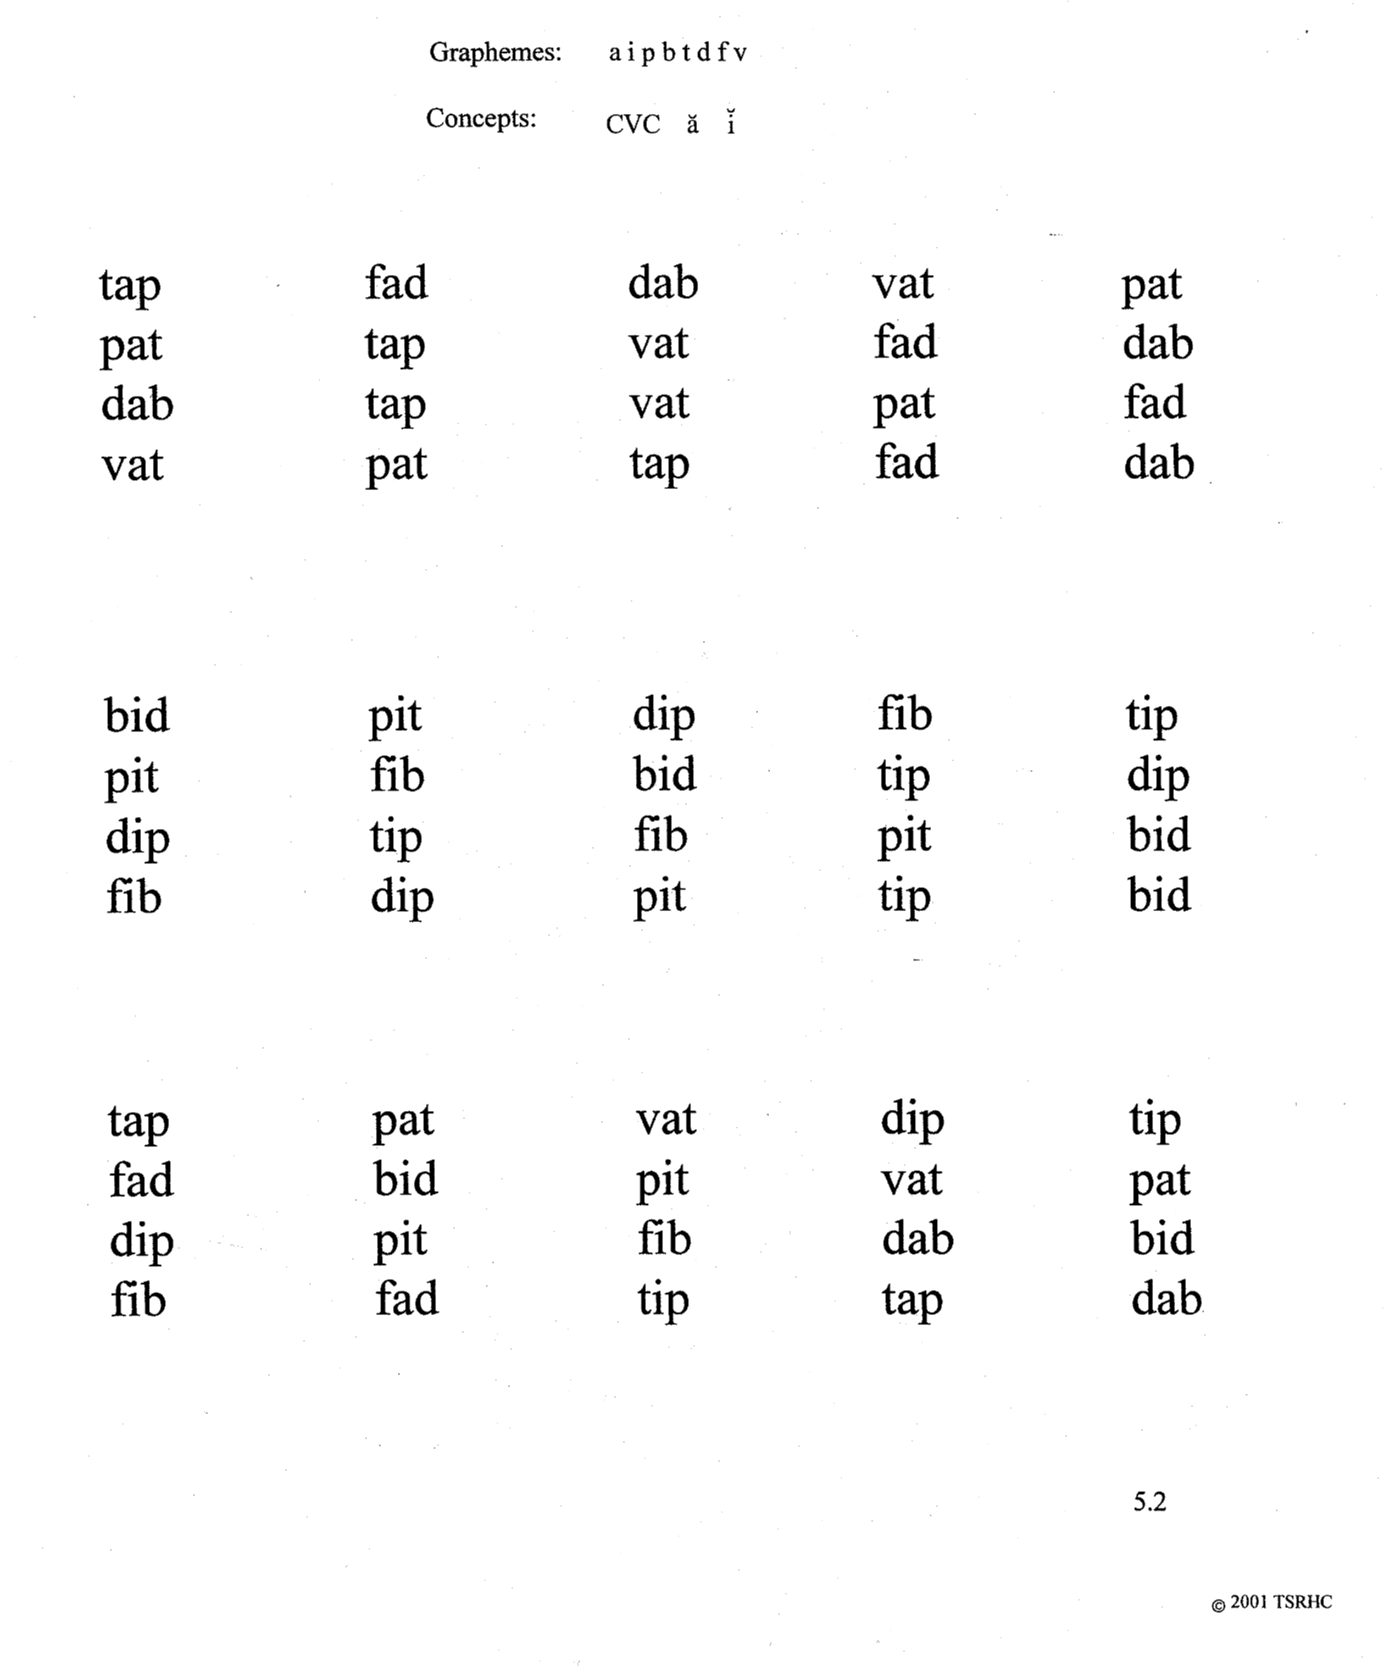

Slide 18
Instant Word Practice
Instant words are a list of 300 words that occur frequently in reading.
Purpose
Provide repeated practice of the 300 words presented in groups of ten
Develop rapid, accurate word recognition

Slide 19
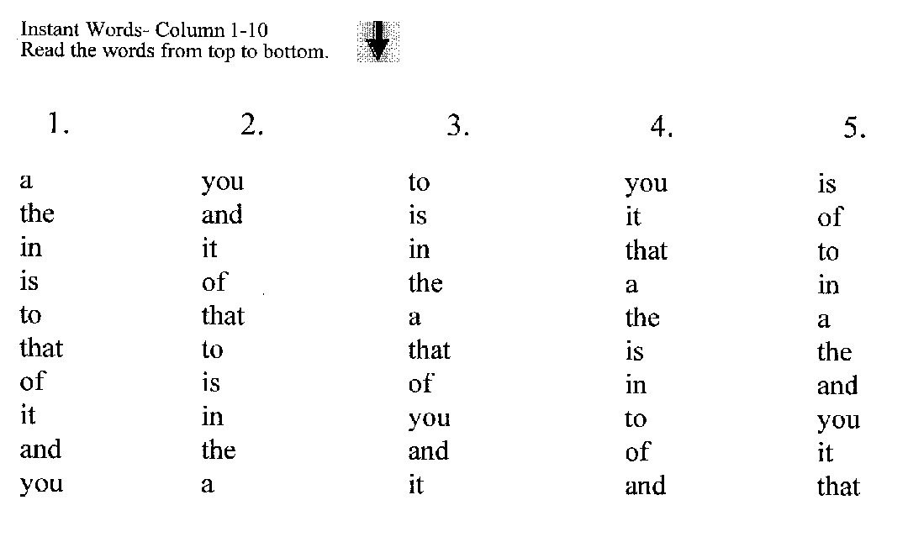
Columns

Slide 20
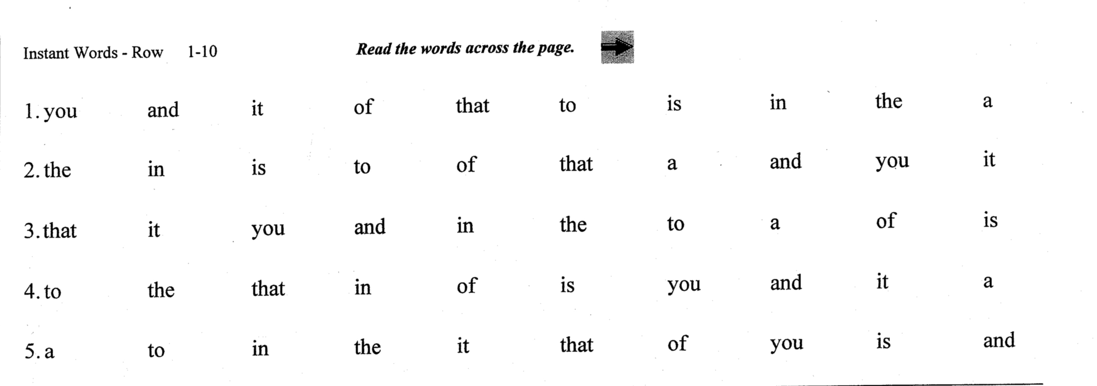
Rows

Slide 21
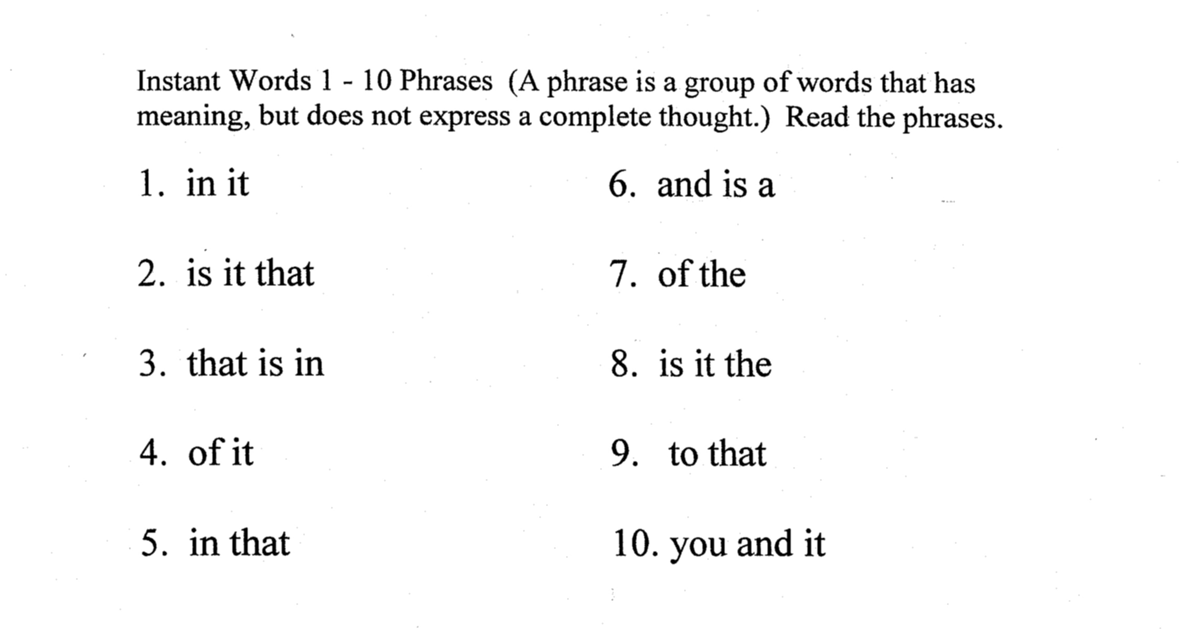
Phrases

Slide 22
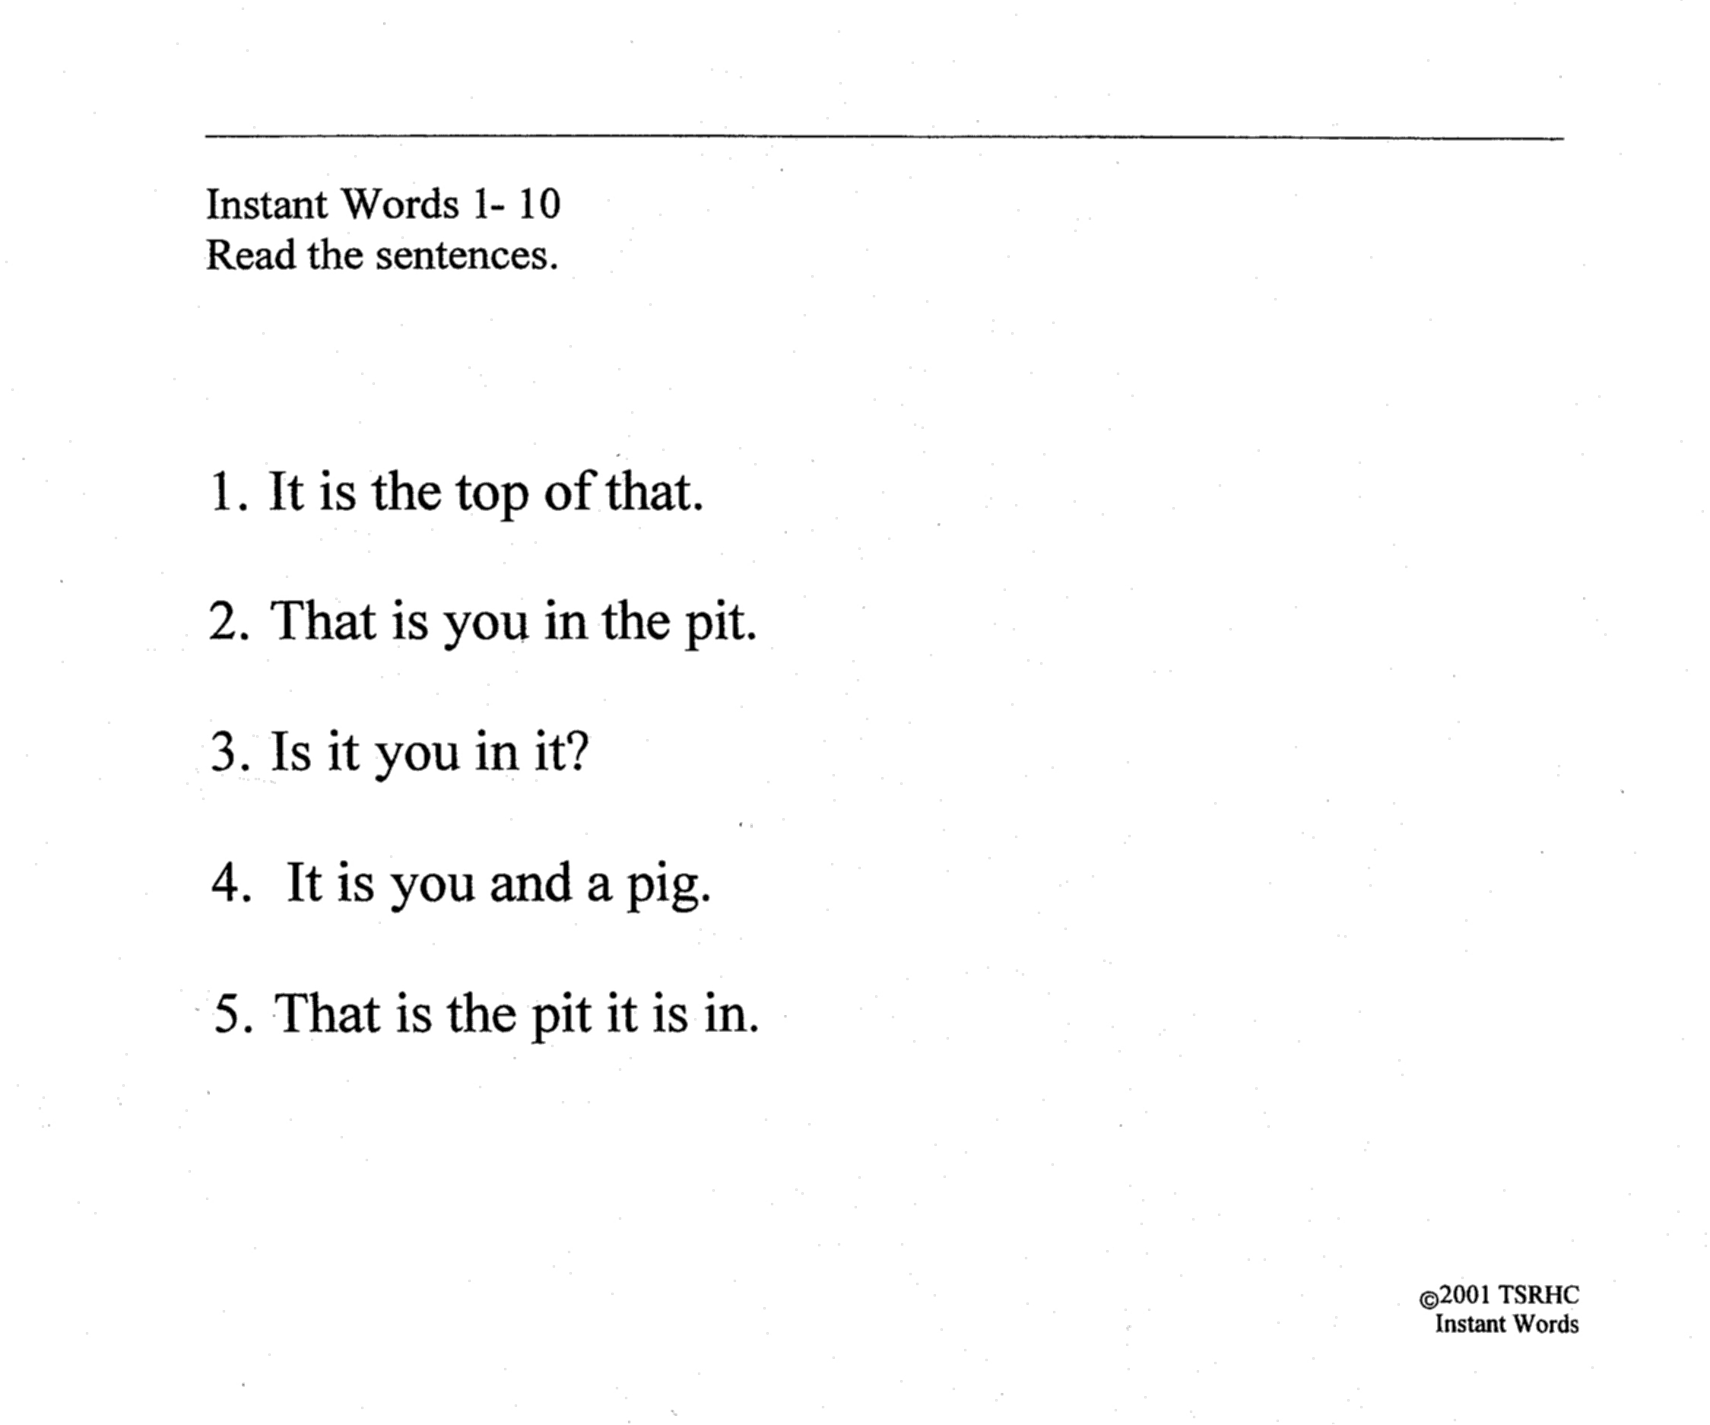
Sentences

Slide 23
Homework
The Dyslexic Therapist may provide additional practice for your child to work on at home.
This may include:
  Handwriting Practice
  Instant Word Practice
  Reading To & With your child
    Reading Comprehension

Slide 24
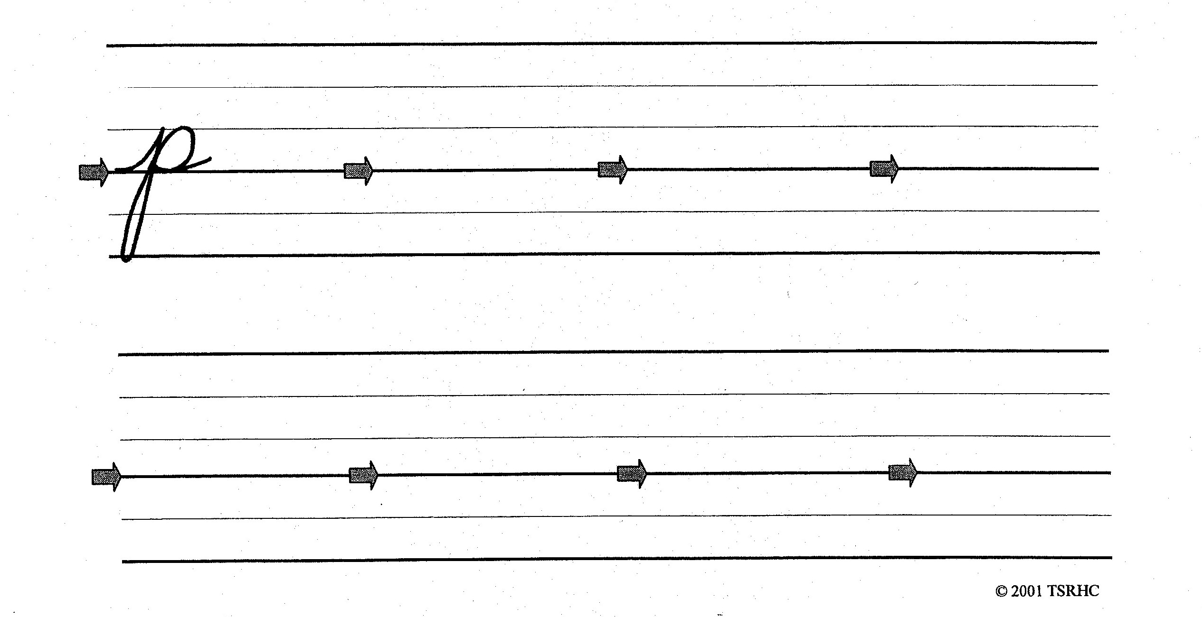
Handwriting Homework

Slide 25
Instant Word Homework
Instant word practice should be quick and completed in a minute or less. If your child does not know a word, or uses the wrong word, correct instantly, child echos the correct word, and continues on.
Words in columns
Words in Rows
Phrases
Sentences

Slide 26
Read Aloud to Your Child
Purpose:
  Connect pleasure with reading
  Expose to quality literature
  Provide a good reading model
  Increase vocabulary
  Expand background knowledge
Minimum of 15 minutes per day

Slide 27
Is Listening to a Book Cheating?
No!
Dr. Daniel Willingham, cognitive scientist and professor of psychology at the University of Virginia
  “I’ve been asked this question a lot and I hate it. I’ll just change it to ‘does your mind do more or less the same thing when you listening to an audiobook and when you read print?’
  The short answer is ‘mostly’.”
Decoding obviously refers to figuring out words from print. Language processing refers to the same mental processes you use for oral language. Reading, as an evolutionary late-comer, must piggy-back on mental processes that already existed, and spoken communication does much of the lending.
So according to the simple model, listening to an audio book is exactly like reading print, except that the latter requires decoding and the former doesn’t (Gough & Tumner, 1986).

Slide 28
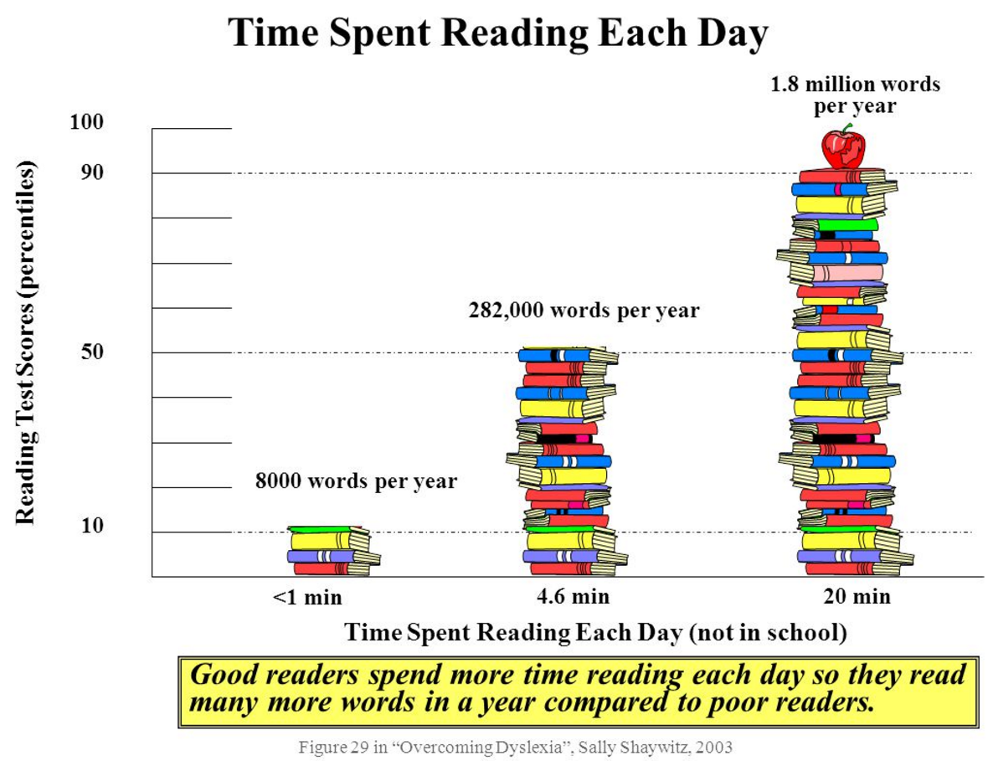
Impact of Reading

Slide 29
Comprehension Instruction
Comprehension Instruction is getting meaning from what is read.
Strategies:
  Preview and Predict
  Identifying important information
  Develop self-correcting strategies

Slide 30
Preview and Predict
Discuss the title and author
Look for picture clues
Read first one or two paragraphs and ask questions such as:
  “What do I know and what do I still need to know?”
  “What do I think this story will be about?”

Slide 31
Identify Important Information
Who?
What?
When?
Where?
Why?
How?

Slide 32
Develop Self-Monitoring Strategies
As you read, ask yourself questions such as:
“Did that make sense?”
“What does that word mean?”
“What else do need to know?”
“I wonder…?”

Slide 33
Develop Self-Correcting Strategies
Use a dictionary to look for unfamiliar words
Reread a sentence or a paragraph for clearer understanding
Gain more knowledge from encyclopedia, computer experts, & peers

Slide 34
Create a successful read aloud experience
Establish a daily routine
Eliminate interruptions
Enjoy first and then teach
Examine the Illustrations
Explore the story further

Slide 35
“There are no right or wrong ways to read aloud, but anything you can do to make the experience more fun will encourage your kids to love reading for the long term”
“The love of reading is created by the emotional sparks between a child, a book, and the person reading. It isn’t achieved by the book alone, nor by the child alone, nor by the adult who’s reading aloud – it’s the relationship winding between all three, bringing them together in easy harmony.”
-- Mem Fox, author

