Slide 1

Secretaries meeting
August 29, 2024
Purchasing department agenda

Slide 2




Requisitions /purchase orders
Purchase Order Deadline’s December 10 (POs)/17 (CCs)
eCommerce Purchase Order Deadlines – Complete calendar is posted on the Purchasing webpage.
Amazon/Office Depot/Staples
November 19 and December 10
199 fund purchase orders unreceived/unpaid by 8/31 – will be paid using your 2024-2025 budget
Quotes – Cooperative Contract #’s are required

Slide 3




Requisitions/purchase orders
You MUST receive on your purchase orders for vendors to be paid.
“As needed” purchase orders must be monitored so a new requisition can be submitted when funds are needed.
Be sure to look at the contract the vendor is using and add the contract # to the requisition. If expired, the requisition will not be approved
Do not email accounts.payable@gpisd.org when you have received on a purchase order.

Slide 4




NEW - procedures
All requisitions over $50,000 will require Superintendent approval before being processed into a purchase order.
All invoices over $50,000 must be signed by the Superintendent before payment is made by Accounts Payable
Three (3) quotes will be required for all purchases of $10,000 or more, regardless of funding source*
Budget Code Selection: 1st use your Title funds, if does not qualify; 2nd use your Grant/Donation funds; 3rd use your SCE funds (199 General); then use your General funds.
*Federal funds will still require three (3) quotes regardless of dollar amount

Slide 5




NEW - procedures
An RFP must be created by the Purchasing Department for all contracts that exceed $1million even if the vendor is on a cooperative/interlocal contract.
Updated “quote request sample email” and “items to be quoted” forms are on the Purchasing Department webpage. Please use these updated email samples and items to be quoted samples. If you have the old version saved on your computer, please delete.
Meals – travel cards will no longer have meals. A separate requisition using DP group needs to be entered. Meals will be deposited in the traveler’s personal bank account. Enter two weeks prior to travel date. No change to meals when traveling with students.
Travel requisitions using Federal Funds – funds cannot be encumbered or expensed using Federal funds until the travel has taken place. Beginning September 1, all travel using Federal funds must be entered using your 199 or activity account. Once the travel takes place, the budget code can be changed to your Federal account (if the purchase order has not been paid).

Slide 6


NEW - procedures
Beginning September 3, Amazon orders will be paid by invoice instead of credit card. What this means is that it is VERY IMPORTANT that you electronically RECEIVE on your Amazon orders as you physically receive the materials. Amazon will place the ENTIRE district on CREDIT HOLD if the invoices are not paid in a timely manner.
EXCEPTION: Meals with Federal Funds – because meal per diem is deposited in the traveler’s personal bank account before they leave, the secretary/finance clerk will need to keep track of these requisitions and communicate with the finance department when the change needs to be made along with the account code and the amount.*

Slide 7





Purchasing Violations
No purchases for goods/services should be made without an approved/signed purchase order in place
Please make sure your staff is aware of purchasing procedures.
Staff can request quotes, but must ensure the vendor knows the goods/services should not be shipped/provided until an approved purchase order is received
Purchases made without an approved purchase order may result in the teacher/staff member paying for the goods/services
The Purchasing Procedures Manual is posted on the Purchasing Department webpage

Slide 8



Contracts
All contracts/agreements/software forms need approval through Laserfiche – submit ASAP to prevent delay of requisition approval. *
Software purchases require a Technology Laserfiche form – contact Technology for more information. Software purchases must have the term length on the quote.
Terms (crossing fiscal years) - Pay for product/services within current fiscal year

Slide 9


Vendors
Vendor request form – must be completed when requesting a new vendor. The form is available in Laserfiche.
Approved vendor list is available via Google doc. The link is posted on the Purchasing webpage. This link is for internal use only, please do not send outside of the district

Slide 10
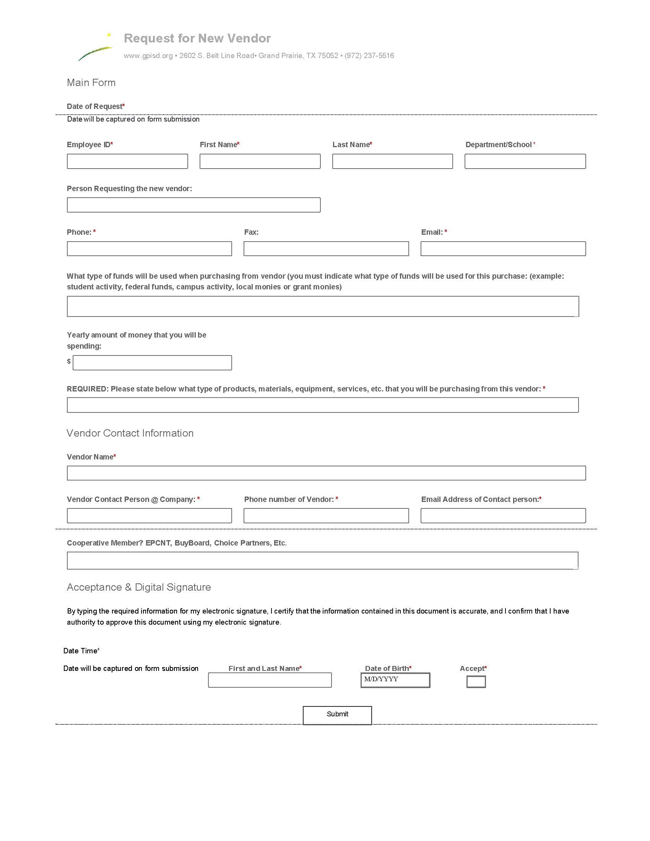
Request for New Vendor - sample

Slide 11





Travel Purchase orders
Collect ALL completed and signed forms prior to submitting requisition.
Obligation and Travel Forms must be digitally signed.
Approved driver packet needs to be submitted to Barry Hosford for driver approval prior to submission of travel requisition. If the traveler is not on the approved driver list, mileage reimbursement will not be approved.
Mileage reimbursement requisitions – submit requisition at the time the travel requisition
is submitted.
Travel packet for rental cars is posted on Purchasing Department webpage. Only use this packet and the quote from Brooke Alexander for car rentals.
Meals – travel cards will no longer have meals. Enter a requisition using your DP group for the traveler and the money will be deposited in their personal bank account. The requisition needs to be entered at least two weeks prior to ensure money is in their account prior to their trip. Accounts Payable runs checks on Thursday of each week.

Slide 12
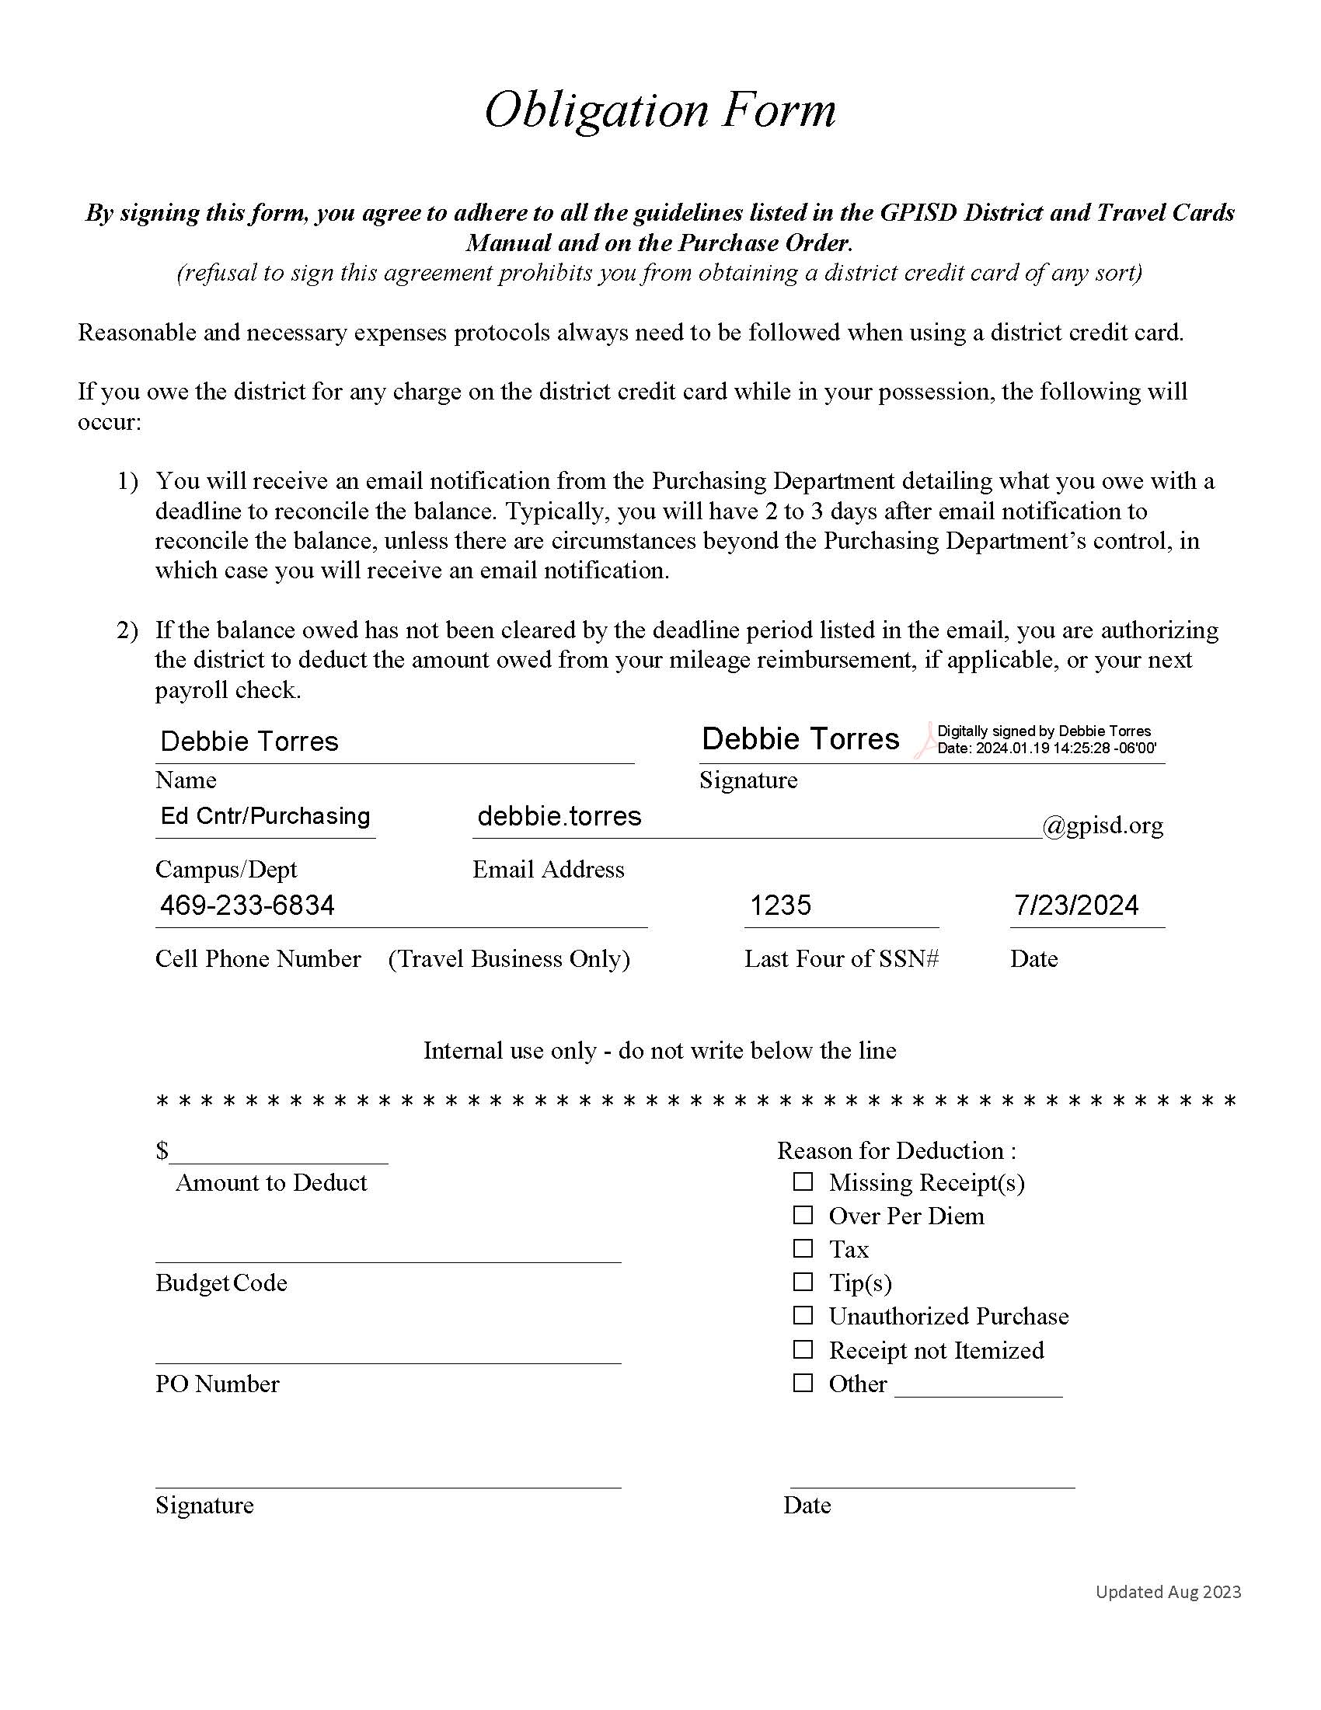
Digitally signed obligation form - sample

Slide 13
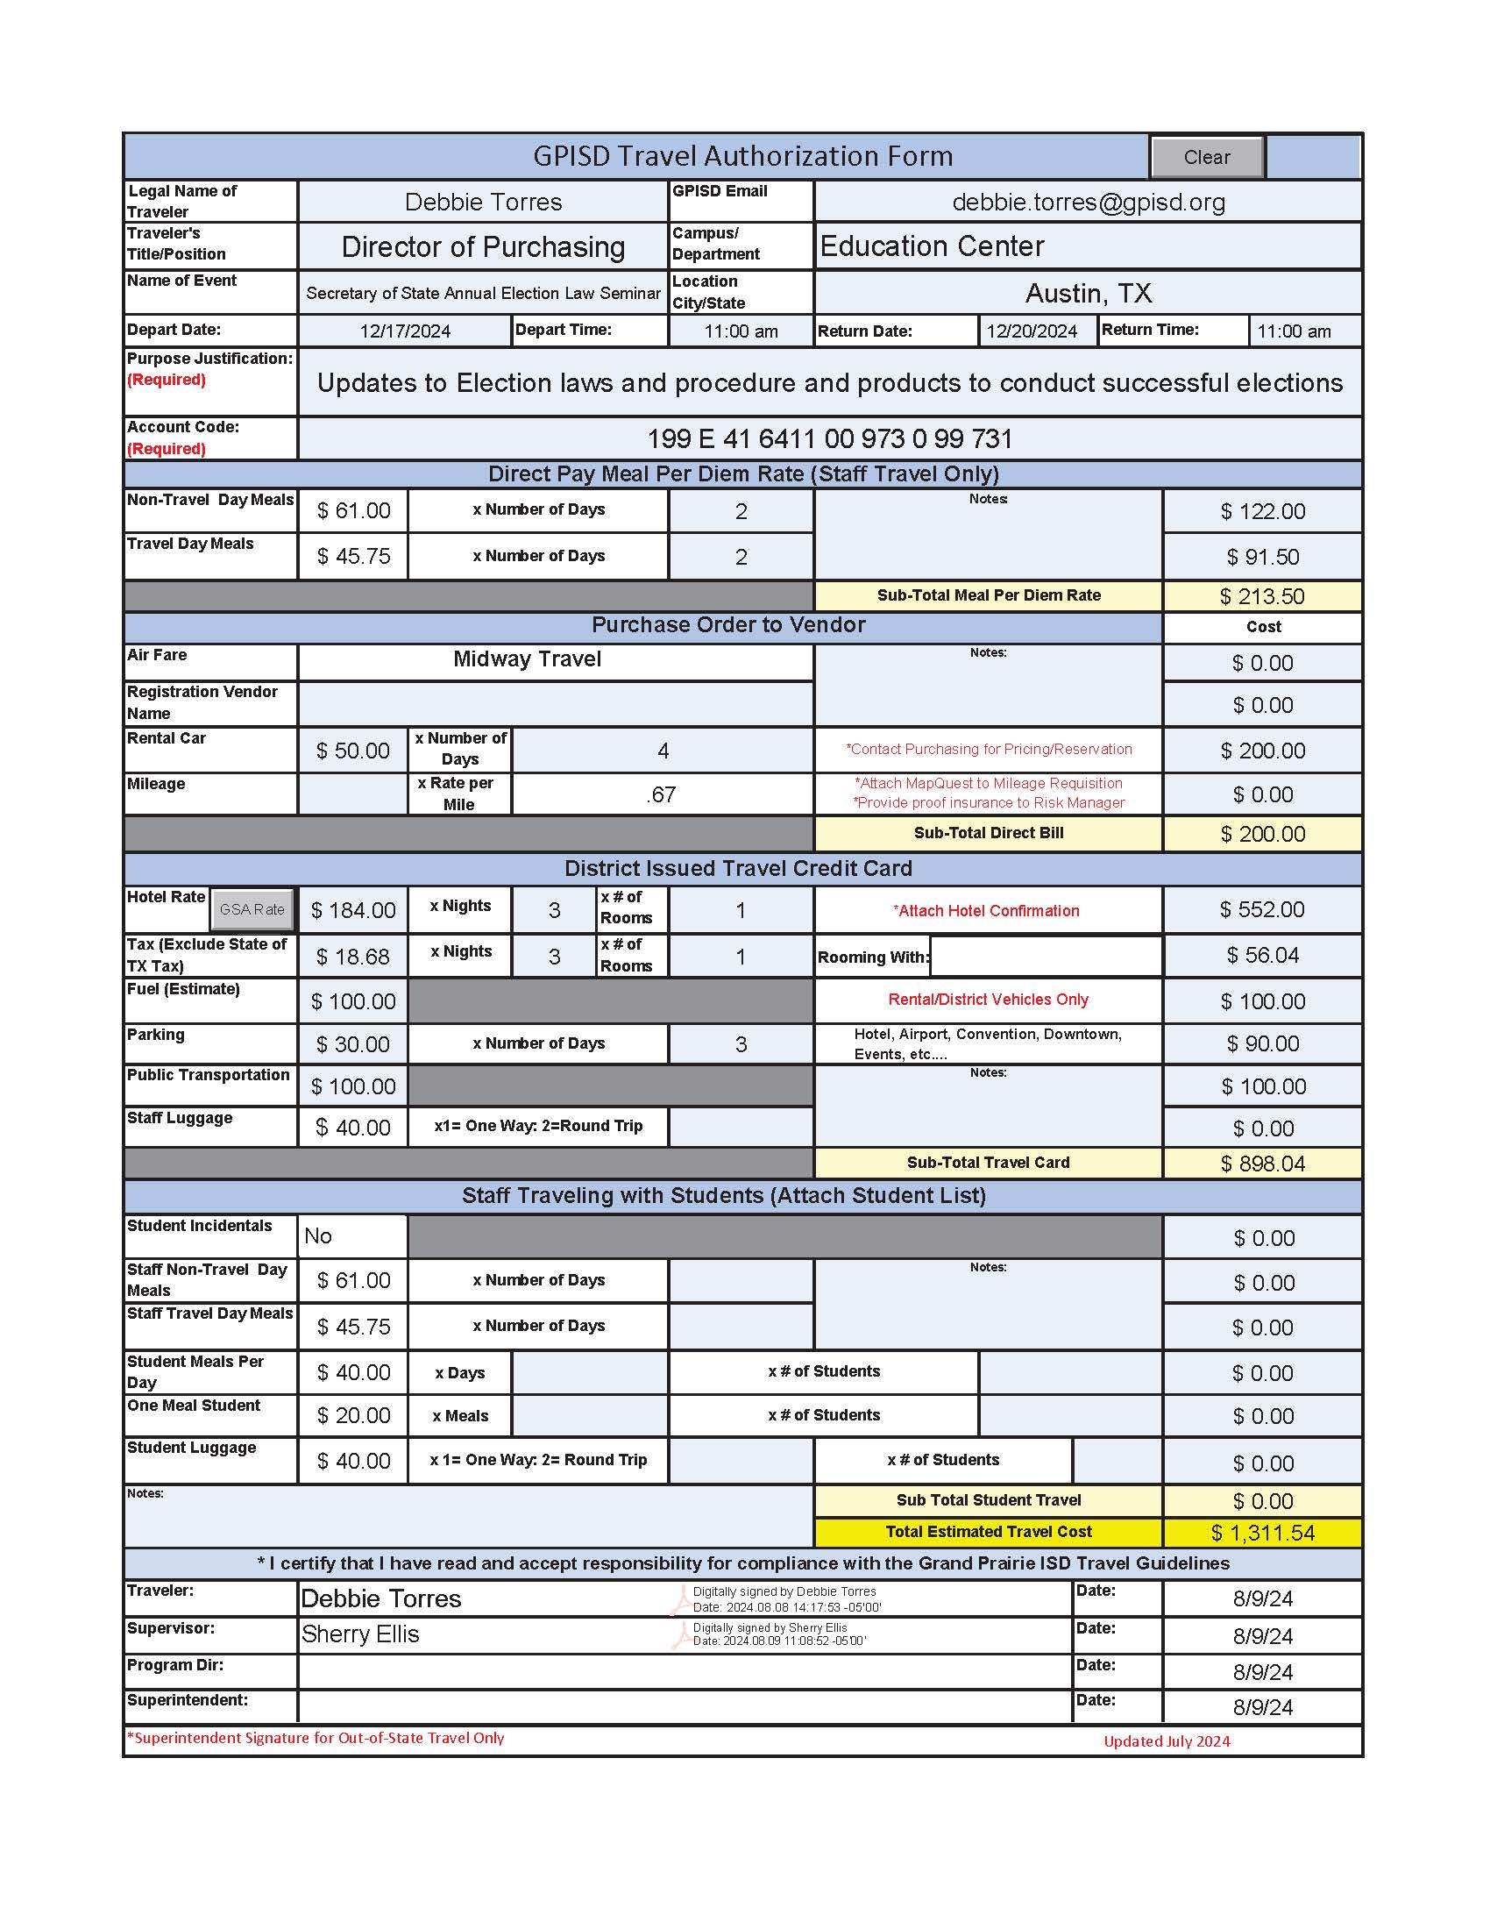
New
DIGITALLY SIGNED travel forM sample

Slide 14


Online forms and help
Purchasing Forms and Instructions – Located on the Purchasing webpage – PLEASE UTILIZE
Technology Price List – Located on the Technology webpage – Updated frequently (do not save on your computer). Always access from the Technology webpage for current pricing. Contact technology if you have questions.

Slide 15

Questions
Contact Information
Debbie Torres – Director – debbie.torres@gpisd.org - Ext. 5515
Jim Colbath – assistant Director – jim.Colbath@gpisd.org - ext. 5516
Brooke Alexander – Coordinator – brooke.alexander@gpisd.org - Ext. 4022

