Slide 1

Induction Final Project
Kaylee Basso
Beresford Elementary School
TK
5/24/23

Slide 2
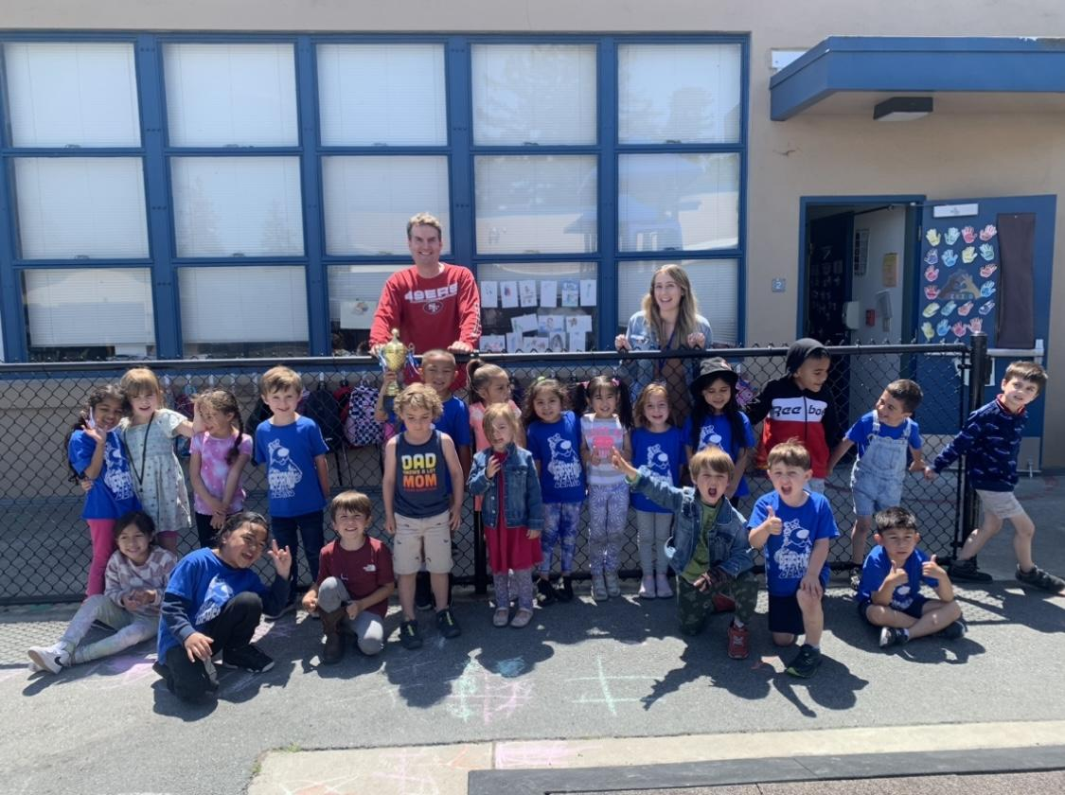
engaging, busy, fun!

Slide 3
My initial goals were supporting multilingual learners, extending/modifying lessons, and attending professional developments.
The most important goal I achieved this year was attending the PDs, collaborating with colleagues to gain new perspective and support. I was also able to extend/modify lessons using the Twig Science this year.

Slide 4

During my Inquiry 1 I collected data on students literacy skills. We began Heggerty in February and focused on beginning sounds, ending sounds, and rhymes.
What did you learn?
Our class has come a long way and boosted our literacy skills. I learned students really enjoyed blending but had a harder time segmenting. Also students who had a harder time with letter names and letter sounds did better during Heggerty as it is a listening and repeating lesson. It’s a great way to see students assets and knowledge in a different form.

Slide 5
What Professional Development did you attend?
ELRISE PD academic text to deepen language literacy
Supports in the Classroom: How to Implement Reinforcement Strategies
Alexs Pate's Innocent Classroom: Building Authentic Relationships with Each and Every Child
How did this impact your work on your goals and your teaching?
I felt my work, goals, and teaching were impacted by these professional developments because they gave me different perspectives, ideas, and ways to integrate strategies in my classroom.

Slide 6


I feel that through work with my L&L TOSA, I was able to build my knowledge of literacy and be better able to serve my students.
The area that was the most challenging was learning to accept things I cannot control.

Slide 7

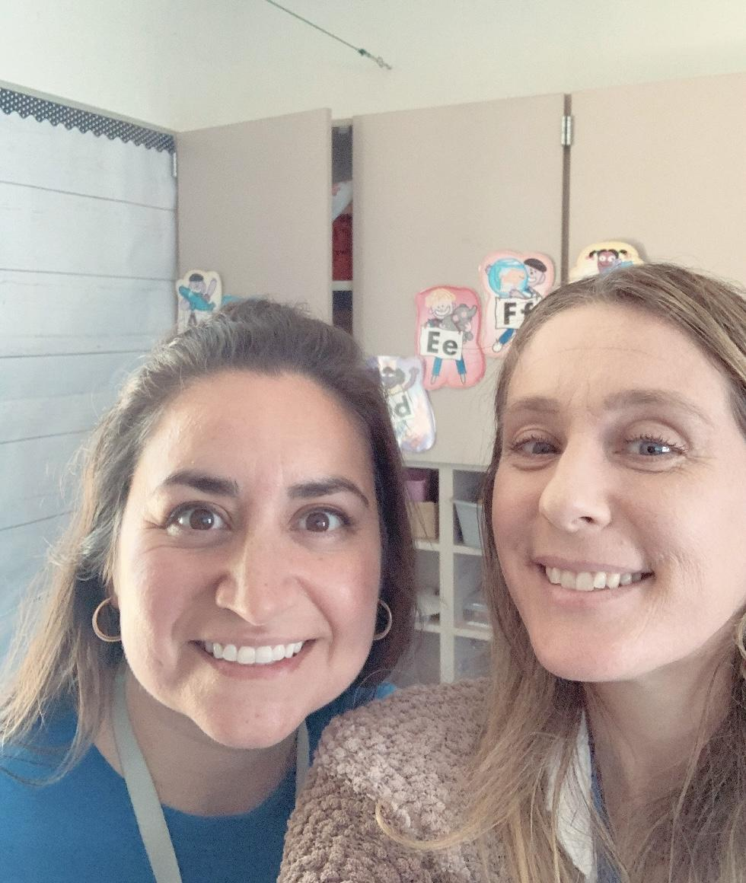
Talk about your motivation here:
You more than likely had a few highs this past year, and now it’s time to reflect on them. Think about the steps you took to reach these highs and what motivated you to get there in the first place.
-The professional developments really helped me to help the students make a lot of progress this year. This progress was evident during the Open House we just recently had. My students were able to take their parents around to show them many of the things they learned throughout the year and their parents were very impressed with all the knowledge they had gained.
And then, ask yourself, what helped you get through your lows?
-Being able to talk to coworkers/colleagues and getting tips. Also being able to plan vacations and time for myself helped me not to worry about work all the time.

Slide 8
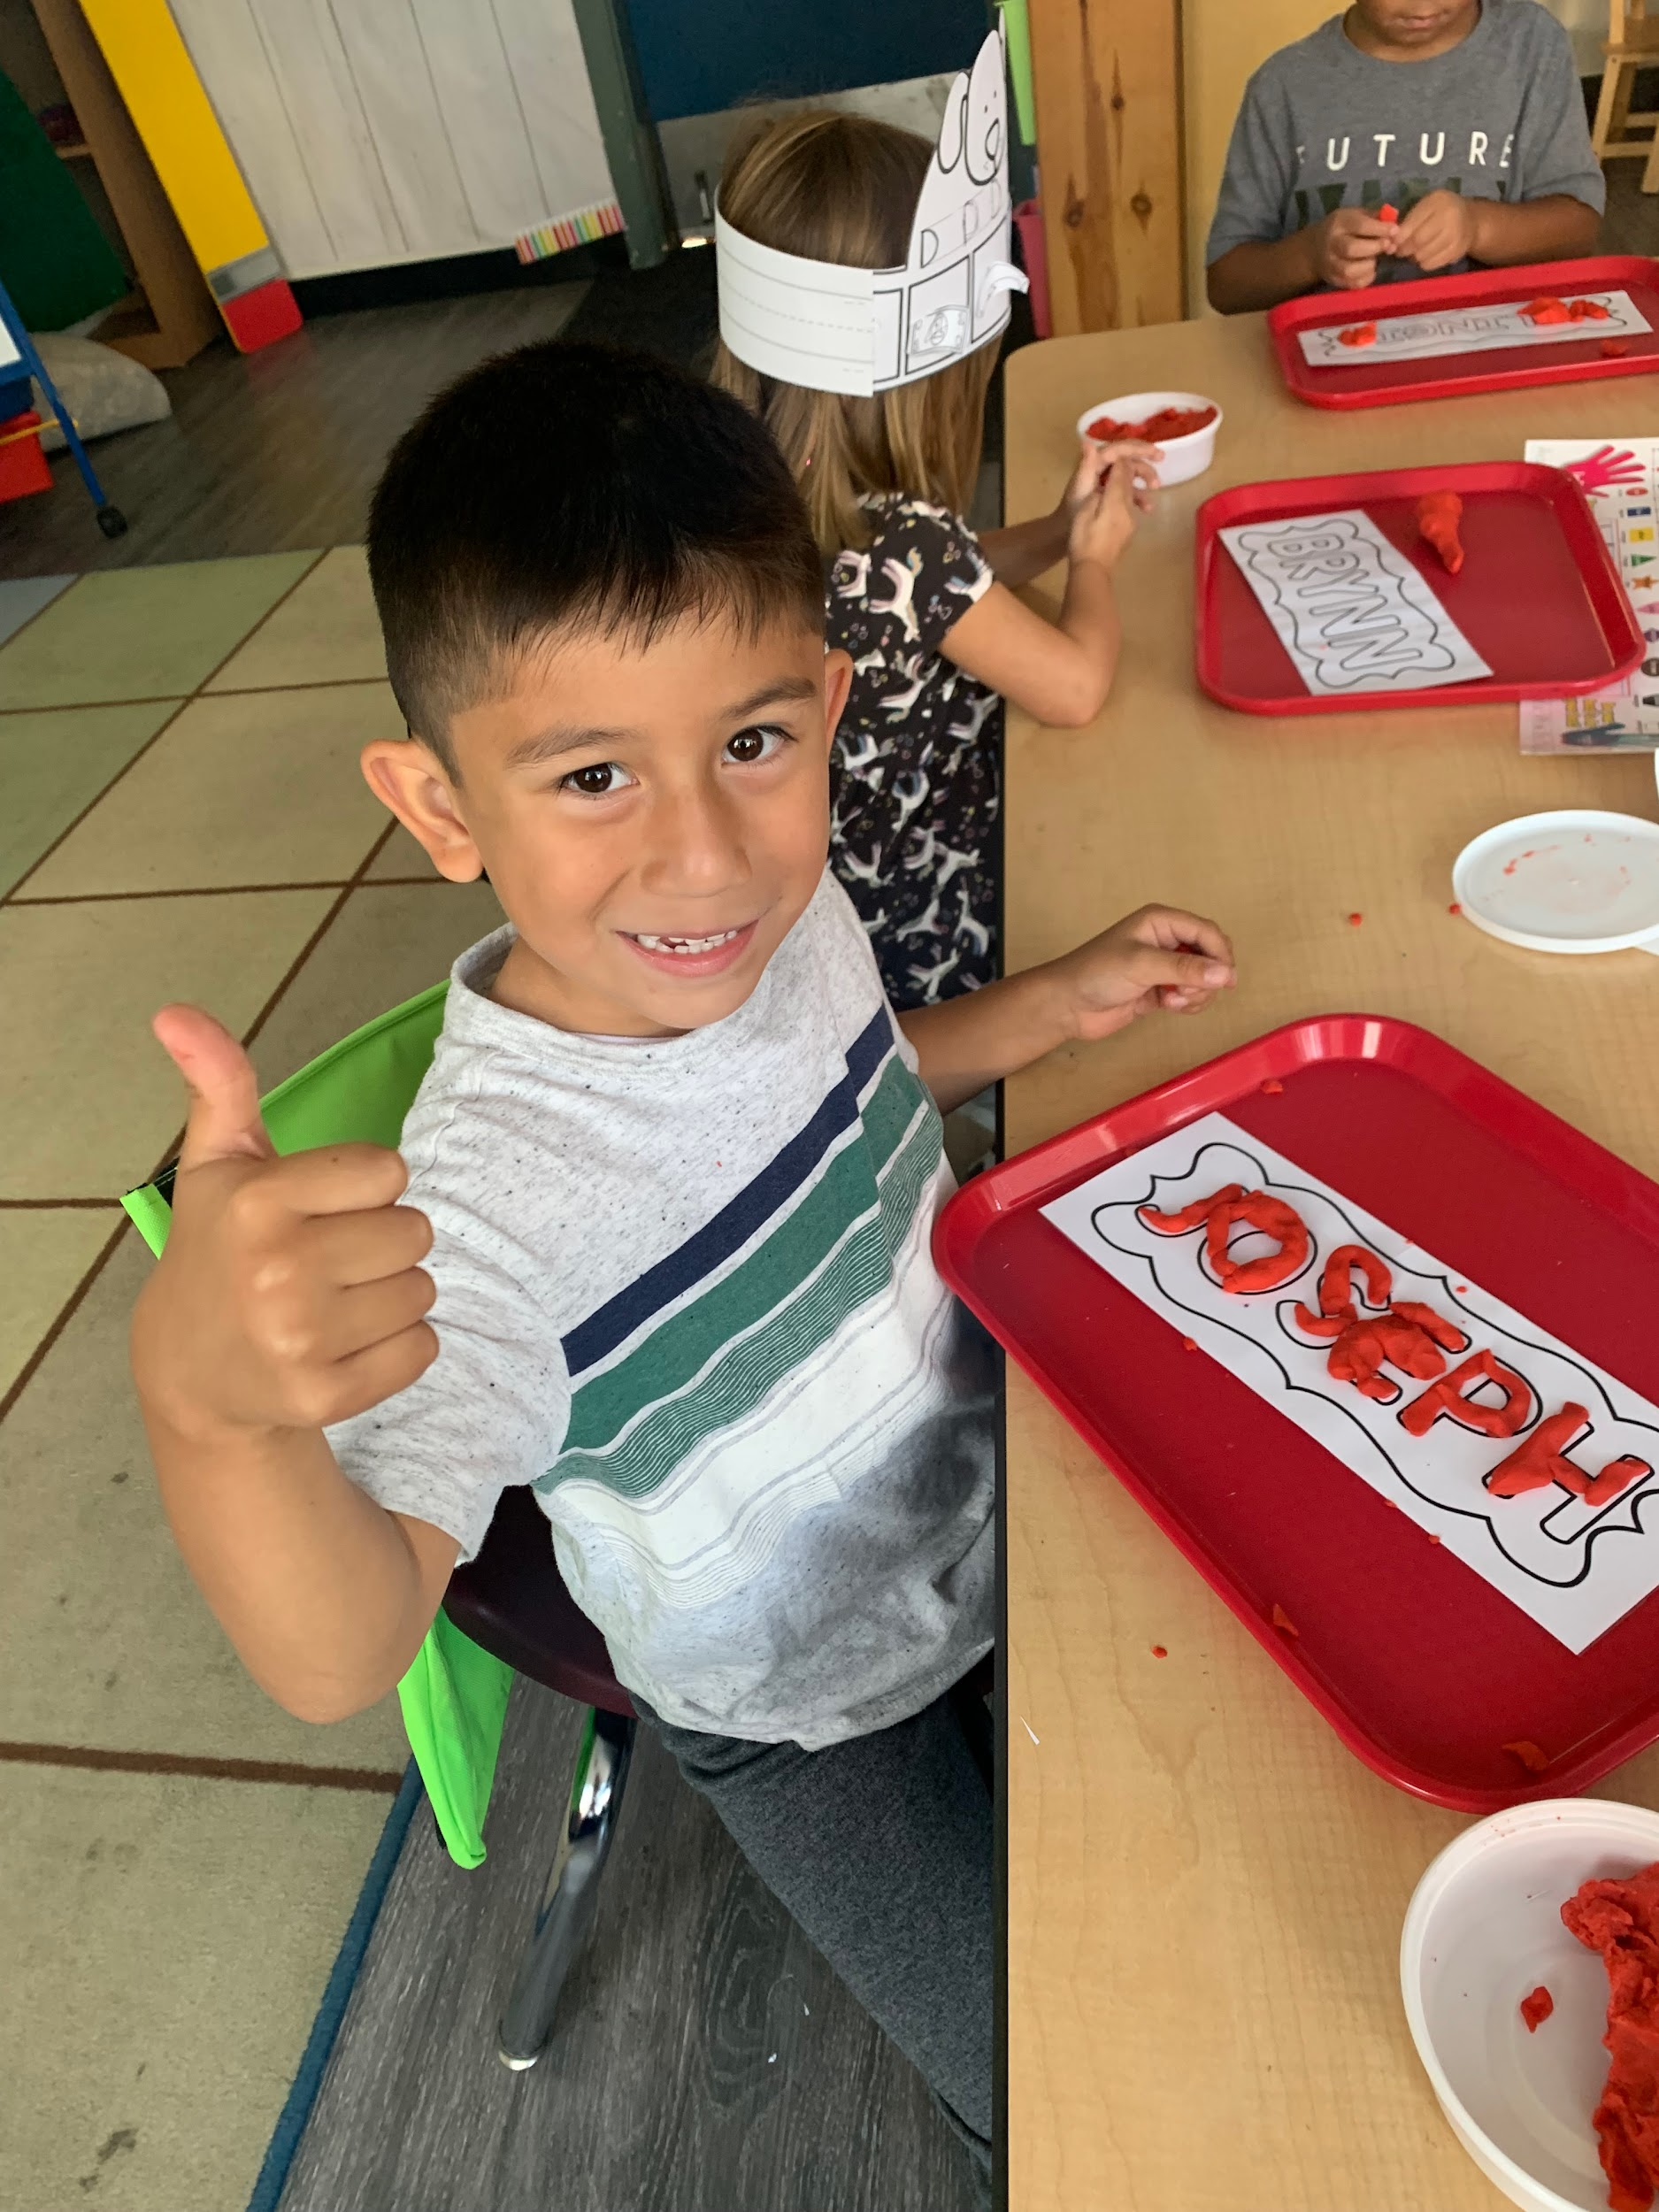
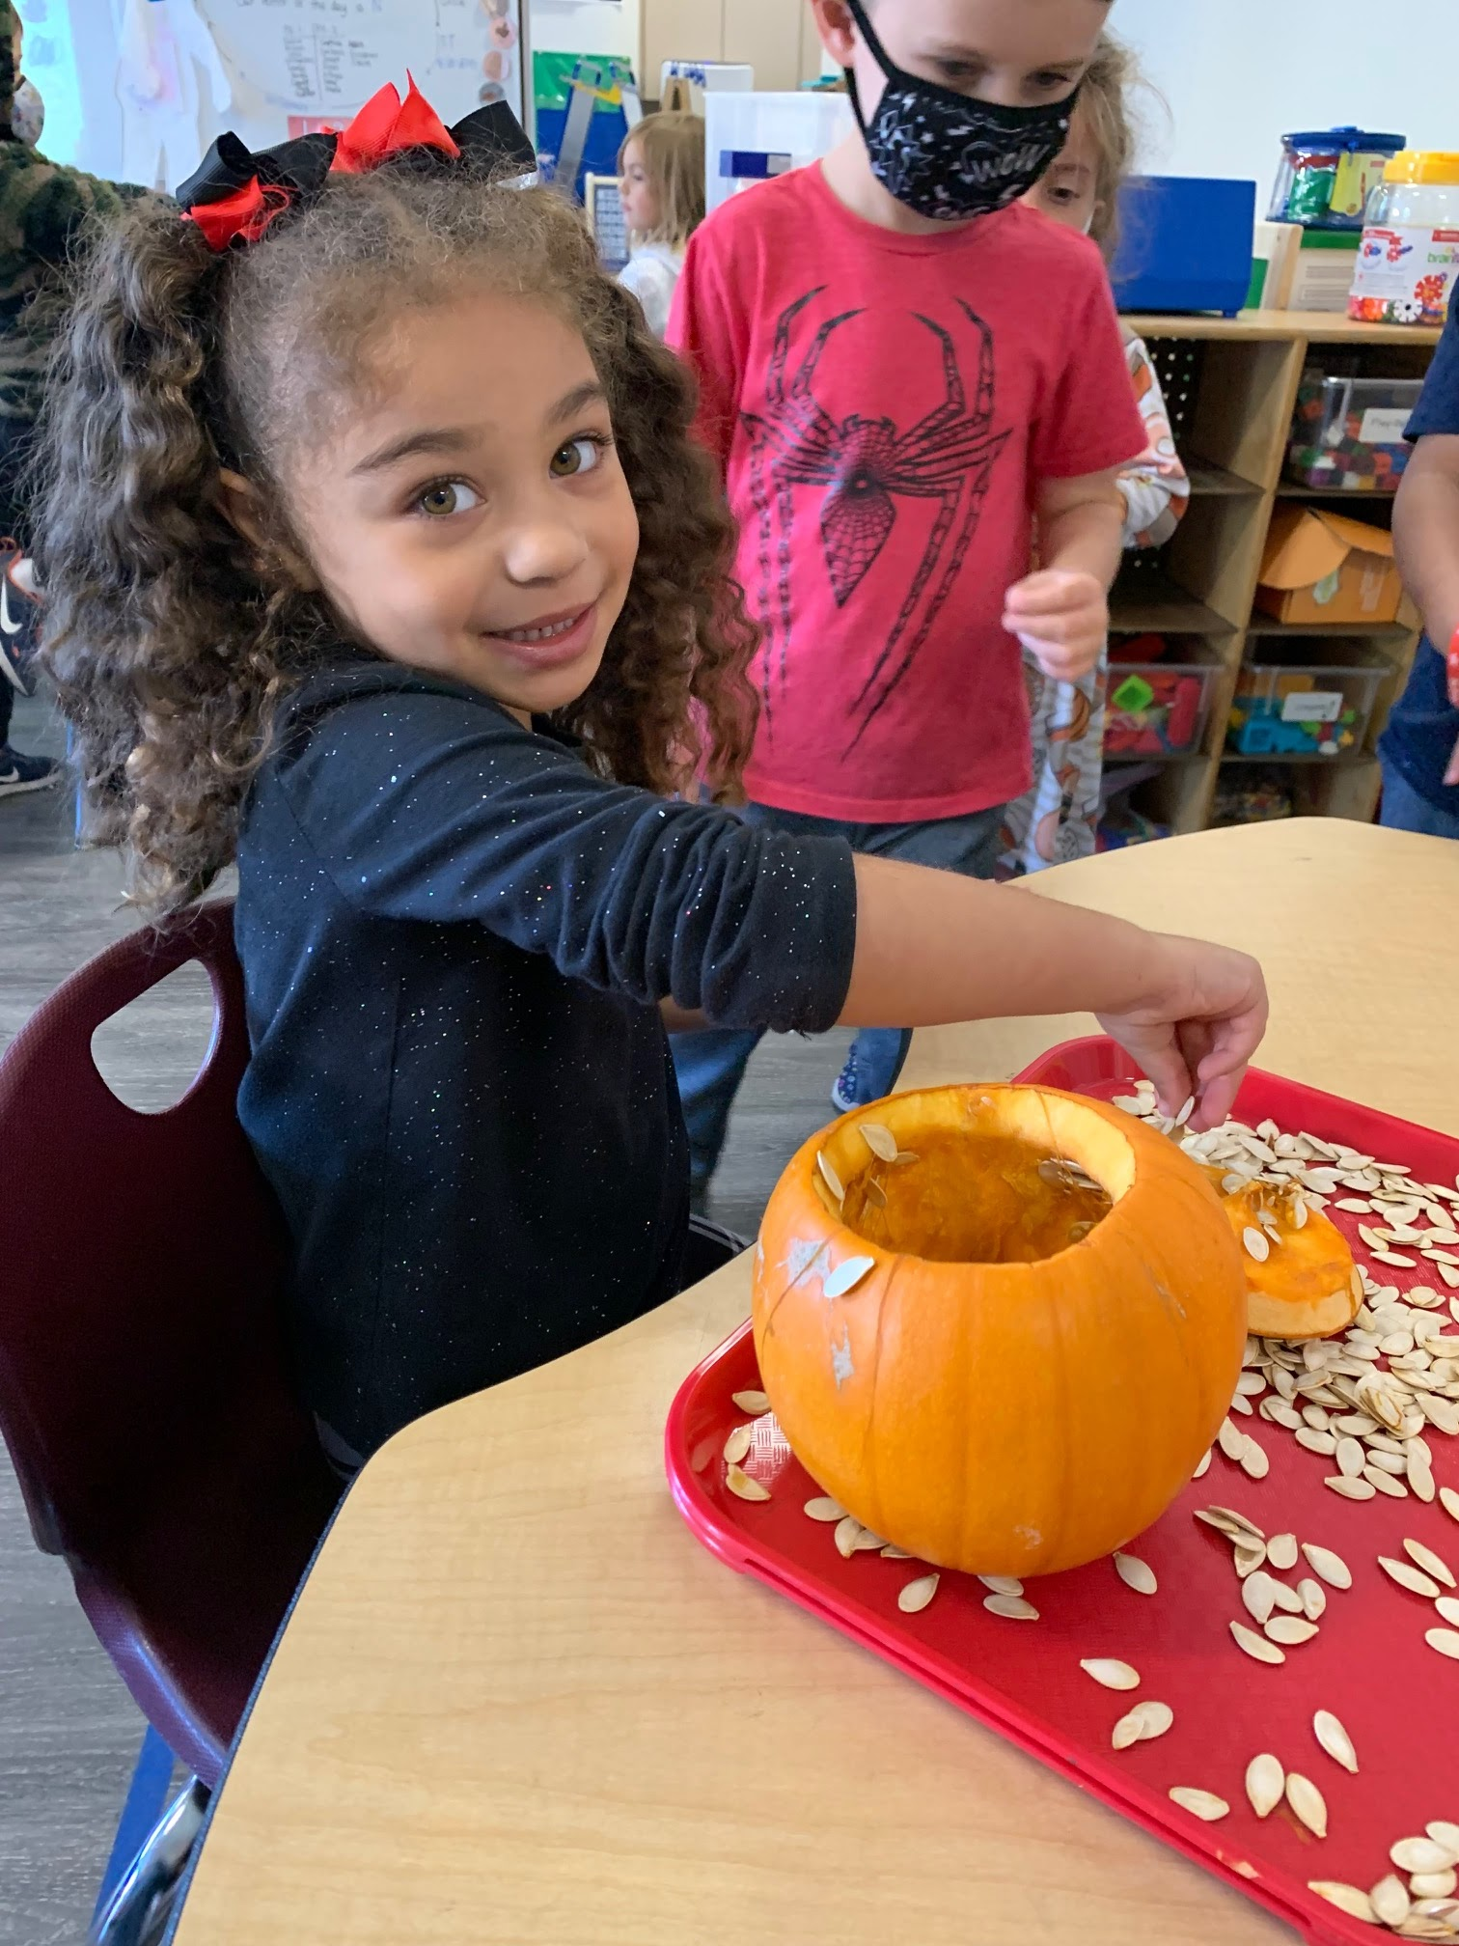
If I could travel back in time, I would advise myself to be in the moment and to focus on the things that I have control over.

Slide 9
What was your biggest career accomplishment this y﻿ear?
Building connections with my students and creating community within our classroom!
Learning to be flexible when things do not go as planned.
Taking in feedback from colleagues and PD’s and implementing strategies to best support our students.
Goals for next year:
Improve on my targeted small group instruction.
Improve my organizational skills with scheduling out targeted small group instruction time.

