Slide 1

2014/15 Annual Report Measure K and Measure Q
DRAFT
Agenda Item B - XX
Board Meeting – December 9, 2015
Notes:
Good evening, Board President _________, members of the Board and Superintendent Hanson. On behalf of the Citizens Oversight Committee for Measure K and Measure Q, I am presenting the 2013/2014 annual report. This report covers the period July 1, 2013 through June 30, 2014. The Oversight Committee reviewed and approved the draft report at their October 28th meeting.
I want to thank all the members of the Citizens Oversight Committee for their service to the district. In particular, I am grateful to Mr. Nick Yovino, Committee chair, for his dedication and for being here this evening.
I also want to again thank the voters for their support of Measure K and Measure Q, without which essential funding for school facility improvements would not be available.
Before I present the report, Mr. Yovino has some comments.

Slide 2
Fresno Unified Bond Measures
DRAFT
Measure Q - 2010
$280 million
Measure K - 2001
$199 million
Notes:
First, some brief background ……
Measure Q was approved in November 2010 with 76% voter approval.
Measure K received 67% voter approval in March 2001. It was among the first Proposition 39 bonds, the state initiative that reduced the approval requirement for local school facilities bonds from 2/3 to 55%. The lower voter approval percentage triggers additional oversight requirements including an oversight committee and annual performance audits.

Slide 3
Citizens Oversight Committee
DRAFT
Citizens Oversight Committee provides expenditure oversight for bond program
Annual Report of Citizens Oversight Committee
  Verify compliance with California Constitution
  Summary of activities
Reports of independent external auditor
  Quarterly reports of agreed upon procedures
  Annual performance audit
  Annual financial audit
Notes:
The Citizens Oversight Committee is a statutory requirement with the responsibility to verify Fresno Unified’s compliance with the State Constitution regarding how bond proceeds are expended. Each Board member has two appointments to the committee, and the Superintendent appoints the Chair. The Committee meets quarterly and the meetings are publically noticed per the Brown Act. At each meeting, project and financial updates are presented, including a detailed report of expenditures by project. In April we take Oversight Committee members on a tour of projects in construction and recently completed so they can see up close the work being done at our schools.
Also at every meeting, the district’s external auditor reviews the results of the most recent quarterly “agreed upon procedures” report. The auditors select a sample of 25 expenditures during the quarter, with representation across all construction projects, vendors and expenditure amounts. The auditor examines purchase orders and invoices for each of the selected expenditures to verify they were properly charged to eligible projects. These quarterly reports exceed the statutory requirement for only an annual report, and demonstrate our commitment to transparency and accountability in our bond program. The auditors also conduct the required annual performance audit, as well as the annual financial audit along with all district funds.
All 2013/14 quarterly reports, and the annual performance audit, were “clean” which means all bond expenditures were properly charged and properly coded, and were for the construction of school facilities. The Oversight Committee approved every quarterly report and the annual performance audit, thereby verifying the district’s compliance with the requirements of Article XIIIA, Section 1(b)(3) of the California Constitution.

Slide 4
2014/15 Bond-funded Projects
DRAFT
New classrooms and core facilities
New school construction
School modernization
Measure K/Q
Dollars at Work
Deferred maintenance
Energy conservation projects
Site and athletic facility upgrades
Notes:
This is an overview of the types of projects our bond funds are supporting. The following slides show examples of the larger projects underway.

Slide 5
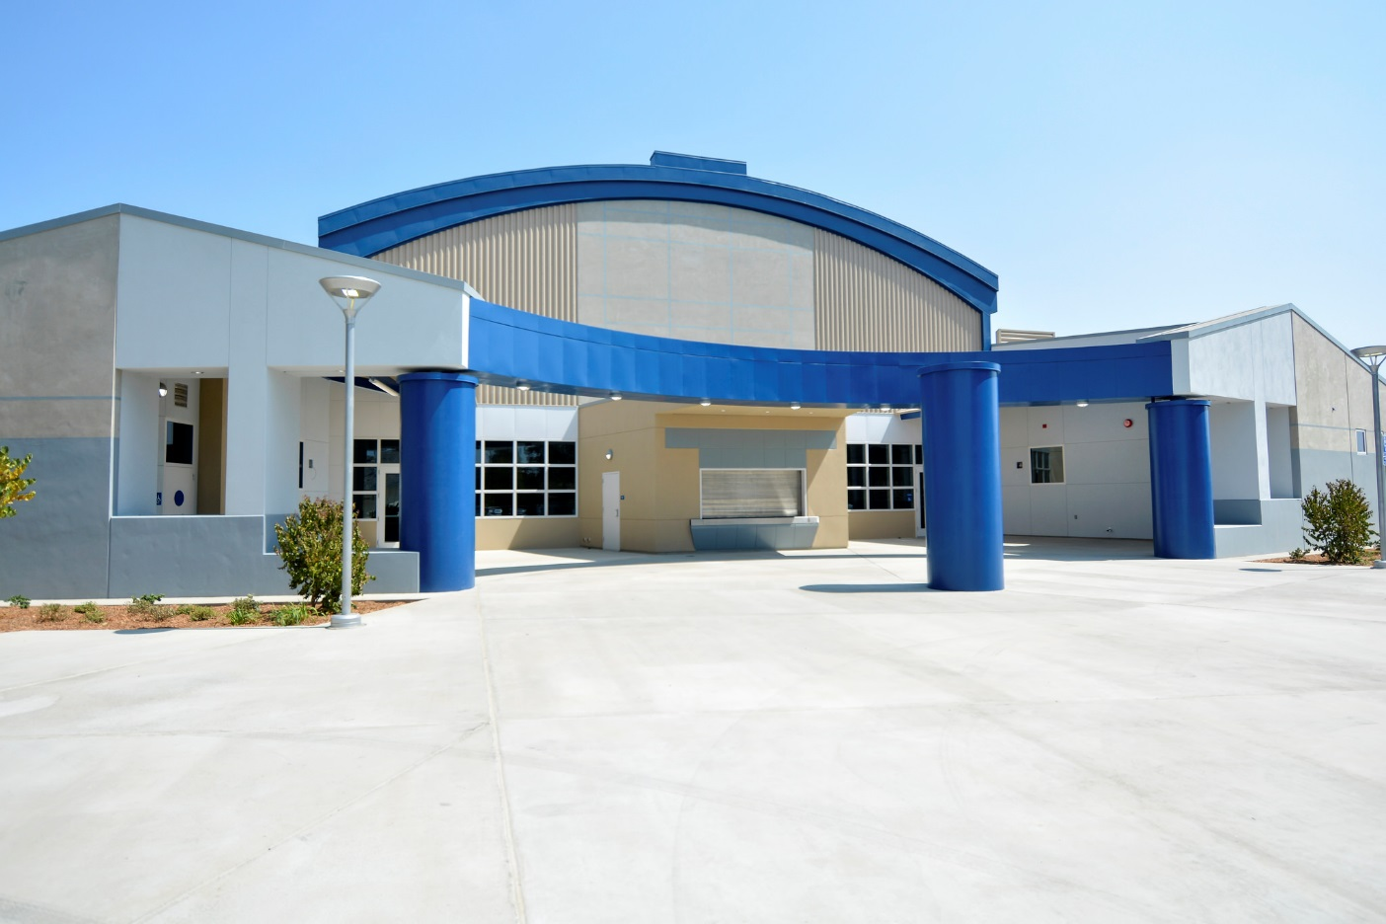
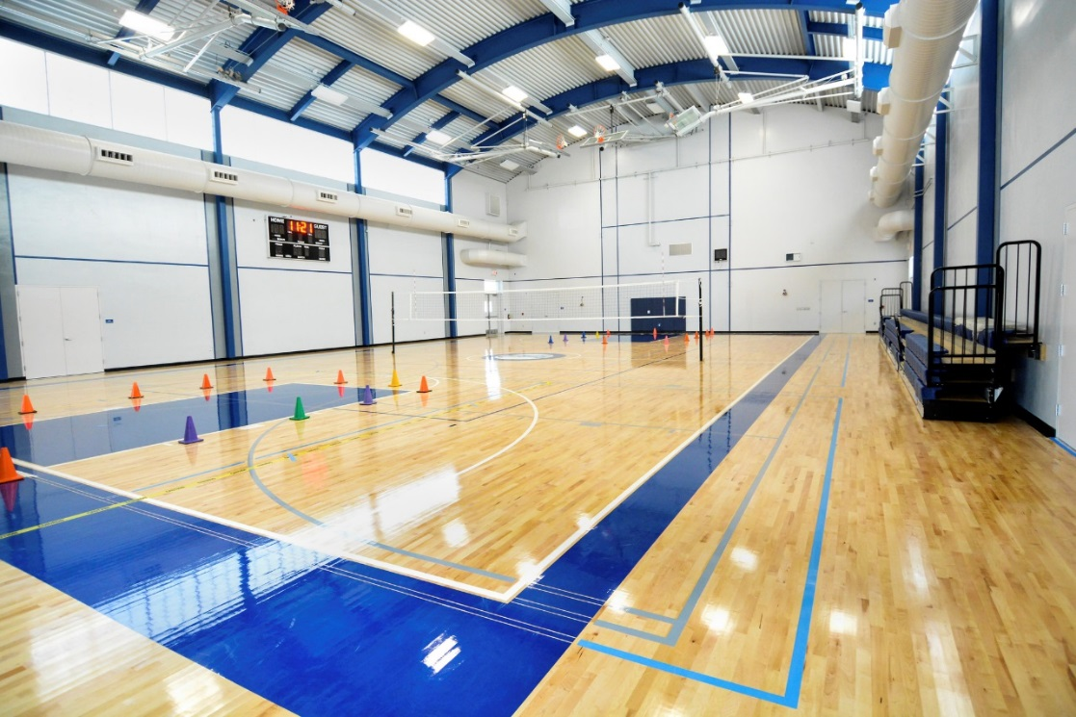
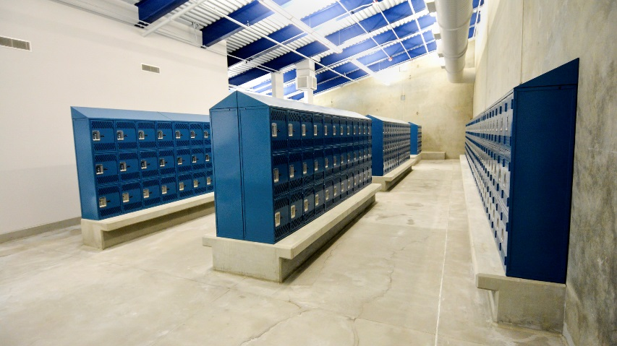
Baird Gym
DRAFT
Baird
Gym

Slide 6
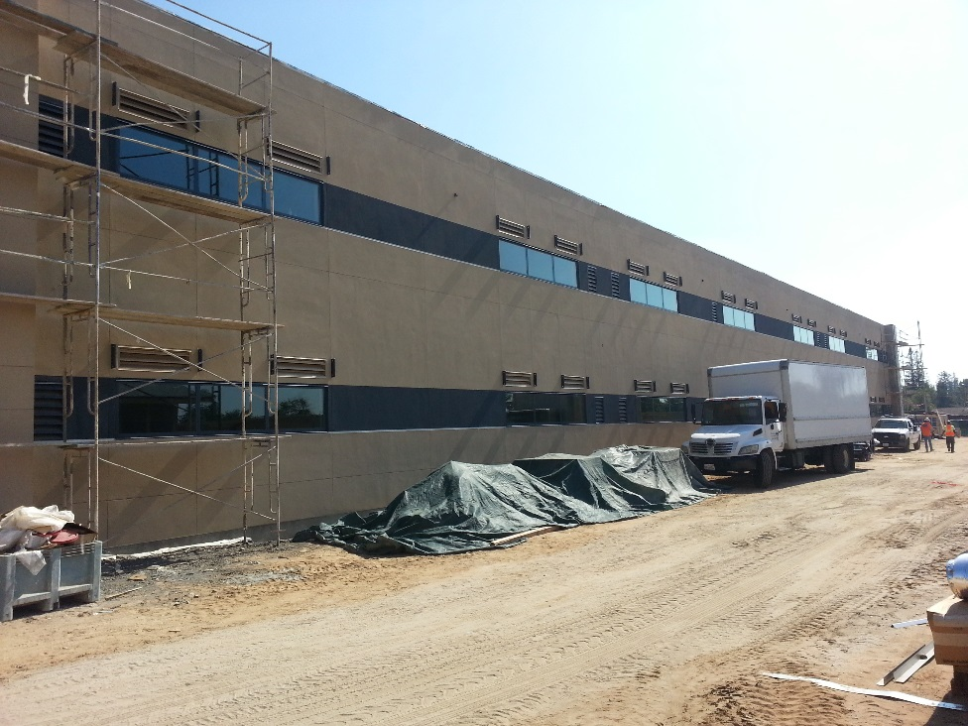
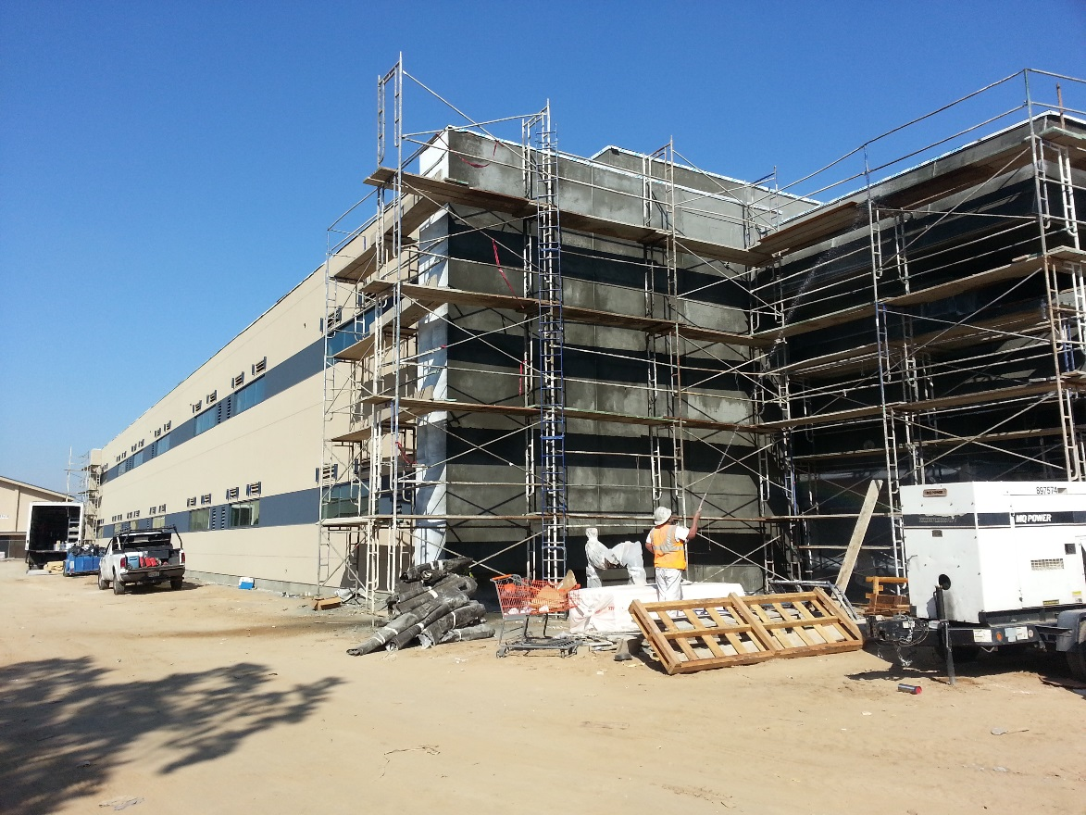
Bullard Classroom Building
DRAFT

Slide 7
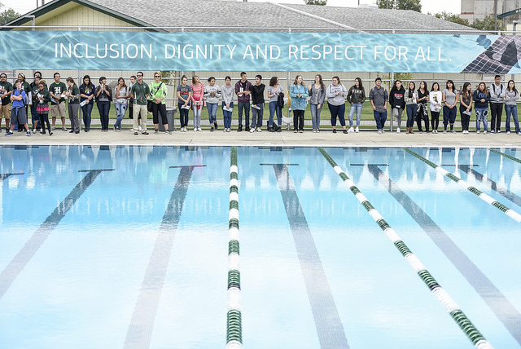
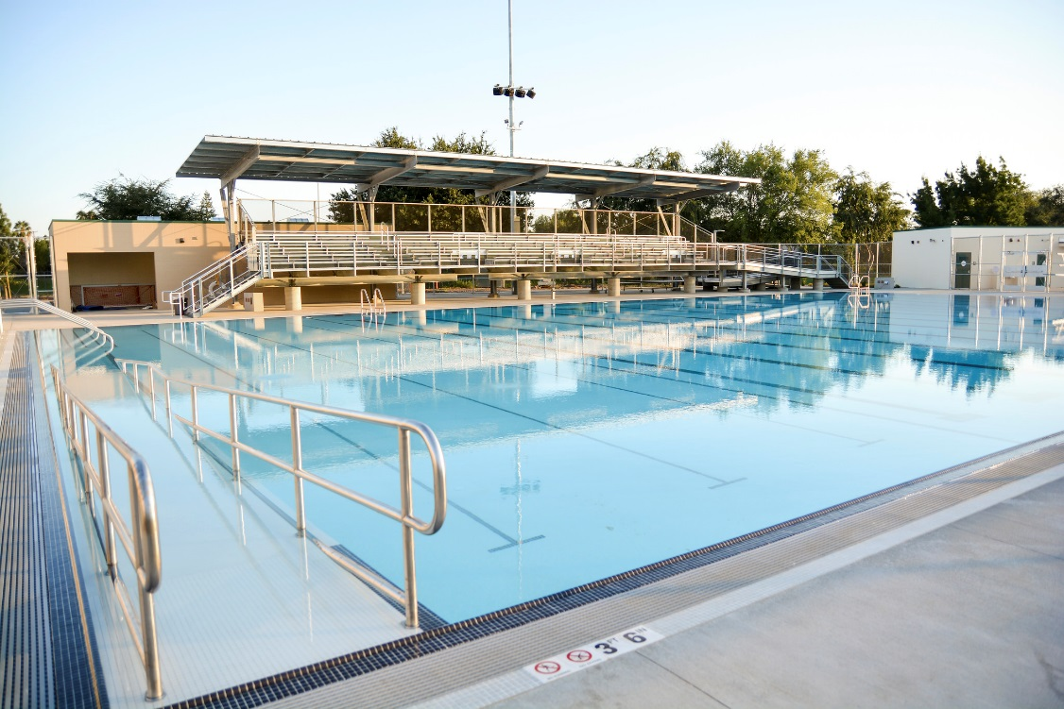
Hoover Aquatic Center
DRAFT

Slide 8
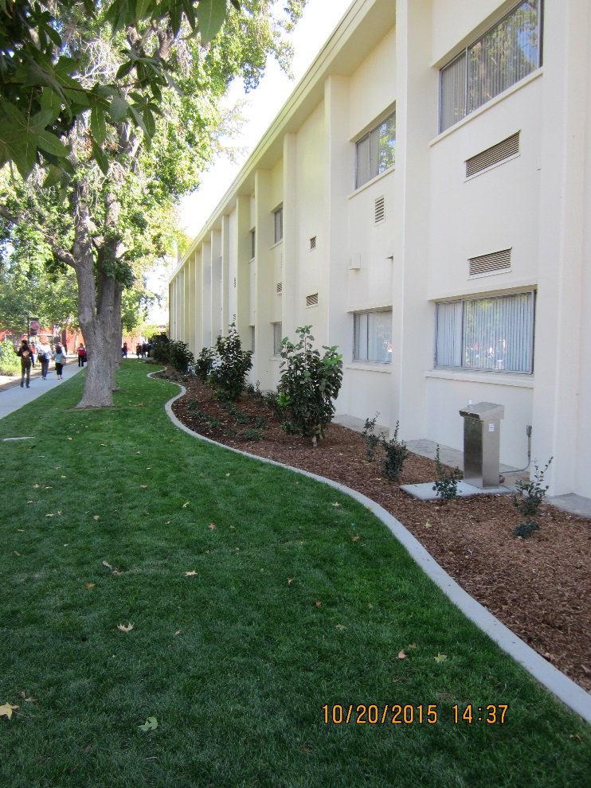
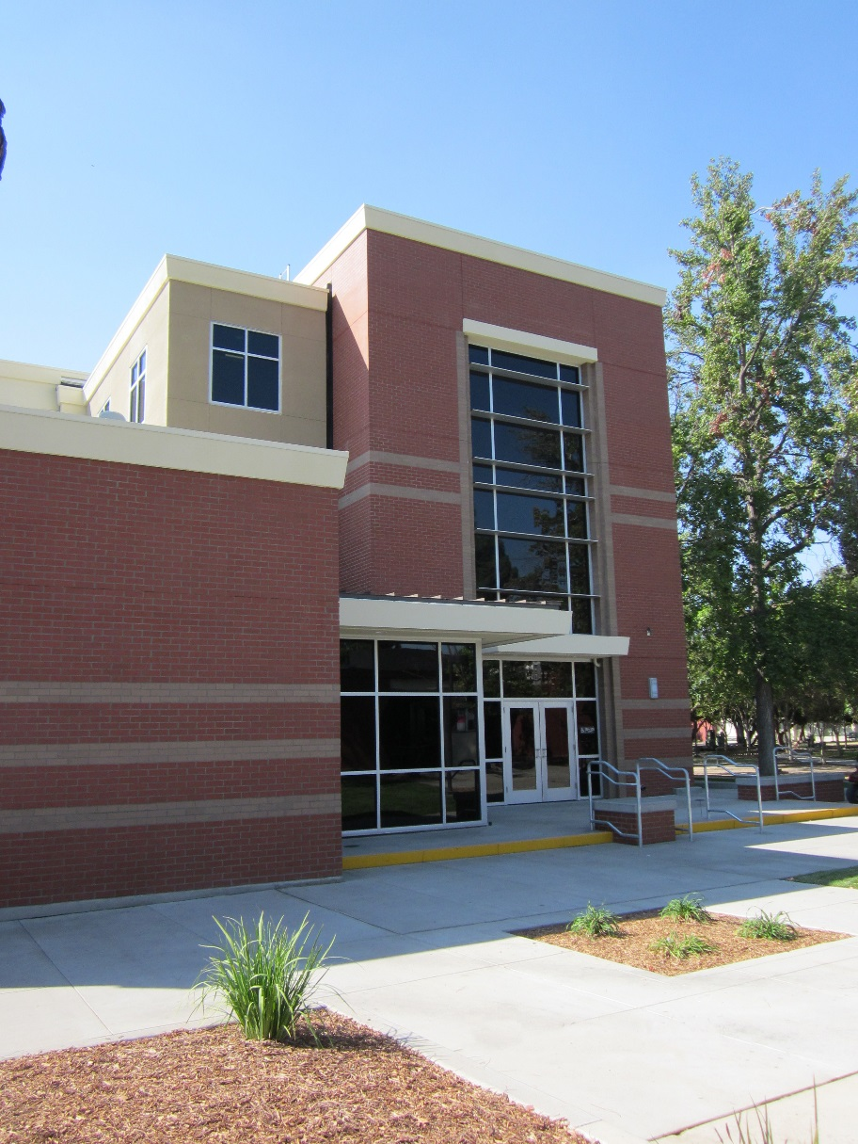
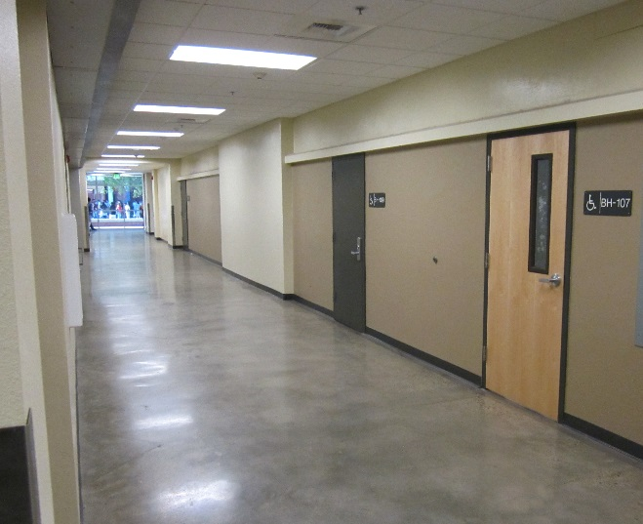
McLane Classroom Building
DRAFT

Slide 9
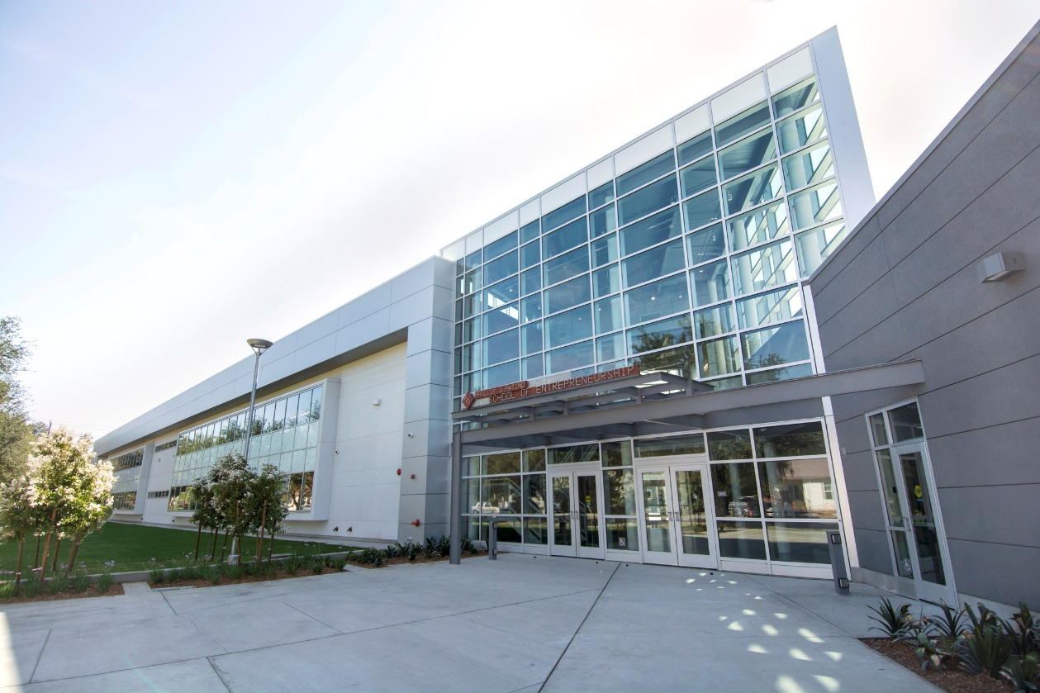
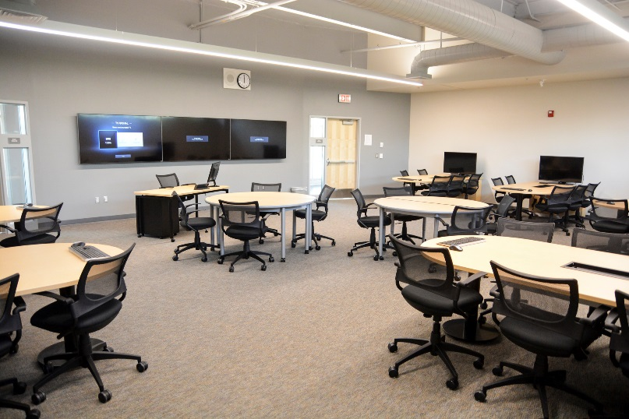
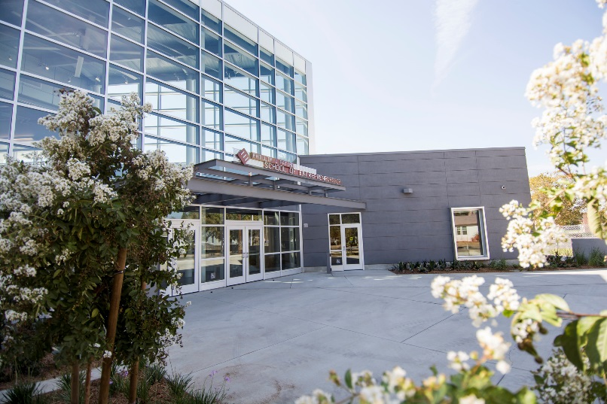
Patiño School of Entrepreneurship
DRAFT

Slide 10
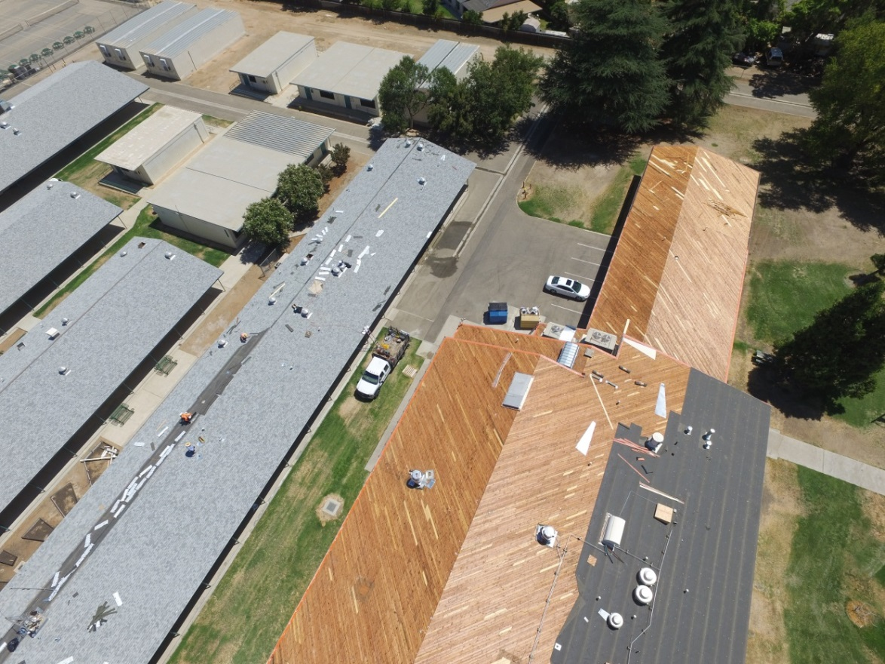
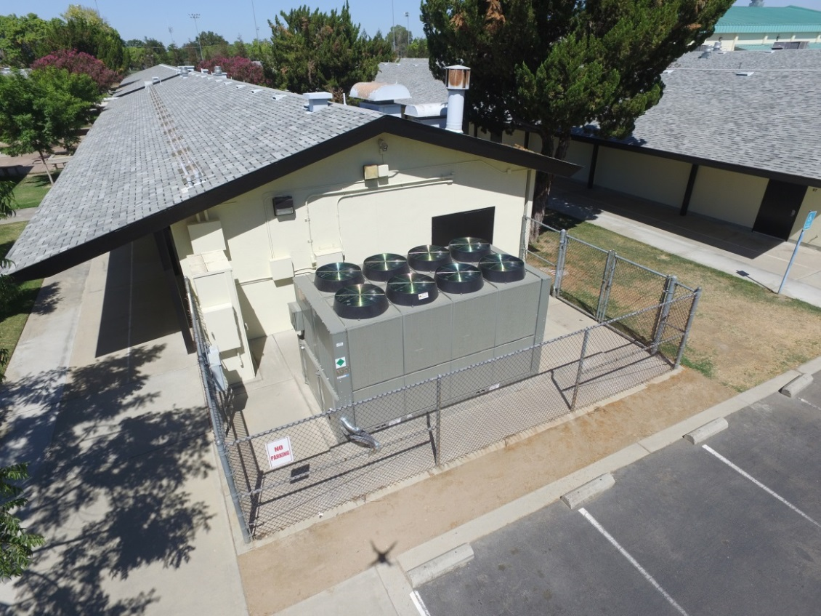
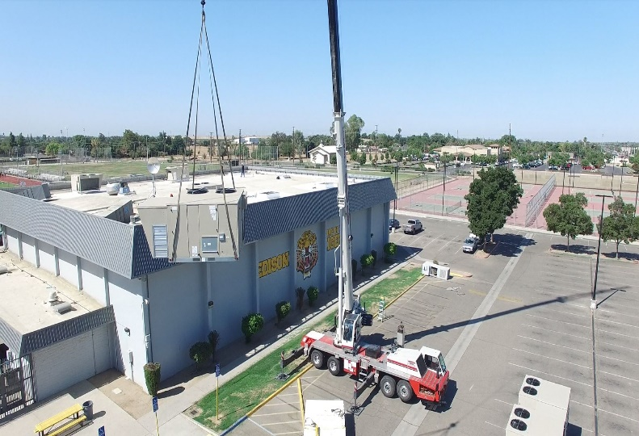
Facility Improvement
Projects
DRAFT
Kings Canyon –
Roofing
Edison –
Gym Cooling
Computech –
HVAC upgrade

Slide 11
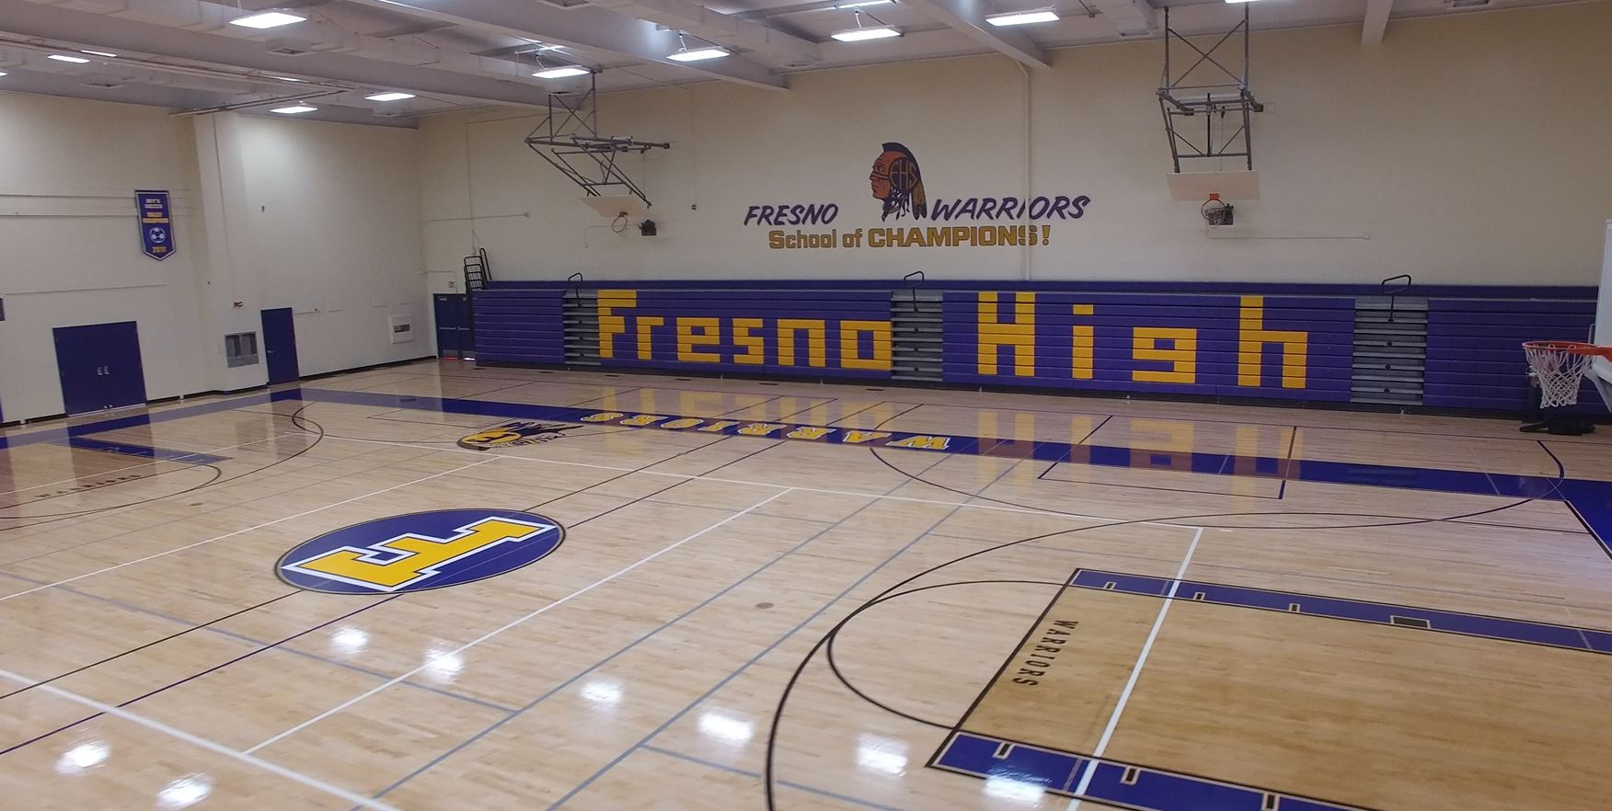
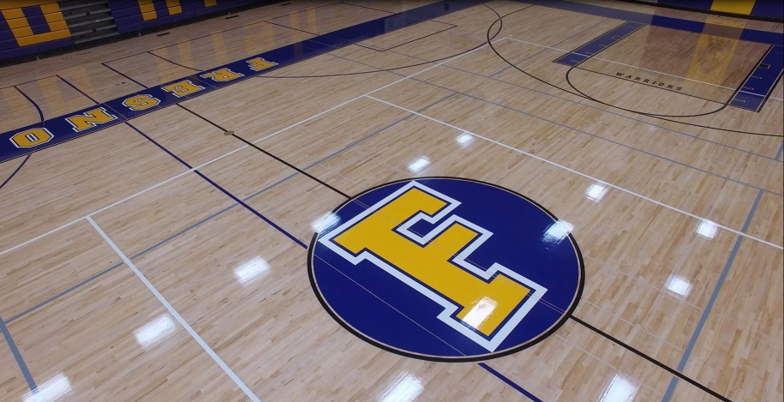
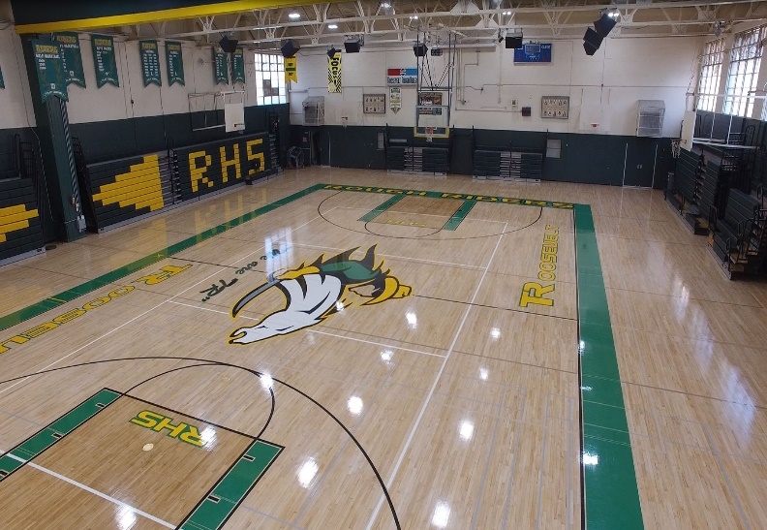
Facility Improvement Projects
DRAFT

Slide 12
Update: June 30, 2015
DRAFT
Measure Q
Measure K
$214 million in projects completed and underway
$50 million in projects obligated during 2014/15
Approximately 90% of project dollars to local contractors
$359 million in total project value
Leveraged $160 million in state funding
All Measure K bond funds have been expended
Notes:
Now moving to Measure Q and Measure K financial updates. As of June 30, 2014 -- a total of $164 million had been obligated for Measure Q projects, with $45 million in projects last year alone. Consistent with our commitment, approximately 90% of the project dollars have remained local.
For Measure K, the program is concluding, as all bond funds have been obligated. Measure K has served the district very well, with a total of $359 million in projects including new school construction, school modernization, infrastructure upgrades, and a variety of other campus improvements.
------------------
The total value of the projects to be completed with Measure Q funding will be dependent upon the structure and criteria of future state facilities programs, and the availability of state facilities bond funding. As future state programs are defined, we can update the estimate of total Measure Q projects over the life of the bond. Staff continues to look for all opportunities for state funding, and we are continuing to submit applications, to get in line and preserve future funding opportunities.
Measure K 2013/14: design on Hoover pool, upgrades to Roosevelt track, McLane locker room, some Gaston expenses

Slide 13
Maximizing Our Investment
$214 million in Measure Q Projects through June 30, 2015
DRAFT
Notes:
This is an illustration of the district’s combined $523 million Measure Q and Measure K investments. Due to our aggressive pursuit of state funding, Measures Q and K have leveraged $192 million in state funding. Put another way, our local investment has yielded close to 60 cents from the state for every bond dollar spent.
-----------
Our ability to continue this trend in the future will depend on future state bond measures and the structure of future facilities funding programs. In addition to the state dollars received to date, another $36 million in Fresno Unified project applications has been approved for funding; however, there is not currently state funding for these facilities programs so these applications will remain in “approved but unfunded” status until a source of funds is identified at the state level. Currently, there is a lack of clarity with respect to future state support for school facilities funding. Fresno Unified continues to take extra steps to ensure that facilities projects meet the eligibility requirements of the existing state programs, in the event that funds become available in the future.

Slide 14
Measure Q Issuances
As of June 30, 2015
As of September 30, 2015
Notes:
These charts represent, for Measure Q, the bond authorization used and remaining. We issued $80 million in Measure Q bonds in September 2011, then $55 million in August 2013 and most recently $60 million this past September.
The chart on the left illustrates the status of Measure Q issuances as of June 30, the period of the annual report. The blue is the bond authorization used - $135 million - and the green is the bond authorization remaining at that time - $145 million.
I added the chart on the right to give a picture of the current status, after the September 2014 $60 million issuance. You can see that currently, $85 million in Measure Q remains for future issuances. We evaluate project funding needs regularly, in consultation with our financial advisor, and at this point we anticipate coming to the Board in the May-June 2015 timeframe to request authorization for the next Measure Q issuance.
---------
Debt service payments on the general obligation bonds authorized for issuance by Measure Q are made by the County of Fresno Auditor-Controller from the Bond Interest and Redemption Fund.

Slide 15
Recommendation
DRAFT
Approve 2014/15 Annual Report
Measure K and Measure Q
THANK YOU to the Voters and the Citizens Oversight Committee!
Notes:
Consistent with Measure Q’s commitment, close to 220 aging portables have been or will be removed from school sites due to construction of new classrooms; core facilities are being constructed and improved; state-of-the-art athletic facilities are being provided for our students and community; and campus infrastructure such as electrical and HVAC is being upgraded. Bond funds are at work across our community transforming schools and neighborhoods, and creating local jobs.
This concludes the presentation. We are available for questions
---------------------------
Next bond measure: We are working closely with the district’s financial advisor on a future bond measure and are targeting a Board workshop in the first quarter of 2015 to provide an update and preliminary plan for a potential new bond measure. The objective is to provide continuity in our facilities improvement program.
Originally, the long-range plan pointed to the potential for a 2018 bond measure, however changes in state legislation and local economic conditions (negative/stagnant AV) are impacting the timeframe. We continue to monitor and plan, to ensure the best outcome for the district and community.
CABs: Bonds on which interest is paid at maturity. Allows flexibility in structuring a bond issuance, depending on factors including local bond capacity, need for funds to move forward on critical projects for students, and evaluation of the entire bond program.
AB 182: Feb. 2013. Placed restrictions on the use of capital appreciation bonds. Repayment ratio and length of maturity. Due to the rules changing in the middle of Measure Q, there will be less bond proceeds accessible on a timely basis moving forward.

