Slide 1


Tapestry Online Learning Journal
Information for parents of Oakley School

Slide 2
What is Tapestry?
Tapestry is an online learning journal system
There is an app and browser version available – please see help guides on our website for how to use tapestry on different devices.
We can use it to record children’s learning and development using tablet devices and PCs
We can set you up as parents with your own secure logins so you can view, comment on and add your own observations to their child’s journal
When your child leaves, we can export a PDF copy of your child’s journal and a ZIP file including photos and videos for you
If they move to another setting also using Tapestry, their journal can be transferred across as well as your account

Slide 3
Why are we using Tapestry?
It creates a two-way communication between us as a school, and you, the parents/guardians/carers.
We can upload media, meaning you can see pictures and videos of progress and ‘wow moments’ in your child’s development.
There are greater opportunities to extend your child’s learning at home – you can view next steps, add your own observations and communicate with us.
Unlike a physical, hard copy book, it’s easy to share with groups of relatives, such as extended families, separated parents and relatives living overseas

Slide 4
How will we use Tapestry?
The use of Tapestry at Oakley School is solely for sharing moments of progression and milestones in your child’s development.
This will not be daily, but rather over a half term you should have received a few observations for your child. So, by the end of the year, you will have a collection of observations that will document and celebrate the progress your child has made.
Tapestry will not be used as a two-way communication/ chat between school staff and parents/carers. Please see slide 9 for more information.
Tapestry observations are in addition to the following Teacher-Parent communication:
Parents’ Evening, Book Looks, Come and Play sessions and the End of Year School Report.

Slide 5
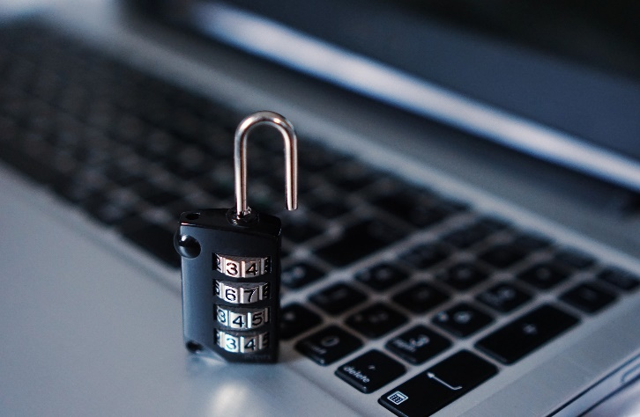
How is the data kept safe?
A password is required to access Tapestry, remember the stronger the password you set, the more secure your account is
You are linked manually to your child/children so you can only view observations for them
We don’t need to store any of the data entered onto Tapestry, they store it for us on secure cloud servers within the EU
Data is stored separately for each school
Tapestry’s developers and support personnel require our permission to access our Tapestry account
For more information about Tapestry security, you can go on their website https://tapestry.info/security.html

Slide 6
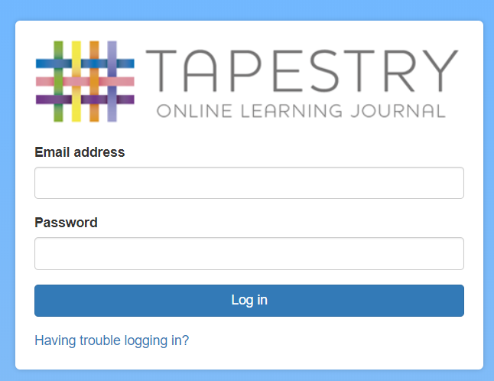
Logging in
To login to Tapestry we will need to have an email address for you.
You must complete the consent form and information form that was sent to you at the start of the year.
Once you activate your account you can then login using your email and password
You can reset your password by email if you forget it
Passwords are case sensitive
Remember to set a strong password
You can read this article for some guidance on how to set a strong and memorable password https://eyfs.info/forums/topic/47249-password-setting-advice/

Slide 7
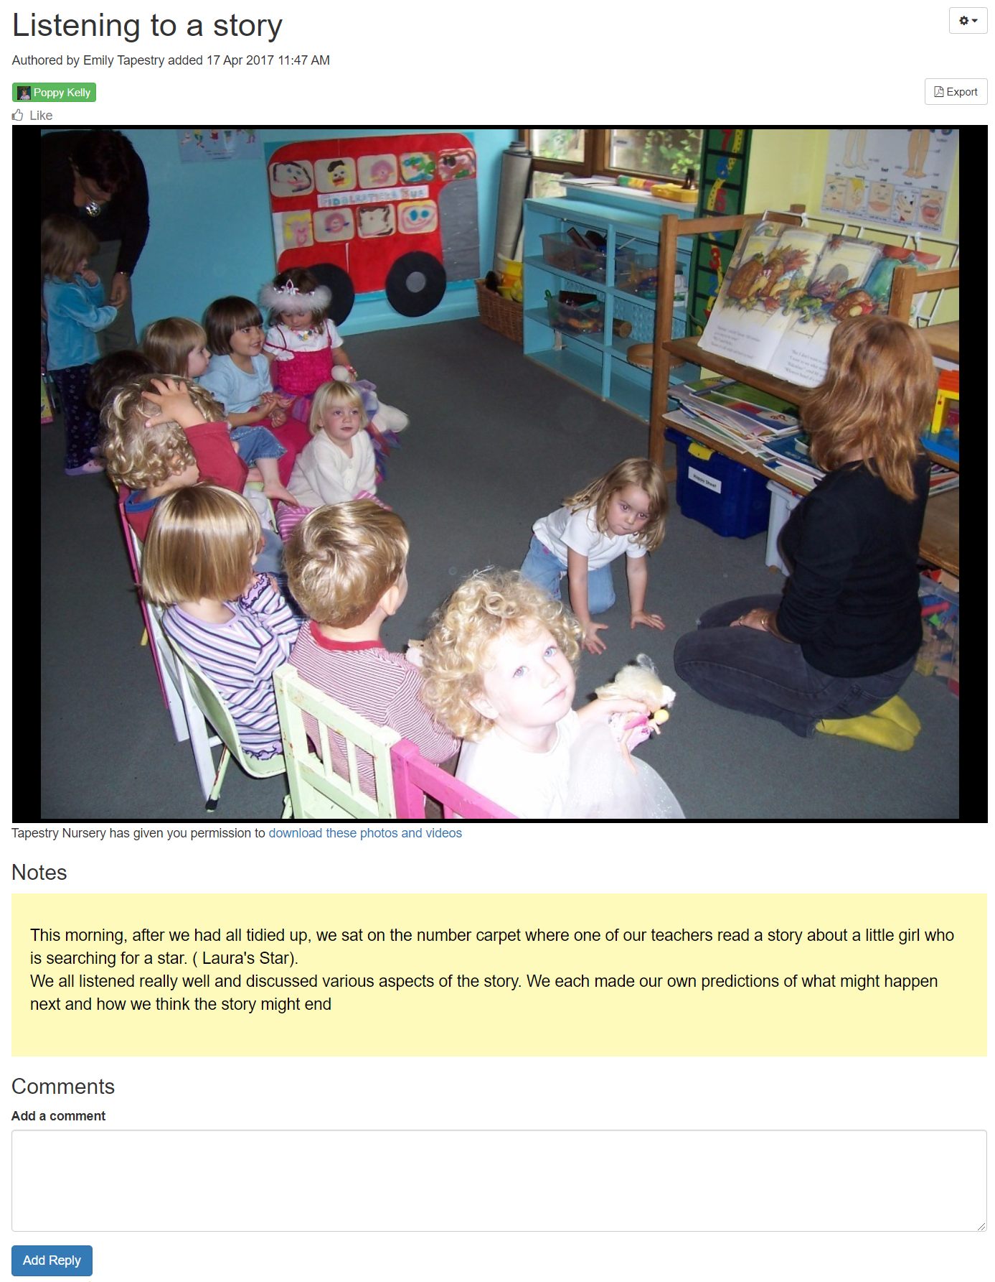
Observations
When you login to your account you will be able to see any observations for your child that have been added to their journal
You will be able to see any photos/videos/audio files/documents attached to the observation.
Underneath the media you will see the notes. This is the observation inputted by school staff. It will give a brief outline of what happened and how this links to our curriculum and assessment.
You will also be able to add comments and like the observation
You can also add your own observations

Slide 8
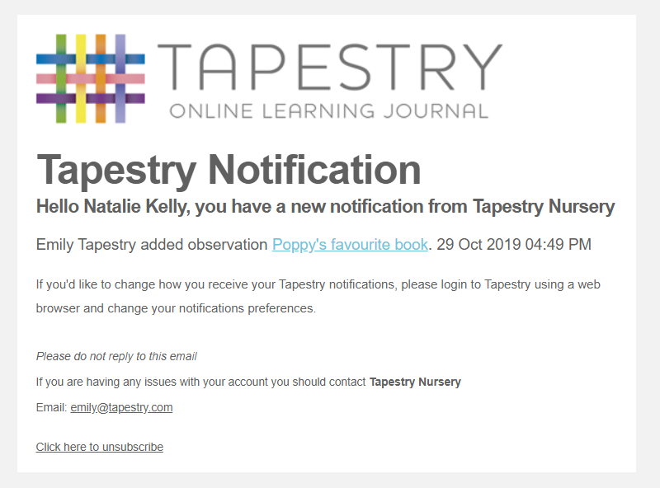
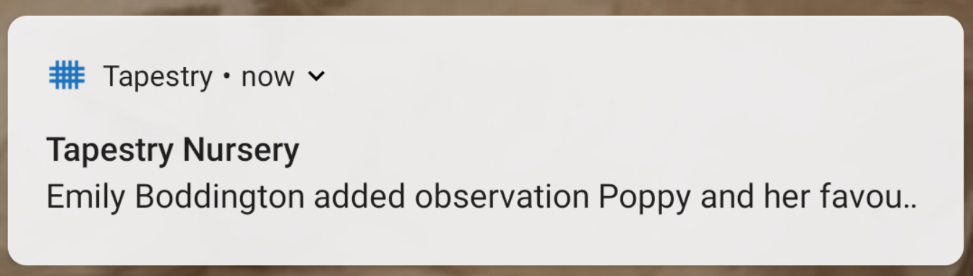
Notifications
If you would like to receive notifications it’s possible to receive email notifications immediately, daily or weekly
There are different notifications for things like new observations and observation comments

Slide 9

Other communication
Tapestry will not be used to communicate daily or weekly information
We will continue to use our whole school communication app ‘My Child at School’ (Bromcom)
Please ensure you always send messages intended for teachers/ school staff via the ‘My Child at School’ app/ admin email address (not via Tapestry)

Slide 10
When will we get started?
You will receive an introductory letter and consent forms. This will enable you to grant your permission and provide an email address. Please note that it’s not possible for parents to both be set up using the same email address.
We have shared user guides on our school website for further assistance.
We should have your account created within a week, and you will receive a link to set a password for yourself, remember to check your spam/junk folders for this
If you have any questions, please contact the school office.

