Slide 1

Citizens’ Bond Oversight Committee –
Annual Report
November 17, 2022
August 17, 2023

Slide 2
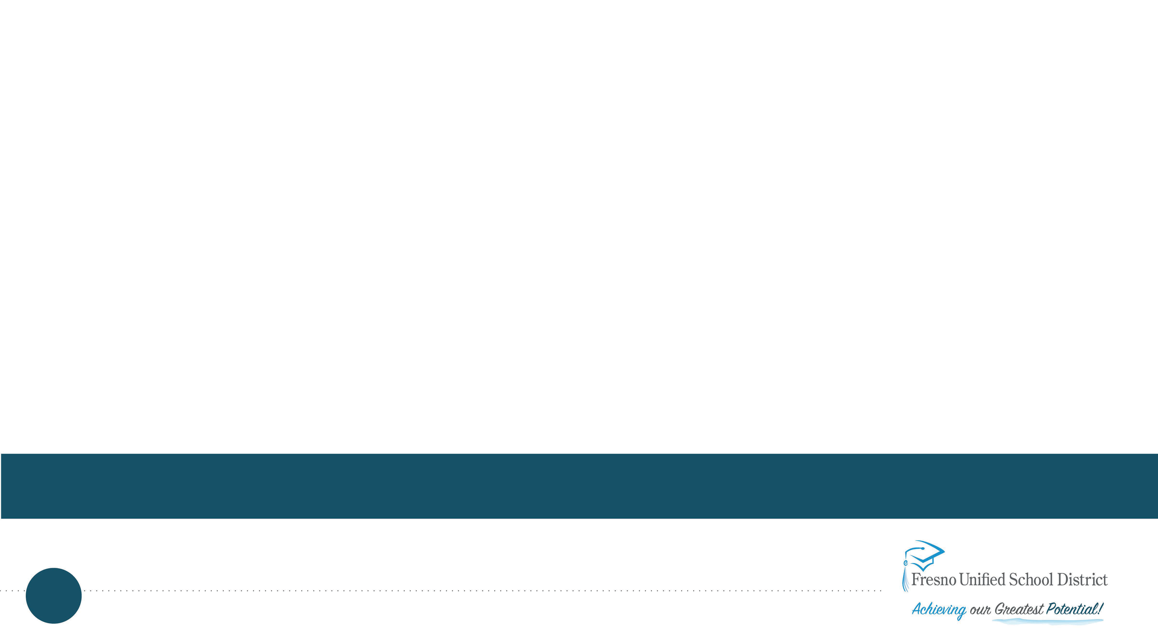


Major Construction and Modernization Projects

Slide 3
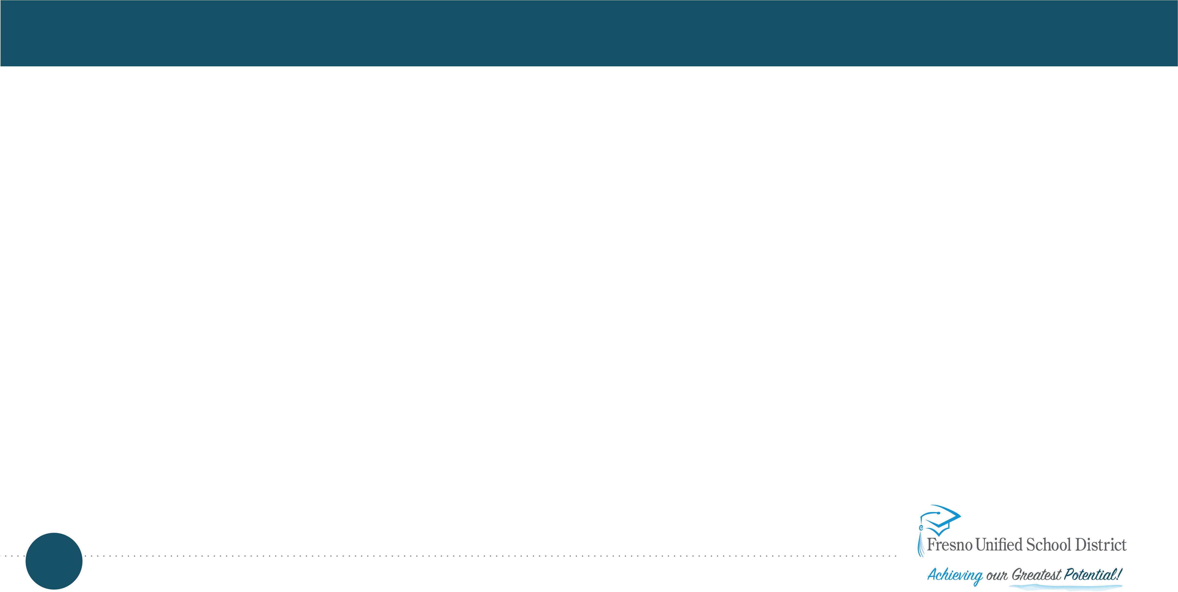
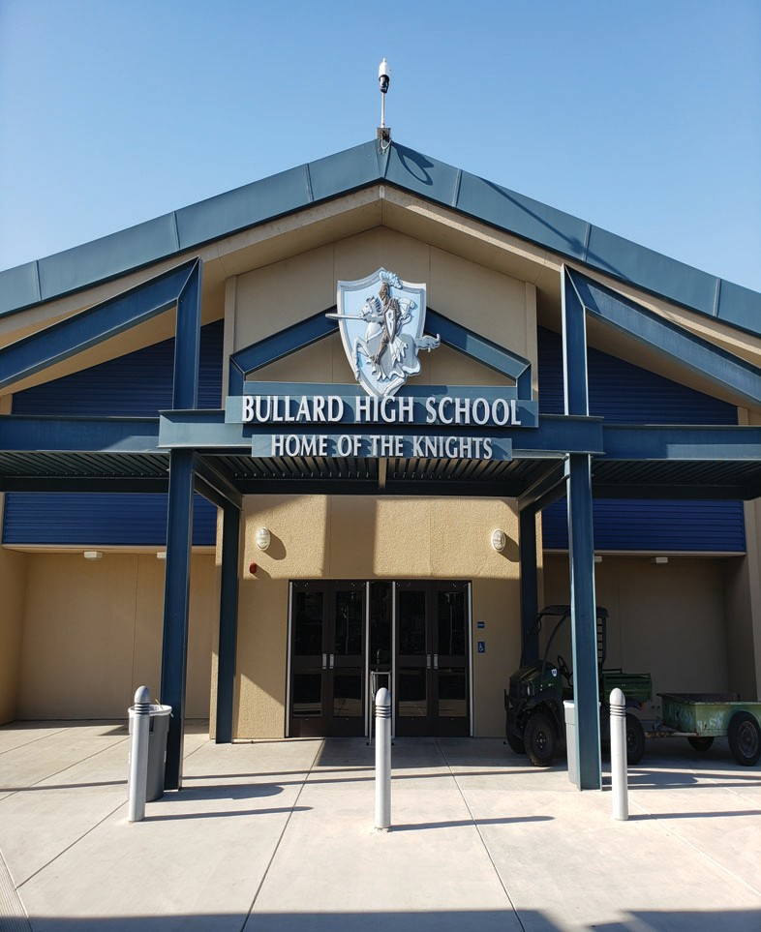
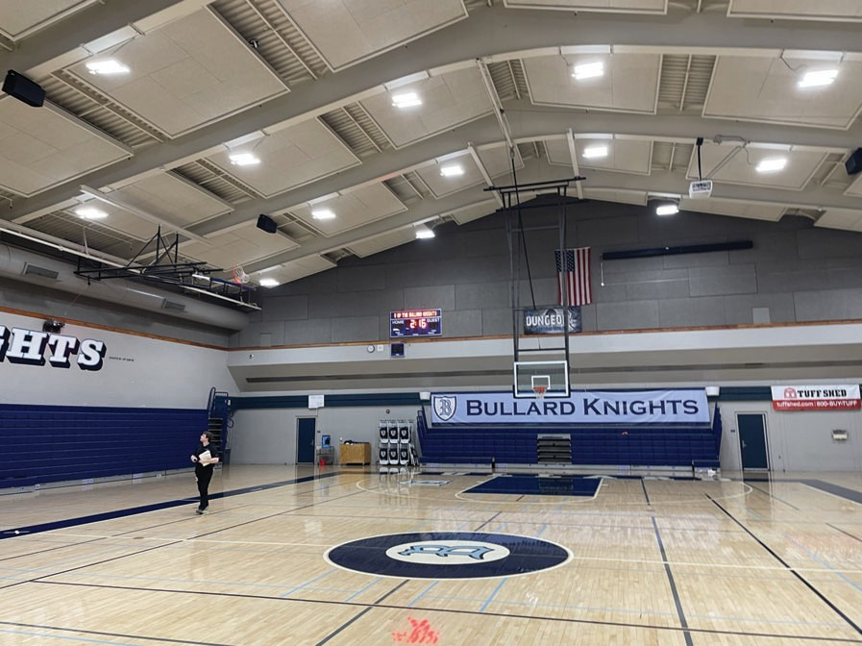
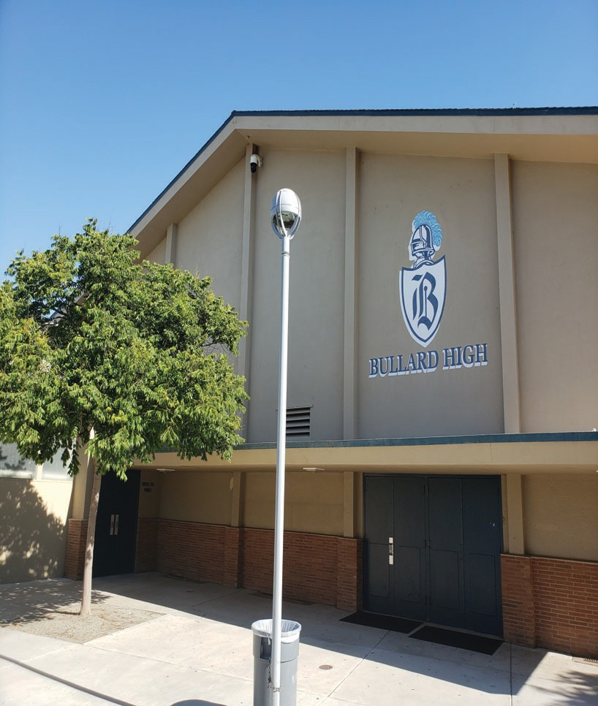
Bullard High School – HVAC for Gyms
5445 N. Palm Ave.
The North gym will have the existing evaporative coolers removed and will add a new air handler and chiller to condition the space
The South Gym will get an all-new system which will provide conditioning to the gym.
Completion targeted for end of year 2024

Slide 4
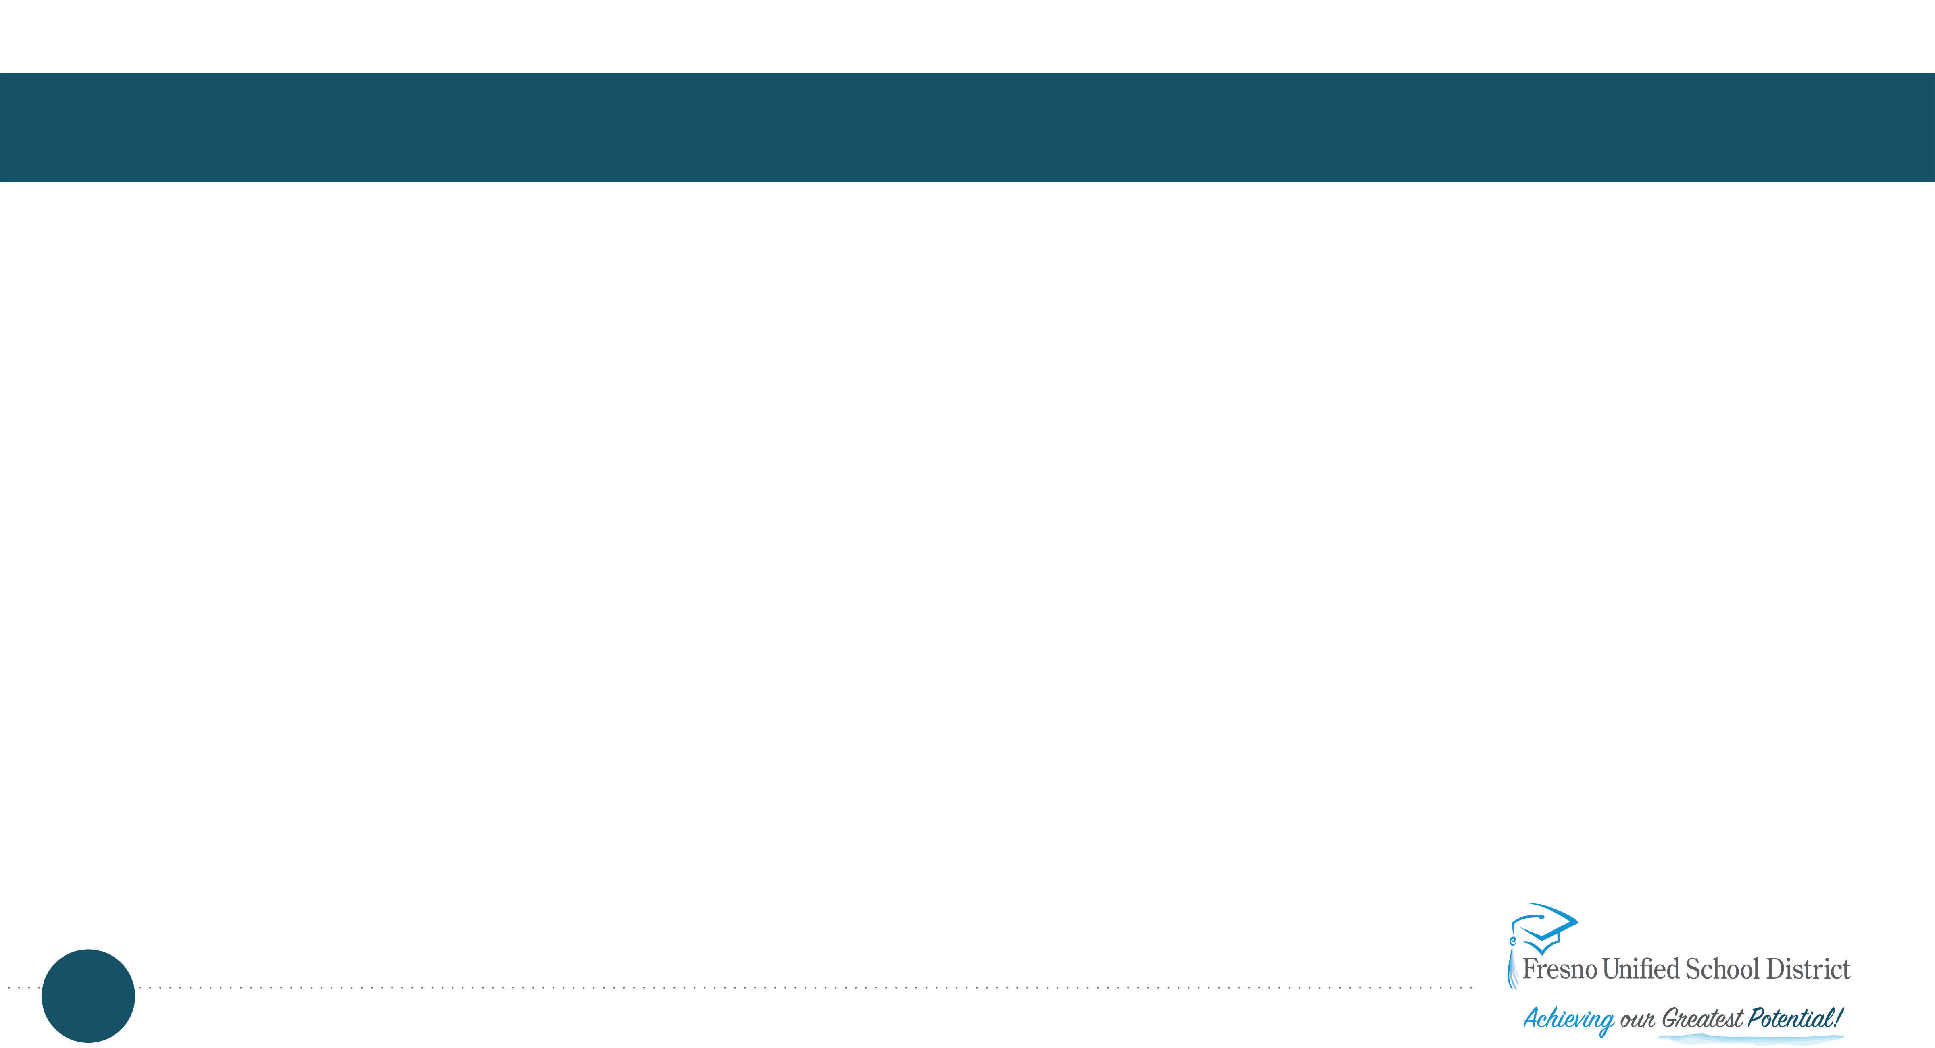
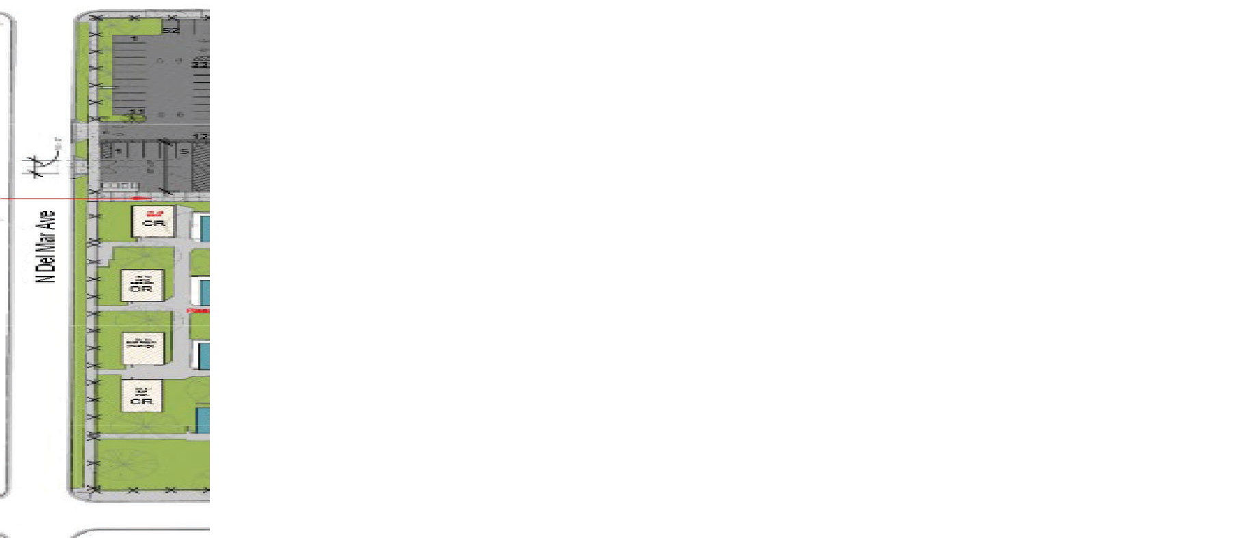
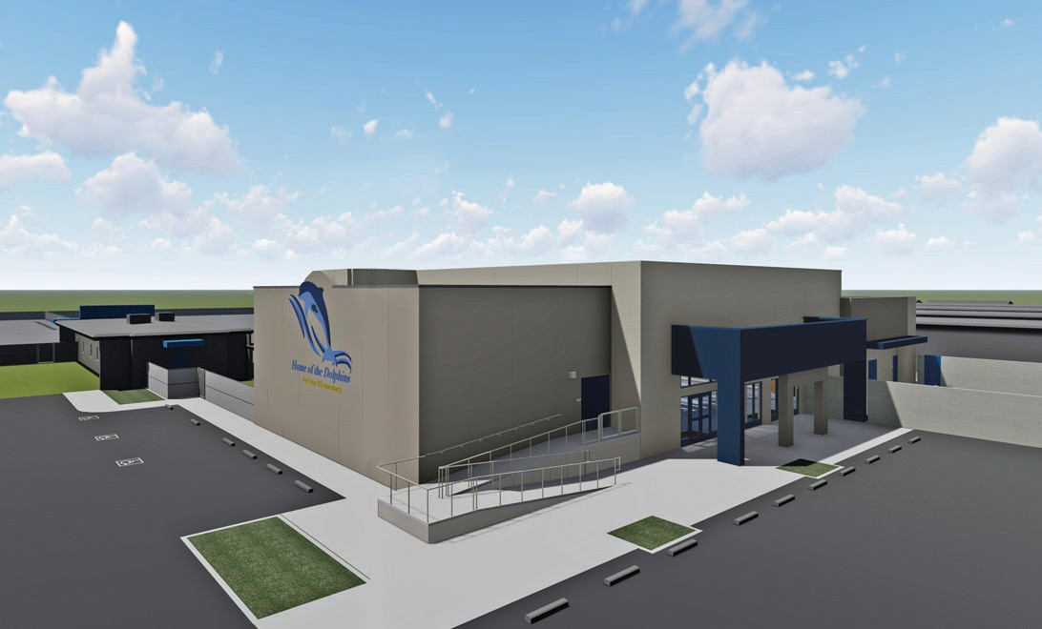
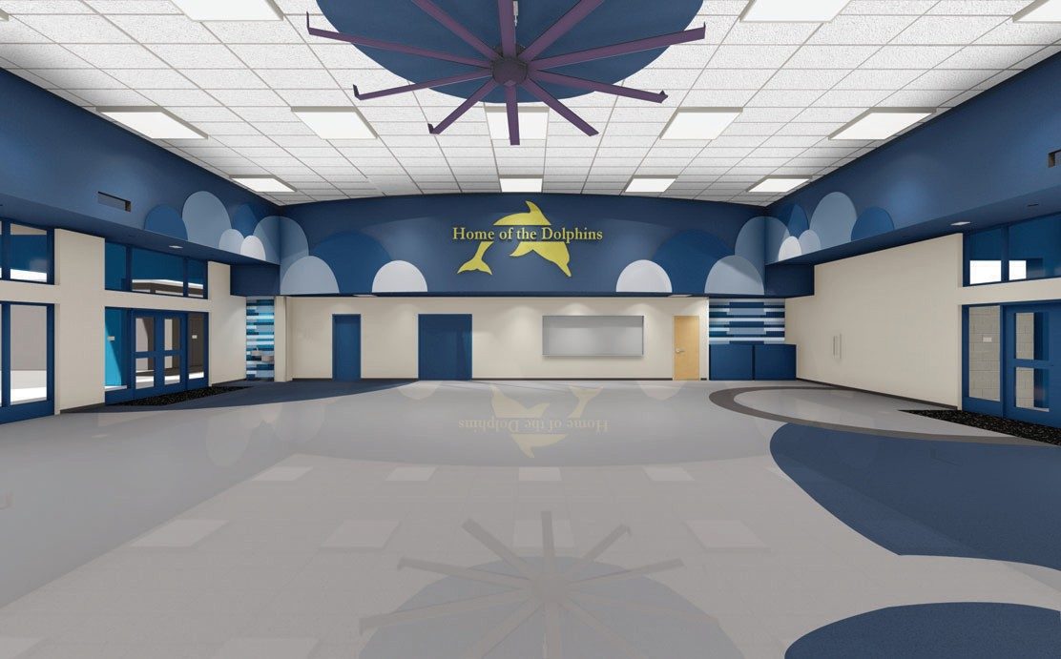
Del Mar Elementary – New Multi-Purpose Building
4122 N. Del Mar Ave.
New MPR square footage 11,613 which includes:
Stage with Music Storage
Staff Lounge
Boys and Girls restrooms
Measure M Funded
Completion Targeted for Fall 2024

Slide 5
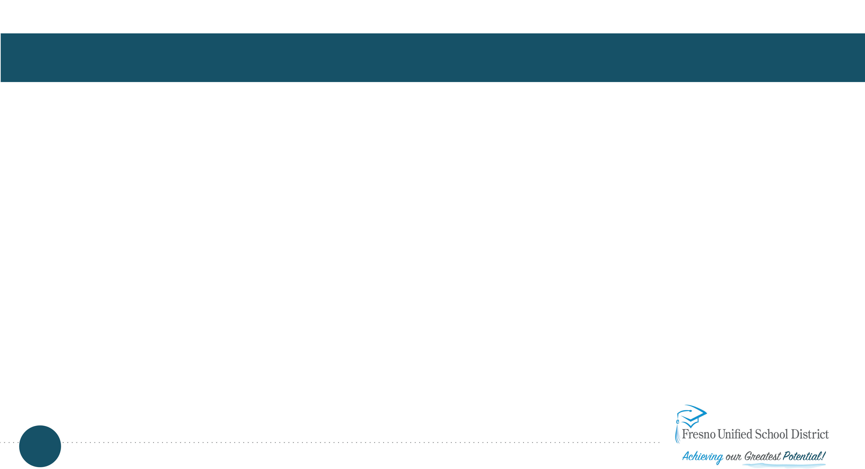
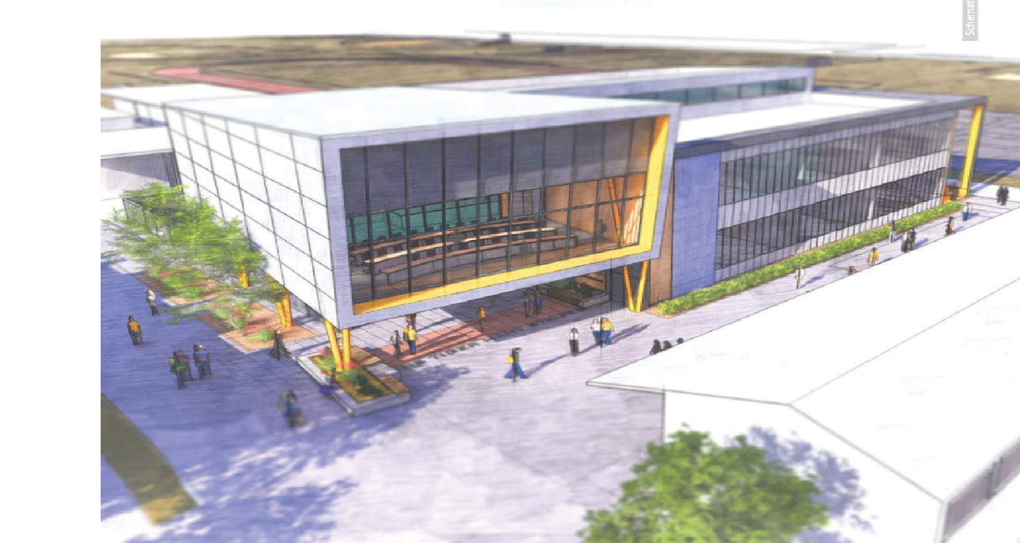
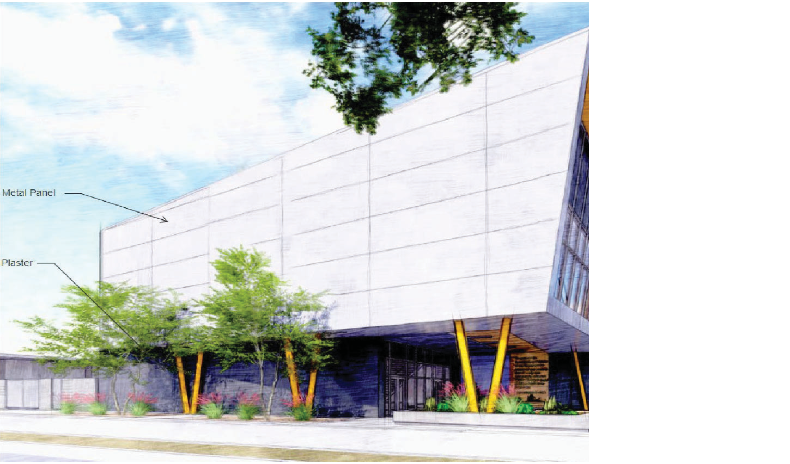
Edison High School – New CTE Building and Interim Housing
540 E. California Ave
31,211 square feet
The new CTE building will provide Edison HS with 13 modern classrooms to support current and future teaching strategies.
CTE pathways - biomedicine/kinesiology, engineering design and development, green energy, and computer science
Completion targeted for summer of 2024

Slide 6


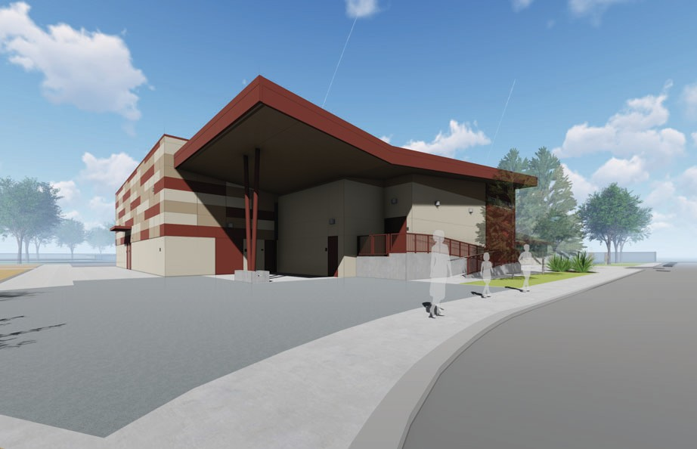
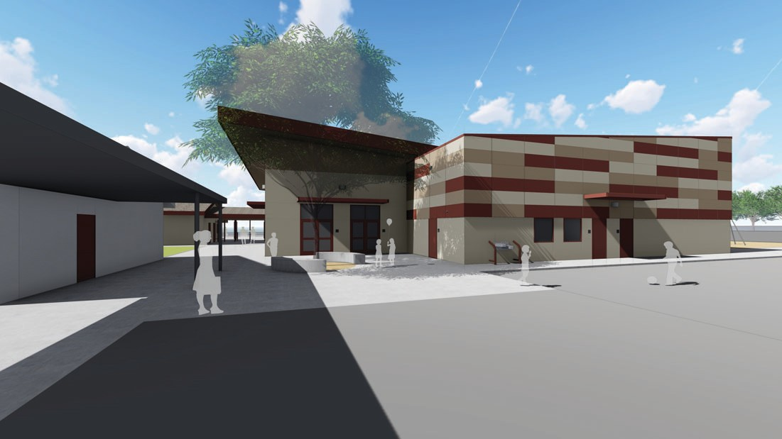
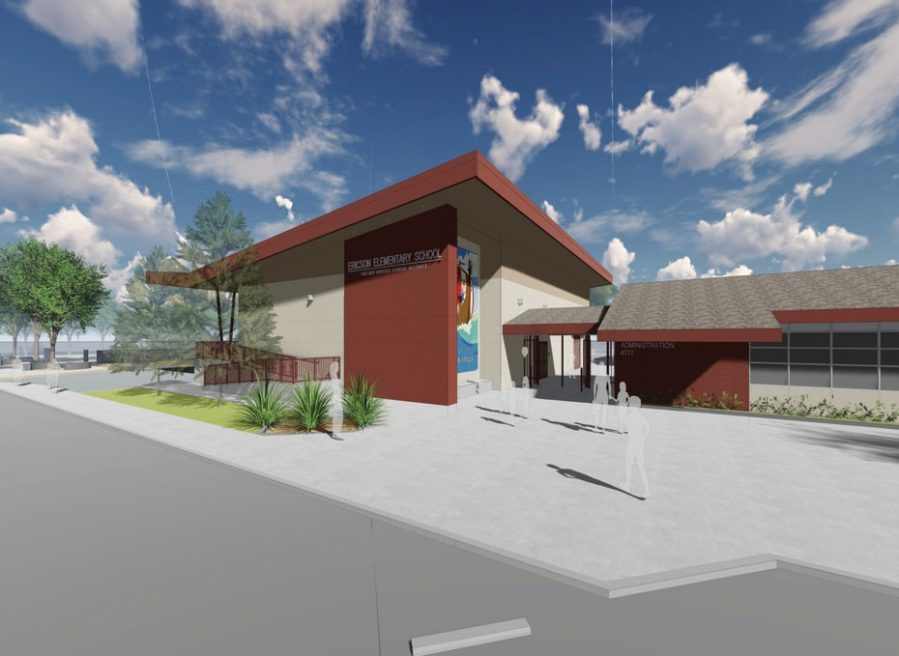
Ericson Elementary – New Multi-Purpose Building
4777 E. Yale Ave.
New MPR square footage 11,436 s.f which includes:
Stage with Music Storage
Staff Lounge / Parent Room
Boys and Girls restrooms
Measure M Funded
Anticipated completion Fall 2024

Slide 7
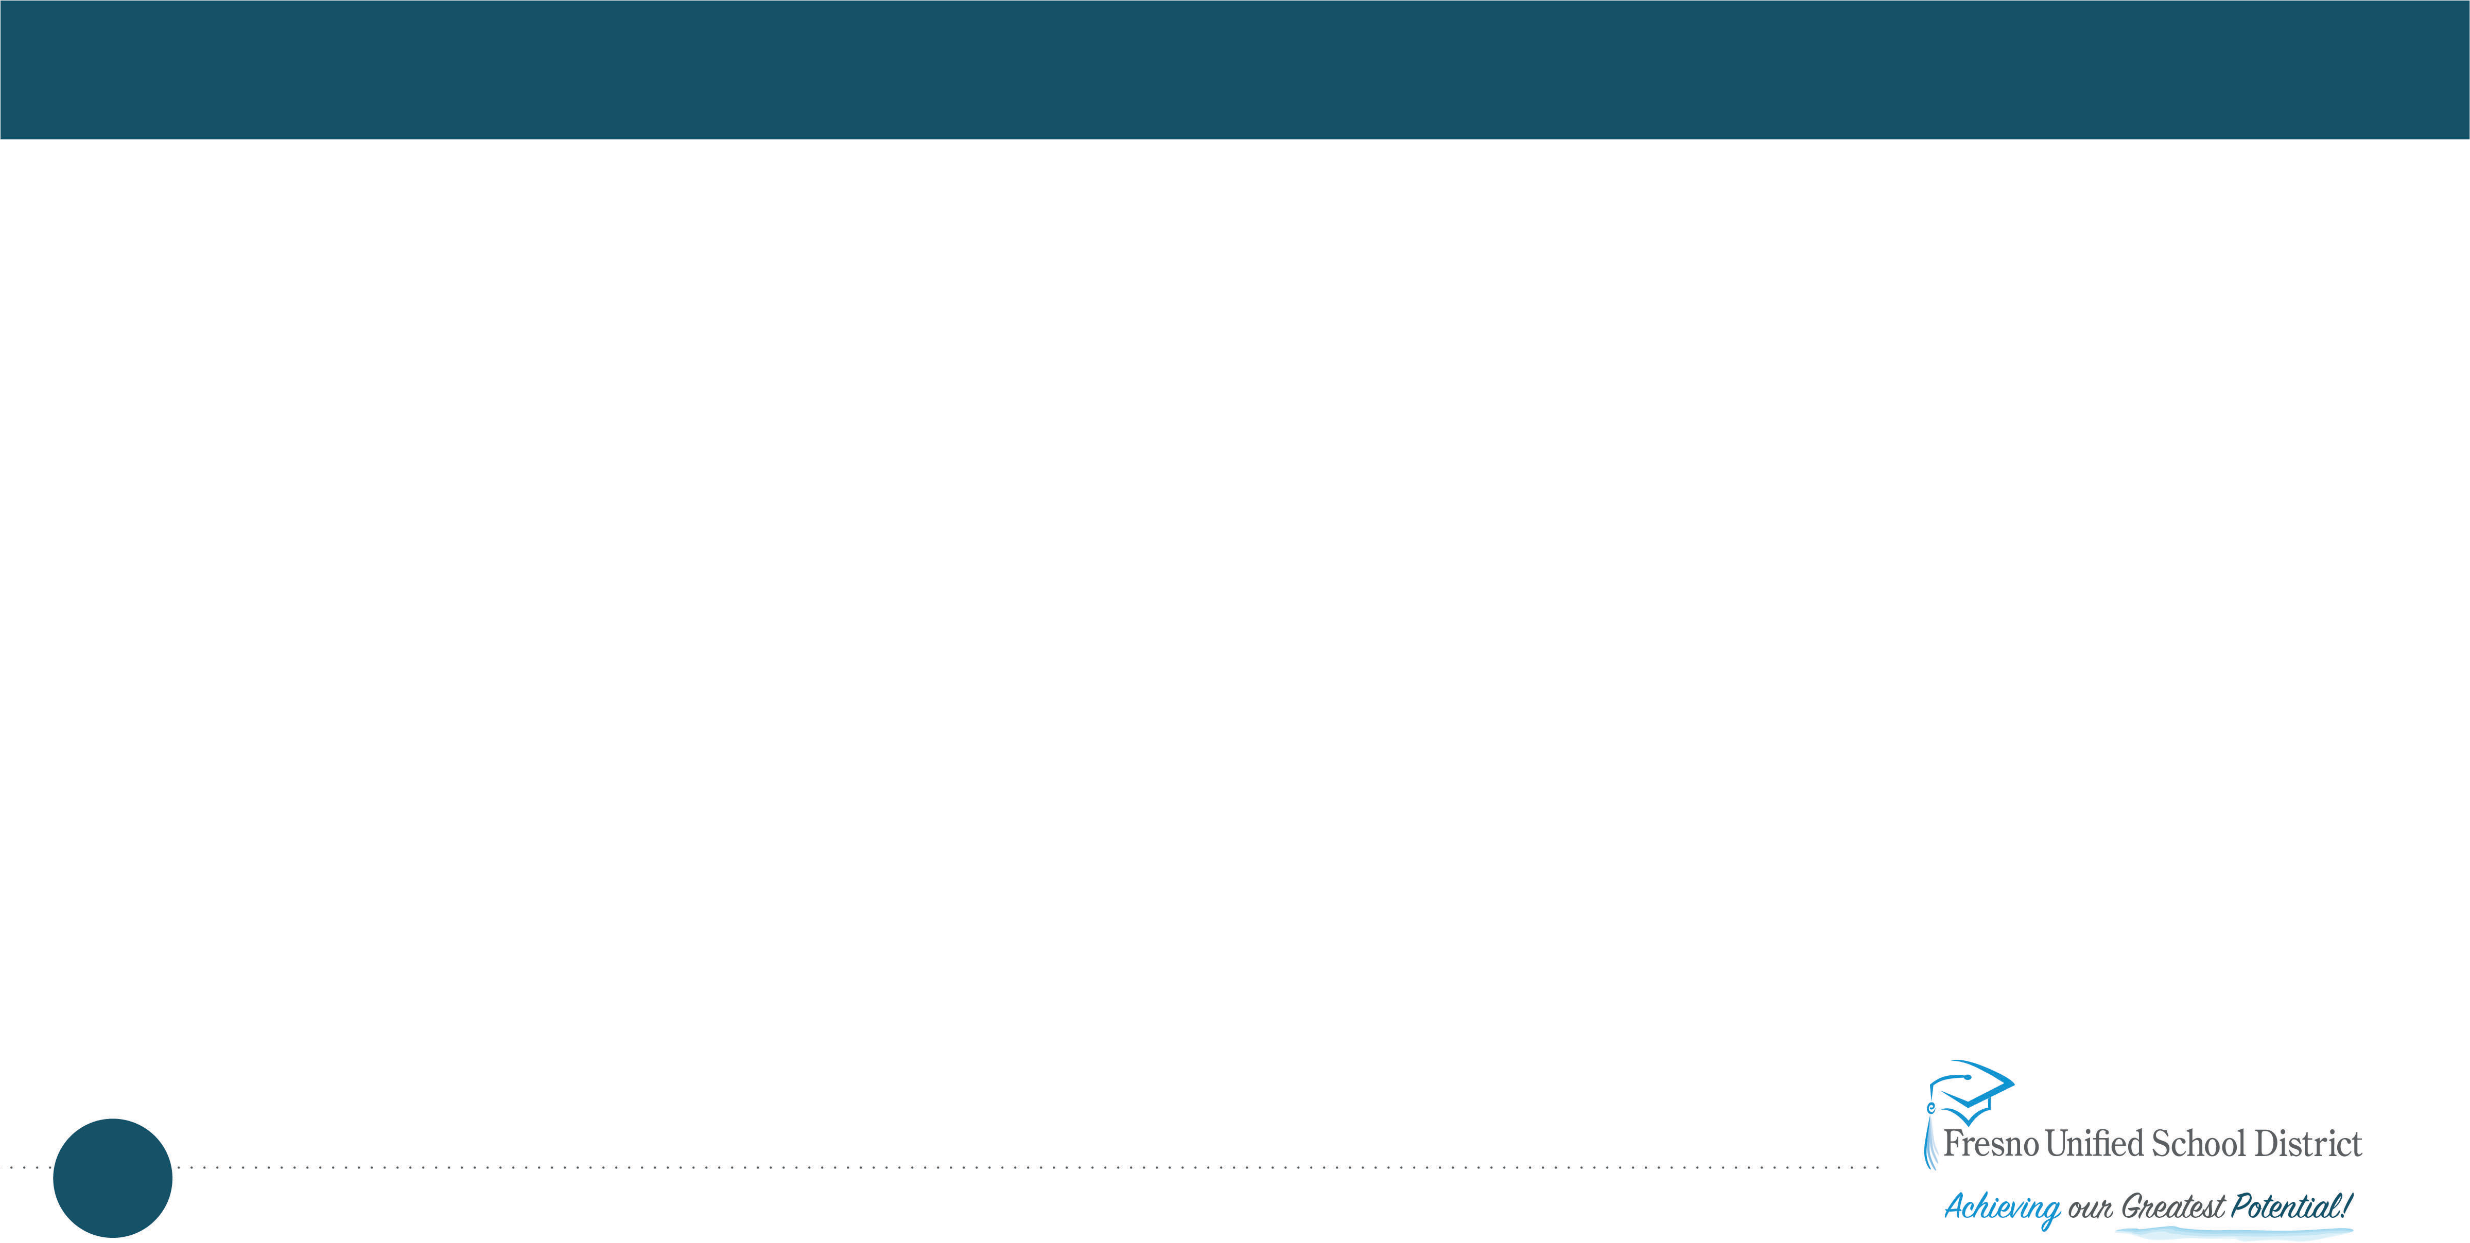
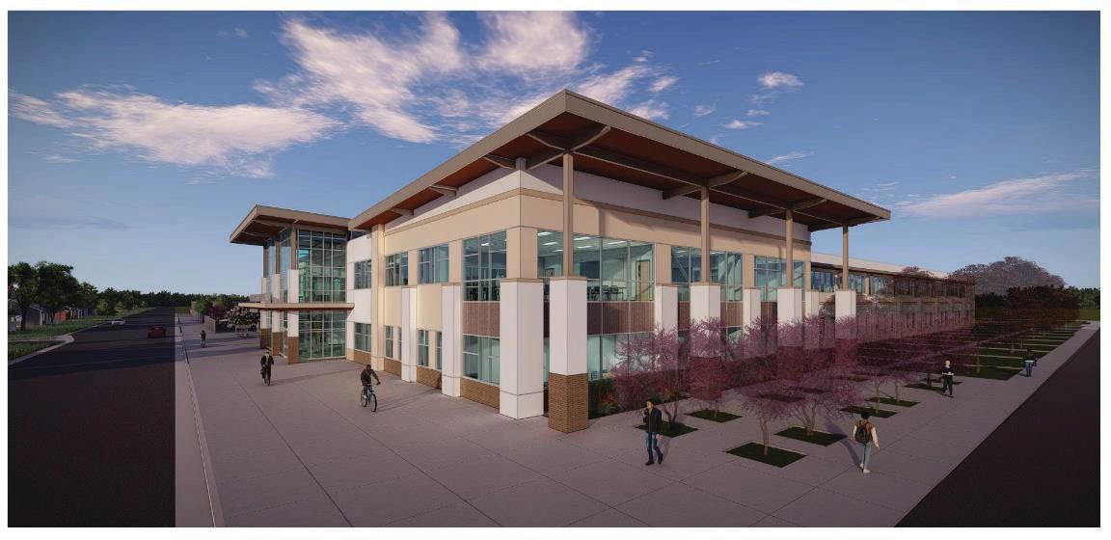
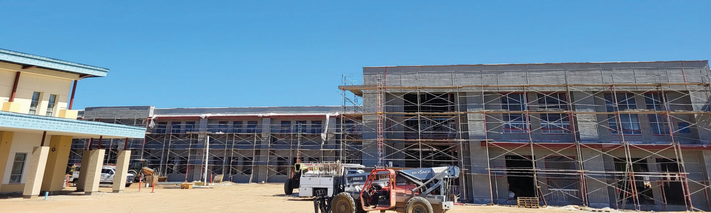
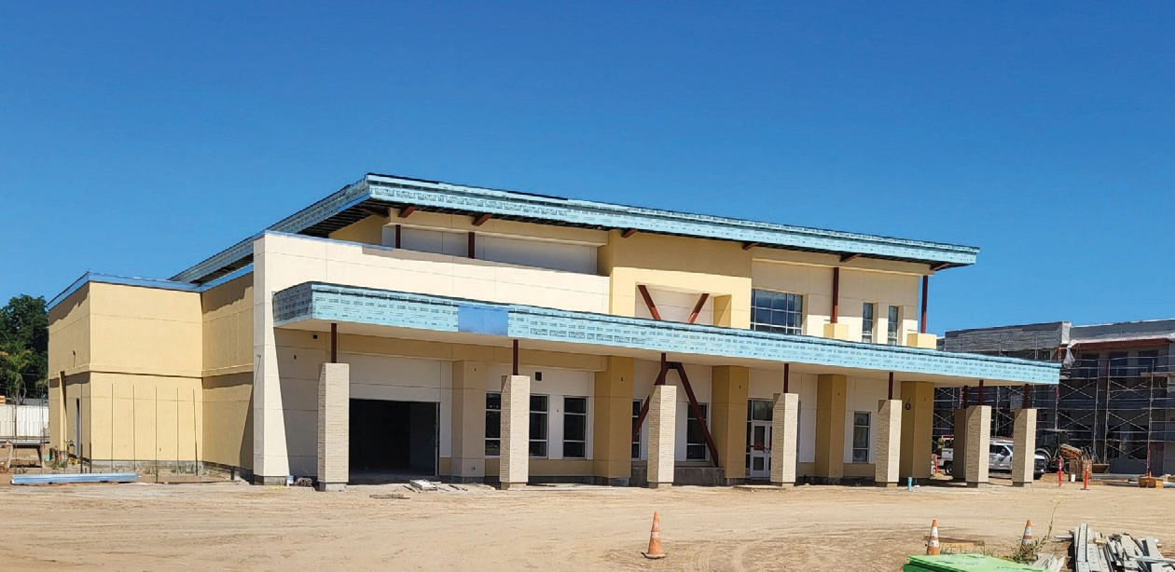
Francine and Murray Farber Educational Campus at Ventura and Tenth
Campus to be built on northerly part of the 12.8-acre site
Will bring together existing programs: JE Young, Cambridge, eLearn Academy, and Educational Resource Center
A two-story building and separate CTE/multipurpose building will include 32 Classrooms, 3 CTE work rooms, office space, parent engagement spaces, multi-purpose room/cafeteria, and Learning Lab spaces for early learning program
Board award recommendation February 16, 2022
Completion targeted for spring 2024

Slide 8
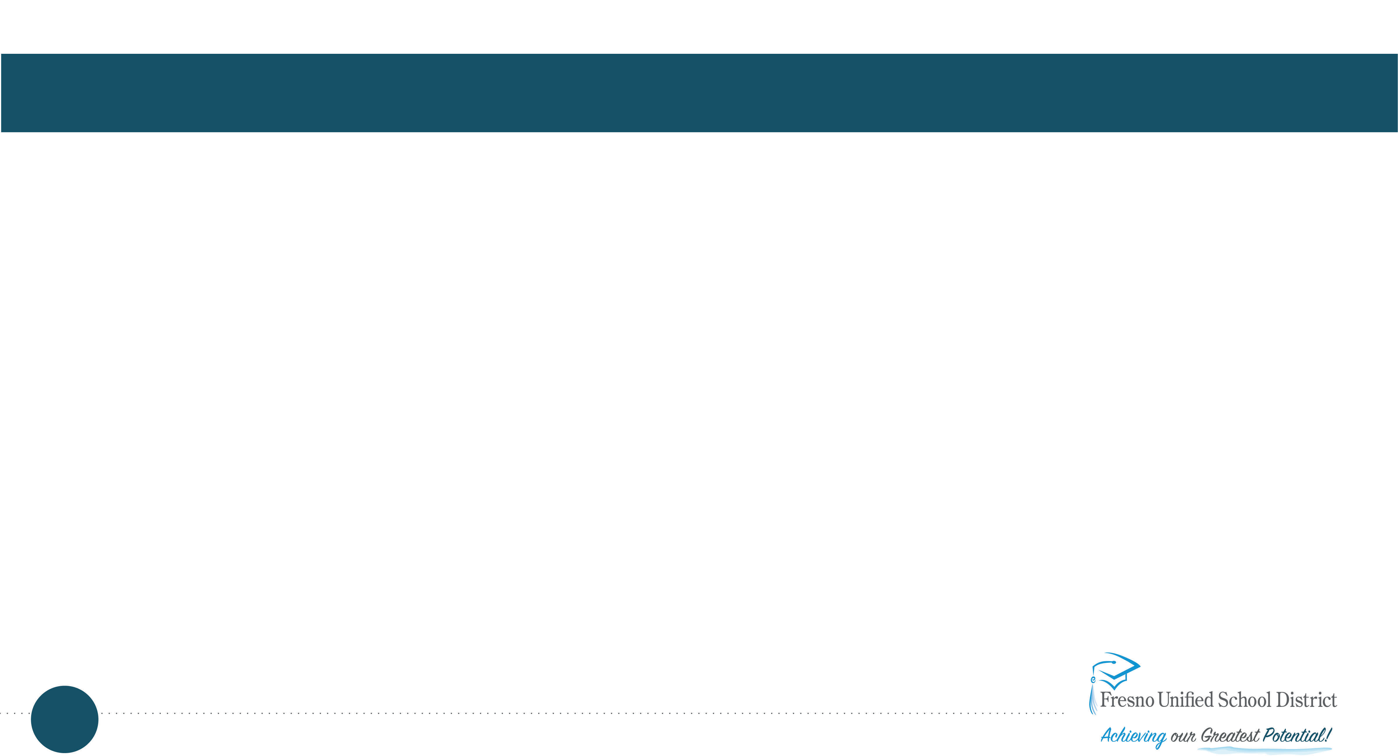
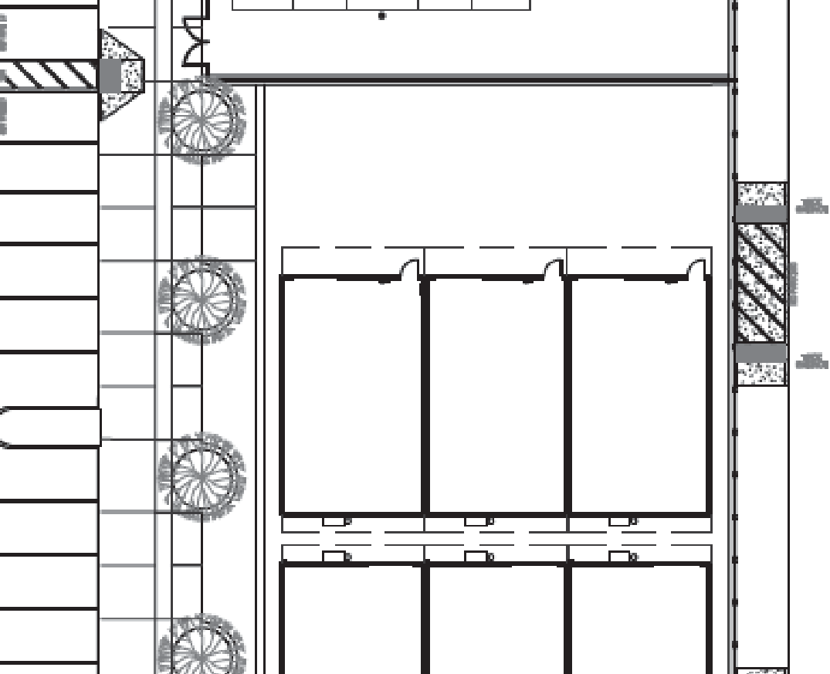
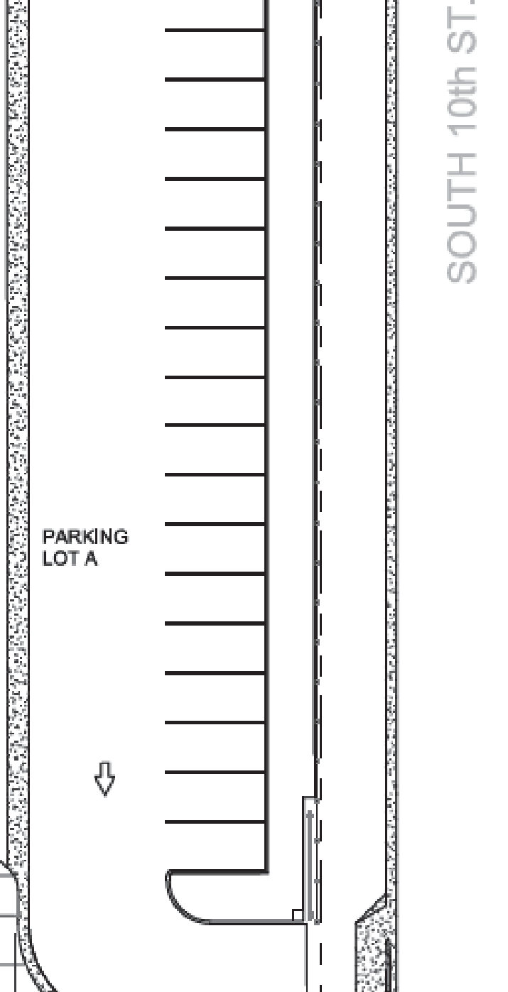
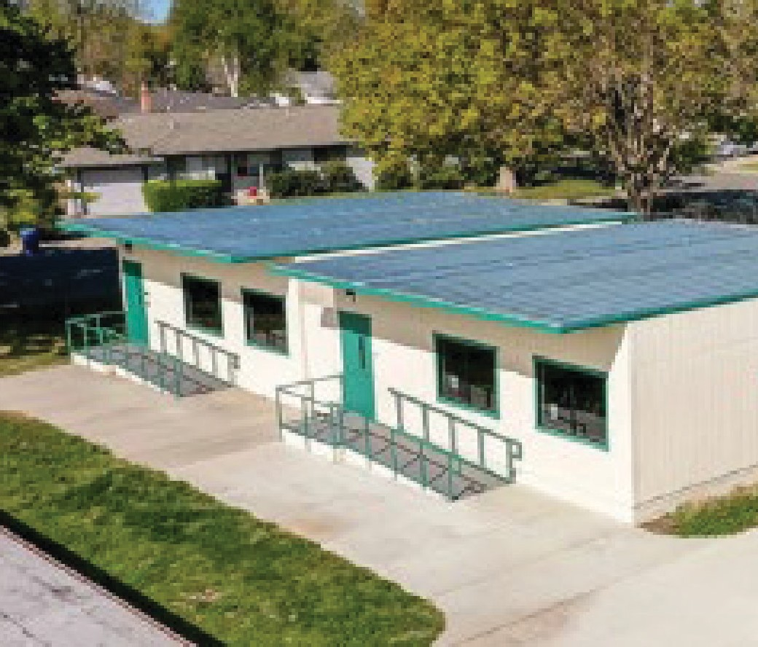
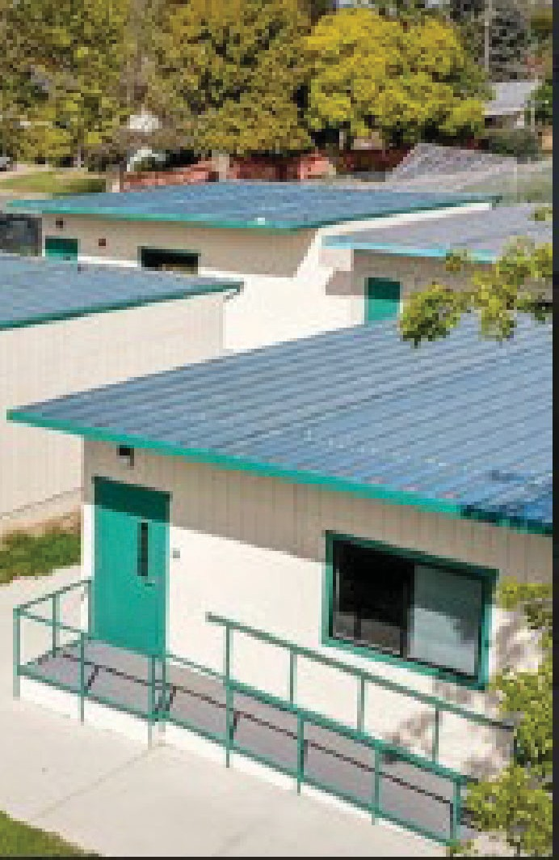
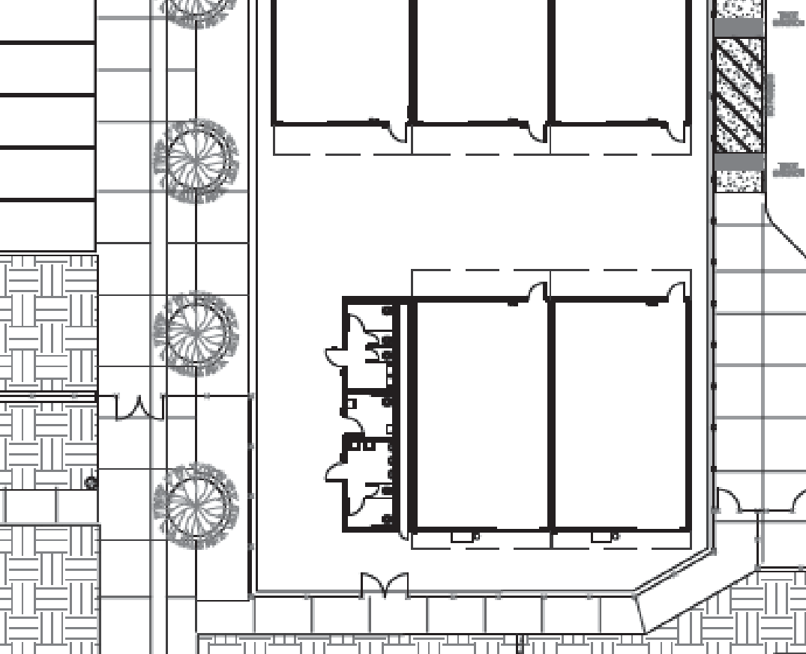
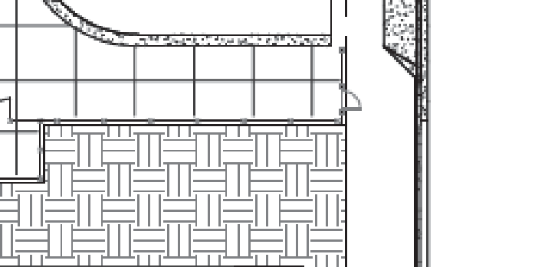

Farber Educational Center- Huerta Early Learning Portables
720 South Tenth Street at Ventura Avenue
Portables will provide interim housing for the remainder of the E-learn program that is slated to relocate to the new Farber Education Center.

Slide 9
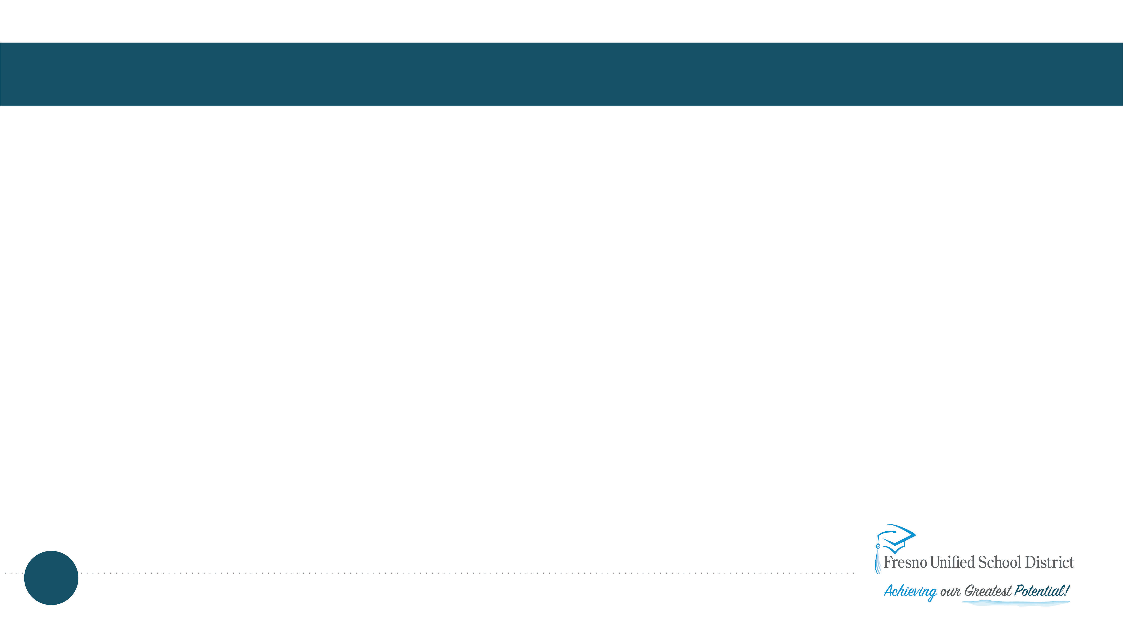
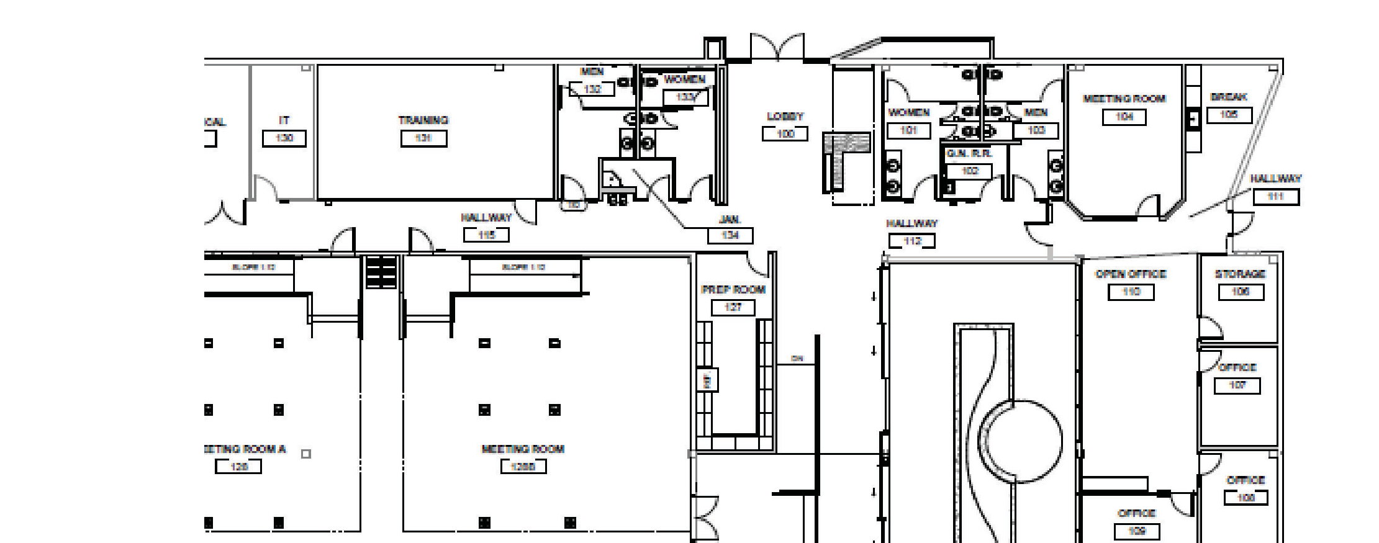
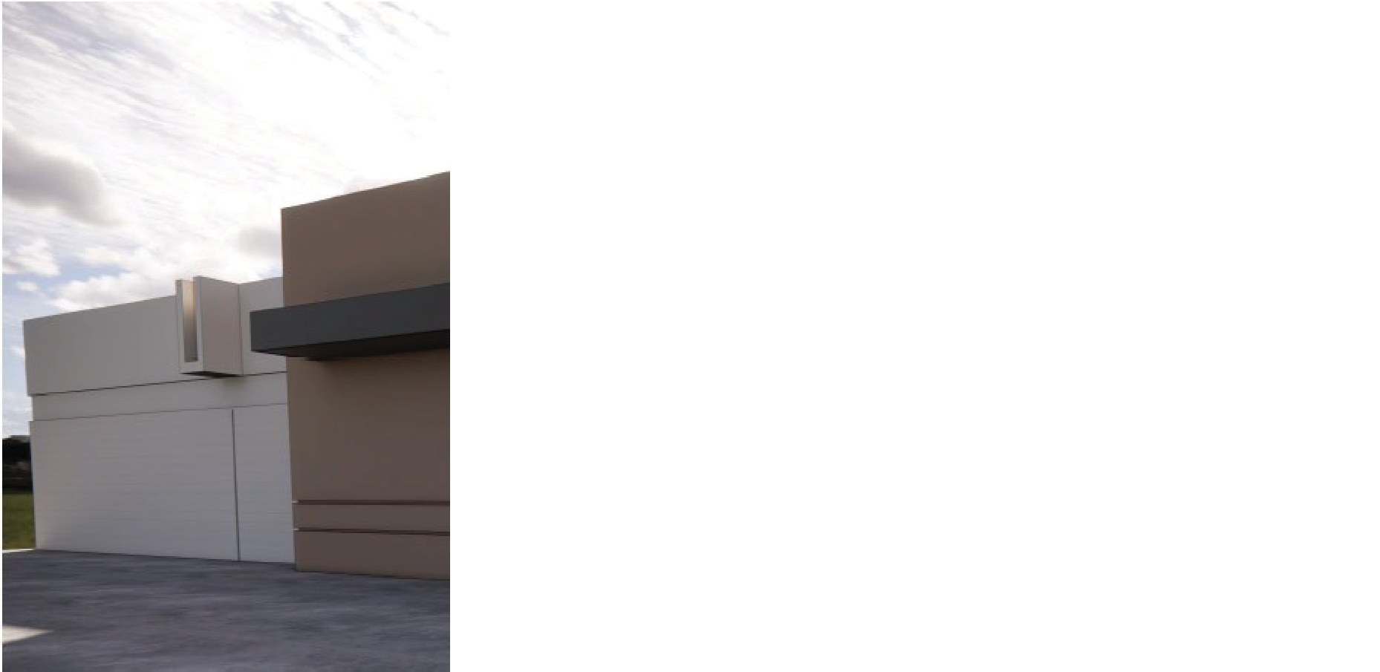
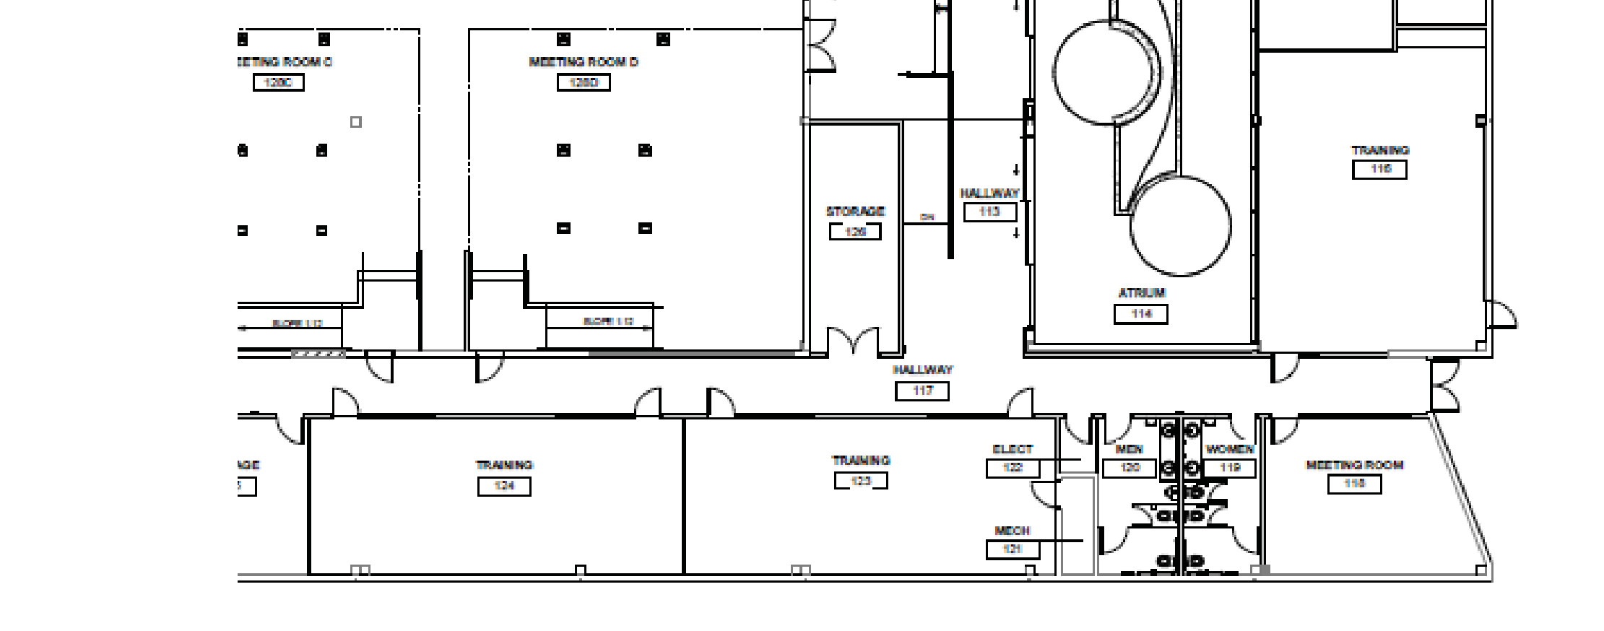
Farber South Building A- Professional Training Center Modernization
890 South Tenth Street, Building A
Anticipated Start: December 2023
Anticipated Completion: Fall 2024
Square Footage: Approximately 21,140
Create large conference room to support large training events, will include integrated audio/visual system to serve all training rooms and a prep room to support dining service

Slide 10
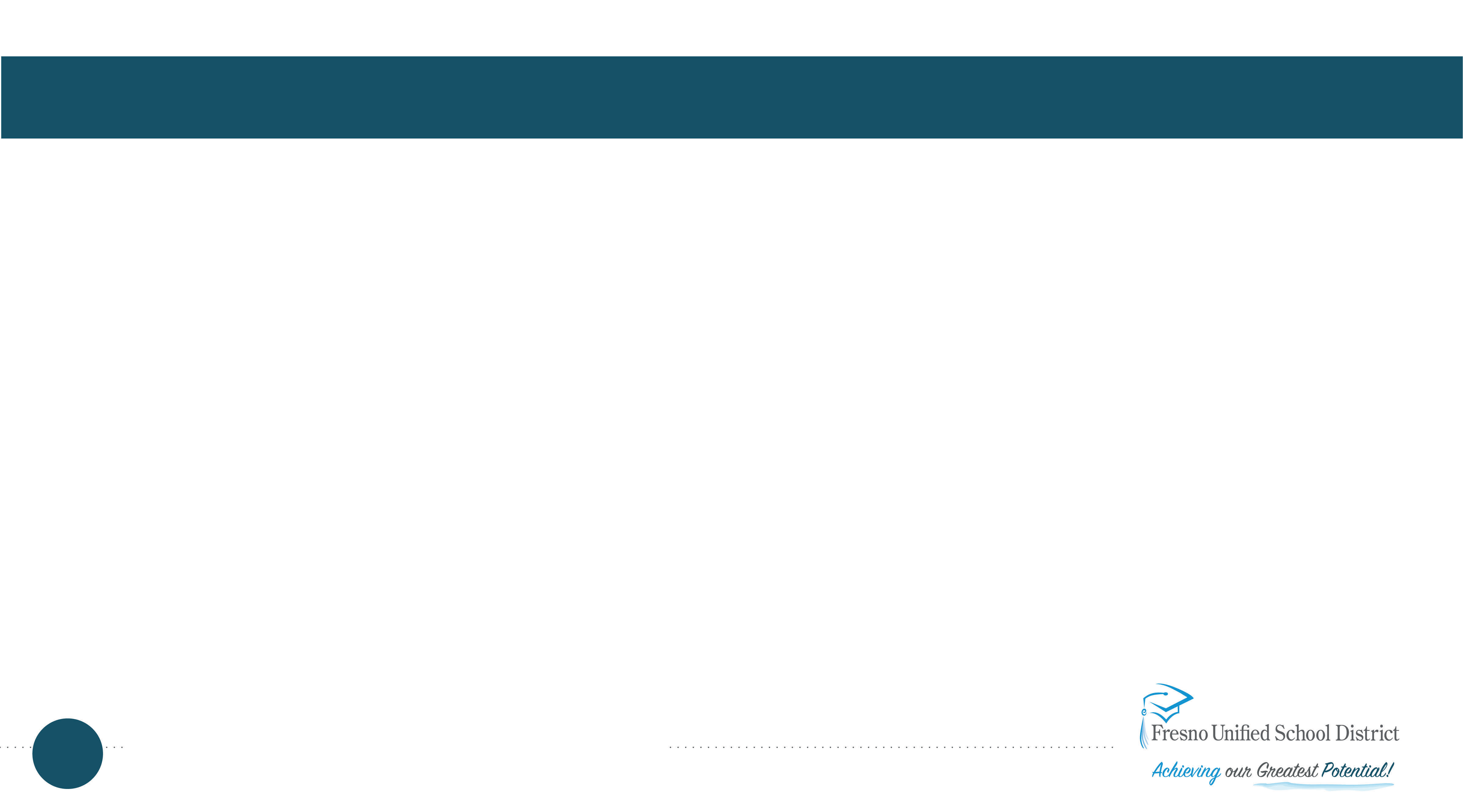
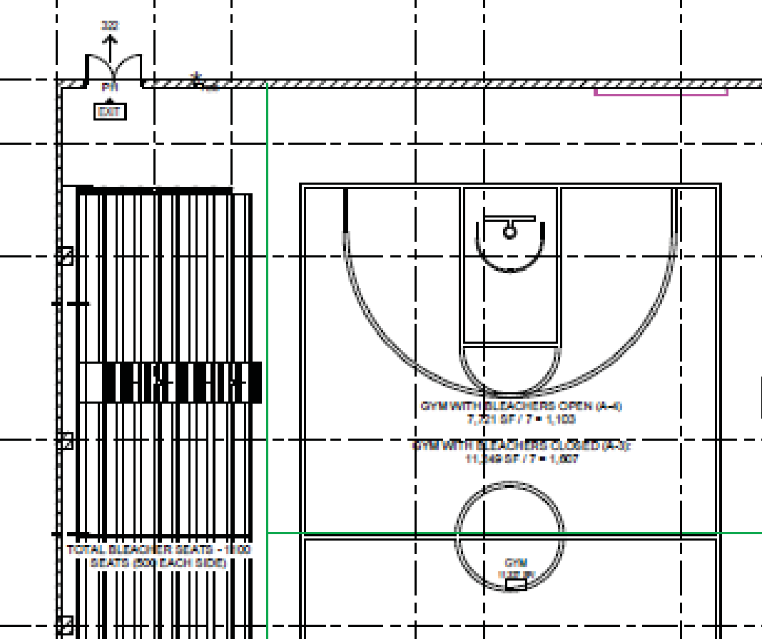
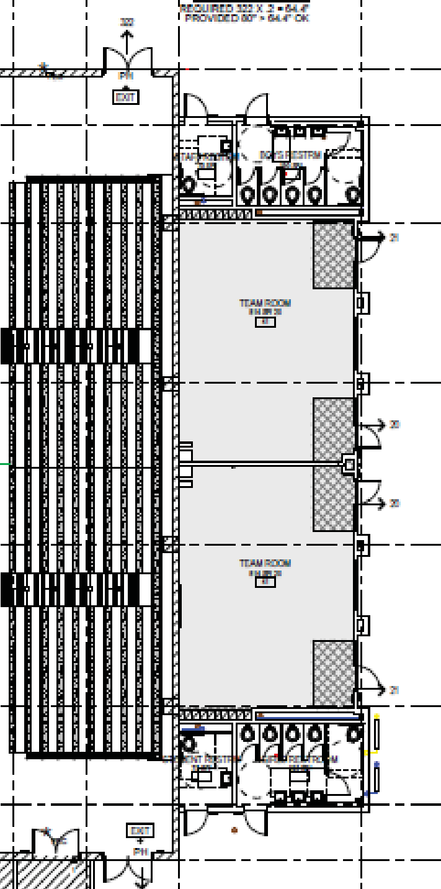
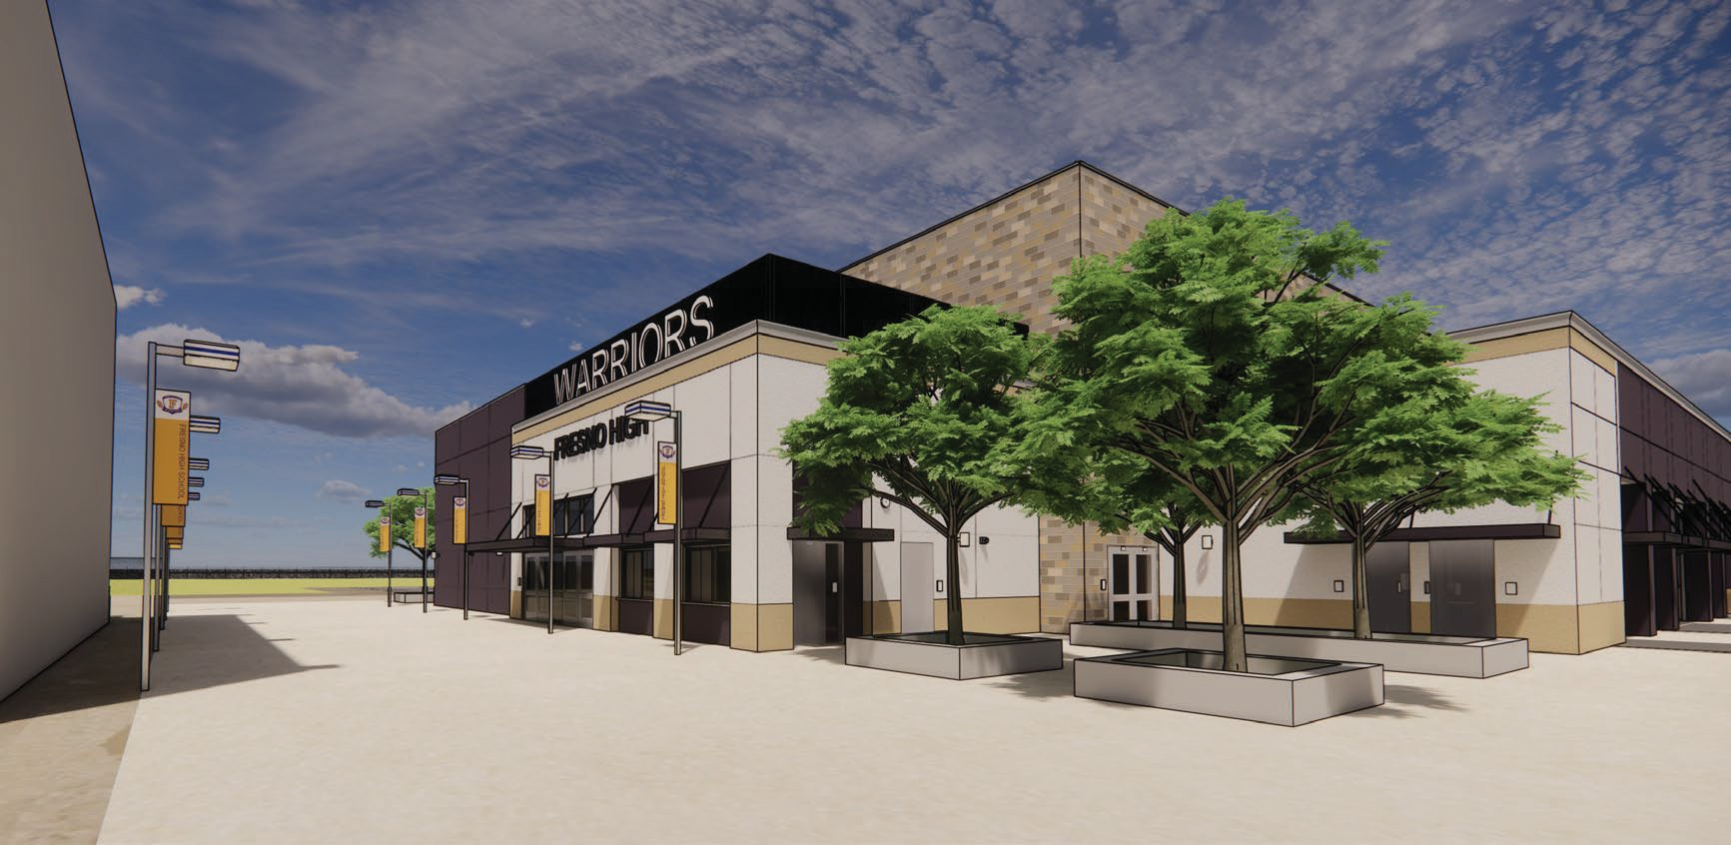
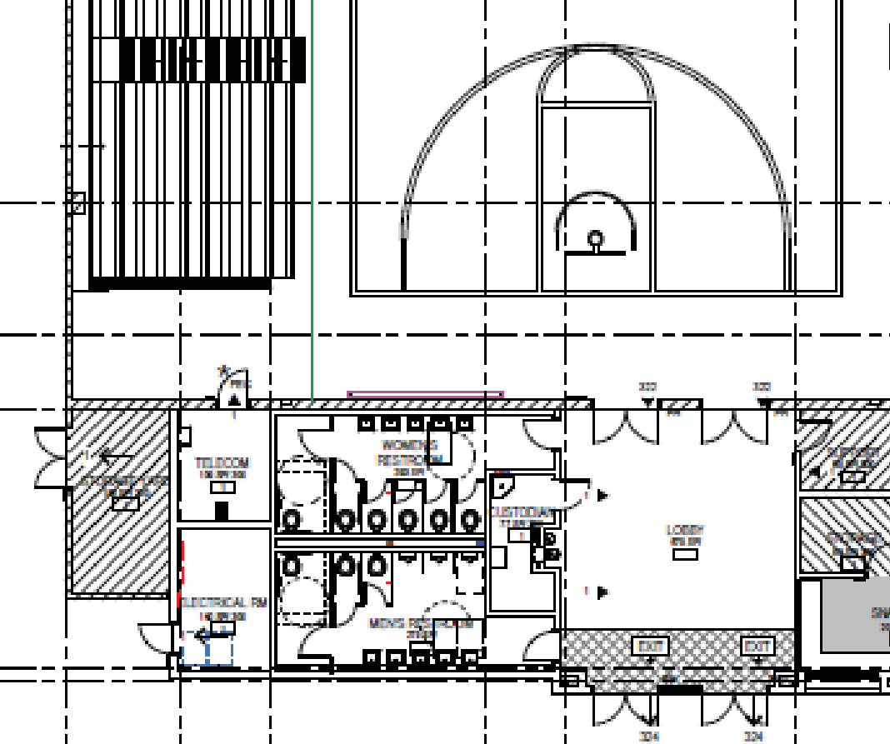
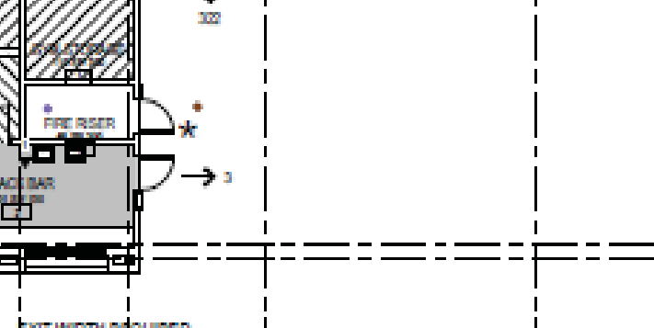
Fresno High School- Auxiliary Gym and Tennis Courts
1839 North Echo Avenue at McKinley Ave
New auxiliary gym will provide student support spaces, gender inclusive restrooms.
Two additional tennis courts will enable Fresno High School to host CIF tournaments.
Completion targeted for summer 2025

Slide 11
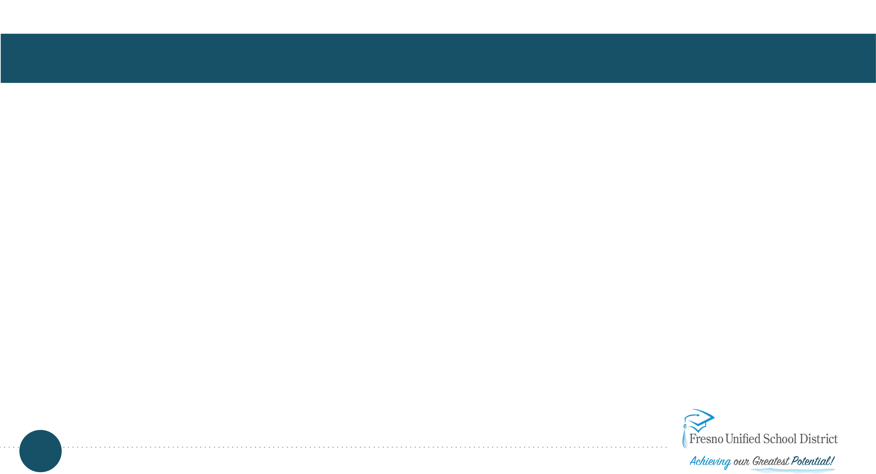
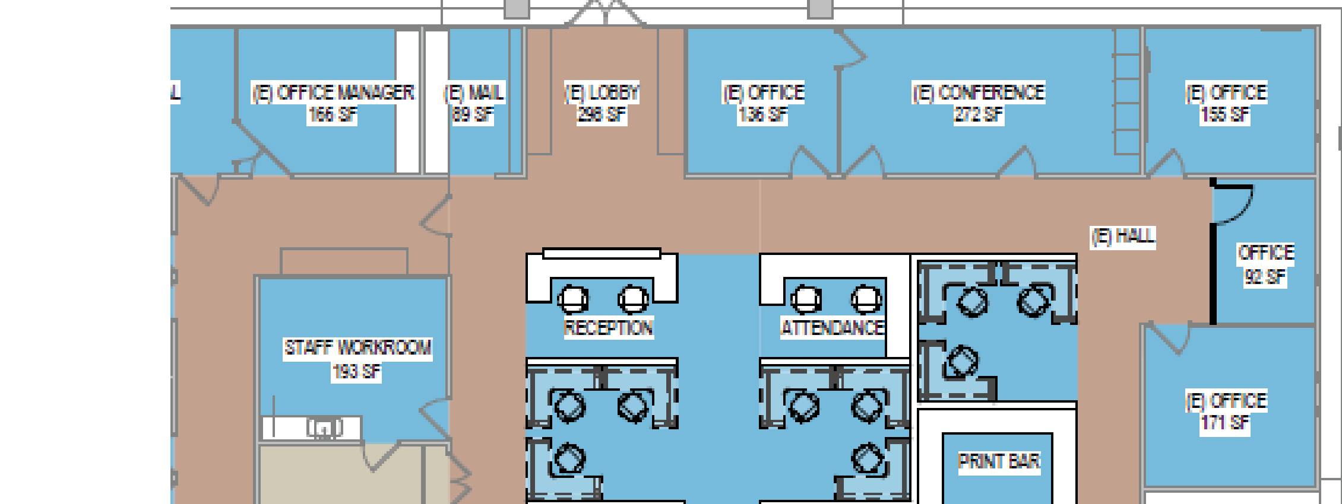
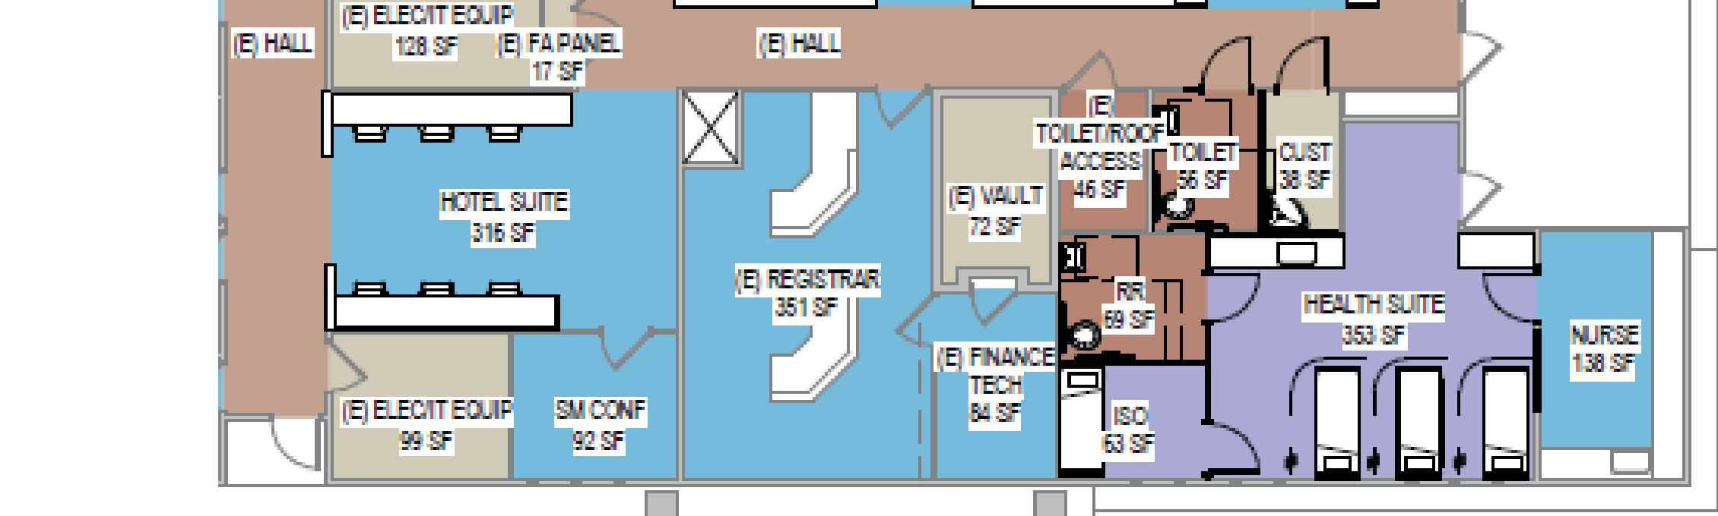
Roosevelt High School – Administration Building Modernization
4250 East Tulare Street at Cedar
Modernization will include paint and carpet, creating a few new offices
The health suite will also be upgraded as part of the modernization.
Completion targeted for fall of 2024

Slide 12
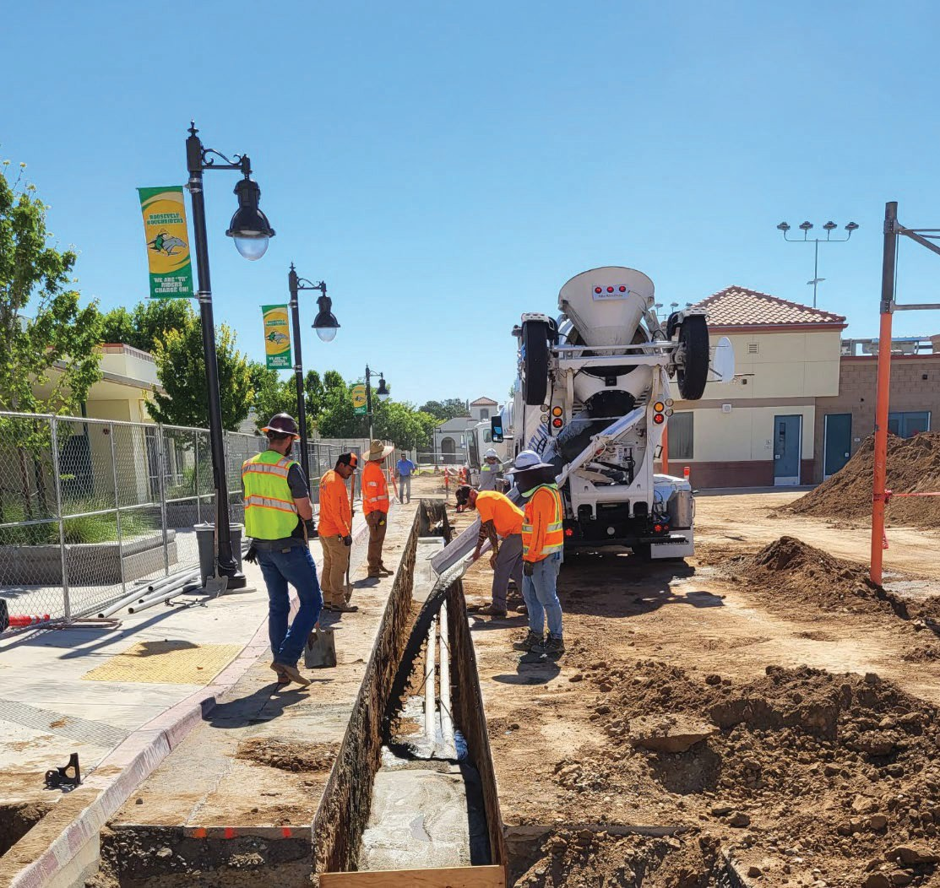
Roosevelt High School- Interim Housing
4250 East Tulare Street at Cedar
Install two large portables
First, portables will provide interim housing for administration during modernization.
Portables will then provide interim housing for the library during library modernization.
Anticipated removal from site summer 2025

Slide 13
Sunnyside High School – New CTE Building Health Science Building
Anticipated start: January 2023
Anticipated completion: August 2024
Square Footage: Approx. – 11,500 square feet
The new CTE building will provide Sunnyside HS with 4 medical technology classrooms, 1 sports medicine therapy lab, and 1 performance lab. Also includes a presentation space, and 4 small offices
Completion targeted for fall 2024

Slide 14
Examples of Other Campus Improvement Projects

Slide 15
Asphalt Upgrades
Ayer Elementary School
Fort Miller Middle School

Slide 16
Exterior Paint Projects
Columbia Elementary School
Fremont Elementary School

Slide 17
Play Structure Upgrade and Library Remodel
Malloch Elementary School
Scandinavian Middle School
17
August 17th, 2023 CBOC - Project Updates

Slide 18
Other Facility/Site Improvements
Accessibility
Athletic Fields
Building Automation
Electrical Panel/Service
Fire Alarm Panel Upgrades
Gym Floors
Gym Lockers
Heating & Air Conditioning
Intrusion System Upgrades
Irrigation/Water Conservation
LED Lighting
Marquees
Paving/Play Court Renovation
Playground Equipment
Public Address/Signal Systems
Security Camera Systems
18
August 17th, 2023 CBOC - Project Updates

