Slide 1




Wilson Elementary School
Mrs. Makarets
School Nurse
Back to School Night 2024-2025 Year

Slide 2

Welcome Parents!
My goal each year is to create a safe and healthy learning environment for all the children and staff of our building
Elena Makarets, RN, BSN, CSN

Slide 3
State Requirements-Documentation
Per the State of New Jersey, all students entering school for the first time or enrolling in a new school district must present a health physical from their physician
Mandatory vaccines must be completed
If you received a letter or email from the health office regarding missing documentation, please provide information as soon as possible

Slide 4
Medication Orders
No Medication may be given in school unless a written order is received from a Doctor
There are general medication orders, Asthma Action Plan Orders, Allergy and Anaphylaxis Plan Orders and Seizure Plan Orders under district website. district>department>health services
Parent must provide medication in the original prescription packing (not expired), with child’s name printed on the label. Medications must be dropped off by parent with written orders from the doctor. (Medication must be picked up by parent at end of every year)
Students are not permitted to carry or self-administer medications (including Tylenol, Motrin or cough drops (choking hazard for elementary)
Inhaler usage: Spacer must be provided by the parent

Slide 5

Emergency Contact Info.
Please keep your contact information as well as emergency contacts updated throughout the school year
The information should include:
  Contact phone numbers for use during the school day
  Active email accounts for parents
  Please try to provide 2 emergency contacts
  Please update the information throughout the year if there are any changes
  Please have contacts that could pick up your child within 30-60 minutes (or drop spare clothes off in needed)

Slide 6
School Policies
If your child will be absent from school please call and leave a voicemail or email indicating the reason for absence
An automated message around 10am will be sent out each day the child is marked absent
If your child has an injury (e.g. cast/stitches) they will not be able to participate in gym/recess. Please provide a doctor’s note with any restrictions or considerations necessary
For a student to resume normal activities after an injury a doctor’s clearance letter is required

Slide 7
Sick Days
Fever-If child has a fever of 100.4 degrees or higher they will be required to stay home from school (or sent home if they are already at school). Student may return to school once they have been fever-free for 24 hours without the aid of fever-reducing medication (Tylenol/Motrin)
Pink eye- Requires doctor clearance (Redness with thick discharge/crust)
Strep throat- 24 hours after treatment (antibiotics). (Pain when swallowing, swollen glands, white spots on the roof of the mouth, fever, headache or stomach pains)
Vomiting/diarrhea- if your child is experiencing vomiting or diarrhea, they must be v/d free 24 hours and able to tolerate food prior to returning to school. (If sent home during the school day-student should stay home the next day)

Slide 8
Sick Days Cont.
Persistent cough- can be disruptive to your child/classmates during the school day, making learning difficult. A child with a deep or uncontrollable cough should stay home
General – if your child is “just not feeling well”, i.e. very tired, loss of appetite, irritable, pale or presents any change from their normal behavior, a day of rest at home should be considered
If your doctor indicates that your child should stay home for a specific number of days due to illness, please keep your child home
Please forward a copy of any doctor’s notes to the nurse. Although they do not “excuse” absences, they will be noted for reason of absence

Slide 9

Accidents happen
Bathroom accidents
Food/drink spills
Please put a change of clothes (shirt, pants, underwear, socks) in your child’s backpack to keep at school in case of an accident

Slide 10
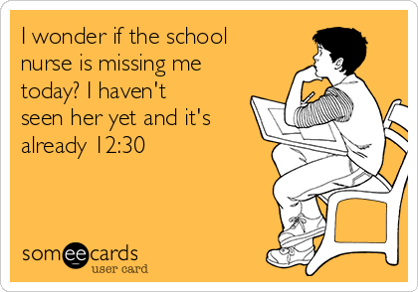
Contact Information
Please do not hesitate to contact me with any questions or concerns regarding your child
Phone: 732-525-5237
Email: Elena.Makarets@Sayrevillek12.net

