Slide 1
Building & Site Modification
Planning Process and Requirements
Presenter name: Dr. Lou Fletcher, Executive Director of Facilities & Operations

Slide 2
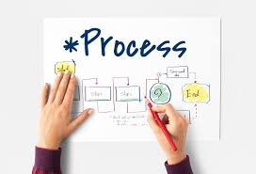

Agenda
Topic one: Purpose
Topic two: Building Modification
Topic three: What’s the Difference?
Topic four: Workflow
Topic five: Roles & Responsibilities
Topic six: Final Recommendations
Topic seven: Capital Planning & Project Cycle

Slide 3
Purpose
Procedures
Tasks
Policies
Mission, Purpose, Vision & Values
Strategic Plan & Objectives
Establish a unified approach on how a building is modified
Submission requirements
Approval process
Priority process
Financial responsibilities
Notes:
2023–24 was unique in the fact we had an influx of unexpected funding, and many needs and wants were identified, solidified and implemented.
Moving forward, with 2024-25 school year, we will be re-aligning with a systematic approach to ensure the safety and integrity of the buildings, grounds, equipment and systems owned by the District are standardized, maintained or replaced in accordance with our Master Plan; while allowing a process for changes and improvements vetted for code compliance, license impacts, asset protection, emergency preparedness and professional appearance and durability. Financial responsibilities for modifications will also be defined.
One way to think about the buildings/sites is in a lessee and lessor manner. For the safety and security of all parties, we (operations) is the Lessor or Landlord, and the site / zone leadership is the lessee. In order to protect the District assets, it is our job to vet project viability, long term impacts, and remove unintended consequences or liability. As many of you have seen captured within the Facility Master Plan, we have “flags”, that simple highlight potential impacts to jurisdictional oversite requirements. We do not expect you as educators to know this.
EXAMPLE: A teacher has her “husband” come into the classroom and install a wall for a small group breakout, what’s the unforeseen consequences? Does it meet code, capacity limits, filtration, does this “non-authorized” individual get hurt – file a claim against the district…I could go on an on.
We need to stress the importance of maintaining the process moving forward, in an unified manner. I am requesting assistance from this team, to help ensuring their teams are aware and held accountable to the process. The direction for the Operations staff is to kindly acknowledge the project and direct the individuals to the process portal.

Slide 4
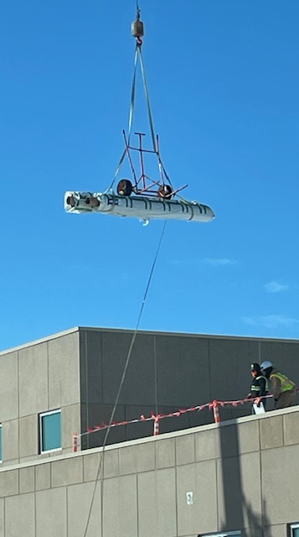
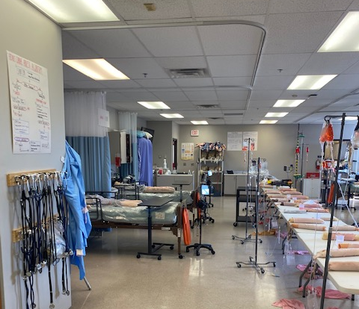
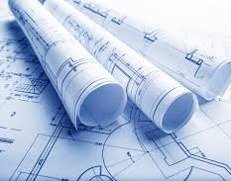
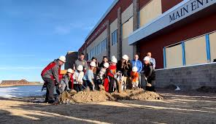
Building and Site Modification
What is it?
Notes:
A Modification is a physical modification to a facility, it’s specialized spaces, or its components that restores or improves the designed level of function. A modification may consist of, but not limited to, an alteration, addition to, or betterment of a facility that changes its function, layout, capacity or purpose.

Slide 5
What’s the Difference?
Terms | Definitions | Examples
Maintenance | The act of keeping property or equipment in good condition by making repairs, correcting problems, etc. | HVAC repairs, Plumbing repairs Wall and concrete repairs Sprinkler repairs Environmental health issues
Planned Maintenance | Regular scheduled maintenance activities to help prevent unexpected failures. | Floor stripping & waxing Deep cleaning of restrooms & carpets Grounds and irrigation Mechanical equipment
Building Modification | Any change to the existing structure; interior or exterior. | Room remodels, Installation of gym equipment Addition to existing site Adding a shade structure Changing a lounge or storage room into an office or classroom TV’s (requires electrical permits, load analysis, etc)
Capital Renewal | A planned investment program that ensures the facilities will function at levels that commensurate with the academic priorities and missions of the District. | Roofing End of life equipment Building Refresh Track & Field replacements Additions to Existing Buildings Infrastructure
Notes:
Operations touches each of these categories, however, we only receive funding for Maintenance, Planned Maintenance and Capital Renewal.
We would love for everyone to feel warm and fuzzy and get their “asks”, however, we are no different than you…. Our budgets are limited, we have competing priorities, and we have to prioritize all needs, which are the operational, or infrastructural, needs of the District.

Slide 6
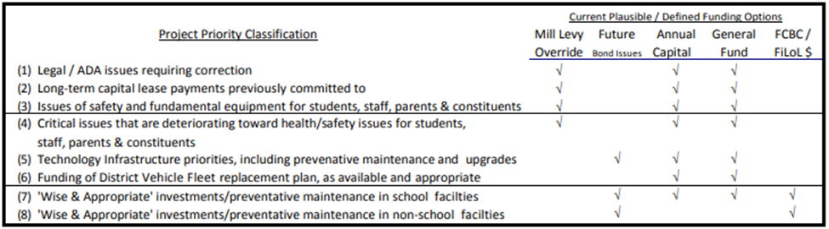
The “Why” behind it all…
In accordance to Board Policy FBC, FBC-R, and DAA Prioritization of Facility Improvements; each project will be categorized utilizing the matrix outlined and approved by the Board of Education.
Notes:
Prioritization and Funding is the big “Why”.
In accordance to Board Policy FBC, FBC-R, and DAA Prioritization of Facility Improvements and funding opportunities are specified
The budget within Operations is strictly for maintenance, whether it is planned or reactive. It is our job to keep the school building(s) operating, with the resources allocated from General Fund.
Capital is allocated for deferred maintenance items, improvements, equipment, infrastructure, vehicles, buses, etc.
Operations is typically allocated $5 to $ 5.5 Million per year, for Capital Renewal, with approximately $ 2 Million allocated to Long-term capital lease payments.
Leaving the team with approximately $ 3 million to $3.5 Million dollars to address the most critical infrastructure needs of the District.

Slide 7
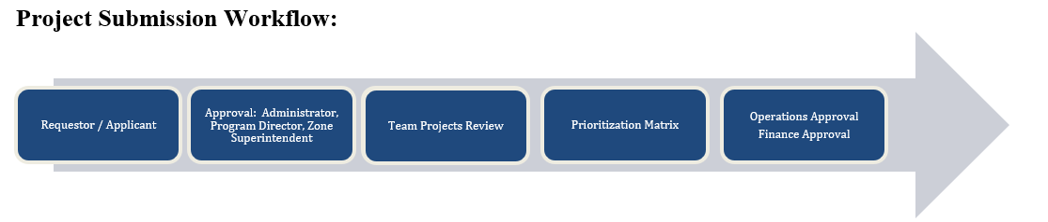
Vision of Building & Site Modification Workflow
Notes:
We understand the educational needs are forever changing, and we, in Operations, need to be flexible and allow a process for changes and improvements, while still being vetted thoroughly. Unintended consequences are costly.
For example: A Building Code has changed since the original building was errected, the District is “grandfathered in” under those rules; we disturb part of the system, now the District must bring the system up to current code regulations.

Slide 8
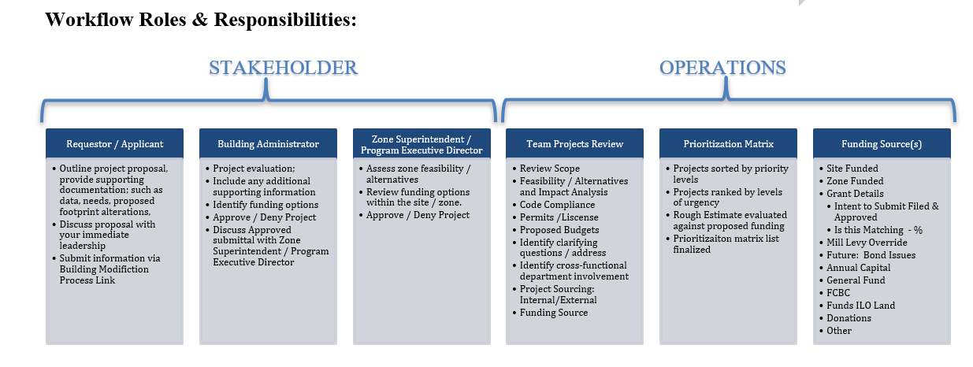
Roles and Responsibilities
Notes:
Ensuring that the sites/programs are communicating their needs with their zone leadership is imperative; this should be prior to the involvement of Operations.. The site or the zone may have funding availability, the zone may have a different vision or alter the ideas to better suit the long term student impact.

Slide 9
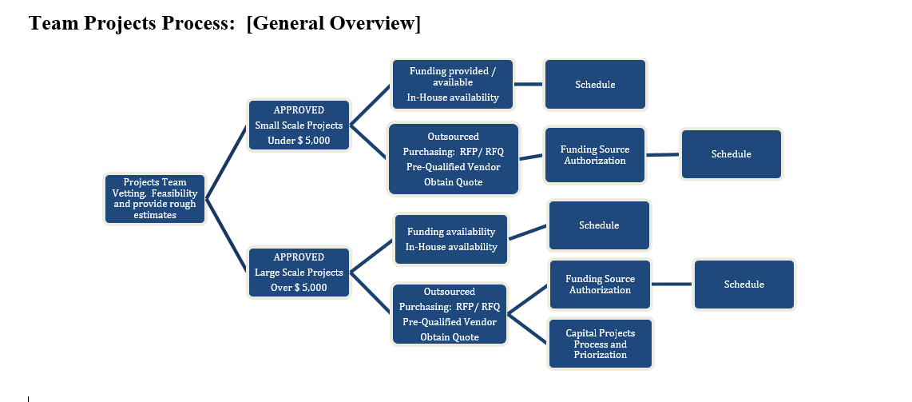
Projects Process
Notes:
This is a general overview that each and every project, including deferred maintenance, runs through annually. While this looks relatively easy, the actual detailed version, is quite intensive.
Capital funding for the upcoming year, is completely allocated to projects by April of the Current year.
Example: April 2024 – Projects are solidified for 2024-25 school year
If additional funding is available – the next prioritized item is selected

Slide 10
Capital Site Audit Team
Safety & Health Compliance Specialist
Custodial Supervisor
Building Manager
Building Maintenance Group Manager
Grounds Manager
Project Manager
Maintenance Tech responsible for site
Planning Manager

Slide 11
Capital Prioritization Committee
Priority Matrix
NO Vested Interest
Working knowledge of each site
Procurement & Financial Guidance
Safety & Health Compliance Specialist
Custodial Supervisor
Project Manager
Building Maintenance Group Manager
Grounds Manager
Planning Manager
Accounting Manger
Budget Manager
Contracts and Procurement Manager
Notes:
The Capital Prioritization Committee is compiled of cross-functional staff with no vested interest in a specific site, has working knowledge of all sites, can solidify procurement regulations and can provide financial guidance.
This team is sequestered away for a minimum of a week to finalize the annual plan.
Every project is evaluated on an annual basis
Every project is ranked 1-7, per board policy
Each “ranking” is than “prioritized” within itself [All P1s are ranked #1 through the number of P1’s]
NOTE: P1 – is not Peter 1; just clarifying
Estimates are reviewed, discussed and reassessed based on current values
Projects are Evaluated against available funding
Funding determines the number of projects

Slide 12
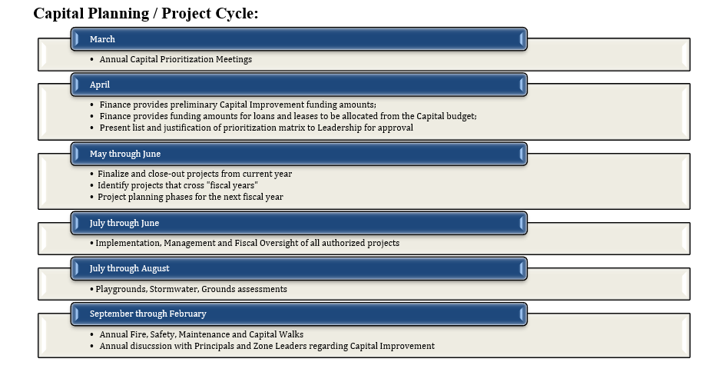
Annual Process
Notes:
If funding is unavailable for a Building Modification, the project request will be integrated with Capital Planning and prioritized according to Board Policy.

Slide 13


Final recommendations will be presented by the Capital Prioritization Committee to;
* Executive Director of Facilities &
Operations and,
* Chief Financial Officer for Final Approval by the Superintendent.

Slide 14



Summary
Notes:
As the rapid growth continues within the District, it is crucial that we move forward with a unified process that provides leadership the capability of making data driven decisions, focuses on academic priorities, highlighting deferred maintenance, while remaining financial stewards of taxpayer monies.
This process will be a trial and error…if you see an opportunity to streamline the process, or have suggestions, please let us know.

