Slide 1

Overlook Avenue/McKinley Drive
Storm Drainage Improvements
Public Involvement Meeting
September 19, 2024

Slide 2
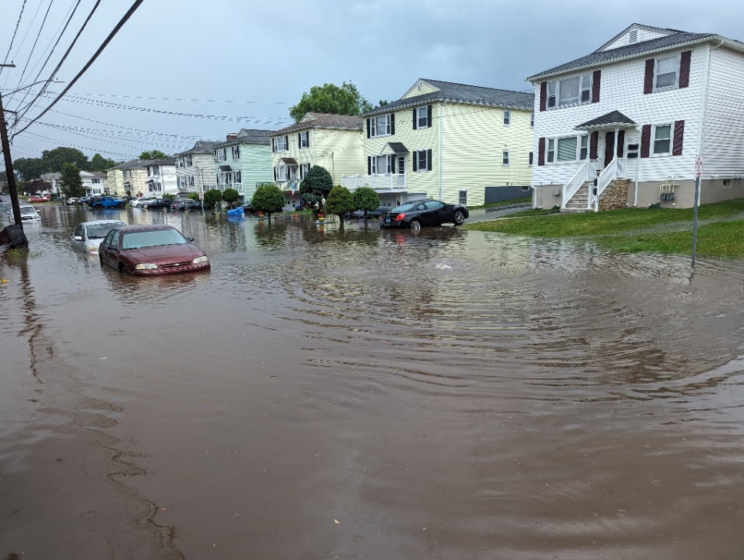
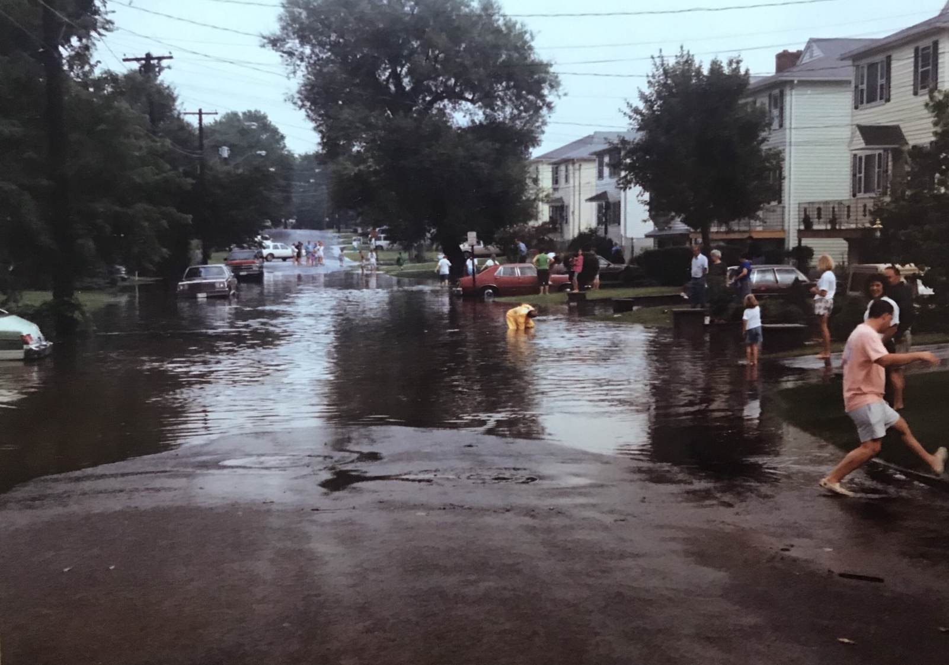
OVERLOOK AVENUE FLOODING
July 4, 2023 – Overlook Avenue
1985 – Overlook Avenue

Slide 3
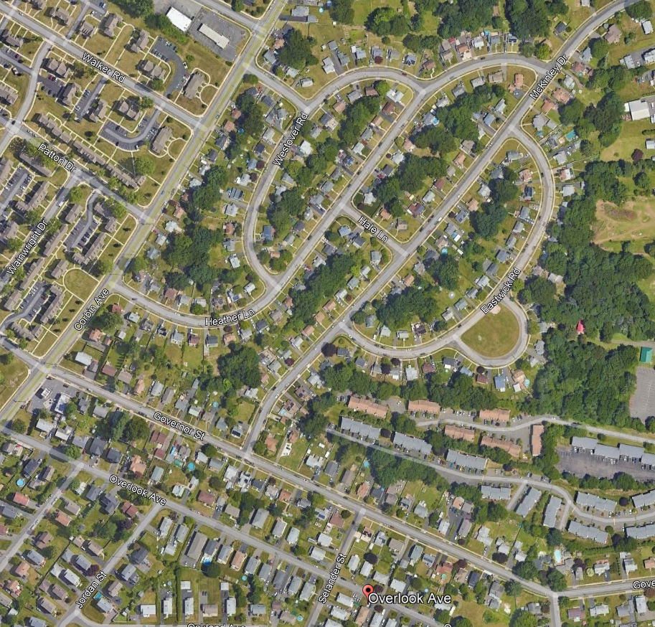
PROJECT AREA
PHASE 2
PHASE 1
McKinley Dr
LOCATION OF PHOTOS

Slide 4
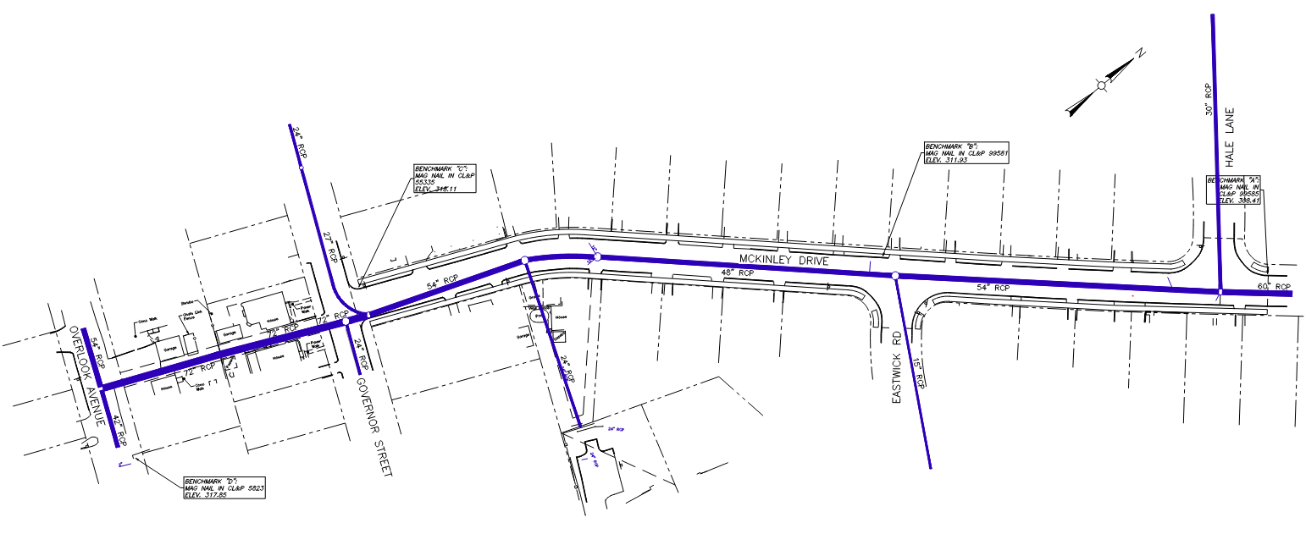
EXISTING CONDITIONS
Hale Lane
30” RCP
Project Length 850’
27” RCP
McKinley Drive
54” RCP
54” RCP
48” RCP
54” RCP
60”
RCP
Governor Street
Overlook Avenue
24” RCP
72” RCP
15” RCP
24” RCP
42” RCP
IN: 72”+24”+27” DIAMETER PIPES
OUT: 54” DIAMETER PIPE

Slide 5
FLOOD STUDIES
Tata & Howard (2019)
  Analyzed the 450-acre watershed
  Developed peak flows
  Identified 2 phases to address issues with existing drainage system
Weston & Sampson (2020)
  Reviewed hydraulics and modifying drainage on McKinley Drive
  Developed plans and cost estimate
    Phase 1 Completed December 2021
      Construction Cost $100,000
      Install new manhole to eliminate turbulence on Overlook
    Phase 2 Design complete and construction starting soon

Slide 6
PHASE 1
Phase 1 Completed December 2021
  Construction Cost $100,000
  Install new manhole to eliminate turbulence on Overlook

Slide 7
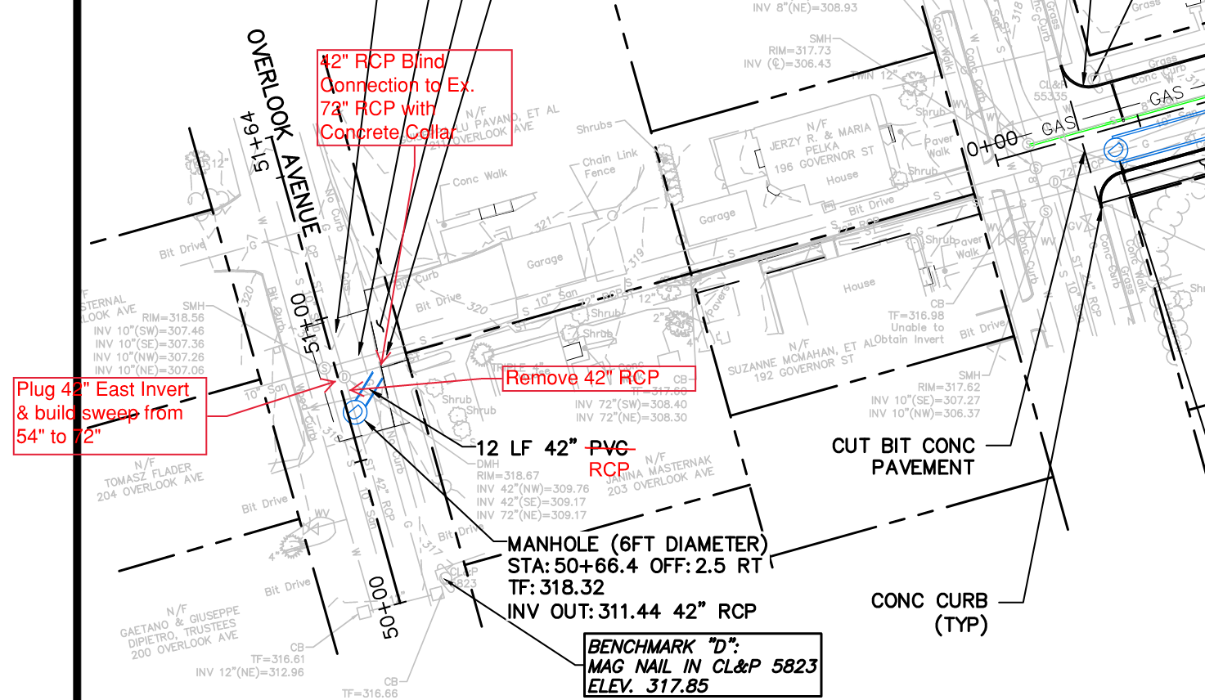
PHASE 1 DEC. 2021
54” RCP
72” RCP
42” RCP

Slide 8
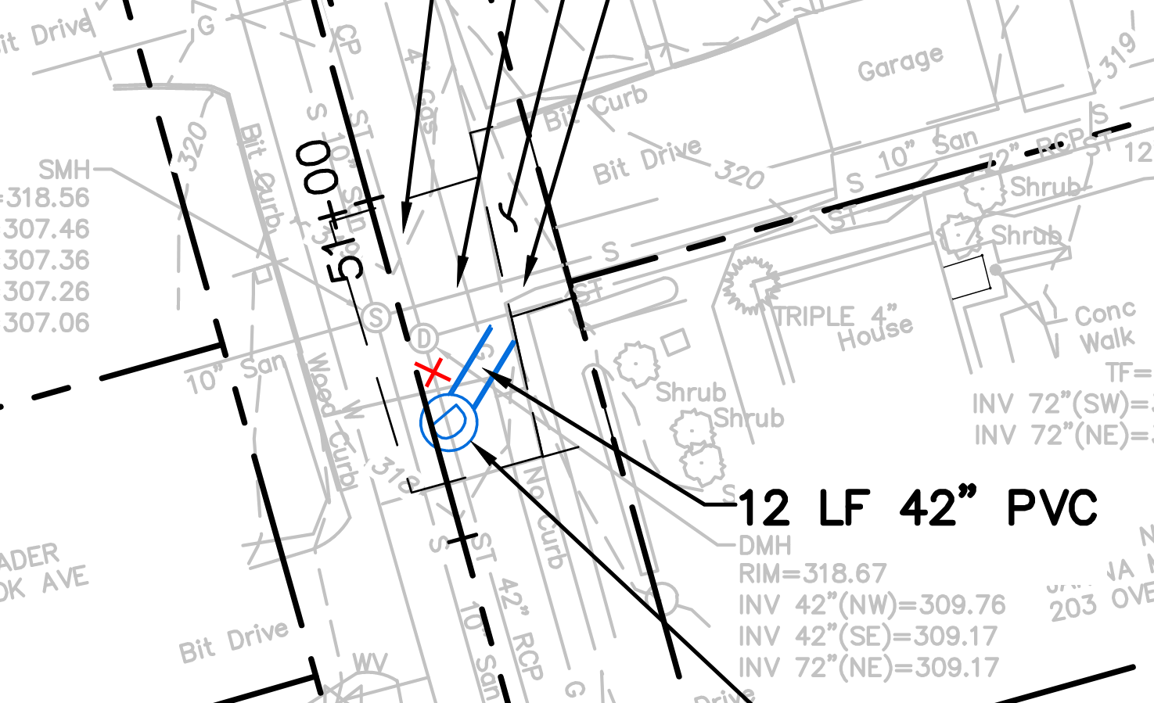
PHASE 1 DEC. 2021
72” RCP
54” RCP
42” RCP

Slide 9
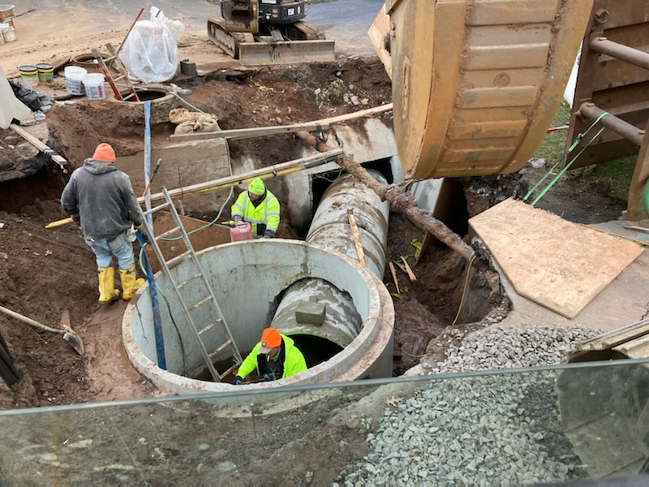
PHASE 1 OVERLOOK AVE 12/2021

Slide 10
PHASE 2 DESIGN CHANGES
Previous design included 4’x8’ box culvert
Revised design installs a parallel 54” concrete pipe and increase the 48” pipe section to 54”
  Two 54” pipes have equivalent capacity to the 4’x8’ box culvert
  Eliminates need for crane onsite for duration of construction
  Allows for 1 way access to be maintained
  Reduced lead time on materials
  Major project cost reduction (Approx. $1 Million)

Slide 11
PHASE 2
Design is completed
  Cost of $2.2M ($2.0M in ARPA funds and City Clean Water Fund)
  Sidewalks, driveway aprons will be replaced
Construction
  Colossale Siteworks has been selected as the contractor
  Submittal Review Approval starting in the coming weeks
  Ground breaking is anticipated in early December
  Working through winter is anticipated as weather allows
  Final paving in the spring

Slide 12
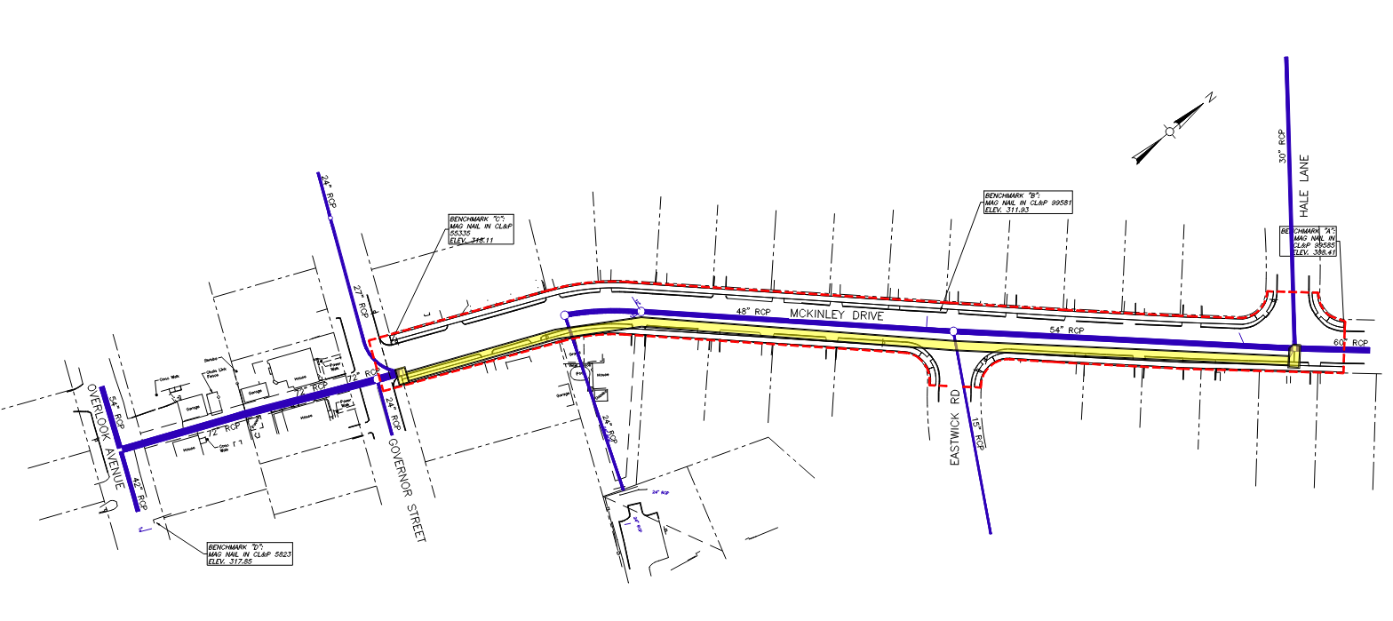
PROJECT DESCRIPTION
Replace 48” section with 54” Diameter Concrete Pipes and install second 54” parallel pipe.
New Sidewalks and Ramps
PROJECT LIMITS
Hale Lane
Project Length 850’
McKinley Drive
Governor Street
Overlook
Additional
54” Concrete Pipe
SPECIAL STRUCTURE
SPECIAL STRUCTURE

Slide 13
PROJECT CONSIDERATIONS
Coordination with CNG to relocate gas main (Completed)
Resident access during construction
Temporary rights to grade for sidewalk and driveways
Lead time on 54” RCP and Special Structures
Handling water during construction
Project restoration
Please provide contact information to make communication easier mostly for residents between 18-92 McKinley Drive

Slide 14
Discussion & Questions
Thank you
City of New Britain Public Works

