Slide 1
Planning for growth
July 2024
Notes:
Sources;
Board Policy
Facility Master Plan – 2023
RTA – Architects
Demographics – Western Demographics
CDE Requirement
UPK Family Handbook, published by the Colorado Department of Early Childhood; and in collaboration with the Coordinator of Early Childhood Education for D49, Stacey Powell.
Zonda
Pikes Peak Building Department
Colorado General Assembly - Attwood Public Affairs – School District 49; 2024 End of Session Report

Slide 2
planning process
Align to FMP
Current State
Educational Impacts
Capacity Overview
Developments & Impact
Future Vision
Path Forward
Notes:
The Agenda was created in such a way that this reflects the indefinite continuous improvement process in planning for growth, while obtaining direction for the path forward.
The intent is to maintain an ongoing, inclusive plan, in compliance with Section F, of the Districts policy manual. More specifically, policy FB – Facility Planning, item one. The directive is to “plan facilities that will efficiently house students and staff in permanent structures that are conducive to optimal teaching, learning and working.” Outside influences will rise to the forefront in planning; as mandates trickle down the pipeline, or the need to simply highlight potential impacts on the horizon, it becomes imperative to understand, integrate, and capture within the process.
As needs adjust, the plan adjusts, however, the consistency in the process remains. The intent is to;
Align with the Facility Master Plan
Define Current State – review & update Delta / Pluses
Discuss Educational Impacts
Review Capacity Modeling
Highlight Developments and Potential Impacts
Future Vision, or opportunities, inclusive of Delta / Pluses
The hope is that the data will contribute to the desired District “Path Forward”

Slide 3
Facility master plan alignment - 2023
Safety and Security
Facilities Condition Index [FCI]
Educational Programs & Offerings
Operational Efficiency
Growth in the District
Notes:
The District Facility Master Plan provides a clear, concise roadmap, evaluated existing facility conditions, understands current and future enrollment projections and reviewed the educational adequacy for each grade level served. By Maintaining this “Roadmap”, we will be able to maintain a rolling Capital Improvement Plan, while planning for the future growth of the District
Keep in mind that these objectives outlined in the FMP are broad based, and consist of different meanings, as they are applied to, or integrated with Facility and Planning applications.
For example, Safety and Security:
From a facility standpoint may include
Compliance with various jurisdictional oversite authorities; Building Codes, Fire Codes, CDE Regulations, ADA Requirements, Legislative Mandates, etc.
I suspect this is very different from the position of the Director of Safety & Security standpoint.
Educational Programs & Offerings:
From a facility standpoint, we look at square footage per classroom/students, whereas, the educational standpoint is typically scholastic based

Slide 4
Current state [ES/MS/HS]: school model
High School [1,200] Students
Middle School [900] Students
Elementary School [600 Students]
Elementary School [600 Students]
Elementary School [600 Students]
(3) ES at 600 = 100 students per grade, or 300 5th graders
(1) MS at 900 students = 300 students per grade
(1) HS at 1,200 students = 300 students per grade
C
A
P
A
C
I
T
Y
Notes:
The current school model is your standard ES, MS, and HS;
In essence, 100 children per grade at the ES level, each feeder system has three ES that funnel into a Middle School, and so on

Slide 5
current state – “status –quo”: delta
Standard model [ES/MS/HS]:
Safety & Security
Additional sites to maintain and monitor
Operational Efficiency
Sustainability / Flexibility
ES connected to Parks
Shift in societal norms, behavior and expectations
Transportation
Growth
Universal PK [UPK] mandates implemented July of 2023
Schools / Sites at or near capacity / Mobile Dependent
Feeder System crosses boundaries
Educational Programs and Offerings
Core Educational Curriculum
“Walkable” sites
Notes:
With the standard feeder patters, of ES/MS/HS; Operations as a whole, looks at the integration of the various divisions of; Facilities, Grounds, Transportation, Safety & Security, Nutrition Services, etc. into the modeling,
Safety & Security
Additional sites to Maintain (Systems/Trades) / Monitor (Security/Alarms)
Parks: Per the City and County Land Development Codes & Board Policy; Elementary School are typically connected to parks; is this a Delta or a Plus?
Shifting Norms: Todays behavior is not what it used to be
Operational Efficiency
Sustainability / Flexibility:
Elementary School is always an ES – lack of ability to adapt to changing needs
Reduced capacity to service community
Transportation:
Ability to staff appropriately
Behavior
“Walkable Sites”
Growth
Universal PK [UPK] mandates put into effect July of 2023
Currently we are at a deficient of seats available Districtwide
Ideally incorporation of PK to modeling would be instrumental for planning forward
Educational Programs and Offerings:
In a decentralized educational system; meaning “Zones”; there is a potential impact when crossing feeder systems
Core Educational Curriculum

Slide 6
Current state [ES/MS/HS]: Plus
Operational Efficiency
Typically a Clean “Feeder System”
Safety & Security
Elementary School are typically connected to parks
Age appropriate students together
The way it’s always been – “Status-Quo”
Maintains “Core Educational Curriculum”
Notes:
Safety & Security:
Elementary schools are typically connected to parks
Age appropriate students together
The way it’s always been
Operational Efficiency: Feeder System – Typically a Clean “Feeder System: if sites are maintained within the same zone

Slide 7

Colorado Universal preschool program
Notes:
SOURCE: UPK Family Handbook, published by the Colorado Department of Early Childhood; and in collaboration with the Coordinator of Early Childhood Education for D49, Stacey Powell.
We will briefly touch on the Universal Preschool Program that began implementation July 2023

Slide 8
2022 Legislative session – Overview of UPK
Voluntary, high-quality pre-school for all
Every Colorado child in the year before Kindergarten Is eligible
The Colorado Department of Early Childhood [CDEC] operates the program
Mixed-delivery system
Licensed Community-based programs
School based programs
Licensed home providers
HB22-1295 Established the Colorado Universal Preschool Program [UPK]
Notes:
In essence,
HB22-1295 Established Colorado Universal Preschool Program [UPK], sunsetting the Colorado Preschool Program, formally [CPP]
Jurisdictional oversight will be through the Colorado Department of Early Childhood [CDEC]
The Goal is to ensure every Colorado child has the opportunity to attend preschool, with up to 15 hours, per week, of free education.
Through the registered providers, a choice program is available; whether it is
Licensed community based programs, school based programs or Licensed home providers

Slide 9

Preschool…
Improves Math
Encourages Early Reading
Builds Social and Emotional Skills
Notes:
UPK ensures “up to” 15 hours of free preschool – for all Colorado children
Preschool….
Improves Math
Encourages Early Reading
Builds Social and Emotional Skills

Slide 10
Universal preschool program [UPK] - seat availability
Tuition Based
Preschool Program with qualifying factors
Pre Kindergarten Program
The District is required by law to provide services for students with disabilities beginning at age three.
D49 is NOT required to have a seat for general education students;
Notes:
Things we know,
UPK will drive capacity needs
Ensuring adequate space for UPK, the District has an increased probability for Retention of students

Slide 11
Capacity overview
School – Program - functional

Slide 12
School Capacity
No. of Students that can be reasonably accommodated
Program Capacity
Counts ALL instructional space, regardless of current use
Functional Capacity
Not a one-size-fits all
Program capacity adjusted for current programming and operational factors
Notes:
When we talk about capacity of schools; there are different forms; School, Program and Functional Capacity;
The preference is to work towards maintaining Functional Capacity, as this provides flexibility to adapt to the needs of the students and staff.
School Capacity
Number of Students that can be reasonably accommodated by a school, building or site
Not a one size fits all; considers the limitations of the physical environment, operational goals and unique programs at each campus
Physical: Building size & area, No. of Teaching stations, Support Facilities (Kitchen/Dining), Infrastructure (hallways), Building & Life Safety Codes, Site Amenities
Operational: Staffing, Utilization Rates, Operational Policies, Teacher / Union Regulations, Space Managements, Staff & Operational Budgets, Specialty Program Offerings
Programmatic Variables: Class Sizes & Staff Rations, Educational Program Offerings, Operational Models, Specialty Programs, Schedules, Partnerships (Concurrent Enrollment)
Program Capacity
Counts ALL instructional space, regardless of current use (Empty classrooms, classrooms used for office space, breakout sessions, intervention, etc).
Functional Capacity
Program Capacity with adjustments for current programming and operational factors.
ES: The functional capacity of a classroom used for core instruction receives a multiplication factor of 1.0
Does not consider unique programs such as special education, intervention, OT, speech, etc.
Students attend exploratory during teachers planning periods.
MS/HS: Multiplier used to adjust for academic schedule flexibility, teacher academic planning, bell schedules [6 periods used / 8 total periods = 75%]
Classrooms occupied by students 75% of the time

Slide 13
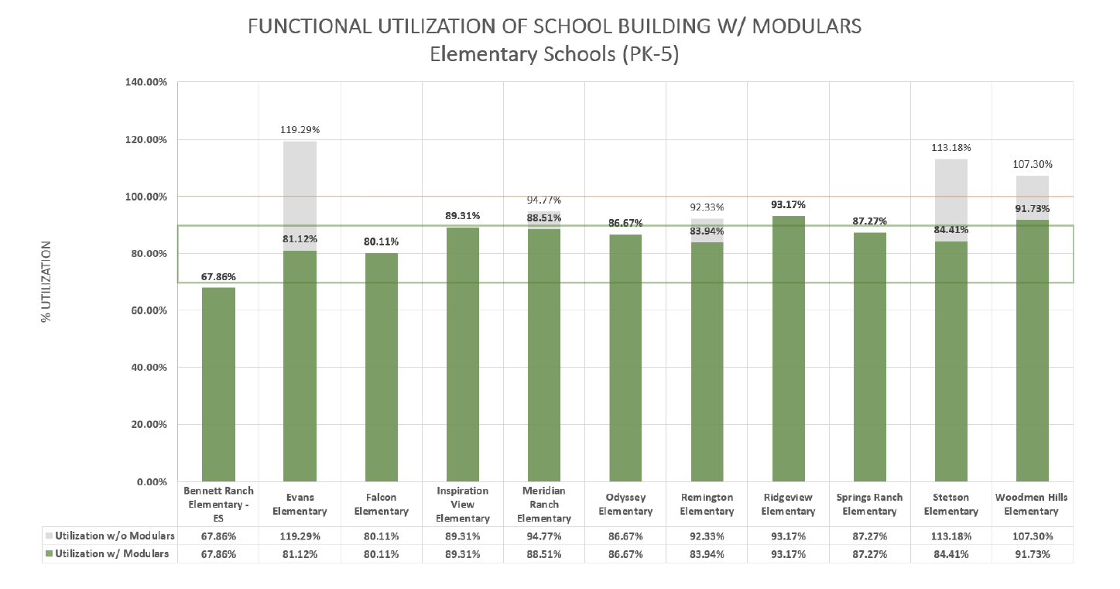
functional utilization of school building w/modular – Elementary schools [PK-5]
Notes:
Green – Utilization w/Modulars
Gray – Utilization w/o Modulars
Yellow Line represents 100% Utilization – every nook and cranny is occupied
To accommodate the flexibility schools need to address individualized student needs, it is recommended that enrollment does not exceed 90% of the Program Capacity
Heavy Dependency on Modulars at Evans, Stetson and Woodmen Hills
Moderate Dependency at Meridian ES and Remington ES
Rule of Thumb
The higher the utilization, the tighter the scheduling, larger students/teacher ratios, shared space, lack of intervention space, etc
The ideal balance is to maintain between 70% and 90% utilization

Slide 14
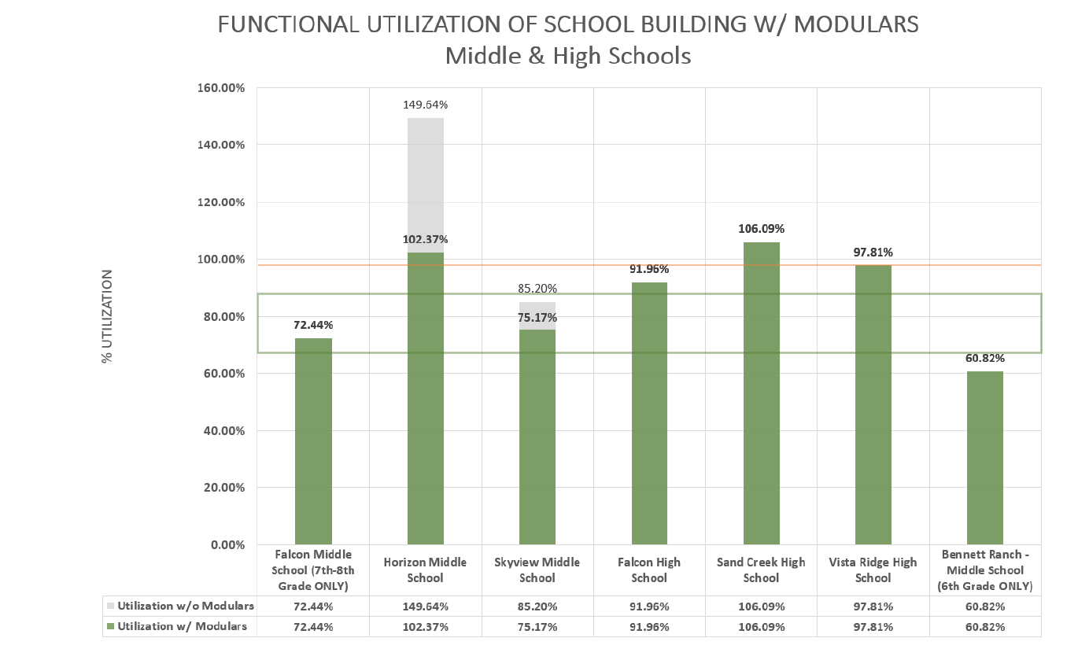
functional utilization of school building w/modular [middle & high schools]
Notes:
Green – Utilization w/Modulars
Gray – Utilization w/o Modulars
Horizon MS is heavily dependent on Modulars, however, an addition is currently being added and Modulars are slated for removal;

Slide 15
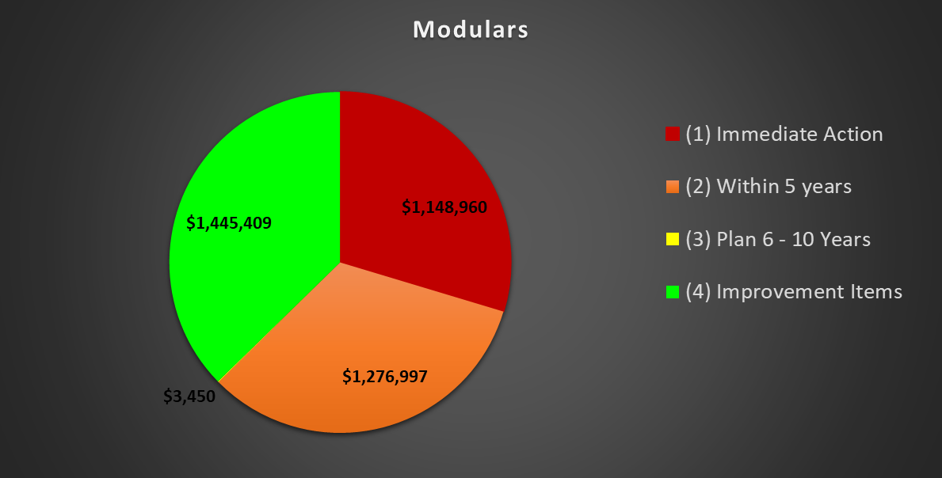
Modulars – Deferred Maintenance: Fail time rank
Projected Total Costs w/soft costs
Excludes: Escalation, contingencies and GC Expenditures
Notes:
Throughout the discuss thus far; I think it is fair to imply,
The School District is currently modular dependent
The intent of a modular is “temporary”
Modular’s have a short Life span
Cost efficiency is questionable at best
The District Modular portfolio contains
17 units, purchased prior to 2000
With approximately 20 Modular Purchased after 2000
Some modular units lack purchase information
In alignment with the Facility Master Plan, this graph provides a snap shot of the deferred maintenance specific to the existing modular units;
Projected Total Cost w/soft costs – NO Escalation, contingencies, or GC Expenditures
[Red] Immediate Actions = 1,148,960
Central Office $ 928,133
SvMS $ 122,296
HMS $ 77,280 – ETA on demo? / Capacity of Wing
FMS $ 17,112
SCHS $ 4,140
[Orange] Replace within 5 years = 1,276,997
Central Office $ 1,380
FMS: $ 302,441
HMS: $ 13,080 – ETA on demo? / Capacity of Wing
RVES: $ 215,280
SCHS: $ 24,840
SvMS: $503,976
SRES: $ 215,280
[Yellow] Replace within 6-10 years = 3,450
[Green] Improvement Items = 1,445,409

Slide 16
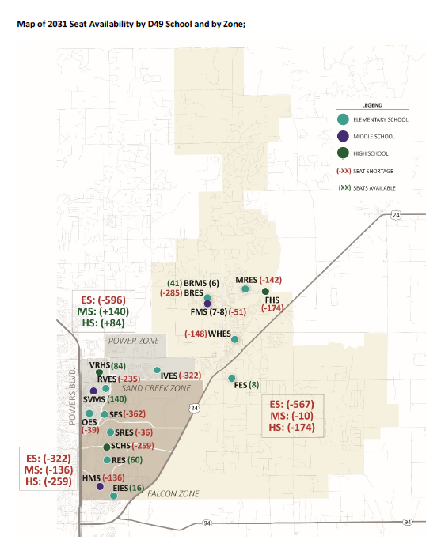
2031 potential seat availability Districtwide
Notes:
Source: Western Demographics
Based on the information captured within the FMP, by 2031
Falcon Zone is expected to be short 567 seats or, One (1) ES. MS appears to be short 10 seats providing BRES, maintains a MS wing, HS with 174 seat shortage
Power Zone will be in need of a ES
Where as Sand Creek Zone reflects seat shortage through out all levels
Assumptions made:
BRES will maintain a MS wing
Figures are based on platted lots, not build out

Slide 17
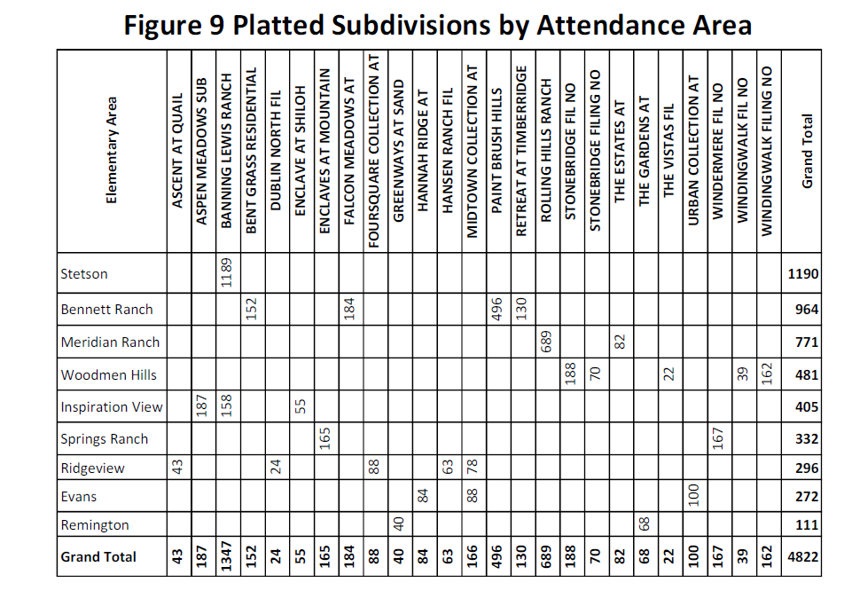
Platted Subdivisions by Attendance Area
Notes:
SOURCE: Facility Master Plan, provided by Western Demographics, Compiled by RTA Architects
The data thus far is based on the “Platted Subdivisions by Attendance Area”, captured by Western Demographics
There are nearly 5,000 platted lots in the district, simply meaning they are ready to build…In general, vacant lot availability is not a restriction to district growth
Keep in Mind that the data provided, is based on a “Snap-Shot” of what subdivisions were platted when the data was collected - Not District Build Out
My preference is to look at District Build Out – being the developers already own the land.

Slide 18
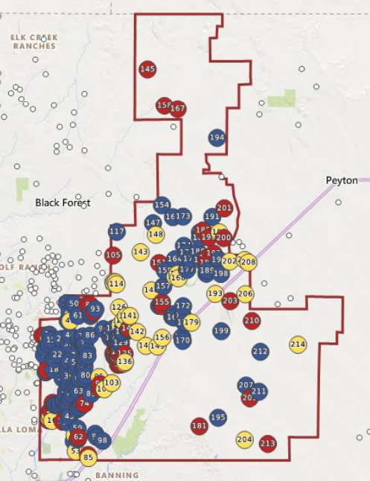
Subdivision Status: 1Q24
Active
Future
Built-out
Future 22,164
Occupied 28,170
Active 2,560
Estimated District Build Out: 52,894
Notes:
SOURCE: Zonda
Looking at the District holistically and Utilizing data collected from Zonda for 1st quarter of 2024, this provides a “big picture” overview for the district as a whole;
Red is your Active Developments (2,560 housing units), Yellow is the Future plans (22,164) – subject to change, and Blue is Occupied, or Built Out housing units.
All combined is roughly 53k housing units, or just over 53% developed and occupied, Districtwide
Figures exclude the “undeveloped/not yet planned” acreage near the bottom of the District, encompassing US 24 – this is all owned by Norwood
Whereas the North, or top portion of the District is more large acreage, agricultural based areas, very, very slowing subdividing
Subdivisions excludes “Apartment” buildings, “Flats”, “Lofts”, “Modular” Units, “3-stories” and over, Accessory Dwelling units, alternative builds, etc.

Slide 19
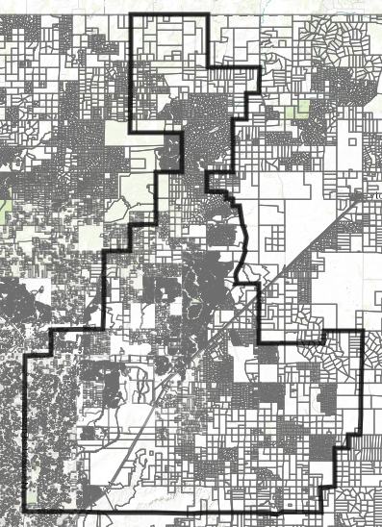
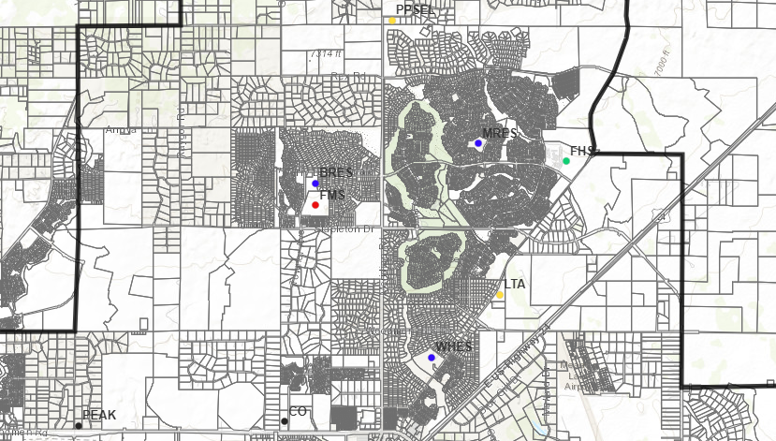
density
Density = Land Parcels
Darker the gray the greater the Density
White is undeveloped land
PUD’s change throughout their life, expanding years, even decades
Notes:
The map of the District reflects the current Density levels or Land Parcels
Darker the gray the greater the density, or more homes per acre
White is undeveloped land, may also include, city or county property, regional parks, airports, metro districts, etc.
The zoomed in map version, purple outline is Meridian Ranch – maximum homes allowed for this development, or PUD was 5,000 homes. They have approximately 800 units remaining. The red circle of the same map; is Sterling Ranch to the WEST, The Ranch to the EAST and Percheron the South, for a combined total of nearly 7,000 homes.
As a side note, Sterling Ranch is split between D20 and D49, you can see the high density, or dark gray to the west of the District boundary
Planned Unit Developments [PUD’s] or Master Plans change throughout their life cycle, lasting years, even decades; Developers are able to;
Adapt to current, changing needs,
Adjust modeling to what sells and appropriate price points
Drive changes in Land Development Codes

Slide 20
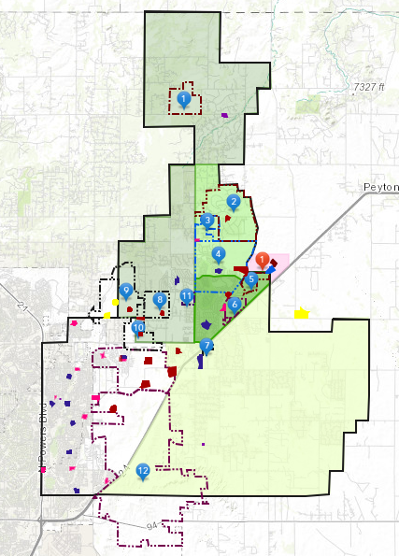
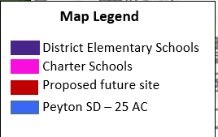
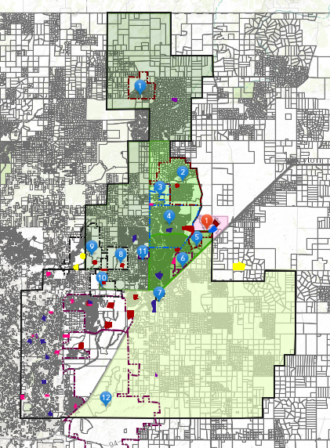
Falcon Zone: Top Landowners
#1 –Winsome [143 Units]
#8 – The Ranch [2,144 Units]
#10 – Percheron [2,800 Units]
#2 - Latigo Trails [227 Units]
#3 – Antlers Ridge [TBD]
#4 – Meridian Ranch [5,000 Units]
#5 - Waterbury [1,010 Units]
#6 – Meadow Lake Ranch [400 units]
#7 – Commons at Falcon Field [139 Units]
#9 – Sterling Ranch [2,100 Units]
#11 – Autumn Hills [619 Units]
#12 – Norwood [TBD]
Notes:
Falcon Zone (Green): Top Landowners
Currently working with Classic and Norwood – to potentially right size the dedication and location for proposed school site(s).
#8 [The Ranch / Classic] – 2,100 Units
#9 [Sterling Ranch / Classic] – 2,100 units – no longer age restricted
* The Master Plan is split with neighboring school district and the yellow dots are where the school sites are located
#10 [Percheron/Norwood] – 2,800 units
Potential Impact:
Waterbury; upwards of 1,500 units
Red 1: Grandview Reserve – approximately 3,000 units

Slide 21
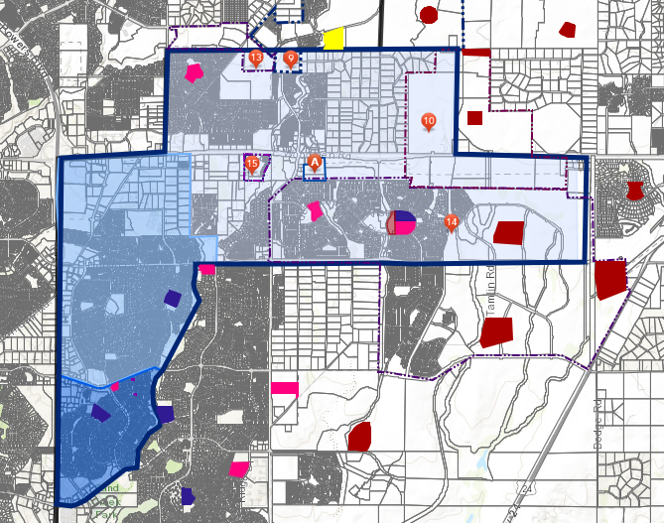
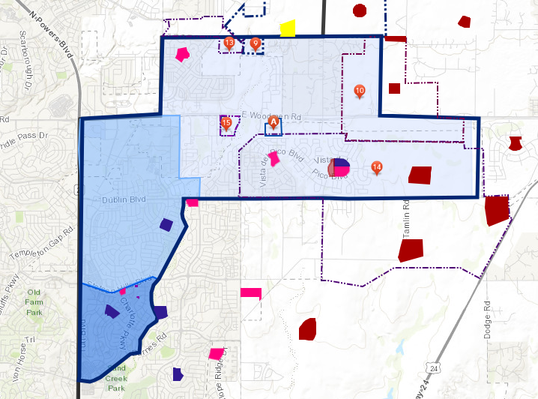
Power zone: Top landowners
#9 - Sterling Ranch [279 Units]
#A - Solace at the Ranch [Apartments]
#14 - Banning Lewis Ranch [Max 2,124 Units]
#10 - Percheron – Elevate [122 Units]
#15 – Cottages/Ascent at Woodmen Heights
#13 - Stonebridge [Commercial/Industrial]
#10 - Sports Complex [Norwood]
#10 - Percheron – Noma [49 Units]
#10 -Percheron – Rivet [110 Units]
#10 - Percheron – Midtown [162 Units]
Notes:
Elementary School Boundary – all noted developments is currently within the IVES school boundary
Banning Lewis Ranch itself will be adding approximately 2,100 homes, over the course of the next decade
To gain perceptive, there are currently 2,151 occupied units within BLR
Next phase for BLR is expected to be submitted in September / October of 2024 – Maximum Units is 6,159
Spans both SCZ and PZ
Estimated 2,124 Units for Power Zone & roughly 4,032 units for SCZ
Build-out 10-12 years

Slide 22
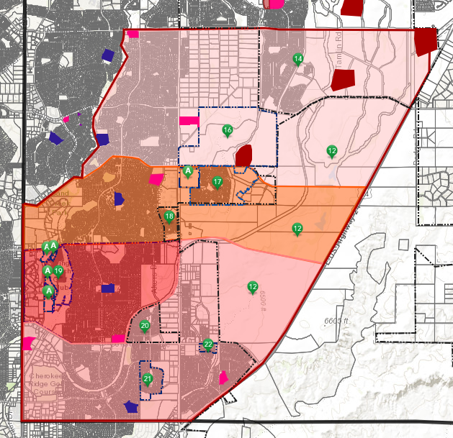
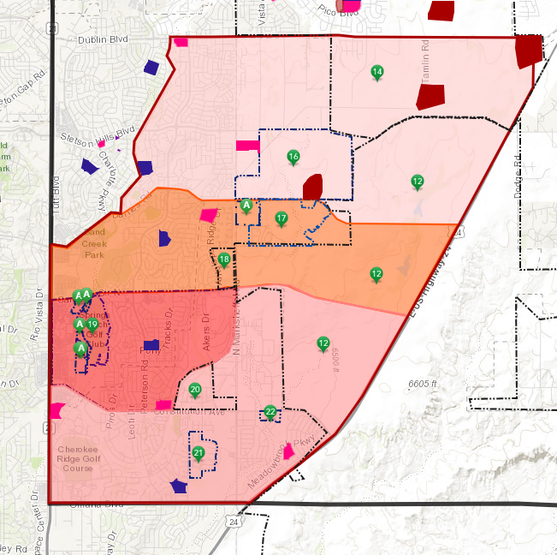
Sand Creek zone: top landowners
#20 - Hannah Ridge [42 units remaining]
#21 - Wilshire Ranch [389 Units remaining]
#18 – Windermere [96 Units remaining]
#17 - Enclaves at Mountain Vista [1,001 Units]
#12 - Norwood [Not Yet Planned]
#16 - Freestyle [2,433 Units]
#14 - Banning Lewis Ranch [Max 4,032 Units]
#19 – Greenways at Sand Creek [486 units]
#22 – Claremont Ranch [107 Townhomes]
Notes:
Whereas the immediate impacts for the Sand Creek Zone;
Is Banning Lewis Ranch (#14), Freestyle (#16), Enclaves at Mountain Vista (#17) and Greenways at Sand Creek (#19)

Slide 23
Colorado general assembly
End of Session 2024 overview: Land Use and Housing
HB24-1313
Intended to encourage transit-oriented housing development, centerpiece of land use legislation
HB24-1007
Ban on local laws setting residential occupancy limits
HB24-1152
Some local governments will have to ease restrictions on constructing accessory dwelling units under this bill
HB24-1304
This proposal to limit the power of local governments to require parking in residential developments was significantly amended
Notes:
Colorado General Assembly
Attwood Public Affairs – School District 49; 2024 End of Session Report
Land Use and Housing – The failure of the land use bill in 2023 caused a shift of tactics for the 2024 session, and multiple bills on the subject of land use and housing were introduced and passed.
For instance, HB24-1313 applies more to metro districts, COS currently has an initiative to backfill or infill with multi-family affordable housing
HB24-1007 – is broad based, and can encourage Co-Parenting / Living; Multi-Generational Living, etc.
HB24-1152 – easing restrictions, coupled with financial incentives for AUD;
High level; reducing the loan to value of financial qualification to add the AUD, as one “may” have the potential of “renting” the AUD out
HB24-1304 – reducing the required right of ways within a development may increase the units per acre
Failed Measures impacting Land Use and Housing:
Attempts to change construction defect laws – directly impacting condominium construction
Key takeaways include:
Significant funding is devoted to K-12 educations, property tax relief, and housing initiatives

Slide 24
Future vision school model / Pre-K to 8th grade
High School [1,600] Students
Middle School [900] Students
Elementary School [600 Students]
Elementary School [600 Students]
Elementary School [600 Students]
Pre-K to 8th Grade School [1,050] Students
(3) ES at 600 = 100 students per grade, or 300 5th graders
(1) Pre-K to 8th grade at 1,050 students and (1) MS at 900 students = 400 students per grade
(1) HS at 1,600 students = 400 students per grade
C
A
P
A
C
I
T
Y
Notes:
Future State of School Models – PreK to 8th grade, viable option
PK to 8th grade model, can easily be built with additional seating to create a more flexible model, such as Bennett Ranch ES; or “planned” for expansion, similar to Woodmen Hills
BRES Functional Capacity is 1,022 / Program Capacity 1,371
Should the need arise to house additional students, the District has roughly 350 seats. Again, basically “building in” flexibility
SOURCE: Capacity models are based on current (2023) CDE square footage requirements and Facility Master Plan

Slide 25
Future vision: Delta
Operational Efficiency
Branding
Educational Adequacy
Safety & Security
Transportation
Behavior
Notes:
PreK- Model [Any other Delta’s]
As we move through the Delta / Pluses – keep in mind the integration with Facilities, what may impact the Safety & Security of a PK site.
Safety & Security -
Transportation
Typically there is a 2-tier systems in place – MS/HS; and ES is segregated
Few cases, 3-tier system is in place, being all three (3) age groups at once and drop at respective schools
Goal is no more than an hour on the buses, especially special needs students
Behavior
Are there unintended consequences of behavior when ES & MS students are together on a bus
Operational Efficiency
Perhaps rebrand the PK8 model as an “Academy” to fit the uncertainty and flexibility model
Educational Adequacy

Slide 26
Future vision: plus
Safety & Security
Segregated Entrances and Work Spaces
Operational Efficiency
Sustainable
Growth
Ability to adapt to the needs
Flexible
Space easily converted for need
Dedicated rooms for Technology, Art, Music and Project-based learning
Independent Operations
Middle School organized in PODS w/ separate restrooms
Automation
Athletic Space can be isolated preventing access to facility
Incorporate UPK into sites
Relief valve to serve quick influx of students
Educational Adequacy
Less sites to monitor / maintain
Notes:
Safety & Security
Segregated entrances / work spaces: for preschool spaces and guests
Middle School space is organized in pods so that all of the team classes are together with their own bathrooms (perfect for MS)
Grade levels pods can be isolated for specific grades of students, utilized for separate programs, or simply for summer activities and programs
Automation allowing different hallways and entrances to have secure door entries when needed.
Athletic space can be closed off during events so guests do not gain access to other parts of the school
Operational Efficiency
Flexible – change with the needs
Independent Operations - Provides the ability to operate as an independent Elementary, independent Middle School, or combination of both.
Has a full size gym; an elementary gym that could be used as an Auxiliary Gym
Contains science labs that can be used for lab based activities
Has 2 office spaces that can be used to accommodate flexible needs for different purposes
Contains a full performance stage / auditorium style; incorporated into the Commons
Everything built with flexibly in mind, to allow for easy conversion of space for other purposes where needed.
Rooms dedicated for technology, art, music, and project based learning.
Educational Adequacy
Growth
Provides the ability to continuously adapt to the needs
Incorporates PK into the sites itself

Slide 27
Upcoming meetings
Reassess FMP Deficiencies & impacts
2023-2024 projects to FMP Deficiencies
Financial Strategies
Understanding the Districts School Building Replacement / Growth Program
COP, MLO, Bonds
Accelerated property tax collections
Excise Tax
Sales and Use Tax
Alternative Strategies
Comprehensive Accommodations
Enrollment Management
Site based space reallocations
Teacher / Student ratios
Multi-track, year-round use
Modified daily schedules
Off-Campus classes in non-school locations
Adding / Refurbishing Modular Units
Construction of new school / additions
2024-25 forecast of project impact
Update Facility Condition Index [FCI]
Transparency
…Telling our Story
Communications
Community Engagement
Website Development
Surveys
Other Options TBD
Notes:
With phase one, the completion of the FMP finalized, we are moving strategically through phase two of the development of a thorough, thoughtful strategy; to plan for the growth and transition from a rural district to urban / suburban density levels
Growth potential is substantial
Approach to accommodating students may require multiple solutions
Of course, nothing happens without a strategy for funding – how are we going to fund these needs
Next Meeting: December 3, 2024 @ 3 pm
Tools for Accommodating Changing Enrollments…
Determine relevant options and a comprehensive accommodations with an anticipated service level strategy for the District moving forward.
Enrollment Management
Boundary Adjustments
School of Choice
Site based space reallocation
Teacher / Student Ratios
Multi-track, year-round use
Modified daily schedules
Off-campus classes in non-school locations
Adding / Refurbishing Modular units
Construction of a new school or additions to existing schools
To ensure we remain financial stewards of taxpayer dollars and build trust within the community, we need to reassess the 2023-24 impact of the annual projects as it relates to Facility deficiencies identified throughout the FMP
Timeline: September / October
Forecast the “potential impact” with 2024-2025, projects that have been solidified
Determine Financial Strategies moving forward [Funding Mechanisms by others]
COPs, MLO’s, bonds, grants, accelerated property tax collections, various tax options or alternative strategies, etc.
Transparency – Making sure we are Telling our Story…
Communications,
Community Engagement
Website development, surveys
Other Options
Communication and Transparency rises to the forefront in planning and strategy.

