Slide 1
Enrollment
2023-2024 October Report
Notes:
Enrollment data is extracted from CDE Membership or Student Count, also referred to as “official” October Count or Fall Report

Slide 2
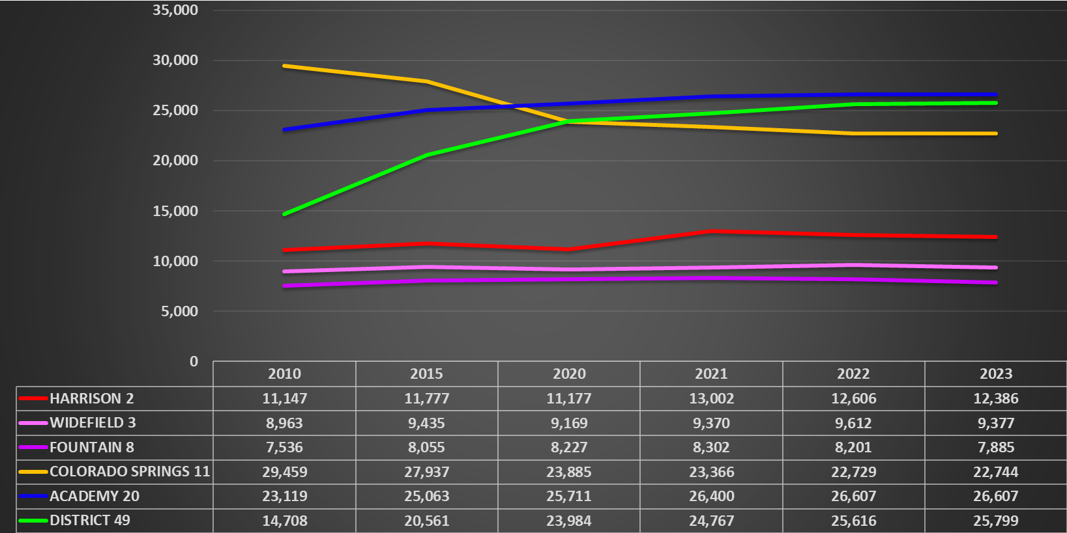
Top 6 El Paso County School District(s)
Enrollment Trends – Year over Year
Notes:
We are going to start with a quick glance of enrollment trends with the top 6 districts of El Paso County [EPC]
The Gold line represents Colorado Springs 11; it appears the District has been in a declining trend through the years, but appears to be stablizing
Academy 20, your blue line remains relatively stable
District 49, the Green line
D49 remains 11th in the State of Colorado, for enrollment numbers
2030 projections for D49 are 28,739

Slide 3
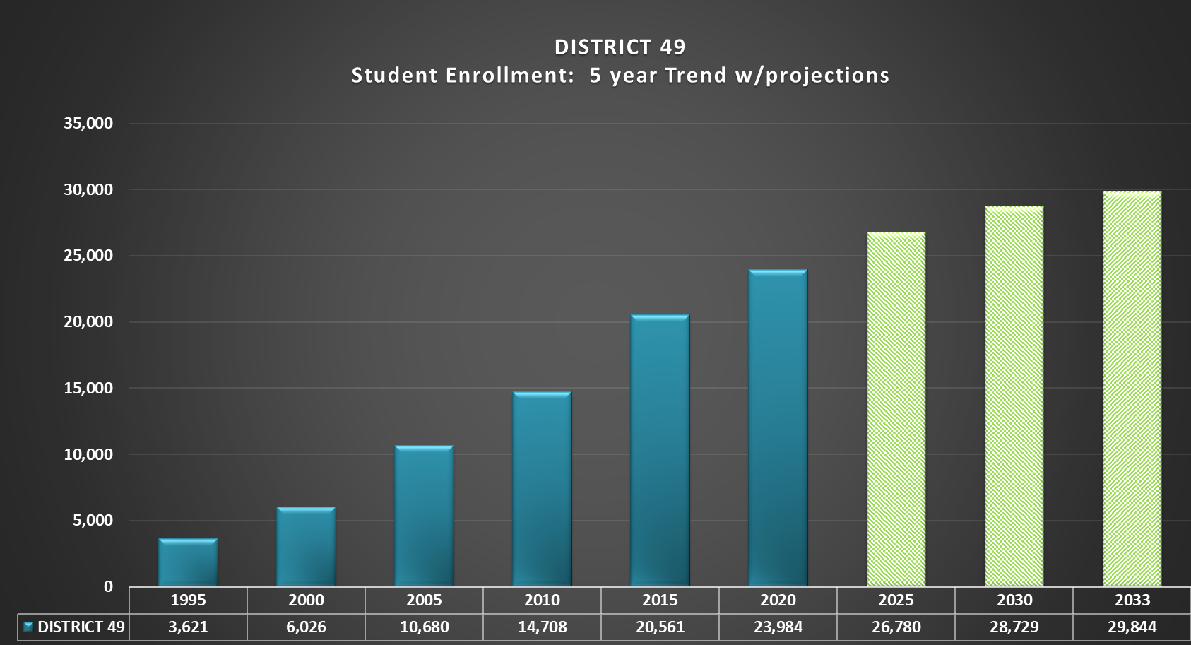
Student Enrollment – District
5-year Trend with Projections
Notes:
Student Enrollment - Year over Year
reflects steady growth
projections 2024-2033, where extracted from the Facility Master Plan, provided by Western Demographics

Slide 4
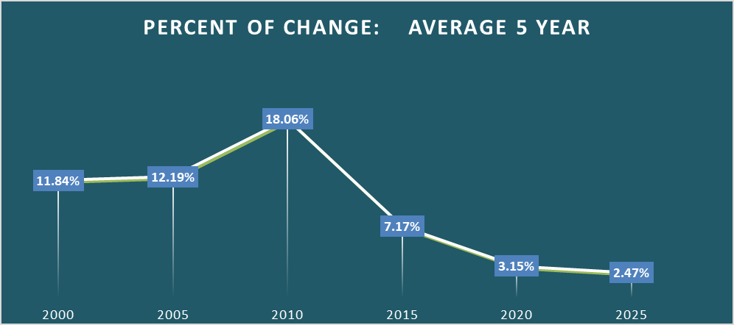
Student Enrollment
5-Year Average - Percent of Change
Notes:
1995 was the baseline data; 5-year averages start with 1996-2000
2025 is averaged through official October Count for 2023
If I add the unofficial count through 08/31/2024 – we are down nearly 600 students, thus, would drop the average, rate to 1.28% average student growth

Slide 5
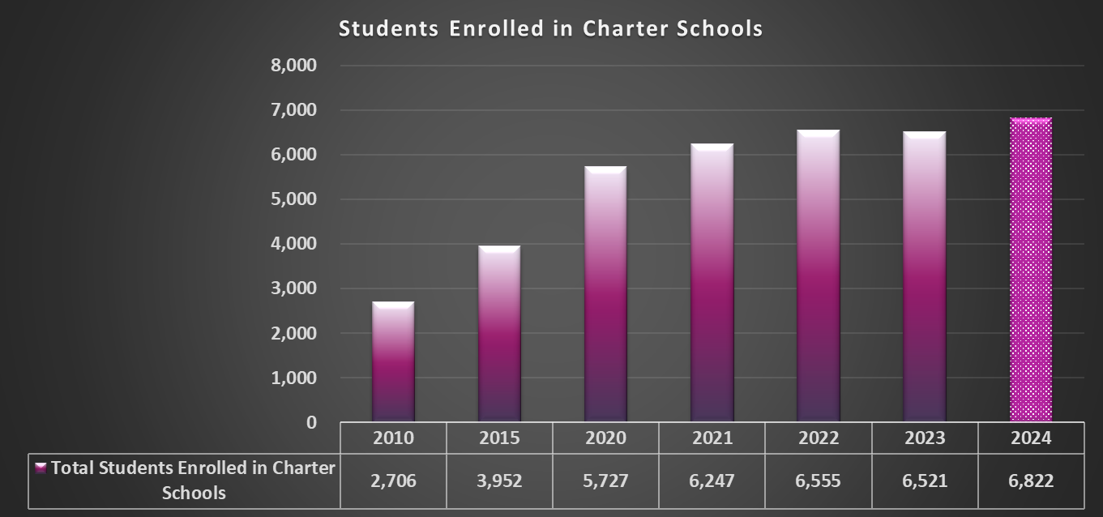
Student Enrollment – Charter Schools
Notes:
District 49 started partnering with Charter Schools to accommodate the growth;
Official student counts run through 2023, as captured by CDE
2024 current count of 6,822 is unofficial and lacks GOAL
To date, there is roughly an increase of 301 Charter students

Slide 6
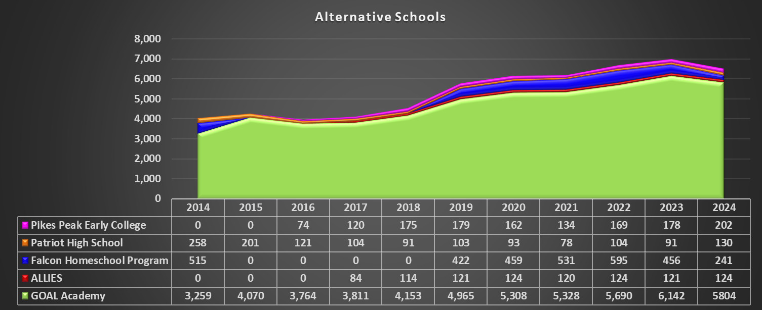
Alternative Schools - District
Notes:
Alternative Schools within the District; 2024 reflects unofficial counts
Goal Academy – Green, represents the majority of students
Pike Peak Early College – Purple
Patriot High School – Orange
Falcon Homeschool Program – Blue
Allies – red

Slide 7
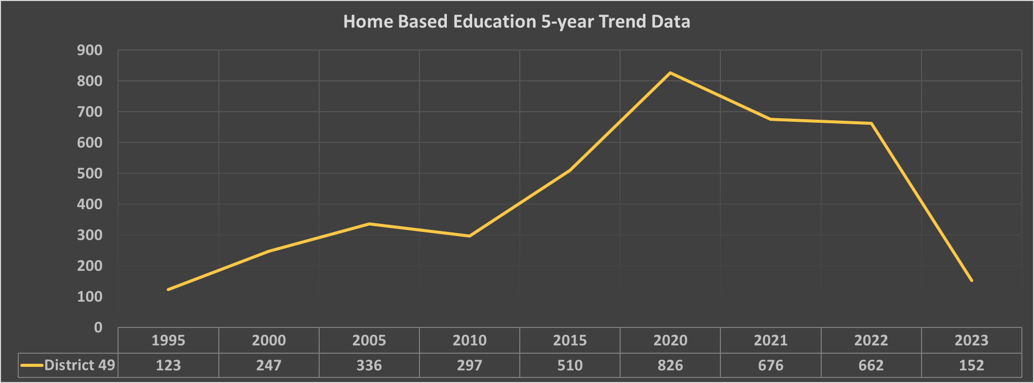
Home Based Education Trend Data - District
Notes:
Home Based Education was relatively small until the pandemic of 2020; As COVID eased, normalcy is returning

Slide 8
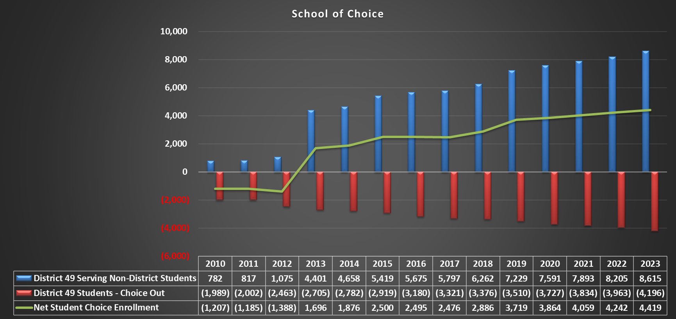
Public School of Choice - District
Notes:
School of Choice / Open Enrollment Trends – Year over Year
Blue represents the students enrolled within D49, but do not reside within the District boundaries
Nearly 1,806 students' choice in from District 11 – Colorado Springs
Red are those students that opted out of D49 with the majority attending Academy 20
Green Line is you Net Balance: approximately 4,419 as of Fall of 2023
Per C.R.S. 22-36-1010 Choice of programs and schools within school districts.
Commencing with the 1994-95 school year and thereafter, The Public Schools of Choice law allows resident students to enroll at schools in any Colorado district for which they are not zoned. This is also referred to as “Open Enrollment”
Blue represents the students enrolled within D49, but do not reside within the District –
Nearly 1,806 students choice in from District 11 - COS
Red are those students that opted out of D49 with the majority attending Academy 20
Green Line is you Net Balance: approximately 4,419 as of Fall of 2023

Slide 9
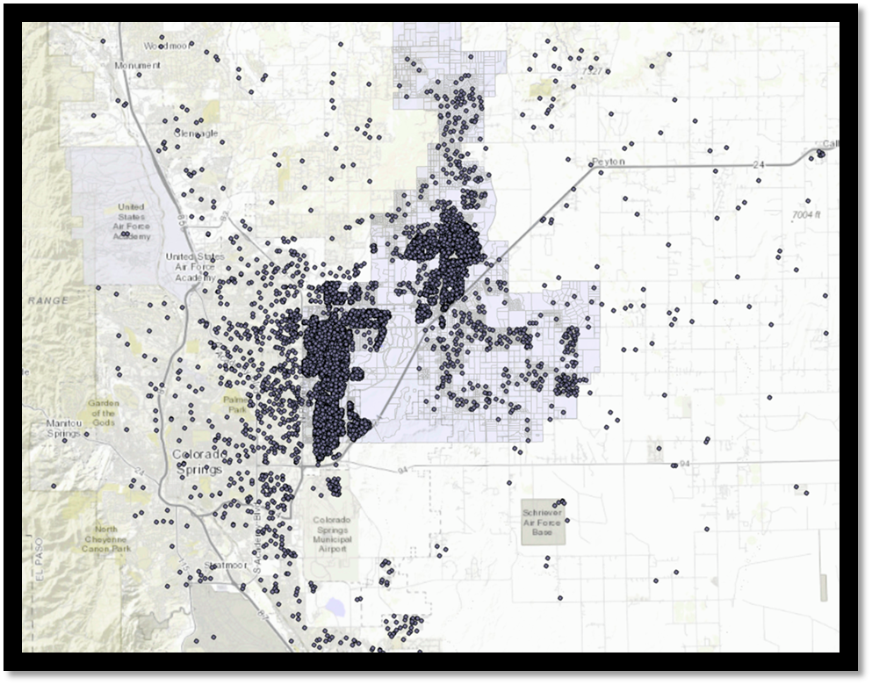
STUDENTS
Notes:
Students enrolled with the District
The dots outside the District boundary are where the students reside, by parent's address

Slide 10
Student Teacher Ratios
Data collected from the Colorado Department of Education
Compiled by the Planning Manager
Notes:
Data utilized from the CDE

Slide 11
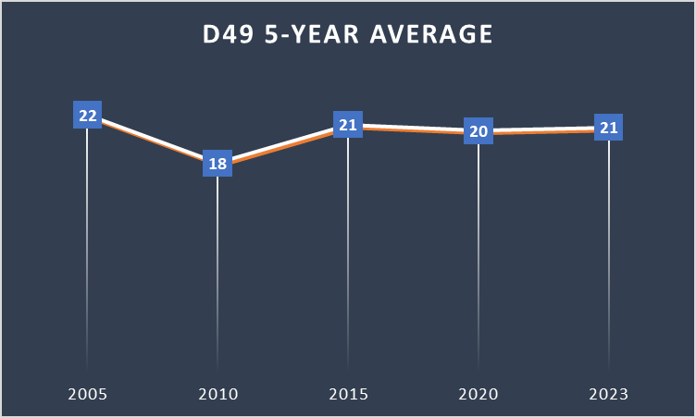
Student / Teacher Ratio - District 49
Notes:
Student / Teacher Ratio’s are an average of the District as a whole;

Slide 12
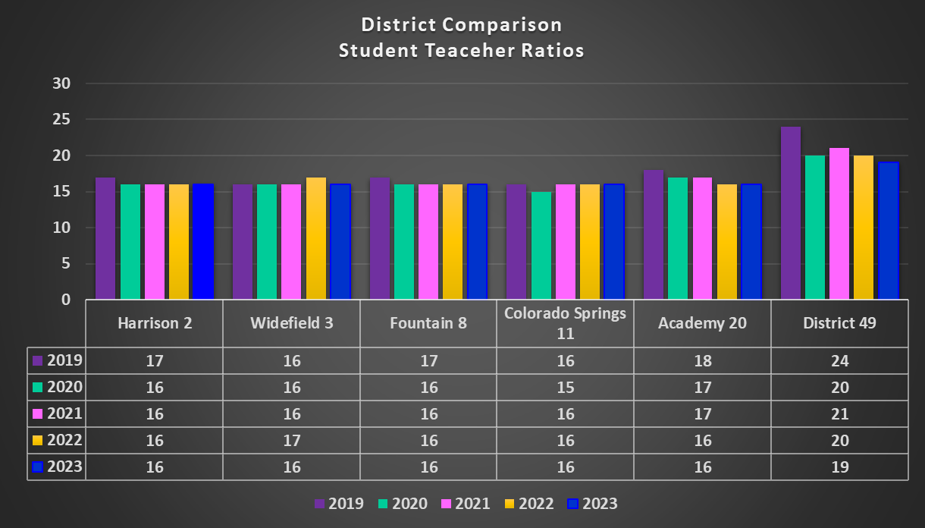
Student / Teacher Ratio - District Comparison
Notes:
Year over Year Comparison with the same Top 6 El Paso County Districts

Slide 13
Live Birth Data
Raw Data from State Health Department
Compiled by Planning Manager

Slide 14
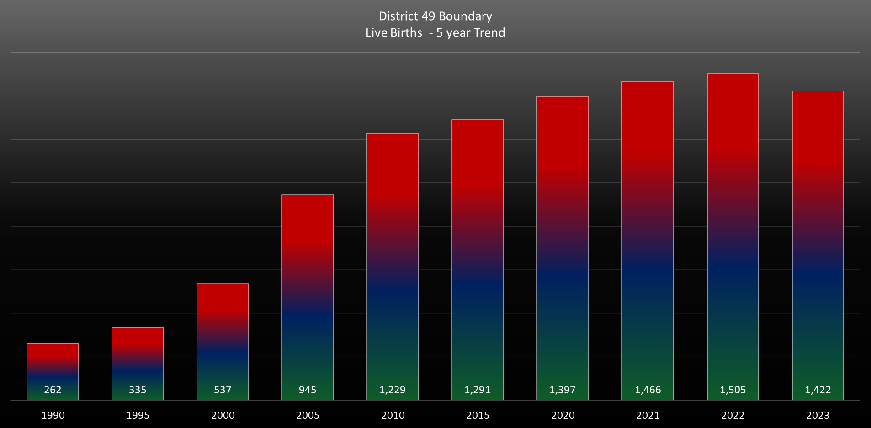
Live Birth Data - District
Notes:
Raw Data from State Health Department, provided on an annual basis by Elementary School Boundaries, current through 2023
5-year trend, year over year, from 1990 through 2020
Annual thereafter starting with 2021

Slide 15
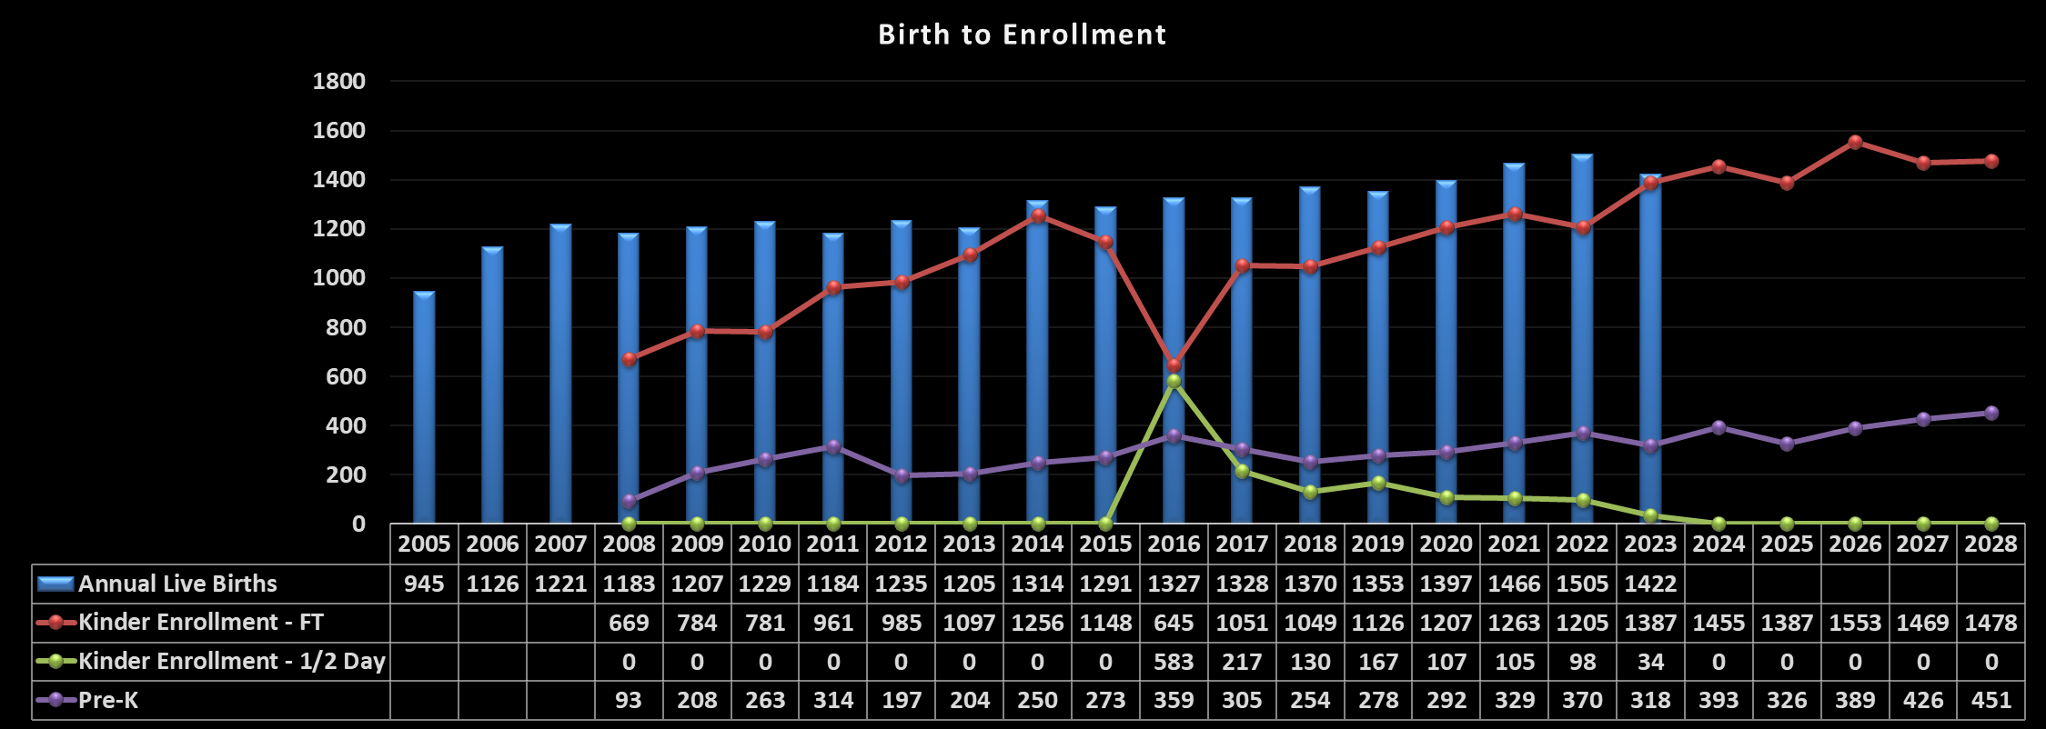
Comparison – Birth to Kinder Enrollment
Notes:
Growth in the cohort; birth to Kinder, is a rough estimate of what happens to enrollment approximately 5 years after the birth of the students.
Birth Data is the blue bar, specific to District 49
2008 birth data is in alignment with the Kinder Enrollment Data of 2013, the Red Line
The sets of data do not completely correlate because birth data is by calendar year and kindergarten enrollment is generally students who turn 6 prior to August of each applicable school year.
The RED line, represents what we expect to happen for Kindergarten enrollment
Excluding any migration, new builds, school of choice, etc
I included the Pre-K enrollment figures, the Purple line, given the transition of CPP, Colorado Preschool Program, to the updated mandates of UPK, Universal Preschool Program
The green line represents the Part Time Kinder Enrollment. It appears to have started in 2016 and is trickling off rather quickly

Slide 16
Questions?

