Slide 1
High School 101 for parents
Radnor High School
September 17, 2024
Notes:
Thank you for taking the time to come out tonight.
My name is Jeannie Semar and I am the school counselor for the entire ninth grade.
I will have you in and out in 45 minutes!
Tonight’s program was developed to give you advance information of school related supports and resources affiliated with the school counseling program that will help you as parents better understand how things work at RHS and to help you and your child navigate the transition to RHS in the best way possible.
There is a lot of information I will share with you tonight. Absorb what you want and can over the next 45 minutes. I will have this information posted on the School Counseling website if you care to reference the information at any time. Or email me and I will send you a copy!

Slide 2
Welcome!
  Your “Go To” People
  Role of Mrs. Semar
  Freshman Year Overview
  Student Engagement
  Social & Emotional Wellness
  Attendance Tips
  Learning Success
  Schoology vs HAC
  Graduation Requirements
  Grades-Report Cards-Transcripts
  Mid-Term and Final Exams
  2025-2026 Course Selection
  Keystone Exams
  College Testing
  Working Papers
  School Counseling 10th-12th
  Questions
Notes:
Tonight’s agenda will cover-
So Buckle UP!

Slide 3
Your Go-To People
9th Grade School Counselor: Jeannie Semar jeannie.semar@rtsd.org
9th Grade Administrator: Eileen.Rudisill@rtsd.org(October) Robert.Sokolowski@rtsd.org
Your Child’s Teachers!
Your Child’s Case Manager: IEP, 504
English Language Development Program: Charlene Mastro charlene.mastro@rtsd.org
School Nurse: Stephanie Grabuski stephanie.grabuski@rtsd.org
Attendance: Stephanie Querze
9th Grade Class Advisor: Dr. Alexis Swinehart alexis.swinehart@rtsd.org

Slide 4
Role of 9th Grade School Counselor
Primary Focus right now is on Your Child’s SEL (social, emotional, learning) Transition to the High School
Mental Health Support
Learning Access Support and Intervention
Individual Check-in Meetings- Sept-Early November.
Develop a personalized Four-Year Academic and Personal Plan- January-May
Course Selection for 10th Grade
Transition to 10th
Notes:
Mental Health- life has its challenges. I am here to help your child with those challenges that impact school life and learning.
Learning- Our teachers have high standards, in many cases your child has even higher standards for themselves. I can help your child understand the resources and connect them to those resources as needed.

Slide 5
Monthly Counselor Chat!
8:45 a.m.- via ZOOM (no longer than 30 minutes)
Second Tuesday of every month
September – April
Stay informed of departmental happenings, updates, and hot topics from the counseling department.
Counseling Department - Radnor High School (rtsd.org)
Notes:
New this year!

Slide 6
Freshman Year overview
10/16 Wednesday PSAT 8/9 Exam
10/28-10/31 LM WEEK (Pep Rally Thursday 10/31)
11/8 Marking Period 1 Ends
12/4-12/18 Winter Keystone Window
1/24, 1/27-1/28 Mid-Term Exams
1/28 Marking Period 2 Ends
February (TBD) Freshmen Semiformal
4/4 Marking Period 3 Ends
5/12-23 Spring Keystone Window
6/6-6/10 Final Exams & Fourth Marking Period Ends 6/11
Class of 2028
Notes:
This is for you to see the big picture of important events and dates in the 9th grade year

Slide 7
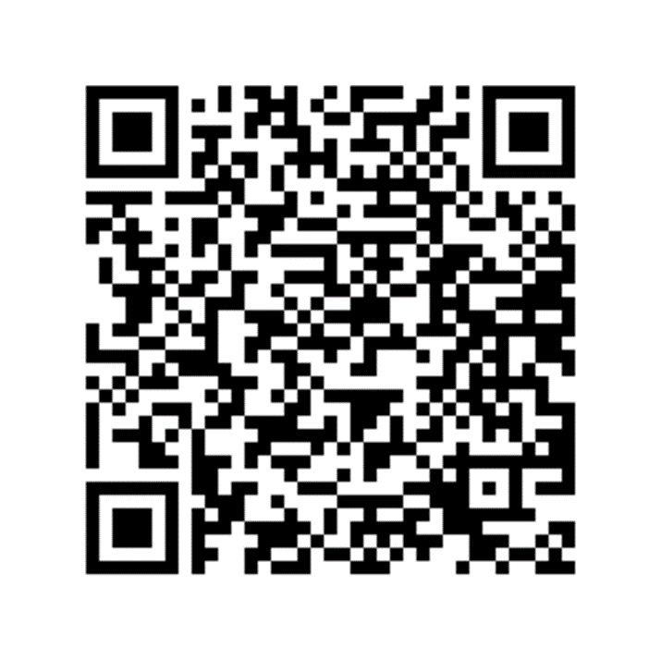
School Connectedness…
Get Involved!
Getting involved helps students develop healthy common interest peer relationships, and connect with coaches, teachers and staff, while developing a sense of connectedness to the Radnor community.
Over 100 RHS Clubs and Organizations- Club & Activities Fair! September 19th during Lunch & Learn
25 PIAA Athletic Teams
    Physicals and Forms Required to Participate
7 Athletic Clubs
Stay Connected- Radnor Reader!
Notes:
This Thursday during Lunch & Learn.
Sign up for anything interesting. Get on the contact list- you can always opt out later.
Try an activity for a few sessions. No commitment unless you want to.

Slide 8
Social & Emotional Wellness Emotional Wellness
Student Assistance Program- SAP
Support for students struggling or concerned with:
  Behavior
  Attendance
  Health
  Social & Mental Health
  Academics
  Drug and Alcohol
SAP team members are school counselors, teachers, administrators, school psychologists, social worker, and applicable contracted staff with expertise in mental health and drug and alcohol resources.
Parents, Students, and Staff may refer a child to the SAP team.
Notes:
I will be monitoring attendance, academics, emotional wellness as best I can.
Reach out if you have concerns and we can do a deeper dive into what is going on and get the child help.

Slide 9
Social Worker
Christine Kulp
610-293-0855 ext. 3823
Christine.kulp@rtsd.org
School Social Workers encourage positive home, school, and community communication in an effort to improve student outcomes and encourage collaborative problem solving.
You or a member of your school team may include school social work participation when appropriate.
You may also seek to speak with the school social worker for assistance in navigating a variety of school or community-based resources related but not limited to:
mental health and behavioral health
family crisis or stressors
medical assistance and county benefits
housing and utilities, and food support.
Notes:
Christine is our liaison with community resources and she is an incredible problem solver for BIG challenges that come up with families who suddenly need assistance.

Slide 10
Attendance
First Period Starts at 8:30!
Electronic Excuse Notes Accepted for Absences!
To report an absence parents/guardians must email (RHS_absence@rtsd.org) with their child’s first and last name, the date of the absence, the reason, and the parent/guardian’s first and last name.
Late due to an appointment? - bring attendance a note from the doctor’s office and sign in at attendance.
Bring a note to attendance by 8:30 AM indicating your need for an early dismissal.
Educational Trip Request Form - Submit the request a minimum of ten days prior to the trip for administrative approval.
Notes:
If there is one thing you can do to help your child find success in school ife and learning it is TO GET THEM TO SCHOOL ON TIME!
First period starts at 8:30!

Slide 11
Learning Success
Help your child get to school on time everyday!
Teachers are invested in your child’s success, contact them if you are concerned. They will appreciate the contact and the partnership in helping your child.
All teachers have dedicated time during the week to meet with students outside of class.
Additional Supports
  Lunch & Learn Wednesday &Thursday Block days 11:24-12:24
  Learning Center Drop in and get help
  ELP – stay tuned for updates in October
  Academic Success Center Class- .5 credit
Notes:
Every teacher wants their students to be successful.
High standards don’t change that at Radnor.
If your child is struggling in a class reach out to the teacher. They want to know and be given the chance to support them.

Slide 12
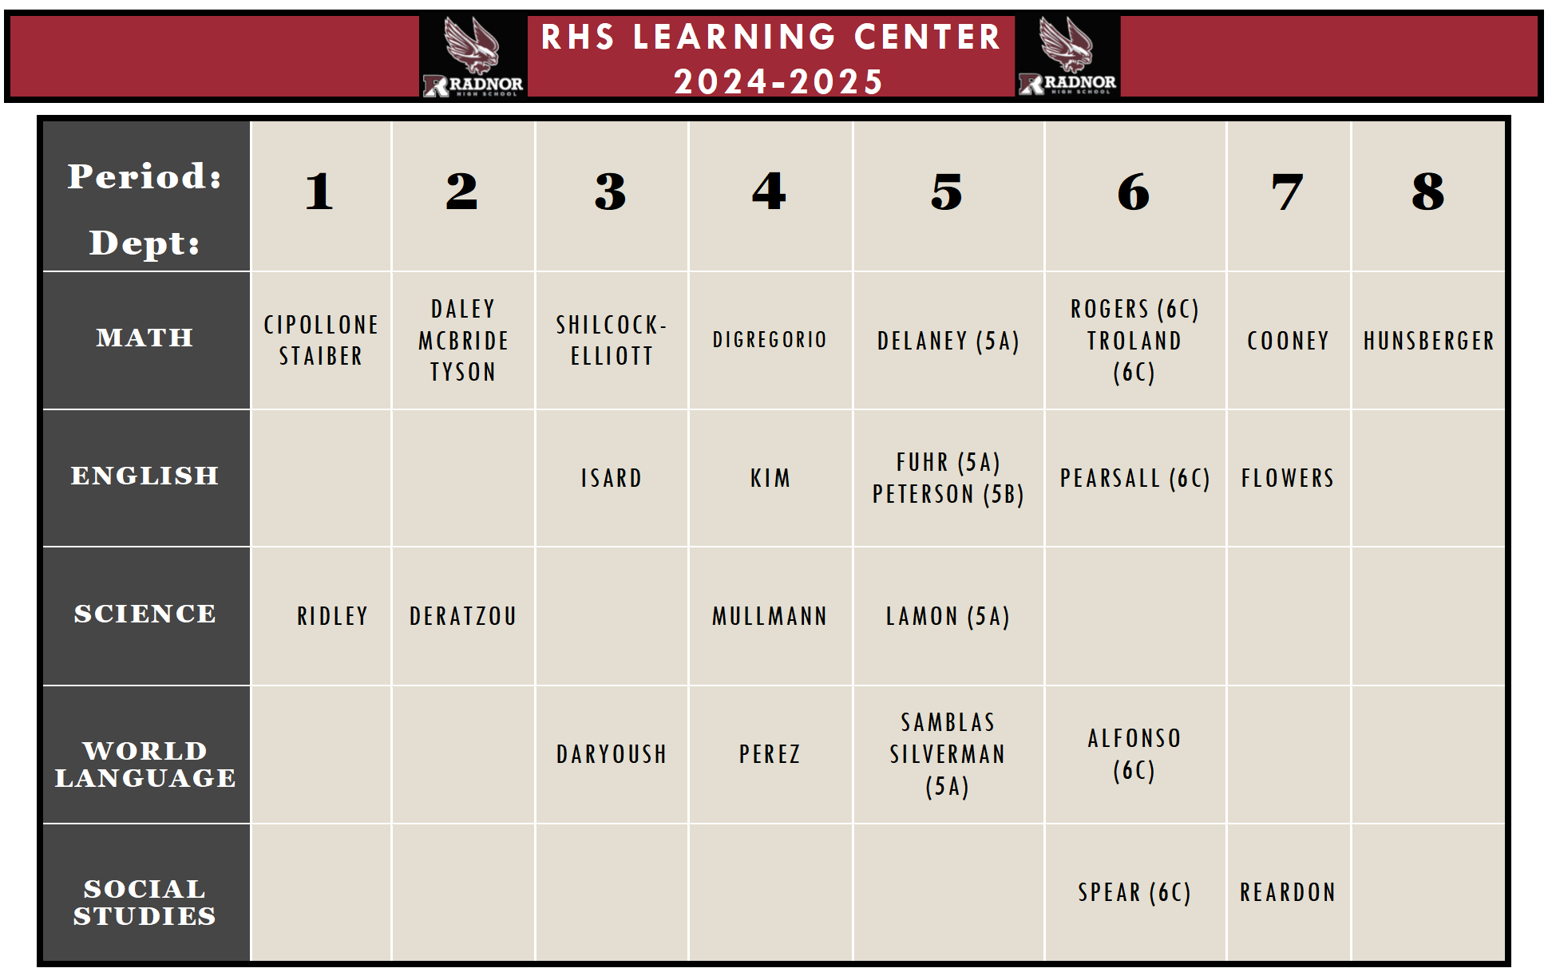
Learning Center
Notes:
This schedule could change! Help your child make the Learning Center a “go To”place for help.
This is a college model- they will see it in college.

Slide 13

SCHOOLOGY vs.
HAC
Schoology is a learning management system which allows students and teachers to interact online, in and outside of the classroom. Through Schoology, teachers can post course content, provide resources for students, and review assignments. Student’s login to access one calendar and their class resources. They can submit assignments, take quizzes and participate in online discussions.
Parents also have access to Schoology under a separate log in.
Need a Schoology Parent Account or Help?
Home Access Center (HAC) is an online database that provides parents/guardians access to their child(ren)'s class schedule, grades in progress and report cards.
Each parent/guardian can have their own HAC account.
Need a HAC Parent Account or Help?
Notes:
New to RTSD- this is for you.
There are tutorials available to help you learn how to navigate both.

Slide 14
Graduation Requirements
22.5 Total Credits-must include
  4.0 English
  3.0 Social Studies
  3.0 Math
  3.0 Science
  1.0 Health (.5 9th and .5 10th)
  .5 Wellness
  .5 within Business/Technology
  .5 within Art/Music/Theater/FACS
Notes:
There is an end game to high school- graduation!
These are the bare minimum.
There is plenty of room to explore academic and personal interests and challenge your strengths beyond these core requirements.

Slide 15
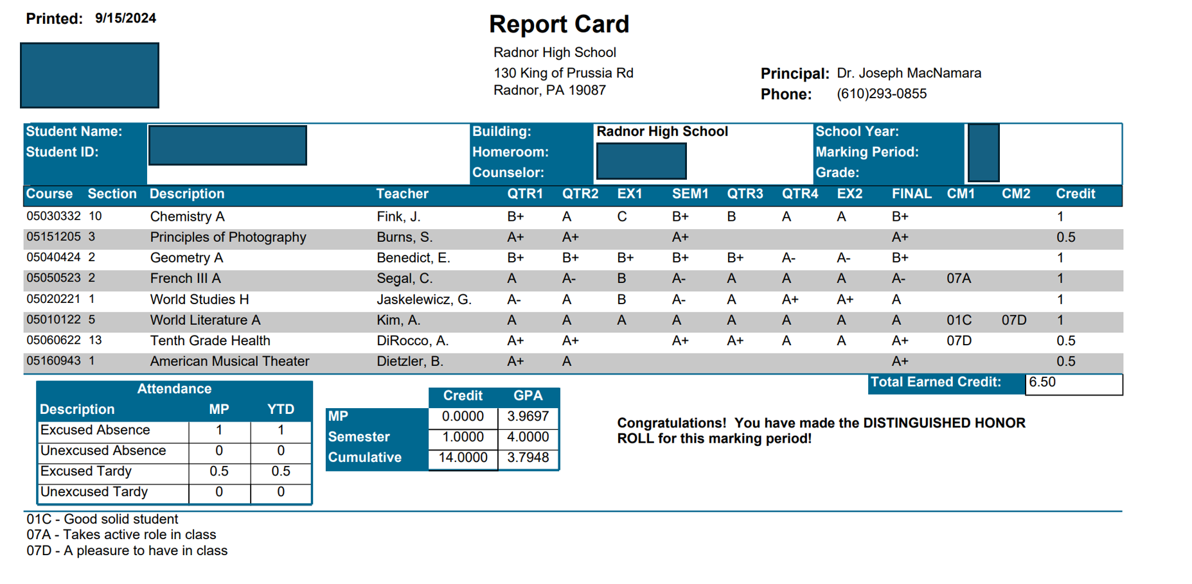




Report Card
Notes:
Focus on marking segments- Note- EX1, SEM 1, EX2 and FINAL

Slide 16
Mid-Term & Final Exams
Mid-term Exams
    January 24, 27-28
    10% of Final course grade
    2 exam sessions per day by discipline
      8:45-10:15, 11:45-1:15
    English, Social Studies, Math, Science, World Language, Conflicts & Make-ups
    Taking two classes in the same discipline?
Final Exams
    June 6-10 weather may impact dates!
    10% of Final course grade
    Same schedule as Mid-terms
    Personal time conflict?
      Make up the exam over the summer, graded in September

Slide 17
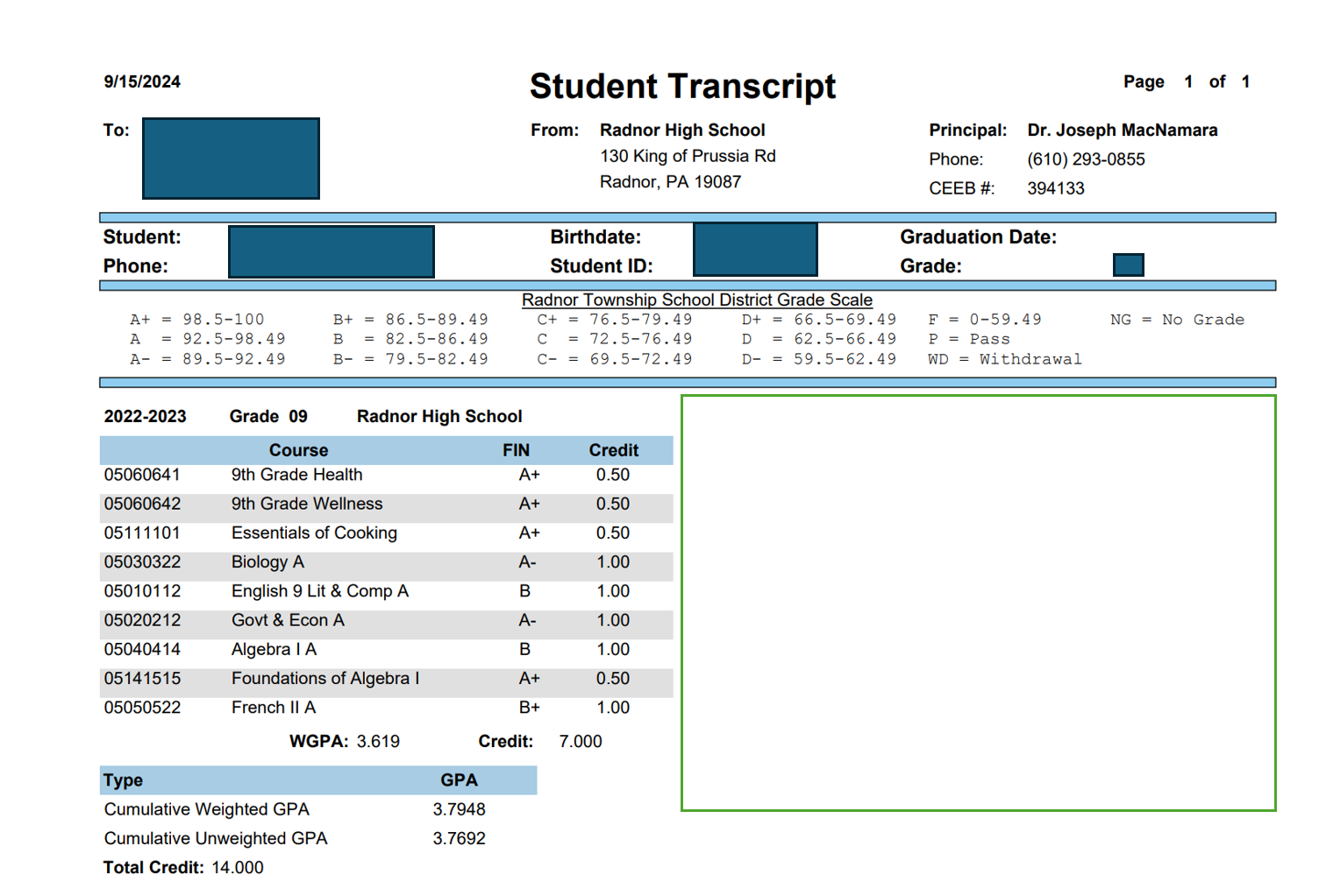

Transcript
Notes:
End of this year…..
Notice the Cumulative Weighted GPA and Cumulative Unweighted GPA- it is only 1 year!
Lets talk about the weight in a GPA-

Slide 18
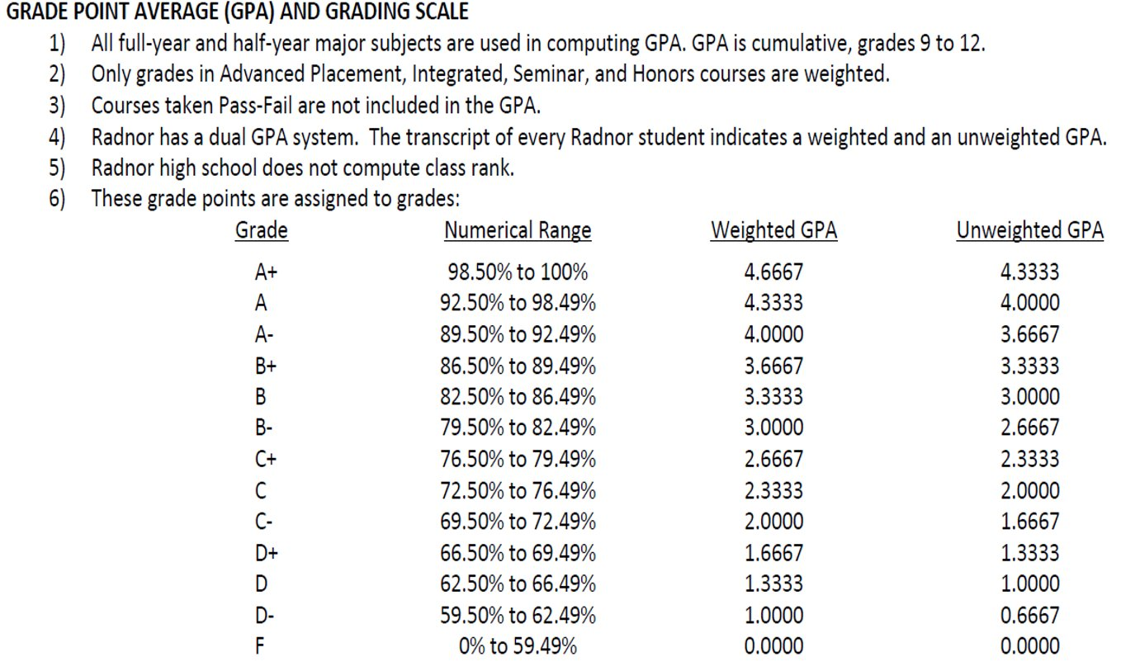

Grading Scale

Slide 19
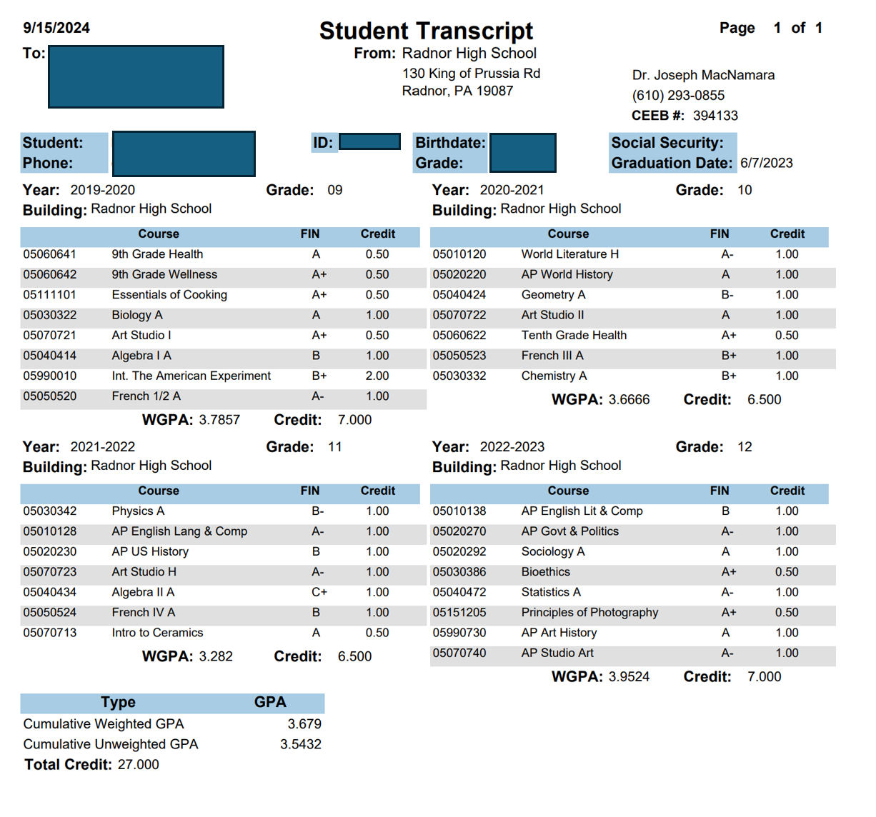





Final Transcript
Notes:
We are a long way away from this!

Slide 20
Course Selection for
2025-2026
TIMELINE
Winterfest & Program of Studies- Mid-January
Teachers will make recommendations in late January-early February
Students will select elective choices in mid-February
Mrs. Semar will meet with every student and review teacher recommendations and student elective choices in late February-March
No changes after mid-April!
SUMMER SCHOOL MATH
  Algebra 1, Geometry Advanced, Geometry Honors.
  Registration opens in late January
  Courses run only if enough students register
  Summer 2024 Schedule- June 18th-August 2nd
  Instruction: 7:45 AM – 11:45 AM
  Tutoring 11:45AM – 12:15PM

Slide 21
Keystone Exams
Three Exams:
  Biology
  Algebra 1
  Literature
Winter: December 4-18
Spring: May 12-23
Multiple Pathways to Meet PA Graduation Requirement-Keystone Pathways
Notes:
The state required assessments-
Science & Environment- Biology exam 10th
Math sequencing varies- Once you complete Algebra 1 or the two-year equivalent- Take Keystone Algebra 1
Literature- Most will take the Literature test in Spring of 10th
New to RTSD- Did you take Algebra 1 at previous school- may need to take December test. See me
If your child is not Proficient on the three tests, don’t panic. Admin will communicate the alternative Pathways as needed. You are in good hands!

Slide 22
College Testing Terminology
PSAT (9th, 10th, 11th)
SAT
ACT
Test Optional or Test Flexible
AP- Advanced Placement
Notes:
These are the college admissions related tests
Every child has their own unique plan! Our college and career counsleors will help them determine which tests if any are best for your child.

Slide 23
College Testing Time-line
9th Grade- PSAT 8/9
10th Grade- PSAT 10/11 NMSQT October
11th Grade- PSAT 10/11 NMSQT October
SAT and ACT- Individualized plan spanning spring of 10th through fall of grade 12
AP EXAMS- May (two-week window)
  Radnor Policy requires a student to take the AP Exam to earn the AP designation for the respective course on their transcript
Notes:
PSAT’s during the school day
Radnor covers the cost
No registration required
SAT/ACT- Saturday tests, you schedule for a national test center and pay the fees
AP Exams- Collegeboard determines the dates, we administer, you pay!

Slide 24
College Testing PSAT
PSAT 8/9 on Weds 10/16 8:30-11:30
  Digital Testing
  BLUE BOOK App on school issued devices will be pushed out shortly
  BYO device users must download the BLUE BOOK app on their own
  Schoolwide device readiness check app 2-3 weeks before in homeroom. Access codes will be given to every student at this time
  Practice navigating the app in preparation for test day
  Arrive on time and report to assigned testing room
  Bring FULLY CHARGED DEVICE AND CHARGER
  Bring snacks and water for the break
  Dress for comfort and layers
  Relax….it’s just a practice test
  Test results come out in December- students must create a Collegeboard account for themselves to access scores and testing report
  Parent Study Guide
Notes:
Simple PSAT 8/9 At A Glance Hand out

Slide 25
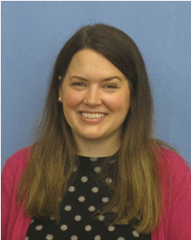
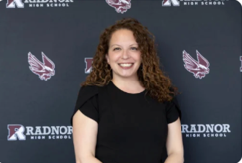
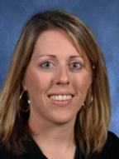
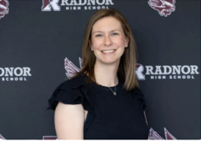
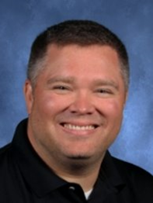
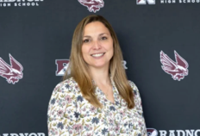
School Counselor & College Counselor Teams Grades 10-12
After 9th grade students will transition to a team of two counselors for grades 10-12.
School Counselor College & Career
Sierra Calaman Kellie Wiedlich
Amy Wess Sarah Pace
JJ Lemon Rachelle Gough
Notes:
Next year- your child will shift to a two-person counselor team.
New last year-
They stay with that team through graduation.

Slide 26
College & Career Counseling
College and Career Counselors:
Will assist students with career exploration and post-secondary planning, 2 -4-year college, technical or trade school, military options, gap year and more.
Will work with students in both individual and group meetings, classroom lessons, lunch and learn workshops and evening programs.
Will develop a post-secondary plan with the student, providing support and structure in the development and implementation of this plan.
Notes:
The role of the college and career counselor…

Slide 27
CCTP Course for Juniors
College and Career Transition 0.25 Credit Course (2024-2025 Flex Mod Option) Spring Semester; Grade: 11
This course guides students throughout their college and career journey. Students will gain an understanding of the skills necessary for developing future career paths and applying to post-secondary institutions (college, vocational, military, etc.).
Topics are geared to ensure access to a viable and challenging instructional experience that better prepares students for the career and college selection process including, but not limited to: resume building, college essay writing, securing letters of recommendation, NCAA eligibility, finding internships/relevant work experiences, Gap Year considerations, and interview skills.
Notes:
A course was created for those students who wanted 1 on 1 and small group assistance with college and career transition at the end of their junior year.
For those who wanted to get a jump start on developing and implementing their plan for after graduation.

Slide 28
Working Papers
Working Papers for Ages 14-18
To receive a Work Permit, students must complete and return the Application for Work Permit to any admin asst. in the main office
Requirements-
  The applicant must be at least 14 years of age at time of application
  Have a completed and signed Application for Work Permit
  The applicant must present a birth certificate or current passport
  The applicant MUST be present to sign and receive the Work Permit.
Once issued, the Work Permit is good until the applicant is 18 years old.
Notes:
Probably not at the forefront of your worries right now but keep this is mind for when it does come up.

Slide 29
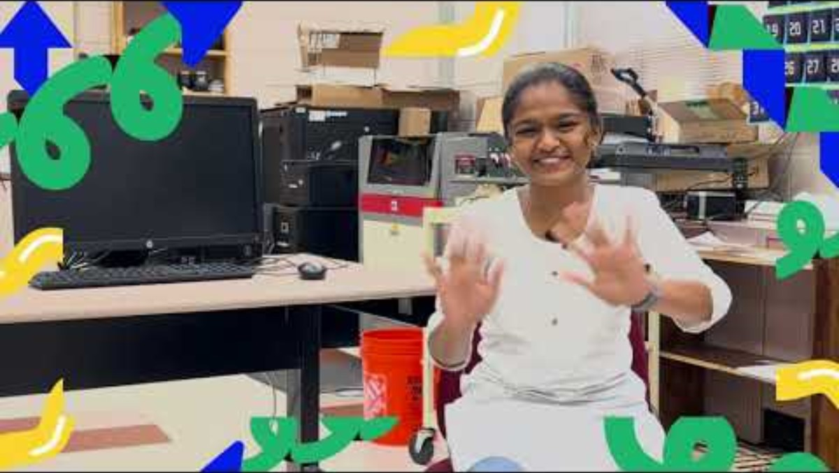
Advice from the Class of 2027!
Notes:
Last May we welcomed our 8th graders from RMS for our Move Up Day. Drew Krupp, one of our Technology teachers and I grabbed a handful of kids from the study hall room next to his classroom and asked them the following questions-
What has been your favorite thing about freshman year?
What has been the biggest challenge?
What advice do you have for the class of 2028?

Slide 30
Take Aways from the Class of 2027!
FAVORITE THING ABOUT FRESHMAN YEAR
  Lunch & Learn
  LM Week (10/28-10/31)
  Made new friends
BIGGEST CHALLENGE
  Cycle days the first few weeks
  Figuring out how to study
  Balancing fun and schoolwork
  Finding where I belong
  Navigating the building
  Time management
ADVICE
  Be kind
  Stay positive
  Don’t lose your surface pen
  Branch out- make new friends
  Get Involved
  Have fun
Notes:
In Summary- from those in the trenches last year…..
Last thing I want to share- and I thank you for your patience… HELPFUL RESOURCES
I am certain your children will offer similar advice at the years end!

Slide 31
Resource Page
Jeannie.semar@rtsd.org 610 293-0855 x3527
RHS School Counseling Website- Counseling Department - Radnor High School (rtsd.org)
Student Assistance Program SAP
RHS Attendance Info
ParentU - Radnor Township School District (rtsd.org)
Delaware County Crisis Connections Team: 1-855-889-7827.
Suicide & Crisis Lifeline: Text, Call or Chat 988
Safe2SaySomething:
Call 1-844-SAF2SAY https://www.safe2saypa.org/
Collegeboard
Working Papers- Work Permits - Radnor High School (rtsd.org)
PSAT 8/9 Parent Guide- Their Head Start Starts Here (collegeboard.org)
Parent training on navigating Schoology https://youtu.be/f6X7kCkcLyc
Parent training on navigating the RTSD HAC https://youtu.be/ZMkXKPOD5Zk
TEAM PA Free Crisis Counselor: Call 855-284-2494
PA Mental Health Resources

Slide 32

Thank you & Questions?
Follow us on INSTA!
Notes:
You can Follow the Radnor High School Counselors on Instagram!

